Slide 1


Perception
and Individual
Decision Making
Prepared by Dr. Ahmad AL-Naimi
Lecture 9

Slide 2


Perception
www.midocean.ae

Slide 3
What Is Perception?
A process by which individuals organize and interpret their sensory impressions to give meaning to their environment.
People’s behavior is based on their perception of what reality is, not on reality itself.
The world as it is perceived is the world that is behaviorally important.

Slide 4
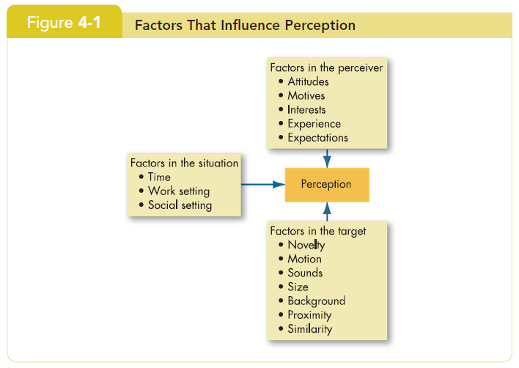
Factors that Influence Perception

Slide 5
Attribution Theory: Judging Others
Our perception and judgment of others is significantly influenced by our assumptions of the other person’s internal state:
  When individuals observe behavior, they attempt to determine whether it is internally or externally caused.
    Internal causes are under that person’s control.
    External causes are not—person forced to act in that way.

Slide 6
Attribution Theory: Judging Others
Causation judged through:
  Distinctiveness
    Shows different behaviors in different situations.
  Consensus
    Response is the same as others to same situation.
  Consistency
    Responds in the same way over time.

Slide 7
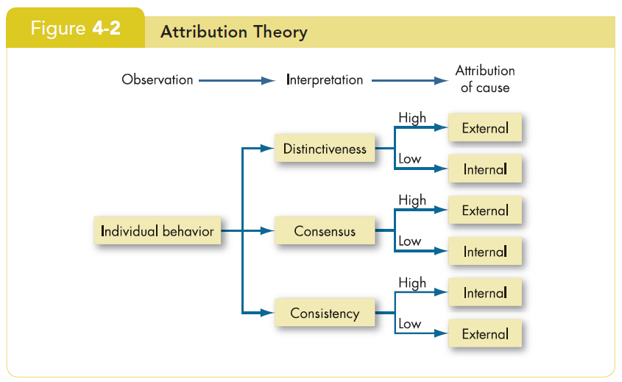
Elements of Attribution Theory

Slide 8
Errors and Biases in Attributions
Fundamental attribution error
  The tendency to underestimate the influence of external factors and overestimate the influence of internal factors when making judgments about the behavior of others
  We blame people first, not the situation
Self-serving bias
  The tendency for individuals to attribute their own successes to internal factors while putting the blame for failures on external factors.
  It is ‘our’ success but ‘their’ failure.

Slide 9
Frequently Used Shortcuts in Judging Others
Selective perception
  People selectively interpret what they see based on their interests, background, experience, and attitudes.
Halo effect
  Drawing a general impression about an individual on the basis of a single characteristic.
Contrast effects
  Evaluation of a person’s characteristics that are affected by comparisons with other people recently encountered who rank higher or lower on the same characteristics.

Slide 10
Another Shortcut: Stereotyping
Stereotyping: Judging someone on the basis of one’s perception of the group to which that person belongs—a prevalent and often useful, if not always accurate, generalization.
Profiling: A form of stereotyping in which members of a group are singled out for intense scrutiny based on a single, often racial, trait.

Slide 11
Specific Shortcut Applications in Organizations
Employment Interview
  Perceptual biases of raters affect the accuracy of interviewers’ judgments of applicants.
  Formed in a single glance – 1/10 of a second!
Performance Expectations
  Self-fulfilling prophecy (Pygmalion effect): The lower or higher performance of employees reflects preconceived leader expectations about employee capabilities.
Performance Evaluations
  Appraisals are often the subjective (judgmental) perceptions of appraisers of another employee’s job performance .
  Critical impact on employees.

Slide 12
Perceptions and Individual Decision Making
Problem
  A perceived discrepancy between the current situation and a desired state.
Decisions
  Choices made from among alternatives developed from data.
Perception linkage:
  All elements of problem identification and the decision-making process are influenced by perception.
    Problems must be recognized.
    Data must be selected and evaluated.
    Expediency dominates business decision making

Slide 13
Decision-Making Models in Organizations (cont’d)
Bounded reality
  The “real world” model seeks satisfactory and sufficient solutions from limited data and alternatives.
Intuition
  A non-conscious process created from distilled experience that results in quick decisions.
    Relies on holistic associations.
    Affectively charged—engaging the emotions.

Slide 14
Common Biases and Errors in Decision Making
Over-confidence bias
  Believing too much in our own ability to make good decisions—especially when outside of own expertise.
Fastening bias
  Using early, first received information as the basis for making subsequent judgments.
Confirmation bias
  Selecting and using only facts that support our decision.
Availability bias
  Emphasizing information that is most readily at hand.
    Recent
    Vivid

Slide 15
More Common Decision-Making Errors
Escalation of commitment
  Increasing commitment to a decision despite evidence that it is wrong—especially if responsible for the decision!
Randomness error
  Creating meaning out of random events—superstitions.
Hindsight bias
  After an outcome is already known, believing it could have been accurately predicted beforehand.

Slide 16
Individual Differences in Decision-Making
Personality
  Conscientiousness may affect escalation of commitment.
    Achievement-strivers are likely to increase commitment.
    Dutiful people are less like to have this bias.
  Self-Esteem.
    High self-esteem people are susceptible to self-serving bias.
Gender
  Women analyze decisions more than men—rumination.
  Women are twice as likely to develop depression.
  Differences develop early.

Slide 17
Organizational Constraints
Performance evaluation
  Managerial evaluation criteria influence actions.
Reward systems
  Managers will make the decision with the greatest personal payoff for them.
Formal regulations
  Limit the alternative choices of decision makers.
System-imposed time constraints
  Restrict ability to gather or evaluate information.
Historical precedents
  Past decisions influence current decisions.

Slide 18
Understanding
Work Teams
www.midocean.ae

Slide 19
Differences between Groups and Teams
A work group interacts primarily to share information and to make decisions to help each group member perform within his or her area of responsibility.
  No joint effort required.
A work team generates positive synergy through coordinated effort. The individual efforts result in a performance that is greater than the sum of the individual inputs.

Slide 20
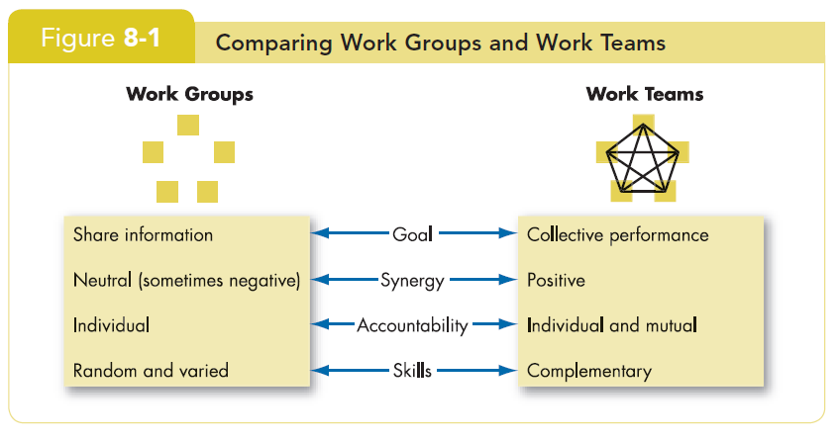
Comparing Work Groups and Work Teams

Slide 21
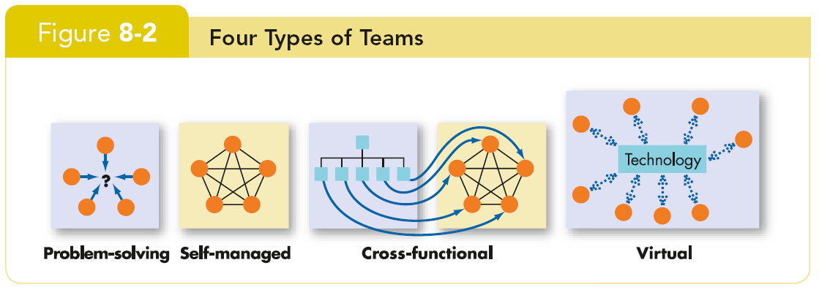
Types of Teams
There are four types of teams.

Slide 22
Types of Teams (cont’d)
Problem solving teams
  Groups of 5 to 12 employees from the same department who meet for a few hours each week to discuss ways of improving quality, efficiency, and the work environment.
Self-managed work teams
  Groups of 10 to 15 people who take on the responsibilities of their former supervisors.

Slide 23
Types of Teams (cont’d)
Cross-functional teams
Employees from about the same hierarchical level, but from different work areas, who come together to accomplish a task.
  Very common
  Task forces
  Committees

Slide 24
Types of Teams (cont’d)
Virtual teams
Teams that use computer technology to tie together physically dispersed members to achieve a common goal.
Characteristics
  Limited socializing.
  The ability to overcome time and space constraints.
To be effective, needs:
  trust among members;
  close monitoring;
  to be publicized.

Slide 25
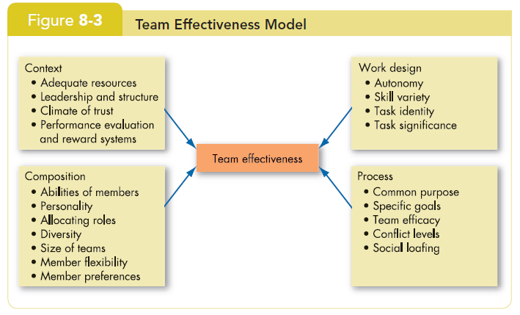
A Team-Effectiveness Model

Slide 26
Key Components of Effective Teams
Context
Composition
Work design
Process variables

Slide 27
Creating Effective Teams: Context
Adequate resources
  Need the tools to complete the job.
Effective leadership and structure
  Agreeing to the specifics of work and how the team fits together to integrate individual skills.
  Even ‘self-managed’ teams need leaders.
  Leadership especially important in multi-team systems.

Slide 28
Creating Effective Teams: Context (cont’d)
Climate of trust
  Members must trust each other and their leader.
Performance and reward systems that reflect team contributions
  Cannot just be based on individual effort.

Slide 29
Creating Effective Teams: Composition
Abilities of members
  Need technical expertise, problem solving, decision making, and good interpersonal skills.
Personality of members
  Conscientiousness, openness to experience, and agreeableness all relate to team performance.

Slide 30
Creating Effective Teams: Composition (cont’d)
Allocating roles and diversity
  Many necessary roles must be filled.
  Diversity can often lead to lower performance.
Size of team
  The smaller the better: 5 to 7 is optimal.
Member’s preference for teamwork
  Do the members want to be on teams?

Slide 31
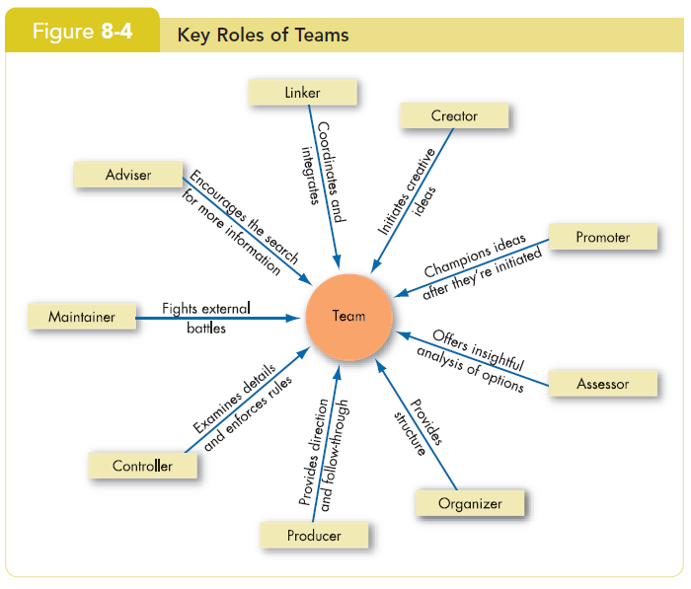
Key Roles On Teams

Slide 32
Creating Effective Teams: Work Design
Freedom and autonomy
  Ability to work independently.
Skill variety
  Ability to use different skills and talents.
Task identity
  Ability to complete a whole and identifiable task or product.
Task significance
  Working on a task or project that has a substantial impact on others.

Slide 33
Creating Effective Teams: Process
Commitment to a common purpose
  Create a common purpose that provides direction.
  Have reflexivity: willing to adjust plan if necessary.
Establishment of specific team goals
  Must be specific, measurable, realistic, and challenging.
Team efficacy
  Team believes in its ability to succeed.

Slide 34
Creating Effective Teams: Process (cont’d)
Mental models
  Have an accurate and common mental map of how the work gets done.
A managed level of conflict
  Task conflicts are helpful; interpersonal conflicts are not.
Minimized social loafing
  Team holds itself accountable both individually and as a team.

Slide 35
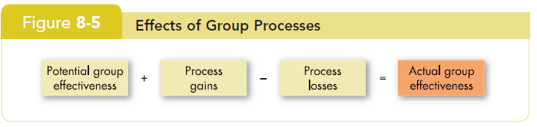
Creating Effective Teams: Process (cont’d)

Slide 36
Turning Individuals into Team Players
Selection
  Make team skills one of the interpersonal skills in the hiring process.
Training
  Individualistic people can learn.
Rewards
  Rework the reward system to encourage cooperative efforts rather than competitive (individual) ones.
  Continue to recognize individual contributions while still emphasizing the importance of teamwork.

Slide 37
Beware! Teams Aren’t Always the Answer
Teamwork takes more time and resources than does individual work.
Three tests to see if a team fits the situation:
  Is the work complex and is there a need for different perspectives: will it be better with the insights of more than one person?
  Does the work create a common purpose or set of goals for the group that is larger than the aggregate of the goals for individuals?
  Are members of the group involved in interdependent tasks?

Slide 38
Summary and Managerial Implications
Effective teams have common characteristics:
  Adequate resources
  Effective leadership
  A climate of trust
  Appropriate reward and evaluation systems
  Composed of members with correct skills and roles
  Smaller

Slide 39
Summary and Managerial Implications (cont’d)
  Effective teams have common characteristics (cont’):
  Work that provides freedom, autonomy, and the chance to contribute
  Tasks are whole and significant
  Members believe in the team’s capabilities
Managers should modify the environment and select team-oriented individuals to increase the chance of developing effective teams.

Slide 40


Thank You

