Slide 1

Adversarial Search
(Heuristics in Two-Person Games)
Dr. Mohamed Mostafa
AI 511
Foundations of Artificial Intelligence
Lecture 6

Slide 2


  Revision on uninformed Search
Adversarial Search
( Heuristics in Two-Person Games )
  Minimax Procedure
    Exhaustive Minimax for Nim (Splitting Stacks)
    Minimax to a Fixed Ply Depth
  Alpha-Beta Procedure
    Alpha-Beta Example
01

Slide 3
Resources for this lecture
  Chapter 3 (Structures & Strategies for State Space Search; sections 3.2, and 3.3) and Chapter 4 (Heuristic Search) from George F. Luger, "Artificial Intelligence: Structures and strategies for complex problem solving, " Sixth edition (2009), Pearson Education Limited..

Slide 4
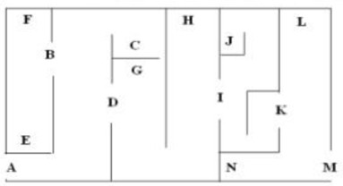
Breadth First Search for a Maze Problem
Step 1: Create the graphical representation for the problem.

Slide 5
Breadth First Search for a Maze Problem
Step 1: Create the graphical representation for the problem.
A
0
B
C
D

Slide 6
Breadth First Search for a Maze Problem
Step 1: Create the graphical representation for the problem.
A
0
B
C
D
E
F

Slide 7
Breadth First Search for a Maze Problem
Step 1: Create the graphical representation for the problem.
A
0
B
C
D
E
F
G
I
H

Slide 8
Breadth First Search for a Maze Problem
Step 1: Create the graphical representation for the problem.
A
0
B
C
D
E
F
G
I
H
J
K

Slide 9
Breadth First Search for a Maze Problem
Step 1: Create the graphical representation for the problem.
A
0
B
C
D
E
F
G
I
H
J
K
L
M

Slide 10
Adversarial Search Strategies

Slide 11

Adversarial Search Strategy
It is particularly in two-person games like chess or tic-tac-toe, involves the development and utilization of heuristics to guide decision-making processes for players.
In the context of two-person games, heuristics play a crucial role in determining which moves to make, especially when exhaustive search of all possible moves is not feasible due to the game's complexity; these heuristics aim to evaluate the current state of the game and estimate the likelihood of success for each possible move.
Two heuristic pruning procedures:
  Minimax Algorithm.
  Alpha-beta Algorithm.

Slide 12
The Minimax Adventure
Meet Our Players:
  Max and Min are our star players. They’re like rival game characters, each trying to outsmart the other.
  Max wants to maximize their score, while Min aims to minimize Max’s gains.
The Game Tree:
  Imagine a tree with branches representing all possible moves in our game. Each leaf at the end of a branch holds a score.
  Max and Min will explore this tree together.
Max’s Turn:
  Max starts at the top of the tree. They look at all the branches and pick the one with the highest score. Max thinks, “I’m going big!”
Min’s Turn:
  Min follows Max down the chosen branch. Min examines all the branches and selects the one with the lowest score. Min grins, “I’ll bring Max down!”

Slide 13
The Minimax Adventure
Back and Forth:
  Max and Min take turns, climbing up and down the tree. Max always wants the biggest score, while Min tries to keep it small. It’s like a seesaw battle!
Terminal Nodes:
  Finally, they reach the leaves—the terminal nodes. These hold actual scores.
  Max and Min compare these scores and decide who wins that branch.
Backtrack:
  Now, they backtrack. Max and Min remember their choices and adjust their strategies.
  They climb back up, recalculating scores as they go.
The Ultimate Decision:
  At the very top, Max and Min reveal their final scores.
  Max celebrates if it’s high, while Min smirks if it’s low.
  And that’s how the Minimax Algorithm works! 🎮🌳

Slide 14
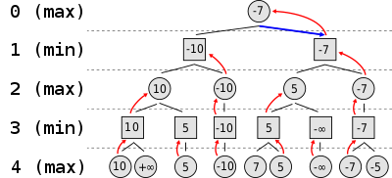
The Minimax Adventure

Slide 15
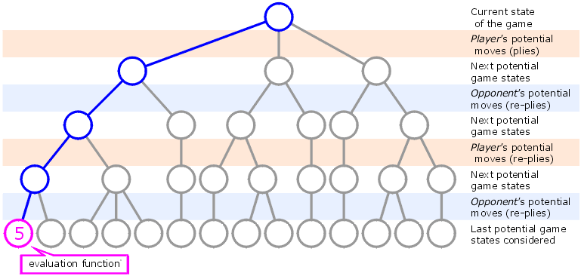
Minimax to a Fixed Depth

Slide 16
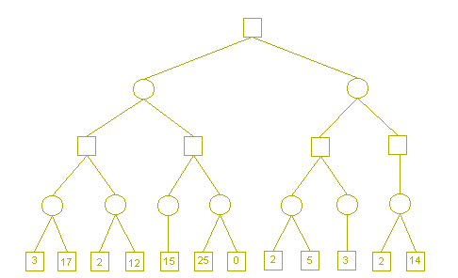
The Minimax Adventure

Slide 17
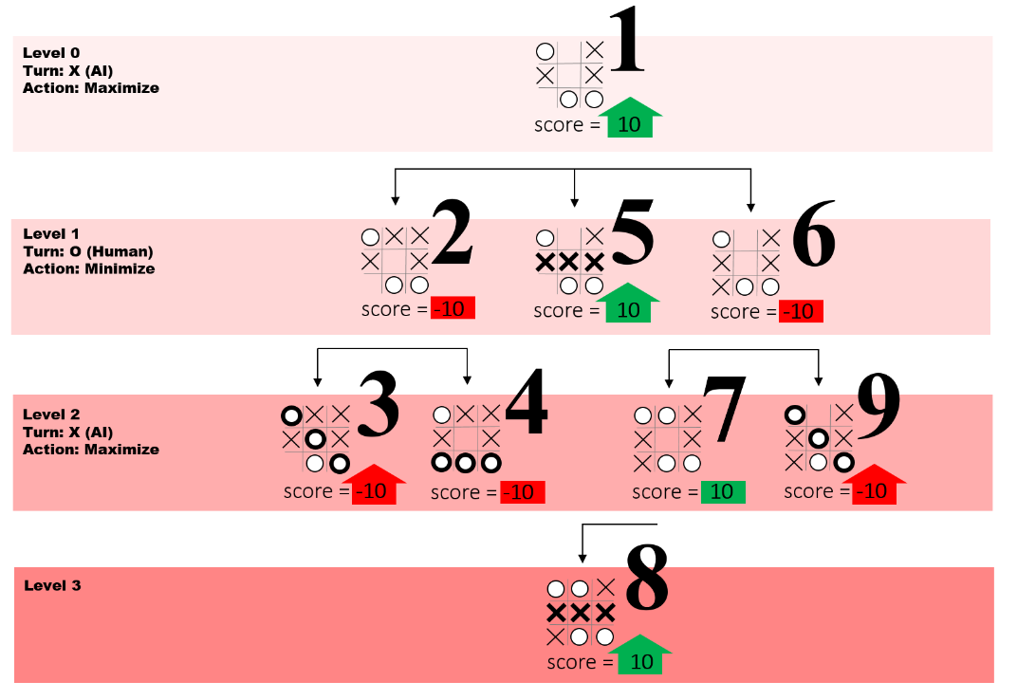
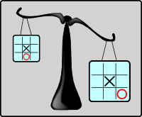
Tic Tac Toe Example
Some moves are better than others.
Source: freecodecamp

Slide 18

Alpha–Beta Pruning Algorithm
  Alpha–beta pruning is an optimization technique applied to the minimax algorithm. It aims to reduce the number of nodes evaluated during the search process in a game tree.
  This algorithm is commonly used for machine playing of two-player combinatorial games such as Tic-tac-toe, Chess, Connect 4, and more.

Slide 19

Alpha–Beta Pruning Algorithm
  Core Idea
Imagine a game tree representing different possible situations in the game. Each node in the tree corresponds to a specific game state.
At each node, the algorithm maintains two values:
  Alpha: Represents the minimum score that the maximizing player (usually the AI) is assured of.
  Beta: Represents the maximum score that the minimizing player (usually the opponent) is assured of.
Initially, alpha is set to negative infinity, and beta is set to positive infinity—both players start with their worst possible scores.
As the search progresses, the algorithm prunes away branches that cannot significantly influence the final decision.
α
β

Slide 20
Alpha–Beta Pruning Algorithm
Initial Setup:
  The Alpha-beta pruning algorithm begins with an initial call to the search function, typically starting from the root node of the game tree.
  It initializes two variables, alpha and beta, representing the best scores found so far for the maximizing player and the minimizing player, respectively. Initially, alpha is set to negative infinity, and beta is set to positive infinity.
Recursive Tree Traversal:
  The algorithm proceeds with a depth-first search through the game tree, evaluating nodes recursively.
  At each level of the tree, the algorithm alternates between two types of nodes: maximizing nodes (belonging to the maximizing player) and minimizing nodes (belonging to the minimizing player).
Alpha Update (Maximizing Node):
  During the evaluation of a maximizing node, the algorithm updates the alpha value if it finds a score greater than the current alpha. This new alpha represents the best score found so far for the maximizing player on the path from the root to the current node.
Beta Update (Minimizing Node):
  Conversely, during the evaluation of a minimizing node, the algorithm updates the beta value if it finds a score lower than the current beta. This new beta represents the best score found so far for the minimizing player on the path from the root to the current node.
α
β

Slide 21
Alpha–Beta Pruning Algorithm
Pruning Condition:
  At each level of the tree, if the algorithm encounters a situation where the alpha value of a maximizing node becomes greater than or equal to the beta value of a minimizing node, it indicates that the current branch can be pruned.
  This condition implies that the minimizing player (or the opponent) will never choose this path because there exists a better alternative for them elsewhere in the tree. Hence, further exploration of this branch is unnecessary.
Termination and Decision-making:
  The algorithm continues to traverse the tree recursively, updating alpha and beta values and pruning branches as necessary.
  Once the search reaches a terminal state or a specified depth limit, the algorithm returns the score associated with that state.
  Finally, the optimal move is determined based on the highest score obtained for the maximizing player at the root level.
α >= β

Slide 22

Alpha–Beta Pruning Example
α = -∞
Β = +∞
α >= β
Max= α
Min = β
Min
α = -∞
Β = +∞
Max
α = -∞
Β = +∞
Min
α = -∞
Β = +∞
Max

Slide 23
Alpha–Beta Pruning Example
α = -∞
Β = +∞
α >= β
Max= α
Min = β
Min
α = -∞
Β = +∞
Max
α = -∞
Β = +∞
Min
α = 3
Β = +∞
Max

Slide 24
Alpha–Beta Pruning Example
α = -∞
Β = +∞
α >= β
Max= α
Min = β
Min
α = -∞
Β = +∞
Max
α = -∞
Β = +∞
Min
α = 17
Β = +∞
Max
Notes:
Suppose the game being played only has a maximum of two possible moves per player each turn. The algorithm generates the tree below, where the circles represent the moves of the player running the algorithm(maximizing player), and squares represent the moves of the opponent(minimizing player).

Slide 25
Alpha–Beta Pruning Example
α = -∞
Β = +∞
α >= β
Max= α
Min = β
Min
α = -∞
Β = +∞
Max
α = -∞
Β = 17
Min
α = 17
Β = +∞
Max
Notes:
Suppose the game being played only has a maximum of two possible moves per player each turn. The algorithm generates the tree below, where the circles represent the moves of the player running the algorithm(maximizing player), and squares represent the moves of the opponent(minimizing player).

Slide 26
Alpha–Beta Pruning Example
α = -∞
Β = +∞
α >= β
Max= α
Min = β
Min
α = -∞
Β = +∞
Max
α = -∞
Β = 17
Min
α = 17
Β = +∞
α = -∞
Β = 17
Max
Notes:
Suppose the game being played only has a maximum of two possible moves per player each turn. The algorithm generates the tree below, where the circles represent the moves of the player running the algorithm(maximizing player), and squares represent the moves of the opponent(minimizing player).

Slide 27
Alpha–Beta Pruning Example
α = -∞
Β = +∞
α >= β
Max= α
Min = β
Min
α = -∞
Β = +∞
Max
α = -∞
Β = 17
Min
α = 17
Β = +∞
α = 2
Β = 17
Max
Notes:
Suppose the game being played only has a maximum of two possible moves per player each turn. The algorithm generates the tree below, where the circles represent the moves of the player running the algorithm(maximizing player), and squares represent the moves of the opponent(minimizing player).

Slide 28
Alpha–Beta Pruning Example
α = -∞
Β = +∞
α >= β
Max= α
Min = β
Min
α = -∞
Β = +∞
Max
α = -∞
Β = 17
Min
α = 17
Β = +∞
α = 12
Β = 17
Max
Notes:
Suppose the game being played only has a maximum of two possible moves per player each turn. The algorithm generates the tree below, where the circles represent the moves of the player running the algorithm(maximizing player), and squares represent the moves of the opponent(minimizing player).

Slide 29
Alpha–Beta Pruning Example
α = -∞
Β = +∞
α >= β
Max= α
Min = β
Min
α = -∞
Β = +∞
Max
α = -∞
Β = 12
Min
α = 17
Β = +∞
α = 12
Β = 17
Max
Notes:
Suppose the game being played only has a maximum of two possible moves per player each turn. The algorithm generates the tree below, where the circles represent the moves of the player running the algorithm(maximizing player), and squares represent the moves of the opponent(minimizing player).

Slide 30
Alpha–Beta Pruning Example
α = -∞
Β = +∞
α >= β
Max= α
Min = β
Min
α = 12
Β = +∞
Max
α = -∞
Β = 12
Min
α = 17
Β = +∞
α = 12
Β = 17
Max
Notes:
Suppose the game being played only has a maximum of two possible moves per player each turn. The algorithm generates the tree below, where the circles represent the moves of the player running the algorithm(maximizing player), and squares represent the moves of the opponent(minimizing player).

Slide 31
Alpha–Beta Pruning Example
α = -∞
Β = +∞
α >= β
Max= α
Min = β
Min
α = 12
Β = +∞
Max
α = -∞
Β = 12
Min
α = 12
Β = +∞
α = 17
Β = +∞
α = 12
Β = 17
Max
Notes:
Suppose the game being played only has a maximum of two possible moves per player each turn. The algorithm generates the tree below, where the circles represent the moves of the player running the algorithm(maximizing player), and squares represent the moves of the opponent(minimizing player).

Slide 32
Alpha–Beta Pruning Example
α = -∞
Β = +∞
α >= β
Max= α
Min = β
Min
α = 12
Β = +∞
Max
α = -∞
Β = 12
Min
α = 12
Β = +∞
α = 17
Β = +∞
α = 12
Β = 17
Max
α = 12
Β = +∞
Notes:
Suppose the game being played only has a maximum of two possible moves per player each turn. The algorithm generates the tree below, where the circles represent the moves of the player running the algorithm(maximizing player), and squares represent the moves of the opponent(minimizing player).

Slide 33
Alpha–Beta Pruning Example
α = -∞
Β = +∞
α >= β
Max= α
Min = β
Min
α = 12
Β = +∞
Max
α = -∞
Β = 12
Min
α = 12
Β = 15
α = 17
Β = +∞
α = 12
Β = 17
Max
α = 15
Β = +∞
Notes:
Suppose the game being played only has a maximum of two possible moves per player each turn. The algorithm generates the tree below, where the circles represent the moves of the player running the algorithm(maximizing player), and squares represent the moves of the opponent(minimizing player).

Slide 34
Alpha–Beta Pruning Example
α = -∞
Β = +∞
α >= β
Max= α
Min = β
Min
α = 12
Β = +∞
Max
α = -∞
Β = 12
Min
α = 12
Β = 15
α = 17
Β = +∞
α = 12
Β = 17
α = 12
Β = 15
Max
α = 15
Β = +∞

Slide 35
Alpha–Beta Pruning Example
α = -∞
Β = +∞
α >= β
25>15
Max= α
Min = β
Min
α = 12
Β = +∞
Max
α = -∞
Β = 12
Min
α = 12
Β = 15
α = 17
Β = +∞
α = 12
Β = 17
α = 25
Β = 15
Max
α = 15
Β = +∞

Slide 36
Alpha–Beta Pruning Example
α = -∞
Β = +∞
α >= β
Max= α
Min = β
Min
α = 15
Β = +∞
Max
α = -∞
Β = 12
Min
α = 12
Β = 15
α = 17
Β = +∞
α = 12
Β = 17
α = 25
Β = 15
Max
α = 15
Β = +∞
Notes:
Suppose the game being played only has a maximum of two possible moves per player each turn. The algorithm generates the tree below, where the circles represent the moves of the player running the algorithm(maximizing player), and squares represent the moves of the opponent(minimizing player).

Slide 37
Alpha–Beta Pruning Example
α = -∞
Β = 15
α >= β
Max= α
Min = β
Min
α = 15
Β = +∞
Max
α = -∞
Β = 12
Min
α = 12
Β = 15
α = 17
Β = +∞
α = 12
Β = 17
α = 25
Β = 15
Max
α = 15
Β = +∞
Notes:
Suppose the game being played only has a maximum of two possible moves per player each turn. The algorithm generates the tree below, where the circles represent the moves of the player running the algorithm(maximizing player), and squares represent the moves of the opponent(minimizing player).

Slide 38
Alpha–Beta Pruning Example
α = -∞
Β = 15
α >= β
Max= α
Min = β
Min
α = 15
Β = +∞
α = -∞
Β = 15
Max
α = -∞
Β = 12
Min
α = 12
Β = 15
α = 17
Β = +∞
α = 12
Β = 17
α = 25
Β = 15
Max
α = 15
Β = +∞
Notes:
Suppose the game being played only has a maximum of two possible moves per player each turn. The algorithm generates the tree below, where the circles represent the moves of the player running the algorithm(maximizing player), and squares represent the moves of the opponent(minimizing player).

Slide 39
Alpha–Beta Pruning Example
α = -∞
Β = 15
α >= β
Max= α
Min = β
Min
α = 15
Β = +∞
α = -∞
Β = 15
Max
α = -∞
Β = 12
α = -∞
Β = 15
Min
α = 12
Β = 15
α = 17
Β = +∞
α = 12
Β = 17
α = 25
Β = 15
Max
α = 15
Β = +∞
Notes:
Suppose the game being played only has a maximum of two possible moves per player each turn. The algorithm generates the tree below, where the circles represent the moves of the player running the algorithm(maximizing player), and squares represent the moves of the opponent(minimizing player).

Slide 40
Alpha–Beta Pruning Example
α = -∞
Β = 15
α >= β
Max= α
Min = β
Min
α = 15
Β = +∞
α = -∞
Β = 15
Max
α = -∞
Β = 12
α = -∞
Β = 15
Min
α = 12
Β = 15
α = -∞
Β = 15
α = 17
Β = +∞
α = 12
Β = 17
α = 25
Β = 15
Max
α = 15
Β = +∞
Notes:
Suppose the game being played only has a maximum of two possible moves per player each turn. The algorithm generates the tree below, where the circles represent the moves of the player running the algorithm(maximizing player), and squares represent the moves of the opponent(minimizing player).

Slide 41
Alpha–Beta Pruning Example
α = -∞
Β = 15
α >= β
Max= α
Min = β
Min
α = 15
Β = +∞
α = -∞
Β = 15
Max
α = -∞
Β = 12
α = -∞
Β = 15
Min
α = 12
Β = 15
α = 2
Β = 15
α = 17
Β = +∞
α = 12
Β = 17
α = 25
Β = 15
Max
α = 15
Β = +∞
Notes:
Suppose the game being played only has a maximum of two possible moves per player each turn. The algorithm generates the tree below, where the circles represent the moves of the player running the algorithm(maximizing player), and squares represent the moves of the opponent(minimizing player).

Slide 42
Alpha–Beta Pruning Example
α = -∞
Β = 15
α >= β
Max= α
Min = β
Min
α = 15
Β = +∞
α = -∞
Β = 15
Max
α = -∞
Β = 12
α = -∞
Β = 15
Min
α = 12
Β = 15
α = 5
Β = 15
α = 17
Β = +∞
α = 12
Β = 17
α = 25
Β = 15
Max
α = 15
Β = +∞
Notes:
Suppose the game being played only has a maximum of two possible moves per player each turn. The algorithm generates the tree below, where the circles represent the moves of the player running the algorithm(maximizing player), and squares represent the moves of the opponent(minimizing player).

Slide 43
Alpha–Beta Pruning Example
α = -∞
Β = 15
α >= β
Max= α
Min = β
Min
α = 15
Β = +∞
α = -∞
Β = 15
Max
α = -∞
Β = 12
α = -∞
Β = 5
Min
α = 12
Β = 15
α = 5
Β = 15
α = 17
Β = +∞
α = 12
Β = 17
α = 25
Β = 15
Max
α = 15
Β = +∞
Notes:
Suppose the game being played only has a maximum of two possible moves per player each turn. The algorithm generates the tree below, where the circles represent the moves of the player running the algorithm(maximizing player), and squares represent the moves of the opponent(minimizing player).

Slide 44
Alpha–Beta Pruning Example
α = -∞
Β = 15
α >= β
Max= α
Min = β
Min
α = 15
Β = +∞
α = -∞
Β = 15
Max
α = -∞
Β = 12
α = -∞
Β = 5
Min
α = 12
Β = 15
α = 5
Β = 15
α = 17
Β = +∞
α = 12
Β = 17
α = 25
Β = 15
α = -∞
Β = 5
Max
α = 15
Β = +∞
Notes:
Suppose the game being played only has a maximum of two possible moves per player each turn. The algorithm generates the tree below, where the circles represent the moves of the player running the algorithm(maximizing player), and squares represent the moves of the opponent(minimizing player).

Slide 45
Alpha–Beta Pruning Example
α = -∞
Β = 15
α >= β
Max= α
Min = β
Min
α = 15
Β = +∞
α = -∞
Β = 15
Max
α = -∞
Β = 12
α = -∞
Β = 5
Min
α = 12
Β = 15
α = 5
Β = 15
α = 17
Β = +∞
α = 12
Β = 17
α = 25
Β = 15
α = 3
Β = 5
Max
α = 15
Β = +∞
Notes:
Suppose the game being played only has a maximum of two possible moves per player each turn. The algorithm generates the tree below, where the circles represent the moves of the player running the algorithm(maximizing player), and squares represent the moves of the opponent(minimizing player).

Slide 46
Alpha–Beta Pruning Example
α = -∞
Β = 15
α >= β
Max= α
Min = β
Min
α = 15
Β = +∞
α = -∞
Β = 15
Max
α = -∞
Β = 12
α = -∞
Β = 3
Min
α = 12
Β = 15
α = 5
Β = 15
α = 17
Β = +∞
α = 12
Β = 17
α = 25
Β = 15
α = 3
Β = 5
Max
α = 15
Β = +∞
Notes:
Suppose the game being played only has a maximum of two possible moves per player each turn. The algorithm generates the tree below, where the circles represent the moves of the player running the algorithm(maximizing player), and squares represent the moves of the opponent(minimizing player).

Slide 47
Alpha–Beta Pruning Example
α = -∞
Β = 15
α >= β
Max= α
Min = β
Min
α = 15
Β = +∞
α = 3
Β = 15
Max
α = -∞
Β = 12
α = -∞
Β = 3
Min
α = 12
Β = 15
α = 5
Β = 15
α = 17
Β = +∞
α = 12
Β = 17
α = 25
Β = 15
α = 3
Β = 5
Max
α = 15
Β = +∞
Notes:
Suppose the game being played only has a maximum of two possible moves per player each turn. The algorithm generates the tree below, where the circles represent the moves of the player running the algorithm(maximizing player), and squares represent the moves of the opponent(minimizing player).

Slide 48
Alpha–Beta Pruning Example
α = -∞
Β = 15
α >= β
Max= α
Min = β
Min
α = 15
Β = +∞
α = 3
Β = 15
Max
α = -∞
Β = 12
α = -∞
Β = 3
α = 3
Β = 15
Min
α = 12
Β = 15
α = 5
Β = 15
α = 17
Β = +∞
α = 12
Β = 17
α = 25
Β = 15
α = 3
Β = 5
Max
α = 15
Β = +∞
Notes:
Suppose the game being played only has a maximum of two possible moves per player each turn. The algorithm generates the tree below, where the circles represent the moves of the player running the algorithm(maximizing player), and squares represent the moves of the opponent(minimizing player).

Slide 49
Alpha–Beta Pruning Example
α = -∞
Β = 15
α >= β
Max= α
Min = β
Min
α = 15
Β = +∞
α = 3
Β = 15
Max
α = -∞
Β = 12
α = -∞
Β = 3
α = 3
Β = 15
Min
α = 12
Β = 15
α = 5
Β = 15
α = 17
Β = +∞
α = 12
Β = 17
α = 25
Β = 15
α = 3
Β = 5
α = 3
Β = 15
Max
α = 15
Β = +∞
Notes:
Suppose the game being played only has a maximum of two possible moves per player each turn. The algorithm generates the tree below, where the circles represent the moves of the player running the algorithm(maximizing player), and squares represent the moves of the opponent(minimizing player).

Slide 50
Alpha–Beta Pruning Example
α = -∞
Β = 15
α >= β
Max= α
Min = β
Min
α = 15
Β = +∞
α = 3
Β = 15
Max
α = -∞
Β = 12
α = -∞
Β = 3
α = 3
Β = 15
Min
α = 12
Β = 15
α = 5
Β = 15
α = 17
Β = +∞
α = 12
Β = 17
α = 25
Β = 15
α = 3
Β = 5
α = 25
Β = 15
Max
α = 15
Β = +∞
Notes:
Suppose the game being played only has a maximum of two possible moves per player each turn. The algorithm generates the tree below, where the circles represent the moves of the player running the algorithm(maximizing player), and squares represent the moves of the opponent(minimizing player).

Slide 51
Alpha–Beta Pruning Example
α = -∞
Β = 15
α >= β
25>15
Max= α
Min = β
Min
α = 15
Β = +∞
α = 3
Β = 15
Max
α = -∞
Β = 12
α = -∞
Β = 3
α = 3
Β = 15
Min
α = 12
Β = 15
α = 5
Β = 15
α = 17
Β = +∞
α = 12
Β = 17
α = 25
Β = 15
α = 3
Β = 5
α = 25
Β = 15
Max
α = 15
Β = +∞
Notes:
Suppose the game being played only has a maximum of two possible moves per player each turn. The algorithm generates the tree below, where the circles represent the moves of the player running the algorithm(maximizing player), and squares represent the moves of the opponent(minimizing player).

Slide 52
Alpha–Beta Pruning Example
α = -∞
Β = 15
α >= β
Max= α
Min = β
Min
α = 15
Β = +∞
α = 3
Β = 15
Max
α = -∞
Β = 12
α = -∞
Β = 3
α = 3
Β = 15
Min
α = 12
Β = 15
α = 5
Β = 15
α = 17
Β = +∞
α = 12
Β = 17
α = 25
Β = 15
α = 3
Β = 5
α = 25
Β = 15
Max
α = 15
Β = +∞
Notes:
Suppose the game being played only has a maximum of two possible moves per player each turn. The algorithm generates the tree below, where the circles represent the moves of the player running the algorithm(maximizing player), and squares represent the moves of the opponent(minimizing player).

Slide 53
Alpha–Beta Pruning Example
α = -∞
Β = 3
α >= β
Max= α
Min = β
Min
α = 15
Β = +∞
α = 3
Β = 15
Max
α = -∞
Β = 12
α = -∞
Β = 3
α = 3
Β = 15
Min
α = 12
Β = 15
α = 5
Β = 15
α = 17
Β = +∞
α = 12
Β = 17
α = 25
Β = 15
α = 3
Β = 5
α = 25
Β = 15
Max
α = 15
Β = +∞
Notes:
Suppose the game being played only has a maximum of two possible moves per player each turn. The algorithm generates the tree below, where the circles represent the moves of the player running the algorithm(maximizing player), and squares represent the moves of the opponent(minimizing player).

Slide 54
Alpha Beta Pruning Example
A
Max
Min
B
C
D
F
G
Max
E
2
7
5
3
5
9
0
1

Slide 55
Alpha Beta Pruning Example
α = -∞
Β = +∞
A
Max
Min
α = -∞
Β = +∞
B
C
α = -∞
Β = +∞
D
F
G
Max
E
2
7
5
3
5
9
0
1

Slide 56
Alpha Beta Pruning Example
α = -∞
Β = +∞
A
Max
Min
α = -∞
Β = +∞
B
C
α = 3
Β = +∞
D
F
G
Max
E
2
7
5
3
5
9
0
1

Slide 57
Alpha Beta Pruning Example
α = -∞
Β = +∞
A
Max
Min
α = -∞
Β = 3
B
C
α = 3
Β = +∞
D
F
G
Max
E
2
7
5
3
5
9
0
1

Slide 58
Alpha Beta Pruning Example
α = -∞
Β = +∞
A
Max
Min
α = -∞
Β = 3
B
C
α = 3
Β = +∞
α = -∞
Β = 3
D
F
G
Max
E
2
7
5
3
5
9
0
1

Slide 59
Alpha Beta Pruning Example
α = -∞
Β = +∞
A
Max
Min
α = -∞
Β = 3
B
C
α = 3
Β = +∞
α = 5
Β = 3
D
F
G
Max
E
2
7
5
3
5
9
0
1

Slide 60
Alpha Beta Pruning Example
α = -∞
Β = +∞
A
Max
α > Β → Pruning
Min
α = -∞
Β = 3
B
C
α = 3
Β = +∞
α = 9
Β = 3
D
F
G
Max
E
2
7
5
3
5
9
0
1

Slide 61
Alpha Beta Pruning Example
α = 3
Β = +∞
A
Max
Min
α = -∞
Β = 3
B
C
α = 3
Β = +∞
α = 9
Β = 3
D
F
G
Max
E
2
7
5
3
5
9
0
1

Slide 62
Alpha Beta Pruning Example
α = 3
Β = +∞
A
Max
α = 3
Β = +∞
Min
α = -∞
Β = 3
B
C
α = 3
Β = +∞
α = 3
Β = +∞
α = 9
Β = 3
α = 3
Β = +∞
D
F
G
Max
E
2
7
5
3
5
9
0
1

Slide 63
Alpha Beta Pruning Example
α = 3
Β = +∞
A
Max
α = 3
Β = +∞
Min
α = -∞
Β = 3
B
C
α = 7
Β = +∞
α = 3
Β = +∞
α = 9
Β = 3
α = 3
Β = +∞
D
F
G
Max
E
2
7
5
3
5
9
0
1

Slide 64
Alpha Beta Pruning Example
α = 3
Β = +∞
A
Max
α = 3
Β = 3
α = Β → Pruning
Min
α = -∞
Β = 3
B
C
α = 7
Β = +∞
α = 3
Β = +∞
α = 9
Β = 3
α = 3
Β = +∞
D
F
G
Max
E
2
7
5
3
5
9
0
1

Slide 65
Alpha Beta Pruning Example
α = 3
Β = +∞
A
Max
α = 3
Β = 3
Min
α = -∞
Β = 3
B
C
α = 3
Β = +∞
α = 9
Β = 3
α = 3
Β = +∞
D
F
G
Max
E
2
7
5
3
5
9
0
1

Slide 66
Additional Resources
  Game Playing
  https://pages.cs.wisc.edu/~dyer/cs540/notes/games.html
  Alpha–Beta Pruning in Chess Game
  https://www.youtube.com/watch?v=l-hh51ncgDI

Slide 67



Thank You

