Slide 1


Communication
Skills
Prepared by Dr. Merna Emad
Lecture 1
www.midocean.ae

Slide 2


Communication skills

Slide 3
Communication skills
Developing communication skills can help many aspects of your life, from your professional career, to social gatherings, to your family life. In today's hectic world, we rely heavily on sharing information, resulting in greater emphasis being placed on having good communication skills. Good verbal and written communication skills are essential in order to deliver and understand information quickly and accurately. Being able to communicate effectively is a vital life skill and should not be overlooked.
In contrast, poor communication skills can have a negative impact - a poorly delivered message may result in misunderstanding, frustration and in some cases disaster.

Slide 4
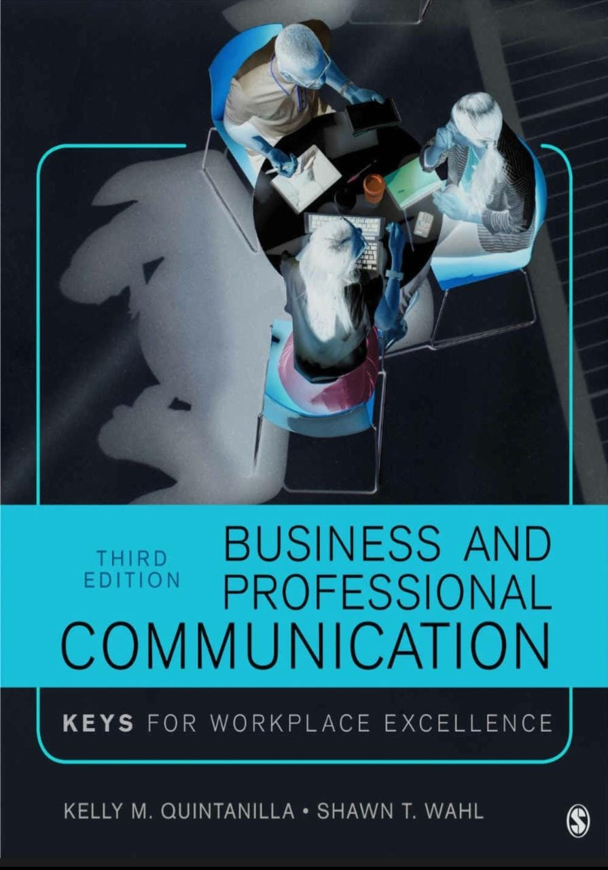

Slide 5
The book aims to:
Provide Business and Professional Communication students with the knowledge and skills they need to move from interview candidate, to team member, to leader.
Accessible coverage of new communication technology and social media prepares students to communicate effectively in real world settings.

Slide 6
The book aims to:
With an emphasis on building skills for business writing and professional presentations, this text empowers students to successfully handle important work-related activities, including job interviewing, working in team, strategically utilizing visual aids, and providing feedback to supervisors.

Slide 7

After completing this course you will be able to:
Recognize cultural differences that impact members of an organization and enact appropriate communication strategies to help attain cultural diversity
Understand the communication process and recall how networks and channels influence the communication process in organizations
Send and interpret verbal and nonverbal messages with accuracy and effectiveness

Slide 8
After completing this course you will be able to:
Evaluate listening habits and practice effective listening skills
Build positive interpersonal relationships in the workplace
Learn about all the interviewing stages.
Plan and conduct an interview in both interviewee and interviewer roles.

Slide 9
After completing this course you will be able to:
Distinguish groups and teams and recall communication factors that influence the effective development of teams
Identify and overcome common obstacles in group meetings
Demonstrate competence in making a decision as a leader.
Create and deliver a business presentation, reports and meetings.

Slide 10
Outline of the Book
The book is organized into five distinct parts.
Overview of key concepts
Developing the skills in the workplace
Developing strategies of communications
Enhancing interpersonal competency
Leadership and balancing between work and life through communication

Slide 11

Chapter Objectives
Chapter 1
Business and Professional Excellence in the Workplace
Define professional excellence and communication
The importance of human communication in business and professional contexts
Explain the components of the communication model
Describe the communication challenges posed by social media and technology
Discuss communication and professional excellence from an ethical perspective

Slide 12
Chapter Objectives
Chapter 2
Verbal and non-verbal Communication
Define Verbal communication
Define Non-Verbal communication
Appraise your verbal and nonverbal communication skills
Discuss examples of how verbal and nonverbal communication are related

Slide 13
Chapter Objectives
Chapter 3
Listening
Explain the difference between hearing and listening
Discuss the barriers to listening and how to avoid them
Describe strategies for developing and sustaining professional excellence using active listening skills

Slide 14
Chapter Objectives
Chapter 4
Entering the Workplace
Identify the six stages of the job-seeking process
Explain the important role of exploring and researching in the job-seeking process
Develop a customized résumé and cover letter
Discuss examples of how to interview and negotiate successfully

Slide 15
Chapter Objectives
Chapter 5
Diversity in the Workplace
Describe each phase of the assimilation process
Assess the culture in your organization
Define key concepts related to diversity in the workplace and the important role they play
Discuss examples of different kinds of diversity that you may encounter as you enter the workplace

Slide 16
Chapter Objectives
Chapter 6
Developing in the Workplace
Describe each phase of the assimilation process
Explain the impact of the environment, the topic(s), and the participants on communication within meetings
Describe ways to foster innovative thinking in a team context
Discuss the concepts involved in effective problem solving
Discuss the need for conflict and the strategies for productive conflict

Slide 17
Chapter Objectives
Chapter 6
Excelling in the Workplace
Discuss the impact technology has on business and professional communication
Explain how emotion is expressed with technology
Discuss how the drawbacks of technology can prevent you from excelling as a professional
Explain how to use professional etiquette with technology

Slide 18
Chapter Objectives
Chapter 7
Written communication in the Workplace
Explain the impact of written communication on professional excellence
Describe the different indirect messages sent with written communication
Discuss the different types of written communication

Slide 19
Chapter Objectives
Chapter 8
Leadership and Conflict management
Discuss what constitutes leadership and power
Explain the relationship between leadership theory and communication
Discuss communication strategies for hiring quality employees
Describe ways to lead effective teams and difficult people
Discuss ways to manage your public image

Slide 20
Chapter Objectives
Chapter 9
Presenting in the Workplace
Discuss the importance of professional excellence in public speaking
Identify presenting opportunities
Design an informative and persuasive speech
Analyze audience and context
Organize the body, introduction and conclusion of a speech and incorporate effective transitions

Slide 21
Chapter Objectives
Chapter 10
Surviving in the Workplace
Discuss the impact of work-life balance on professional excellence
Define work-life balance
Identify the triggers to imbalance
Develop strategies for achieving work-life balance

Slide 22

What I expect from you?

Slide 23

What I expect from you?

Slide 24



What I expect from you?

Slide 25

What I expect from you?

Slide 26


