Slide 1


Final Project
Prepared by Dr. Fayez Jrad
(PMG 697)
Lecture 0 Orientation

Slide 2



Final Project
Lecture 0
(PMG 697)
Orientation
Prepared by
Dr. Fayez Jrad
www.midocean.ae

Slide 3
Course Guide
Graduation projects are the fundamental building block for students and researchers to begin a prosperous future because they are a crucial practical experience that will serve as a bridge to their working lives after graduation and an actual test of their abilities to analyze problems and come up with new solutions.
www.midocean.ae

Slide 4
Course Guide
From this vantage point, Midocean University Faculty of Management has placed a strong emphasis on the permanence and sustainability of the development and upgrading of the quality of graduation projects over time, as well as increasing their interoperability with novel axes and topics in the specialization of management, project management, and risk management.
www.midocean.ae

Slide 5
Graduation Project Objectives
A. Describe the nature of the scientific method and the traits of scientific thinking to the student.
B. Defining the fundamental ideas in management research and related domains (management - project management - risk management).
C. Introduce the student to several scientific research techniques and outline each one's applications in the student's area of concentration.
www.midocean.ae

Slide 6
Graduation Project Objectives
D) Give the student the ability to recognize the procedures, curriculum, and resources used in administrative research for gathering and analyzing data and information.
E) Teach the student how to create a proposed plan for administrative research using data-gathering methods.
H) Making a proposed study strategy using scientific research techniques.
www.midocean.ae

Slide 7
Graduation Project Objectives
As a result, this guide was divided into two main sections:
the first discusses the components that must be included in the proposal for the graduation project, along with a thorough explanation of each element.
The second concerns setting up, managing, and directing the graduating project (Thesis).
www.midocean.ae

Slide 8
Graduation Projects
- The group is formed of 2 students.
Teams can be formed between departments of Project Management and Business Administration, but members of Risk Management should represent the same department.
Three days after the study's start, a proposal containing the names of the team members is submitted (team leader and other member).
- The general supervisor must approve the team's formation within two days of the course's delivery.
www.midocean.ae

Slide 9
Graduation Projects
The weekly review of the course's recorded lectures and periodic practical application of these stages in the graduation project.
The team is committed to submitting the project title the first week of the semester.
The deadline for delivering all plans is the beginning of the third week of the semester.
The team is committed to submitting the final project the eight week of the semester.
www.midocean.ae

Slide 10
Graduation Projects
The student is committed to actively participating in the team graduation project's work plan in accordance with the methodologies used in scientific research.
- Commitment of all team members to participate in the application of the practical part of the project (survey - interview - observation - workshops - training - analysis of data -..... Etc.)
www.midocean.ae

Slide 11
Graduation Projects
- Examination of the plagiarism percentage provided that it does not exceed 25%, which means the total percentage of plagiarism from all sources relied on by the researcher in the preparation of the same research.
- Finish the study delivery by the deadline, the beginning of the eleventh week of the semester, and then discuss the projects before the semester's final exams.
www.midocean.ae

Slide 12
Follow-up and delivery schedule of graduation project tasks
Weeks | Recorded Subjects | Week
1St week 25/5/2024 | Lecture Orientation | 0
2nd week 01/6/204 | Scientific Research The concept of scientific research Fields of scientific research in administrative sciences Research types Scientific research goals Research Proposal The stages of the research process Research Proposal components: | 1
www.midocean.ae

Slide 13
Follow-up and delivery schedule of graduation project tasks
3rd Week 08/6/204 | Research Proposal Research Proposal components: Research Methods Types of research methods | 2
15/6/2024 -22/6/2024 | إجازة عيد الأضحى المبارك
4th Week 22/6/2024 | Population and Sampling The concept of population and research sample Sample type Random sample (probability) Population and Sampling Non-random samples Sample selection steps Specify the sample size | 3
www.midocean.ae

Slide 14
Follow-up and delivery schedule of graduation project tasks
5th Week 29/6/2024 | Data Collection Primary data and secondary data Methods for collecting primary data Validity and Reliability First: Validity Second: Reliability | 4
6th Week 06/7/2024 | Data Types: (Quantitative & Qualitative) The first stage: Presentation and analysis of data using the SPSS program The second stage: Describing the data using statistical measures. The third stage: Data analysis using SPSS Research Conclusion: - Research Findings Research Recommendations Research References | 5
www.midocean.ae

Slide 15
Follow-up and delivery schedule of graduation project tasks
7th Week 13/7/2024 | The Practical Application and study case. | 6
8th Week 20/7/204 | The Practical Application and study case. | 7
9th Week 27/7/2024 | Start date for Final project submission. The Practical Application and study case. | 8
10th Week 03/8/2024 | The Practical Application and study case. | 9
11th Week 10/8/2024 | End date for Final project submission 02/8/2024 | 10
12th Week 17/8/2024 | Top Projects Discussion | 11
www.midocean.ae

Slide 16
Part One
Preparation of graduation project plan
The student must submit the plan according to the following steps:
- Research Title.
- Introduction.
- Study problem.
- The importance of the study.
- Objectives of the study.
- Study questions.
- Previous studies and theoretical framework.
www.midocean.ae

Slide 17
Part One
Preparation of graduation project plan
- Theoretical premises of study.
- Methodology and research methods.
- Study tools (data Collection tools).
- Study Limitation.
- List of references and preliminary sources.
(Taking into account the privacy of the programs).
www.midocean.ae

Slide 18
Research Title
- To express the project exactly and transparently.
- To express the researcher as an idea that provokes the mind of the researcher.
- Be concise and non-meaningful.
- To be a new and non-duplicate title for previous studies.
www.midocean.ae

Slide 19
The Introduction
- To introduce the project's subject matter.
- Expanding on the reasons for selecting this particular topic.
- Providing historical context for the project's concept.
- Emphasizing the study's significance and its relevance to society.
- Structure the plan progressively, from broad to specific.
- Describing the issue and connecting it to existing knowledge.
- Drawing connections to prior research in the field to build upon existing perspectives, leverage their insights, and identify emerging data by examining previous studies
www.midocean.ae

Slide 20
Importance of the study
The following aspects of significance should be addressed:
- Clearly articulate the theoretical significance.
- Clearly outline the anticipated practical significance.
- Identify the individuals or entities that will benefit from the study's findings and specify the domains of this benefit.
www.midocean.ae

Slide 21
Study Questions
The following aspects of significance should be addressed:
- Clarify the main question that the study seeks to answer.
- Clarify the sub-questions of the study.
- Validate the alignment of the study questions with the research problem.
- Highlight that the questions are in accordance with the study's objectives.
www.midocean.ae

Slide 22
Previous studies and theoretical framework
- Start from where others have ended.
- Obtain sufficient and accurate data and information.
- Start in terms of the results of the previous studies.
- Avoid the cons of those studies.
www.midocean.ae

Slide 23
Theoretical premises of the study
Theory and research are interdependent, as theory represents a consolidation of knowledge and the outcome of scientific inquiry.
With scientific research, theories would evolve and have the opportunity to validate their hypotheses.
The relationship between theory and research is not one of separation but rather one where theory underpins research endeavors.
www.midocean.ae

Slide 24
Research Methodology
- Identify the research methodology applied in the study.
- Explain the connection between the curriculum and the study's subject matter.
- Elaborate on the approaches for utilizing both the curriculum and research methods.
www.midocean.ae

Slide 25
Study Tools
- Recognize the instruments for data collection, ensuring their validity and reliability.
- Specify the tools employed for data analysis.
www.midocean.ae

Slide 26
Study Limitation
- Scope of the Study.
- Researcher Bias.
- Time Constraints..
www.midocean.ae

Slide 27
Second Part
Formal rules for organizing and directing the graduation project
The general framework for writing the graduation project.
- Graduation project contents.
- Part one: the introduction.
- The second part is the theoretical framework of the study.
- Third part: The practical study and its methodological procedure.
- Fourth Part: The appendix of the study.
www.midocean.ae

Slide 28
General framework for writing the graduation project
The student must follow academic guidelines when writing the report, including the proper inclusion and scientific formatting of references.
When writing the scientific material for the project, the student shall commit to using the scientific language “concepts, terms, definitions, quotations, and theories.”
The titles should be consistent with the specialization and the subject of the study, as well as translated into Arabic and English.
www.midocean.ae

Slide 29
General framework for writing the graduation project
The study can be written in Arabic or English, and it should be written in a proper language to avoid any grammatical or spelling errors.
Students must use one of the recognized academic writing styles, such as APA (American Psychological Association), MLA (Modern Language Association), Chicago, and others, focus on formatting, citations, and references rather than font choices.
www.midocean.ae

Slide 30
General framework for writing the graduation project
To ensure that all sources are fully documented in the project's reference list and having identifying references in the main body of the text.
References should be grouped at the end of the project and in order of precedence or alphabetical order.
All the appendixes that were used in the practical application, from the tools of data collection and the list of arbitrators for those tools or correspondence with the institutions in which the application was applied, should be included
www.midocean.ae

Slide 31
General framework for writing the graduation project
In the end, the abstract shall be written in Arabic and English for each project, regardless of the written language of the project, and it includes at least four main paragraphs, including the following:
The problem of the study, the reason for its selection, and the importance of addressing it on a theoretical and practical level.
The type of study, its scope, methodology, and the research tools relied upon to achieve its objectives.
www.midocean.ae

Slide 32
General framework for writing the graduation project
The most important results of the project that can be used.
The significance of the results and the possibility of applying them practically, in addition to the professional proposal.
www.midocean.ae

Slide 33
مواعيد حلقات النقاش
الفصل الدراسي الثالث 2024
يوم الثلاثاء/ الساعة |  | الاسبوع | حلقة النقاش
7:00-8:00 مساءاَ بتوقيت مكة المكرمة | 4/06/2024 | الأسبوع التوجيهي | الأولى (المحاضرة التعريفية)
7:00-8:00 مساءاَ بتوقيت مكة المكرمة | 11/06/2024 | الأسبوع الثاني | الثانية (البحث العلمي وخطوات اعداد الخطة البحثية)
7:00-8:00 مساءاَ بتوقيت مكة المكرمة | 2/07/2024 | الأسبوع الرابع | الثالثة (الاطار النظري للبحوث)
7:00-8:00 مساءاَ بتوقيت مكة المكرمة | 13/07/2024 | الأسبوع السادس | الرابعة (أدوات جمع وتحليل البيانات)
7:00-8:00 مساءاَ بتوقيت مكة المكرمة | 13/08/2024 | الأسبوع العاشر | الخامسة (النشر العلمي)

Slide 34
The Importance of scientific publishing
1. Enhancing the academic path.
2. Knowledge exchange.
3. Improving research skills.
4. Increasing job opportunities.
5. Providing new analyses.
www.midocean.ae

Slide 35
Classification of scientific journals
Journals are categorised into four quartiles: Q1, Q2, Q3 and Q4. Journals in Q1 and Q2 are considered top-tier journals while the lower-tier journals are classified as Q3 and Q4.
Q1 and Q2 journals have a higher impact factor than Q3 and Q4 ranked journals.
Some of the factors considered in the categorisation include the aim and scope of the journal, the quality of its board, the impact factor, external opinions about the journal and quality of the papers.
The number of citations for journal publications is an influencing factor, called the impact factor, which is used to rank journal ranks
www.midocean.ae

Slide 36
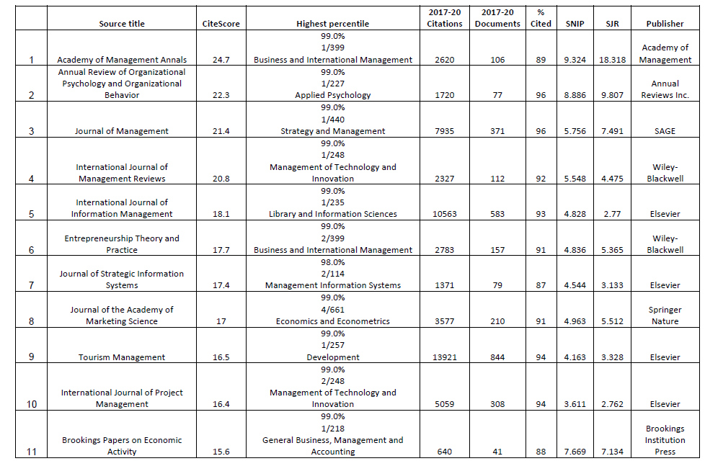
www.midocean.ae

Slide 37
كيفية اختيار المجلات
1. قم بإجراء بحث شامل للمجلات المتاحة التي تغطي مجال بحثك، وتأكد من أن المجلة تنشر الأبحاث التي تتعلق بموضوع بحثك.
2. قم بمراجعة معايير النشر في المجلة وتأكد من أن بحثك يلبي متطلباتها، مثل طابع الأصالة والأهمية العلمية.
3. إذا كانت المجلة تعتمد نظام المراجعة النظرية (Peer Review)، فتأكد من جودة هذا النظام واحترامه لأصول البحث العلمي.
4. قد تحتاج أيضًا إلى النظر في زمن ومهلة النشر في المجلة المختارة ومن ثم قرار إذا كان يتناسب مع جدولك.
5. قم بمراجعة تكاليف النشر في المجلة، حيث تختلف هذه التكاليف من مجلة إلى أخرى.
6. تأكد من أنك تتوافق مع نوعية ومستوى المجلة، فإذا كان بحثك ذو مستوى عالٍ، فقد ترغب في التوجه إلى مجلات علمية عالية المستوى
www.midocean.ae

Slide 38
كتابة البحث واعداده للنشر
1الأخطاء العامة قبل الكتابة
كتابة البحث
كيف نكتب العنوان
معلومات الباحثين
الملخص والكلمات المفتاحية
كتابة المقدمة
مواد البحث وطرائقه
نتائج البحث
مناقشة النتائج
انشاء الاشكال
الجداول
الاعتماد على المراجع
تقديم البحث للمجلة
www.midocean.ae

Slide 39
Evaluation of the final project
 | Sections | Content
1 | Introduction | Cover Acknowledgments List of Content Tables and charts
2 | Chapter 1: Introduction | Introduction Problem Statement Study Purposes Study Importance Study Questions Research Hypotheses Theoretical Model
www.midocean.ae

Slide 40
Evaluation of the final project
3 | Chapter 2: Literature review | Introduction Dependent Variable Independent Variable Summary of Past studies Theoretical Framework of the Study
4 | Chapter 3: Research Methodology | Introduction Research Design Population of the study Sample Characteristic Sample Size Determination Data Collections procedures Study Determinants Method of Analysis
www.midocean.ae

Slide 41
Evaluation of the final project
5 | Chapter 4: Practical Study | Research Findings Research Recommendations Arabic and English references
6 | Appendixes | Appendixes for example (questionnaire ….etc) Arabic abstract English abstract
7 | Scientific Research | Published Pabers Q1& Q2 Published Pabers
 | Total
www.midocean.ae

Slide 42



Thank You

