Slide 1



Strategic Brand Management
Prepared by Dr. Perihan Salah
MKT
Brands and Brand Management
Introduction

Slide 2


Strategic Brand Management
Introduction
MKT
Brands and Brand Management
Prepared by
Dr. Perihan Salah

Slide 3

Chapter
00
LEARNING OBJECTIVES
Chapter 1: Brands and Brand Management
Chapter 2: Customer-Based Brand Equity
Chapter 3: Brand Positioning
Chapter 4: Brands Resonance and the Brand Value Chain
Chapter 5: Choosing Brand Elements to build Brand Equity
Chapter 6: Designing Marketing Programs to Build Brand Equity
www.midocean.ae

Slide 4
Chapter
00
LEARNING OBJECTIVES
Chapter 7: Integrating Marketing Communications to build brand equity
Chapter 8: Leveraging Secondary Brand Associations to build brand equity
Chapter 9: Branding in the Digital Era
Chapter 10: Introducing and Naming New Products and Brand Extensions
www.midocean.ae

Slide 5
Course Content
Define “brand,” state how brand differs from a product, and explain what brand equity is
Summarize why brands are important
Explain how branding applies to virtually everything
Describe the main branding challenges and opportunities
Identify the steps in the strategic brand management process
Lecture 1:
Brands and Brand Management
www.midocean.ae

Slide 6
Brand Elements
The key to creating a brand:
  Able to choose a name, logo, symbol, package design, or other characteristic that identifies a product
  Distinguishes it from other products
Components that identify and differentiate a brand are brand elements
Can be based on people, places, things, and abstract images
Lecture 1:
Brands and Brand Management
www.midocean.ae

Slide 7
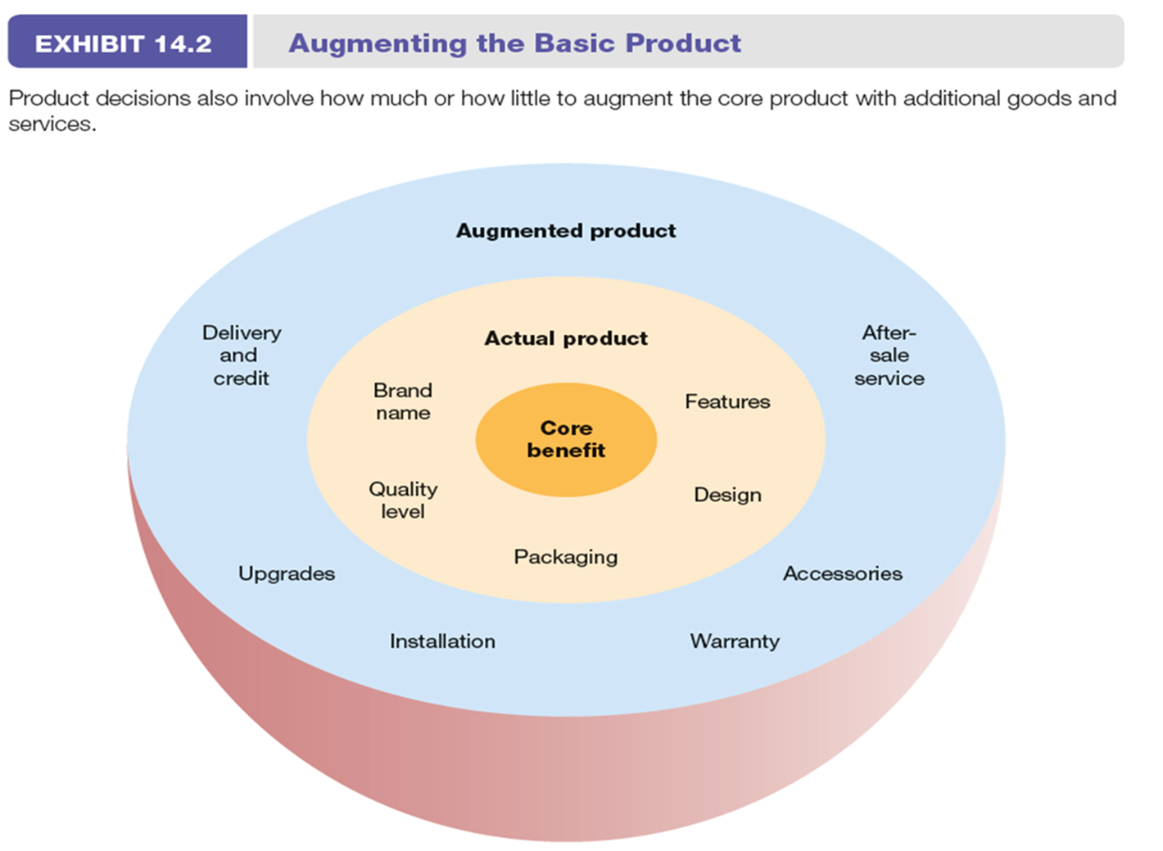
Brand Elements
Lecture 1:
Brands and Brand Management
www.midocean.ae

Slide 8
Course Content
Define customer-based brand equity
Outline the sources and outcomes of customer based brand equity
Lecture 2:
Customer-Based Brand Equity
www.midocean.ae

Slide 9
Customer-Based Brand Equity
Defining Customer-Based Brand Equity (what makes a brand strong? And how to build strong brand?, what do different brands mean to consumers?, how does brand knowledge affect consumers response to marketing activity?
Lecture 2:
Customer-Based Brand Equity
www.midocean.ae

Slide 10
Defining Customer-Based Brand Equity
How does the customer see the brand.
The customer-based brand equity (CBBE) provides a unique point of view on what brand equity is and how it should best be built, measured, and managed.
The CBBE concept approaches brand equity from the perspective of the consumer (valuable brand)
Lecture 2:
Customer-Based Brand Equity
www.midocean.ae

Slide 11
Brand Equity
From company perspective is the brand value $
From the perspective of the consumer is how valuable brand is it
Lecture 2:
Customer-Based Brand Equity
www.midocean.ae

Slide 12
Course Content
Identify the four components of brand positioning
Describe the guidelines in developing a good brand positioning
Explain brand mantras and how they should be developed
Lecture 3:
Brand Positioning
www.midocean.ae

Slide 13
Customer-Based Brand Equity
Positioning requires defining ideal brand knowledge structure and establishing points-of-parity and points -of differences(POD) to establish the right brand identity and brand image. Unique POD’s provide a competitive advantage and the reason why consumers should buy the brand
Lecture 3:
Brand Positioning
www.midocean.ae

Slide 14
Customer-Based Brand Equity
Brand positioning:
  Act of designing the company’s offer and image so that it occupies a distinct and valued place in the target customers’ minds
  Finding the proper “location” in the minds of consumers or market segment
  Allows consumers to think about a product or service in the “right” perspective
Lecture 3:
Brand Positioning
www.midocean.ae

Slide 15
Course Content
Define brand resonance
Describe the steps in building brand resonance
Define the brand value chain
Identify the stages in the brand value chain
Contrast brand equity and customer equity
Lecture 4:
Brands Resonance and the Brand Value Chain
www.midocean.ae

Slide 16
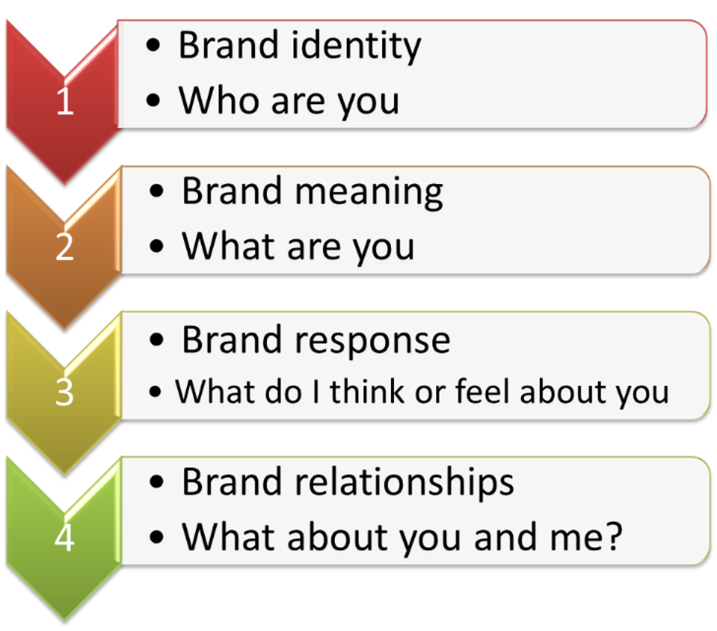
The Four Steps of Brand Building
Lecture 4:
Brands Resonance and the Brand Value Chain
www.midocean.ae

Slide 17
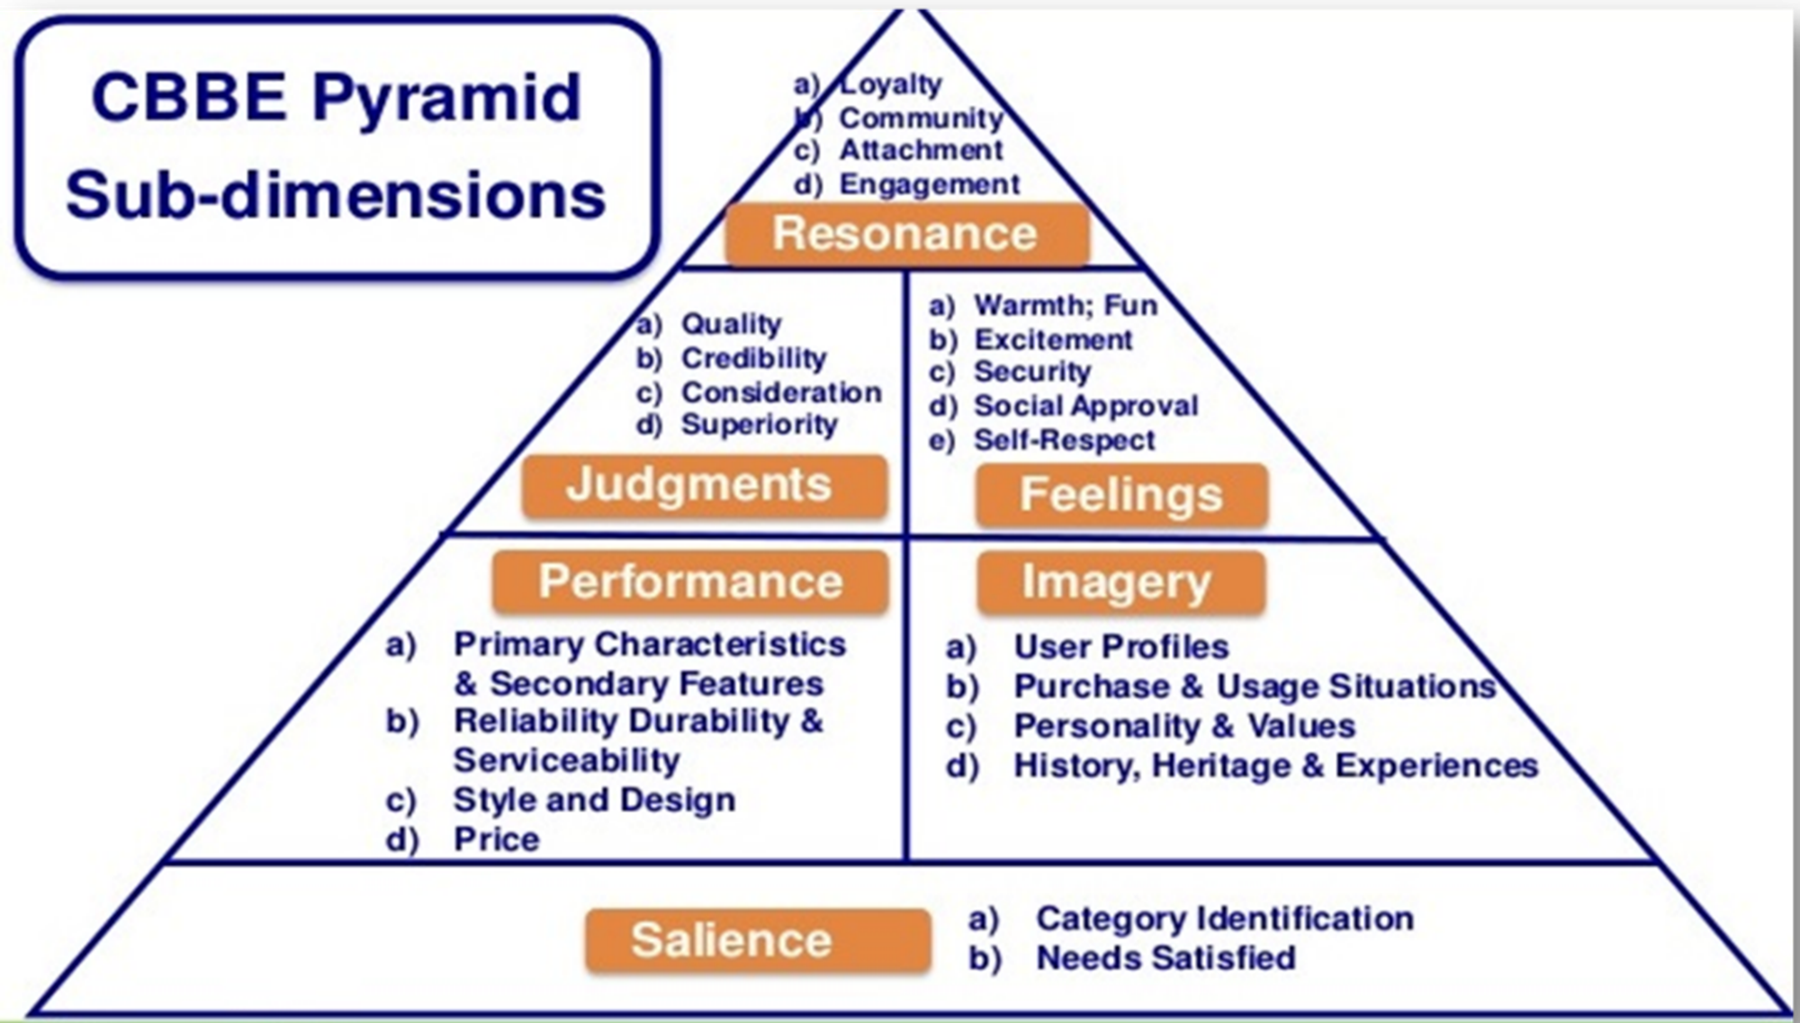
The Four Steps of Brand Building
Lecture 4:
Brands Resonance and the Brand Value Chain
www.midocean.ae

Slide 18
Course Content
Identify the different types of brand elements
List the general criteria for choosing brand elements
Describe key tactics in choosing different brand elements
Explain the rationale for “mixing and matching” brand elements
Highlight some of the legal issues surrounding brand elements
Lecture 5:
Choosing Brand Elements to build Brand Equity
www.midocean.ae

Slide 19
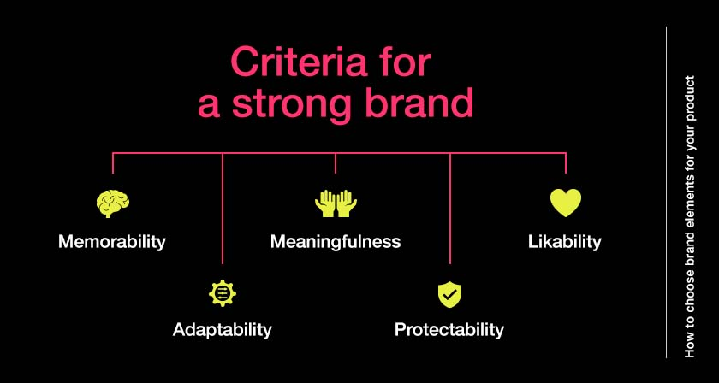
What makes a Good Brand Element
Lecture 5:
Choosing Brand Elements to build Brand Equity
www.midocean.ae

Slide 20
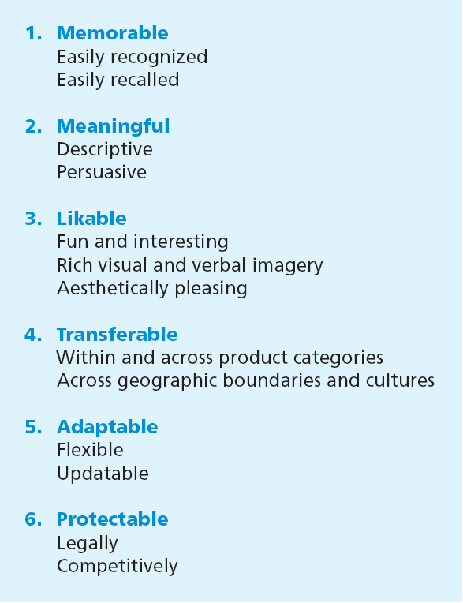
What makes a Good Brand Element
Lecture 5:
Choosing Brand Elements to build Brand Equity
www.midocean.ae

Slide 21
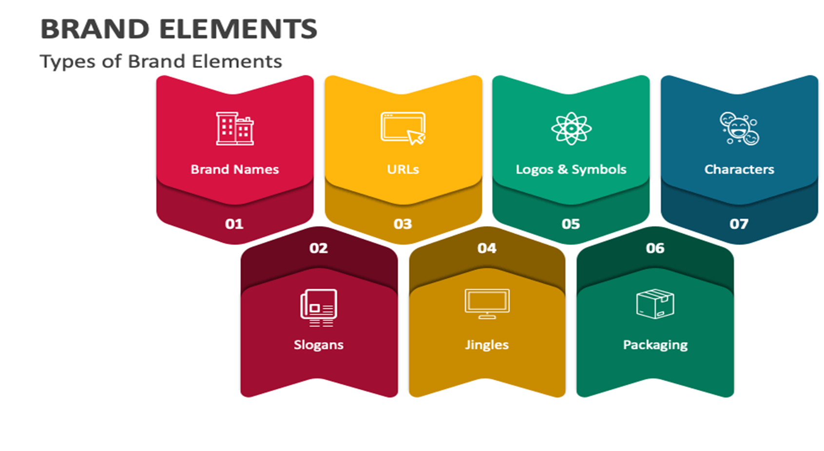
Types of Brand Elements
Lecture 5:
Choosing Brand Elements to build Brand Equity
www.midocean.ae

Slide 22
Course Content
Describe some of the changes in the new media environment
Outline the major marketing communication options
Describe some of the key tactical issues in evaluating different communication options
Identify the choice criteria in developing an integrated marketing communication program
Explain the rationale for mixing and matching communication options
Lecture 6:
Designing Marketing Programs to Build Brand Equity
www.midocean.ae

Slide 23
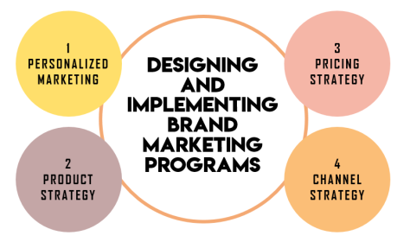
Course Content
Lecture 6:
Designing Marketing Programs to Build Brand Equity
www.midocean.ae

Slide 24
New Approaches Embraced by Marketers
Rapid technological developments (using tech, AI,VR,QR in everything ‘IOT’ internet of things)
Greater customer empowerment (engage & experience)
Fragmentation of traditional media (which fits)
Growth of interactive and mobile marketing options (sms, emails, apps)
Channel transformation and disintermediation (ex. Radio before & now, PR &CSR create awareness & be part of community)
Increased competition and industry convergence (using Guerilla mktg)
Globalization and growth of developing markets
Heightened (exceeding environmental, community, and social concerns (doing good things so I will recall the brand)
Severe economic recession (how to get money)
Lecture 6:
Designing Marketing Programs to Build Brand Equity
www.midocean.ae

Slide 25
Course Content
Define “brand,” state how brand differs from a product, and explain what brand equity is
Summarize why brands are important
Explain how branding applies to virtually everything
Describe the main branding challenges and opportunities
Identify the steps in the strategic brand management process
Lecture 7:
Integrating Marketing Communications to build brand equity
www.midocean.ae

Slide 26
Marketing Communication
They are means by which firms attempt to inform, persuade, and remind consumers about the brands they sell
  Can contribute to brand equity by:
    Creating awareness of the brand
    Linking points-of-parity and points-of-difference associations to the brand in consumers’ memory
    Induce/obtain positive brand judgments or feelings
    Facilitating a stronger consumer-brand connection and brand resonance.
    At the same time, brand equity helps marketers determine how to design and implement different marketing options.
Lecture 7:
Integrating Marketing Communications to build brand equity
www.midocean.ae

Slide 27
Challenges in Designing Brand-Building Communications
Skillfully designed and implemented marketing communications programs
  Should be efficient and effective
  Require careful planning and creative talent (acquired by practice).
  The simplest and most useful way to judge any communication option is by its ability to contribute to building brand equity.
Lecture 7:
Integrating Marketing Communications to build brand equity
www.midocean.ae

Slide 28
Course Content
Lecture 8:
Leveraging Secondary Brand Associations to build brand equity
Outline the eight main ways to leverage secondary associations
Explain the process by which a brand can leverage secondary associations
Describe some of the key tactical issues in leveraging secondary associations from different entities
www.midocean.ae

Slide 29
Conceptualizing the Leveraging Process
Linking the brand to some other entity may, some source factor or related person, place or thing may:
  Create a new set of associations from the brand to the entity , consumers may form a metal association from the brand to this other entity. (Toshiba EL Araby)
  These secondary brand associations are most likely to affect evaluations of a new product.
  Affect the existing brand associations, when a brand is identified as linked to that entity, consumers may infer that some associations, judgments or feelings. In other words, in the mind of consumers, what is true for the entity, must be true for the brand. (TATA & Jaguar)
Lecture 8:
Leveraging Secondary Brand Associations to build brand equity
www.midocean.ae

Slide 30
Course Content
Describe changes in marketing and consumer behavior in a digital era
Define brand engagement and understand the brand engagement pyramid and key drivers of brand engagement
Understand digital communications and the various options available
Define the role of e-mail marketing and Web site optimization as important components of digital marketing strategy
Lecture 9:
Branding in the Digital Era
www.midocean.ae

Slide 31
Course Content
Appreciate the pros and cons of various social media channels (e.g., Facebook and Twitter) as digital marketing tools
Understand the developments within mobile marketing
Develop a broad understanding of influencer marketing approaches and how word-of-mouth and social influence occurs and can be managed
Describe content marketing and its role in creating brand awareness and engagement
Describe changes in brand management organizational structure
Lecture 9:
Branding in the Digital Era
www.midocean.ae

Slide 32
Key Digital Era Trends with Implications for Branding and Brand Management
Changes in the consumer decision journey
Sharp increase in buying via online retail channels
Shift in advertising and promotion expenditures toward digital channels
The rise of many-to-many communications
Dramatic increase in consumer touchpoints
Tremendous increase in data availability
The use of digital personalization
A loss of control over the brand message and the co-creation of brand meaning
The role of user experiences
The growth of brands as cultural symbols
Lecture 9:
Branding in the Digital Era
www.midocean.ae

Slide 33
Course Content
Define the different types of brand extensions
List the main advantages and disadvantages of brand extensions
Summarize how consumers evaluate extensions and how extensions contribute to parent brand equity
Outline the key assumptions and success criteria for brand extensions
Lecture 10:
Introducing and Naming New Products and Brand Extensions
www.midocean.ae

Slide 34
New Products and Brand Extensions
Brand extension: When a firm uses an established brand name to introduce a new product
  Line extension - Adds a different variety, a different form or size, or a different application for the brand
  Category extension - Marketers apply the parent brand to enter a different product category from the one it currently serves
Lecture 10:
Introducing and Naming New Products and Brand Extensions
www.midocean.ae

Slide 35
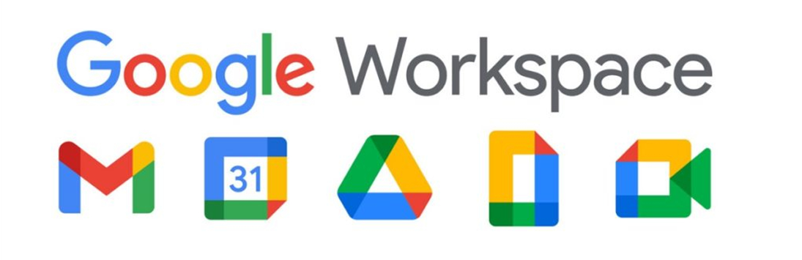
New Products and Brand Extensions
Brand extension: When a firm uses an established brand name to introduce a new product
  Line extension - Adds a different variety, a different form or size, or a different application for the brand
  Category extension - Marketers apply the parent brand to enter a different product category from the one it currently serves
Lecture 10:
Introducing and Naming New Products and Brand Extensions
www.midocean.ae

Slide 36
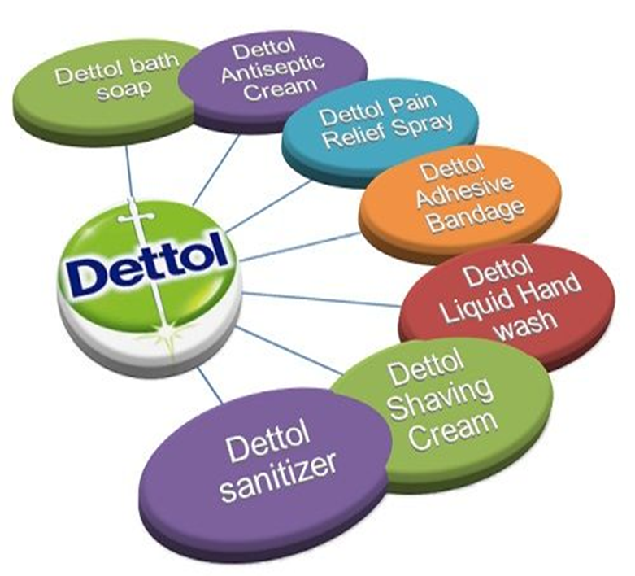
New Products and Brand Extensions
Lecture 10:
Introducing and Naming New Products and Brand Extensions
New products and brand extensions
  Sub-brand: New brand combined with an existing brand.
  Parent brand: An existing brand that gives birth to a brand extension.
  Family brand: Parent brand associated with multiple products through brand extensions.
www.midocean.ae

Slide 37


Chapter 1: Brands and Brand Management
Chapter 2: Customer-Based Brand Equity
Chapter 3: Brand Positioning
Chapter 4: Brands Resonance and the Brand Value Chain
Chapter 5: Choosing Brand Elements to build Brand Equity
Chapter 6: Designing Marketing Programs to Build Brand Equity
Chapter 7: Integrating Marketing Communications to build brand equity
Chapter 8: Leveraging Secondary Brand Associations t build brand equity
Chapter 9: Branding in the Digital Era
Chapter 10: Introducing and Naming New Products and Brand Extensions
www.midocean.ae

Slide 38

Thank You
Dr. Perihan Salah

