Slide 1




AWS Cloud Security Foundations– AWS-CSF
Dr. Ibrahim Gomaa
Lecture 2 – AWS Identity, Networking and Content Delivery

Slide 2


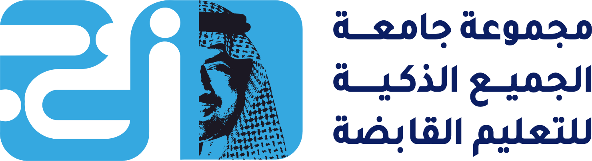
Lecture
AWS Identity, Networking and Content Delivery
2
Activities
Label a network diagram
Demo
VPC demonstration
Lab
Build your VPC and launch a web server
Topics
AWS shared responsibility model
AWS Identity and Access Management (IAM)
Networking basics
Amazon VPC, Networking and Security
Amazon Route 53
Amazon CloudFront
Knowledge check
AWS Cloud Security Foundations– AWS-CSF
Lecture 2 – AWS Identity, Networking and Content Delivery
Dr. Ibrahim Gomaa

Slide 3
Lecture
AWS Identity, Networking and Content Delivery
2
AWS shared responsibility model
AWS Cloud Security Foundations– AWS-CSF
Lecture 2 – AWS Identity, Networking and Content Delivery
Dr. Ibrahim Gomaa

Slide 4
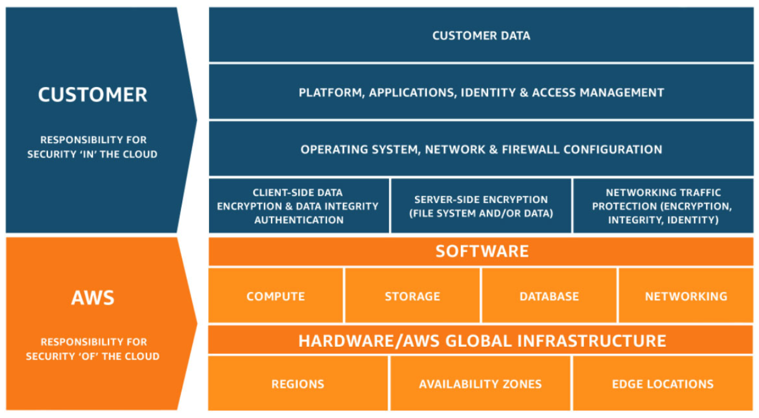
Lecture
AWS shared responsibility model
2
AWS Cloud Security Foundations– AWS-CSF
Lecture 2 – AWS Identity, Networking and Content Delivery
Dr. Ibrahim Gomaa

Slide 5


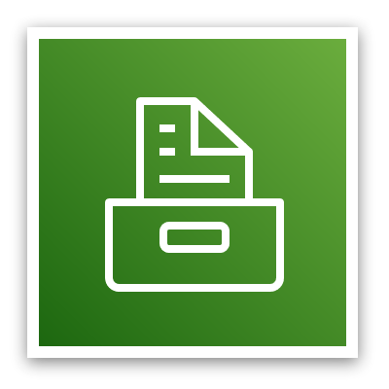
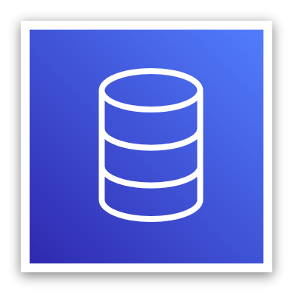
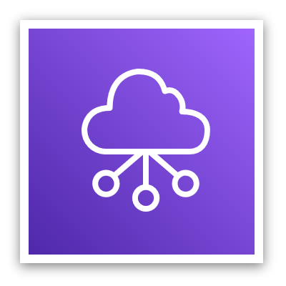


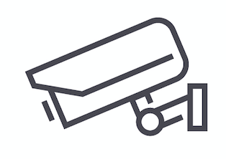
Lecture
AWS shared responsibility model
2
AWS responsibility: Security of the cloud
AWS services
AWS responsibilities:
Physical security of data centers
  Controlled, need-based access
Hardware and software infrastructure
  Storage decommissioning, host operating system (OS) access logging, and auditing
Network infrastructure
  Intrusion detection
Virtualization infrastructure
  Instance isolation
Compute
Storage
Database
Networking
AWS Global
Infrastructure
Regions
Availability Zones
Edge locations
AWS operates, manages, and controls the components from the bare metal host operating system and hypervisor virtualization layer down to the physical security of the facilities where the services operate
AWS Cloud Security Foundations– AWS-CSF
Lecture 2 – AWS Identity, Networking and Content Delivery
Dr. Ibrahim Gomaa

Slide 6
Lecture
AWS shared responsibility model
2
Customer responsibility: Security in the cloud
Customer responsibilities:
Amazon Elastic Compute Cloud (Amazon EC2) instance operating system
  Including patching, maintenance
Applications
  Passwords, role-based access, etc.
Security group configuration
OS or host-based firewalls
  Including intrusion detection or prevention systems
Network configurations
Account management
  Login and permission settings for each user
Customer data
Applications, IAM
Operating system, network, and firewall configuration
Client-side data
encryption and data integrity authentication
Server-side encryption
(file system or data)
Network traffic protection
(encryption, integrity, identity)
Customer-configurable
AWS Cloud Security Foundations– AWS-CSF
Lecture 2 – AWS Identity, Networking and Content Delivery
Dr. Ibrahim Gomaa

Slide 7



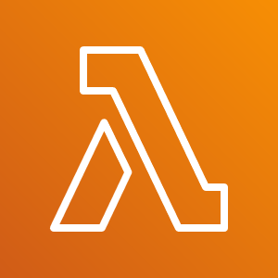


Lecture
AWS shared responsibility model
2
Service characteristics and security responsibility
Example services managed by the customer
Infrastructure as a service (IaaS)
Customer has more flexibility over configuring networking and storage settings
Customer is responsible for managing more aspects of the security
Customer configures the access controls
Platform as a service (PaaS)
Customer does not need to manage the underlying infrastructure
AWS handles the operating system, database patching, firewall configuration, and disaster recovery
Customer can focus on managing code or data
Amazon
EC2
Amazon Elastic Block Store (Amazon EBS)
Amazon
Virtual Private Cloud (Amazon VPC)
Example services managed by AWS
AWS
Lambda
Amazon
Relational Database Service (Amazon RDS)
AWS Elastic Beanstalk
AWS Cloud Security Foundations– AWS-CSF
Lecture 2 – AWS Identity, Networking and Content Delivery
Dr. Ibrahim Gomaa

Slide 8



Lecture
AWS shared responsibility model
2
Service characteristics and security responsibility (continued)
SaaS examples
Software as a service (SaaS)
Software is centrally hosted
Licensed on a subscription model or pay-as-you-go basis.
Services are typically accessed via web browser, mobile app, or application programming interface (API)
Customers do not need to manage the infrastructure that supports the service
AWS Trusted
Advisor
AWS Shield
Amazon Chime
AWS Trusted Advisor is an online tool that analyzes your AWS environment and provides real-time guidance and recommendations to help you provision your resources by following AWS best practices
Amazon Chime is a communications service that enables you to meet, chat, and place business calls inside and outside your organization
AWS Cloud Security Foundations– AWS-CSF
Lecture 2 – AWS Identity, Networking and Content Delivery
Dr. Ibrahim Gomaa

Slide 9
Lecture
AWS Identity, Networking and Content Delivery
2
AWS Identity and Access Management (IAM)
AWS Cloud Security Foundations– AWS-CSF
Lecture 2 – AWS Identity, Networking and Content Delivery
Dr. Ibrahim Gomaa

Slide 10

Lecture
2
AWS Identity and Access Management (IAM)
Use IAM to manage access to AWS resources –
  A resource is an entity in an AWS account that you can work with
  Example resources; An Amazon EC2 instance or an Amazon S3 bucket
Example – Control who can terminate Amazon EC2 instances
Define fine-grained access rights –
  Who can access the resource
  Which resources can be accessed and what can the user do to the resource
  How resources can be accessed
IAM is a no-cost AWS account feature
AWS Identity and Access Management
(IAM)
AWS Cloud Security Foundations– AWS-CSF
Lecture 2 – AWS Identity, Networking and Content Delivery
Dr. Ibrahim Gomaa

Slide 11




Lecture
2
AWS Identity and Access Management (IAM)
IAM: Essential components
A person or application that can authenticate with an AWS account.
IAM user
A collection of IAM users that are granted identical authorization.
IAM group
The document that defines which resources can be accessed and the level of access to each resource.
IAM policy
Useful mechanism to grant a set of permissions for making AWS service requests.
IAM role
AWS Cloud Security Foundations– AWS-CSF
Lecture 2 – AWS Identity, Networking and Content Delivery
Dr. Ibrahim Gomaa

Slide 12

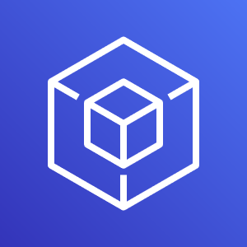

Lecture
2
AWS Identity and Access Management (IAM)
Authenticate as an IAM user to gain access
  When you define an IAM user, you select what types of access the user is permitted to use.
  Programmatic access
      Authenticate using:
        Access key ID
        Secret access key
      Provides AWS CLI and AWS SDK access
  AWS Management Console access
      Authenticate using:
        12-digit Account ID or alias
        IAM user name
        IAM password
      If enabled, multi-factor authentication (MFA) prompts for an authentication code.
AWS CLI
AWS Tools and SDKs
AWS Management Console
AWS Cloud Security Foundations– AWS-CSF
Lecture 2 – AWS Identity, Networking and Content Delivery
Dr. Ibrahim Gomaa

Slide 13

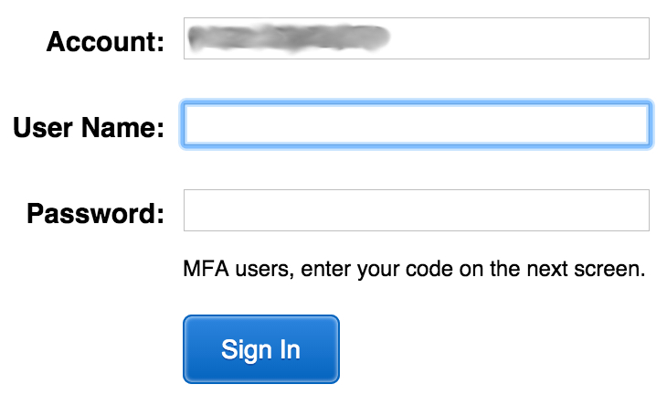

Lecture
2
AWS Identity and Access Management (IAM)
IAM MFA
  MFA provides increased security.
  In addition to user name and password, MFA requires a unique authentication code to access AWS services.
User name and password
MFA token
AWS Management Console
AWS Cloud Security Foundations– AWS-CSF
Lecture 2 – AWS Identity, Networking and Content Delivery
Dr. Ibrahim Gomaa

Slide 14
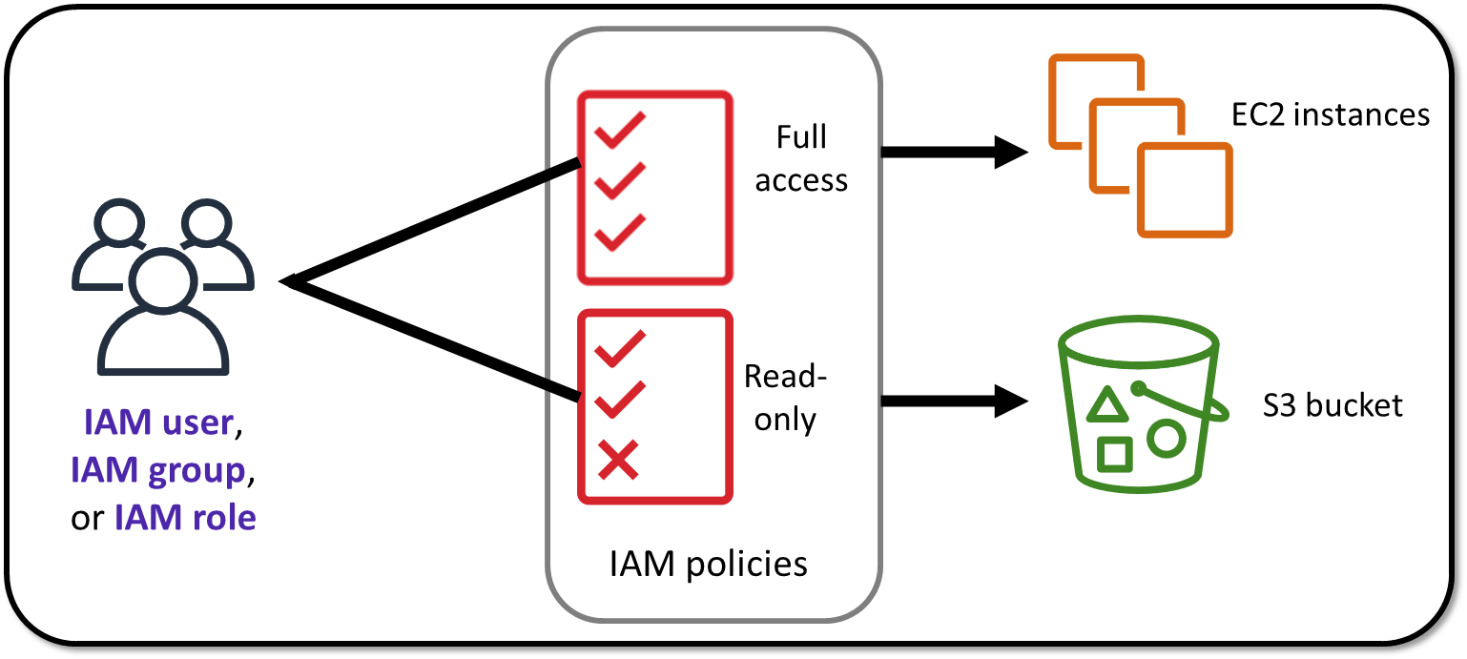
Lecture
2
AWS Identity and Access Management (IAM)
Authorization: What actions are permitted
AWS Cloud Security Foundations– AWS-CSF
Lecture 2 – AWS Identity, Networking and Content Delivery
Dr. Ibrahim Gomaa

Slide 15

Lecture
2
AWS Identity and Access Management (IAM)
IAM: Authorization
  Assign permissions by creating an IAM policy.
  Permissions determine which resources and operations are allowed:
  All permissions are implicitly denied by default.
  If something is explicitly denied, it is never allowed.
Best practice: Follow the principle of least privilege.
Note: The scope of IAM service configurations is global. Settings apply across all AWS Regions.
IAM permissions
AWS Cloud Security Foundations– AWS-CSF
Lecture 2 – AWS Identity, Networking and Content Delivery
Dr. Ibrahim Gomaa

Slide 16
Lecture
2
AWS Identity and Access Management (IAM)
IAM policies
An IAM policy is a document that defines permissions
  Enables fine-grained access control
Two types of policies – identity-based and resource-based
Identity-based policies –
  Attach a policy to any IAM entity
    An IAM user, an IAM group, or an IAM role
  Policies specify:
    Actions that may be performed by the entity
    Actions that may not be performed by the entity
  A single policy can be attached to multiple entities
  A single entity can have multiple policies attached to it
Resource-based policies
  Attached to a resource (such as an S3 bucket)
IAM entities
Attach to one of
IAM user
IAM policy
IAM group
IAM role
AWS Cloud Security Foundations– AWS-CSF
Lecture 2 – AWS Identity, Networking and Content Delivery
Dr. Ibrahim Gomaa

Slide 17

Lecture
2
AWS Identity and Access Management (IAM)
IAM policy example
{
"Version": "2012-10-17",
"Statement":[{
"Effect":"Allow",
"Action":["DynamoDB:*","s3:*"],
"Resource":[
"arn:aws:dynamodb:region:account-number-without-hyphens:table/table-name",
"arn:aws:s3:::bucket-name",
"arn:aws:s3:::bucket-name/*"]
},
{
"Effect":"Deny",
"Action":["dynamodb:*","s3:*"],
"NotResource":["arn:aws:dynamodb:region:account-number-without-hyphens:table/table-name”,
"arn:aws:s3:::bucket-name",
"arn:aws:s3:::bucket-name/*"]
}
]
}
Explicit allow gives users access to a specific DynamoDB table and…
…Amazon S3 buckets.
Explicit deny ensures that the users cannot use any other AWS actions or resources other than that table and those buckets.
An explicit deny statement takes precedence over an allow statement.
AWS Cloud Security Foundations– AWS-CSF
Lecture 2 – AWS Identity, Networking and Content Delivery
Dr. Ibrahim Gomaa

Slide 18


Lecture
2
AWS Identity and Access Management (IAM)
Resource-based policies
Identity-based policies are attached to a user, group, or role
Resource-based policies are attached to a resource (not to a user, group or role)
Characteristics of resource-based policies –
  Specifies who has access to the resource and what actions they can perform on it
  The policies are inline only, not managed
Resource-based policies are supported only by some AWS services
AWS Account
IAM user MaryMajor
S3 bucket photos
attached
Defined inline
on the bucket
Identity-based policy
Resource-based policy
Policy grants list, read objects to the photos bucket
Policy grants user MaryMajor list, read objects
AWS Cloud Security Foundations– AWS-CSF
Lecture 2 – AWS Identity, Networking and Content Delivery
Dr. Ibrahim Gomaa

Slide 19
Lecture
2
AWS Identity and Access Management (IAM)
IAM permissions
How IAM determines permissions:
Is the permission explicitly denied ?
Is the permission explicitly allowed ?
No
No
Deny
Implicit deny
Yes
Yes
Deny
Allow
AWS Cloud Security Foundations– AWS-CSF
Lecture 2 – AWS Identity, Networking and Content Delivery
Dr. Ibrahim Gomaa

Slide 20
Lecture
2
AWS Identity and Access Management (IAM)
IAM groups
  An IAM group is a collection of IAM users
  A group is used to grant the same permissions to multiple users
    Permissions granted by attaching IAM policy or policies to the group
  A user can belong to multiple groups
  There is no default group
  Groups cannot be nested
AWS account
IAM group:
Admins
IAM group:
Developers
IAM group:
Testers
Carlos Salazar
Li Juan
Zhang Wei
Márcia Oliveira
Mary Major
John Stiles
Richard Roe
Li Juan
AWS Cloud Security Foundations– AWS-CSF
Lecture 2 – AWS Identity, Networking and Content Delivery
Dr. Ibrahim Gomaa

Slide 21
Lecture
2
AWS Identity and Access Management (IAM)
IAM roles
An IAM role is an IAM identity with specific permissions
Similar to an IAM user
  Attach permissions policies to it
Different from an IAM user
  Not uniquely associated with one person
  Intended to be assumable by a person, application, or service
Role provides temporary security credentials
Examples of how IAM roles are used to delegate access –
  Used by an IAM user in the same AWS account as the role
  Used by an AWS service—such as Amazon EC2—in the same account as the role
  Used by an IAM user in a different AWS account than the role
IAM role
AWS Cloud Security Foundations– AWS-CSF
Lecture 2 – AWS Identity, Networking and Content Delivery
Dr. Ibrahim Gomaa

Slide 22



Lecture
2
AWS Identity and Access Management (IAM)
Example use of an IAM role
AWS Cloud
Scenario:
An application that runs on an EC2 instance needs access to an S3 bucket
Solution:
Define an IAM policy that grants access to the S3 bucket.
Attach the policy to a role
Allow the EC2 instance to assume the role
Application has permissions to access the S3 bucket
Amazon EC2 instance
Application
3
Amazon S3 bucket photos
Role assumed by
the EC2 instance
2
attached
IAM role
1
IAM policy grants access to photos bucket
AWS Cloud Security Foundations– AWS-CSF
Lecture 2 – AWS Identity, Networking and Content Delivery
Dr. Ibrahim Gomaa

Slide 23
Lecture
Networking basics
2
Networking basics
AWS Cloud Security Foundations– AWS-CSF
Lecture 2 – AWS Identity, Networking and Content Delivery
Dr. Ibrahim Gomaa

Slide 24


Lecture
Networking basics
2
Networks
Subnet 1
Subnet 2
Router
AWS Cloud Security Foundations– AWS-CSF
Lecture 2 – AWS Identity, Networking and Content Delivery
Dr. Ibrahim Gomaa

Slide 25
Lecture
Networking basics
2
IP addresses
192
.
0
.
2
.
0
11000000
00000000
00000010
00000000
AWS Cloud Security Foundations– AWS-CSF
Lecture 2 – AWS Identity, Networking and Content Delivery
Dr. Ibrahim Gomaa

Slide 26
Lecture
Networking basics
2
IPv4 and IPv6 addresses
IPv4 (32-bit) address: 192.0.2.0
IPv6 (128-bit) address: 2600:1f18:22ba:8c00:ba86:a05e:a5ba:00FF
AWS Cloud Security Foundations– AWS-CSF
Lecture 2 – AWS Identity, Networking and Content Delivery
Dr. Ibrahim Gomaa

Slide 27
Lecture
Networking basics
2
Classless Inter-Domain Routing (CIDR)
Network identifier (routing prefix)
Host identifier
192
.
0
.
2
.
0
/
24
Tells you how
many bits are
fixed
11000000
00000000
00000010
00000000
to 11111111
Fixed
Fixed
Fixed
Flexible
AWS Cloud Security Foundations– AWS-CSF
Lecture 2 – AWS Identity, Networking and Content Delivery
Dr. Ibrahim Gomaa

Slide 28
Lecture
Amazon VPC, networking and security
2
Amazon VPC, Networking and Security
AWS Cloud Security Foundations– AWS-CSF
Lecture 2 – AWS Identity, Networking and Content Delivery
Dr. Ibrahim Gomaa

Slide 29
Lecture
Amazon VPC, networking and security
2
Amazon VPC
Enables you to provision a logically isolated section of the AWS Cloud where you can launch AWS resources in a virtual network that you define
Gives you control over your virtual networking resources, including:
  Selection of IP address range
  Creation of subnets
  Configuration of route tables and network gateways
Enables you to customize the network configuration for your VPC
Enables you to use multiple layers of security
Amazon
VPC
AWS Cloud Security Foundations– AWS-CSF
Lecture 2 – AWS Identity, Networking and Content Delivery
Dr. Ibrahim Gomaa

Slide 30



Lecture
Amazon VPC, networking and security
2
VPCs and subnets
AWS Cloud
VPCs:
  Logically isolated from other VPCs
  Dedicated to your AWS account
  Belong to a single AWS Region and
  can span multiple Availability Zones
Subnets:
  Range of IP addresses that divide a VPC
  Belong to a single Availability Zone
  Classified as public or private
Region
Availability Zone 1
Availability Zone 2
VPC
Subnet
Subnet
AWS Cloud Security Foundations– AWS-CSF
Lecture 2 – AWS Identity, Networking and Content Delivery
Dr. Ibrahim Gomaa

Slide 31
Lecture
Amazon VPC, networking and security
2
IP addressing
When you create a VPC, you assign it to an IPv4 CIDR block (range of private IPv4 addresses).
You cannot change the address range after you
create the VPC.
The largest IPv4 CIDR block size is /16.
The smallest IPv4 CIDR block size is /28.
IPv6 is also supported (with a different block size limit).
CIDR blocks of subnets cannot overlap.
VPC
x.x.x.x/16 or 65,536 addresses (max)
to
x.x.x.x/28 or 16 addresses (min)
AWS Cloud Security Foundations– AWS-CSF
Lecture 2 – AWS Identity, Networking and Content Delivery
Dr. Ibrahim Gomaa

Slide 32
Lecture
Amazon VPC, networking and security
2
Reserved IP addresses
Example: A VPC with an IPv4 CIDR block of 10.0.0.0/16 has 65,536 total IP addresses.
The VPC has four equal-sized subnets. Only 251 IP addresses are available for use by each subnet.
IP Addresses for CIDR block 10.0.0.0/24 | Reserved for
10.0.0.0 | Network address
10.0.0.1 | Internal communication (VPC local router)
10.0.0.2 | Domain Name System (DNS) resolution
10.0.0.3 | Future use
10.0.0.255 | Network broadcast address
VPC: 10.0.0.0/16
Subnet 1 (10.0.0.0/24)
Subnet 2 (10.0.2.0/24)
251 IP addresses
251 IP addresses
Subnet 4 (10.0.1.0/24)
Subnet 3 (10.0.3.0/24)
251 IP addresses
251 IP addresses
AWS Cloud Security Foundations– AWS-CSF
Lecture 2 – AWS Identity, Networking and Content Delivery
Dr. Ibrahim Gomaa

Slide 33
Lecture
Amazon VPC, networking and security
2
Public IP address types
Public IPv4 address
Manually assigned through an Elastic IP address
Automatically assigned through the auto-assign public IP address settings at the subnet level
Elastic IP address
a static and public IPv4 address
Associated with an AWS account
associate with any instance or network interface for any VPC in your account
Can be allocated and remapped anytime
Additional costs might apply
AWS Cloud Security Foundations– AWS-CSF
Lecture 2 – AWS Identity, Networking and Content Delivery
Dr. Ibrahim Gomaa

Slide 34

Lecture
Amazon VPC, networking and security
2
Elastic network interface
An elastic network interface is a virtual network interface that you can:
  Attach to an instance.
  Detach from the instance and attach to another instance to redirect network traffic.
Its attributes follow when it is reattached to a new instance.
Each instance in your VPC has a default network interface that is assigned a private IPv4 address from the IPv4 address range of your VPC.
Subnet: 10.0.1.0/24
Elastic network interface
AWS Cloud Security Foundations– AWS-CSF
Lecture 2 – AWS Identity, Networking and Content Delivery
Dr. Ibrahim Gomaa

Slide 35
Lecture
Amazon VPC, networking and security
2
Route tables and routes
A route table contains a set of rules (or routes) that you can configure to direct network traffic from your subnet.
Each route specifies a destination and a target.
By default, every route table contains a local route for communication within the VPC.
Each subnet must be associated with a route table (at most one).
Main (Default) Route Table
Destination | Target
10.0.0.0/16 | local
VPC CIDR block
AWS Cloud Security Foundations– AWS-CSF
Lecture 2 – AWS Identity, Networking and Content Delivery
Dr. Ibrahim Gomaa

Slide 36
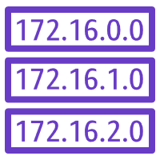



Lecture
Amazon VPC, networking and security
2
Internet gateway
An internet gateway is a scalable, redundant, and highly available VPC component that allows communication between instances in your VPC and the internet
AWS Cloud
Region
Availability Zone
Public Subnet Route Table
VPC: 10.0.0.0/16
Destination | Target
10.0.0.0/16 | local
0.0.0.0/0 | igw-id
Public subnet:10.0.1.0/24
Private subnet: 10.0.2.0/24
Route
table
Internet
gateway
(igw-id)
Internet
AWS Cloud Security Foundations– AWS-CSF
Lecture 2 – AWS Identity, Networking and Content Delivery
Dr. Ibrahim Gomaa

Slide 37

Lecture
Amazon VPC, networking and security
2
Network address translation (NAT) gateway
A network address translation (NAT) gateway enables instances in a private subnet to connect to the internet or other AWS services, but prevents the internet from initiating a connection with those instances.
AWS Cloud
Public Subnet Route Table
Region
Destination | Target
10.0.0.0/16 | local
0.0.0.0/0 | igw-id
Availability Zone
VPC: 10.0.0.0/16
Public subnet:10.0.1.0/24
Public route
table
NAT gateway
(nat-gw-id)
Private Subnet Route Table
Private subnet: 10.0.2.0/24
Internet
gateway
(igw-id)
Destination | Target
10.0.0.0/16 | local
0.0.0.0/0 | nat-gw-id
Private route
table
Internet
AWS Cloud Security Foundations– AWS-CSF
Lecture 2 – AWS Identity, Networking and Content Delivery
Dr. Ibrahim Gomaa

Slide 38
Lecture
Amazon VPC, networking and security
2
Activity: Label this network diagram
AWS Cloud
?
?
?
Public subnet:10.0.1.0/24
?
?
Internet
?
_?_ IP address
Q6
?
Destination | Target
? | local
0.0.0.0/0 | ?
Private subnet: 10.0.2.0/24
?
?
?
_?_ IP address
10.0.0.0/16
AWS Cloud Security Foundations– AWS-CSF
Lecture 2 – AWS Identity, Networking and Content Delivery
Dr. Ibrahim Gomaa

Slide 39
Lecture
Amazon VPC, networking and security
2
Security groups
AWS Cloud
A security group acts as a virtual firewall for your instance, and it controls inbound and outbound traffic. Security groups act at the instance level, not the subnet level. Therefore, each instance in a subnet in your VPC can be assigned to a different set of security groups.
Region
Availability Zone
VPC: 10.0.0.0/16
Public subnet:10.0.1.0/24
Security group
Security groups act at
the instance level.
Private subnet: 10.0.2.0/24
Security group
AWS Cloud Security Foundations– AWS-CSF
Lecture 2 – AWS Identity, Networking and Content Delivery
Dr. Ibrahim Gomaa

Slide 40
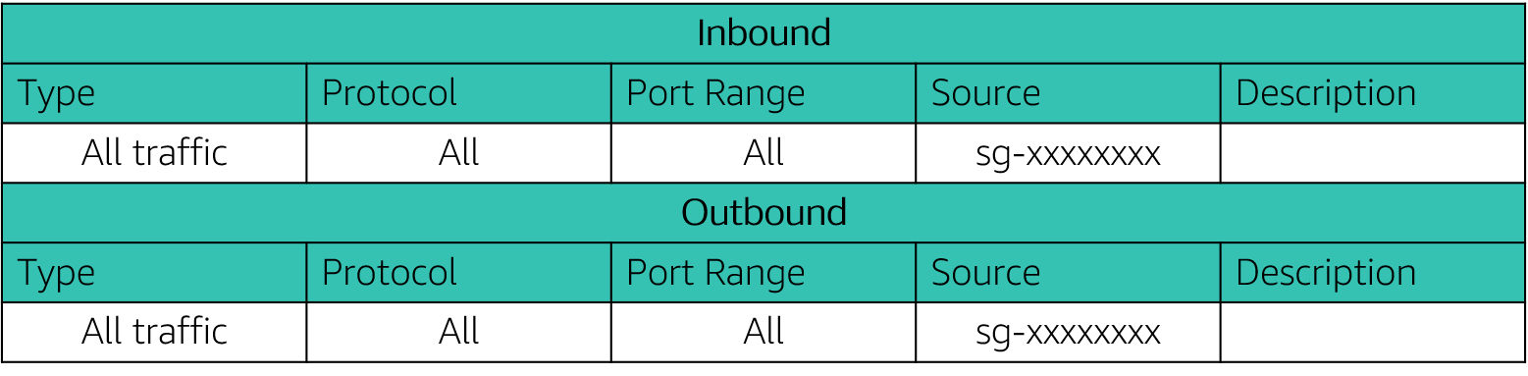
Lecture
Amazon VPC, networking and security
2
Security groups
Security groups have rules that control inbound and outbound instance traffic.
Default security groups deny all inbound traffic and allow all outbound traffic.
Security groups are stateful.
AWS Cloud Security Foundations– AWS-CSF
Lecture 2 – AWS Identity, Networking and Content Delivery
Dr. Ibrahim Gomaa

Slide 41
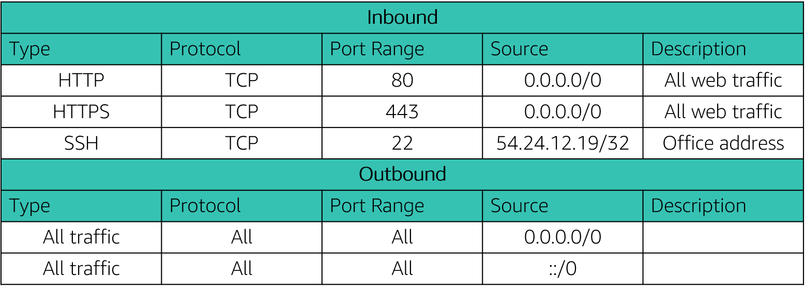
Lecture
Amazon VPC, networking and security
2
Custom security groups
You can specify allow rules, but not deny rules.
All rules are evaluated before the decision to allow traffic.
AWS Cloud Security Foundations– AWS-CSF
Lecture 2 – AWS Identity, Networking and Content Delivery
Dr. Ibrahim Gomaa

Slide 42

Lecture
Amazon VPC, networking and security
2
Network access control lists (network ACLs)
AWS Cloud
A network access control list (network ACL) is an optional layer of security for your Amazon VPC. It acts as a firewall for controlling traffic in and out of one or more subnets. To add another layer of security to your VPC, you can set up network ACLs with rules that are similar to your security groups.
Region
Availability Zone
VPC: 10.0.0.0/16
Public subnet:10.0.0.0/24
Network ACLs act at
the subnet level.
Private subnet: 10.0.4.0/22
AWS Cloud Security Foundations– AWS-CSF
Lecture 2 – AWS Identity, Networking and Content Delivery
Dr. Ibrahim Gomaa

Slide 43
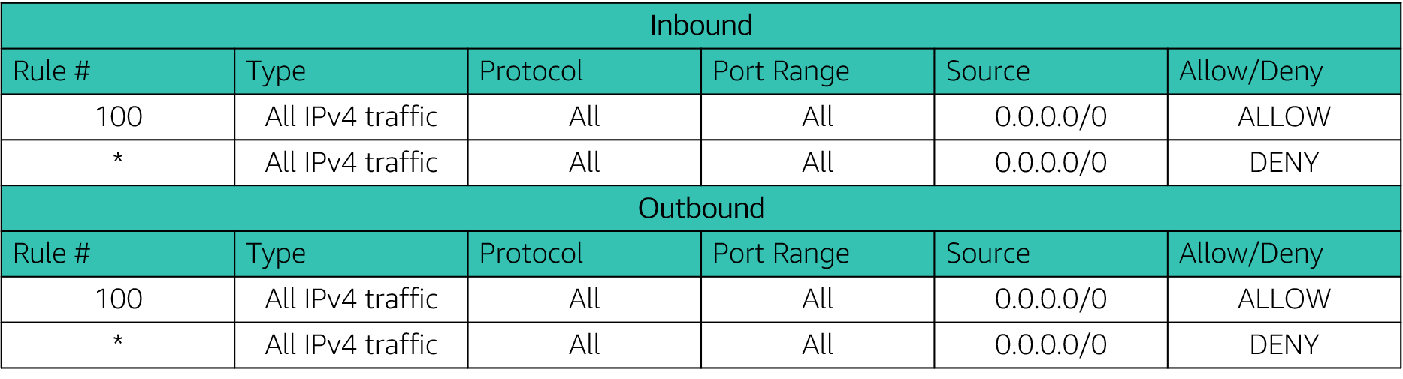
Lecture
Amazon VPC, networking and security
2
Network access control lists (network ACLs)
A network ACL has separate inbound and outbound rules, and each rule can either allow or deny traffic.
Default network ACLs allow all inbound and outbound IPv4 traffic.
Network ACLs are stateless.
AWS Cloud Security Foundations– AWS-CSF
Lecture 2 – AWS Identity, Networking and Content Delivery
Dr. Ibrahim Gomaa

Slide 44
Lecture
Amazon VPC, networking and security
2
Security groups versus network ACLs
Attribute | Security Groups | Network ACLs
Scope | Instance level | Subnet level
Supported Rules | Allow rules only | Allow and deny rules
State | Stateful (return traffic is automatically allowed, regardless of rules) | Stateless (return traffic must be explicitly allowed by rules)
Order of Rules | All rules are evaluated before decision to allow traffic | Rules are evaluated in number order before decision to allow traffic
AWS Cloud Security Foundations– AWS-CSF
Lecture 2 – AWS Identity, Networking and Content Delivery
Dr. Ibrahim Gomaa

Slide 45
Lecture
Amazon Route 53
2
Amazon Route 53
AWS Cloud Security Foundations– AWS-CSF
Lecture 2 – AWS Identity, Networking and Content Delivery
Dr. Ibrahim Gomaa

Slide 46

Lecture
Amazon Route 53
2
Is a highly available and scalable Domain Name System (DNS) web service
Is used to route end users to internet applications by translating names (like www.example.com) into numeric IP addresses (like 192.0.2.1) that computers use to connect to each other
Is fully compliant with IPv4 and IPv6
Connects user requests to infrastructure running in AWS and also outside of AWS
Is used to check the health of your resources
Features traffic flow
Enables you to register domain names
Amazon
Route 53
AWS Cloud Security Foundations– AWS-CSF
Lecture 2 – AWS Identity, Networking and Content Delivery
Dr. Ibrahim Gomaa

Slide 47
Lecture
Amazon Route 53
2
Amazon Route 53 supported routing
Amazon Route 53 supports several types of routing policies, which determine how Amazon Route 53
responds to queries:
Simple routing (round robin) – Use in single-server environments
Weighted round robin routing – Assign weights to resource record sets to specify the frequency
Latency routing – Help improve your global applications
Geolocation routing – Route traffic based on location of your users
Geoproximity routing – Route traffic based on location of your resources
Failover routing – Fail over to a backup site if your primary site becomes unreachable
Multivalue answer routing – Respond to DNS queries with up to eight healthy records selected at random
AWS Cloud Security Foundations– AWS-CSF
Lecture 2 – AWS Identity, Networking and Content Delivery
Dr. Ibrahim Gomaa

Slide 48


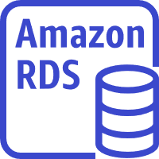

Lecture
Amazon Route 53
2
DNS failover for a multi-tiered web application
Record Sets
CNAME www
lastic_load_balancer
Routing Policy = Failover
Record Type = Primary
Amazon S3 website
Routing Policy = Failover
Record Type = Secondary
AWS Cloud
Availability Zone A
Availability Zone B
Auto Scaling group
Amazon EC2
Amazon EC2
Primary
User
Amazon Route 53
Amazon Relational Database Service (Amazon RDS)
instance
Amazon Relational Database Service (Amazon RDS)
instance
Secondary
Amazon S3 static website
AWS Cloud Security Foundations– AWS-CSF
Lecture 2 – AWS Identity, Networking and Content Delivery
Dr. Ibrahim Gomaa

Slide 49
Lecture
Amazon CloudFront
2
Amazon CloudFront
AWS Cloud Security Foundations– AWS-CSF
Lecture 2 – AWS Identity, Networking and Content Delivery
Dr. Ibrahim Gomaa

Slide 50

Lecture
Amazon CloudFront
2
Content delivery and network latency
Hop
Router
Hop
Hop
Origin server
Hop
Router
Router
Hop
Hop
Client
Router
Hop
User
AWS Cloud Security Foundations– AWS-CSF
Lecture 2 – AWS Identity, Networking and Content Delivery
Dr. Ibrahim Gomaa

Slide 51
Lecture
Amazon CloudFront
2
Content delivery network (CDN)
Is a globally distributed system of caching servers
Caches copies of commonly requested files (static content)
Delivers a local copy of the requested content from a nearby cache edge or Point of Presence
Accelerates delivery of dynamic content
Improves application performance and scaling
AWS Cloud Security Foundations– AWS-CSF
Lecture 2 – AWS Identity, Networking and Content Delivery
Dr. Ibrahim Gomaa

Slide 52

Lecture
Amazon CloudFront
2
Amazon CloudFront
Fast, global, and secure CDN service
Global network of edge locations and Regional edge caches
Self-service model
Pay-as-you-go pricing
Amazon
CloudFront
AWS Cloud Security Foundations– AWS-CSF
Lecture 2 – AWS Identity, Networking and Content Delivery
Dr. Ibrahim Gomaa

Slide 53
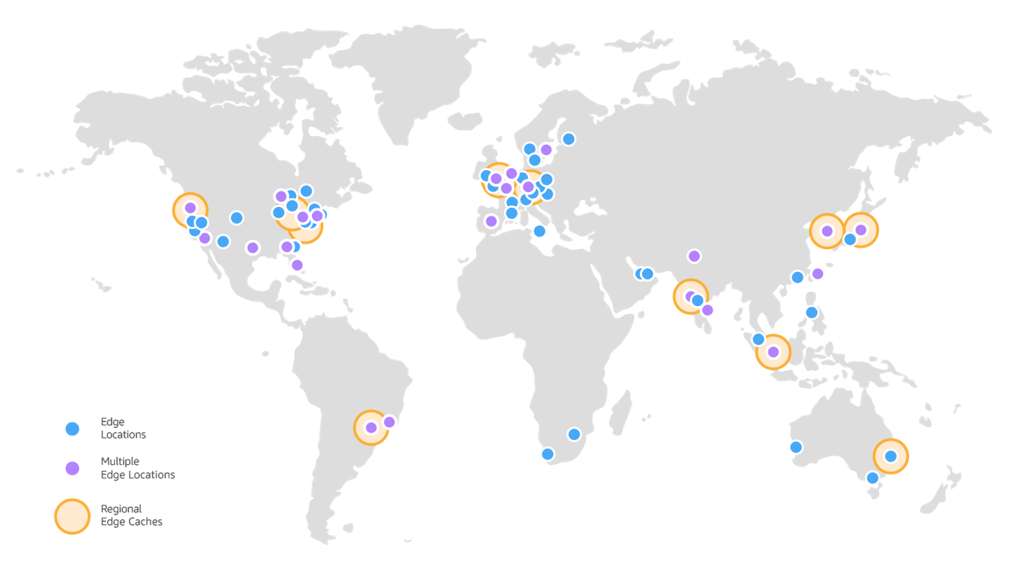
Lecture
Amazon CloudFront
2
Amazon CloudFront infrastructure
Edge locations
Multiple edge locations
Regional edge caches
Edge locations – Network of data centers
that CloudFront uses to serve popular content quickly to customers.
Regional edge cache – CloudFront
location that caches content that is not
popular enough to stay at an edge location.
It is located between the origin server and
the global edge location.
AWS Cloud Security Foundations– AWS-CSF
Lecture 2 – AWS Identity, Networking and Content Delivery
Dr. Ibrahim Gomaa

Slide 54
Lecture
Amazon CloudFront
2
Amazon CloudFront benefits
Fast and global
Security at the edge
Highly programmable
Deeply integrated with AWS
Cost-effective
AWS Cloud Security Foundations– AWS-CSF
Lecture 2 – AWS Identity, Networking and Content Delivery
Dr. Ibrahim Gomaa

Slide 55
Lecture
Amazon CloudFront
2
Amazon CloudFront pricing
Data transfer out
Charged for the volume of data transferred out from Amazon CloudFront edge location to the internet or to your origin.
HTTP(S) requests
Charged for number of HTTP(S) requests.
Invalidation requests
No additional charge for the first 1,000 paths that are requested for invalidation each month. Thereafter, $0.005 per path that is requested for invalidation.
Dedicated IP custom SSL
$600 per month for each custom SSL certificate that is associated with one or more CloudFront distributions that use the Dedicated IP version of custom SSL certificate support.
AWS Cloud Security Foundations– AWS-CSF
Lecture 2 – AWS Identity, Networking and Content Delivery
Dr. Ibrahim Gomaa

Slide 56
Lecture
AWS Identity, Networking and Content Delivery
2
Thanks
AWS Cloud Security Foundations– AWS-CSF
Lecture 2 – AWS Identity, Networking and Content Delivery
Dr. Ibrahim Gomaa

