Slide 1


Marketing Management
MGM612
Dr. Ayman Hassan
  Lecture -3 - Marketing strategy

Slide 2

Chapter
3
Marketing strategy
Lecture 3
Dr. Ayman Hassan

Slide 3
Chapter
3
In the previous lecture,
We have discussed
Which Concept of Marketing Is The Best?
The marketing functions
Product/Service Management
Marketing-Information Management
Pricing
Channel Management
Promotion
Selling

Slide 4



Chapter
3
  Lecture - 3 - Marketing strategy
Dr. Ayman Hassan

Slide 5
Learning Outcomes
After studying this chapter you should be able to:
Marketing strategy (Introduction, define, Developing and Creating )
History of strategic marketing management
Marketing strategy vs. marketing plan
Market Analysis
Explain The (4 P’s) and (7 P’s) of Marketing

Slide 6
Chapter
3
Introduction
Marketing: is the process by which companies create value for customers and build strong customer relationships in order to capture value from customers in return.
What is strategy?
A fundamental pattern of present and planned objectives, resource deployments, and interactions of an organization with markets, competitors, and other environmental factors.
Your strategy comes before your plan
As soon as you have determined what your marketing strategy is, you can draw up a marketing plan. The plan describes how you are going to execute your strategy. It also shows how you will evaluate its effectiveness or success.

Slide 7
Chapter
3
Introduction,2
Corporate strategy
Organizations scope and resource deployment
Business-level strategy
Competitive strategy of a business unit in its industry
Marketing strategy
Targeting, segmenting and positioning for a product. Figuring out the marketing mix

Slide 8
Chapter
3
Marketing strategy define
Marketing strategy
can be defined as a process that can allow an organization to concentrate its resources on the optimal opportunities with the goals of increasing sales and achieving a sustainable competitive advantage.
Marketing strategy includes
All basic and long-term activities in the field of marketing that deal with the analysis of the strategic initial situation of a company and the formulation, evaluation and selection of market-oriented strategies and therefore contribute to the goals of the company and its marketing objectives.

Slide 9
Chapter
3
Developing a marketing strategy
Marketing strategy involves careful and precise scanning of the internal and external environments:
Internal environmental factors include the marketing mix and marketing mix modeling, plus performance analysis and strategic constraints.
External environmental factors include customer analysis, competitor analysis, target market analysis, as well as evaluation of any elements of the technological, economic, cultural or political/legal environment likely to impact success.

Slide 10
Chapter
3
Marketing strategy vs. marketing plan
Many people use the two terms interchangeably, but their meanings are quite different.
Marketing strategy
This includes an explanation of the goals a company needs to achieve with its marketing efforts.
A company’s business goals shape its strategy.
Marketing plan
A business’ marketing plan describes how it is going to achieve its marketing goals.

Slide 11

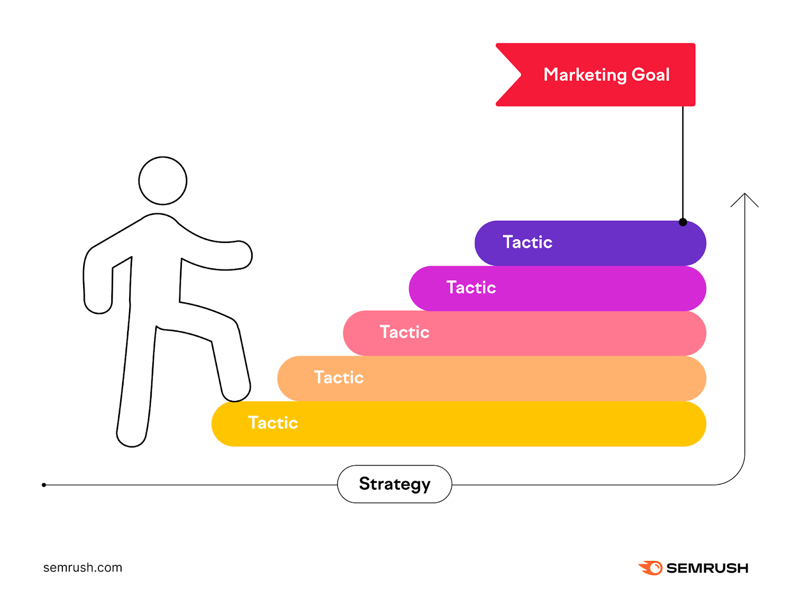

Chapter
3
Creating a marketing strategy
To create a marketing strategy, it must include the following topics:
Targeting and positioning
Promotional tactics
Monitoring and evaluation

Slide 12
Chapter
3
Creating a marketing strategy
Targeting and positioning
You must target the market segments that represent the greatest profits for your business.
What your product or service offers must meet the needs and expectations of the target market you have selected.
promotional tactics
When you have designed your marketing strategy, you need to decide how to make sure your target segment knows about your product or service.
You must also tell them why and how your product can meet their needs.
Monitoring and evaluation
You must monitor and evaluate or assess your strategy.
It is important. Unfortunately, many people in business skip this part

Slide 13
Chapter
3
The marketing concept
“ Determining the needs and wants of target markets and delivering the desired satisfactions more effectively and efficiently than competitor’s do.”
(Kotler et al, ‘96)

Slide 14
Chapter
3
Please pay close attention
We have highlighted the following words in Professor Kotler's definition in a different color:
The importance of identifying both
Needs
Desires
For whom?
For the target market
Why?
To provide the required satisfaction
Are there limits?
Yes
What are they?
Efficiency and effectiveness
Is it absolutely?
No
So what is the comparison?
Competitors and their competing products

Slide 15
Chapter
3
Efficiency & Effectiveness.
These two common words are often used interchangeably, especially in the workplace.
Here we’ll cover all the differences between efficiency and effectiveness and how you can use both to achieve your team’s goals.
As Peter Drucker put it simply, effectiveness is doing the right things, while efficiency is doing things right.
Efficiency
Using the least amount of inputs to achieve the highest amount of outputs
So
Efficiency = Output ÷ Input
Effectiveness
Achieving planned goals with the least possible deviation
So
Effectiveness = Achieved goals ÷ Planned goals

Slide 16
Chapter
3
What is strategic marketing management?
Definition of strategic marketing management
Strategic marketing management is the process of implementing your business’ mission through specific and strategic processes in order to maximize your current marketing plan.
Essentially, it is the act of making strategic decisions within a marketing plan in order to better than plan.

Slide 17
Chapter
3
History of strategic marketing management
Over the past nearly 30 years, strategic management has evolved considerably compared to what it is today.
Budgeting
Long-range planning
Strategic planning
Strategic marketing management

Slide 18
Chapter
3
1.Budgeting
date: From the late 19th century
  Key Thinkers: Frederick Winslow Taylor,
  Key Ideas:
  Emphasis on quantification and scientific modeling, reduce work to the smallest possible units and assign work to specialists, exercise control through rigid managerial hierarchies, standardize inputs to reduce variation, and defects and control costs, use quantitative forecasting methods to predict any changes
Initially, strategic management, marketing, and otherwise were simply referred to as budgeting.
Just as the name suggests, the methodology was mainly concerned with budgetary and control mechanisms.
The methodology itself used the budget and its many variants as a way to manage marketing plans and marketing audits.

Slide 19
Chapter
3
2.Long-range planning
Date: 1950s
Key Thinkers: Herbert Alexander Simon
Key Ideas:
After budgeting, long-range planning emerged as the focus shifted towards forecasting.
Using trends at the time, predictions were made concerning sales, costs, and profits.

Slide 20
Chapter
3
3. Strategic planning
(known as corporate planning)
Date: 1960s
Key Thinker: Michael Porter
Key Ideas
Organizations must find the right fit within the industry structure; Advantage comes from industry concentration and market power; Firms must strive to achieve monopoly or near-monopoly; Successful firms must be able to erect barriers to entry.
During the 70s and 80s, strategic planning placed focus on overall direction and control over planning.
There was still a bit of forecasting involved, but the main focus was on the business side of things.

Slide 21

Chapter
3
4. Strategic marketing management
Date: from the late 1970s
Key thinkers: Robert D. Buzzell and Bradley T. Gale (Author
Key Ideas:
Each business is unique and there can be no formula for achieving competitive advantage; firms should adopt a flexible planning and review process that aims to cope with strategic surprises and rapidly developing threats; management's focus is on how to deliver superior customer value; highlights the key role of marketing as the link between customers and the organization.
The idea behind strategic marketing management is to adapt to your market as things change around you.
The goal remains the same, but the path that leads you towards your goal can change.

Slide 22
Chapter
3
The benefits of strategic marketing management
Strategic marketing management aims to respond to your market as it changes.
The goal is constant, but the path to it can alter.
The advantages of adopting strategic marketing management are well known in the business sector.
Here’s why strategic marketing management is essential:
Understand your market better
Identify Your Strategic Direction
Small Actions, Big Results

Slide 23
Chapter
3
Understand your market better
Understand your market better
The research required to apply strategic marketing management successfully will eventually result in a deeper grasp of your specific market.
You will learn about domestic and international markets, competition, and market trends.
The ability to update to changes occurring in the markets such as "technological development - social changes - environmental changes - legal changes - etc.

Slide 24
Chapter
3
2. Identify Your Strategic Direction
Identify Your Strategic Direction
Strategic marketing management helps you make more innovative judgments that link your strategy with the company’s objectives.
Therefore
we can say that it achieves compatibility with the company's goals according to changes in the markets

Slide 25
Chapter
3
3. Small Actions, Big Results
Small Actions, Big Results
Strategic marketing management, when done right, may deliver some remarkable outcomes for a company.
As a result, a company’s budget may be better managed, and its overall longevity may rise.
Overall, there are numerous advantages to this management approach.
You are making strategic decisions to improve your business and grasp the industry as a whole by applying strategic marketing management.
Therefore
It can be said that when we take a strategic marketing management approach, we can achieve efficiency and effectiveness

Slide 26
Chapter
3
Examples of strategic marketing management
The best way to learn is often to study those who have already achieved the steps you want to achieve – so let’s take a look at some examples of strategic marketing.
Apple
Tesla

Slide 27


Chapter
3
Examples of strategic marketing management
Apple
In its early years, Apple made all of its decisions based on forecasting and strategy.
For example, the Apple logo is very simple in its design because they wanted it to be easy to remember. The same goes for the name “Apple”.
They also (famously) looked at the mobile phone market and saw a need for a product, then made the necessary decisions and implemented a strategy.
Now, over a billion people have an iPhone in their pocket.
Come and find out that
Based on Apple's net profit from October 2022 to September 2023, the company made a profit of $3,074 per second during this period.

Slide 28

Chapter
3
Examples of strategic marketing management
Tesla
Tesla's evolution over the past few years is another great example. Tesla came in when people thought electric cars were boring money-savers — and then they completely changed the industry. Thanks to strategic marketing management, Tesla is viewed as the world’s first luxury electric vehicle manufacturer.
Tesla's success story is one of the most prominent stories of clean energy electric car manufacturers.
The company is famous for developing electric cars that combine high performance and modern luxury, in addition to its work in the field of solar energy and energy storage.
Tesla aims to accelerate the global transition to sustainable energy through its innovative products and advanced environmental solutions.

Slide 29
Chapter
3
Market Analysis
Initially, market analysis is a procedure to evaluate and identify the various internal and external factors and conditions (strategic thinking) in the market within a specific niche. Basically, the main ideas of market analysis are as follows:
Assess the market size
Identify growth trends
Identify and identify the target audience
Get an in-depth view of the competitive landscape
Define business objectives

Slide 30
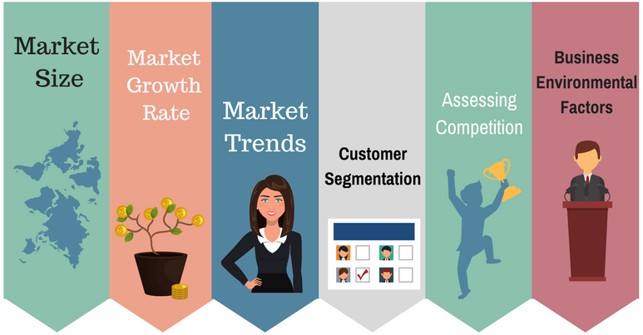
Chapter
3
Market Analysis
  Market Analysis Techniques for Building a Solid Marketing Strategy
  Step 1: Defining Business Goals
  Step 2: Assessing Market Size
  Step 3: Identifying Market Trends And Growth Rate
  Step 4: Getting an In-Depth Look at Competitors
  Step 5: Identifying the Right Demographic
  Step 6: Accounting for Internal and External Factors

Slide 31

Chapter
3
What Does Market Analysis Include?
Market analysis can take into account a whole variety of factors, but there are a few key points we suggest you focus on. They are:
Market volume
Market value
Market need
Competition
Regulation

Slide 32
Chapter
3
The Difference Market Analysis and Marketing Plan
Market Analysis
Describes Targets (Who & Why)
Marketing Plan
Describes Tactics (How)
Customers
Competition
Competitive Advantage
Critical Success Factors
Critical Risks
Potential Sales/Market Share
Product Positioning
Price
Placement
Promotion
Sales Process
Partnerships

Slide 33
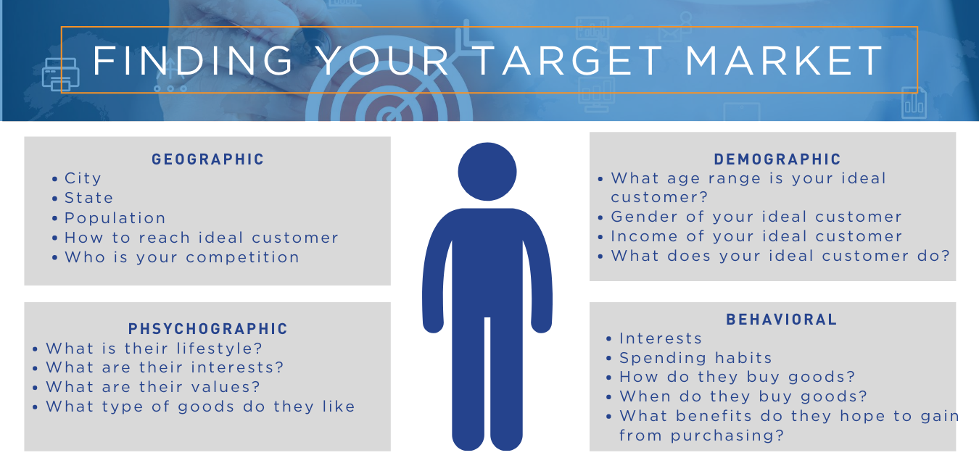
Chapter
3
Ways to Target the Market
Geographic
  local, regional, national, international
Demographic
  B2C: gender, age, income, education, ethnicity
  B2B: revenues, employees, industry
Psychographic
  values, lifestyles, hobbies
Behavioral
  benefits sought, usage rate

Slide 34

Chapter
3
Who Is My Competition?
Competition = everybody who’s after the same consumer dollar you are.
Direct Competitors
Indirect Competitors
Possible New Entrants

Slide 35
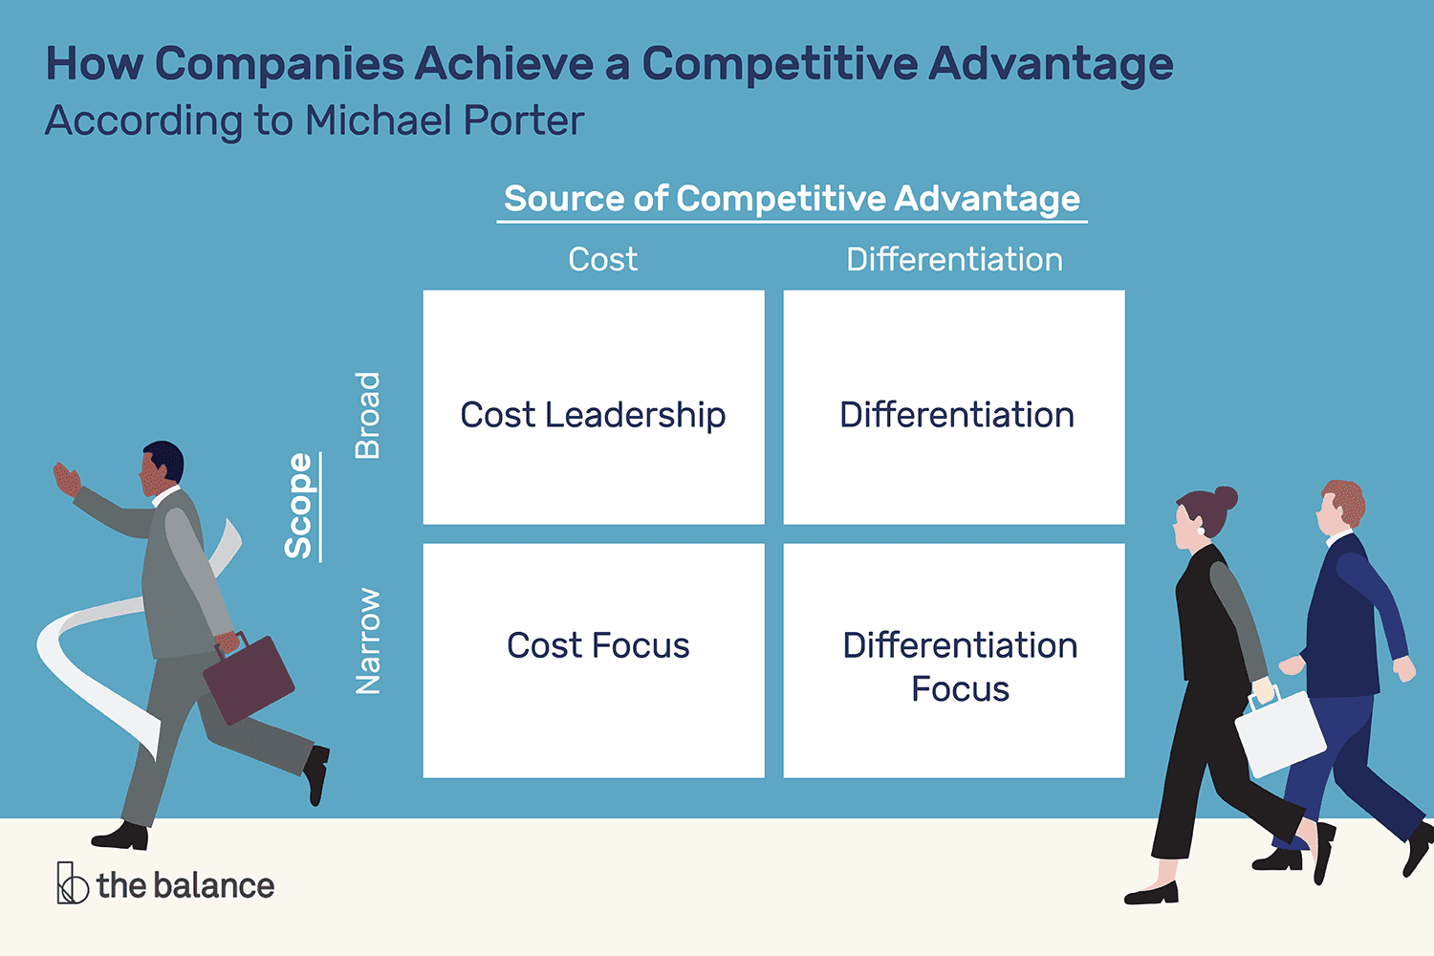
Chapter
3
Create Competitive Advantage
Having a Sustainable Competitive Advantage allows you to distinguish your product from the competition’s.
It’s what gives you a significant edge.
The basis of your a sustainable competitive advantage (SCA) must not be able to be duplicated or imitated and is not substitutable.
Superior Product/Brand
Quality – Selection -Availability
Operational Excellence
Creative Leadership
Intimate Customer Relationships/Experiences
Cost Advantage

Slide 36
Chapter
3
The Marketing Plan
What Is a Marketing Plan?
A marketing plan is an operational document that outlines an advertising strategy that an organization will implement to generate leads and reach its target market.
A marketing plan details the outreach and Public relations campaigns to be undertaken over a period, including how the company will measure the effect of these initiatives.
The functions and components of a marketing plan include the following:
Market research to support pricing decisions and new market entries
Tailored messaging that targets certain demographics and geographic areas
Platform selection for product and service promotion—digital, radio, Internet, trade magazines, and the mix of those platforms for each campaign
Metrics that measure the results of marketing efforts and their reporting timelines

Slide 37
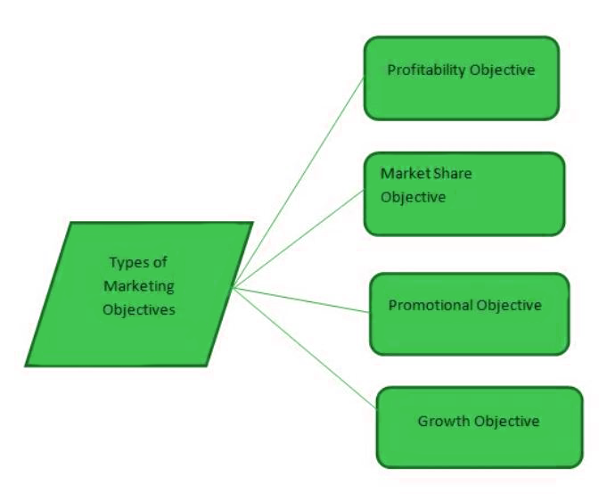
Chapter
3
Structure of Marketing Plan
The structure of a marketing plan can include the following sections:
Marketing Objectives
Market Research – Market Analysis/Consumer Analysis
Target Market
SWOT Analysis
Marketing Strategy
Marketing Budget
Marketing objectives
are goals set by business houses to promote its goods and services to its consumers within a specific timeframe.
Marketing objectives are the strategy’s set to attain the overall growth of the organization.

Slide 38
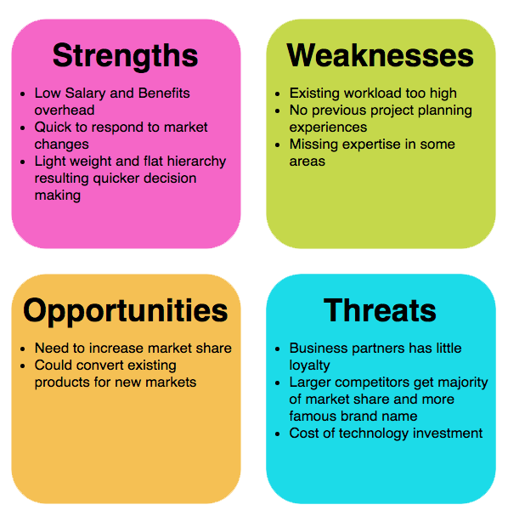
Chapter
3
SWOT Analysis

Slide 39
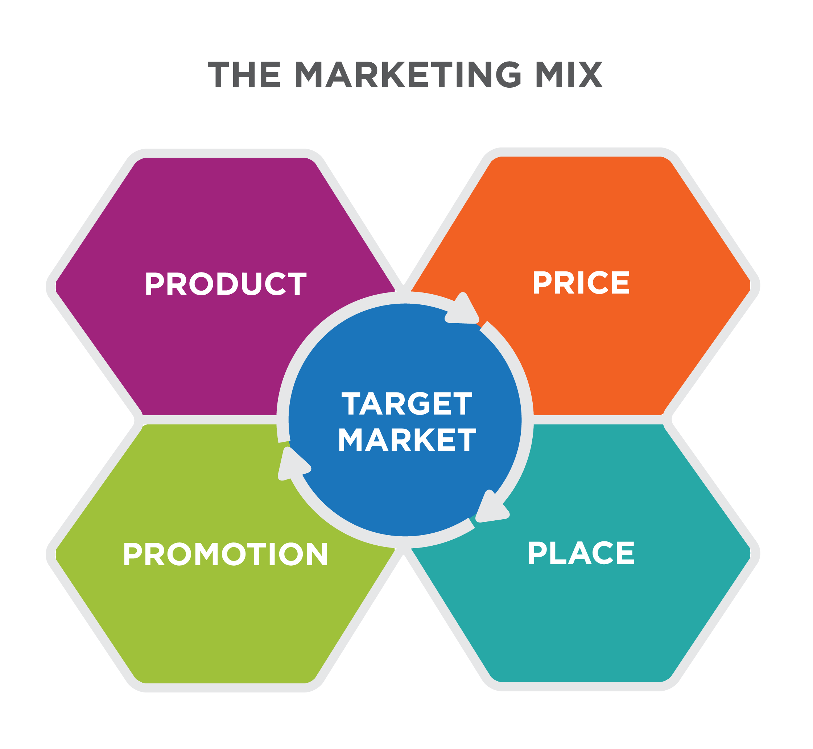
Chapter
3
The marketing mix
The marketing mix is the combination of variables that a business uses to carry out its marketing strategy and meet customer needs.
The marketing mix is often called the 4Ps:
Product
Price
Place
Promotion

Slide 40


Chapter
3
The 4P’s of Marketing explained
Product | Price | Place
Is there a demand for the product or service? How to make the product appeal to consumer Packaging—includes the design, color, size, and brand names | How much are customers willing to pay? Is the price competitive with other products? Can the company make a profit? | Distribution is getting the right product to the right place at the right time in the right amount and in the right condition Storage Warehousing Transporting
Promotion
Making customers aware of a product Advertising Coupons Rebates Sales Free give aways Publicity

Slide 41
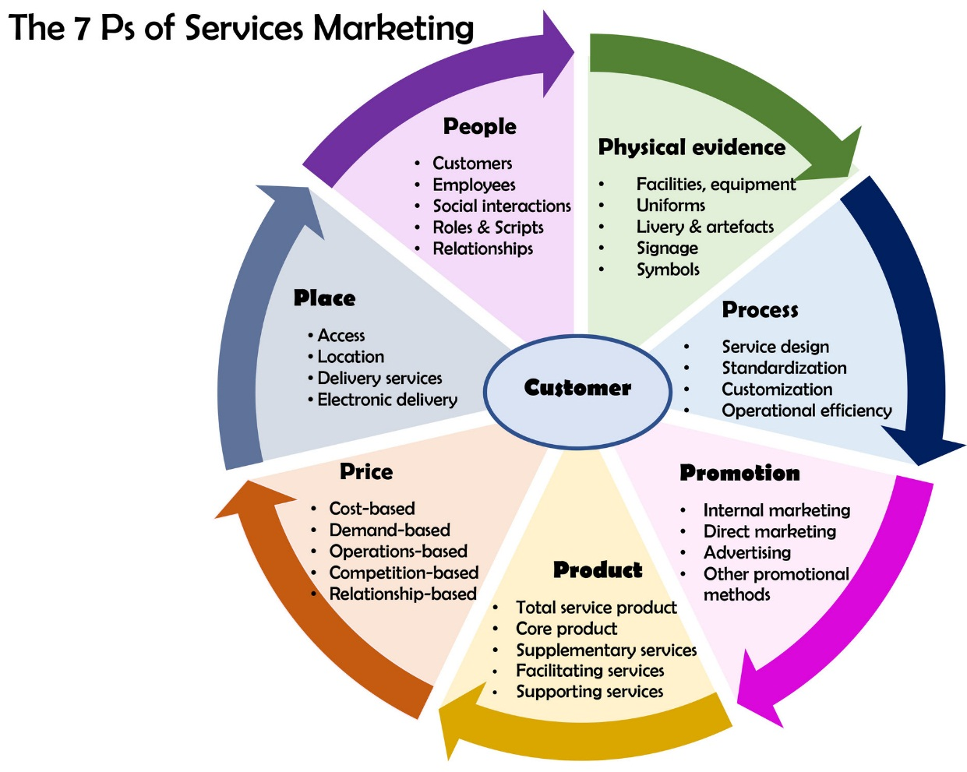
Chapter
3
The 7 P’s of Services Marketing
In addition to the 4P'S that we discussed previously, there are 3P'S added to them to give us 7P'S, which are:
People
Process
Physical evidence

Slide 42
Chapter
3
People – Process -Physical Evidence
People: People are a defining factor in a service delivery process, since a service is inseparable from the person providing it.
Thus, a restaurant is known as much for its food as for the service provided by its staff. The same is true of banks and department stores. Consequently, customer service training for staff has become a top priority for many organizations today
Process: The process of service delivery is crucial since it ensures that the same standard of service is repeatedly delivered to the customers.
Therefore, most companies have a service blue print which provides the details of the service delivery process, often going down to even defining the service script and the greeting phrases to be used by the service staff.
Physical Evidence: Since services are intangible in nature most service providers strive to incorporate certain tangible elements into their offering to enhance customer experience.
Thus, there are hair salons that have well designed waiting areas often with magazines and plush sofas for patrons to read and relax while they await their turn. Similarly, restaurants invest heavily in their interior design and decorations to offer a tangible and unique experience to their guests

Slide 43
Chapter
3
See you in the next lecture

Slide 44
Chapter
3
Resources and References
Establishing Your Target Market | DECA Direct Online
What Is Strategic Marketing Management? (airfocus.com)
What Is Competitive Advantage? (thebalancemoney.com)

Slide 45

Thanks for listening.
01
Best wishes
Dr. Ayman Hassan

