Slide 1



Common Network Protocols
Lecture 2
HCIA-Security
Prepared by
Dr. Abdelrhman Ahmed

Slide 2
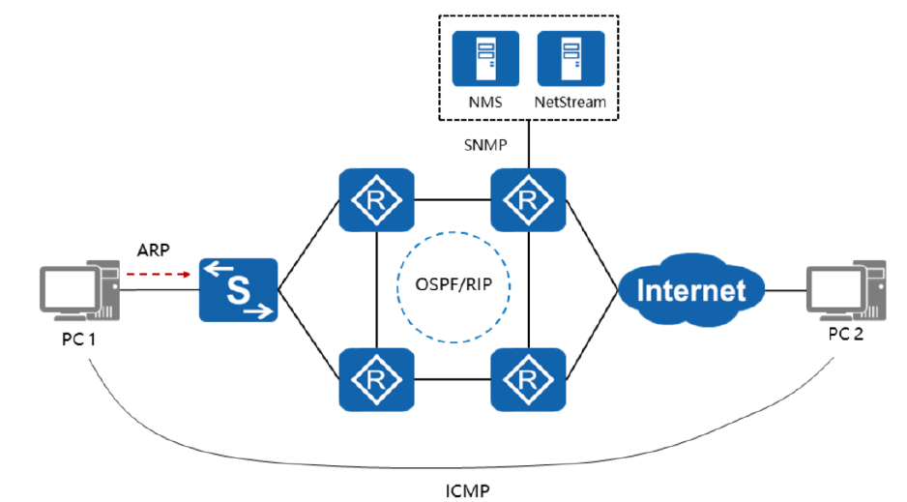
Chapter
02
Common Network Protocols

Slide 3
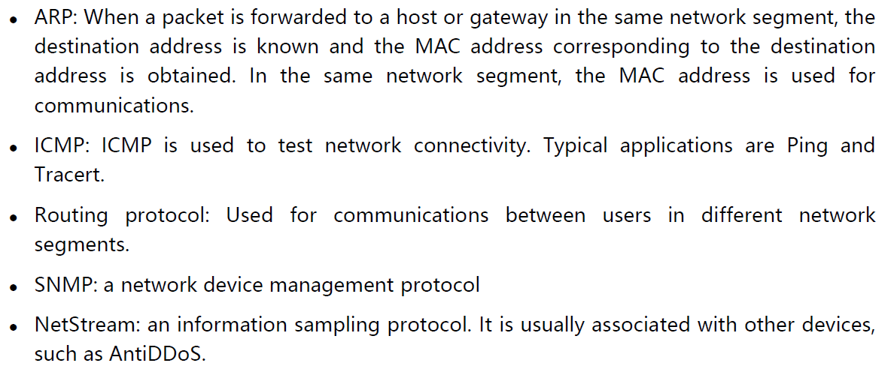
Chapter
Common Network Protocols
02

Slide 4
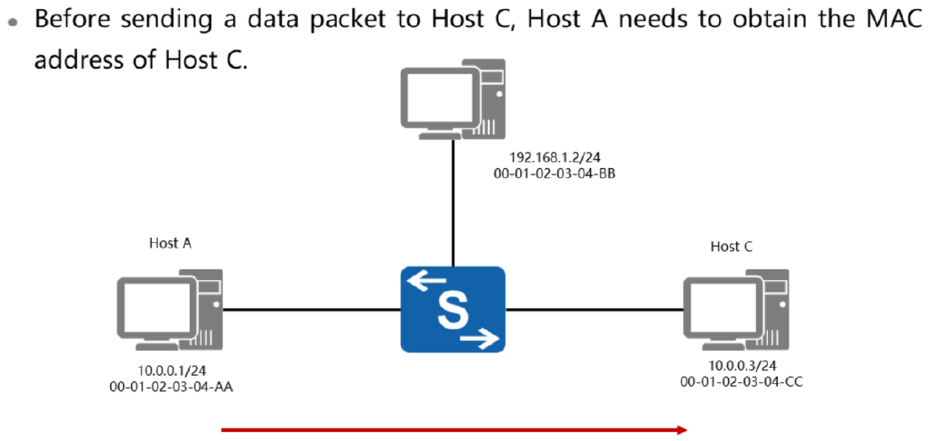
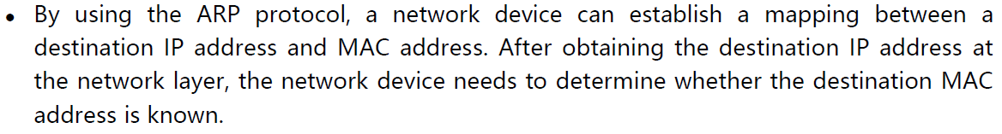
Chapter
Overview of ARP
02

Slide 5
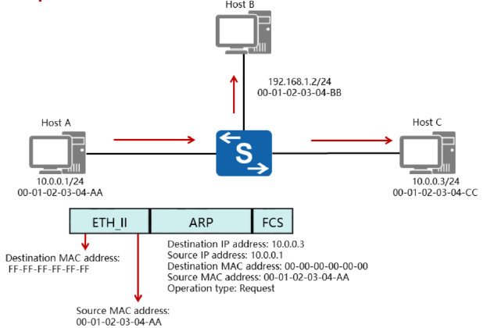
Chapter
ARP Request
02

Slide 6
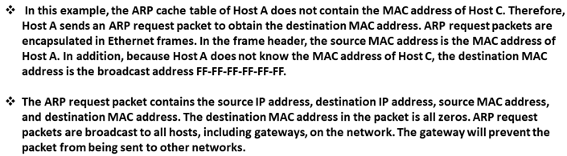
Chapter
ARP Request
02

Slide 7
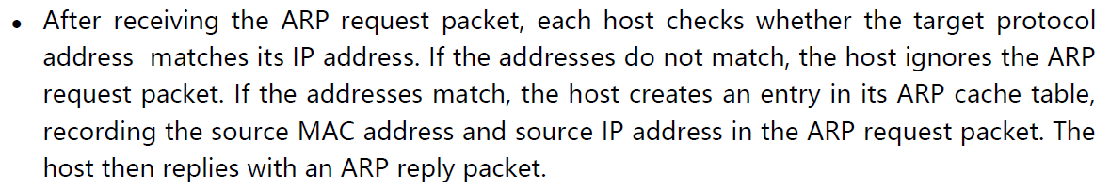
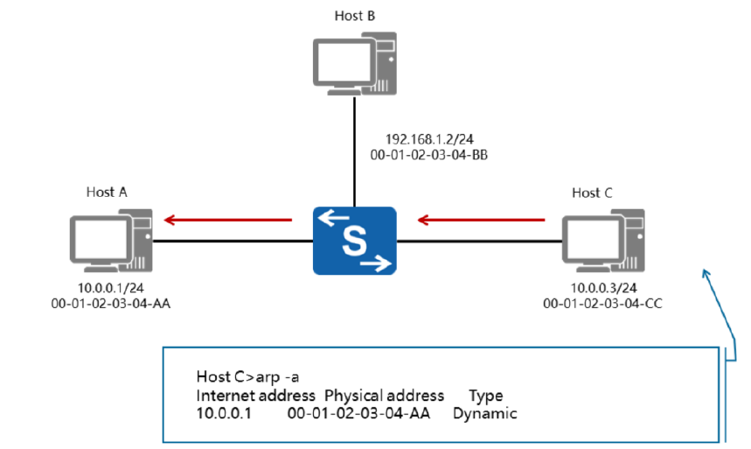
Chapter
02
ARP Reply

Slide 8
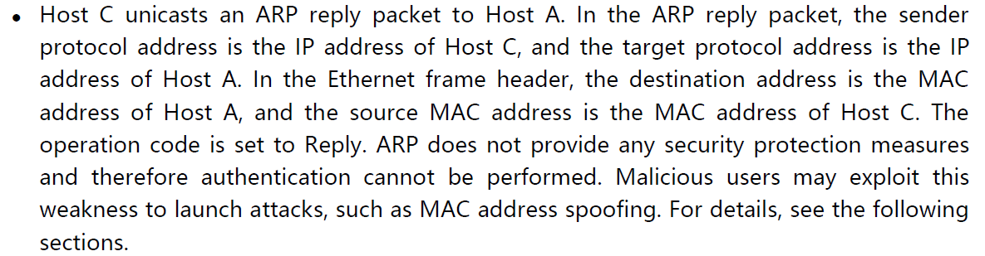
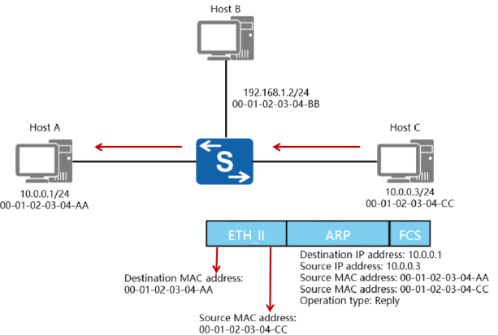
Chapter
02
ARP Reply

Slide 9
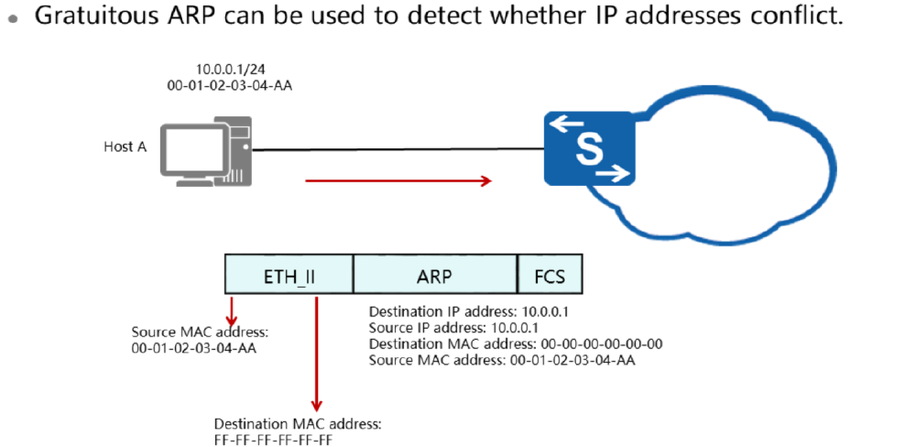
Chapter
Gratuitous ARP
02

Slide 10
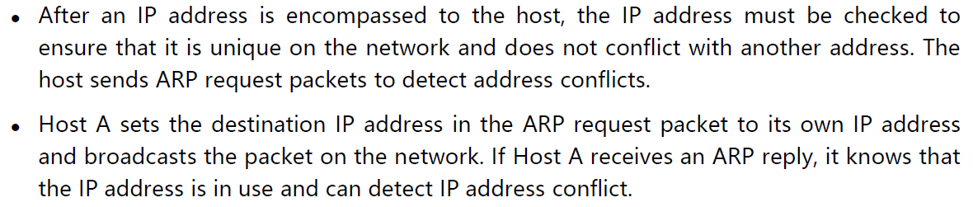
Chapter
Gratuitous ARP
02

Slide 11
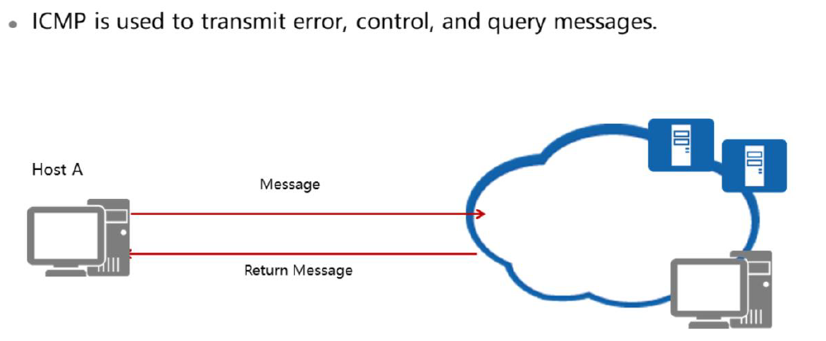
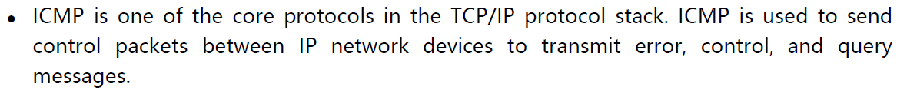
Chapter
Introduction to ICMP
02

Slide 12
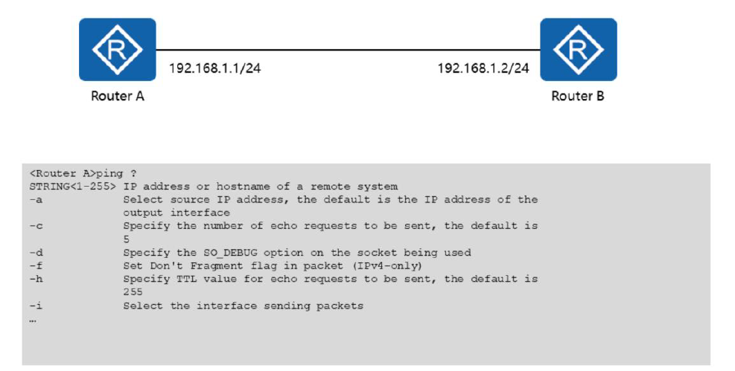
Chapter
ICMP Application: Ping (1)
02

Slide 13
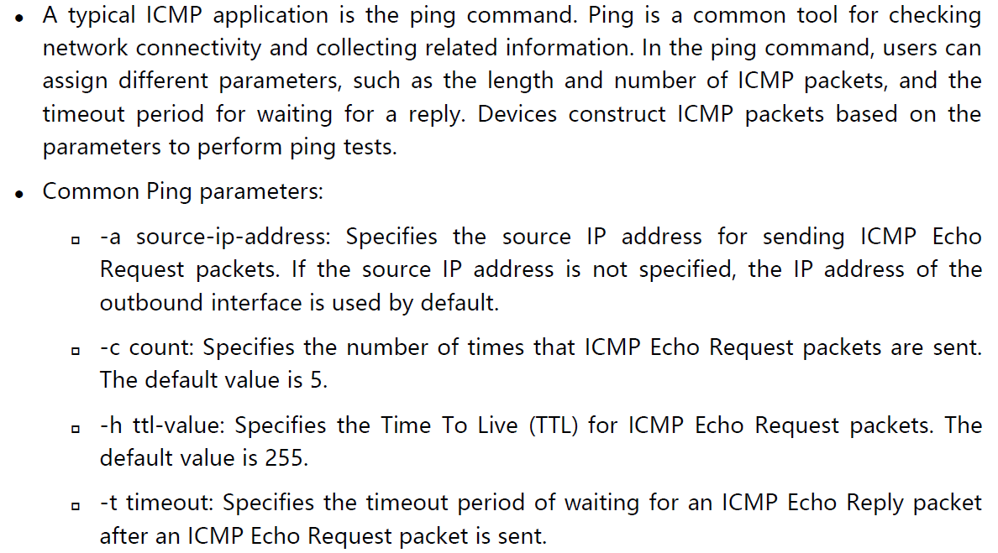
Chapter
02
ICMP Application: Ping (1)

Slide 14
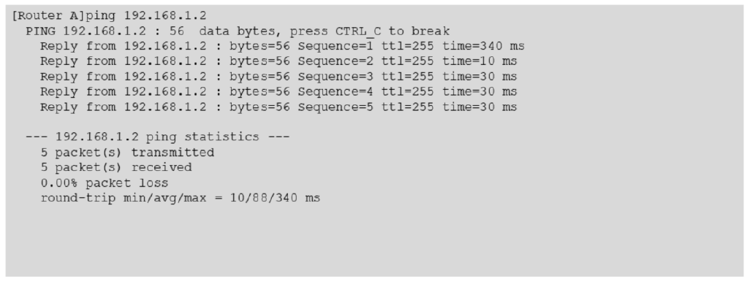
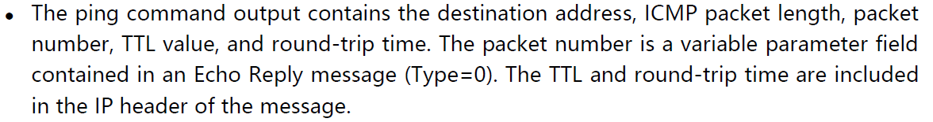
Chapter
02
ICMP Application: Ping (2)

Slide 15
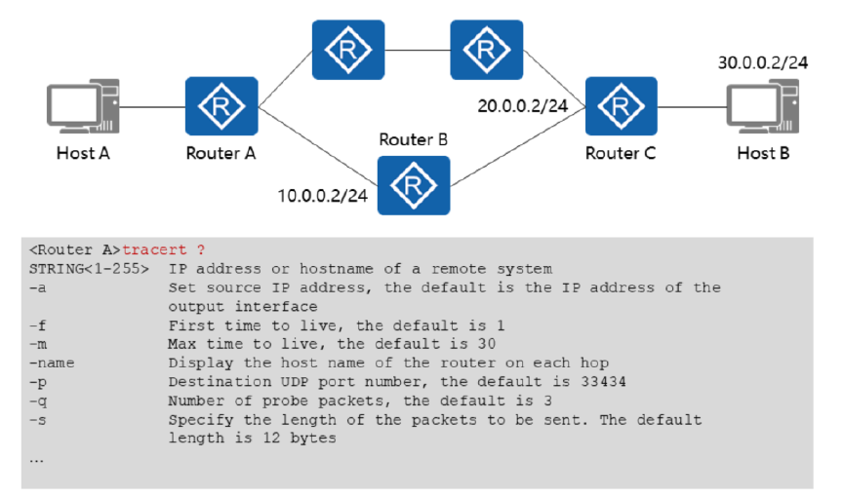
Chapter
02
ICMP Application: Tracert (1)

Slide 16
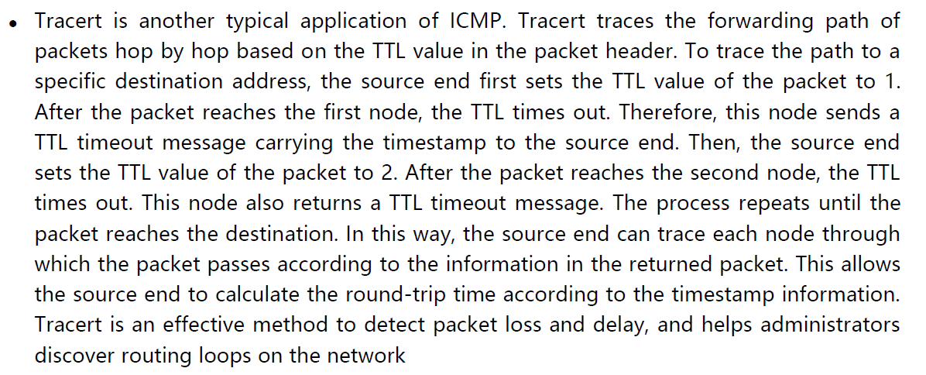
Chapter
02
ICMP Application: Tracert (1)

Slide 17
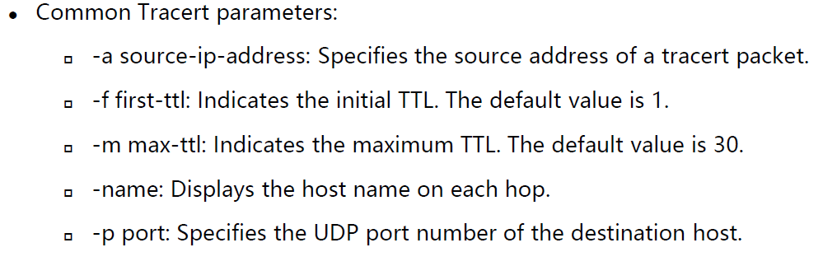
Chapter
02
ICMP Application: Tracert (1)

Slide 18
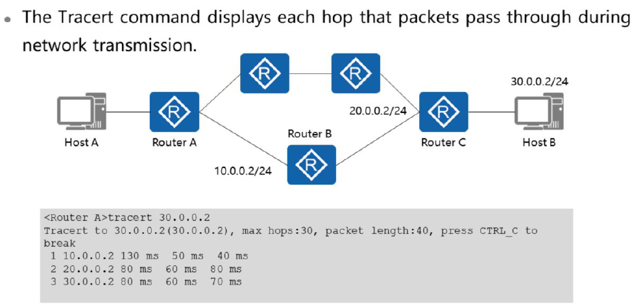
Chapter
02
ICMP Application: Tracert (2)

Slide 19
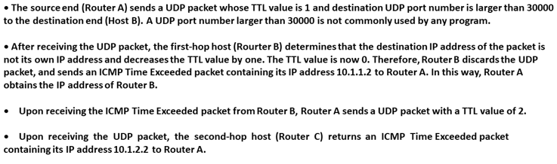
Chapter
02
ICMP Application: Tracert (2)

Slide 20
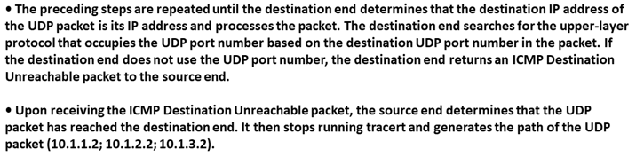
Chapter
02
ICMP Application: Tracert (2)

Slide 21
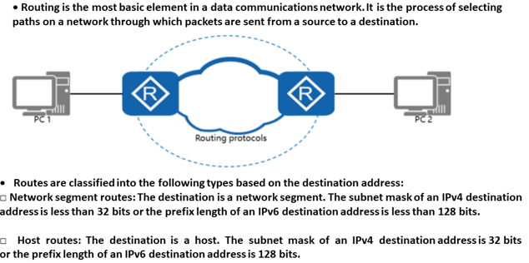
Chapter
02
Routing Protocol Overview

Slide 22
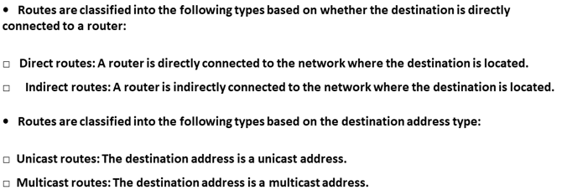
Chapter
02
Routing Protocol Overview

Slide 23
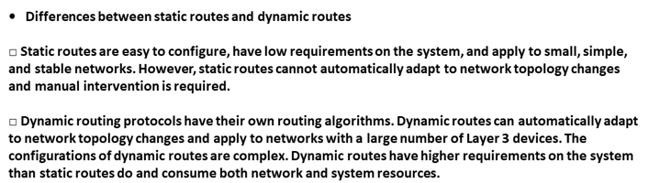
Chapter
02
Routing Protocol Overview

Slide 24
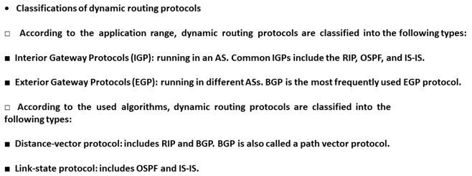
Chapter
02
Routing Protocol Overview

Slide 25
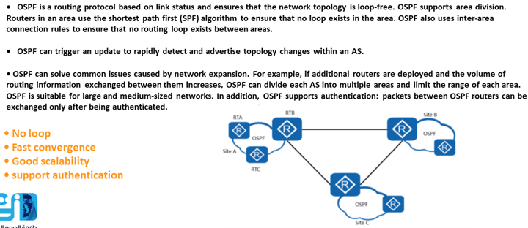
Chapter
02
Introduction to OSPF

Slide 26



Thank You

