Slide 1



Introduction to Data Mining
Prepared by Dr. Amjad Qtaish
DS601
Data Mining
Lecture 01

Slide 2




Lecture: #01
Introduction to Data Mining
Dr. Amjad Qtaish
Faculty of Informatics
Midocean University
Data Mining (DS601)
www.midocean.ae

Slide 3
Chapter
Outline
01
    Introduction to Data Mining
Why Data Mining?
What Is Data Mining?
A Multi-Dimensional View of Data Mining
What Kind of Data Can Be Mined?
What Kinds of Patterns Can Be Mined?
What Technology Are Used?
What Kind of Applications Are Targeted?
Major Issues in Data Mining
Summary
Data Mining, Dr. Amjad Qtaish
3
www.midocean.ae

Slide 4
Chapter
Why Data Mining?
01
The Explosive Growth of Data: from terabytes to petabytes
  Data collection and data availability
    Automated data collection tools, database systems, Web, computerized society
  Major sources of abundant data
    Business: Web, e-commerce, transactions, stocks, …
    Science: Remote sensing, bioinformatics, scientific simulation, …
    Society and everyone: news, digital cameras, YouTube
We are drowning in data, but starving for knowledge!
“Necessity is the mother of invention”—Data mining—Automated analysis of massive data sets
Data Mining, Dr. Amjad Qtaish
4
www.midocean.ae

Slide 5
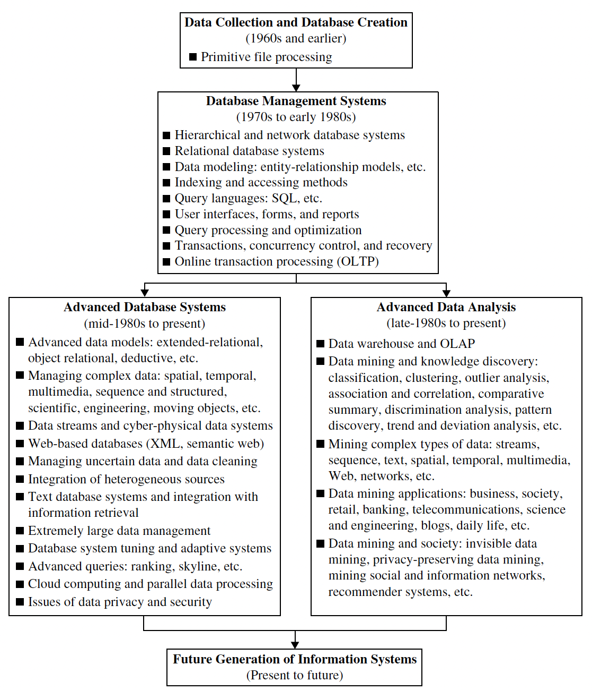
Chapter
Why Data Mining?
01
Data Mining, Dr. Amjad Qtaish
5
www.midocean.ae

Slide 6
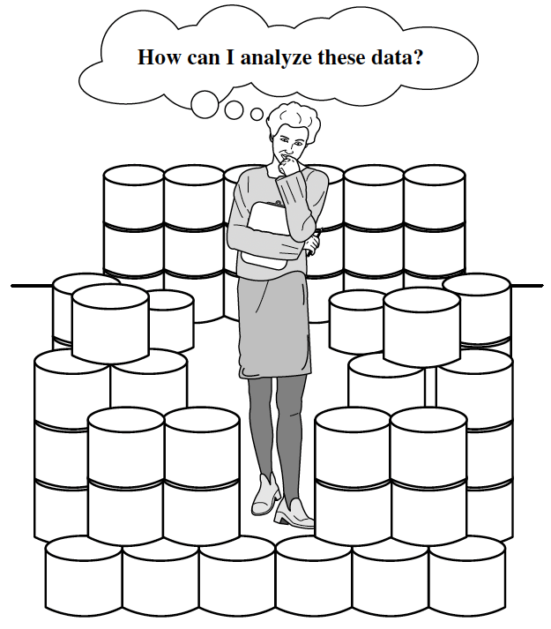
Chapter
Why Data Mining?
01
Data Mining, Dr. Amjad Qtaish
6
www.midocean.ae

Slide 7
Chapter
Outline
01
    Introduction to Data Mining
Why Data Mining?
What Is Data Mining?
A Multi-Dimensional View of Data Mining
What Kind of Data Can Be Mined?
What Kinds of Patterns Can Be Mined?
What Technology Are Used?
What Kind of Applications Are Targeted?
Major Issues in Data Mining
Summary
Data Mining, Dr. Amjad Qtaish
7
www.midocean.ae

Slide 8
Chapter
What Is Data Mining?
01
Data mining (knowledge discovery from data)
  Extraction of interesting (non-trivial, implicit, previously unknown and potentially useful) patterns or knowledge from huge amount of data
  Data mining: a misnomer?
Alternative names
  Knowledge discovery (mining) in databases (KDD), knowledge extraction, data/pattern analysis, data archeology, data dredging, information harvesting, business intelligence, etc.
Watch out: Is everything “data mining”?
  Simple search and query processing
  (Deductive) expert systems
Data Mining, Dr. Amjad Qtaish
8
www.midocean.ae

Slide 9
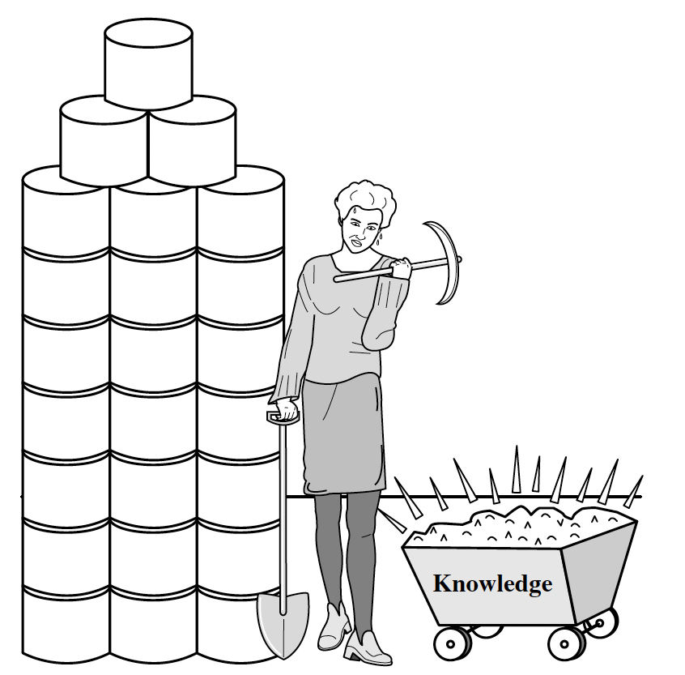
Chapter
What Is Data Mining?
01
Data Mining, Dr. Amjad Qtaish
9
www.midocean.ae

Slide 10
Chapter
Knowledge Discovery (KDD) Process
01
This is a view from typical database systems and data warehousing communities
Data mining plays an essential role in the knowledge discovery process
Knowledge
Pattern Evaluation
Data Mining
Task-relevant Data
Data Warehouse
Selection
Data Cleaning
Data Integration
Databases
Data Mining, Dr. Amjad Qtaish
10
www.midocean.ae

Slide 11
Chapter
Knowledge Discovery (KDD) Process
01
  Data cleaning (to remove noise and inconsistent data)
  Data integration (where multiple data sources may be combined)
  Data selection (where data relevant to the analysis task are retrieved from the database)
  Data transformation (where data are transformed and consolidated into forms appropriate for mining by performing summary or aggregation operations)
  Data mining (an essential process where intelligent methods are applied to extract data patterns)
  Pattern evaluation (to identify the truly interesting patterns representing knowledge based on interestingness measures)
  Knowledge presentation (where visualization and knowledge representation techniques are used to present mined knowledge to users)
Data Mining, Dr. Amjad Qtaish
11
www.midocean.ae

Slide 12
Chapter
Example: A Web Mining Framework
01
Web mining usually involves
  Data cleaning
  Data integration from multiple sources
  Warehousing the data
  Data cube construction
  Data selection for data mining
  Data mining
  Presentation of the mining results
  Patterns and knowledge to be used or stored into knowledge-base
Data Mining, Dr. Amjad Qtaish
12
www.midocean.ae

Slide 13
Chapter
Data Mining in Business Intelligence
01
Increasing potential
to support
business decisions
End User
Decision Making
Data Presentation
Business
Analyst
Visualization Techniques
Data Mining
Data
Analyst
Information Discovery
Data Exploration
Statistical Summary, Querying, and Reporting
Data Preprocessing/Integration, Data Warehouses
Data Sources
DBA
Paper, Files, Web documents, Scientific experiments, Database Systems
Data Mining, Dr. Amjad Qtaish
13
www.midocean.ae

Slide 14
Chapter
KDD Process: A Typical View from ML and Statistics
01
Pattern
Information
Knowledge
Input Data
Data Pre-Processing
Data Mining
Post-Processing
Data integration
Normalization
Feature selection
Dimension reduction
Pattern discovery
Association & correlation
Classification
Clustering
Outlier analysis
… … … …
Pattern evaluation
Pattern selection
Pattern interpretation
Pattern visualization
This is a view from typical machine learning and statistics communities
Data Mining, Dr. Amjad Qtaish
14
www.midocean.ae

Slide 15
Chapter
Example: Medical Data Mining
01
Health care & medical data mining – often adopted such a view in statistics and machine learning
Preprocessing of the data (including feature extraction and dimension reduction)
Classification or/and clustering processes
Post-processing for presentation
Data Mining, Dr. Amjad Qtaish
15
www.midocean.ae

Slide 16
Chapter
Outline
01
    Introduction to Data Mining
Why Data Mining?
What Is Data Mining?
A Multi-Dimensional View of Data Mining
What Kind of Data Can Be Mined?
What Kinds of Patterns Can Be Mined?
What Technology Are Used?
What Kind of Applications Are Targeted?
Major Issues in Data Mining
Summary
Data Mining, Dr. Amjad Qtaish
16
www.midocean.ae

Slide 17
Chapter
Multi-Dimensional View of Data Mining
01
Data to be mined
  Database data (extended-relational, object-oriented, heterogeneous, legacy), data warehouse, transactional data, stream, spatiotemporal, time-series, sequence, text and web, multi-media, graphs & social and information networks
Knowledge to be mined (or: Data mining functions)
  Characterization, discrimination, association, classification, clustering, trend/deviation, outlier analysis, etc.
  Descriptive vs. predictive data mining
  Multiple/integrated functions and mining at multiple levels
Techniques utilized
  Data-intensive, data warehouse (OLAP), machine learning, statistics, pattern recognition, visualization, high-performance, etc.
Applications adapted
  Retail, telecommunication, banking, fraud analysis, bio-data mining, stock market analysis, text mining, Web mining, etc.
Data Mining, Dr. Amjad Qtaish
17
www.midocean.ae

Slide 18
Chapter
Outline
01
    Introduction to Data Mining
Why Data Mining?
What Is Data Mining?
A Multi-Dimensional View of Data Mining
What Kind of Data Can Be Mined?
What Kinds of Patterns Can Be Mined?
What Technology Are Used?
What Kind of Applications Are Targeted?
Major Issues in Data Mining
Summary
Data Mining, Dr. Amjad Qtaish
18
www.midocean.ae

Slide 19
Chapter
Data Mining: On What Kinds of Data?
01
Database-oriented data sets and applications
  Relational database, data warehouse, transactional database
Advanced data sets and advanced applications
  Data streams and sensor data
  Time-series data, temporal data, sequence data (incl. bio-sequences)
  Structure data, graphs, social networks and multi-linked data
  Object-relational databases
  Heterogeneous databases and legacy databases
  Spatial data and spatiotemporal data
  Multimedia database
  Text databases
  The World-Wide Web
Data Mining, Dr. Amjad Qtaish
19
www.midocean.ae

Slide 20
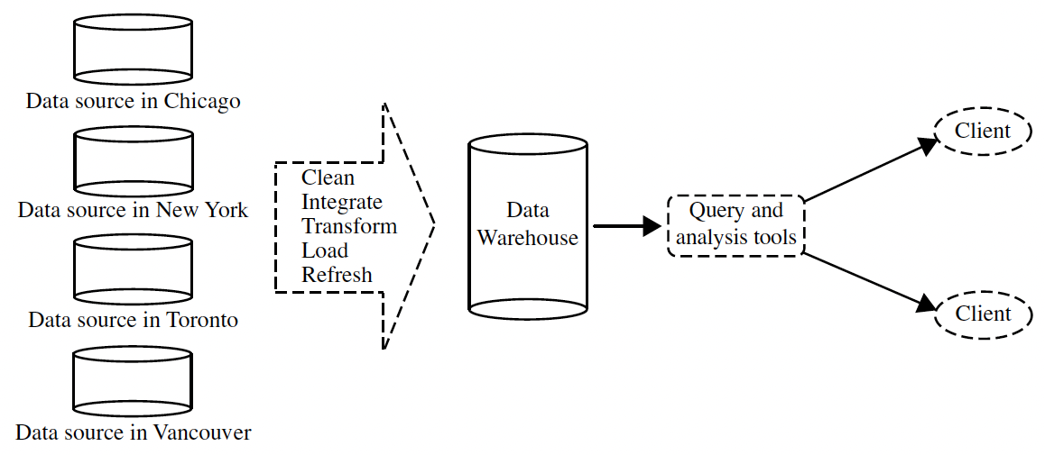
Chapter
Data Mining: On What Kinds of Data?
01
A data warehouse is a repository of information collected from multiple sources, stored under a unified schema, and usually residing at a single site. Data warehouses are constructed via a process of data cleaning, data integration, data transformation, data loading, and periodic data refreshing.
Data Mining, Dr. Amjad Qtaish
20
www.midocean.ae

Slide 21
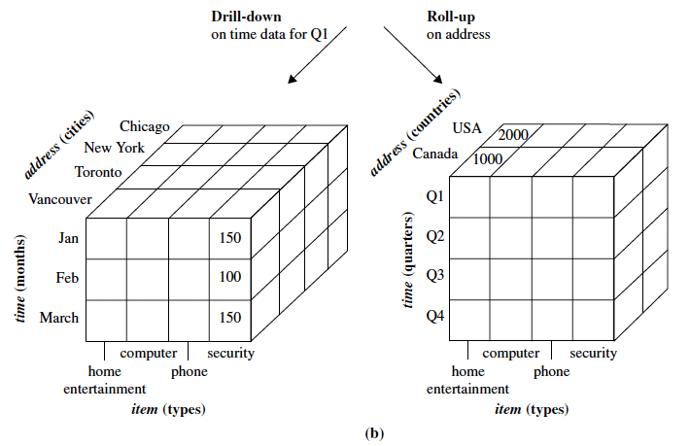
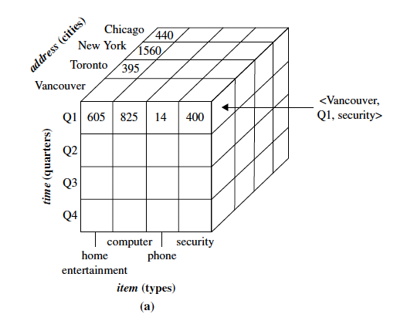
Chapter
Data Mining: On What Kinds of Data?
01
A data warehouse is usually modeled by a multidimensional data structure, called a data cube, in which each dimension corresponds to an attribute or a set of attributes in the schema, and each cell stores the value of some aggregate measure such as count or sum(sales amount).
A data cube provides a multidimensional view of data and allows the precomputation and fast access of summarized data.
Data Mining, Dr. Amjad Qtaish
21
www.midocean.ae

Slide 22
Chapter
Outline
01
    Introduction to Data Mining
Why Data Mining?
What Is Data Mining?
A Multi-Dimensional View of Data Mining
What Kind of Data Can Be Mined?
What Kinds of Patterns Can Be Mined?
What Technology Are Used?
What Kind of Applications Are Targeted?
Major Issues in Data Mining
Summary
Data Mining, Dr. Amjad Qtaish
22
www.midocean.ae

Slide 23
Chapter
Data Mining Function: (1) Generalization
01
Information integration and data warehouse construction
  Data cleaning, transformation, integration, and multidimensional data model
Data cube technology
  Scalable methods for computing (i.e., materializing) multidimensional aggregates
  OLAP (online analytical processing)
Multidimensional concept description: Characterization and discrimination
  Generalize, summarize, and contrast data characteristics, e.g., dry vs. wet region
Data Mining, Dr. Amjad Qtaish
23
www.midocean.ae

Slide 24
Chapter
Data Mining Function: (1) Generalization
01
Data characterization is a summarization of the general characteristics or features of a target class of data. The data corresponding to the user-specified class are typically collected by a query.
For example, to study the characteristics of software products with sales that increased by 10% in the previous year, the data related to such products can be collected by executing an SQL query on the sales database.
Data discrimination is a comparison of the general features of the target class data objects against the general features of objects from one or multiple contrasting classes.
For example, a user may want to compare the general features of software products with sales that increased by 10% last year against those with sales that decreased by at least 30% during the same period.
Data Mining, Dr. Amjad Qtaish
24
www.midocean.ae

Slide 25
Data Mining Function: (2) Association and Correlation Analysis
Chapter
01
Frequent patterns (or frequent itemsets)
  What items are frequently purchased together in your Walmart?
Association, correlation vs. causality
  A typical association rule
Buys(X, “computer”) → buys(X, “software”) [support=1%, confidence= 50%]
  where X is a variable representing a customer. A confidence, or certainty, of 50% means that if a customer buys a computer, there is a 50% chance that she will buy software as well. A 1% support means that 1% of all the transactions under analysis show that computer and software are purchased together
  Are strongly associated items also strongly correlated?
How to mine such patterns and rules efficiently in large datasets?
How to use such patterns for classification, clustering, and other applications?
Data Mining, Dr. Amjad Qtaish
25
www.midocean.ae

Slide 26
Chapter
Data Mining Function: (3) Classification
01
Classification and label prediction
  Construct models (functions) based on some training examples
  Describe and distinguish classes or concepts for future prediction
    E.g., classify countries based on (climate), or classify cars based on (gas mileage)
  Predict some unknown class labels
Typical methods
  Decision trees, naïve Bayesian classification, support vector machines, neural networks, rule-based classification, pattern-based classification, logistic regression, …
Typical applications:
  Credit card fraud detection, direct marketing, classifying stars, diseases, web-pages, …
Data Mining, Dr. Amjad Qtaish
26
www.midocean.ae

Slide 27
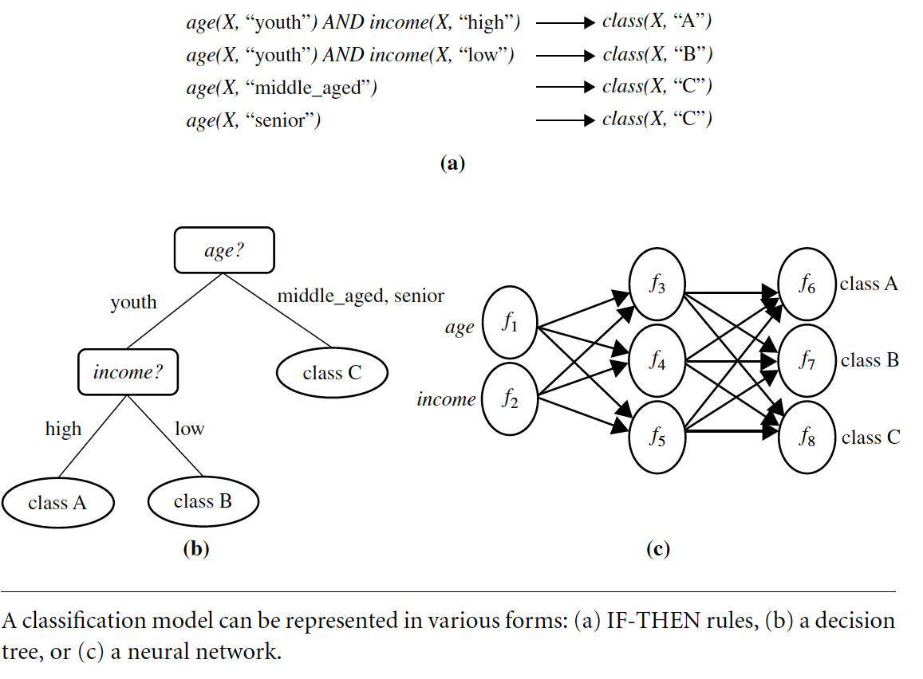
Chapter
Data Mining Function: (3) Classification
01
Data Mining, Dr. Amjad Qtaish
27
www.midocean.ae

Slide 28
Chapter
Data Mining Function: (4) Cluster Analysis
01
Unsupervised learning (i.e., Class label is unknown)
Group data to form new categories (i.e., clusters), e.g., cluster houses to find distribution patterns
Principle: Maximizing intra-class similarity & minimizing interclass similarity
Many methods and applications
Data Mining, Dr. Amjad Qtaish
28
www.midocean.ae

Slide 29
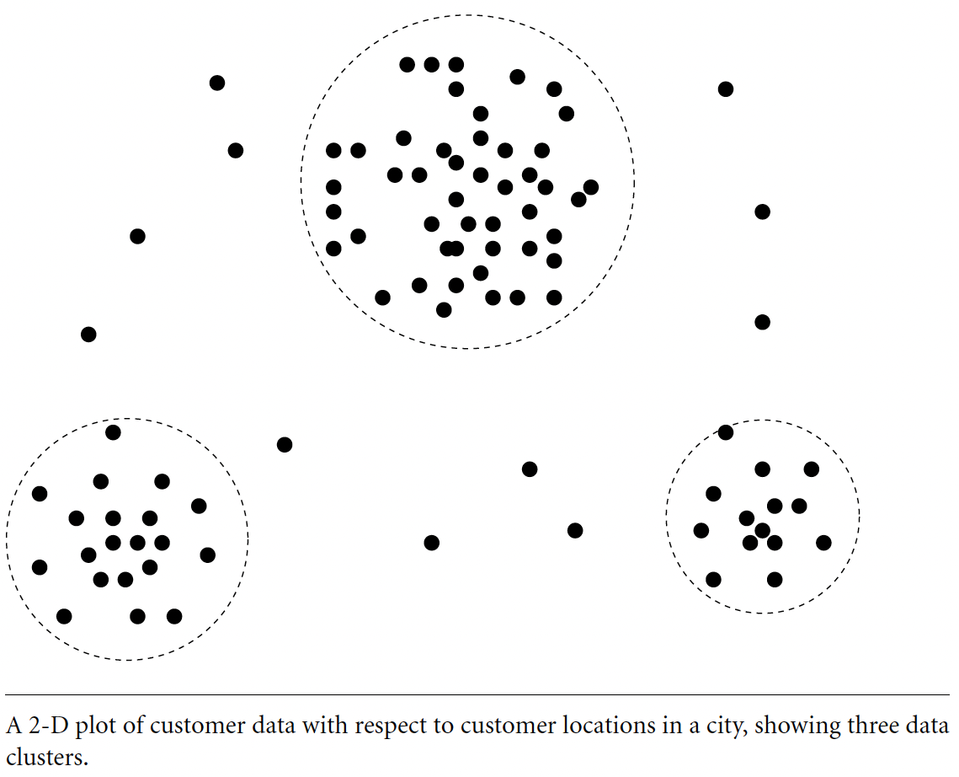
Chapter
Data Mining Function: (4) Cluster Analysis
01
Data Mining, Dr. Amjad Qtaish
29
www.midocean.ae

Slide 30
Chapter
Data Mining Function: (5) Outlier Analysis
01
Outlier analysis
  Outlier: A data object that does not comply with the general behavior of the data
  Noise or exception? ― One person’s garbage could be another person’s treasure
  Methods: by product of clustering or regression analysis, …
  Useful in fraud detection, rare events analysis
Data Mining, Dr. Amjad Qtaish
30
www.midocean.ae

Slide 31
Time and Ordering: Sequential Pattern, Trend and Evolution Analysis
Chapter
01
Sequence, trend and evolution analysis
  Trend, time-series, and deviation analysis: e.g., regression and value prediction
  Sequential pattern mining
    e.g., first buy digital camera, then buy large SD memory cards
  Periodicity analysis
  Motifs and biological sequence analysis
    Approximate and consecutive motifs
  Similarity-based analysis
Mining data streams
  Ordered, time-varying, potentially infinite, data streams
Data Mining, Dr. Amjad Qtaish
31
www.midocean.ae

Slide 32
Chapter
Structure and Network Analysis
01
Graph mining
  Finding frequent subgraphs (e.g., chemical compounds), trees (XML), substructures (web fragments)
Information network analysis
  Social networks: actors (objects, nodes) and relationships (edges)
    e.g., author networks in CS, terrorist networks
  Multiple heterogeneous networks
    A person could be multiple information networks: friends, family, classmates,
  Links carry a lot of semantic information: Link mining
Web mining
  Web is a big information network: from PageRank to Google
  Analysis of Web information networks
    Web community discovery, opinion mining, usage mining, …
Data Mining, Dr. Amjad Qtaish
32
www.midocean.ae

Slide 33
Chapter
Evaluation of Knowledge
01
Are all mined knowledge interesting?
  One can mine tremendous amount of “patterns” and knowledge
  Some may fit only certain dimension space (time, location, …)
  Some may not be representative, may be transient, …
Evaluation of mined knowledge → directly mine only interesting knowledge?
  Descriptive vs. predictive
  Coverage
  Typicality vs. novelty
  Accuracy
  Timeliness
  …
Data Mining, Dr. Amjad Qtaish
33
www.midocean.ae

Slide 34
Chapter
Outline
01
    Introduction to Data Mining
Why Data Mining?
What Is Data Mining?
A Multi-Dimensional View of Data Mining
What Kind of Data Can Be Mined?
What Kinds of Patterns Can Be Mined?
What Technology Are Used?
What Kind of Applications Are Targeted?
Major Issues in Data Mining
Summary
Data Mining, Dr. Amjad Qtaish
34
www.midocean.ae

Slide 35
Chapter
Data Mining: Confluence of Multiple Disciplines
01
Machine
Learning
Pattern
Recognition
Statistics
Applications
Data Mining
Visualization
Algorithm
Database
Technology
High-Performance
Computing
Data Mining, Dr. Amjad Qtaish
35
www.midocean.ae

Slide 36
Chapter
Why Confluence of Multiple Disciplines?
01
Tremendous amount of data
  Algorithms must be highly scalable to handle such as tera-bytes of data
High-dimensionality of data
  Micro-array may have tens of thousands of dimensions
High complexity of data
  Data streams and sensor data
  Time-series data, temporal data, sequence data
  Structure data, graphs, social networks and multi-linked data
  Heterogeneous databases and legacy databases
  Spatial, spatiotemporal, multimedia, text and Web data
  Software programs, scientific simulations
New and sophisticated applications
Data Mining, Dr. Amjad Qtaish
36
www.midocean.ae

Slide 37
Chapter
Outline
01
    Introduction to Data Mining
Why Data Mining?
What Is Data Mining?
A Multi-Dimensional View of Data Mining
What Kind of Data Can Be Mined?
What Kinds of Patterns Can Be Mined?
What Technology Are Used?
What Kind of Applications Are Targeted?
Major Issues in Data Mining
Summary
Data Mining, Dr. Amjad Qtaish
37
www.midocean.ae

Slide 38
Chapter
Applications of Data Mining
01
Web page analysis: from web page classification, clustering to PageRank & HITS algorithms
Collaborative analysis & recommender systems
Basket data analysis to targeted marketing
Biological and medical data analysis: classification, cluster analysis (microarray data analysis), biological sequence analysis, biological network analysis
Data mining and software engineering (e.g., IEEE Computer, Aug. 2009 issue)
From major dedicated data mining systems/tools (e.g., SAS, MS SQL-Server Analysis Manager, Oracle Data Mining Tools) to invisible data mining
Data Mining, Dr. Amjad Qtaish
38
www.midocean.ae

Slide 39
Chapter
Outline
01
    Introduction to Data Mining
Why Data Mining?
What Is Data Mining?
A Multi-Dimensional View of Data Mining
What Kind of Data Can Be Mined?
What Kinds of Patterns Can Be Mined?
What Technology Are Used?
What Kind of Applications Are Targeted?
Major Issues in Data Mining
Summary
Data Mining, Dr. Amjad Qtaish
39
www.midocean.ae

Slide 40
Chapter
Major Issues in Data Mining (1)
01
Mining Methodology
  Mining various and new kinds of knowledge
  Mining knowledge in multi-dimensional space
  Data mining: An interdisciplinary effort
  Boosting the power of discovery in a networked environment
  Handling noise, uncertainty, and incompleteness of data
  Pattern evaluation and pattern- or constraint-guided mining
User Interaction
  Interactive mining
  Incorporation of background knowledge
  Presentation and visualization of data mining results
Data Mining, Dr. Amjad Qtaish
40
www.midocean.ae

Slide 41
Chapter
Major Issues in Data Mining (2)
01
Efficiency and Scalability
  Efficiency and scalability of data mining algorithms
  Parallel, distributed, stream, and incremental mining methods
Diversity of data types
  Handling complex types of data
  Mining dynamic, networked, and global data repositories
Data mining and society
  Social impacts of data mining
  Privacy-preserving data mining
  Invisible data mining
Data Mining, Dr. Amjad Qtaish
41
www.midocean.ae

Slide 42
Chapter
Outline
01
    Introduction to Data Mining
Why Data Mining?
What Is Data Mining?
A Multi-Dimensional View of Data Mining
What Kind of Data Can Be Mined?
What Kinds of Patterns Can Be Mined?
What Technology Are Used?
What Kind of Applications Are Targeted?
Major Issues in Data Mining
Summary
Data Mining, Dr. Amjad Qtaish
42
www.midocean.ae

Slide 43
Chapter
Summary
01
Data mining: Discovering interesting patterns and knowledge from massive amount of data
A natural evolution of database technology, in great demand, with wide applications
A KDD process includes data cleaning, data integration, data selection, transformation, data mining, pattern evaluation, and knowledge presentation
Mining can be performed in a variety of data
Data mining functionalities: characterization, discrimination, association, classification, clustering, outlier and trend analysis, etc.
Data mining technologies and applications
Major issues in data mining
Data Mining, Dr. Amjad Qtaish
43
www.midocean.ae

Slide 44



Thank You

