Slide 1


Strategic Management
Prepared by Dr. Sahar Ahmed
Week Three
Lecture 2

Slide 2
Learning Outcome
Understand the differences between the two traditional models of strategy and the strengths and weaknesses of each
01
02
Explain the steps in the strategic management process and the interrelatedness of its sequence of steps
Appreciate the different corporate and business unit strategies and the human resource challenges inherent with each
03
Understand the different human–resource related challenges in private and publicly held organizations
04

Slide 3

Week
Strategic Management
Introduction
Strategic management is the process of formulating and implementing an action plan to achieve corporate objectives, specifically including how these objectives are to be met.
Senior management must find “fit” between the organization, its strategy and its environment. Strategic plans are long-range in nature, and require review and updating to ensure continued fit.

Slide 4
Week
Introduction
Introduction
The central idea behind strategic human resource (HR) management is that all initiatives involving how people are managed need to be aligned with and in support of the organization’s overall strategy. No organization can expect to be successful if it has people management systems that are at odds with its vision and mission.

Slide 5
Models of Strategy
Industrial Organization (I/O) Model
Resource Based View of the Firm (RBV)
- External environment should be the primary determinant of firm strategy.
- External environment presents threats and opportunities, and equal access to highly mobile resources across industry firms.
- Organizations should operate within the industry that affords the best opportunities, and where competitive advantage can be developed.
- Organizational resources and capabilities, including human resources, should be the basis for strategic decision making.
- Organizations can develop a competitive advantage through the acquisition and value enhancement of their resources.

Slide 6
Week
Contrasting the two approaches
Industrial Organization (I/O) Model | Resource Based View of the Firm (RBV) | Research provides support for both positions.
External consideration drive strategy | Internal consideration drive strategy

Slide 7
Process of Strategic Management
Mission Statement
Goals and Objectives
01
04
defines organizational purpose
Shoud be specific, measurable and flexible
Environmental Analysis
Strategy Plan
02
05
regulatory, competitive; market, economic, technological, demographic
how the organization intends to achieve its goals,
Organizational Self-Assessment
03
06
Identify Assumptions
organizational resources, management system
about future conditions in the external environment

Slide 8
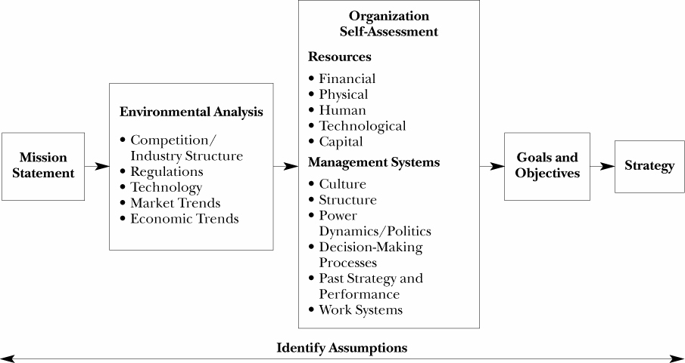
Process of Strategic Management

Slide 9
Week
1- Define Mission Statement
A statement that explains in very simple terms the organization’s purpose and reason for existence.
Mission statements are usually very broad and generally limited to no more than a couple of sentences.
Although the statement appears to be simple, it is often very difficult to construct because it serves as the foundation for everything that the organization does.
It requires those formulating it to have a clear and articulated understanding and vision of the organization and to be in consensus on what the organization is all about and why it exists in the first place.

Slide 10

Week
Microsoft Vision, Mission and Values
CH.3
Vision: To help people and businesses throughout the world realize their full potential.
Mission: Our mission is to empower every person and every organization on the planet to achieve more.
Values:
Integrity and honesty
Passion for customers, partners, and technology
Open and respectful with others and dedicated to making them better
Willingness to take on big challenges and see them through
Self-critical, questioning and committed to personal excellence and self-improvement
Accountable for commitments, results, and quality to customers, shareholders, partners and employees.

Slide 11
Week
2- Analysis of the Environment
Upon establishing a mission statement, the next step is to analyze the external environment in which the organization operates consistent with the I/O model of strategic management.
Decision makers need to analyze a variety of different components of the external organization, identify key “players” within those domains, and be very cognizant of both threats and opportunities within the environment.
Among the critical components of the external environment are competition and industry structure, government regulations, technology, market trends, and economic trends

Slide 12
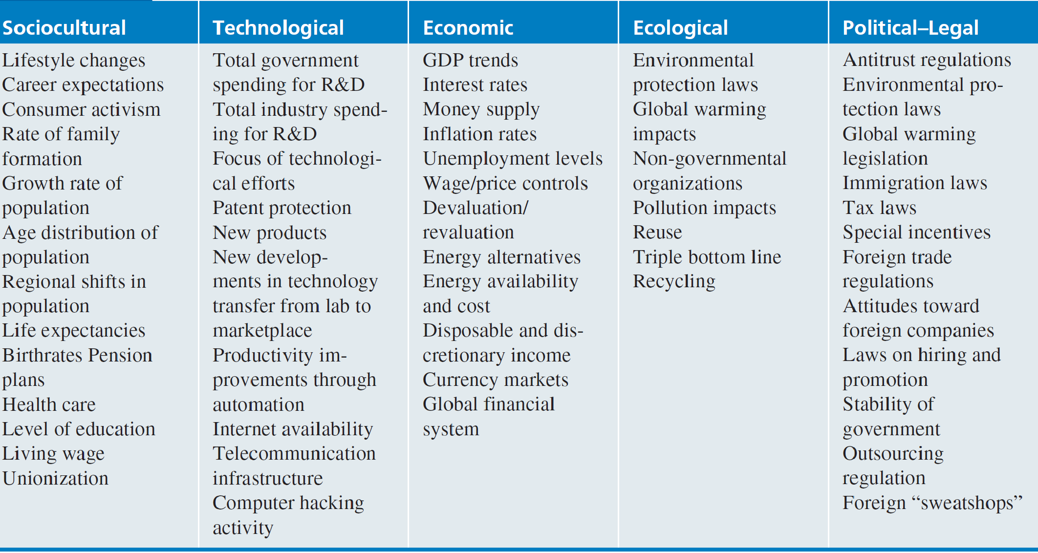
Week
Important Factors in the External Environment

Slide 13
3- Organization Self-Assessment
After analyzing external threats and opportunities, companies need to look inward. This internal assessment, the third stage of strategic management, focuses on identifying strengths and weaknesses. The goal is to leverage strengths (as highlighted by the RBV theory) and address weaknesses to maximize success. This involves examining both the resources available and the internal processes that govern how the company operates.

Slide 14
Organization Self-Assessment- Internal Resources
Financial Resources
Physical
Resources
Technological
Resources
Human Resources
Capital Resources
The ability to generate or borrow funds allows companies to invest in other assets and influence overall performance.
Includes tangible assets like machinery, facilities, and location. These resources can vary greatly depending on the industry (e.g., a manufacturing plant vs. an e-commerce business).
Intangible assets like brand reputation, customer relationships, goodwill. Can be more sustainable sources of advantage because they're
often harder for competitors to replicate.
Employees' skills, knowledge, and motivation are crucial for success. The organization's commitment to its workforce also plays a role.
The processes and technologies used for production can impact cost structures and efficiency. Protecting these processes through patents can be a valuable advantage.

Slide 15
Organization Self-Assessment- Internal management systems
Culture: Understanding the company's core values and how they impact employee behavior is crucial. These values can be unspoken assumptions that guide daily activities.
Structure: The organizational structure defines how work is done, how departments interact, and who's accountable. Different structures suit different strategic goals, so choosing the right one can be a catalyst for success.
Power Dynamics & Politics: It's important to identify who truly holds power and how political maneuvering influences decision-making. Power doesn't always reside with high-ranking positions, and understanding these dynamics is key.
.

Slide 16
Organization Self-Assessment- Internal management systems
Decision-Making Processes: Efficient decision-making is vital. Analyzing who makes decisions, who's involved, information flow, and speed of decision-making helps identify potential roadblocks or competitive advantages.
Past Strategy & Performance: Examining past strategic initiatives and their outcomes allows companies to learn from successes and failures, identify what worked and what didn't, and adapt future strategies accordingly.
Work Systems: These involve designing jobs and assigning responsibilities to achieve goals. This includes ensuring a good fit between job requirements and employee skills, and considering if training current employees or seeking external hires is necessary to meet future needs.

Slide 17
Organization Self-Assessment- Internal management systems
1
Culture
Understanding the company's core values and how they impact employee behavior is crucial.
2
Structure
The organizational structure defines how work is done, how departments interact, and who's accountable.
3
Power& Politics
Who truly holds power and how political maneuvering influences decision-making
4
Decision Making
Efficient decision-making is vital. Analyzing who makes decisions, who's involved, information flow, and speed of decision-making
5
Past strategy
Examining past strategic initiatives and their outcomes allows companies to learn from successes and failures
6
Work systems
designing jobs and assigning responsibilities to achieve goals

Slide 18
4- Establishing Goals and Objectives
Following Mission & Analysis: Goals are established after defining the organization's mission, analyzing the external environment (opportunities & threats), and assessing internal resources & management systems (strengths & weaknesses).
Specificity & Measurement: Goals should be clear and measurable. Deciding how performance will be measured is crucial when setting goals, as achieving them without a way to track progress is pointless.

Slide 19
4- Establishing Goals and Objectives
Flexibility & Adaptation: Goals need to be flexible. Since the future is uncertain, overly rigid goals can become unrealistic. They should be adaptable based on how external events unfold. Upward or downward adjustments may be necessary.
Strategic Vision in Volatile Environments: Highly volatile environments might benefit more from a long-term strategic vision, which is less detailed and formal than strategic plans but still guides daily decision-making at all levels.

Slide 20
5. Setting Strategy
Strategy After Goals: Once goals are defined, the organization determines its strategy – the specific actions and overall approach to achieve those goals.
HR's Role in Strategy: The HR department plays a crucial role throughout strategic management. Their involvement is essential for successful planning and implementation.
HR Strategy Alignment: Strategic choices need to be translated into a general HR strategy. This ensures alignment between the overall organizational strategy and specific HR practices, policies, and programs.

Slide 21
5. Setting Strategy
Fit Between Strategies: The ideal HR strategy creates a "fit" by aligning individual HR programs and policies with the broader corporate strategy.
Uniqueness Matters: There's no one-size-fits-all approach to HR strategy. Each organization is unique, and "best practices" should be evaluated based on their specific context and needs.

Slide 22
Corporate Strategies
Different corporate strategies require different approaches to Human Resources (HR). Here's a breakdown:
Types of Strategies & HR Needs:
Growth Strategy: Focuses on expanding the company. HR challenges include:
  Hiring and training new employees quickly.
  Communicating promotion and development opportunities to existing employees.
  Maintaining quality standards during rapid growth.
Stability Strategy: Aims to maintain the current state. The main HR challenge is limited employee opportunities due to lack of growth. Retention strategies are crucial.

Slide 23
Corporate Strategies
Turnaround Strategy:
Aims to downsize or streamline operations. Key HR challenges are:
  Cost reduction, often through layoffs. This requires careful legal compliance.
  Managing "survivors" - employees who remain after layoffs. They may be demoralized and require support to maintain productivity.
HR's Role in Different Strategies:
HR plays a vital role in adapting its programs to each strategy.
Growth requires HR to focus on recruitment, training, and development.
Stability requires retention strategies to keep employees engaged.
Turnaround situations necessitate managing layoffs ethically and supporting remaining employees through a difficult period.

Slide 24
Corporate Strategies
Growth
Stability
Turnaround or Retrenchment
Expanding internally (hiring more) or externally (acquisitions).
HR challenges include:
Planning for new hires and training.
Keeping employees informed about growth opportunities.
Maintaining performance and quality.
Merging HR systems and cultures (for acquisitions) - this can lead to layoffs.
Organizations maintain the status quo, often resulting in limited upward mobility opportunities for employees that can lead to turnover.
HR challenges include:
Key employees should be identified and retention strategies developed.
Organizational downsizing or down scoping may lead to cost cutting in payroll/HR.

Slide 25
Best Buy’s Turnaround Strategy: From Decline to Revival
Introduction:
In 2012, Best Buy faced a critical situation. Their stock price had plummeted, and the rise of online retailers and competitor strategies threatened their business model. They needed a turnaround strategy to stay afloat.

Slide 26
Best Buy’s Turnaround Strategy: From Decline to Revival
Challenges:
Showrooming: Customers browsed products in-store but purchased them online for lower prices.
Online Discounting: Online retailers offered deep discounts without the overhead costs of physical stores, making competition fierce.
The Apple Experience: Apple's retail experience provided highly trained staff and encouraged customer interaction with products, making Best Buy's approach seem outdated.
Weak Customer Loyalty: There was little incentive for customers to build relationships with Best Buy, hindering repeat business.

Slide 27
Best Buy’s Turnaround Strategy: From Decline to Revival
Solutions:
Enhanced Customer Service: Best Buy planned to invest in employee training to improve customer service skills and incentivize sales associates to close deals during browsing.
Cost Reduction & Price Matching: Closing stores and reducing staff aimed to cut costs by $800 million, allowing Best Buy to pass savings on to customers and compete with online discounts.
Product Focus Shift: Remodeling stores and prioritizing high-demand products like tablets and smartphones would cater to changing consumer preferences.
Loyalty Program Expansion: Expanding the existing program with free shipping and a price match guarantee aimed to attract and retain customers.
By addressing these challenges head-on, Best Buy's turnaround strategy aimed to regain a competitive edge in the evolving retail landscape.

Slide 28
Business Unit Strategies
Cost Leadership:
Aims to be the most efficient competitor, offering lower prices.
This strategy works best when:
Customers are highly price-sensitive.
Products or services are perceived as similar across brands.
Differentiation: Focuses on creating unique products or services that command premium prices and brand loyalty.
Focus Strategy: Targets a specific market segment with unique needs.

Slide 29
Business Unit Strategies
HR Implications for Each Strategy:
Cost Leadership:
  HR focuses on short-term performance measures and efficiency.
  Jobs are specialized, with cross-training during downtime.
  Incentives might encourage employee departures, especially high-salary managers.
Differentiation:
  HR incentivizes creativity and innovation to distinguish the product/service.
  Performance measures focus on long-term brand building.
  Staffing may prioritize external hiring for fresh perspectives.
Focus Strategy:
  HR ensures employees understand the target market's unique needs.
  Training and customer satisfaction are critical.
  Hiring may target individuals who share the target market's characteristics.

Slide 30
Business Strategies
Cost Leadership
Differentiation
Differentiation Focus
Focuses on being the most efficient and cheapest producer.
HR prioritizes short-term cost-cutting over long-term employee development.
Specialized jobs with less need for broad skills.
Cross-training employees. Incentives for higher-paid employees to leave (e.g., early retirement packages).
Assumes that different market segments have different needs, and attempts to satisfy particular groups.
Employees must be aware of what makes that particular market unique, and should be appropriately trained to ensure customer satisfaction.
Standing out from competitors through unique products, services, or brand image.
Use premium pricing based on the perceived value.
Performance metrics focus on long-term goals like brand loyalty.
May Emphasize external recruitment to bring in fresh ideas and creativity.
Train existing staff less on cost-cutting and more on understanding the unique value proposition.

Slide 31
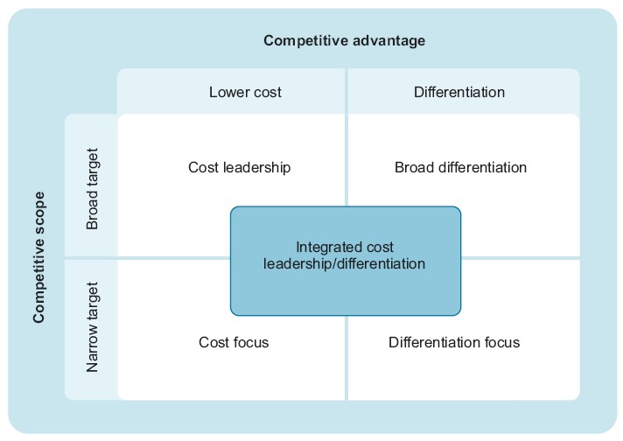
Business Strategies

Slide 32

General Electric Cost Differentiation Strategy
General Electric (GE) serves as a prime example of a company that successfully implemented a value cost leadership strategy. In the 1990s, GE faced challenging economic times, prompting them to re-evaluate their strategies.
Instead of solely focusing on cost reduction, GE adopted a more comprehensive approach that emphasized improving product and service quality while cutting unnecessary expenses.

Slide 33
General Electric Cost Differentiation Strategy
This strategy involved initiatives such as:
Design for manufacturability: Redesigning products for ease of manufacturing to reduce production costs.
Supply chain management: Optimizing the supply chain to minimize inventory and transportation costs.
Targeted cost reduction: Focusing on reducing expenses in non-core areas while protecting investments in innovation and quality.

Slide 34
General Electric Cost Differentiation Strategy
Outcomes of the Value Cost Leadership Strategy:
The value cost leadership strategy led to a significant transformation for GE:
Improved financial performance: GE's profits saw a significant increase after implementing this strategy.
Enhanced customer satisfaction: Customer satisfaction with GE's products and services rose.
Maintained innovation: GE continued to invest in research and development, leading to new innovations.

Slide 35
Business Unit Strategies
Additional Business Unit Strategy Framework:
This framework categorizes strategies by "logics of control":
Investment Logic: Focuses on adapting to changing markets.
  HR utilizes loose control and minimal rules to encourage adaptability.
  Jobs are broadly defined, and compensation rewards initiative and creativity.
Inducement Logic: Focuses on cost control and efficiency.
  HR uses tight controls like budgets and reports to manage day-to-day operations.
  Jobs are narrowly defined for maximum efficiency.
  Loyalty and commitment are rewarded to reduce turnover.

Slide 36
Business Unit Strategies
Additional Business Unit Strategy Framework:
Involvement Logic: Balances cost control with innovation.
  HR adopts a mix of practices from Investment and Inducement logics.
In conclusion, HR strategy needs to be aligned with the specific business unit strategy to achieve optimal results.

Slide 37
Business Unit Strategies
Innovation as a Driver:
Innovation can fuel growth, turnaround efforts, and even retrenchment strategies seeking new ways to operate.
Innovation & Existing Strategies:
Cost leadership, differentiation, and focus strategies can all benefit from or even require innovation.
Innovation as a Competency: Some companies, like Procter & Gamble, view innovation as a core skill and assess it in new hires.

Slide 38
The Privatization Decision as Part of Strategy
Public vs. Private Ownership:
Typical Path: Most companies start private and then go public (IPO) to raise capital for growth.
Newer Trend: Publicly traded companies are increasingly choosing to go private.
Reasons for Going Private:
Dissatisfaction with Wall Street: Executives may feel their stock is undervalued and analysts' demands are burdensome.
Compliance Costs: Increased regulations like Sarbanes-Oxley Act have made being public more expensive.
While privatization is a significant decision, it's not a complete strategy itself. It's a choice made within the context of a company's overall strategic direction.

Slide 39
HR Challenges: Public vs. Private Organizations
Public organizations face stricter HR constraints due to bureaucratic red tape and government regulations, limiting their flexibility compared to private companies.
However, this doesn't negate the possibility of innovation in public Organizations. By strategically applying creative practices, public organizations can still achieve significant improvements in effectiveness and efficiency.

Slide 40

Case Study: Abu Dhabi National Oil Company (ADNOC)
Introduction:
The Abu Dhabi National Oil Company (ADNOC), established in 1962, is a leading integrated oil and gas company headquartered in Abu Dhabi, United Arab Emirates. As a key driver of the UAE's economy, ADNOC plays a critical role in the global energy sector. It boasts a significant production capacity, with ambitions to further increase its output in the coming years.

Slide 41
Case Study: Abu Dhabi National Oil Company (ADNOC)
Main Challenges:
Despite its success, ADNOC faces several challenges in today's dynamic energy landscape:
Global Oil Price Fluctuations: The oil and gas industry is susceptible to volatile market conditions. ADNOC needs to navigate price fluctuations to ensure financial stability.
Shifting Energy Landscape: The growing focus on renewable energy sources and environmental sustainability presents a long-term challenge for ADNOC's core business.
Talent Acquisition and Retention: Attracting and retaining top talent in a competitive global market is crucial for ADNOC's continued success and technological advancement.

Slide 42
Case Study: Abu Dhabi National Oil Company (ADNOC)
Strategy: The Abu Dhabi National Oil Company (ADNOC) implemented its "Talent 2030" strategy to develop its human capital and ensure global competitiveness. This strategy includes the following elements:
Attracting Global Talent: ADNOC offers competitive salaries and benefits, professional development programs, and flexible work opportunities to attract top talent from around the world.
Developing Local Talent: ADNOC focuses on developing the skills and capabilities of Emirati citizens through training and education programs, mentorship initiatives, and vocational training.
Building a Performance Culture: ADNOC fosters a culture of high performance and accountability, rewarding employees for their achievements.
Enhancing Innovation: ADNOC incentivizes employees to innovate through incentive programs and provides them with the resources to experiment with new ideas.

Slide 43
Conclusion
Importance of Strategy Alignment
Strategy Models
The process of Strategic Management
Corporate Strategies
Business Strategies
New framework for Business Unit Strategies
New Trends in setting strategies

Slide 44
Week
01
References
Main Reference
Mello A .Jeffrey (2011). Strategic Management of Human Resources (3rd ed.) South-Western Cengage Learning.
Additional Resources for extra reading.
Boselie, Paul (2014). Strategic Human Resource Management: A Balanced Approach .McGraw Hill Companies.
Millmor, Mike, Philip Lewis, and others (2007), Strategic Human Resource Management Contemporary issues. Ft Prentice Hall.

Slide 45



Thank You

