Slide 1





Critical Thinking
Prepared by Dr. Ahmed Alqarni
Lecture 7
MGM115
Critical Thinking

Slide 2


Lecture 7
Categorical and Propositional Logics
Mostly from Critical Thinking, Bassham and others

Slide 3
Lecture7
Categorical and Propositional Logics
This lecture includes:
CATEGORICAL STATEMENTS
PROPOSITIONAL LOGIC

Slide 4
Lecture 7
CATEGORICAL STATEMENTS
A categorical statement makes a claim about the relationship between two or more categories or classes of things. In this lecture we look at what are called standard-form categorical statements, which have one of the following
four forms:
All S are P. ( Example: All Democrats are liberals.)
No S are P. ( Example: No Democrats are liberals.)
Some S are P. ( Example: Some Democrats are liberals.)
Some S are not P. ( Example: Some Democrats are not liberals.)

Slide 5
Lecture 7
CATEGORICAL STATEMENTS
Logicians have discovered a number of techniques to test the validity of simple categorical arguments. The easiest method involves drawing a series of overlapping circles and associated markings called Venn diagrams.
Suppose we wish to draw a Venn diagram of the statement “All Democrats are liberals.” We start by drawing a circle to stand for the class of Democrats:

Slide 6
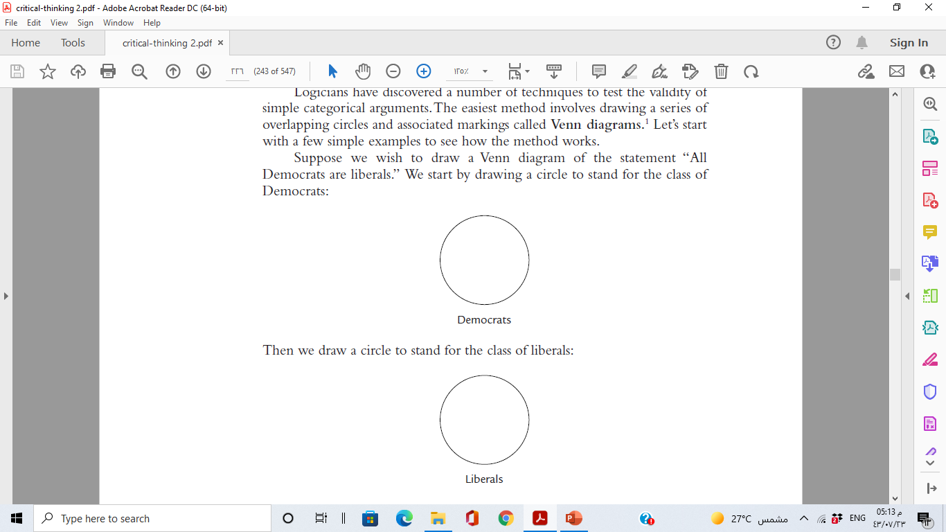
Lecture 7
CATEGORICAL STATEMENTS
The first circle includes anyone who is a Democrat; the second circle includes anyone who is a liberal.
Next we need to connect the two circles to indicate that the two classes are being related to each other in the statement. We do this by drawing the circles so that they partially overlap:

Slide 7
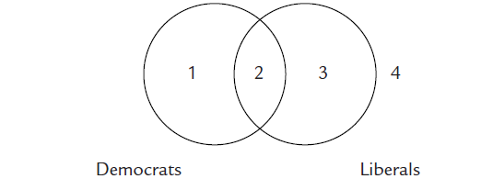
Lecture 7
CATEGORICAL STATEMENTS
Anything in area 1 is a Democrat but not a liberal. Anything in area 2 is both a Democrat and a liberal. Anything in area 3 is a liberal but not a Democrat.
And anything in area 4, the area outside the two circles, is neither a Democrat nor a liberal.

Slide 8
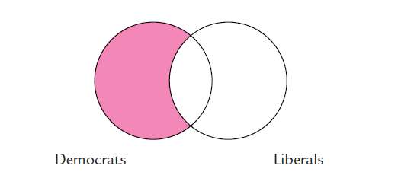
Lecture 7
CATEGORICAL STATEMENTS
Finally, we need some way to represent the asserted relationship between these two classes, namely, that all members of the class of Democrats are also members of the class of liberals. To do this we shade that part of the Democrats circle that does not overlap with the Liberals circle:

Slide 9
Lecture 7
CATEGORICAL STATEMENTS
The shading means that that part of the Democrats circle that does not overlap with the liberals circle is empty; that is, it contains no members. The diagram thus asserts that there are no Democrats who are not liberals. This is what we mean when we say that all Democrats are liberals.

Slide 10
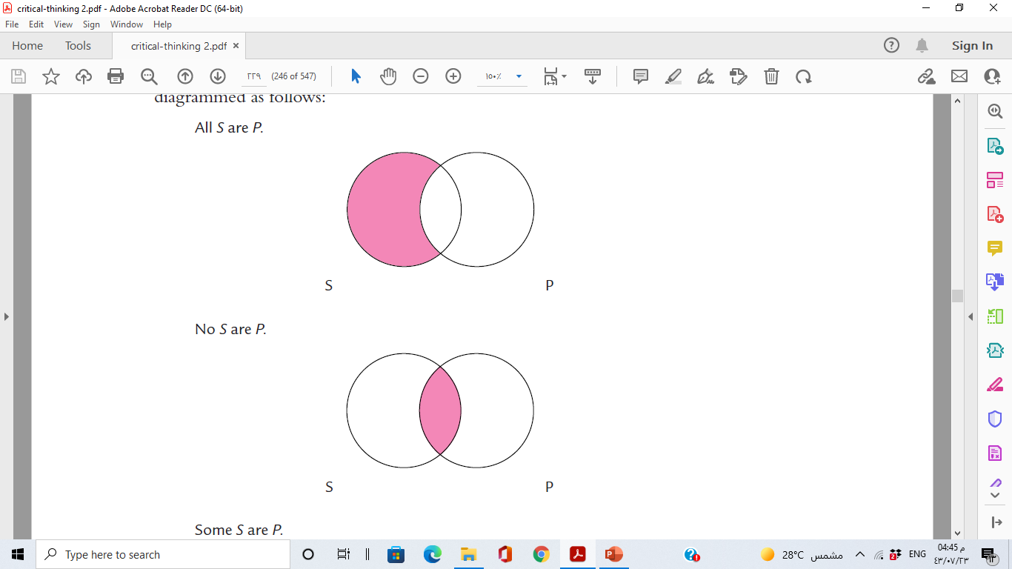
Lecture 7
CATEGORICAL STATEMENTS
In summary, the four kinds of standard-form categorical statements are diagrammed as follows:

Slide 11
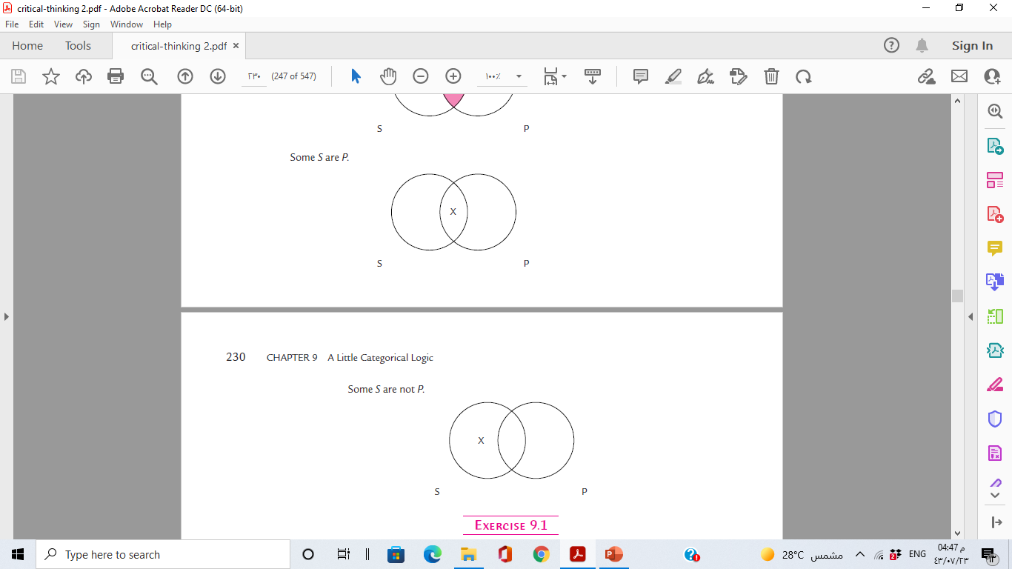
Lecture 7
CATEGORICAL STATEMENTS

Slide 12
Lecture 7
TRANSLATING INTO STANDARD CATEGORICAL FORM
Standard-form categorical statements have a very simple logical structure. Here, once again, are the four standard categorical forms:
All S are P.
No S are P.
Some S are P.
Some S are not P.

Slide 13
Lecture 7
TRANSLATING INTO STANDARD CATEGORICAL FORM
Notice that each of these statement forms has four basic parts:
They all begin with the word all, no, or some. These words are called quantifiers because they are used to express a quantity or a number.
2. They all have a subject term —a word or phrase that names a class and that serves as the grammatical subject of the sentence. In these statement forms, the subject term is represented by S.

Slide 14
Lecture 7
TRANSLATING INTO STANDARD CATEGORICAL FORM
3. They all have a predicate term —a word or phrase that names a class and that serves as the subject complement of the sentence. In these statement forms, the predicate term is represented by P.
4. They all have a copula, or linking verb, which is some form of the verb to be. The copula serves to link, or join, the subject term with the predicate term.

Slide 15
Lecture 7
CATEGORICAL SYLLOGISMS
A syllogism is a three-line deductive argument—that is, a deductive argument that consists of two premises and a conclusion. In a categorical syllogism, all the statements in the argument are categorical statements. Here are several examples of categorical syllogisms:
No doctors are professional wrestlers.
All cardiologists are doctors.
So, no cardiologists are professional wrestlers.

Slide 16
Lecture 7
CATEGORICAL SYLLOGISMS
All snakes are reptiles.
All reptiles are cold-blooded animals.
So, all snakes are cold-blooded animals.

Slide 17
Lecture 7
CATEGORICAL SYLLOGISMS
We see how Venn diagrams can be used to test the validity of categorical syllogisms. Let’s take this example:
No doctors are professional wrestlers.
All cardiologists are doctors.
So, no cardiologists are professional wrestlers.

Slide 18
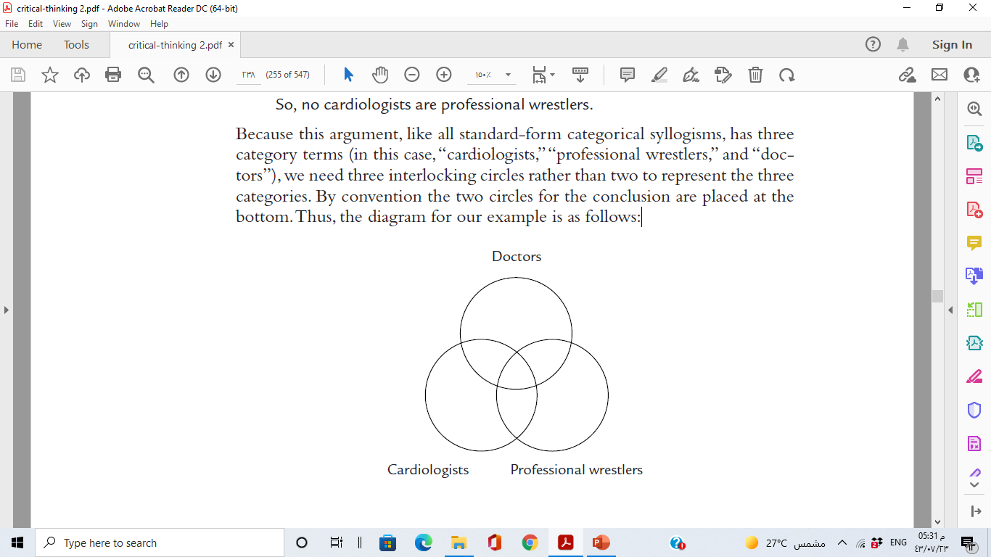
Lecture 7
CATEGORICAL SYLLOGISMS
Because this argument, like all standard-form categorical syllogisms, has three category terms (in this case, “cardiologists,” “professional wrestlers,” and “doctors”), we need three interlocking circles rather than two to represent the three categories. By convention the two circles for the conclusion are placed at the bottom. Thus, the diagram for our example is as follows:.

Slide 19
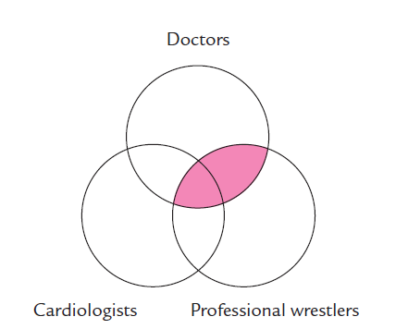
Lecture 7
CATEGORICAL SYLLOGISMS
The first premise states that no doctors are professional wrestlers. To represent this claim, we shade that part of the Doctors circle that overlaps with the Professional wrestlers circle:

Slide 20
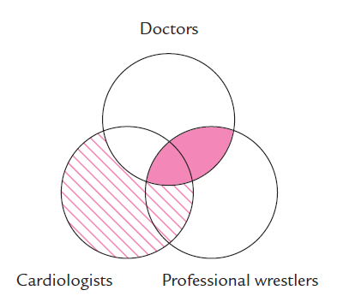
Lecture 7
CATEGORICAL SYLLOGISMS
The second premise states that all cardiologists are doctors. To represent this claim, we shade that part of the Cardiologists circle that does not overlap
with the Doctors circle:

Slide 21
Lecture 7
CATEGORICAL SYLLOGISMS
We now have all the information we need to see whether the argument is valid. The conclusion tells us that no cardiologists are professional wrestlers. This means that the area where the Cardiologists and Professional wrestlers circles overlap is shaded, that is, empty. We look at the diagram to see if this area is shaded, and we see that it is indeed shaded. That means that the conclusion is implicitly “contained in” (i.e., follows logically from) the premises. Thus, the argument is shown to be valid.

Slide 22
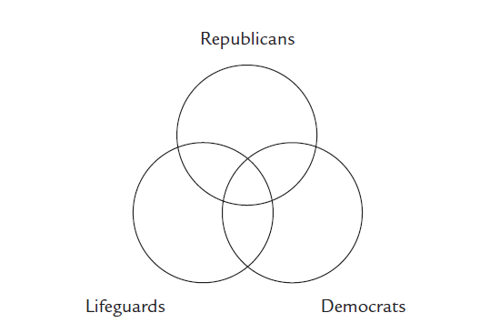
Lecture 7
CATEGORICAL SYLLOGISMS
Another example:
No Democrats are Republicans.
Some lifeguards are Republicans.
So, some lifeguards are not Democrats.
First we draw and label the three circles:

Slide 23
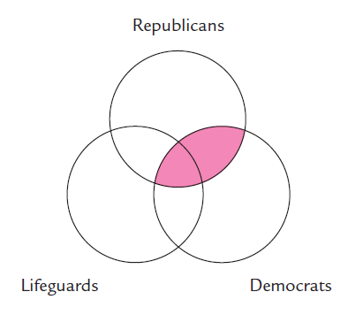
Lecture 7
CATEGORICAL SYLLOGISMS
Because one premise begins with no and one begins with some, we start by diagramming the premise that begins with no. That premise states that no Democrats are Republicans. To represent this information, we shade that part of the Democrats circle that overlaps with the Republicans circle:

Slide 24
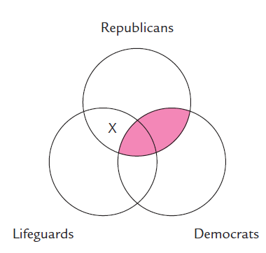
Lecture 7
CATEGORICAL SYLLOGISMS
The second premise states that some lifeguards are Republicans. To diagram this claim, we place an X in the area of the Lifeguards circle that overlaps with the Republicans circle. Because part of this area is shaded, we place the X in that part of the area that is not shaded:

Slide 25
Lecture 7
CATEGORICAL SYLLOGISMS
Finally, we look at the completed diagram to see if the claim made in the conclusion is represented in the diagram. The conclusion states that some lifeguards are not Democrats. This means that there should be an X in that
part of the Lifeguards circle that does not intersect with the Democrats circle.
Inspection of the diagram shows that there is an X in this area. Thus, the argument is shown to be valid.

Slide 26
Lecture 7
PROPOSITIONAL LOGIC
In coming slides, we learn the basics of propositional logic, a way to symbolize the parts of arguments so that we can analyze whole arguments for validity.

Slide 27
Lecture 7
CONJUNCTION
A statement is a sentence that can sensibly be regarded as either true or false. A simple statement consists of just one sentence that sensibly can be regarded as either true or false—for example, “Tina is tall.” A compound statement consists of two or more statements, each of which can separately be considered either true or false—for example, “Tina is tall, and Sarah is tall.”
Sometimes the premise or the conclusion of an argument is a simple statement, such as “Tina is tall.” We can easily symbolize a simple statement
by assigning it a variable. Let’s assign “Tina is tall” the variable p. If the argument contains a second simple statement—for example, “Sarah is tall”—we can symbolize it by assigning it a different variable. Let’s assign “Sarah is tall” the variable q.

Slide 28
Lecture 7
CONJUNCTION
Let’s assume that we do not know whether our premises are true or false. In that case, each of the variables has two possible truth values; that is, each variable could be true or it could be false. With that in mind, we can now set up a truth table for each variable. A truth table is just a list of all possible truth values.

Slide 29
Lecture 7
CONJUNCTION
The truth table for p is
p
T
F
The truth table displays the information that p is either true or false.
We can do the same now for our second variable, q:
q
T
F

Slide 30
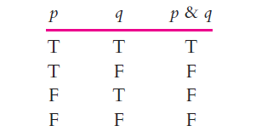
Lecture 7
CONJUNCTION
Now we are ready to determine the truth values for p & q. The compound statement p & q is true only when both of its variables stand for true simple statements.

Slide 31
Lecture 7
CONJUNCTION
In propositional logic any word that conjoins two simple statements is symbolized by the ampersand, &. For the purposes of propositional logic, then, all these words are equivalent and can be symbolized by the ampersand: and, but, yet, while, whereas, although, though, and however.

Slide 32
Lecture 7
CONJUNCTION
The following compound statements are all correctly symbolized as p & q:
Tony had steak, and Theresa had chicken.
Tony had steak, but Theresa had chicken.
Tony had steak, yet Theresa had chicken.
Tony had steak, while Theresa had chicken.
Tony had steak, whereas Theresa had chicken.
Tony had steak, although Theresa had chicken.
Tony had steak, though Theresa had chicken.
Tony had steak; however Theresa had chicken.

Slide 33
Lecture 7
CONJUNCTION AND VALIDITY
We can symbolize the argument as follows (in propositional logic the symbol ؞simply indicates that the conclusion follows):
p
q
؞ p & q

Slide 34
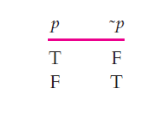
Lecture 7
NEGATION
Negation is simply the use of the word not (or an equivalent word or phrase) to deny a statement. Let’s return to the simple statement “Tina is tall.” The negation of this simple statement would be “Tina is not tall.” If we symbolize “Tina is tall” by assigning it the variable p , we need a convenient way of symbolizing the negation of p , “not p. ” The conventional symbol for negation is the tilde, ˜. So, we can symbolize “Tina is not tall” with ˜ p.

Slide 35
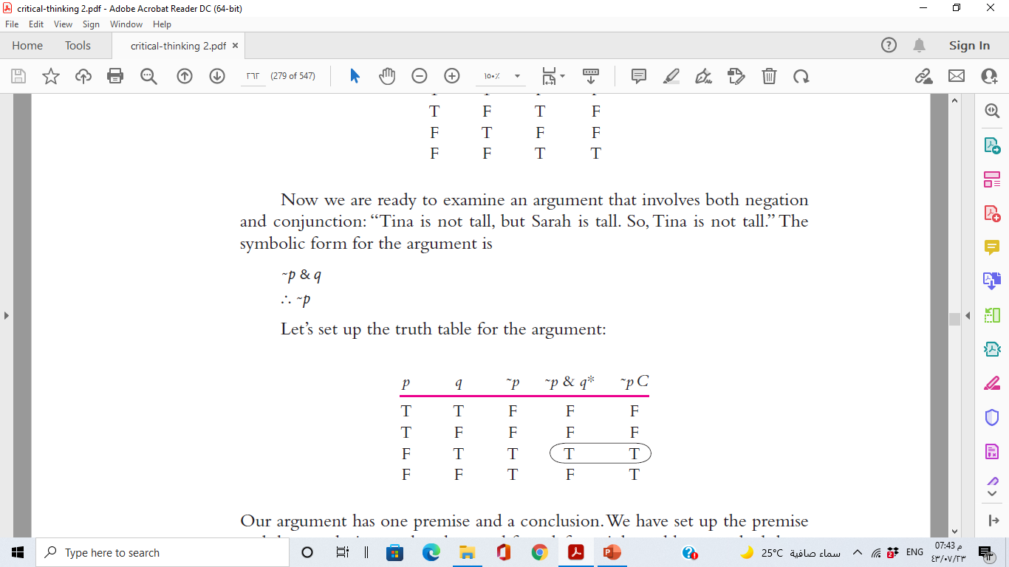
Lecture 7
NEGATION
Now we are ready to examine an argument that involves both negation
and conjunction: “Tina is not tall, but Sarah is tall. So, Tina is not tall.” The symbolic form for the argument is

Slide 36
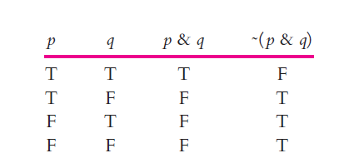
Lecture 7
NEGATION
if p & q is true, we know that ˜( p & q ) is false. Thus, in forming the truth table for ˜( p & q ), we first list the truth values for p & q , then we assign the opposite truth values to ˜( p & q ).

Slide 37
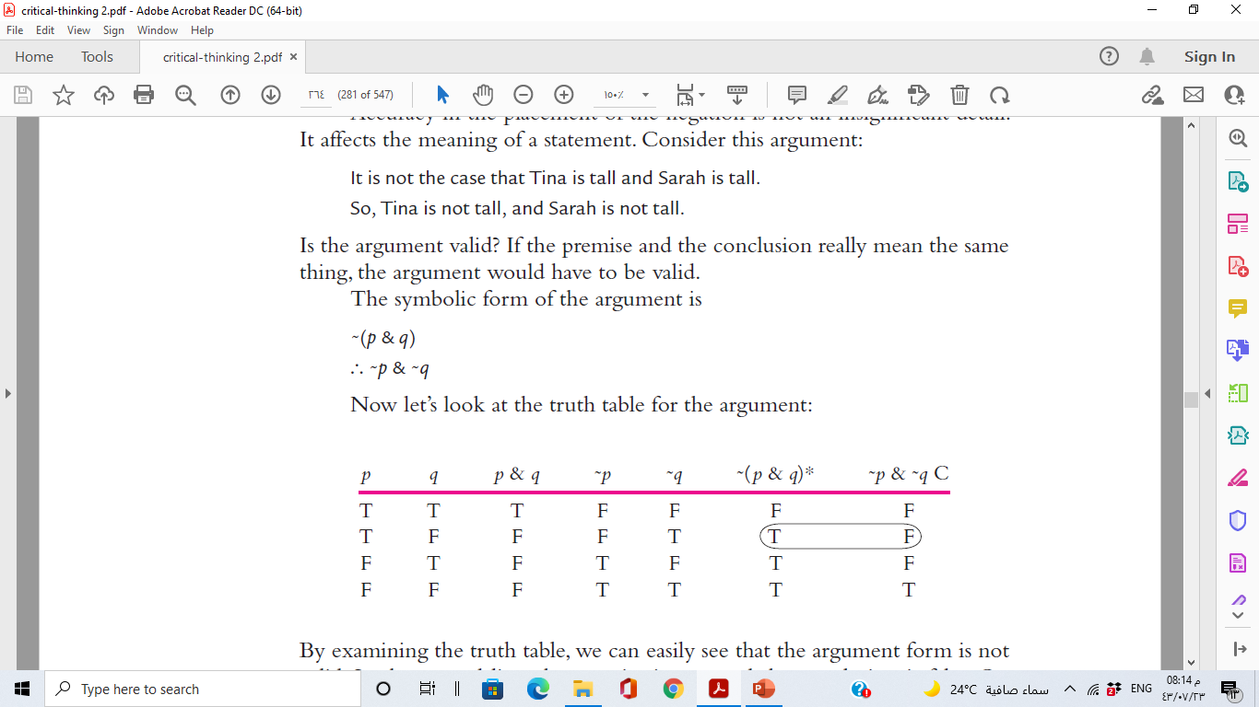
Lecture 7
NEGATION

Slide 38
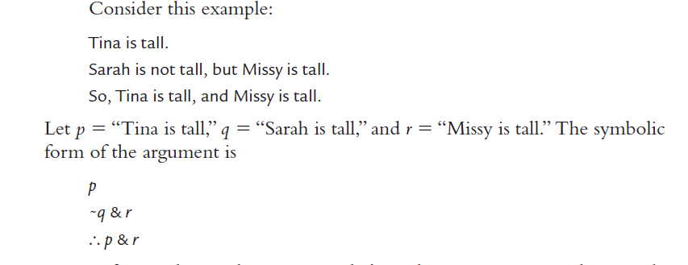
Lecture 7
DEEPER ANALYSIS OF NEGATION AND CONJUNCTION

Slide 39
Lecture 7
DEEPER ANALYSIS OF NEGATION AND CONJUNCTION
The validity of an argument with three variables is determined in the same way as the validity of an argument with two variables. There simply are eight lines to check instead of four. If there is any line in which all the premises are true and the conclusion is false, we know the argument is invalid. If there is no such line, we know the argument is valid.

Slide 40
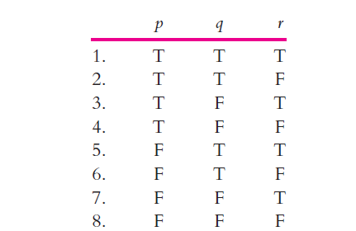
Lecture 7
DEEPER ANALYSIS OF NEGATION AND CONJUNCTION
First step:

Slide 41
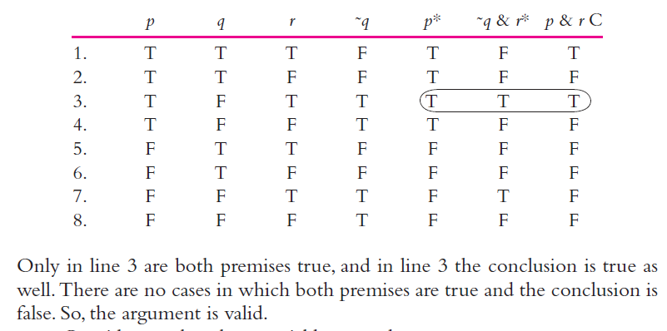
Lecture 7
DEEPER ANALYSIS OF NEGATION AND CONJUNCTION

Slide 42
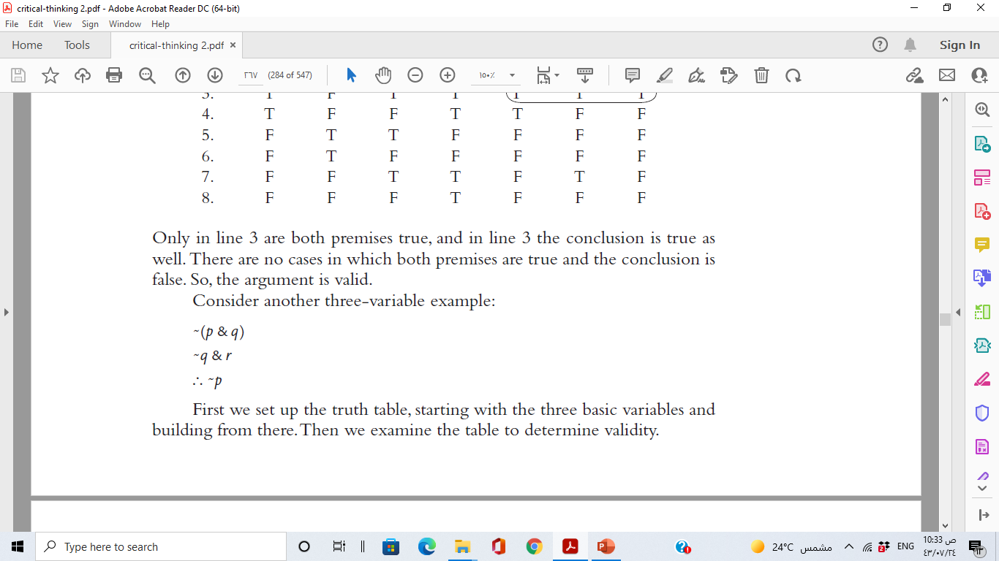
Lecture 7
DEEPER ANALYSIS OF NEGATION AND CONJUNCTION

Slide 43
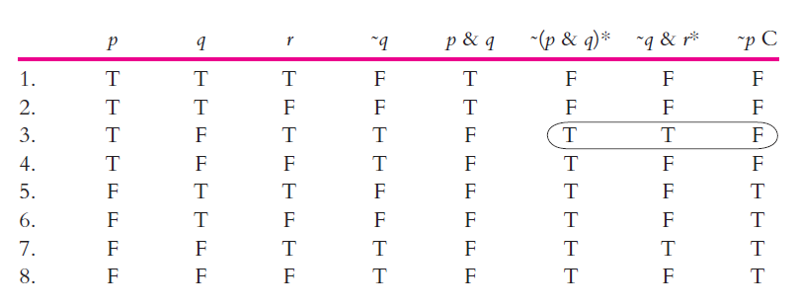
Lecture 7
DEEPER ANALYSIS OF NEGATION AND CONJUNCTION
To determine the validity of the argument, we look for any cases in which both of the premises are true and the conclusion is false. In line 3 both of the premises are true and the conclusion is false. From this line alone we know that the argument is invalid. It does not matter that in line 7 both of the premises are true and the conclusion is true.

Slide 44
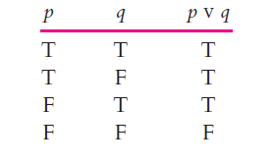
Lecture 7
DISJUNCTION
A disjunction, such as “Frank is angry or Hank is tired,” is true if either Frank is angry or Hank is tired, or both. We can symbolize the disjunction as p v q , and the truth table for the disjunction is as follows:
The truth table shows that the only case in which p v q is false is the final line, in which both p is false and q is false.

Slide 45
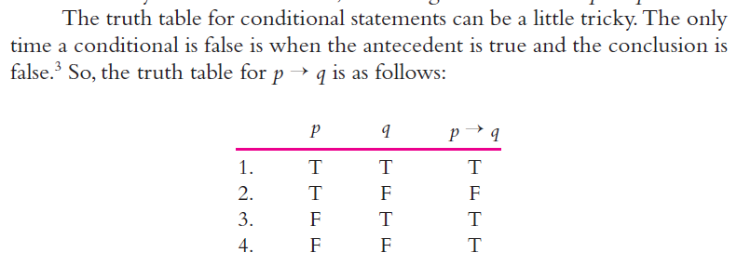
Lecture 7
CONDITIONAL STATEMENTS
“If it rained, then the ground is wet” as p → q.

Slide 46
Lecture 7
Thank you

