Slide 1



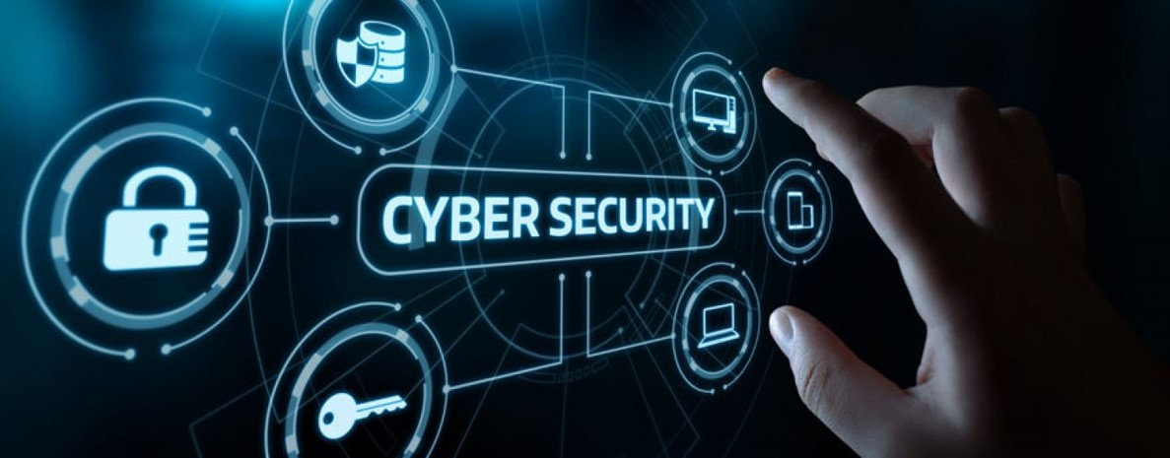

Lecture: #01
Introduction to Networks Concepts
Dr. Redhwan M. A. Saad
Head of Cybersecurity Department
Faculty of Informatics
Midocean University
CyberSecurity Fundamentals (CYB670)
www.midocean.ae

Slide 2

Outline
Lecture
01
The module covers the basics of Network Communication System including:
Transmission Media
Topology and Types of Networks
TCP/IP Protocol Stack
Wireless Network
The Internet
Cybersecurity Fundamentals, Dr. Redhwan M. A. Saad
2
www.midocean.ae

Slide 3
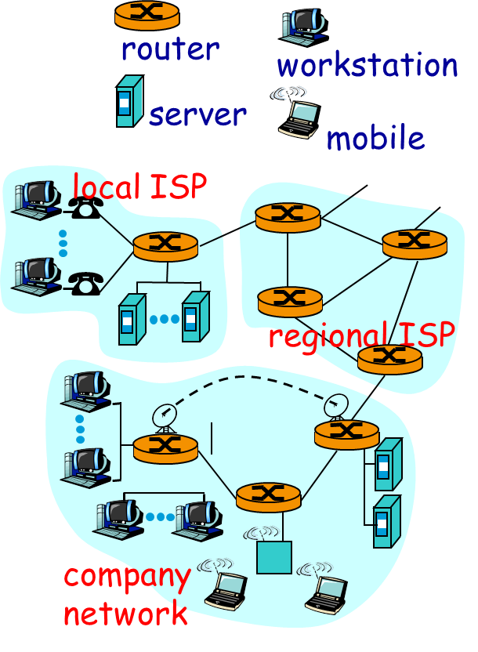
What is a Computer Network
Lecture
01
◆ A set of communication elements connected by
communication links
➭ Communication elements
● Computers, printers, mobile phones, …
● Routers, switches, ...
➭ Communication links
● optic fiber
● coaxial cable
● twisted pair
● wireless (radio, microwave, satellite)
➭ Topologies
● Ring, Star, Bus, Tree, Mesh
Cybersecurity Fundamentals, Dr. Redhwan M. A. Saad
3
www.midocean.ae

Slide 4
What is a Computer Network
Lecture
01
◆ A software/hardware infrastructure
➭ Share resources
● data, files, computing power, video,…
➭ Information highway
● communication between geographically dispersed users
➭ Electronic Society
● Cyberspace
● Virtual global nation
Cybersecurity Fundamentals, Dr. Redhwan M. A. Saad
4
www.midocean.ae

Slide 5
Uses of Computer Networks
Lecture
01
(Need for Networking)
  Business Applications
  Home Applications
  Mobile Users
  Social Issues
Cybersecurity Fundamentals, Dr. Redhwan M. A. Saad
5
www.midocean.ae

Slide 6
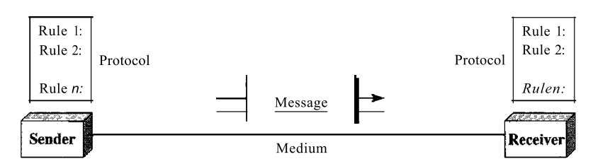
A data communications system components
Lecture
01
A data communications system has five components:
1. Message. The message is the information (data) to be communicated.
Popular forms of information include text, numbers, pictures, audio, and video.
2. Sender. The sender is the device that sends the data message. It can be a computer, workstation, telephone handset, video camera, and so on.
Cybersecurity Fundamentals, Dr. Redhwan M. A. Saad
6
www.midocean.ae

Slide 7
A data communications system components
Lecture
01
A data communications system has five components:
3. Receiver. The receiver is the device that receives the message. It can be a computer, workstation, telephone handset, television, and so on.
4. Transmission medium. The transmission medium is the physical path by which a message travels from sender to receiver. Some examples of transmission media include twisted-pair wire, coaxial cable, fiber-optic cable, and radio waves.
Cybersecurity Fundamentals, Dr. Redhwan M. A. Saad
7
www.midocean.ae

Slide 8
A data communications system components
Lecture
01
A data communications system has five components:
5. Protocol. A protocol is a set of rules that govern data communications. It represents an agreement between the communicating devices. Without a protocol, two devices may be connected but not communicating, just as a person speaking French cannot be understood by a person who speaks only Japanese.
Cybersecurity Fundamentals, Dr. Redhwan M. A. Saad
8
www.midocean.ae

Slide 9
Transmission Media
Lecture
01
All computer communication involves encoding data in a form of energy, and sending the energy across a transmission medium (i.e., the network links).
Guided and Unguided Media
Links can be categorized by the type of path used:
  Guided Media: communication follows an exact path (such as a wire)
  Unguided Media: communication follows no specific path (such as a radio transmission)
Forms of Energy
Links can be categorized by the type of energy used for transmission:
  Electrical Energy is used on wires
  Radio Frequency Transmission is used for wireless
  Light is used for optical fibers and lasers
Cybersecurity Fundamentals, Dr. Redhwan M. A. Saad
9
www.midocean.ae

Slide 10
Taxonomy by Forms of Energy
Lecture
01
Cybersecurity Fundamentals, Dr. Redhwan M. A. Saad
10
www.midocean.ae

Slide 11
Background Radiation and Electrical Noise
Lecture
01
Three important facts about wiring:
Noise (also called random electromagnetic radiation) permeates the environment.
  Even communication systems generate minor amounts of electrical noise as a side-effect of normal operation.
Noise can interfere with signals used for communication
  When it hits metal, electromagnetic radiation produces a small signal
Because it absorbs radiation, metal acts as a shield preventing noise from reaching the wiring
  Thus, placing enough metal between a source of noise and a communication medium can prevent noise from interfering
Cybersecurity Fundamentals, Dr. Redhwan M. A. Saad
11
www.midocean.ae

Slide 12
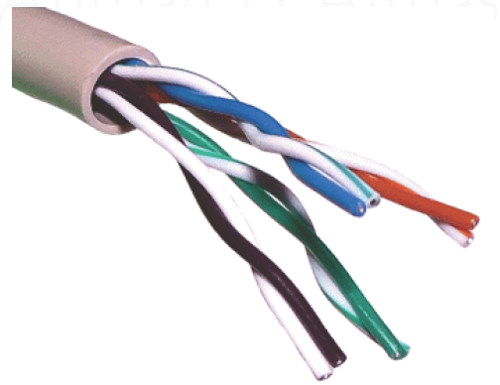
Copper Wire
Lecture
01
Example 1: Twisted pair lines
A pair of wires are twisted together (signal wire and ground reference wire).
Multiple twisted pairs can be enclosed within the same cable.
Multiple Twisted Pair Cable
Cybersecurity Fundamentals, Dr. Redhwan M. A. Saad
12
www.midocean.ae

Slide 13
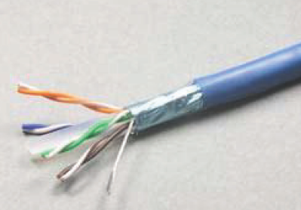
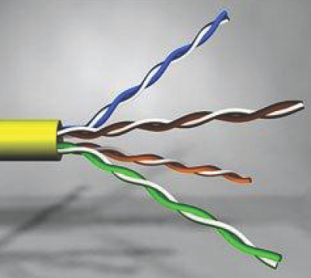
Copper Wire
Lecture
01
Example 1: Twisted pair lines
Shielded twisted pairs (STP) are also used to reduce the effects of interference.
Cat-5 is suitable for 10 - 100 Mbps for short distances (< 100m)
In telephone networks, unshielded twisted pairs (UTP) are extensively used with sophisticated driver and receiver circuits yielding higher bps over longer distances
Cybersecurity Fundamentals, Dr. Redhwan M. A. Saad
13
www.midocean.ae

Slide 14
Copper Wire
Lecture
01
Why is Twisted Pair “twisted”?
When two wires run in parallel:
there is a high probability that one of them is closer to the source of electromagnetic radiation than the other
one wire tends to act as a shield that absorbs some of the electromagnetic radiation
thus, the second wire receives less energy.
Example: In the figure, a total of 32 units of radiation strikes in each case.
In (a): the top wire absorbs 20 units, and the bottom wire absorbs 12, producing a difference of 8
In (b): each of the two wires is on top one-half of the time, which means that each wire absorbs the same amount of radiation
Cybersecurity Fundamentals, Dr. Redhwan M. A. Saad
14
www.midocean.ae

Slide 15
Copper Wire
Lecture
01
Types of Twisted Pair
One variation is known as shielded twisted pair (STP)
  The cable has a thinner, more flexible metal shield surrounding one or more twisted pairs of wires.
  In most versions of STP cable, the shield consists of metal foil, similar to the aluminum foil used in a kitchen.
Cybersecurity Fundamentals, Dr. Redhwan M. A. Saad
15
www.midocean.ae

Slide 16
Copper Wire
Lecture
01
Example 2: Coaxial cable
The shield in a coaxial cable forms a flexible cylinder around the inner wire that provides a barrier to electromagnetic radiation from any direction
The barrier also prevents signals on the inner wire from radiating electromagnetic energy
ThinNet: Supports 10-100 Mbps over ~200 meters
ThickNet: Supports 10-100 Mbps over ~500 meters
Cybersecurity Fundamentals, Dr. Redhwan M. A. Saad
16
www.midocean.ae

Slide 17
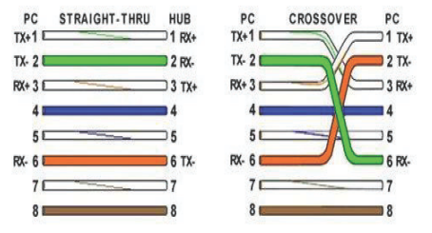
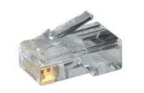
Copper Wire
Lecture
01
Connection Types for UTP & STP Cable
RJ-45 Connector
Straight cable used between different devices such as PC and Switches
Crossover Cable used between same types of devices such as Switch with Switch
Cybersecurity Fundamentals, Dr. Redhwan M. A. Saad
17
www.midocean.ae

Slide 18
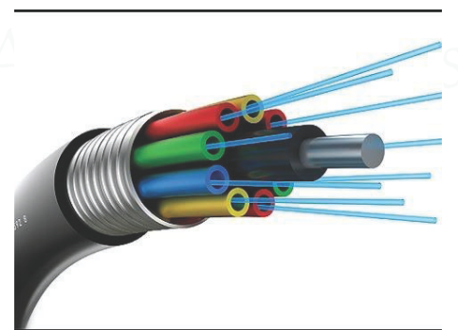
Glass Fibers (or Optical Fibers)
Lecture
01
Optical fiber:
carries the transmitted information as a fluctuating beam of light
is immune to electromagnetic interference and crosstalk
is good for security, because it is difficult to tap an optical fiber cable
supports transmission rates of hundreds of megabits per second over several kilometers.
Components:
Single glass fiber for each signal
Optical transmitter (light-emitting diode (LED) or injection diode (ILD)) converts from electrical signals to a light signal
Optical Receiver (photodiode or photo transistor) converts from light signals to electrical
Cybersecurity Fundamentals, Dr. Redhwan M. A. Saad
18
www.midocean.ae

Slide 19
Glass Fibers (or Optical Fibers)
Lecture
01
Fiber Optic Advantages
greater capacity (bandwidth of up to 2 Gbps)
smaller size and lighter weight
lower attenuation
immunity to environmental interference
highly secure due to tap difficulty and lack of signal radiation
Fiber Optic Disadvantages
expensive over short distance
requires highly skilled installers
adding additional nodes is difficult
Cybersecurity Fundamentals, Dr. Redhwan M. A. Saad
19
www.midocean.ae

Slide 20
Comparing Copper Wiring and Fiber
Lecture
01
Cybersecurity Fundamentals, Dr. Redhwan M. A. Saad
20
www.midocean.ae

Slide 21
Topology and Types of Networks
Lecture
01
Why we need a topology?
Choosing one topology over another can impact :
  type of equipment the network needs
  capabilities of the equipment
  network’s growth
  way a network is managed
Cybersecurity Fundamentals, Dr. Redhwan M. A. Saad
21
www.midocean.ae

Slide 22
Network Topology: Physical & Logical
Lecture
01
The topology of a network defines how the nodes of a network are connected.
A network is defined by a physical topology and a logical topology.
Physical topology defines how the nodes of the network are physically connected .
Logical topology dedicated connections between certain selected source-destination pairs using the underlying physical topology.
In order to have an efficient system, the logical topology should be chosen such that either the average hop distance or the packet delay or the maximum flow on any link must be minimal.
Another important issue to select the logical topology is the simplicity of the routing.
Cybersecurity Fundamentals, Dr. Redhwan M. A. Saad
22
www.midocean.ae

Slide 23
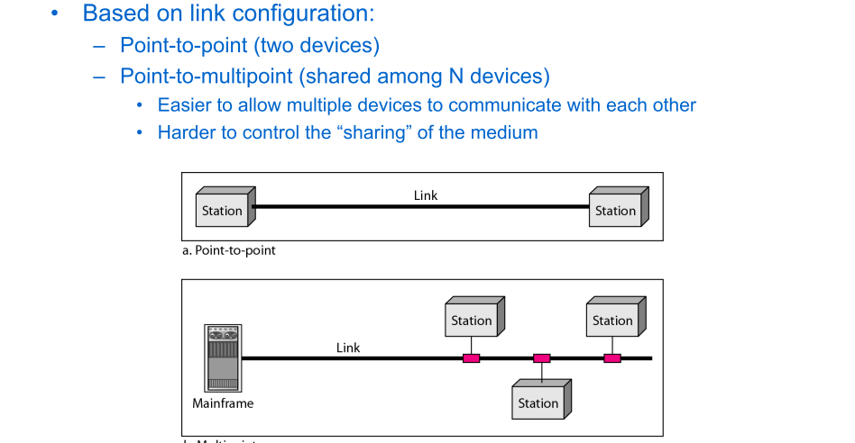
Categorizing Networks
Lecture
01
Cybersecurity Fundamentals, Dr. Redhwan M. A. Saad
23
www.midocean.ae

Slide 24
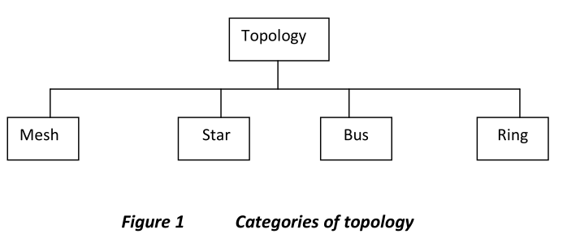
Communication Networks
Lecture
01
  The topology of a network is the geometric representation of the relationship of all the links and linking devices (usually called nodes) to one another.
Physical topology: physical layout of nodes on a network
Four fundamental shapes:
The Bus Network
Hub/Tree Network
Star Network
Ring Network
May create hybrid topologies
Topology integral to type of network, cabling infrastructure, and transmission media used
Cybersecurity Fundamentals, Dr. Redhwan M. A. Saad
24
www.midocean.ae

Slide 25
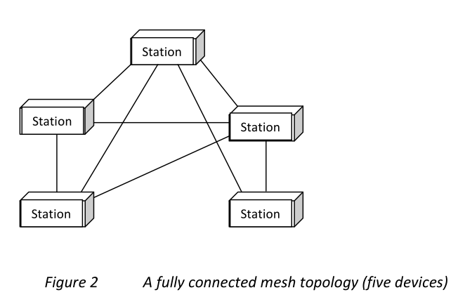
Mesh Topology
Lecture
01
  Mesh
  Every device has a dedicated point to point link to every other device.
  The term dedicated means that the link carries traffic only between the two devices it connects.
Cybersecurity Fundamentals, Dr. Redhwan M. A. Saad
25
www.midocean.ae

Slide 26
Advantages & Disadvantages of Mesh Topology
Lecture
01
  Advantages
Use of dedicated links guarantees that each connection can carry its own data load.
A mesh topology is robust.
The advantage of privacy or security
Point to point links make fault identification and fault isolation easy
This enables the network manger to discover the exact location of the fault and helps in finding its cause and solution.
  Disadvantages
The amount of cabling and that of I/O ports required: - installation and reconnection are difficult, - the wiring can be greater than the available Space, - the hardware required to connect each link
Cybersecurity Fundamentals, Dr. Redhwan M. A. Saad
26
www.midocean.ae
Notes:
Advantages: First, the use of dedicated
links guarantees that each connection can carry its own data load, thus eliminating the traffic
problems that can occur when links must be shared by multiple devices. Second, a mesh
topology is robust. If one link becomes unavailable it does not harm the entire system.
Third, there is the advantage of privacy or security. Whenever message travels along a
dedicated line, only the intended recipient sees it. Finally, point to point links make fault
identification and fault isolation easy. Traffic can be routed to avoid links with suspected
problems. This enables the network manger to discover the precise location of the fault and
aids in finding its cause and solution.

Slide 27
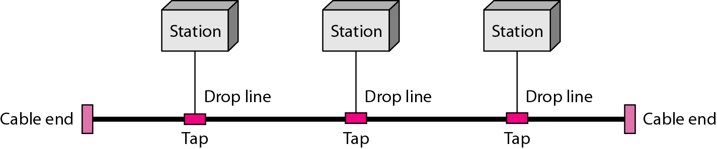
Bus Topology
Lecture
01
Single cable connects all network nodes without intervening connectivity devices
Devices share responsibility for getting data from one point to another
Terminators stop signals after reaching end of wire
  Prevent signal bounce
Inexpensive, not very scalable
Difficult to troubleshoot, not fault-tolerant
Cybersecurity Fundamentals, Dr. Redhwan M. A. Saad
27
www.midocean.ae

Slide 28
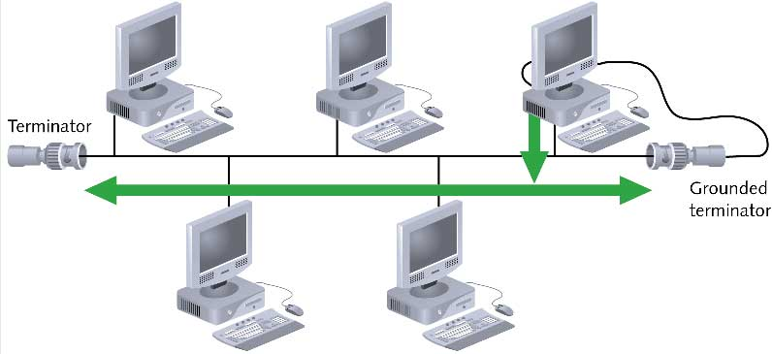
Advantages & Disadvantages of Bus Topology
Lecture
01
Advantages
Works well for small networks
Relatively inexpensive to implement
Easy to add to it
Disadvantages
Management costs can be high
Potential for congestion with network traffic
Cybersecurity Fundamentals, Dr. Redhwan M. A. Saad
28
www.midocean.ae

Slide 29
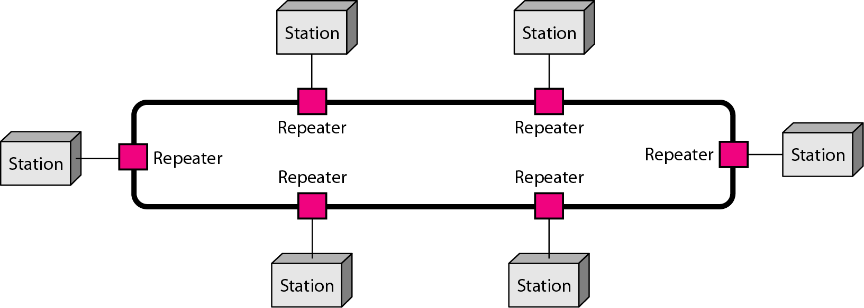
Ring Topology
Lecture
01
  Each node is connected to the two nearest nodes so the entire network forms a circle
  One method for passing data on ring networks is token passing
Active topology
  Each workstation transmits data
The unidirectional traffic can be a disadvantage.
In a simple ring, a break in the ring (such as a disabled station) can disable the entire network.
This weakness can be solved by using a dual ring or a switch capable of closing off the break.
Cybersecurity Fundamentals, Dr. Redhwan M. A. Saad
29
www.midocean.ae

Slide 30
Advantages and Disadvantages of Ring Topology
Lecture
01
Advantages
Easier to manage; easier to locate a defective node or cable problem
Well-suited for transmitting signals over long distances on a LAN
Handles high-volume network traffic
Enables reliable communication
Disadvantages
Expensive
Requires more cable and network equipment at the start
Not used as widely as bus topology
  Fewer equipment options
  Fewer options for expansion to high-speed communication
Cybersecurity Fundamentals, Dr. Redhwan M. A. Saad
30
www.midocean.ae

Slide 31
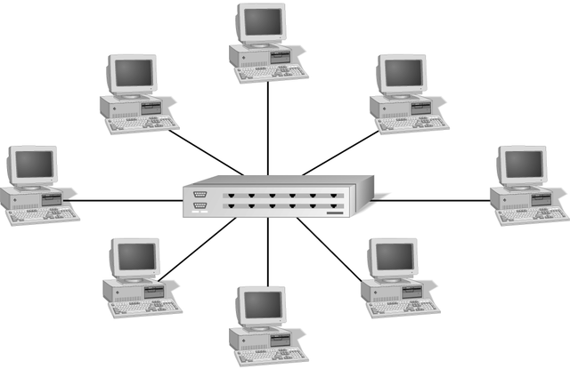
Star Topology
Lecture
01
  Every node on the network is connected through a central device
Any single cable connects only two devices
  Cabling problems affect two nodes at most
Requires more cabling than ring or bus networks
  More fault-tolerant
Easily moved, isolated, or interconnected with other networks
  Scalable
Supports max of 1024 addressable nodes on logical network
Cybersecurity Fundamentals, Dr. Redhwan M. A. Saad
31
www.midocean.ae

Slide 32
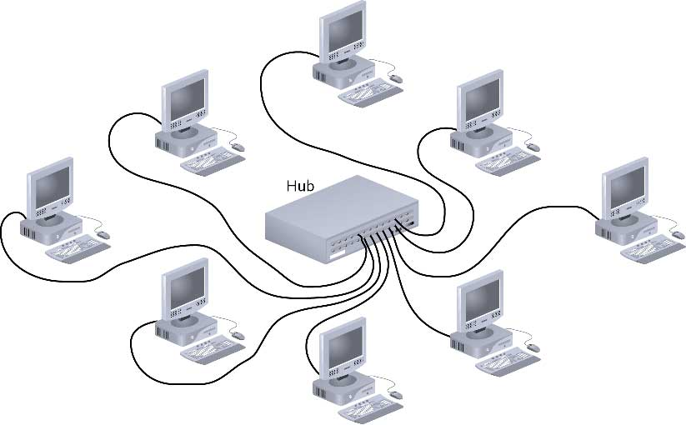
Advantages & Disadvantages of Star Topology
Lecture
01
Advantages
Good option for modern networks
Low startup costs
Easy to manage
Offers opportunities for expansion
Most popular topology in use; wide variety of equipment available
Disadvantages
Hub is a single point of failure
Requires more cable than the bus
Cybersecurity Fundamentals, Dr. Redhwan M. A. Saad
32
www.midocean.ae

Slide 33
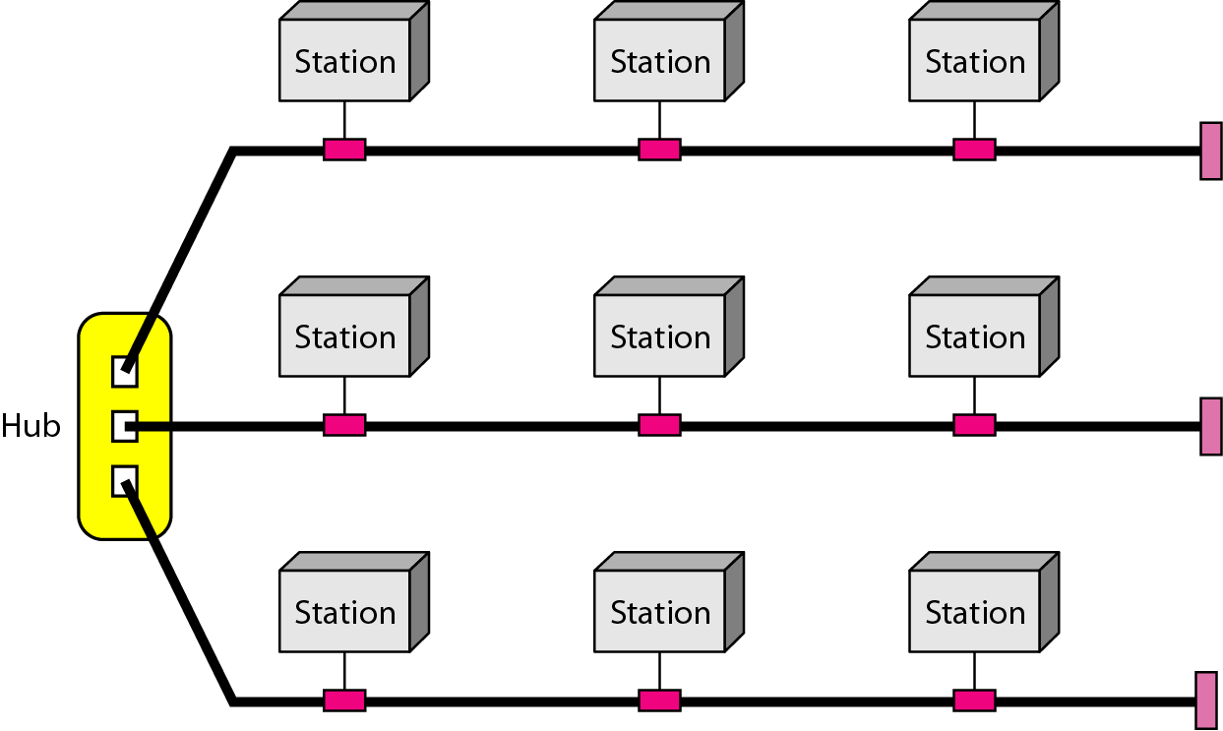
Hybrid Topology
Lecture
01
  Hybrid Topology
  A network can be hybrid. For example, we can have a main star topology with each branch connecting several stations in a bus topology
Combination of two or more network topology
Cybersecurity Fundamentals, Dr. Redhwan M. A. Saad
33
www.midocean.ae

Slide 34
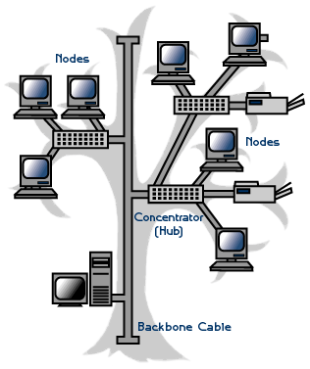
Tree Topology
Lecture
01
One example of Hybrid Topology is Tree topology
Tree topology is a combination of Bus and Star topology.
It consists of groups of star-configured workstations connected to a linear bus backbone cable.
If the backbone line breaks, the entire segment goes down
An example of this network could be cable TV technology
Cybersecurity Fundamentals, Dr. Redhwan M. A. Saad
34
www.midocean.ae

Slide 35
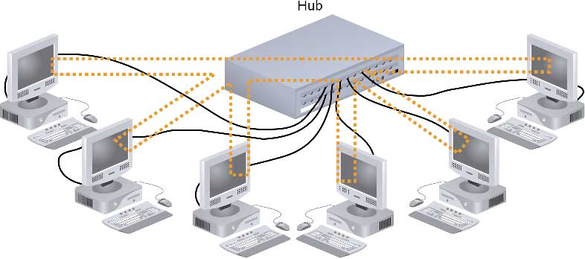
Hybrid Physical Topologies
Lecture
01
Star-Wired Ring
Cybersecurity Fundamentals, Dr. Redhwan M. A. Saad
35
www.midocean.ae

Slide 36
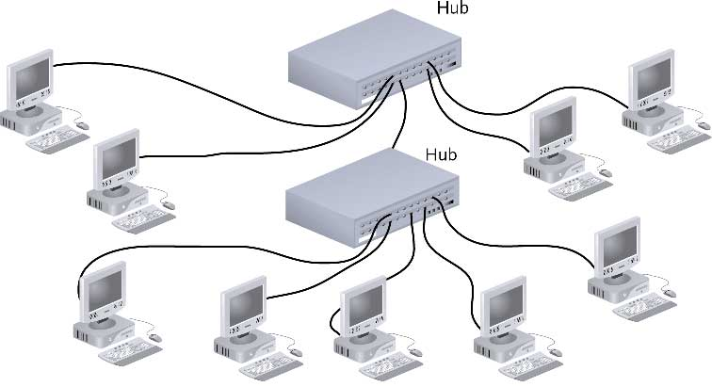
Hybrid Physical Topologies
Lecture
01
Star-Wired Bus
Cybersecurity Fundamentals, Dr. Redhwan M. A. Saad
36
www.midocean.ae

Slide 37
Logical Topologies
Lecture
01
Logical topology: how data is transmitted between nodes
  May not match physical topology
Bus logical topology: signals travel from one network device to all other devices on network
  Required by bus, star, star-wired physical topologies
Ring logical topology: signals follow circular path between sender and receiver
  Required by ring, star-wired ring topologies
Cybersecurity Fundamentals, Dr. Redhwan M. A. Saad
37
www.midocean.ae

Slide 38
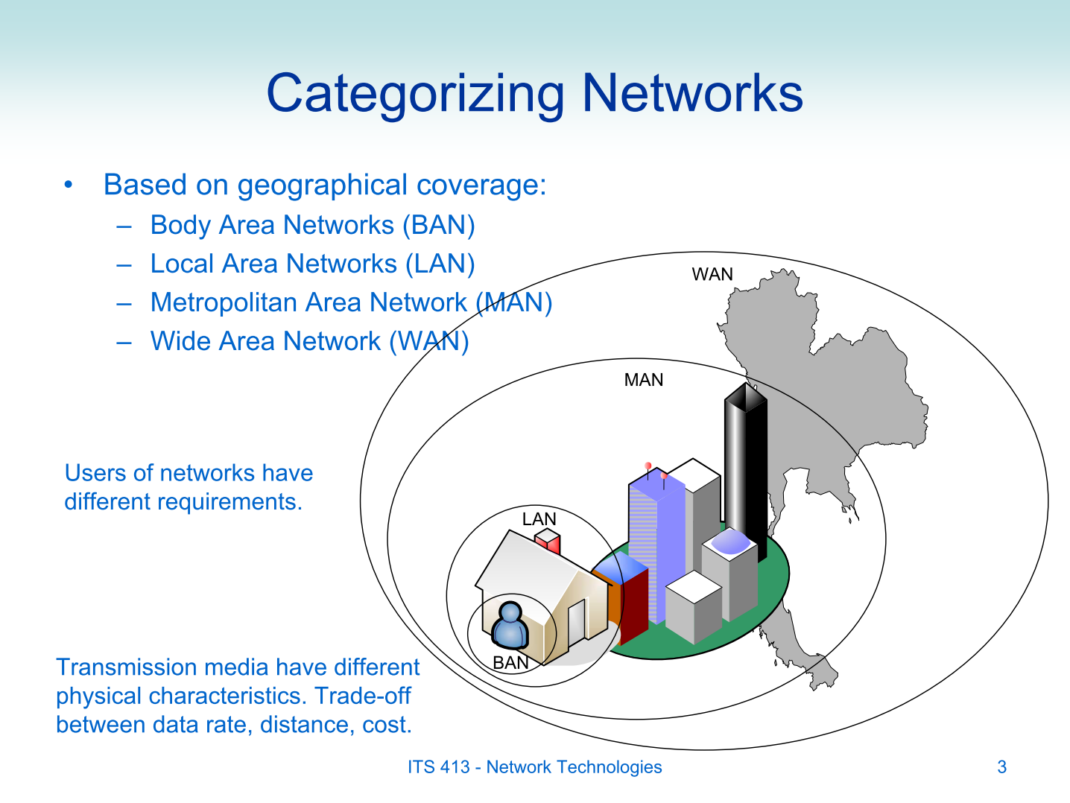
Type of Networks
Lecture
01
Cybersecurity Fundamentals, Dr. Redhwan M. A. Saad
38
www.midocean.ae

Slide 39
Type of Networks
Lecture
01
  Categories of Networks / Network Technologies
  Today There are two primary categories: local area networks (LANs) and wide area networks (WANs).
  The category into which a network falls is determined by its size.
  A LAN normally covers an area less than 2 miles; a WAN can be worldwide.
  Networks of a size in between are normally referred to as metropolitan area networks (MANs) and span tens of miles.
Cybersecurity Fundamentals, Dr. Redhwan M. A. Saad
39
www.midocean.ae

Slide 40
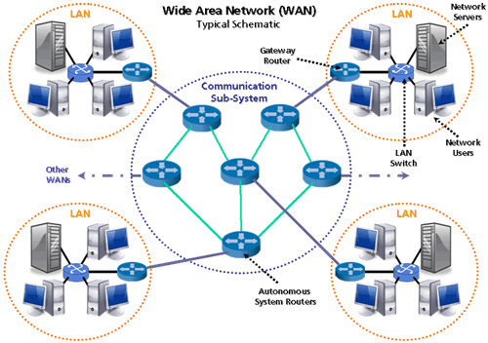
The Internet
Lecture
01
Wide Area Network (WAN)
  WAN provides long distance transmission of data, image, audio, video information over large geographic area that may comprise a country, a continent or even the whole world.
  Switched WAN: complex as the backbones that connect the Internet.
  - The switched WAN connects the end systems which usually comprise a router (internet – working connecting devices) that connects together LAN or WAN.
  Point to Point WAN: simple as a dial-up line that a home computer to the Internet.
  The point to point WAN is normally a line leased from a telephone or cable T.V provider that connects a home computer or a small LAN to an Internet service provider (ISP).
Cybersecurity Fundamentals, Dr. Redhwan M. A. Saad
40
www.midocean.ae

Slide 41

The Internet
Lecture
01
  Interconnection of Networks: Internetwork
  Today, it is very rare to see a LAN, a MAN or a WAN in isolation; they are connected to one another.
  When two or more networks are connected, they become an internetwork or internet.
Internet: A network of networks, joining many government, university and private computers together and providing an infrastructure for the use of E-mail, bulletin boards, file archives, hypertext documents, databases and other computational resources.
Internet: The largest network of networks in the world.
Cybersecurity Fundamentals, Dr. Redhwan M. A. Saad
41
www.midocean.ae

Slide 42
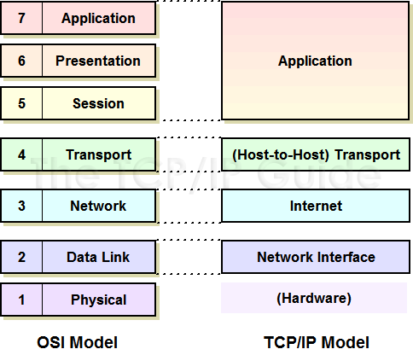
TCP/IP Stack
Lecture
01
The TCP/IP Stack, or the internet protocol suite, is a set of communication protocols used by the Internet or similar networks.
The TCP/IP stack comprises a series of Protocols (HTTP, FTP, SMTP, ISDN, IGMP, ARP).
The TCP/IP Stack works just like the OSI model by establishing a set of rules and standards for communication in and between the different layers. These rules ensure that different products can communicate with each other because they are developed around the same guidelines.
Cybersecurity Fundamentals, Dr. Redhwan M. A. Saad
42
www.midocean.ae
Notes:
https://www.linkedin.com/pulse/what-tcpip-stack-phillip-zito/

Slide 43
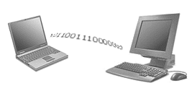
Wireless Network
Lecture
01
What is a wireless network?
  A technology that enables two or more entities to communicate without network cabling
Cybersecurity Fundamentals, Dr. Redhwan M. A. Saad
43
www.midocean.ae

Slide 44
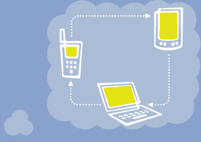
Wireless Network
Lecture
01
Complete Wireless Networks
The physical size of the network is determined by the maximum reliable propagation range of the radio signals.
Referred to as ad hoc networks
Are self-organizing networks without any centralized control
Suited for temporary situations such as meetings and conferences.
Cybersecurity Fundamentals, Dr. Redhwan M. A. Saad
44
www.midocean.ae

Slide 45
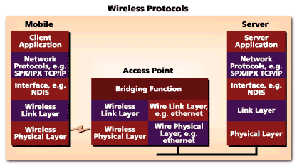
Wireless Network
Lecture
01
Integration With Existing Networks
Wireless Access Points (APs) - a small device that bridges wireless traffic to your network.
Most access points bridge wireless LANs into Ethernet networks, but Token-Ring options are available as well.
Cybersecurity Fundamentals, Dr. Redhwan M. A. Saad
45
www.midocean.ae

Slide 46
Self Assignment Question
Lecture
01
Self Assignment Question:
1- What is the Backbone Networks: Serial Backbone and Daisy chain?
2- OSI model.
The END ☺
Cybersecurity Fundamentals, Dr. Redhwan M. A. Saad
46
www.midocean.ae

Slide 47


Thank You

