Slide 1


Storage Technologies
IT403
Prepared by
Dr. Ahmed El-Douh
Lecture 1

Slide 2



Storage Technologies
Lecture 1
IT403
Introduction to Information Storage and Management
Prepared by
Dr. Ahmed El-Douh

Slide 3
Course Learning Outcomes
After learning the course, the students should be able to:
  Describe the information lifecycle.
  To explain the design of a data center and storage requirements.
  To discuss the various types of storage and their properties.
  To explain physical and virtualized storage.
  To explain the backup and archiving regarding recovery and business continuity.
  Describe the components of an intelligent storage system.
  Discuss Data Protection Technologies and Applications.
  Design Storage Business Continuity Solutions and Storage System Operation Management.
www.midocean.ae

Slide 4
Objectives
On completion of this course, you will be able to:
  Understand the definition of storage;
  Understand the development history of storage technologies;
  Understand the evolution of storage technologies and its development trends;
  Learn about Storage Products and Solutions.
www.midocean.ae

Slide 5
Chapter
Outlines
01
Data and Information
What is storage?
Structure of Storage
Storage Architecture Development
Data Storage Types
Storage System Components
Data Storage Applications
Cloud Storage: Distributed Storage
Storage Virtualization
www.midocean.ae

Slide 6


Chapter
01
Data and Information
www.midocean.ae

Slide 7
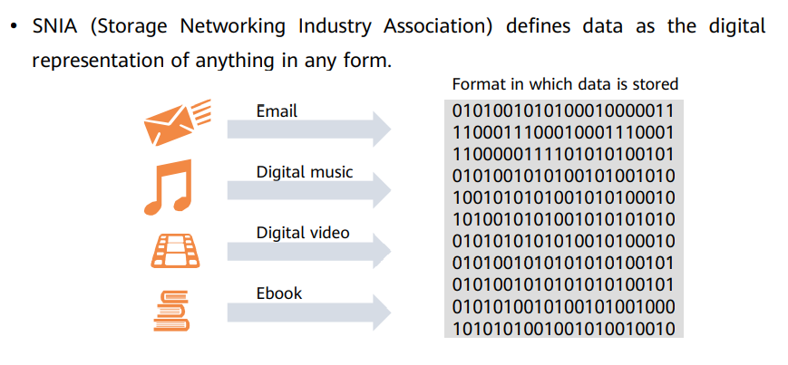
What is Data
www.midocean.ae

Slide 8
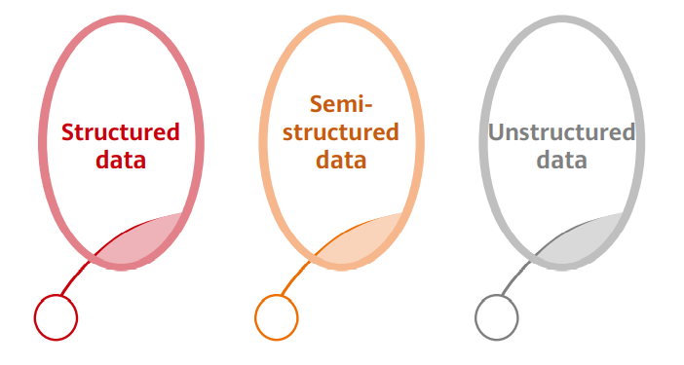
Data Types
www.midocean.ae

Slide 9
Data Types
Based on Data storage and management modes, data is classified:
  • Structured data: It can be represented and stored in a relational database and is often represented as a two-dimensional table.
    ▫ SQL Server, MySQL, Oracle.
  • Semi-structured data: It does not conform to the structure of relational databases or other data tables but uses tags to separate semantic elements or enforces hierarchies of records and fields.
    ▫ XML, HTML, JSON
  • Unstructured data: It is not organized in a regular or complete data structure or does not have a predefined data model.
    ▫ Texts, pictures, reports, images, audios, and videos
www.midocean.ae

Slide 10
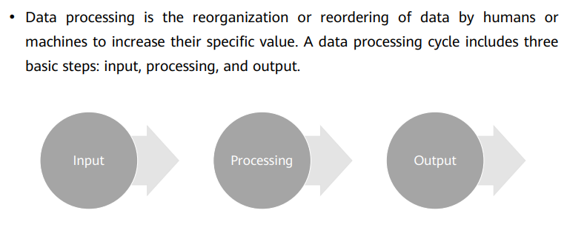
Data Processing Cycle
www.midocean.ae

Slide 11
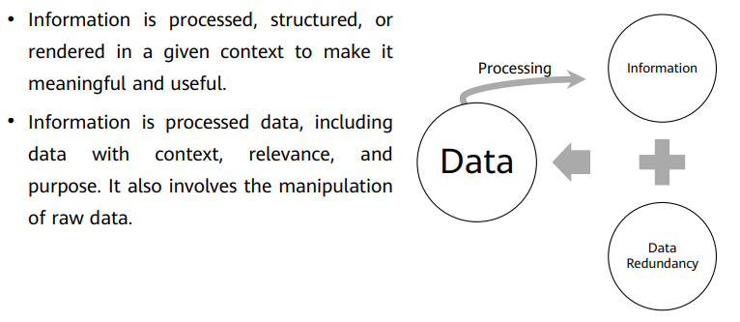
What is Information
www.midocean.ae

Slide 12
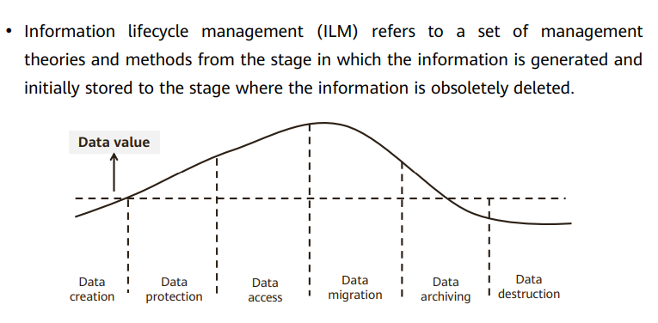
Information Lifecycle Management
www.midocean.ae

Slide 13
Information Lifecycle Management
Data creation phase: Data is generated from terminals and saved to storage devices.
Data protection phase: A storage system provides data protection functions, such as RAID, HA, disaster recovery (DR), and permission management.
Data access phase: Information must be easy to access and can be shared among organizations and applications of enterprises to maximize business value.
Data migration phase: When using IT devices, you need to upgrade and replace devices and migrate the data from the old to new devices.
www.midocean.ae

Slide 14
Information Lifecycle Management
Data archiving phase: The data archiving system supports the business operation for enterprises by providing the record query for transactions and decision-making. Deduplication and compression are often used in this phase.
Data destruction phase: After a period of time, data is no longer saved. In this phase, destroy or reclaim data that does not need to be retained or stored, and clear the data from storage systems and data warehouses.
www.midocean.ae

Slide 15
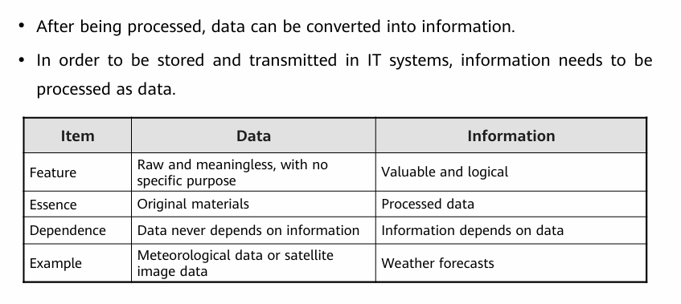
Data vs. Information
www.midocean.ae

Slide 16
Chapter
01
What is Storage?
www.midocean.ae

Slide 17
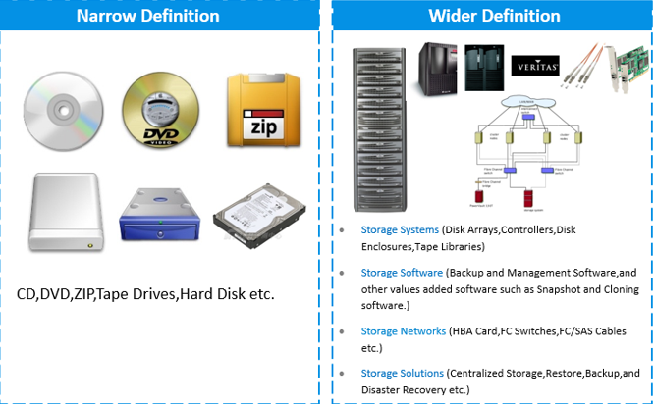
What is Storage?
In a narrow even tapes.
• In a broad sense, storage refers to a portfolio of solutions that provide
information access, protection, optimization, and utilization for enterprises. It is
the pillar of the data-centric information architecture.
A narrow definition of storage can refer to the physical storage devices such as floppy disks, CD/DVD, hard drives or even tape drives that are still used in some enterprises.
A wider definition of storage refers to the storage devices used in Datacenters such as storage systems, storage software, storage networks and storage solutions.
www.midocean.ae

Slide 18
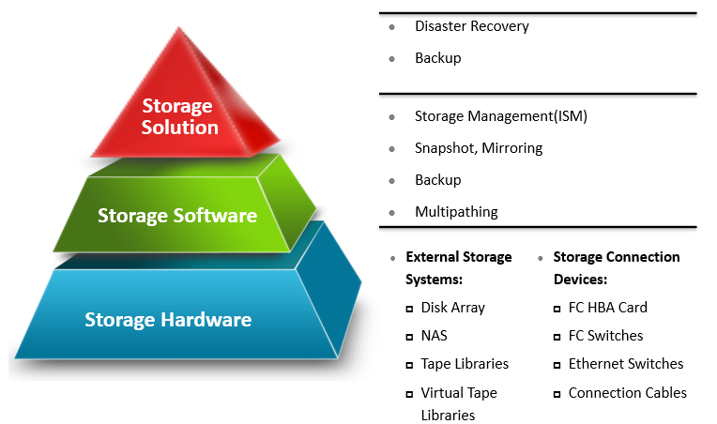
Data Storage System
www.midocean.ae

Slide 19
Chapter
01
Structure of Storage
www.midocean.ae

Slide 20
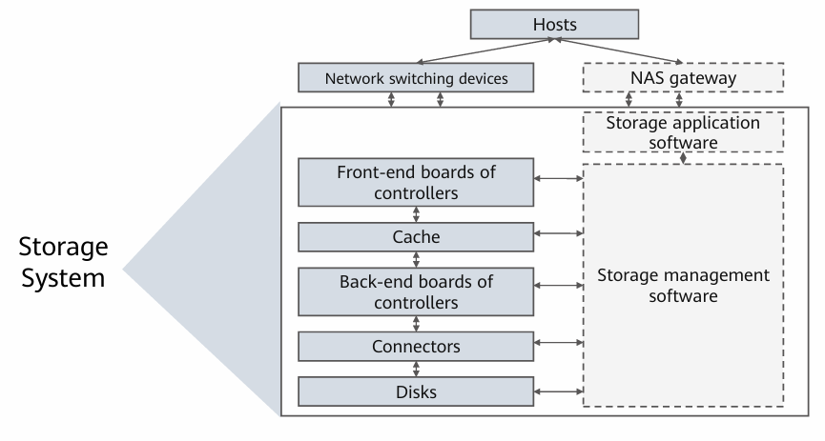
Structure of Storage
www.midocean.ae

Slide 21
Structure of Storage
Storage system consists of the disk subsystem, control subsystem, connection subsystem, and storage management software subsystem.
In terms of the physical structure of storage, disks reside in the bottom layer and are connected to back-end cards and controllers of the storage system via connectors such as optical fibers and serial cables.
The storage system is connected to hosts via front-end cards and storage network switching devices to provide data access services.
Storage management software is used to configure, monitor, and optimize subsystems and connectors of the storage system.
www.midocean.ae

Slide 22
Chapter
01
Storage Architecture Development
www.midocean.ae

Slide 23
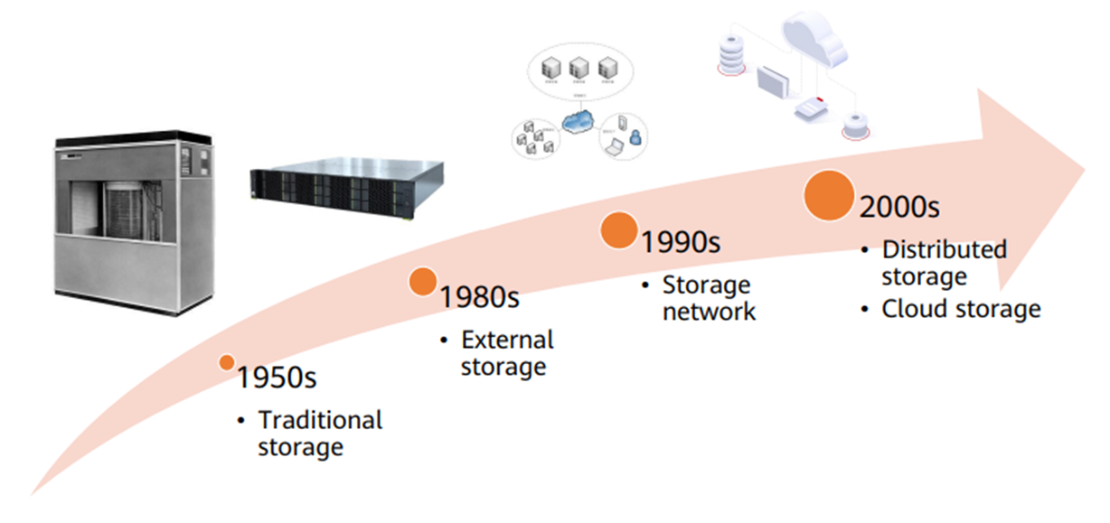
History of Storage Architecture Development
www.midocean.ae

Slide 24
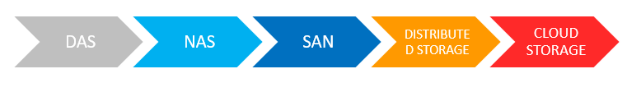
Storage Architecture Development
www.midocean.ae

Slide 25
Chapter
01
Data Storage Types
www.midocean.ae

Slide 26
Data Storage Types
  DAS Architecture.
  NAS Architecture.
  SAN Architecture:
    FC SAN Architecture
    IP SAN Architecture
www.midocean.ae

Slide 27
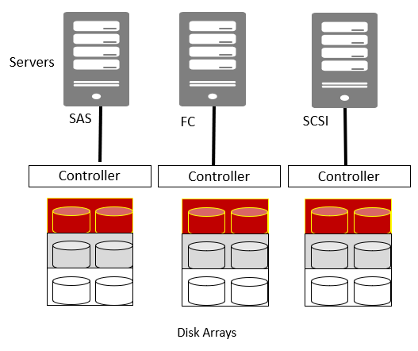
DAS Architecture
Direct Attached Storage (DAS) : is a storage architecture that consist of storage devices are directly connected to the servers.
DAS provides block-based storage for servers (Not File-based storage).
Examples of DAS storage: Internal hard disk in servers, tape libraries that are directly connected to servers, and external hard drives that can be directly connected to servers.
www.midocean.ae

Slide 28
DAS Architecture
DAS can be differentiated into Internal DAS and External DAS based on the location of the storage in relation to the servers.
Internal DAS:
  Storage devices are connected to servers via serial or parallel connections, but due to cable length limitations, they only support short-distance high-speed data transfers.
External DAS:
  In External DAS architecture, servers are directly connected to external storage devices, typically communicating via FC or SCSI protocols.
www.midocean.ae

Slide 29
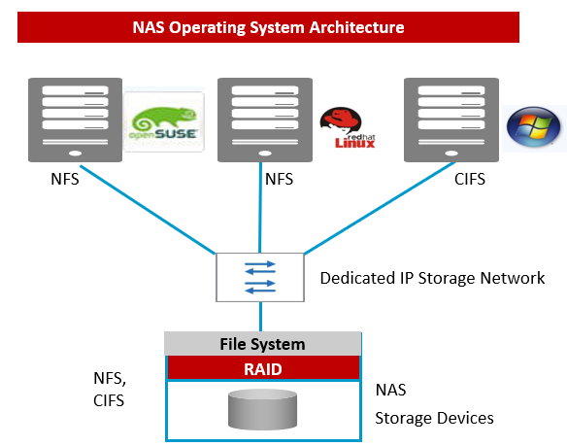
NAS Architecture
Network Attached Storage (NAS) are IP-based file level storage devices that are connected to a local area network.
NAS shares files quickly with lower storage management costs through file-based data access and sharing storage resources over a network.
NAS uses the network and file sharing protocols to implement data archiving and data storage. Among the protocols used by NAS also includes the TCP/IP protocols used for data transmission and CIFS and NFS protocols for remote file management.
www.midocean.ae

Slide 30
SAN Architecture
Storage Area Network (SAN) : is a dedicated high-performance network implemented between the server and storage resources. It has been optimized specifically for high amount of raw data transmission.
DAS provides block-based storage.
SAN can be differentiated into FC SAN and IP SAN.
The default protocols used by FC SAN is SCSI and Fiber Channel.
The default protocol for IP SAN implementation is iSCSI (Internet Small Computer System Interface).
www.midocean.ae

Slide 31
Storage – Types of Data Center Storage
DAS – Storage device is directly attached to a server (block-level)
NAS – Storage device is attached to a network, servers on the network can access device (file-level)
SAN – Clustered storage devices on their own network that servers can connect to (block-level)
www.midocean.ae

Slide 32
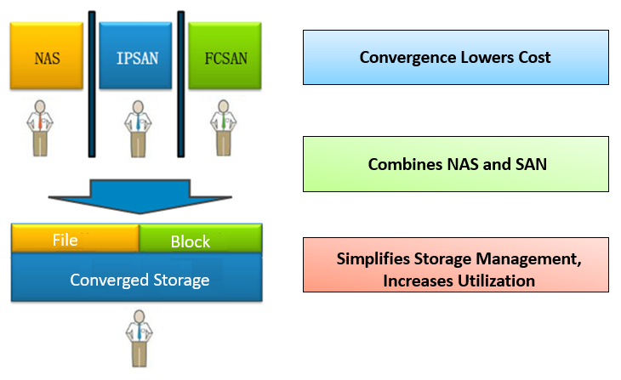
Storage Architecture Trends: Converged Storage
Converged Storage combines both SAN and NAS storage, fulfills elastic business development, simplifies service deployment, increases storage resources utilization and effectively reduces total cost of ownership (TCO).
www.midocean.ae

Slide 33
Chapter
01
Storage System Components
www.midocean.ae

Slide 34
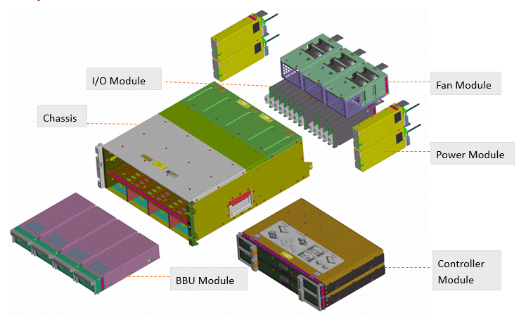
Storage System Components
The diagram above shows the different components that makes up the controller and disk separated chassis.
The main components consist of the chassis, I/O module, fan and power module and the controller and BBU (Backup Battery Unit) module.
This chassis is connected to the external high density disk enclosures via the I/O module.
BBU unit is the backup battery that provides power to the storage controller to save all the I/O cache into the coffer disks in the event of a power failure.
www.midocean.ae

Slide 35
Chapter
01
Data Storage Applications
www.midocean.ae

Slide 36
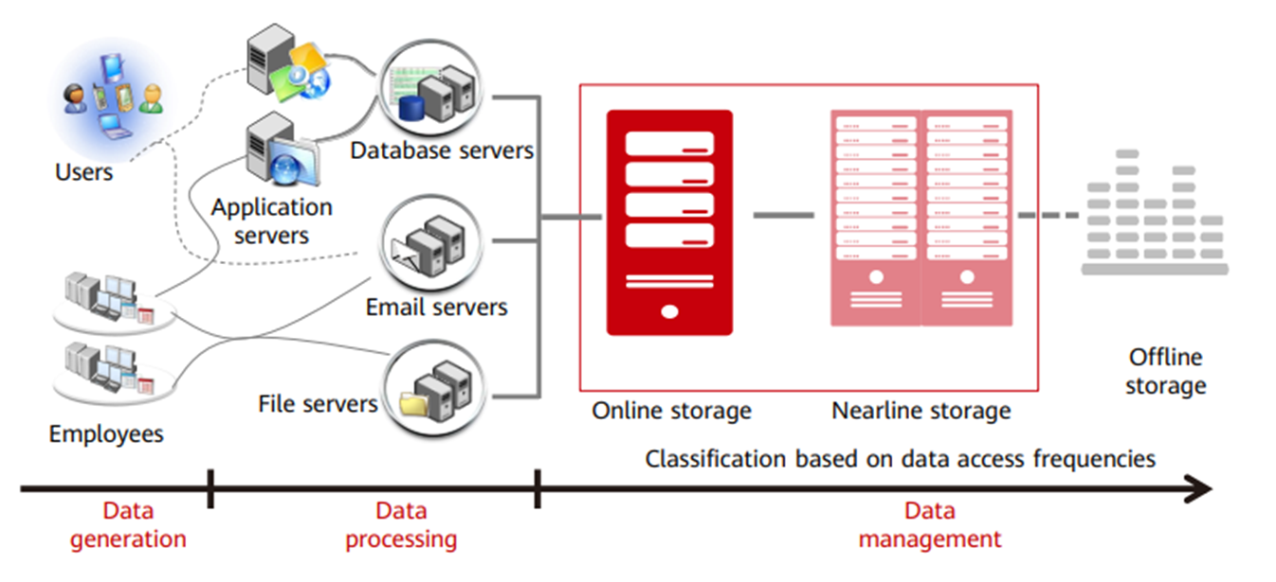
Data Storage Applications
www.midocean.ae

Slide 37
Chapter
01
Cloud Storage: Distributed Storage
www.midocean.ae

Slide 38
Cloud Storage
The Importance of Cloud in Storage:
Scalability: Cloud storage allows organizations to easily scale up or down depending on the amount of data.
Cost Efficiency: Reduces the need for on-premise hardware and maintenance.
Accessibility: Data can be accessed anytime, anywhere, from multiple devices.
Data Protection: Built-in backup, redundancy, and disaster recovery options.
Collaboration: Enables multiple users to access, edit, and share data in real-time.
Integration: Works seamlessly with applications and services for analytics, AI, and business intelligence.
www.midocean.ae

Slide 39
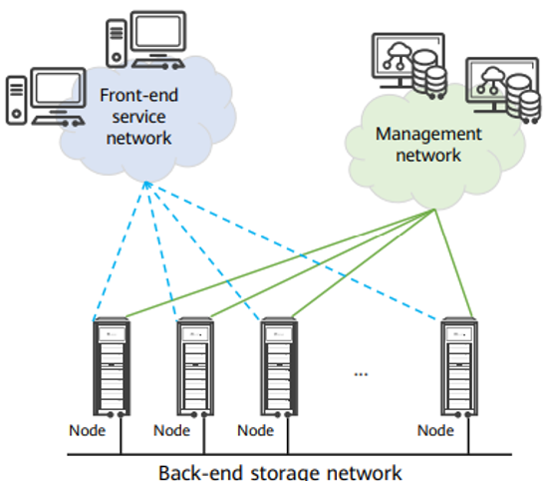
Cloud Storage: Distributed Storage
Distributed storage: storing data in a distributed way across multiple data storage servers on a large-scale storage resource pool, such as internal HDD and SSD.
Physical resources are organized using software to form a high-performance logical storage pool, ensuring reliability and providing multiple storage services.
Generally, distributed storage scatters data to multiple independent storage servers in a scalable system structure. It uses those storage servers to share storage loads and uses location servers to locate storage information.
www.midocean.ae

Slide 40
Chapter
01
Storage Virtualization
www.midocean.ae

Slide 41
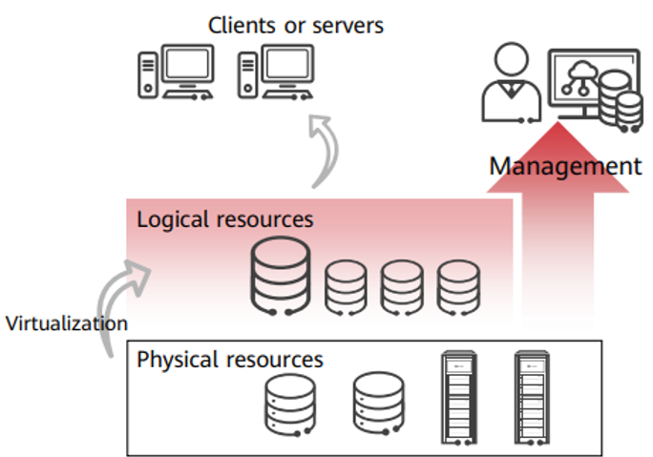
Storage virtualization
Storage virtualization is the process of transforming physical storage resources (such as physical disks and servers) into logical (virtual) resources that can be easily managed and accessed.
  Main Benefits:
  Simplified management
  Improved resource utilization
  Scalability
  Unified storage services across different devices
www.midocean.ae

Slide 42
Storage virtualization
In storage virtualization, a virtualization layer is added between the physical storage system and servers to manage and control all storage devices and provide storage for servers.
The addition, deletion, replacement, splitting, and combination of storage hardware are transparent to servers.
Functions:
  ▫ Simplify the management of physical devices.
  ▫ Integrate existing functions.
  ▫ Eliminate the limitation of the physical capacity.
www.midocean.ae

Slide 43
Summary
Data → Information through lifecycle (Creation – Protection – Access – Migration – Archiving – Destruction)
Storage = Backbone of Information Architecture (Hardware + Software + Networks)
Storage Architectures:
  DAS – Direct, Block-level
  NAS – Network, File-level
  SAN – Dedicated Network, Block-level
  Converged Storage – Combines NAS & SAN
Trends:
  Cloud & Distributed Storage – Flexibility & Reliability
  Storage Virtualization – Simplified management, Scalability, Higher efficiency
www.midocean.ae

Slide 44



Thank You

