Slide 1


English Course- Intermediate Level
Prepared by
Ahmed Soliman

Slide 2



Lecture 8
www.midocean.ae

Slide 3
Listening: A phone call from a customer
Grammar: Future forms: 'will', 'be going to' and present continuous
Pronunciation: linking vowel to vowel (Revision)
www.midocean.ae

Slide 4
Listening
A phone call from a customer
www.midocean.ae

Slide 5

Listen to the recording and decide whether the following sentences are true or false
1. The delivery hasn't arrived yet. True False
2. Andrea is having cash flow issues and needs a payment extension. True False
3. Andrea usually asks for an extension of the payment terms. True False
www.midocean.ae

Slide 6
4. Andrea has a new order to place, even bigger than the last one. True False
5. Junko can extend the payment terms on the last order to 60 days. True False
6. Junko will send Andrea an email confirmation. True False
www.midocean.ae

Slide 7
Grammar
Future forms: 'will', 'be going to' and present continuous
www.midocean.ae

Slide 8
will
We use will to talk about spontaneous plans decided at the moment of speaking. (quick decisions)
I forgot my watch at home. I’ll go back to bring it.
Oops, I forgot to phone Mum! I'll do it after dinner.
There's no milk. I'll buy some when I go to the shops.
www.midocean.ae

Slide 9
going to
We use going to to talk about plans decided before the moment of speaking.
I'm going to phone Mum after dinner. I told her I'd call at 8 o'clock.
I'm going to wear my black dress tonight.
I'm going to go to the supermarket after work. What do we need?
www.midocean.ae

Slide 10
Present continuous
We usually use the present continuous when the plan is an arrangement – already confirmed with at least one other person and we know the time and place.
I’m travelling to Paris next week.
I'm meeting Jane at 8 o'clock on Saturday.
We're having a party next Saturday. Would you like to come?
www.midocean.ae

Slide 11
Exercise
Choose the correct answer
1- It's really hot in here. _____ a window.
a- I'll open
b- I'm opening
2- I've decided that _____ to my boss about the situation.
a- I'll speak
b- I'm going to speak
www.midocean.ae

Slide 12
3- I would love to go out with you tomorrow but _____ dinner with James.
a- I'll have
b- I'm having
4- I want to do more with my free time. I know! I think _____ taking Mandarin lessons.
a- I'll start
b- I'm starting
www.midocean.ae

Slide 13
5- I've paid for the course and _____ lessons next week.
a- I'll start
b- I'm starting
www.midocean.ae

Slide 14
Pronunciation
linking vowel to vowel
(Revision)
www.midocean.ae

Slide 15
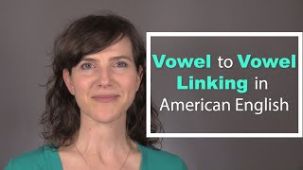
www.midocean.ae

Slide 16
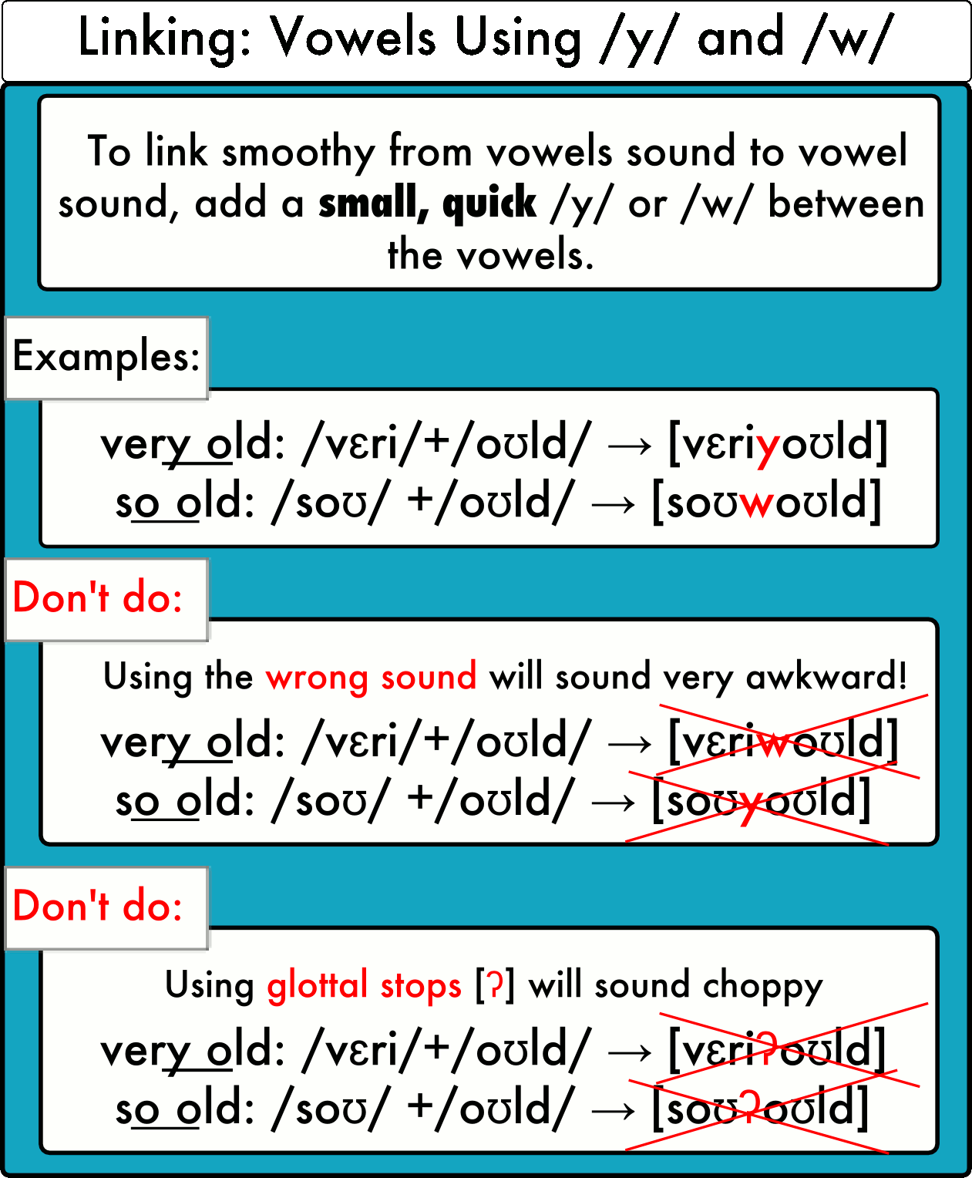
www.midocean.ae

Slide 17
Practice
https://pronuncian.com/linking-vowels-into-vowels
www.midocean.ae

Slide 18




Thank You

