Slide 1


Financial Risk Management
Prepared by Dr. Walaa Mohamed
PMG 633
Market Risk (Part one)
Introductory lecture
Lecture Five

Slide 2

Chapter Outline
6.1 Introduction to Market Risk
6.2 Basics of Financial Instruments

Slide 3
Lecture 5
Key Learning Points
Key Notice
Market risk arises from the trading activities of banks and is a consequence of movements in market prices.
The basic financial instruments are currencies, equities, bonds, loans, commodities, and derivatives. Banks can take either a long or a short position in financial instruments.

Slide 4

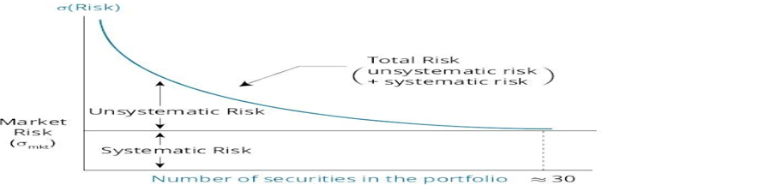
Illustrate systematic and nonsystematic risk, including why an investor should not expect to receive additional return for bearing nonsystematic risk
1. Introduction to Market Risk
Systematic Risk and Nonsystematic Risk
Systematic risk, also known as non-diversifiable or market risk, is the risk that affects the entire market or economy. In contrast, nonsystematic risk is the risk that pertains to a single company or industry and is also known as company-specific, industry-specific, diversifiable, or idiosyncratic risk.
Total variance = Systematic variance + Nonsystematic variance
total risk (as measured by standard deviation) total risk = systematic risk + unsystematic risk
Systematic or non-diversifiable risk is priced and investors are compensated for holding assets or portfolios based only on that investment’s systematic risk. Investors do not receive any return for accepting nonsystematic or diversifiable risk. Therefore, it is in the interest of risk-averse investors to hold only well-diversified portfolios.

Slide 5
2. Basics of Financial Instruments:
Basic financial assets are also called financial products or financial instruments. Banks use financial instruments for trading purposes and to hedge their financial activities. These financial instruments are considered “plain-vanilla” products because they are relatively simple and do not have complex features.
For instance, common stocks and corporate bonds are both considered plain-vanilla (simple) financial instruments. Banks trade both plain-vanilla and complex products, with many complex products that can be broken down into two or more simpler products. New financial instruments usually remix already existing, plain-vanilla instruments into more complex structures, requiring sophisticated pricing and legal structures.
Complex financial instruments include derivatives (such as options, forwards, and futures) and hybrid/compound instruments (such as convertible debt)

Slide 6
1. Currencies
Most countries (or groups of countries) have their own currency (i.e., money).They control its supply through their central bank or a similar institution.
In foreign exchange transactions, one currency is exchanged for another currency. Banking institutions engage in foreign exchange transactions for a wide variety of reasons. For example, they may be conducting operations out-side their home country, requiring them to have cash on hand in a foreign currency to fulfill their obligations in that country.
Exchange rates reflect the relative value of one currency in relation to another currency. For instance, if the exchange rate between the GBP (British pound) and the USD (United States dollar) is 1.50, this means that for each GBP you receive, you must pay USD 1.50. It also means that for each USD you receive, you must pay GBP 0.67 (= 1.0/1.5).

Slide 7
An exchange rate is simply the price or cost of units of one currency in terms of another. In this book we state exchange rates in the form 1.416 USD/EUR, to mean that each euro costs $1.416.
It is common to refer to the different exchange rates of one currency against other currencies in terms of spot exchange rates or spot cross rates. Spot exchange rates The spot rate is the current market price for exchanging one currency for another. Whereas spot cross rates is the exchange rate between two currencies implied by their exchange rates with a common third currency. Cross rates are necessary when there is no active FX market in the currency pair. The rate must be computed from the exchange rates between each of these two currencies and a third currency, usually the USD or EUR.
Figure 6.1 shows the major exchange rates from September 2014. The table expresses the value of six major currencies against each other and is interpreted as follows: For one unit of the column currency, you must pay the amount shown in the appropriate row. So, on that date, one GBP was worth USD 1.6388, CAD 1.7931, EUR 1.2683, and so on. This implies that one USD was worth GBP 0.6102 (= 1.0/1.6388), CAD was worth GBP 0.5576 (= 1.0/1.7931), and one EUR was worth GBP 0.7884 (= 1.0/1.2683).

Slide 8
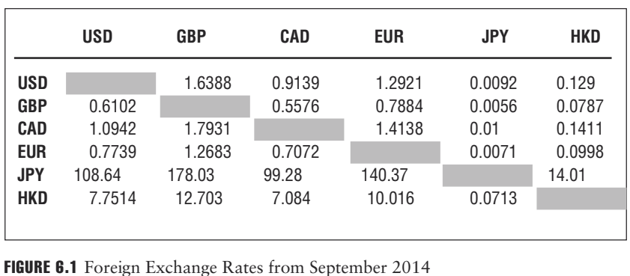

Slide 9

Calculate and interpret currency cross-rates.
The cross rate is the exchange rate between two currencies implied by their exchange rates with a common third currency. Cross rates are necessary when there is no active foreign exchange market in the currency pair. The rate must be computed from the exchange rates between each of these two currencies and a third currency, usually the USD or EUR.
Case 1 : Let's assume that we have the following quotations for Egyptian pounds and Hong Kong dollars:
EGP/USD= 1.60
USD/HKD =1.85
Calculate the cross rate between Egyptian pounds and Hong Kong dollars (EGP/HKD)
Answer:
EGP/HKD= (EGP/USD)*(USD/HKD)= 1.60*1.85=2.96

Slide 10
Calculate and interpret currency cross-rates.
Case 2: Let's assume that we have the following quotations for Egyptian pounds and Hong Kong dollars:
EGP/USD= 1.60
HKD/USD = 0.54
Calculate the cross rate between Egyptian pounds and Hong Kong dollars (EGP/HKD)
Answer:
Here HKD has different position so we would have taken the inverse (reciprocal) to get the quotation into USD/HKD terms.
EGP/HKD= (EGP/USD)*(USD/HKD)= 1.60*(1/0.54)= 2.96

Slide 11
Calculate and interpret currency cross-rates.
Case 3: Let's assume that we have the following quotations for Egyptian pounds and Hong Kong dollars:
USD/EGP= 0.625
HKD/USD = 0.54
Calculate the cross rate between Egyptian pounds and Hong Kong dollars (EGP/HKD)
Answer:
Here both EGP and HKD has different position so we would have taken the inverse (reciprocal) to get the quotation into EGP/USD and USD/HKD terms.
EGP/HKD= (EGP/USD)*(USD/HKD)= (1/0.625)*(1/0.54)= 2.96

Slide 12

In a foreign currency quotation, we have the price of one currency in units of another currency. These are often referred to as the base currency and the price currency. In the quotation 1.25 USD/EUR, the USD is the price currency, and the EUR is the base currency. The price of one euro (base currency) is 1.25 USD (the price currency), so 1.25 is the price of one unit of the base currency in terms of the other. It may help to remember that the euro, in this example, is in the bottom or “base” of the exchange rate given in terms of USD/EUR.
An exchange rate expressed as price currency/base currency is referred to as a direct quote from the point of view of an investor in the price currency country and an indirect quote from the point of view of an investor in the base currency country.
Again, direct quote from the point of view of an investor in the price currency country and an indirect quote from the point of view of an investor in the base currency country. For example, a quote of USD/SAR=.267 would be a direct exchange rate quote for a Saudi-based investor and an indirect quote for an American-based investor. Conversely, a quote of USD/SAR = 1 / .267=3.75 would be a direct exchange rate quote for an American-based investor and an indirect quote for a Saudi-based investor.

Slide 13
There are multiple factors that influence exchange rates. Key factors include inflation rates, political changes and instability, and currency regimes. Currency regimes determine to what extent a country, or its government manages its currency relative to other currencies. Governments may fix (peg) their exchange rates, whereby they attempt to keep the relative value of their currency fixed versus another currency or a basket of representative currencies, or float their exchange rates, whereby the relative value of the currency is determined by general market forces.
When banks trade currencies with each other, they sometimes act as a broker on behalf of their clients who need to secure foreign currency to pay their bills. Many large multinational banks also actively trade currencies as principals with other banks with the hope of profiting from exchange rate movements.

Slide 14

Some countries, especially developing countries, use exchange rate targeting. That is, they target a foreign exchange rate (pegging) between their currency and another (often the U.S. dollar).
As an example, consider a country that has targeted an exchange rate for its currency versus the U.S. dollar. If the foreign exchange value of the domestic currency falls relative to the U.S. dollar, the monetary authority must use foreign reserves to purchase their domestic currency (which will reduce money supply growth and increase interest rates) in order to reach the target exchange rate
Conversely, an increase in the foreign exchange value of the domestic currency above the target rate will require sale of the domestic currency in currency markets to reduce its value (increasing the domestic money supply and decreasing interest rates) to move towards the target exchange rate. One result of exchange rate targeting may be greater volatility of the money supply because domestic monetary policy must adapt to the necessity of maintaining a stable foreign exchange rate.
Over the short term, the targeting country can purchase or sell its currency in the foreign exchange markets to influence the exchange rate
There are limits, however, on how much influence currency purchases or sales can have on exchange rates over time. For example, a country may run out of foreign reserves with which to purchase its currency when the exchange value of its currency is still below the target exchange rate.

Slide 15
2. Fixed Income Instruments
Two of the most commonly referred to and traded fixed income instruments are loans and bonds. Loans and bonds are legally binding contracts through which the borrower (also referred to as the issuer of the bond or loan) borrows the principal amount specified in the bond or loan from an investor and in exchange pays a specified amount of interest, usually at regular intervals. The interest rate referenced in the contract is usually referred to as the coupon rate or nominal rate. This rate may be fixed or floating.
For a plain-vanilla fixed income instrument, the amount of money the borrower receives is set on the day of the bond’s issuance and will remain the same and not be affected by changes in the inflation or exchange rates that can happen over the life of the bond or loan. There are complex fixed income instruments that adjust the interest payments, and, in some cases, even the principal payments, to inflation rates.

Slide 16
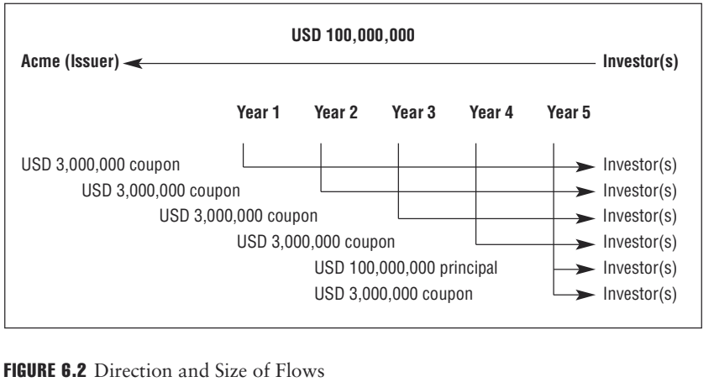
EXAMPLE
Acme Inc. issues a five-year bond to a group of investors. With the bond, the company borrows USD 100 million at a fixed interest rate of 3% per annum. Each year, the company will make one interest payment of 3% * USD 100 million, or USD 3 million, to those investors who purchased and hold the bonds in accordance with their ownership interest. Five years from now, the company will make the last interest payment and repay the principal, the borrowed amount, of USD 100 million. Figure 6.2 shows the direction and size of these flows.

Slide 17
Once issued, most loans and bonds have fixed terms. That is, the coupon rate and the maturity date will not change, and so the size and timing of the loan payments are fixed.
The value of loans and bonds is affected by the interest rate, and the
interest rate is driven primarily by three factors:
1. The interest rate of an equivalent risk-free fixed income instrument
2. The creditworthiness of the borrower or default risk
3. The time to maturity

Slide 18
If the interest rate increases, the value of the loan decreases, because for a fixed-rate bond, the fixed value of the future payments is worth less in present value terms. If the interest rate decreases, the value of the loan increases because the fixed value of the future payments is worth more in present value terms. Hence, loans and bonds are interest rate-sensitive instruments, and their value will fluctuate as interest rates change.
There are also floating-rate bonds and loans where the interest rate and, consequently, the interest payments mirror an index that reflects the level of interest rates. When rates increase, the interest rate on the bond increases as well, and the value of the bond may remain unchanged. Investors should be careful to understand all the characteristics of the bond they may be considering investing in before actually buying the bond.

Slide 19
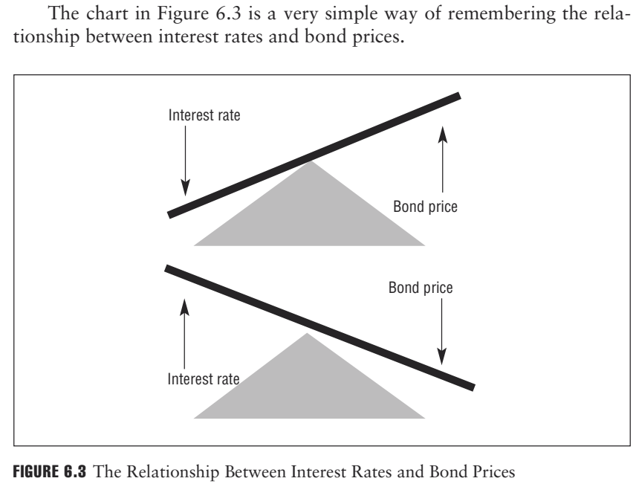
EXAMPLE
When the interest rate is 5%, then the value of USD 100 one year from now is not worth USD 100, but only USD 95.24, because investing USD 95.24 at 5% interest will grow the amount to USD 100. Similarly, when the interest rate increases to 10%, the same USD 100 one year from now is worth only USD 90.91, because investing USD 90.91 at 10% interest will grow the amount to USD 100.

Slide 20
In practice, a risk-free fixed income product would typically be a government bond, which may be considered to have no credit or default risk. If there is any risk of default, the interest rate must be adjusted with a premium that reflects the risk of default It should be noted that the concept of government issued securities being risk-free is now being questioned by regulators and investors around the world. With countries experiencing extreme stress as a result of the financial crisis (e.g., the Greek debt crisis), and countries such as Italy, Portugal, Ireland and others requiring international attention to resolve increasing debt, sovereign issued debt instruments are no longer thought to be without risk.

Slide 21
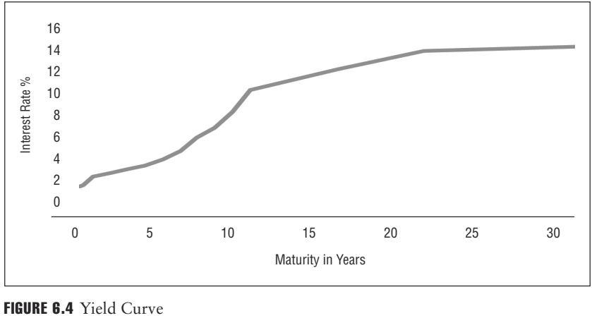
The interest rate depends on several factors, including inflation, the general level of economic activity, the political and economic stability of the country where the issuer is located, and time to maturity. In general, the longer the maturity of the loans or bonds, the higher the interest rate. The explanation is simple: To lend money for a longer time, the lender needs more compensation for the risk of holding the instrument longer, which increases the level of uncertainty. Linking interest rates with maturity creates a yield curve, as shown in Figure 6.4

Slide 22
Banks trade bonds with each other to manage their liquidity, to profit from price appreciation due to changes in interest rates, or to manage their earning assets.
Banks trade loans with each other primarily when they realign their credit portfolio. Usually, the trading of loans is related to credit portfolio management, particularly as it relates to concentration risk.

Slide 23
3. Interbank Loans
Banks also make loans to each other. Some banks have excess deposits either from unexpected inflows of deposits or because they cannot find suitable loan or investment alternatives for their deposits. These banks sell their excess funds to banks that need them to finance the loans they underwrite or investments they make.
Interbank loans can have very short maturities— as short as one day (or overnight). Banks also consider interbank loans to make funds available to their depositors and to manage their liquidity requirements. In many countries, these markets are very active. Like loans and bonds, interbank loans are interest rate-sensitive instruments

Slide 24
Interbank loans are often priced off an index, such as the London Inter- bank Offered Rate, or LIBOR. LIBOR is a daily reference rate average based on the interest rates that London banks charge when lending funds to other banks. LIBOR is quoted for numerous currencies and across different maturities ranging from overnight (one day) to one year. LIBOR rates, irrespective of their maturity, are quoted on an annual basis. LIBOR rates can influence the pricing of various types of financial instruments, including loans that banks make.

Slide 25
EXAMPLE
A USD 10 million floating-rate bond issued by Acme Inc. is priced at a 250 bp (2.50%) premium over three-month LIBOR. The interest rate on the floating-rate bond is determined at the beginning of each quarter.
■On January 1, LIBOR is 3.45%; the interest rate on this floating-rate bond for the next three months would be 3.45% + 2.50%, or 5.95%. The interest payment that Acme Inc. will make for the coming three-month period would then be USD 1,487,500, or USD 10 million * 5.95%/4, as interest rates are quoted on an annual basis.
■On April 1, LIBOR is 2.95%. The interest rate on the floating-rate bond for the next three months would be 2.95% + 2.50% or 5.45%. The interest payment that Acme Inc. will make for the three-month period would then be USD 1,362,500, or USD 10 million* 5.45%/4.

