Slide 1


Human Resources Management
Robert L. Mathis ⏐ John H. Jackson
Prepared by Dr. Samah Abdelfatah
MGM 243
Lecture 04

Slide 2



Part (2):Staffing the Organization
Jobs and Job Analysis
Chapter
06
Lecture 04
MGM 243
Prepared by
Dr. Samah Abdelfatah

Slide 3

Chapter
Learning Outcomes
06
After you have read this chapter, you should be able to:
Discuss workflow analysis and business process re-engineering as approaches to organizational work.
Explain how artificial intelligence and automation are reshaping job design and job analysis practices.
Explain how work schedules and telework can change jobs and work.
Discuss the concept of skills-based job architecture as an emerging alternative to traditional job structures
Describe job analysis and the stages and methods used in the process
Explain how artificial intelligence and automation are reshaping job design and job analysis practices..
Identify both behavioral and legal aspects of job analysis.
List the components of job descriptions.

Slide 4
Chapter
Changing Jobs Era
06
Work and jobs in organizations throughout the world are changing dramatically.
Globalization and technology, artificial intelligence (AI), automation, and post-pandemic workforce restructuring are drivers of this change.
Consider the number of jobs that have been shifted from the United States and Europe to China, India, Romania, Mexico, the Philippines, and other lower-wage countries. Additionally, companies are adopting 'nearshoring' (moving jobs to nearby countries) to improve collaboration and reduce time zone differences."
The rise of the gig economy and platform-based work (e.g., Uber, Fiverr, Upwork) has blurred traditional job boundaries, creating a new class of "non-employees.“

Slide 5
Chapter
Nature of Jobs and Work
06
Work: Effort directed toward accomplishing results.
Job: Grouping of tasks, duties, and responsibilities that constitutes the total work assignment for an employee.
Ideally, when all the jobs in an organization are added together, they should equal the amount of work that the organization needs to have done— no more, no less.
The degree to which this ideal is or is not met drives differences in organizational productivity.

Slide 6
Chapter
Nature of Jobs and Work (Cont.)
06
For HR, how workflows through the organization and how to make that work more efficient is important.
Changing the way jobs are done through redesign, perhaps by using teams or flexible scheduling, may make people more satisfied with their jobs.
Formally reviewing jobs and workflow analysis to identify what is expected to be accomplished is part of a framework for training, pay, performance, and other aspects of HR management.

Slide 7
Chapter
Workflow Analysis
06
Workflow Analysis
  A study of the way work (inputs, activities, and outputs) moves through an organization.
Inputs
People
Materials
Equipment
Activities
Tasks and Jobs
Outputs
Goods and Services
Evaluation
Figure 6-1

Slide 8
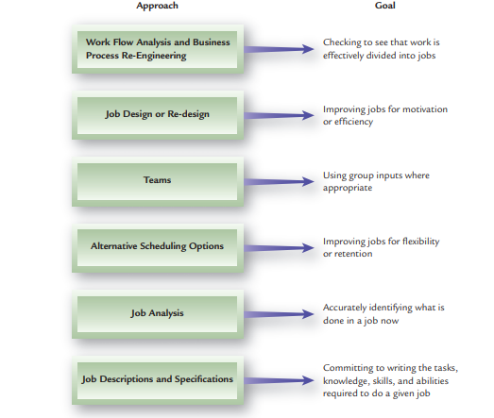
Approaches to Dealing with Jobs
Figure 6-2

Slide 9
Business Process Re-engineering
Business Process Re-engineering (BPR)
Measures for improving such activities as product development, customer service, and service delivery.
Phases of Reengineering
  1. Re-think: Examine how the current organization of work and jobs affects customer satisfaction and service.
  2. Re-design: Analyze how jobs are put together, the workflow, and how results are achieved; then re-design the process, as necessary.
  3. Re-tool: Look at new technologies (equipment, computers, software, AI-powered automation, robotic process automation (RPA), and cloud-based collaboration tools) as opportunities to improve productivity, service quality, and customer satisfaction.

Slide 10
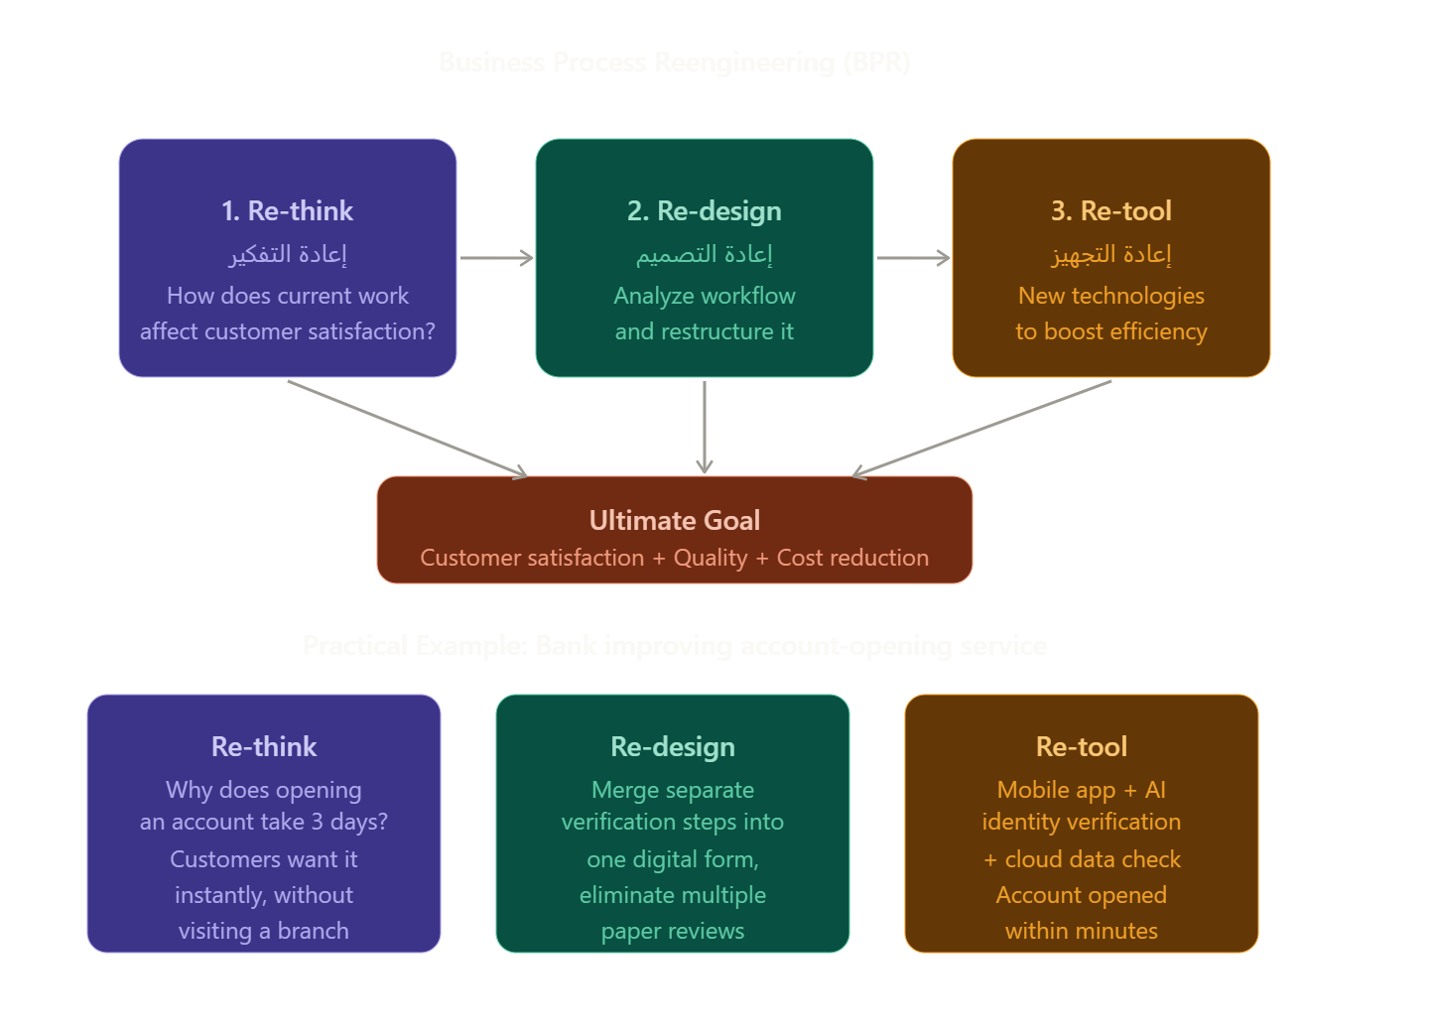
Business Process Re-engineering (BPR) (Cont.)
Figure 6-3

Slide 11
Job Design/Re-design
Job Design
  Organizing tasks, duties, and responsibilities into a productive unit of work.
  Person/job fit Matching characteristics of people with characteristics of jobs.
  Job design can influence the following:
Job Design
Job
Performance
Job
Satisfaction
Physical and
Mental Health
Figure 6-4

Slide 12
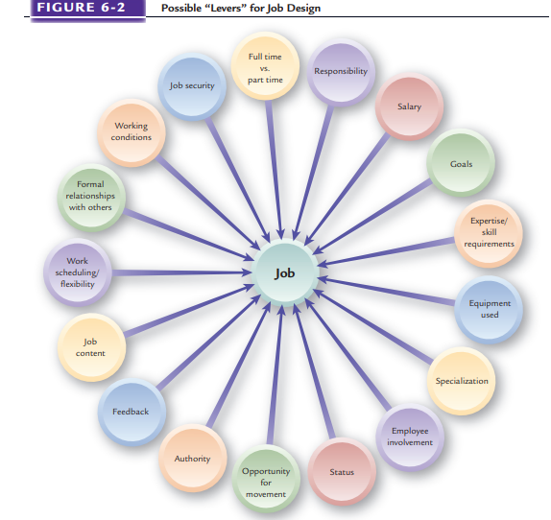
Possible “Levers” for Job Design
Figure 6-5

Slide 13
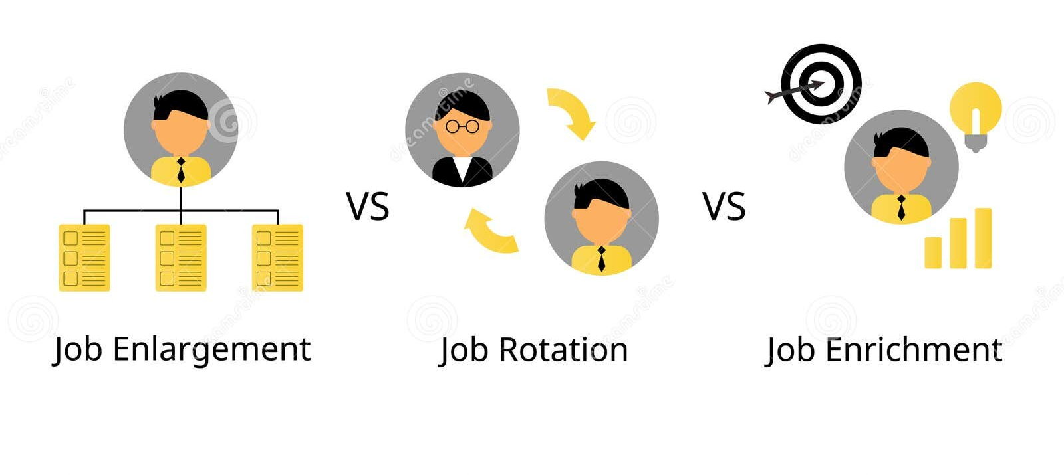

Classic Approaches to Job Design
Job Enlargement
  Broadening the scope of a job by expanding the number of different tasks to be performed.
Job Enrichment
  Increasing the depth of a job by adding the responsibility for planning, organizing , controlling, and evaluating the job.
Job Rotation
  The process of shifting a person from job to job.

Slide 14
Characteristics of Jobs
Job Characteristics
Skill Variety | The extent to which the work requires several different activities for successful completion.
Task Identity | The extent to which the job includes a “whole” identifiable unit of work that is carried out from start to finish and that results in a visible outcome.
Task Significance | The impact the job has on other people.
Autonomy | The extent of individual freedom and discretion in the work and its scheduling.
Feedback | The amount of information received about how well or how poorly one has performed.

Slide 15
Using Teams in Jobs
Types of Teams
Virtual Team | A team whose members work remotely and communicate primarily through digital tools (e.g., Zoom, Teams, Slack)."
Special-Purpose Team | Organizational team formed to address specific problems, improve work processes, and enhance product and service quality.
Quality Circle | Small group of employees who monitor productivity and quality and suggest solutions to problems.
Production Cells | Grouping of workers who produce components or entire products.
Self-directed Work Team | A team composed of individuals assigned a cluster of tasks, duties, and responsibilities to be accomplished.
Shamrock Team | A team composed of a core of members, resource experts who join the team as appropriate, and part-time/temporary members as needed

Slide 16
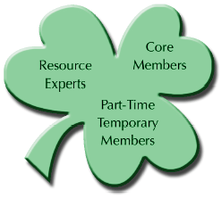
Shamrock Team
Figure 6-6

Slide 17
Team Jobs
Advantages
  Improved productivity
  Increased employee involvement
  More widespread employee learning
  Greater employee ownership of problems
Disadvantages
  Requires employees to be “group oriented”
  Not appropriate for most work in organizations
  Can be overused
  Difficult to measure team performance
  Individual compensation interferes with team concept

Slide 18
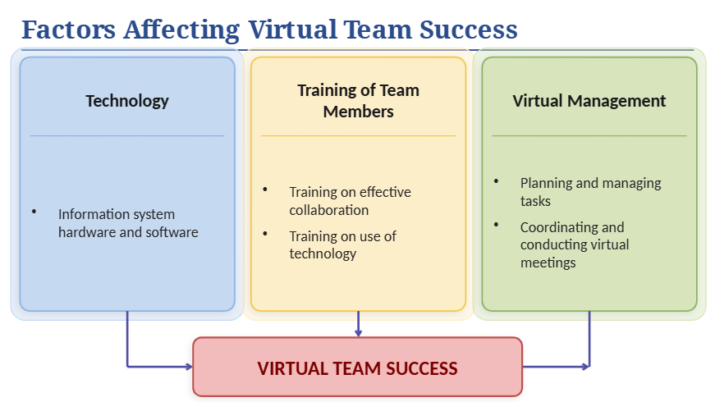
Figure 6-7

Slide 19

Alternative Work Schedules
Flextime
  A work scheduling arrangement in which employees work a set number of hours per day but vary their starting and ending times.
Compressed Work Week
  A work schedule in which a full week’s work is accomplished in fewer than five days.
  Recent research on the four‑day work week (e.g., pilot programs in the UK and Iceland) shows benefits such as reduced burnout and maintained or improved productivity.
  Job sharing Scheduling
  arrangement in which two employees perform the work of one full-time job.

Slide 20

Alternative Work Locations
Telecommuting / Remote Work
Working from home or another location using digital technology.
Temporary Locations
  Hoteling
  Virtual office
Effects of Alternative Work Arrangements
  Greater trust, less direct supervision
  Lack of direct contact (visibility)
  Additionally, research shows that hybrid work (combining remote and on‑site work) has become the most common arrangement for many office jobs.
  Employers now focus on measuring results rather than hours worked.

Slide 21
Nature of Job Analysis
Job analysis : Systematic way of gathering and analyzing information about the content, context, and human requirements of jobs.
  Work activities and behaviors
  Interactions with others
  Performance standards
  Financial and budgeting impact
  Machines and equipment used
  Working conditions
  Supervision given and received
  Knowledge, skills, and abilities needed

Slide 22
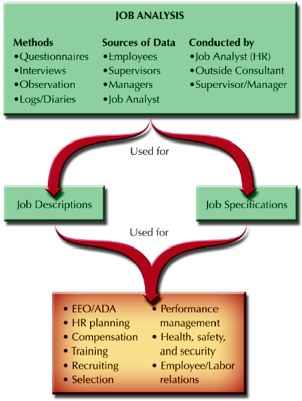
Job Analysis in Perspective
Figure 6-8

Slide 23
Task-based Job Analysis
Task
  A distinct, identifiable work activity composed of motions
Duty
  A larger work segment composed of several tasks that are performed by an individual
Responsibilities
  Obligations to perform certain tasks and duties

Slide 24
Competency Approach To Job Analysis
Competencies
  Basic characteristics that can be linked to enhanced performance by individuals or teams.
Reasons for using the competency approach
  To communicate value behaviors throughout the organization.
  To raise the competency levels of the organization.
  To emphasize the capabilities of people to enhance organizational competitive advantage.

Slide 25
Competency Analysis Methodology
Identify future performance results areas critical to the organization.
Assemble panel groups familiar with the company.
Interview panel members to get examples of job behaviors.
Develop detailed descriptions of competencies.
Rate competencies and levels need to meet them.
Standards of performance are identified and tied to jobs.

Slide 26
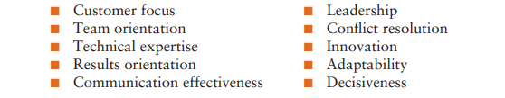
Competency Analysis Methodology (Cont.)
Some of the following have been identified as behavioral competencies:

Slide 27
Choosing a Job Analysis Approach
Whether to use the task-based or competency-based approach to job analysis is affected by the nature of jobs and how work is changing.
In some high technology industries, employees work in cross-functional project teams and shift from project to project.
Organizations in these industries focus less on performing specific tasks and duties and more on competencies needed to attain results.

Slide 28
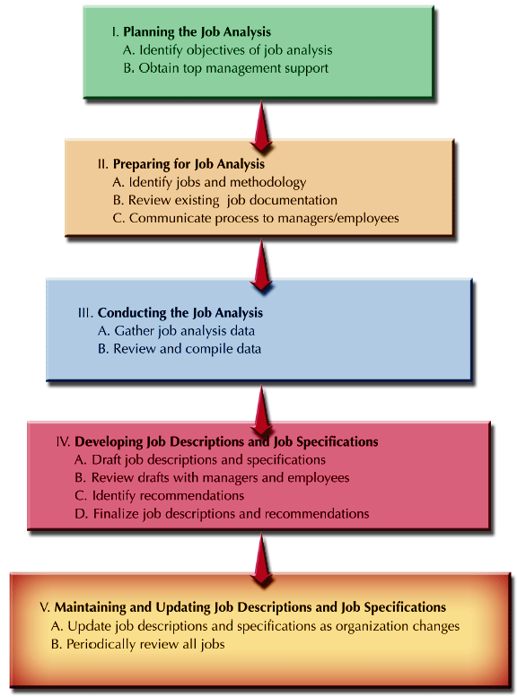
Stages in the Job Analysis Process
Figure 6-9

Slide 29
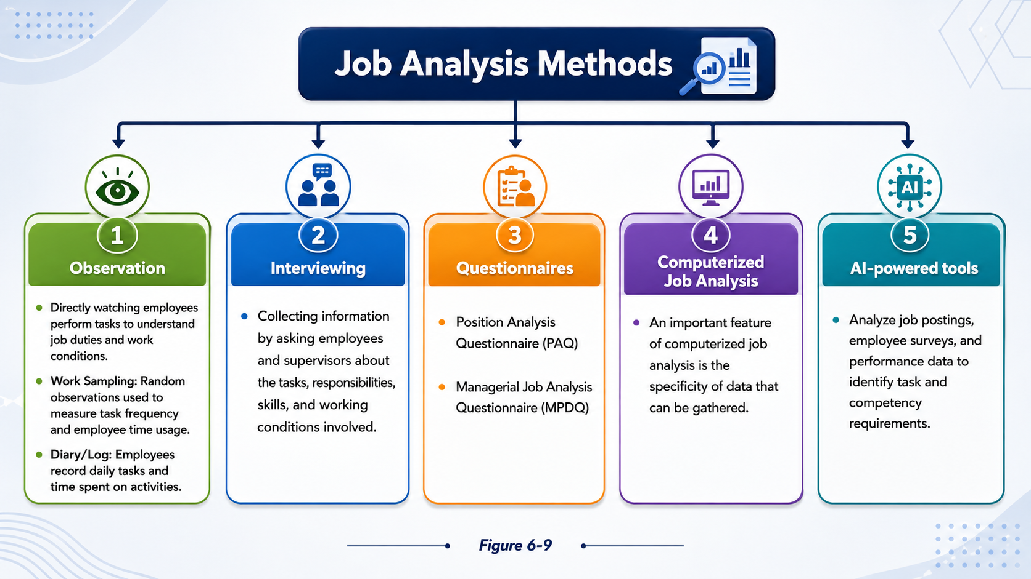
Figure 6-10

Slide 30
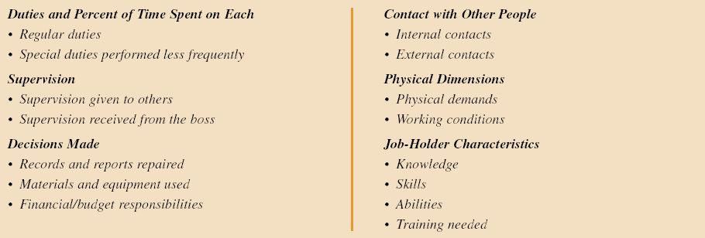
Typical Areas Covered in a Job Analysis Questionnaire

Slide 31
Behavioral Aspects of Job Analysis
“Inflation” of Jobs and Job Titles
Behavioral
Aspects of
Job
Analysis
Employee and Managerial Anxieties
Current Incumbent Emphasis
Figure 6-11

Slide 32
Behavioral Aspects of Job Analysis
“Inflation” of Jobs and Job Titles
Employees and managers have some tendency to inflate the importance and significance of their jobs. Because job analysis information is used for compensation purposes, both managers and employees hope that “puffing up” jobs will result in higher pay levels and greater “status” for résumés and more possible promotion opportunities.

Slide 33
Behavioral Aspects of Job Analysis
Employee and Managerial Anxieties
Managerial Straitjacket :If job descriptions are written restrictively, some employees may use an omission to limit managerial flexibility. The resulting attitude, “It’s not in my job description,” puts a straitjacket on a manager.
Employee Fears: One fear that employees may have concerns the purpose of a detailed investigation of their job. Perhaps they feel that such a detailed look means someone thinks they have done something wrong. The attitude behind such a fear might be “As long as no one knows precisely what I am supposed to be doing, I am safe.”

Slide 34
Behavioral Aspects of Job Analysis
Current Incumbent Emphasis
A job analysis and the resulting job description and job specifications should not describe just what the person currently doing the job does and what his or her qualifications are.
The incumbent may have unique capabilities and the ability to expand the scope of the job to assume more responsibilities.
It is useful to focus on core duties and necessary knowledge, skills, and abilities by determining what the jobs would be if the incumbents quit or were no longer available to do the jobs.

Slide 35
Job Descriptions and Job Specifications
Job Description
  Identification of the tasks, duties, and responsibilities of a job
Performance Standards
  Indicator of what the job accomplishes and how performance is measured in key areas of the job description.
Job Specification
  The knowledge, skills, and abilities (KSAs) an individual needs to perform a job satisfactorily.

Slide 36
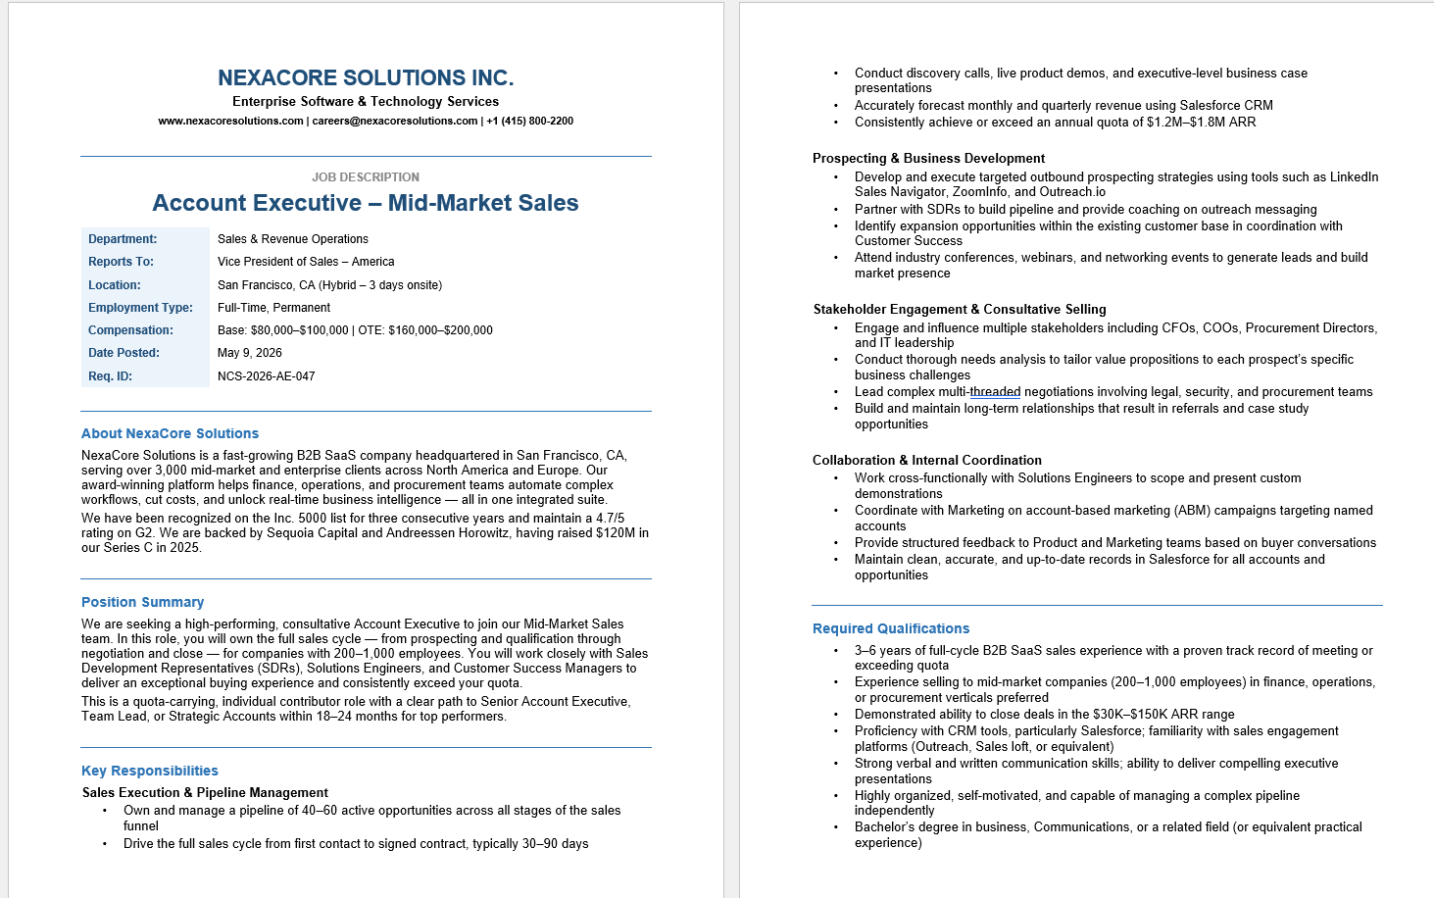
Sample Job Description and Specifications
Figure 6-12a

Slide 37
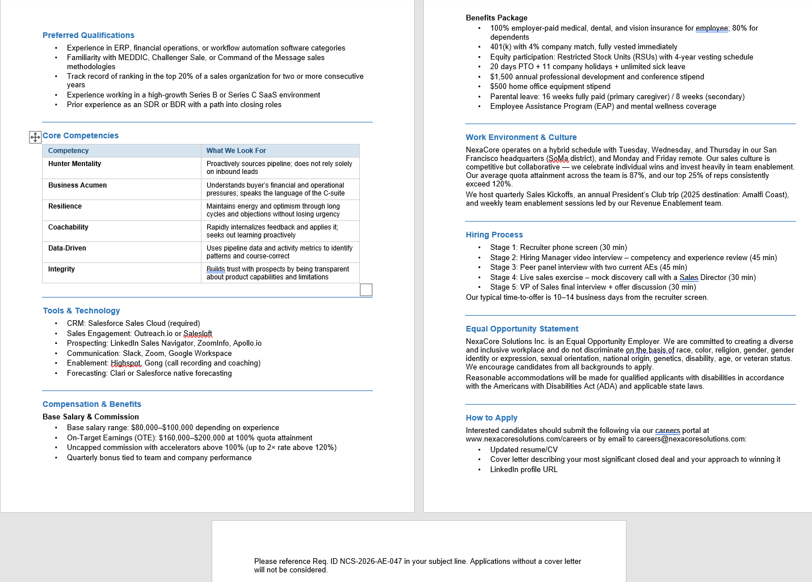
Sample Job Description and Specifications
Figure 6–12b

Slide 38
Job Description Components
Essential Functions and Duties
  Lists major tasks, duties and responsibilities
Job Specifications
  Knowledge, skills, and abilities
  Education and experience
  Physical requirements
  Digital and technology proficiencies
  Behavioral competencies and values alignment
Disclaimer
  Of implied contract
Signature of approvals
Identification
  Job title
  Reporting relationships
  Department
  Location
  Work arrangement (on-site / hybrid / remote)
  organizational level/grade
  Date of analysis
General Summary
  Describes the job’s distinguishing responsibilities and components

Slide 39
SUMMARY
  Changing Jobs Era
  Nature Of Jobs And Work
  Workflow Analysis
  Job Design/Re-design
  Alternative Work Schedules &Locations
  Nature Of Job Analysis
  Task-based Job Analysis
  Competency Approach To Job Analysis
  Job Analysis Methods
  Behavioral Aspects of Job Analysis
  Job Descriptions And Job Specification

Slide 40
References
Armstrong, M., & Taylor, S. (2023). *Armstrong’s handbook of human resource management practice* (16th ed.). Kogan Page.
Dessler, G. (2023). *Human resource management* (17th ed.). Pearson.
Mathis, R. L., Jackson, J. H., Valentine, S., & Meglich, P. (2023). *Human resource management* (16th ed.). Cengage Learning.
Boxall, P., & Purcell, J. (2022). *Strategy and human resource management* (5th ed.). Palgrave Macmillan.
Cappelli, P., & Tavis, A. (2018). HR goes agile. *Harvard Business Review, 96*(2), 46–52.
World Economic Forum. (2023). *The future of jobs report 2023*. WEF.
Harley, A., & Clark, T. (2022). The four‑day work week: A review of global pilot programs. *Human Resource Management International Digest, 30*(5), 12–15.
Tambe, P., Cappelli, P., & Yakubovich, V. (2019). Artificial intelligence in human resources management: Challenges and a path forward. *California Management Review, 61*(4), 15–42.

Slide 41


Thank You

