Slide 1


Value of Information
Prepared by Dr. Sami Alzahrani
PMG 621
Risk and Decision Analysis
Lecture 7

Slide 2


Value of Information
Lecture 7
PMG 621
Risk and Decision Analysis
Prepared by
Dr. Sami Alzahrani
www.midocean.ae

Slide 3

Chapter
Introduction
07
Creating good decision alternatives [I] is one of the most important project management functions. Often, there are opportunities to do additional analysis or to otherwise get more information before making a resource commitment. This chapter shows how to solve value of information problems, where there is an option to obtain more information.
www.midocean.ae

Slide 4
Chapter
07
Revisiting the Wastewater Plant Problem In the Wastewater Plant example in Chapter 5, we evaluate the plan alter- natives with decision tree analysis. The expected value (EV) costs are remarkably similar, ranging from $1.120 to $1.136 million. Figure 6.1 shows the decision model in a "shorthand" format: Implicitly, a copy of every following node is attached to the end of each branch of the preceding node. There are two chance events affecting the cost outcome: Time Plant Operational and Time Other Mine Activities Complete. Whichever chance event is latest controls when the mine commences production.
www.midocean.ae

Slide 5
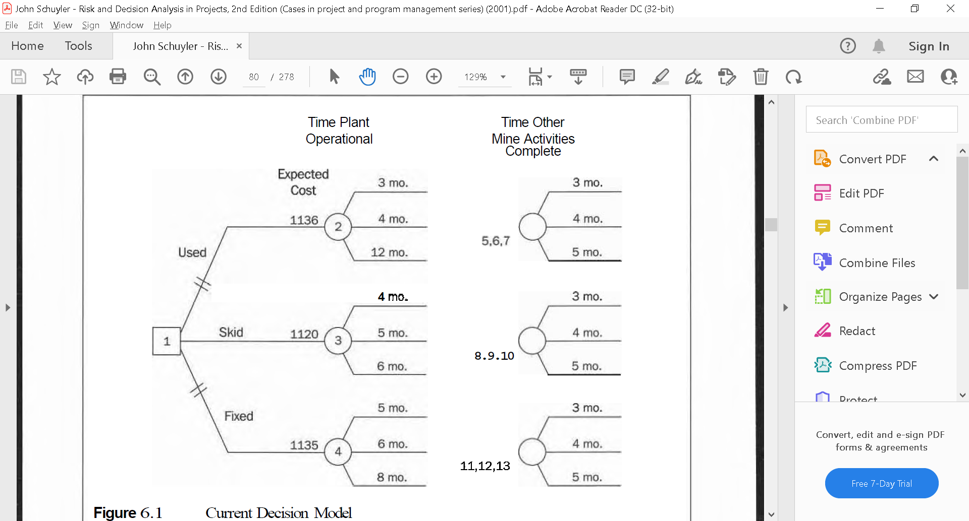
Chapter
07
www.midocean.ae

Slide 6
The decision policy I recommend is to choose the alternative having the lowest EV cost. This is the expected monetary value decision rule, only we are minimizing costs. Schedule and performance criteria are incorporated explicitly into the analysis as cost equivalents, based upon their impact on mine value.
www.midocean.ae

Slide 7
Value of Information:
More information, even imperfect, is generally useful in revising prior assessments. Here are example sources of additional information:
- Prototyping, market studies, and similar directed research
Obtaining and analyzing more data
Modeling in greater detail
Spending additional effort in eliciting expert judgments about model input variables
www.midocean.ae

Slide 8
Time permitting, it might always appear that additional data and analysis are always desirable. However, we should weigh the cost, any delay, and other possible impacts against the value added.
What is the value of additional information? We determine this by adding an information alternative to the decision tree.
www.midocean.ae

Slide 9
A new chance node in the tree represents the possibilities of information-gathering results. We will use the information to revise project assessments or, more often, prior probability assessments.
The equation to determine the value of additional information is:
(value of additional information) =
(value of new decision tree) - (value of old decision tree).
www.midocean.ae

Slide 10
In this calculation, the convention is to temporarily ignore the cost of acquiring the additional information. We compare the value of information to the cost of obtaining the information. If the cost is less than the value, then it is better to acquire the information.
www.midocean.ae

Slide 11
Project delays, often adding to costs, can also be temporarily ignored by assuming that delay is a component of the cost of information. Be certain that the evaluation properly compares the new versus the old tree, both incorporating cost and delay of obtaining more information.
A similar concept is value of control. In a decision analysis, "control" means controlling or influencing the outcome of chance events. Examples include:
www.midocean.ae

Slide 12
Acquiring services or products through turnkey contracts that fix costs
Limiting losses with insurance Protecting commodity prices by forward-selling production.
Specifying higher-grade materials to reduce chance of failure Using conservative operating practices
Investing in backups, redundancy, and flexibility.
.
www.midocean.ae

Slide 13
Valuing additional control is similar to valuing additional information:
compare the new control alternative with the previous best alternative. Control, like information, is most often imperfect.
Note that the analysis does not change the risks. However, information and control concepts often lead to adopting new alternatives with more desirable risk characteristics.
www.midocean.ae

Slide 14
Plant information Alternative:
Now consider a new information alternative for the Wastewater Plant: evaluating the Used Plant first. We can spend approximately one month testing and evaluating the used plant to determine when it could be operational. The evaluation will not change the actual lead-time if we select Used Plant; the used plant would need inspection anyway. The value of the information is in providing a basis to reassess the Used Plant lead-time probabilities.
www.midocean.ae

Slide 15
Lead-times for other alternatives would be the same from the date of commitment. For example, if we spend one month evaluating the Used Plant and then make a decision to purchase a new one, then the New Wastewater Plant acquisition is delayed one month.
www.midocean.ae

Slide 16
The initial cost of evaluating the Used Plant alternative is $30,000 (pre- tax) and is not refundable. This includes a deposit plus the evaluation cost, and would apply to the installation expense if we chose this alternative. Figure 6.2 shows the expanded decision model. The decision tree short-hand illustrates the structure in compact form. The nodes are numbered to match the example calculations to the figures
www.midocean.ae

Slide 17
Revising Probabilities:
The used plant evaluation and testing provide information useful for revising the prior probability assessments in the Time Plant Operational nodes. Note that the evaluation node in this section of the tree is followed by the investment decision. This is necessary to represent how and whether I the new information adds value. If we already know the plant alternative, further information gathering and analysis are pointless.
Additional information adds value to the project only if it has the potential to change what you are going to do.
www.midocean.ae

Slide 18
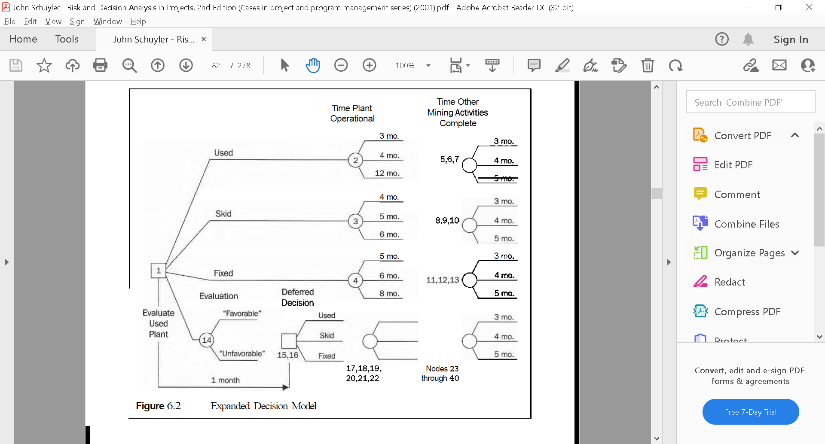
www.midocean.ae

Slide 19
For simplicity, I classified the evaluation results into just two outcomes: "Favorable" and "Unfavorable." Project engineers judge the quality of this imperfect information, as shown in Figure 6.3. These nodes are not numbered, as this tree is a side calculation intermediate step.
www.midocean.ae

Slide 20
The probabilities at the second column of nodes in Figure 6.3 are judgments about the quality of the information. The first node is the prior probability assessments about the event that matters, with today's information. Figure 6.3 has nodes in inverse sequence from the decision model. However, eliciting the judgments in this manner separates them, so that the expert(~) need consider only one event at a time.
www.midocean.ae

Slide 21
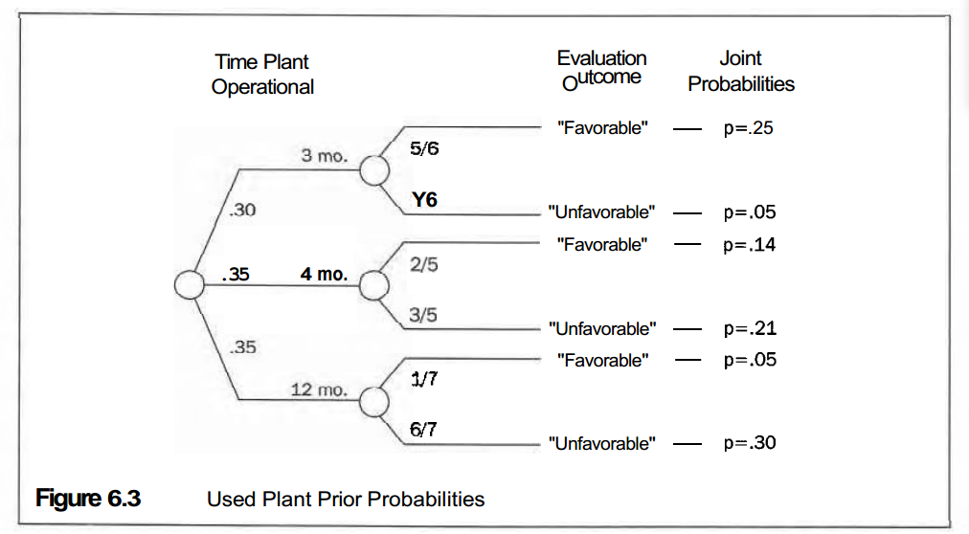
www.midocean.ae

Slide 22
For the decision model (see Figure 6.2 and Figure 6.4), we need to reverse the sequence of the nodes in Figure 6.3. My custom is to place doublequotes about the information event outcome labels to help distinguish the information event (Evaluation Outcome) from the event of interest (Time Plant Operational). The expert assessed probabilities for the evaluation outcomes conditioned upon the Time Plant Operational event outcomes. Rep resenting conditional probabilities is a convenient and powerful feature of decision trees.
www.midocean.ae

Slide 23
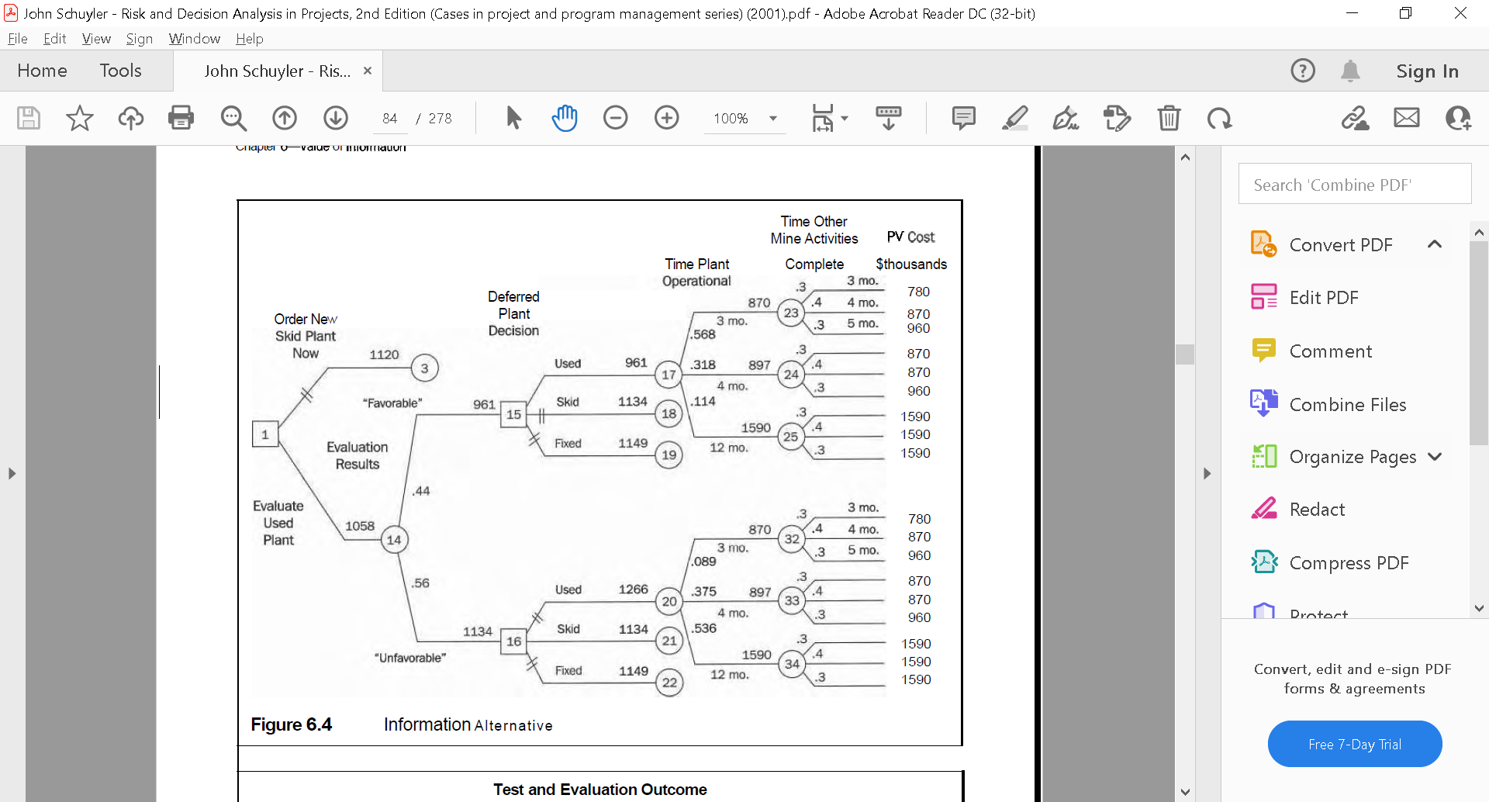
www.midocean.ae

Slide 24
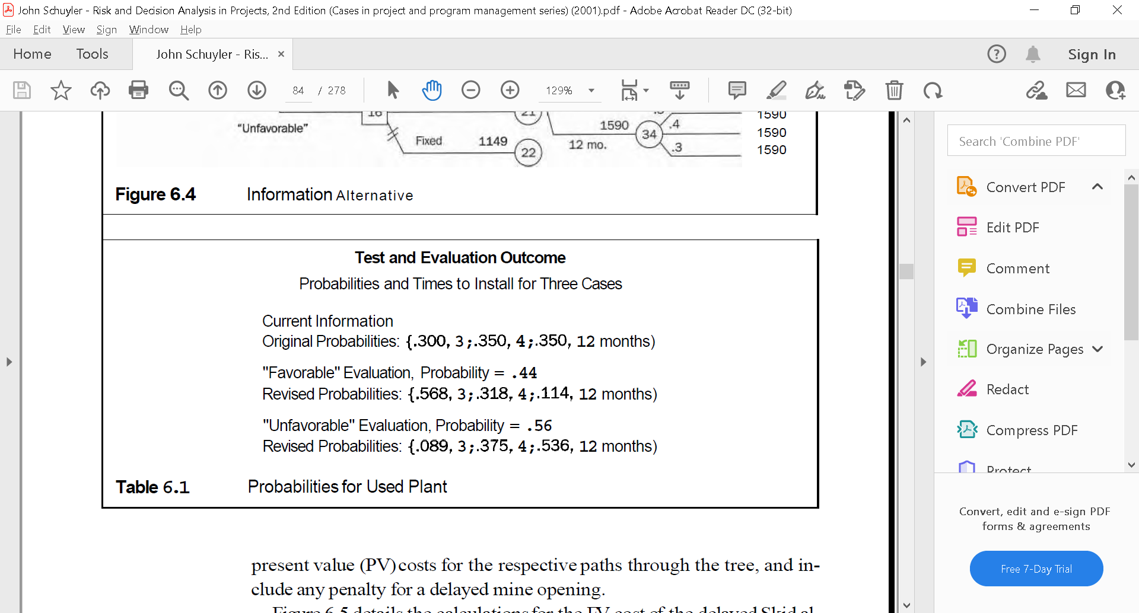
www.midocean.ae

Slide 25
Chapter
07
Figure 6.5 details the calculations for the EV cost of the delayed Skid alternative, given the Evaluate Used Plant choice. This value changed from $1.120 million to $1.134 million because of the added evaluation cost (about $18,000 after taxes) less the present value-timing adjustment (about $4,000) I of delayed investment.
www.midocean.ae

Slide 26
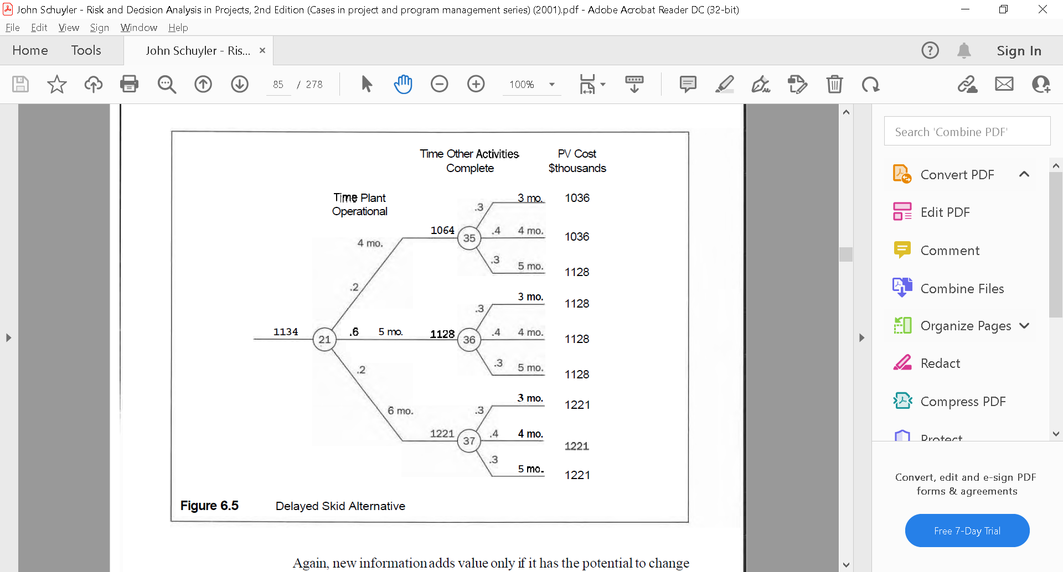
Chapter
07
www.midocean.ae

Slide 27
Chapter
07
Again, new information adds value only if it has the potential to change a decision. In this example, the project manager should choose to install the Used Plant instead of the Skid Plant, if the evaluation result is "Favorable." If the evaluation result is "Unfavorable," then install the Skid Plant as planned.
www.midocean.ae

Slide 28
Chapter
07
The decision tree was back-solved to compute the EV cost for each alternative. Starting at the right, each chance node is replaced (and annotated) with its EV cost. We replace every decision node with the value of its best alternative. Here are several example calculations, starting at the upper right of Figure 6.4 and working backwards:
www.midocean.ae

Slide 29
Chapter
07
EV(23) = $870,000 = .3(780) + .4(870) + .3(960)
EV(17) = $961,000 = .568(870) + .318(897) + .114(1590)
EV(15) = $961,000 = minimum of (961,1134,1149)
EV(14) = $1,058,000 = .44(961) + .56(1134)
www.midocean.ae

Slide 30
Chapter
07
We continually have decision opportunities. We cannot put many into a decision tree, though it is important to represent the key decisions. One option, that adds value to a project, is the ability to terminate a project that is performing poorly. Appendix 6B discusses project "kill" decisions. We extended the Wastewater Plant decision tree analysis to value a new alternative to get more information. Many projects have opportunities to improve value through such additional data gathering and analysis.
www.midocean.ae

Slide 31
Chapter
07
In most cases, it is convenient to structure the decision model using the new information to revise prior probabilities. Alternatively, we can revise assessments for event-outcome values. This usually involves modeling the system to understand and quantify the relationship between the information event (symptom) and the chance event of interest. Occasionally, we may want to model changes in both chance-event probabilities and chance-event out-come values.
www.midocean.ae

Slide 32
Chapter
07
Recourse:
RISK and DECISION ANALYSIS in Projects
Second Edition
By: John Schuyler
Chapter 6
www.midocean.ae

Slide 33


Thank You

