Slide 1



Overview of Management 2
Lecture 2
MGM111
Principle of Management
Prepared by
Dr. Bothaina Mahmoud Fouad
www.midocean.ae
www.midocean.ae

Slide 2

www.midocean.ae
Who is the manager and his needed skills
Difference between Manager and Leader
Explain the Managers and their types
Summarize the essential Management Roles
Understand organization and its performance
The organization functions and process
Learning Outcomes of the Lecture

Slide 3
Chapter
Who is the Manager
02
The people responsible for supervising the use of an organization’s resources to meet its goals.
(Stoner, Freeman and Gilbert, 2008)
Someone who coordinates and oversees the work of other people so that organizational goals can be accomplished.
(Robbins and Coulter, 2012)
Someone whose primary responsibility is to carry out the management process.
(Griffin,2012) 12/26/14 16Contemporary Management
www.midocean.ae

Slide 4
Chapter
Some benefits of being a manager
02
Get to be involved in making important decisions at work
Enjoy some control over what work they do and when and how they work on it
Spend a good deal of time in collaboration with other people and working with teams
Enjoy opportunities for job-related learning and development
Have many options for career advancement within or outside of the workplace
Receive a good salary and benefits
www.midocean.ae

Slide 5
Chapter
Managerial Skills Definition
02
It is a term that refers to the required skills of the manager.
or in another way;
It is the ability to make business decisions and lead the underlying within a company.
Therefore, we can say that no one will make it in the business world without these skills.
www.midocean.ae

Slide 6
Chapter
Manager Skills
02
General skills:
Interpersonal skills
Technical skills
Conceptual skills
Specific skills:
Job knowledge
Oral communication
Problem analysis
Cooperativeness Negotiation
Initiative
www.midocean.ae

Slide 7

Managerial Skills
Technical skills
Human skills
Conceptual skills
Interpersonal Skills
Decision-making Skills
www.midocean.ae

Slide 8
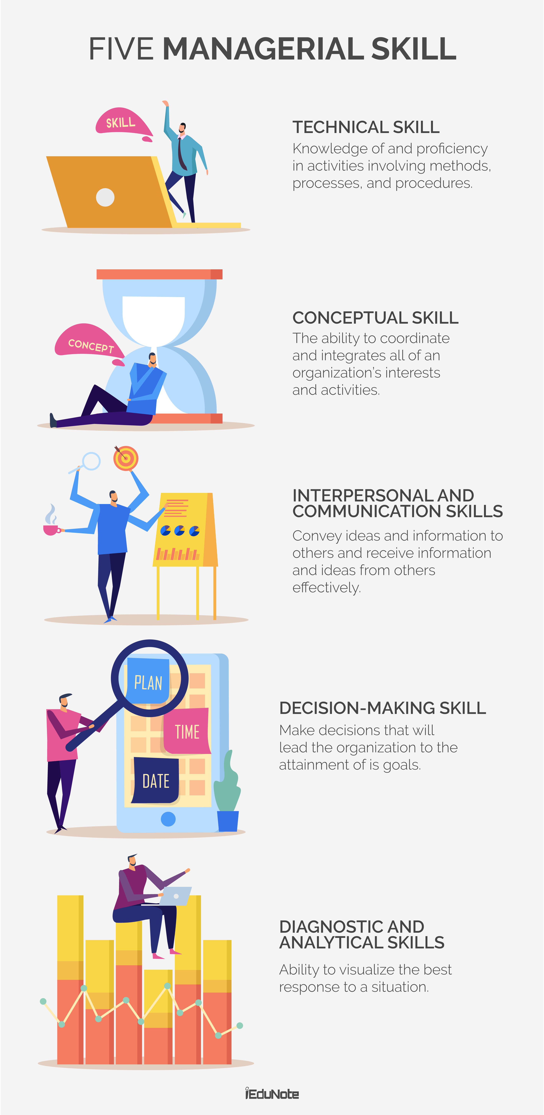
Managerial Skills
www.midocean.ae

Slide 9
Chapter
What Resources does a Manager use?
02
Human Resources-the people. Your most valuable resource!
Financial Resources-the money, the budget
Physical Resources-the buildings, the equipment, supplies
Information-computers, reports
www.midocean.ae

Slide 10
Chapter
Manager’s Roles
02
1. Interpersonal role
2. Informational role
3. Decisional role
www.midocean.ae

Slide 11

Chapter
02
Management Roles
Henry Mintzberg described ten specific management roles that can be placed into three broad categories:
  Interpersonal roles involve interaction with others who are external or internal to the organization, at the same level as the manager, or at higher or lower levels.
  Informational roles focus on obtaining data that are important for the decisions the manager makes.
  Decisional roles deal primarily with the allocation of resources to reach organizational objectives.
www.midocean.ae

Slide 12
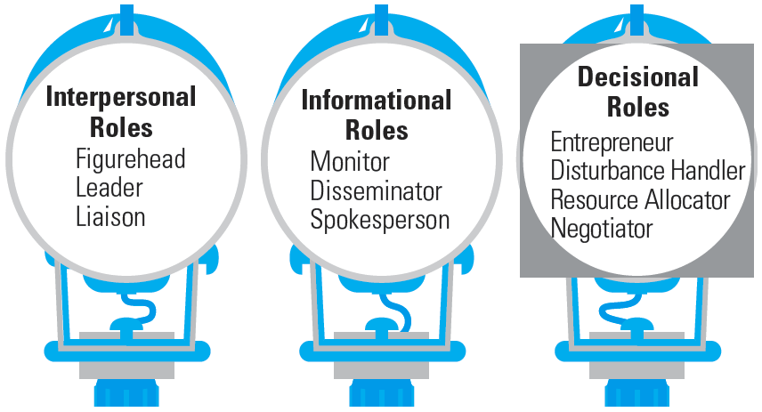
Chapter
02
Ten Roles Managers Play
www.midocean.ae

Slide 13
Chapter
02
Interpersonal role
Roles that managers assume to provide direction and supervision to both employees and the organization as a whole
Figurehead—symbolizing the organization’s mission and what it is seeking to achieve.
Leader—training, counseling, and mentoring high employee performance.
Liaison—linking and coordinating the activities of people and groups both inside and outside the organization.
www.midocean.ae

Slide 14

Chapter
Informational role
02
Roles associated with the tasks needed to obtain and transmit information in the process of managing the organization.
Monitor—analyzing information from both the internal and external environment.
Disseminator—transmitting information to influence the attitudes and behavior of employees.
Spokesperson—using information to positively influence the way people in and out of the organization respond to it.
www.midocean.ae

Slide 15
Chapter
02
Decisional role
Roles associated with methods managers use in planning strategy and utilizing resources
Entrepreneur—deciding which new projects or programs to initiate and to invest resources in.
Disturbance handler—managing an unexpected event or crisis
Resource allocator—assigning resources between functions and divisions, setting the budgets of lower managers.
Negotiator—reaching agreements between other managers, unions, customers, or shareholders.
www.midocean.ae

Slide 16
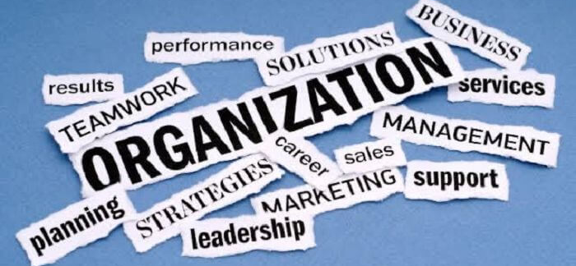
What is an Organization?
www.midocean.ae

Slide 17
The Organization Definition
A group of people who work together in a structured way for a shared purpose
is a two or more people who work together in a structured way to achieve a specific goal or set of goals
can be any structured body such as department, business, company in private or public sector or nonprofit association.
www.midocean.ae

Slide 18
Other definition
organization
people
resource
Goals and objectives
is an arrangement of people and resources to accomplish some specific purpose
www.midocean.ae

Slide 19
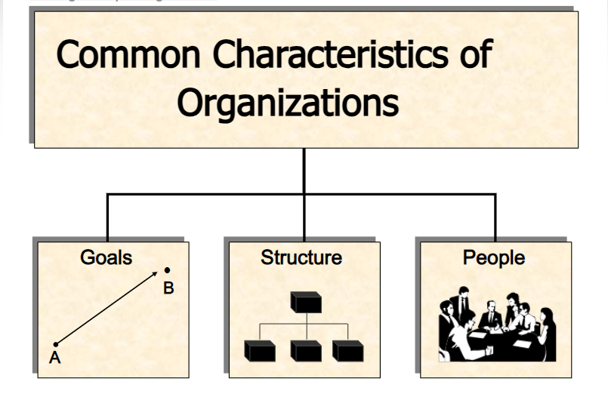
Common Characteristics of Organizations
Have a distinct purpose (goal)
Composed of people
Have a deliberate structure
www.midocean.ae

Slide 20
Chapter
Organizational Performance
02
• A measure of how efficiently and effectively managers use available resources to satisfy customers and achieve organizational goals
Efficiency – A measure of how well or how productively resources are used to achieve a goal
Effectiveness – A measure of the appropriateness of the goals an organization is pursuing and the degree to which they are achieved
www.midocean.ae

Slide 21
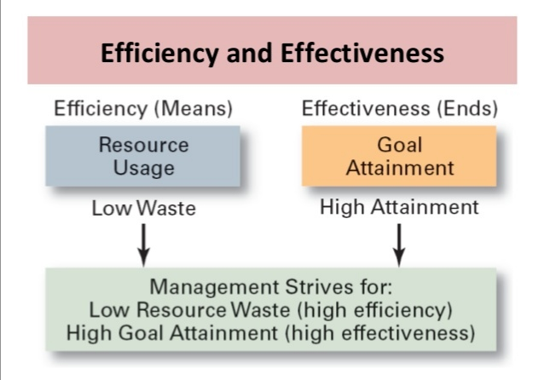
Chapter
Organizational Performance
02
www.midocean.ae

Slide 22
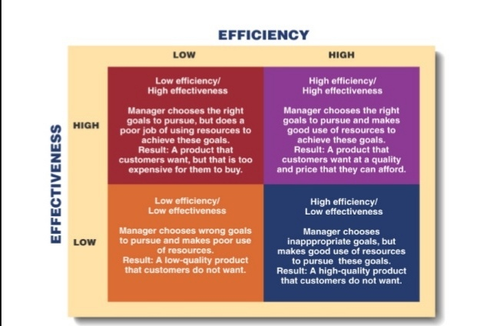
Chapter
Efficiency Vs. Effectiveness
02
www.midocean.ae

Slide 23
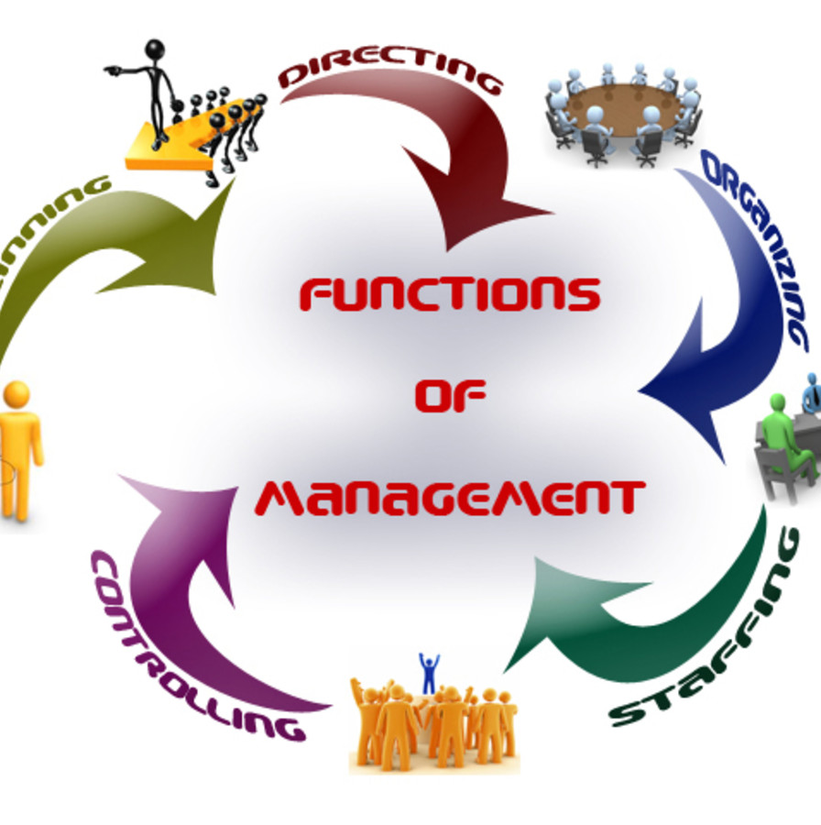
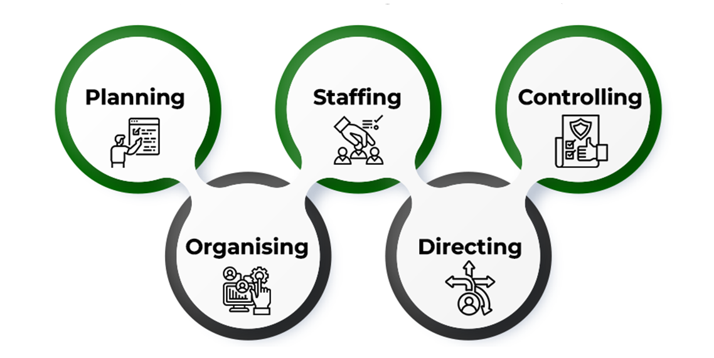
Management Functions
www.midocean.ae

Slide 24
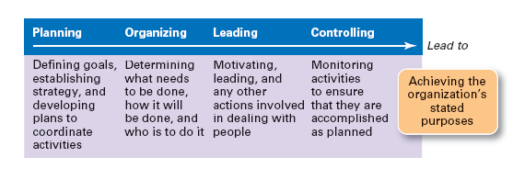
www.midocean.ae

Slide 25
Chapter
1. Planning
02
Planning is setting objectives
Process of identifying and selecting appropriate organizational goals and courses of action.
Planning is determining the objectives and formulating the methods to achieve them. It is more simply said than done
Determining how they’ll be met
www.midocean.ae

Slide 26
Chapter
02
A job well planned is half done
www.midocean.ae

Slide 27
Chapter
2. Organizing
02
Organizing is assembling and coordinating the human, financial, physical, informational, and other resources needed to achieve goals
Delegating and coordinating tasks
Managers lay out lines of authority and responsibility
Allocating resources
www.midocean.ae

Slide 28
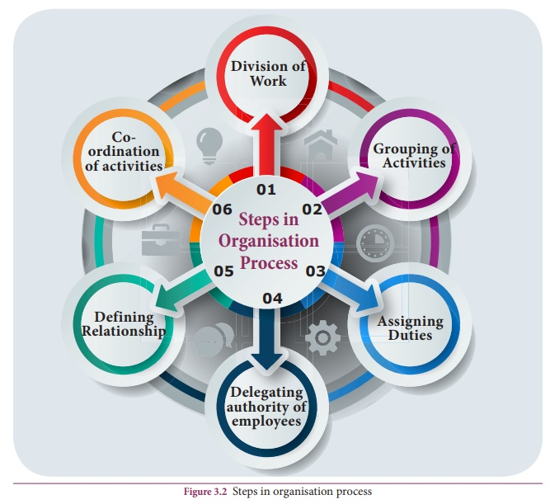
Chapter
Organizing Process
02
Determine what is to be done/ Division of Work
Assign Tasks: Departmentalization
Link Departments: Hierarchy Development
Decide how much Authority to Designate/ Authority, Responsibility and Delegation
Decide the Levels at which Decisions are to be made / Centralization vs. Decentralization
Decide how to Achieve Coordination
www.midocean.ae

Slide 29
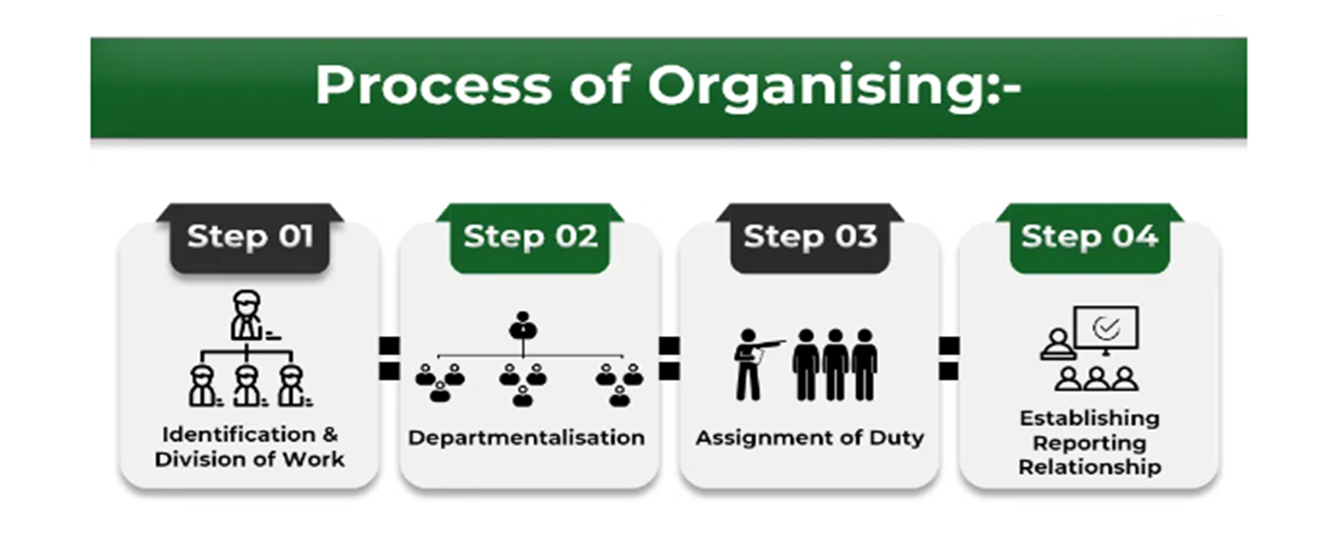
Organizing Process
www.midocean.ae

Slide 30
Chapter
Organizing Process
02
1. Identification and Division of Work:
The function of organizing starts with the identification of the total work which is to be done to achieve the organizational goal. The work is divided systematically so that each person gets a separate task to perform. This helps to avoid unnecessary duplication and wastage of efforts and facilitates the specialization of efforts and skills.
2. Departmentalization:
Once the identification and division of work are done. The next step is to combine group-related activities into units and departments. This process of grouping similar and related activities into groups of large independent units or departments is known as departmentalization. The grouping may be done on the basis of function, product, customer, etc.
www.midocean.ae

Slide 31
Chapter
Organizing Process
02
3. Assignment of Duty:
After grouping various activities into departments, the next step is necessary to allocate the work of different employees. Duty should be assigned based on the knowledge, qualification, experience, and capability of the individual. There should be a proper match between job requirements and the capabilities of employees.
4. Establishing Reporting Relationship:
After assigning duty, the next step is to clearly define the authority and responsibility of the employees. If two or more person is working together for a common goal, then it is necessary to define the relationship between them in clear terms. There is a need to create a hierarchical structure and help in coordination among various departments.
www.midocean.ae

Slide 32
Chapter
3. Leading
02
Leading is stimulating people to be high performers. It is directing, motivating and communicating with employees.
Articulating a clear organizational vision for its members to accomplish, and energize and enable employees so that everyone understands the part they play in achieving organizational goals
Influencing employees to achieve objectives
www.midocean.ae

Slide 33

Management Vs. Leadership
Management
Leadership
is the ability to organize resources and coordinate the execution of tasks necessary to reach a goal in a timely and cost effective manner
is the process of influencing people and providing an environment for them to achieve team or organizational objectives
www.midocean.ae

Slide 34
Chapter
4. Controlling
02
Is the management function of monitoring progress and making changes.
Establishing mechanisms to make sure objectives are met
Implementing mechanisms to make sure objectives are met
www.midocean.ae

Slide 35
Chapter
Steps in the Control Process
02
Establish Standards of Performance
Measure Actual Performance
Compare Performance to Standard
Take Corrective Action
www.midocean.ae

Slide 36
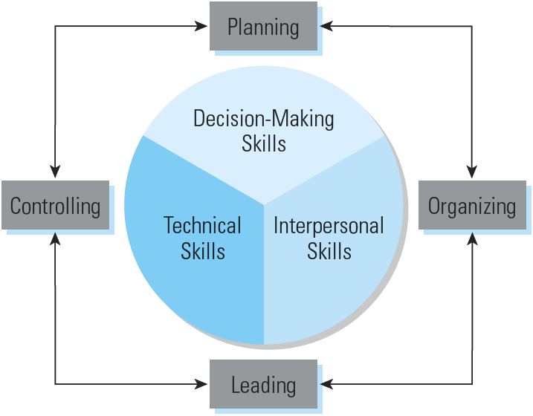
Chapter
Management Skills and Functions
02
www.midocean.ae

Slide 37

Chapter
Functional Area of Business
02
Marketing
Finance
Production
Human Resources
www.midocean.ae

Slide 38
Chapter
Functional Area of Business
02
Production
  Idea generation
  Processing (changing and improving the form of another product)
  Manufacturing (combines raw materials and processes goods into finished products)
www.midocean.ae

Slide 39
Chapter
Functional Area of Business, Con’t
02
Marketing
  Planning and executing the conception, product ,pricing, promotion, and distribution of ideas, goods, and services to create exchanges that satisfy individual and organizational objectives
www.midocean.ae

Slide 40
Chapter
Functional Area of Business, Con’t
02
Finance
  Revenue, expenses, budget, financial records and financial statements
www.midocean.ae

Slide 41
Chapter
Functional Area of Business, Con’t
02
Human Resources = HR
  People who work for a business/organization
  Involves in planning & staffing, performance management, compensation & benefits, and employee relations
www.midocean.ae

Slide 42
Chapter
2
Emerging Trends in Management
Three major trends are impacting businesses today:
  Electronic business (e-business): Achieving management goals through the use of the Internet
  Global organizations: Expanding business activities beyond national boundaries
  Ethics and social responsibility: Leadership in promoting ethical and socially responsible business decisions
www.midocean.ae

Slide 43



Thank You

