Slide 1


CyberSecurity Fundamentals
Master of Science in Cybersecurity
Orientation show
عرض توجيهي
Dr. Redhwan Saad
Everyone Smart University
Faculty of IT
2022

Slide 2
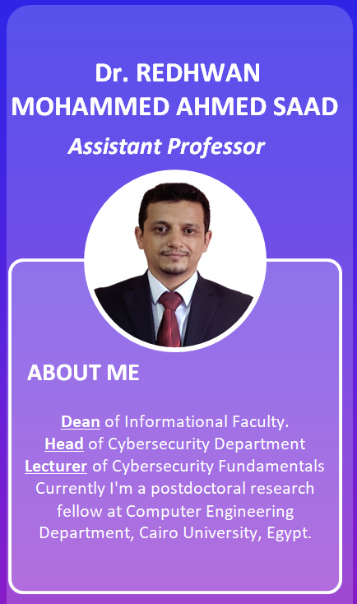

Who Am I?
Dr. Redhwan Mohammed Ahmed Saad
  Assistant Professor in Internet Infrastructure Security
    Ph.D from USM, Malaysia, April. 2016
    Thesis: “ICMPv6 Echo Request DDoS Attack Detection Framework using a Back-propagation Neural Network”.
    M.Sc from “LETI”, RUSSIA, Sep.2007
    B.Sc from “LETI”, RUSSIA, Sep.2004
Cybersecurity Fundamentals, Dr. Redhwan Mohammed, Summer 2022

Slide 3



Who Am I?
  How to reach me
    By email at redhwan@esu.ac.ae
    ( please include “Cybersecurity Fundamentals” in subject line)
  Office hours
  Discussion Time (Tuesday at 9:00 PM) every day
https://scholar.google.com.my/citations?user=4CFExCUAAAAJ&hl=en
https://www.scopus.com/authid/detail.uri?authorId=56105545600
https://orcid.org/0000-0001-7241-9327
Cybersecurity Fundamentals, Dr. Redhwan Mohammed, Summer 2022

Slide 4
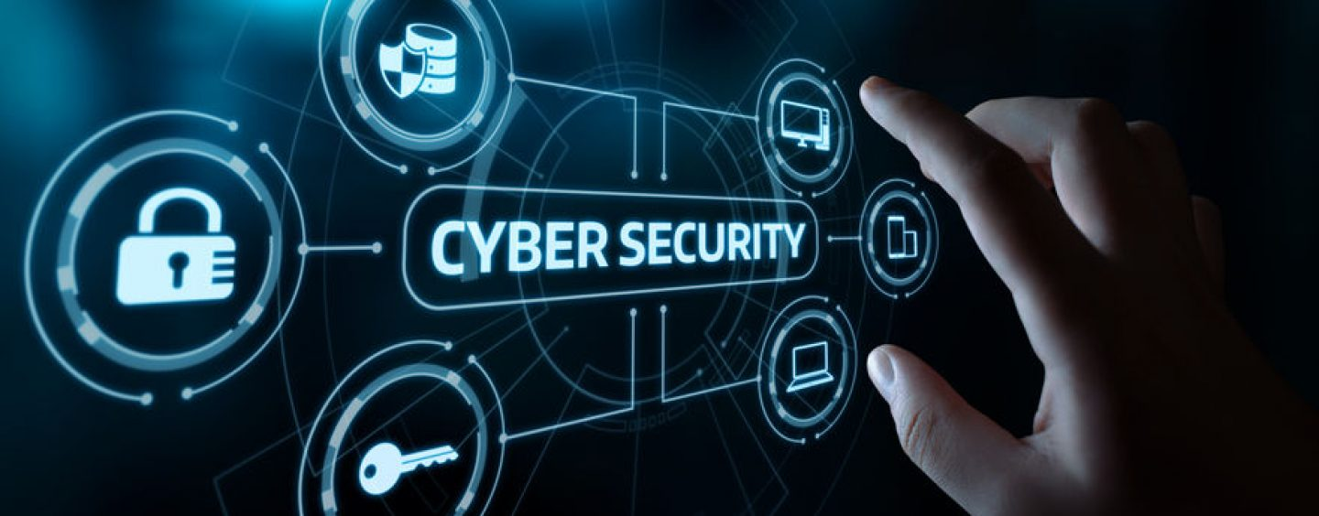
The course that will be taught
Cybersecurity Fundamentals
Cybersecurity Fundamentals, Dr. Redhwan Mohammed, Summer 2022

Slide 5
Primary Goal of This Course
This course aims to:
  Provide students with concepts of
  computer security,
  cryptography,
  secure protocols,
  detection and prevention,
  and other security techniques.
Cybersecurity Fundamentals, Dr. Redhwan Mohammed, Summer 2022

Slide 6
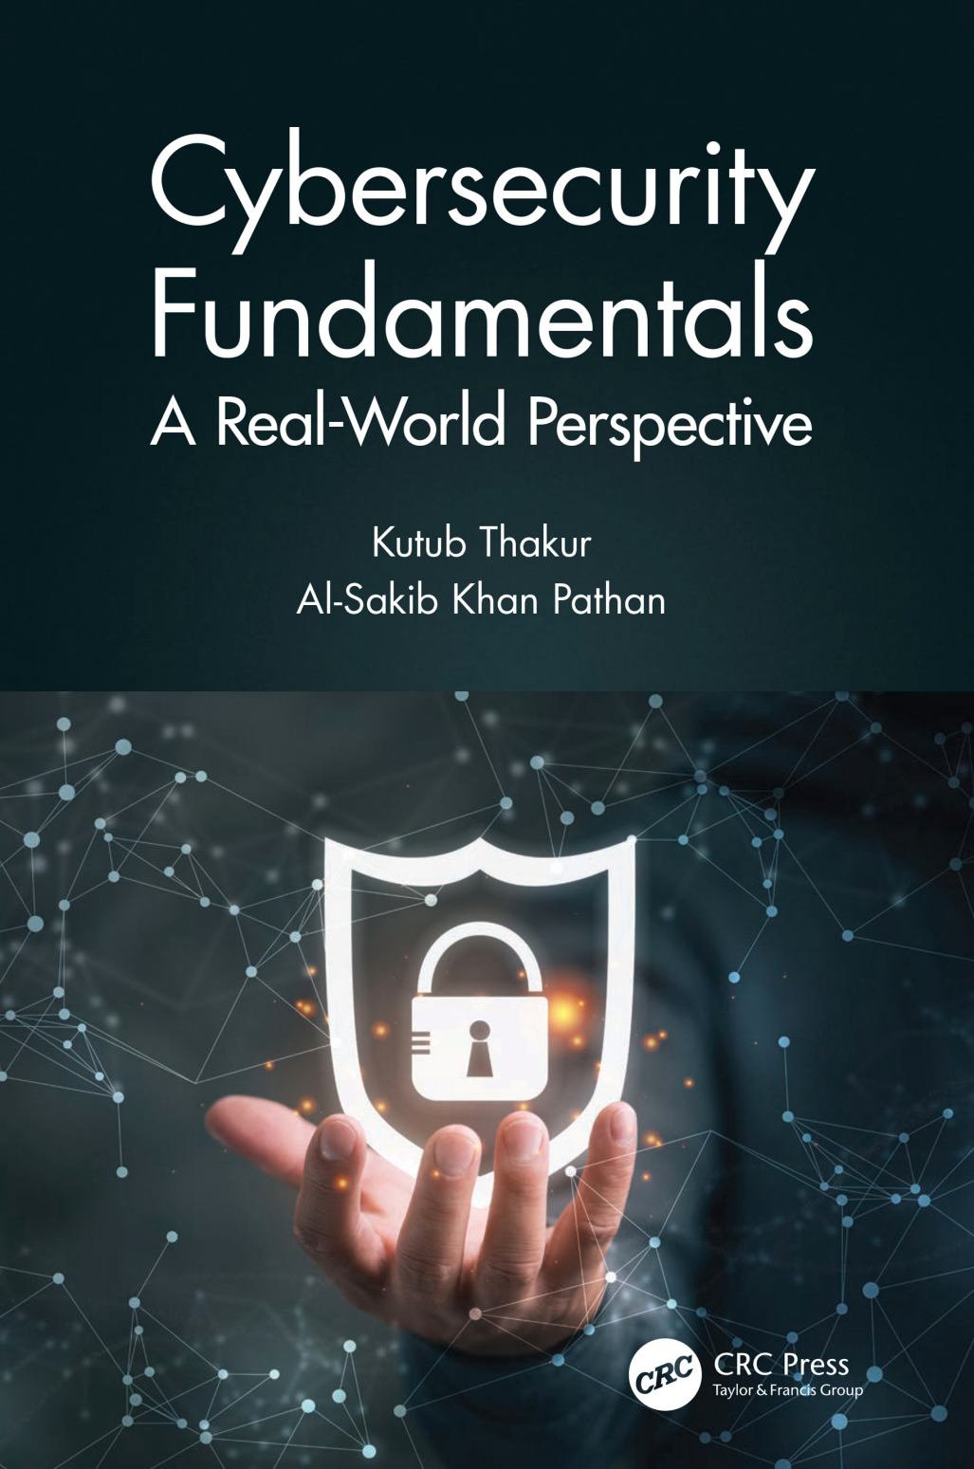
Learning Resources:
Credit Hours:
3 credit hours.
  Required Textbook:
  ISACA, C. (2015). Cybersecurity Fundamentals: ISACA Rolling Meadows.
  Graham, J., Olson, R., & Howard, R. (Eds.). (2016). Cyber security essentials. CRC Press.
  Essential References:
Thakur, K., & Pathan, A. S. K. (2020). Cybersecurity Fundamentals: A Real-World Perspective. CRC Press.
Cybersecurity Fundamentals, Dr. Redhwan Mohammed, Summer 2022

Slide 7
What This Course is About
  The course will help students to gauge understanding in essential techniques in
  protecting information systems,
  IT infrastructure,
  analyzing and monitoring potential threats and attacks,
  devising security architecture,
  and implementing security solutions.
Cybersecurity Fundamentals, Dr. Redhwan Mohammed, Summer 2022

Slide 8
Units of Course Contents
  Lecture Structure:
Module | Course Unit | No.of. Weeks | Contact Hours
1 | Lecture_1_Introduction to Networks Concepts | 1st | 3
2 | Lecture_2_Introduction to Cyber Security Concepts | 2nd | 3
3 | Lecture_3_Hackers and Cyber Crime | 3 | 3
4 | Lecture_4_Malware | 4 | 3
5 | Lecture_5_Attacks Type | 5 | 3
6 | Lecture_6 Securing Your Computers | 6 | 3
7 | Lecture_7_Password Management | 7 | 3
8 | Lecture_8_Prevention from Cyberattacks | 8 | 3
9 | Lecture_9_Wireless Network Security and Mobile Device Security | 9 | 3
10 | Lecture_10_Cybersecurity Standards | 10 | 3
Cybersecurity Fundamentals, Dr. Redhwan Mohammed, Summer 2022

Slide 9

Course Information
  Assessment Method:
Short Exam
  80% marks
    Count of short Exam 10 (Weekly)
    8 Marks for each of short Exam.
  20% Final Examination
Cybersecurity Fundamentals, Dr. Redhwan Mohammed, Summer 2022

Slide 10


Summer 2022
Cybersecurity Fundamentals, Dr. Redhwan Mohammed, Summer 2022

Slide 11
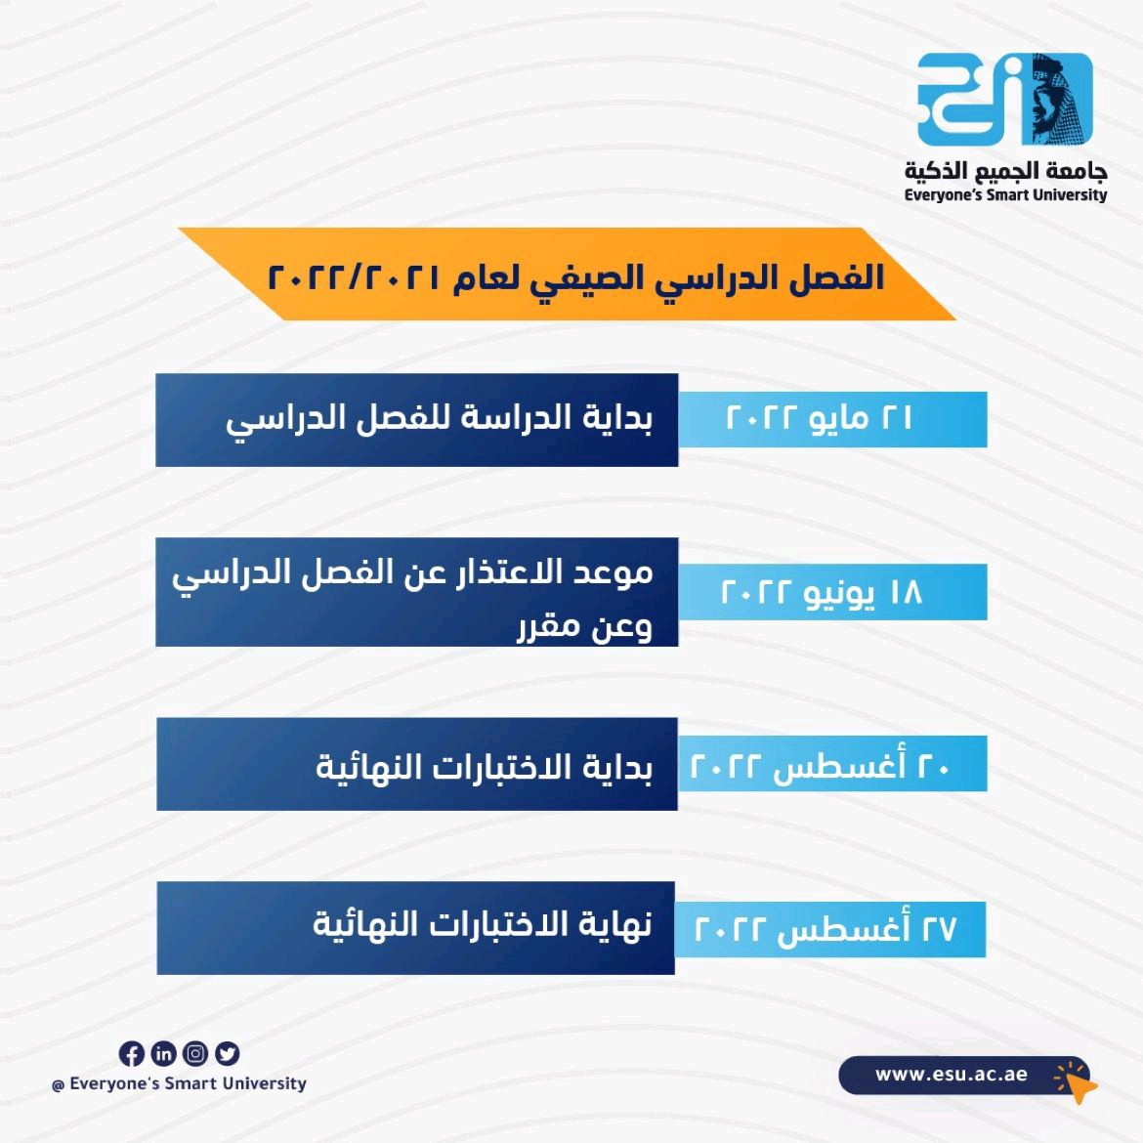
Academic Calendar
Cybersecurity Fundamentals, Dr. Redhwan Mohammed, Summer 2022

Slide 12
Academic Calendar
الفترة الزمنية التعليمية في الفصل الدراسي الصيف تكون مدة ١٣أسبوع
(منهم أسبوعين للاختبار النهائي)
Cybersecurity Fundamentals, Dr. Redhwan Mohammed, Summer 2022

Slide 13
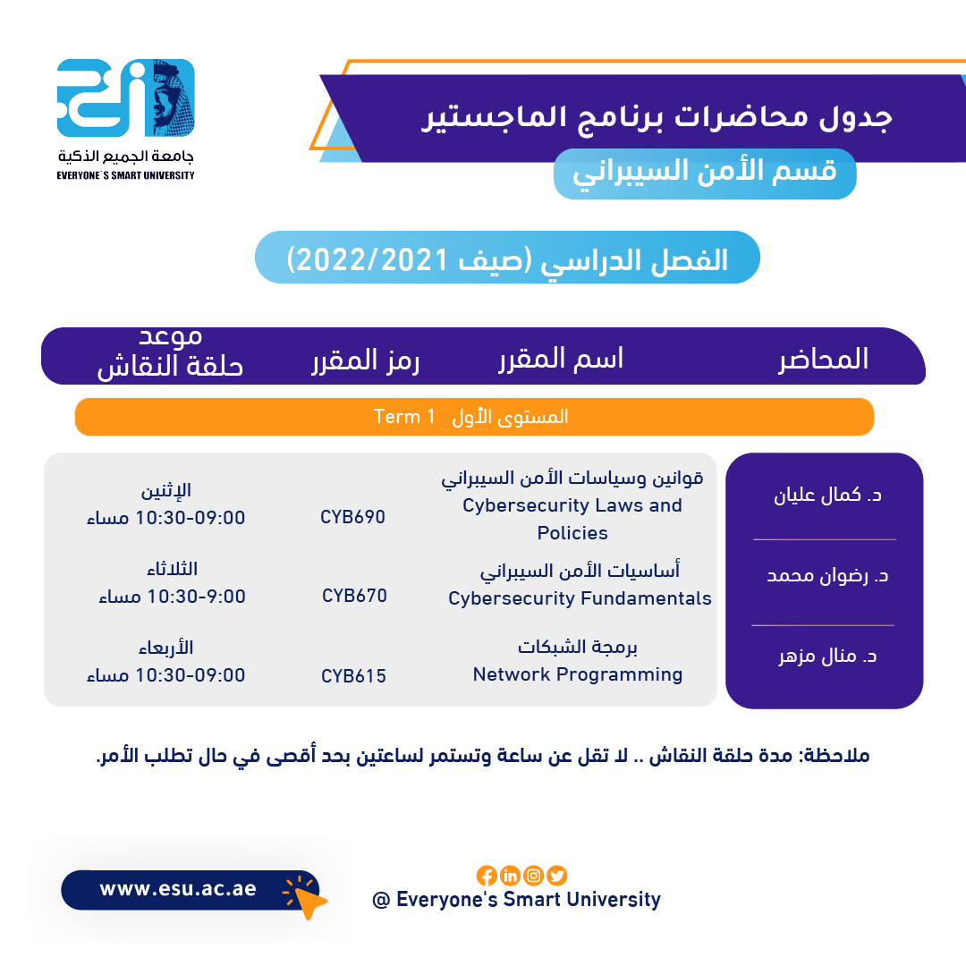
Academic Calendar
عبر برنامج ZOOM
سيتم تثبيت رابط حلقة النقاش على صفحة المقرر
Cybersecurity Fundamentals, Dr. Redhwan Mohammed, Summer 2022

Slide 14
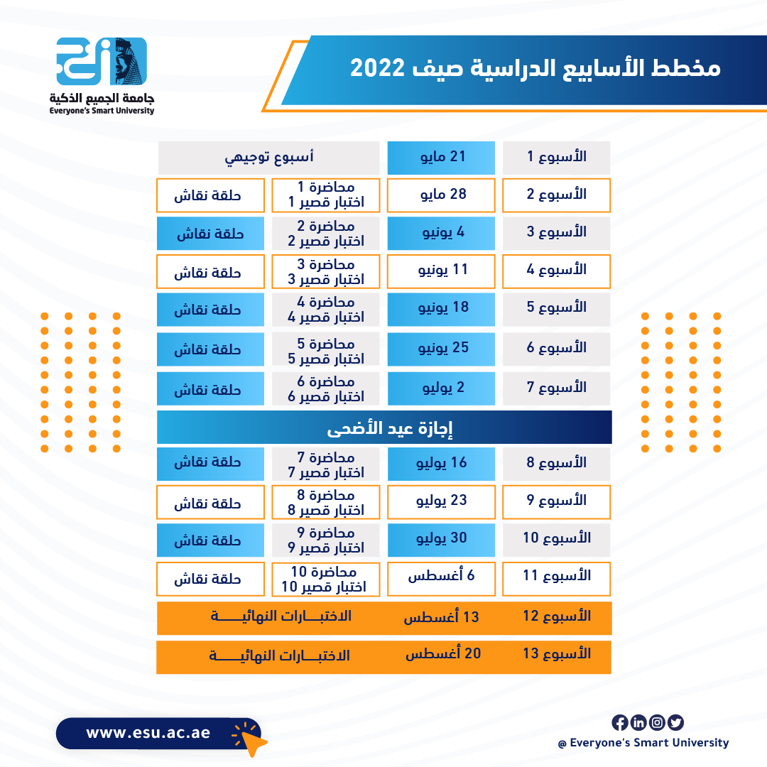
Academic Calendar
Cybersecurity Fundamentals, Dr. Redhwan Mohammed, Summer 2022

Slide 15
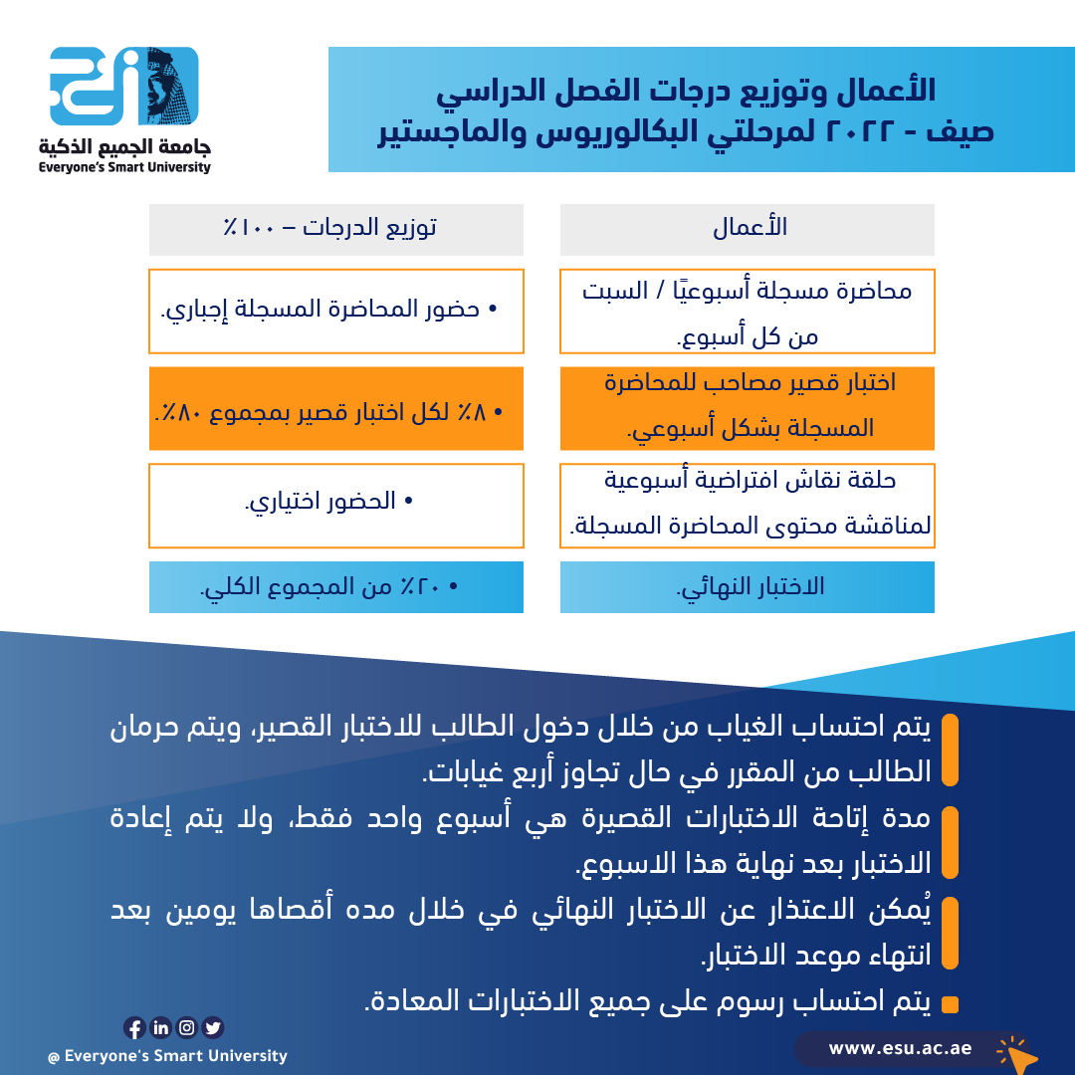
Academic Calendar
-- اللغة الأساسية في المحاضرات هي:
اللغة الإنجليزية
-- الاختبارات باللغة الإنجليزية مع وجود
ترجمة للسؤال.
Cybersecurity Fundamentals, Dr. Redhwan Mohammed, Summer 2022

Slide 16


