Slide 1

Project Risk &Supply Chain Risk
Prepared by Dr. Dalia Hosni
Lecture 3
PMG 663
Project Risk &Supply Chain Risk

Slide 2

Chapter
03
Project Risk Topics
Plan Risk Management
Identify Risks
Perform Qualitative Risk Analysis
Perform Quantitative Risk Analysis
Plan Risk Responses
Monitor and Control Risks

Slide 3
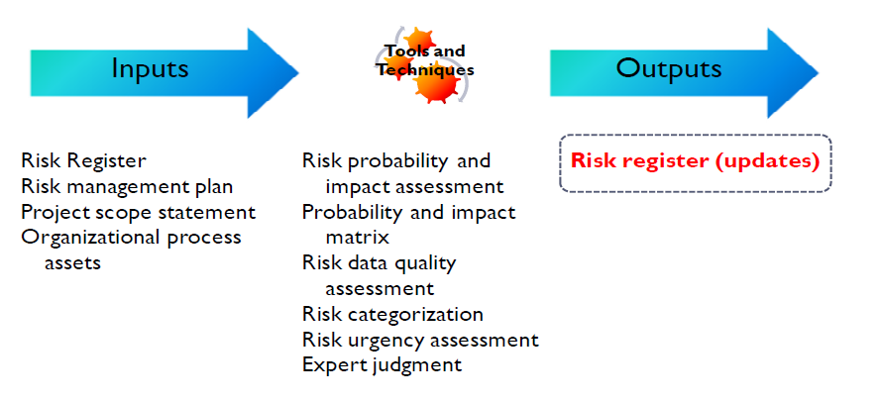
Chapter
03
Perform Qualitative Risk Analysis
The only output to the qualitative risk analysis process is updates to the risk register.
To perform these updates, we use a battery of tools and techniques to help us perform qualitative risk analysis.

Slide 4
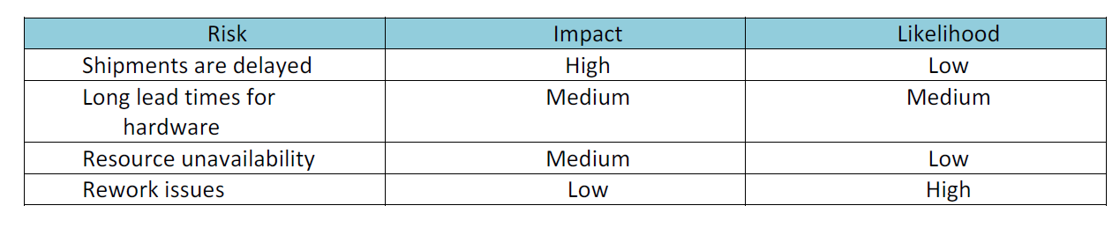
Chapter
03
Perform Qualitative Risk Analysis
Qualitative Risk Assessment Matrix
The qualitative risk assessment matrix offers a summary level of the potential impact of the risk, based on approximate percentages. Notice that this matrix shows general percentages that are not tied to specific dollar amounts or timelines. Another way of showing a qualitative impact is to rank the probabilities as high, medium or low:

Slide 5
Chapter
03
Perform Qualitative Risk Analysis
Risk Register Updates
Partial List of Risk Register Updates:
Ranking and prioritization of project risks
Grouping risks by categories
Risks requiring near-term response
Risks requiring additional analysis and response
Low priority risks to monitor
Look for trends in results – regression analysis or trend charts

Slide 6
Chapter
03
Perform Qualitative Risk Analysis
Risk Register Updates
Risk register updates will generally include the outcome of risk assessments, risk audits, and periodic risk reviews. This can include identification of new risk events or updates to risk probability, risk impact, risk priority and risk response plans
An important use of the risk register is to view the actual outcomes of the project risks and risk responses against anticipated risks. This data can help project managers plan for risk as the project moves forward

Slide 7

Chapter
03
Perform Qualitative Risk Analysis
Risk Register Updates
Risk Register updates are an output of Perform Qualitative Risk Analysis, Perform Quantitative Risk Analysis, Plan Risk Responses and Monitor & Control Risks.

Slide 8
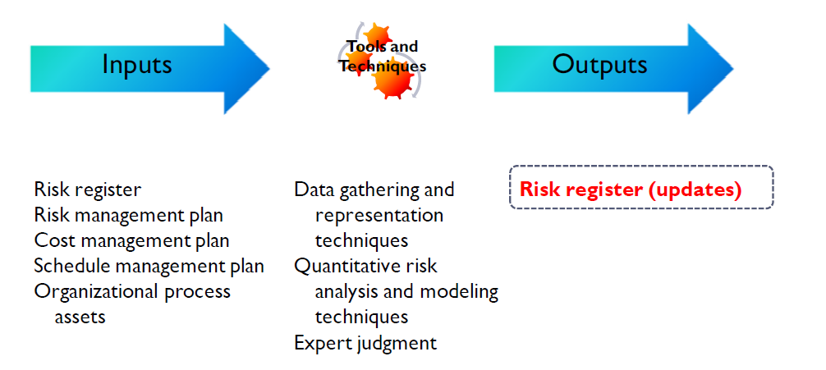
Chapter
03
Perform Quantitative Risk Analysis

Slide 9
Chapter
03
Perform Quantitative Risk Analysis
Quantitative risk analysis involves the numerical quantification and measurement of the effects of identified risks on the project. It frequently involves the use of sophisticated mathematical modeling techniques to create forecasts and trend analysis.

Slide 10
Chapter
03
Perform Quantitative Risk Analysis
One of the more common analysis and
modeling techniques is the sensitivity
analysis, which is used to identify the
risks with the largest potential impact
on the project. The tornado diagram is
frequently used to display the
sensitivity analysis. The example
shown is from the US Department of
Transportation

Slide 11
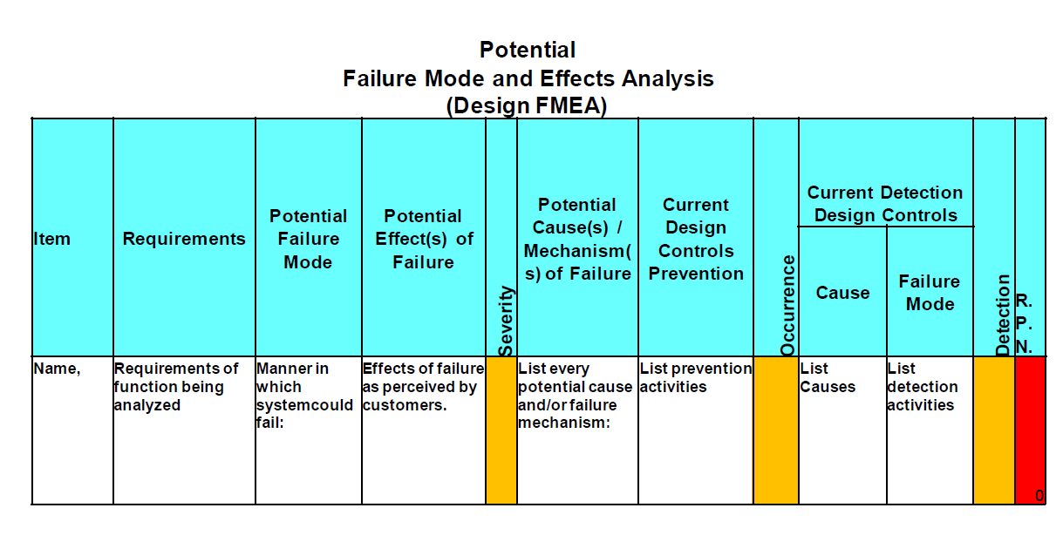
Chapter
03
قابلية الكشف
Perform Quantitative Risk Analysis
Failure Modes Effects Analysis (FMEA)
احتمالية الحدوث
شدة الخطر

Slide 12
Chapter
03
Perform Quantitative Risk Analysis
FMEA: Failure Modes Effects Analysis. The FMEA is useful for manufactured product or where risk may be undetectable:
Utilizes three measures: 1) Severity, 2) Occurrence, 3) Detectability to produce the Risk Priority Number (RPN) : The higher the RPN, the greater the risk

Slide 13
Chapter
03
Perform Quantitative Risk Analysis
A key aspect of the failure modes and effects analysis, or FMEA, is that it uses three measures to determine the Risk Priority Number:
Severity
Probability
Detectability
Severity of the risk - represented on a numeric scale from 1 to 10, 1 representing no effect, to 10 representing a high hazard (unsafe without warning)
Probability of occurrence – 1 representing the current probability of less than .0007%, to 10 representing a probability of 20% (almost continuous failure) or greater
Probability of occurrence – 1 representing the current probability of less than .0007%, to 10 representing a probability of 20% (almost continuous failure) or greater
Detectability of the risk – 1 representing a risk that is highly detectable, to 10 representing a risk that is completely undetectable (failure without warning
Detectability of the risk – 1 representing a risk that is highly detectable, to 10 representing a risk that is completely undetectable (failure without warning
Notes
The three numbers are multiplied together to produce the RPN (Risk Priority Number)

Slide 14


Chapter
03
Perform Quantitative Risk Analysis
The three numbers are multiplied together to produce the RPN (Risk Priority Number)
This risk register type is particularly effective for manufactured products or for software products in which the software controls mechanical devices that could potentially cause serious injury or loss of life if the software (and therefore the device itself) were to fail.

Slide 15
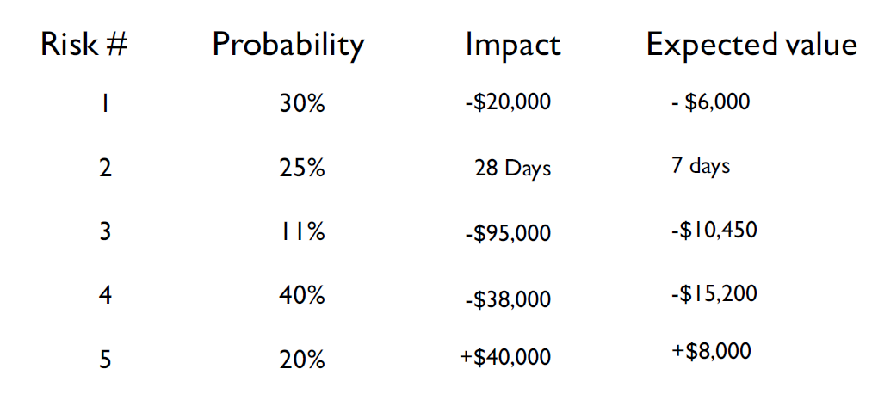
Chapter
03
Perform Quantitative Risk Analysis
Expected Value/ Expected Monetary Value
Expected value or Expected Monetary Value (EMV) is computed by multiplying the probability of an event by its impact. Examples appear below:
المخاطره
الاحتمال
التأثير
القيمة المتوقعة

Slide 16
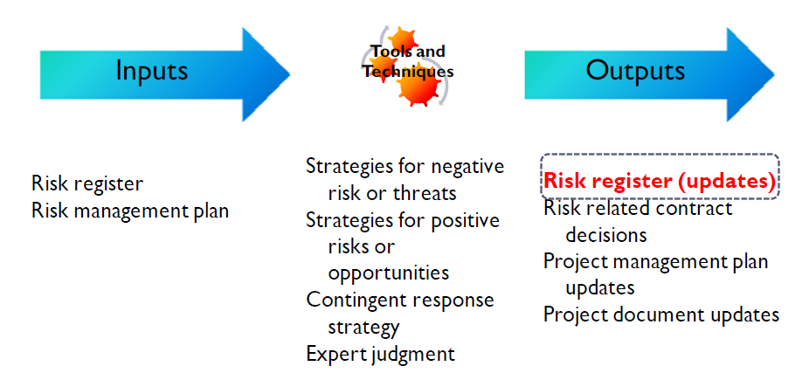
Chapter
03
Plan Risk Responses
سجل المخاطر
خطة إدارة المخاطر

Slide 17
Chapter
03
Plan Risk Responses
After risks are identified and evaluated from a qualitative and quantitative perspective, we can plan our responses to risk, and either to enhance opportunities, or reduce threats for the project.

Slide 18
Chapter
03
Plan Risk Responses
There are a number of risk response strategies that can be employed on a project, however, all of the responses fall into the following basic categories:
Implementing actions to prevent the risk from occurring
Implementing actions in response to a risk occurrence
Implementing actions to mitigate or reduce the risk occurrence
Implementing actions to promote opportunities
Implementing fallback or contingent responses, in the event risk response plans do not work

Slide 19

Chapter
03
Plan Risk Responses
Examples of Risk Strategies – Negative Risks
Avoid Elimination of the potential threat. For example, you are dealing with a
vendor and there is the threat of a potential major strike. Your avoidance strategy would be to switch vendors to an organization that does not have unions at all.

Slide 20

Chapter
03
Plan Risk Responses
Transfer----- This involves shifting some or all of the negative impact of a threat, along with the ownership of the response, to a third party. Examples include purchasing insurance, performance bonds, warranties, or other forms of guarantee.

Slide 21

Chapter
03
Plan Risk Responses
Mitigate______ – this involves a reduction in the probability or impact of the risk. Designing fault tolerance into a system is a risk mitigation strategy. Instead of shouldering the full cost of the development of a new high risk product, you find three or four partners who can share the expense of development. In case of failure, your exposure to loss has been cut by 75-80%

Slide 22

Chapter
03
Plan Risk Responses
Accept – Acceptance means that you cannot eliminate, transfer, or mitigate a threat, and there is no other suitable response strategy. You can actively or passively accept the threat:
        Passive acceptance means you take no action and deal with the risk if it occurs
        Active acceptance commonly means you have set aside contingency reserves to deal with any potential risks

Slide 23
Chapter
03
Plan Risk Responses
Examples of Risk Strategies – Positive Risks
Exploit------is used when the organization wants to ensure an opportunity is realized. Saving funds by using existing equipment or facilities is an exploit strategy

Slide 24

Chapter
03
Plan Risk Responses
Examples of Risk Strategies – Positive Risks
Share_____ occurs when the organization transfers ownership of the opportunity, in part or altogether to a third party to ensure the opportunity occurs. Engaging a sub-contractor with specialized skill sets not available in your organization can help you capture an opportunity that may have been out of reach otherwise.

Slide 25

Chapter
03
Plan Risk Responses
Examples of Risk Strategies – Positive Risks
Enhance___ – used to increase the impact or probability of an opportunity. Ending a project early by using highly experienced resources, or utilizing specific schedule compression echniques, is an enhancement opportunity.

Slide 26

Chapter
03
Plan Risk Responses
Examples of Risk Strategies – Positive Risks
Accept – willing to take advantage of an opportunity without actively pursuing it.

Slide 27

Chapter
03
Plan Risk Responses
Quick Quiz: Look at the next table and see if you can quickly identify what type of risk response strategy is being employed in
each situation:

Slide 28
Chapter
03
Plan Risk Responses
Response Strategy? | Risk Description
 | There is a risk your lead architect may leave the project before her job is completed. As a result you cross-trained one of the developers to handle lead architect responsibility
 | The database for your software project is expected to run into multiple terabytes. After consulting with the infrastructure team you discover there are terabytes of available storage in the data center that can be secured at a much lower cost than purchasing new equipment.
 | An out-of-state vendor on your project has expressed concerns about meeting delivery due dates. You engage a local vendor that can easily meet the delivery dates without issue.
 | Staffing up for customer service on your project will take too long and be too expensive. You identify a vendor that will exceed your customer service requirements and will pay penalties if their service falls below stated quality levels.
mitigate
exploit
Avoid
transfer,

Slide 29
Chapter
03
Risk Register Updates
The risk register is completed at this point and can include:
تحديد المخاطر ووصفها
Identified risks and descriptions
Triggers
Response strategy
Specific actions taken if risk occurs
المحفزات
إستراتيجية الإستجابة
إتخاذ إجراءات محدده في حالة حدوث مخاطر

Slide 30
Chapter
03
Plan Risk Responses
The risk register is designed to be written to a level of detail that corresponds with the priority ranking of the risk and its associated response. Frequently, the lower level, low priority risks are placed on a’ watch list' for periodic review and monitoring.

Slide 31
Chapter
03
Plan Risk Responses
Contingency Plans
Contingency plans are developed for a specific risk. Contingency plans are generally developed when you have accepted a risk and now have developed a plan 'B' or plan 'C' as a contingent response. These plans are executed only under predefined conditions, and when there is sufficient warning to implement the plan.
Fallback plans are implemented when a contingent response is not effective.

Slide 32
Chapter
03
Plan Risk Responses
Residual and Secondary Risks
Residual risks are identified as risks that remain after a risk response strategy was implemented. It is possible that residual risks can be identified in the risk planning process, in which case they are subject to contingency and fallback planning.

Slide 33
Chapter
03
Plan Risk Responses
if you know that certain key personnel on the project might leave before the project is over, your risk response strategy many include required cross-training of other lower level resources.
    There is a potential residual risk that even with cross-training, the lower level resources might not perform to the level expected. In this event, you may have identified a contingent or fallback plan to address the residual risk.

Slide 34

Chapter
03
Plan Risk Responses
A secondary risk is a risk that results from implementing a risk response strategy. Secondary risks can be identified in the planning process, or they might occur as a result of discovery.

Slide 35
Chapter
03
Plan Risk Responses
For example, you implemented a risk avoidance strategy by replacing an unreliable vendor with a highly dependable vendor on a project. However, unknown to you at the time, the dependable vendor was in negotiations to be bought out by a larger company. The secondary risk with the dependable vendor may include elements such as unexpected price changes, changes in resource availability, or a complete change in the business model.

Slide 36
Chapter
03
Project Risk Topics
Plan Risk Management
Identify Risks
Perform Qualitative Risk Analysis
Perform Quantitative Risk Analysis
Plan Risk Responses
Monitor and Control Risks

