Slide 1

International Business Management
Prepared by Dr. Badur elgasim
Lecture 5
MGM 506
Managerial Leadership and Motivation
in an International Context

Slide 2

Lecture 5
Introduction
Many business failures can be traced to functional deficiencies, such as poor planning or marketing. Many more are due to managers’ inability to lead and motivate employees. Effective managers are those who can lead their subordinates toward the accomplishment of organizational goals. This is a feat not easily managed. Among the managerial skills, leadership competency and the ability to motivate are two of the most difficult to master. While managers can rely on assistance from others in technical matters, they have to resolve leadership problems and motivation issues through personal initiatives. Leadership and motivation skills, therefore, are critical to a manager’s success.

Slide 3
Lecture 5
Introduction
If leading and motivating are important determinants of success in a domestic business, they are much more important in an international operation. What constitutes a good leader in one culture may not necessarily be the case in other cultures. Also, what motivates people varies among cultures. Most Americans, for example, prefer democratic leaders who seek inputs from their subordinates. In other cultures, such a leader may be regarded as naive or incompetent.

Slide 4

The Shortcomings of Leadership Theories
The following discussion is based on the assumption that readers are familiar with the leadership theories.
Popular leadership theories assume that the leaders and followers have a lot in common within their value systems and culture and that the roles of leader and followers are universal. These theories, implicitly if not explicitly, advocate democratic, participative leadership behavior as the preferred choice. Almost all theories are developed in the United States and are based on American cultural values.

Slide 5
the American culture has traditionally placed higher values on democratic than on authoritarian leadership, certain biases can be detected in the research on the effects of these leadership styles. A great deal of research is designed to prove that democracy is superior to autocracy, rather than to test that proportion.

Slide 6
The Cultural Relativity of Leadership
Cultural differences have a major influence on the effectiveness of various leadership behaviors. Norms, role expectations, and traditions governing relations between various members of society are strong determinants of effective leadership behavior. These differences are manifested in MNCs whose employees come from different cultural backgrounds. The challenge for international managers working with multicultural employees is to recognize these differences and adapt their relation-ships accordingly.

Slide 7
To learn about these differences, we will review two cultural dimensions:
acceptance of authority
and dealing with uncertainty.
While all cultural values influence the behavior of leaders, these two are of particular importance. Here, we will focus on their influence on leader-follower relationships. Using these two dimensions as a reference, we will discuss the predominant leadership practices in Europe and Japan.

Slide 8
Acceptance of Power and Authority
The use of power and authority is central to managing and leading. Power and authority are universal to all cultures. Hierarchical relations are the mainstay of social interactions. The importance, emphasis, scope, and application of power and authority, however, vary among societies. In societies where power is more evenly distributed among the members, there is only a small gap between the most powerful members and the least powerful. In others, there is a wide variation in power distribution, and the difference between the most powerful and the least powerful is large.

Slide 9
In such societies, the large differences in power are legitimate and acceptable to all members. Members often feel uncomfortable if the distance is knowingly violated.
For example, if a superior in a large-power-distance society attempts to reduce the distance by acting more accessible and friendly, his/her subordinates may not willingly accept such openness.

Slide 10
Avoiding Uncertainty
To live is to deal with uncertainty. Uncertainty is part of life, and all managers deal with uncertainty in running organizations. A critical aspect of managing and leading is dealing with uncertainty by giving subordinates enough direction and instruction to adequately perform their tasks. Society’s orientation toward the handling of uncertainty is reflected in the management of its institutions and organizations.

Slide 11
Uncertainty avoidance is:
the extent to which a society feels threatened by uncertain and ambiguous situations and tries to avoid these situations by providing greater career stability, establishing more formal rules, not tolerating deviant ideas and behavior, and believing in absolute truths and the attainment of expertise.

Slide 12
A clustering of 40 countries according to their position on these two dimensions of power distance and uncertainty avoidance is depicted in Fig. 5.1. As can be seen from Fig. 5.1, the United States, Canada, and most northern European countries are low on power distance and low on uncertainty avoidance. Asians, people from the Mediterranean, and South Americans are high on both dimensions. A few Asian countries are high on power distance and low on uncertainty avoidance (upper left-hand- side quadrant), and a few European countries are low on power distance and high on uncertainty avoidance (lower right-hand-side quadrant).

Slide 13
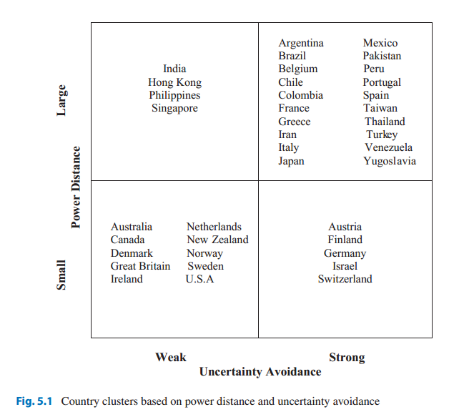

Slide 14
It is important to recognize that the leadership theories referred to in this chapter were all developed in countries that are low on power distance and low on uncertainty avoidance. Both superiors and subordinates in these countries value power sharing. These cultures have a more receptive environment for the practice of democratic-participative management. Therefore, it is not surprising that these theories generally advocate democratic-participative management. Subordinates gain more autonomy and freedom due to their participation in the decision-making process.

Slide 15
Those who are low on uncertainty avoidance are better suited to deal with the autonomy thus gained. In these cultures, superiors are comfortable with the subsequent uncertainty associated with granting autonomy to their subordinates. Similarly, subordinates are not uncomfortable with assuming the risk and uncertainty associated with participation in decision-making. The lower power distance between members of these societies allows for a closer relationship between leaders and followers.

Slide 16
An essential aspect of leadership is the role and behavior of subordinates. Subordinate employees use various strategies to influence their superiors. Table 5.1 summarizes subordinate ships for the two levels of power distance. At each level of power distance, both subordinates and superiors expect certain appropriate behaviors from the leader, and a mismatch poses problems. Which strategy is chosen depends on its perceived appropriateness in a given culture. What an American sub-ordinate may find appropriate may not be viewed similarly by an Asian.

Slide 17
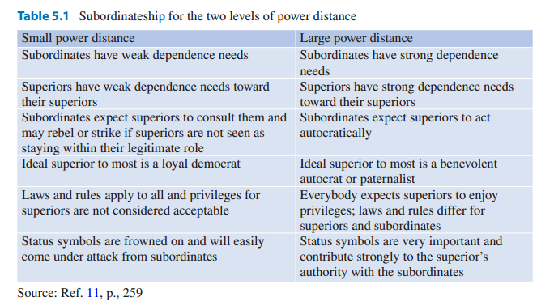

Slide 18
Managerial Leadership in Europe
Managerial leadership centers on the relationship between the manager and the followers. The manner of relating to employees, the style of projecting and using power, and the method of dealing with conflicts and crises set the stage for managerial leadership. The boundaries within which these issues are dealt with vary among cultures. Americans prefer informality and a moderate use of power. They are pragmatic and practical.

Slide 19
While they are conscious of projecting a proper image, they do not sacrifice results for a proper appearance. They allow participation by the lower levels of organization when such participation can lead to improved performance and productivity. Assuming that Europeans, due to a shared cultural heritage, have the same preferences can lead to disappointment.

Slide 20
Britain
On the two dimensions of uncertainty avoidance and power distance, the British are very similar to the Americans. Their high tolerance for ambiguity and low power distance is reflected in their industrial relations practices. Labor-management relations are less codified in England than in any other Western European country, which is not surprising in a country that does not even have a written constitution.

Slide 21
While French managers believe in a rigid separation of professional and private life, British executives perceive a fluid and much more obscure boundary between the two spheres. The British are more passive and empathetic, spending time relaxing, doing chores, and simply being together. While the career strategy of the French executive is more defensive, that of the British counterpart is more aggressive and risk-taking. The British see the most positive characteristics of the boss as persuasive-paternalistic or consultative.

Slide 22
France
The French tend to favor formal and ritual activities over informal activities. They are idealistic and concerned with the essence of values. While the motto of the French republic is(“Liberty, Equality, Fraternity”), the importance of social classes cannot be ignored. The French social classes are the aristocracy, the upper bourgeoisie, the upper-middle bourgeoisie, and the middle, lower-middle, and lower classes. The French are very status conscious. Social status depends on one’s social origin. While Americans can aspire to the highest level of society through their own accomplishments and hard work, the best that the French can do is climb one or two stages of the social ladder. Education, a knowledge of literature and the fine arts, a tastefully decorated beautiful house, and the proper ancestral social origins are outward signs of social status.

Slide 23
Germany
Small power distance and strong uncertainty avoidance are two characteristics of German society., societies that are strong on uncertainty avoidance are intolerant of deviant persons and ideas and consider them dangerous. People of these societies are nationalistic, aggressive, and consensus seeking, have an inner urge to work hard, are concerned with security, and are strong advocates of law and order. Almost all these characteristics are stereotypical of Germans. Germans are known for their industriousness and efficiency. They are an inward people who tend to be very private. They perform better when they are given clear instructions and know what is expected of them.

Slide 24
Compared with Americans, Germans seem to take a long time to develop friendly relations with others. Germans are status conscious and idealistic. They are reserved, and to outsiders, they appear to be cold. They are detail oriented and meticulous. When Ford Motor Company started its world car concept, integrating the worldwide production of automobiles, they learned firsthand about German precision. The Germans made components that required very fine fitting. Other countries, however, were not accustomed to producing, for example, doors and body parts with the precision of a few millimeters. The result was incompatibility of parts and components produced in Germany with those produced in other countries.

Slide 25
Managerial Leadership in Japan Versus the United States
The nature of the decision-making process at the higher levels of organizational hierarchy influences the type of leadership employed throughout the organization. In the United States, of the two components of the decision-making process, decision formulation is the domain of top management, and implementation of those decisions is relegated to the lower levels. In the American system of decision-making, fewer levels and smaller numbers of people are involved. Therefore, a shorter time period is needed to formulate a decision.

Slide 26
To implement these decisions, how-ever, organizations are compelled to secure the commitment and support of the lower levels and a larger number of people. When successful, this method produces quick results. Securing the commitment and support of the lower levels in implementing these decisions requires certain leadership characteristics and skills that are very akin to those required in selling and marketing. To produce results, leaders have to be very persuasive and have to command resources that the subordinates desire, or they need to have the personal traits (charisma) that would make subordinates follow their directions.

Slide 27
Motivation
Motivation has long been a major concern for management because it is linked to productivity, creativity, job turnover, absenteeism, etc. Motivation is defined as the process through which behavior is mobilized to reach certain goals, which in turn satisfies individual and/or organizational needs. Motivation is the total of all forces within individuals that account for the effort he or she applies to the job at hand. Motivation begins with the search to satisfy needs. Figure 5.2shows the three main phases a person undergoes during the need satisfaction process.

Slide 28
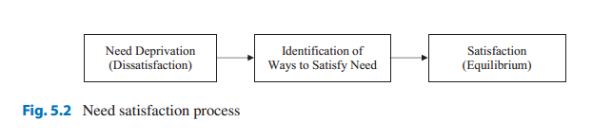

Slide 29
Motivation and Culture
Human motivation is the product of the interaction between people and the physical and social environment. It is important to recognize, however, that most of the management literature on motivation is psychologically oriented and is based on psychological models developed and tested almost exclusively in the United States. While psychological models of motivation are very useful for the management of US businesses, they are inadequate for international management.

Slide 30
We all accept, in principle, that there are differences among people of different cultures. In studying human motivation, however, United States based researchers have taken a simplistic view by ignoring the cultural influences on people’s behavior. To understand human motivation, we need to under-stand not only the people themselves but also their environment and their culture. More specifically, as D’Andrad puts it, “to understand why people do what they do, we have to understand the cultural constructs by which they interpret the world” .

Slide 31
Cultural Influences on Motivation
Organizational performance is a function of employees’ work contributions to organizational goals. The efforts exerted by employees at work are influenced by their motivation. A motivated worker is a more productive worker. If we consider motivation as a psychological state that compels a person to expend a certain amount of effort to accomplish a job, we are dealing with two main concepts: work and the person or “self.”

Slide 32
In studying cross-cultural motivation, we should be careful not to assume that these concepts have a universal meaning. There is a growing body of research that indicates that people of different cultures have different views about these two concepts. The perception of “self” is a product of cultural upbringing, and so is the meaning of work.

Slide 33
Cultural Definitions of Work
Throughout the history of Western civilization, work has been regarded variously as drudgery, a necessary evil, an obligation, a duty, and a way to salvation. To engage in physical work has been considered undignified and demeaning, on one extreme, and honorable, glorified, and exemplifying piety, on the other. According to Max Weber, a contributing factor to the emergence of modern capitalism, characterized by large organizations, was the value and importance that the Protestant religion accorded to work and the accumulation of wealth.

Slide 34
Cultural Definitions of Self
Many consider individualism as the most salient feature of American culture. Many American ideals, such as equality and objectivity in treating people based on their own merits and not on their social standing or political connections, are anchored to individualism. To describe Americans as individualistic does not fully explain the cultural differences between Americans and the people of other nations. Individualism only tells us about the societal and external view of an “individual,” the view that the society holds with regard to a person and his or her relationship with other members of society. To fully comprehend the difference between Americans and the people of other cultures, we need to explore the concept of “individualism” from the personal aspect of “self.”

Slide 35
A summary of the key differences between the independent and interdependent selves is presented in Table 5.2. The two different concepts of self have various implications for motivation. An independent self takes pride in its own attributes and accomplishments. In contrast, an interdependent self may be motivated to avoid such a selfish expression. Instead, the overt expression of pride may often be directed at a collective of which the self is a part. The following is an example of how Japanese feel proud of the accomplishments of their superiors and how every member of the group experiences a shared pride in those accomplishments.

Slide 36
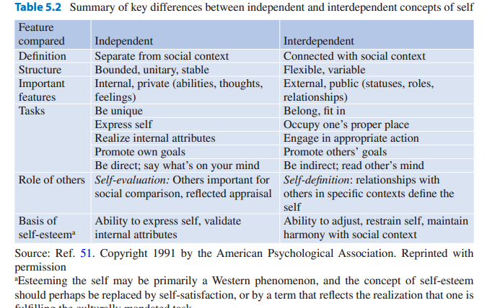

Slide 37
Applicability of Major Motivation Theories
One major obstacle in the effective motivation of employees in MNCs is the assumption that the available motivation theories are universal. These theories erroneously assume that human needs are the same everywhere and that people will respond similarly to a motivation program. Of course, the assumption that “one size fits all” is faulty. There are culturally based differences in people’s needs and the means they use to satisfy them. Because of the difficulties in understanding other cultures, and perhaps due to ethnocentric tendencies, many studies on motivation have, either explicitly or implicitly, ignored cultural differences. In fact, until recently, most management literature paid little attention to the effect of culture on motivation.

Slide 38
Stereotyping and Ethnocentrism
The roots of the universality assumption can be traced to stereotyping, oversimplified conceptions or beliefs about others, and ethnocentrism, which is the belief in the superiority of one’s own ethnic group. When faced with an unfamiliar situation, we rely on stereotypes to simplify our perception of the environment. Stereotypes may be correct or incorrect. When confronted with an unfamiliar culture, people assume similarity with their own culture unless other stereotypes are present. Ethnocentrism leads to the belief that “our way is the best way of doing things.”

Slide 39
Ethnocentrism is an attitude found in almost any culture. Studies have found that people usually think of their country as disproportionately important in the world. In most countries, maps used in the classrooms usually illustrate that country as the center of the world. In Chinese writings, the character for China means the “center of the earth.”
Ethnocentrism often leads to prejudiced behavior. Many people of industrialized countries equate lack of industrialization with lack of culture. Equally erroneous is the tendency to equate the materialism of industrial societies with spiritual corruption.

Slide 40
Global Trends and Motivation
Dramatic technological changes and political restructuring around the world have created new problems as well as opportunities. Acceleration of the rate of change in recent years has made it difficult to predict global trends in motivation. Two major questions have been raised regarding the changes in the management of motivation and human resources.

Slide 41
First, would the collapse of the Soviet system result in the integration of the socialist cultures into the Western cultures? Would this integration lead to more emphasis on social needs in Western organizations (i.e., make them more employee centered)? Some scholars of international management believe that this will hap-pen. They argue that there will be more emphasis on relationships in Western companies and more attention paid to work and production in Eastern societies. So far, there is little evidence to support this contention.

Slide 42
American companies have been reducing their staff and lowering employees’ benefits despite increases in reported profits. Traditionally, increased profits have led to more hiring and increases in employee benefits. Recent practices, however, have been contrary to historical trends. This “getting lean and mean” strategy has left unemployment and the employee benefit problems for the individual or the government to solve.

Slide 43
On the other hand, with the easing of restrictions on businesses in the former communist states, there is a noticeable rise in entrepreneurial attitudes and behaviors. Freed from the communist yoke, these societies have witnessed an explosion of emerging small businesses and privatization of government-controlled industries. Transformation to a market economy, however, has caused new political and economic problems that have yet to be resolved.

Slide 44
Second, will the expansion of global business, advancements in telecommunication technology, and widespread use of the Internet lead to more uniformity among cultures? There are some signs of this development. The popularity of American culture overseas and Americans’ rising interest in learning about other cultures are early indications of such a trend. There are some indications to the contrary as well.

Slide 45
For example, in a study of the macro-environmental characteristics of 18 industrialized nations over the 1960–1988 period, Craig found a diverging pattern. Contrary to the popular assumption, they found that countries were diverging rather than converging. Global economic problems and the resulting protectionist attitudes are major obstacles in the road to a global culture.

Slide 46
Resources:
Kamal Fatehi & Jeongho Choi
International Business Management
Succeeding in a Culturally Diverse World, Second Edition
Chapter 5

