Slide 1


Project Cost Management
PMG 213
Introductory lecture
Prepared by
Dr. Rasha B. AL Jerd

Slide 2



Project Cost Management
PMG 213
Introductory lecture

Slide 3

Introductory lecture
Project Cost
Management
PMG 213
Prepared by
Dr. Rasha B. AL Jerd

Slide 4


Introductory lecture
What is a Cost? Cost is a sacrifice of resources.
When we buy one thing, we give up (sacrifice) the ability to use these resources, for example cash, to buy something else.

Slide 5
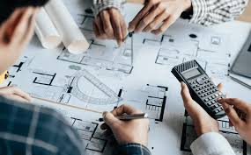

What is a Project?
Introductory lecture
Project: Is a temporary effort undertaken to create a unique service or product or result.
Temporary means has a definite beginning and a definite ending.
Unique means different design, different location, different circumstances …. etc.

Slide 6
Introductory
lecture
Projects always need resources such as materials, labor and equipment, which generate costs.
Those costs must be estimated and controlled throughout the project life cycle to complete the project.
Why Project Cost Management ? It exists to help organization not to fail (they run out of money).
It bridges the gap between creative execution and financial reality, ensuring a project delivers value without bankrupting the organization.
What is Project Cost Management? is the process of planning, estimating, budgeting, financing, funding, managing, and controlling costs so that a project can be completed within the approved budget. It ensures that project teams deliver value without overspending.

Slide 7

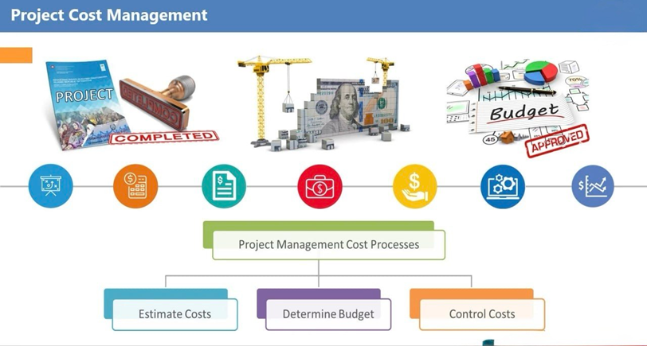
Let’s take a look at the term “cost management,” which is referred to as the act of monitoring, controlling, and optimizing all expenditures for an organization.
Project cost management is a methodical approach used to estimate, allocate, and control the costs within a project. Cost management in project management ensures that the project is completed within the approved budget. The expenditures are predicted and reduce the chances of overbudgeting. Project Cost Management includes every cost of the project (to execute every process), from planning to execution, so that the project can be completed within a given budget.
Introductory
lecture

Slide 8

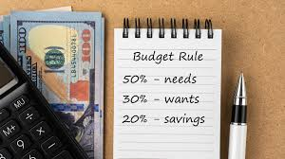
What is a Budget?
Is a spending plan based on income and expenses.
It‘s an estimate of how much money will be made and spent in a definite future time.

Slide 9
Introductory
lecture
Benefits of Cost Management in Project Management:
Project cost management offers numerous benefits:
Enhances cost efficiency.
Facilitates informed decision-making through cost estimates and budget tracking.
Improves resource allocation.
Increases accountability by tracking and auditing project expenses.
Ensures project delivery within budget

Slide 10
Introductory
lecture
Challenges in Project Cost Management:
Proper cost management in project management comes with its own set of challenges, such as:
Accurate forecasting of expenses of unforeseen events.
Market volatility.
Indirect costs cannot be estimated easily like direct costs.
Ensuring high quality within a budget needs hard work and dedication.

Slide 11
Introductory
lecture
Project Cost Management Steps:
The key project cost management steps are to be taken for the successful completion of project within the given budget. These steps are:
Step-1: Cost Estimation
a. Project cost can be estimated using the following ways:
Parametric Estimating uses the historical relationship between historical data and other present variables.
Bottom-up Estimating breaks the project down into smaller components and estimates by doing an analysis of the data.
Three Point Estimating considers the weighted average for realistic cost estimation.
Earned Value Analysis forecasts future performance by considering the present work situation.

Slide 12
Introductory
lecture
b. Factors to Consider in Cost Estimation
Project cost estimation is influenced by the following factors:
-Scope of Project Work.
-Resource Availability.
-Project Scale.
-Market Conditions.
Step-2: Cost Budgeting
The cost estimates are used to develop a detailed budget so stakeholders can understand and fund. It involves:
-Creating a Project Budget.
-Allocating Resources and Expenses.

Slide 13
Introductory
lecture
Step-3: Cost Control
Cost control is an ongoing exercise and needs the following steps to be taken regularly:
-Monitoring Project Costs.
-Managing Cost Variances.
Step-4: Cost Reporting
Proper cost reporting ensures that all relevant parties have a clear view of the finances, no matter where they are in the management project lifecycle.

Slide 14
Project Cost Management Processes
Introductory lecture
Two of the most important documents you’ll prepare for any project are the project schedule and project budget. You’ll use the schedule and budget documents throughout the Executing, Monitoring, and Controlling processes to measure progress and determine if the project is on track.
There are two processes in the Planning group we’ll perform that will lead us to the cost performance baseline output, which is the authorized budget.
They are:
Estimate Costs and
Determine Budget.

Slide 15
Project Cost Management Processes
Introductory lecture
These processes cover several tools and techniques. One process in the Monitoring and controlling group, Control Costs, is used to manage changes in the cost baseline.
A brief overview of processes for cost management in project management are as follows:
Estimate Costs—The process of approximating the monetary resources needed to complete project activities.
Determine Budget—The process of aggregating the estimated costs of individual activities or work packages to establish an authorized cost baseline.
Control Costs—The process of monitoring the project status to update the project costs and manage changes to the cost baseline.

Slide 16
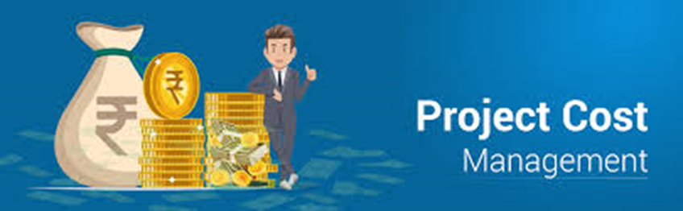
Introductory lecture
This course provides comprehensive exposure to cost estimation in the project domain. It examines the importance of cost management in executing a project plan and incorporates the elements of mid-course changes and cash flow management. Topics include Cost estimation, creating a realistic baseline, evaluating project performance, and presenting Project.

Slide 17
Introductory lecture
This course has the following topics:
Project cost estimating.
Project cost budgeting and control.
Estimating approaches and models.
Improving the estimation process.
Financial management.
Value management.
Time and cost change management.
Impact of cost‐estimation changes on project.

Slide 18
● Analyze the project’s goals and select an appropriate cost‐estimation approach.
● Prepare a cost estimate and analyze staff resources, cost drivers, contingency costs, and management reserves.
● Establish a cost baseline by applying the cost budgeting process.
● Analyze project performance by applying the cost control process.
● Evaluate types of resource costs necessary to draw up a complete cost estimate, and determine the accounting category of each, such as direct, indirect, capital, and operating.
● Managing changes in a project.
Introductory lecture
Learning Outcomes:

Slide 19
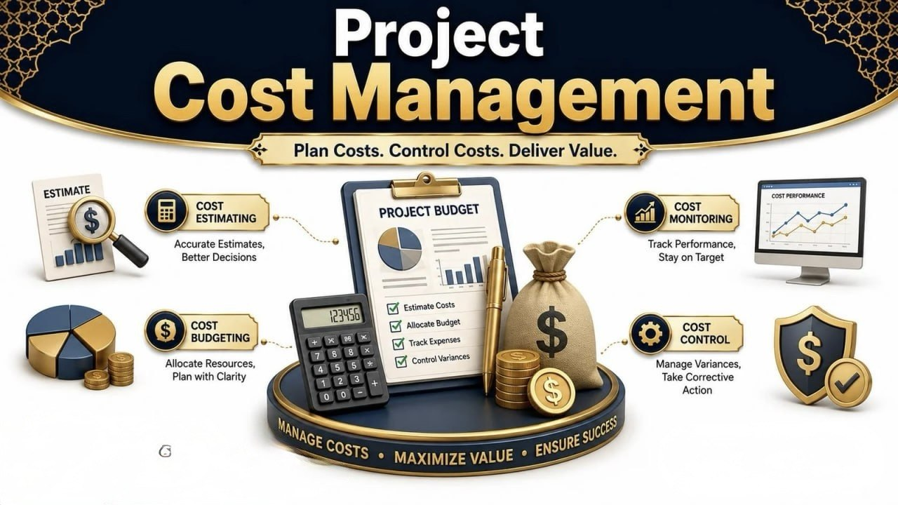

Slide 20



Thank You

