Slide 1




Mathematics 3 – MAT132
Mathematics 3
Lecture 4
MAT 132
Introduction to Fourier Series
Prepared by
Dr. Israa Lewaa

Slide 2
Lecture
05
Lecture Objectives
Chapter Objectives
Fourier Series Formula
Derivatives of Basic Trigonometric Functions
Derivatives for other functions with Trigonometric Functions
Important Relations for Trigonometric Functions
Extra Practice

Slide 3
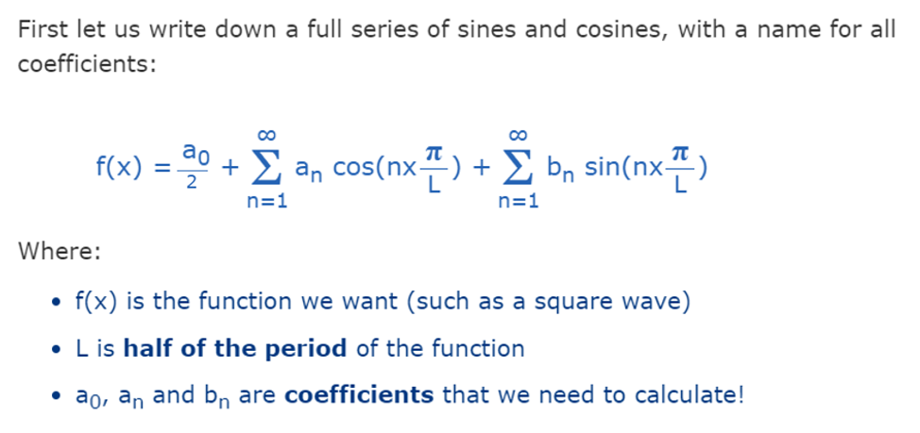
Lecture
05
Fourier Series Formula
Chapter Objectives

Slide 4
Important knowledge for Fourier Series
Lecture
05
Lecture
05
Chapter Objectives
Derivatives of Basic Trigonometric Functions

Slide 5
Derivatives of Basic Trigonometric Functions
Lecture
05
Chapter Objectives
Let’s sketch the graph of the function:
f(x) = sin x and use the interpretation of f’(x) as the slope of the tangent to the sine curve in order to sketch the graph of f’.

Slide 6
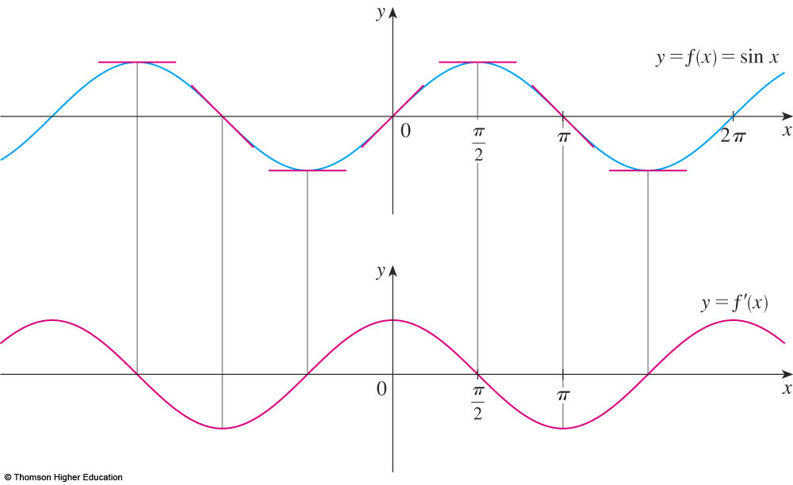
Derivatives of Basic Trigonometric Functions
Lecture
05
Chapter Objectives
Then, it looks as if the graph of f’ may
be the same as the cosine curve.

Slide 7
Rules of Derivatives of Basic Trigonometric Functions
Lecture
05
Chapter Objectives

Slide 8
Derivatives of Basic Trigonometric Functions
Lecture
05
Chapter Objectives
Let’s try to confirm
our guess that, if f(x) = sin x,
then f’(x) = cos x.

Slide 9
Derivatives of Basic Trigonometric Functions
Lecture
05
Chapter Objectives
From the definition of a derivative, we have:

Slide 10
Derivatives of Basic Trigonometric Functions
Lecture
05
Chapter Objectives
Two of these four limits are easy to evaluate.

Slide 11
Derivatives of Basic Trigonometric Functions
Lecture
05
Chapter Objectives
Since we regard x as a constant when computing a limit as h → 0, we have:

Slide 12
Derivatives of Basic Trigonometric Functions
Lecture
05
Chapter Objectives

Slide 13
Important Relation I
Lecture
05
Chapter Objectives

Slide 14
Important Relation II
Lecture
05
Chapter Objectives

Slide 15
Extra Practice
Lecture
05
Chapter Objectives
Extra Practice

Slide 16
Extra Practice – Example 1
Lecture
05
Chapter Objectives
Differentiate:
y = x² sin x.

Slide 17
Example 1 Solution
Lecture
05
Chapter Objectives
y = x² sin x.
  Using the Product Rule and Formula 4, we have:
Lecture 4 Dr. Israa Lewaa Mathematics 3

Slide 18
Extra Practice – Example 2
Lecture
05
Chapter Objectives
Differentiate
y = tan x.

Slide 19
Example 2 Solution
Lecture
05
Chapter Objectives

Slide 20
Extra Practice – Example 3
Lecture
05
Chapter Objectives
Differentiate

Slide 21
Example 4
Lecture
05
Chapter Objectives

Slide 22
Extra Practice – Example 4
Lecture
05
Chapter Objectives
Find:
The 27th derivative of cos x.

Slide 23
Example 4 Solution
Lecture
05
Chapter Objectives
  The first few derivatives of f(x) = cos x
  are as follows:

Slide 24
Remark of Example 4
Lecture
05
Chapter Objectives
  We see that the successive derivatives occur
  in a cycle of length 4 and, in particular,
  f ^{(n)}(x) = cos x whenever n is a multiple of 4.
  Therefore, f ⁽²⁴⁾(x) = cos x
  Differentiating three more times,
  we have:
  f ⁽²⁷⁾(x) = sin x
Lecture 4 Dr. Israa Lewaa Mathematics 3

Slide 25
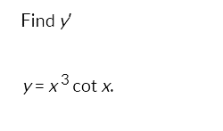
Extra Practice – Example 5
Lecture
05
Chapter Objectives
Lecture 4 Dr. Israa Lewaa Mathematics 3

Slide 26
Example 5 Solution
Lecture
05
Chapter Objectives

Slide 27
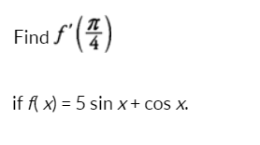
Extra Practice – Example 6
Lecture
05
Chapter Objectives

Slide 28
Example 6 Solution
Lecture
05
Chapter Objectives

Slide 29

Extra Practice – Example 7
Lecture
05
Chapter Objectives
Differentiate

Slide 30
Example 7 Solution
Lecture
05
Chapter Objectives

Slide 31

Extra Practice – Example 8
Lecture
05
Chapter Objectives
Differentiate

Slide 32
Example 8 Solution
Lecture
05
Chapter Objectives

Slide 33
Extra Practice – Example 9
Lecture
05
Chapter Objectives
Differentiate

Slide 34
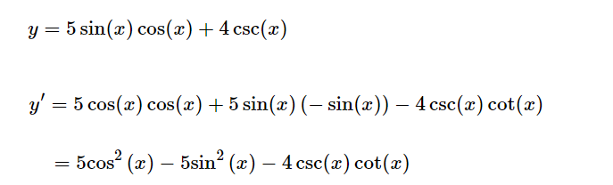
Example 9 Solutions
Lecture
05
Chapter Objectives

Slide 35

Extra Practice – Example 10
Lecture
05
Chapter Objectives
Differentiate

Slide 36
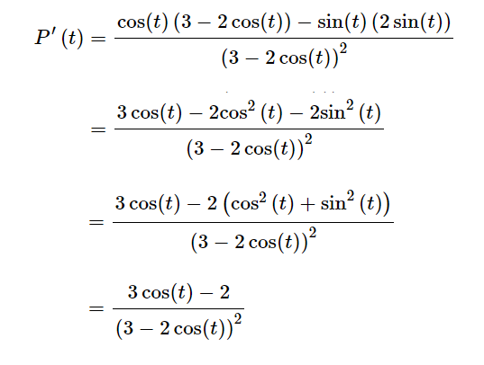
Example 10 Solution
Lecture
05
Chapter Objectives

Slide 37
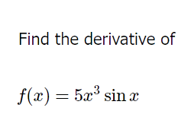
Extra Practice – Example 11
Lecture
05
Chapter Objectives

Slide 38
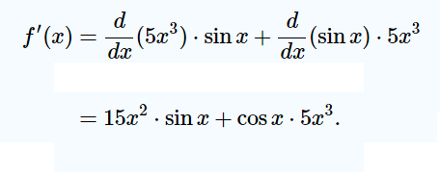
Example 11 Solution
Lecture
05
Chapter Objectives

Slide 39
Lecture Summary
Lecture
05
Chapter Objectives
Fourier Series Formula
Derivatives of Basic Trigonometric Functions
Derivatives for other functions with Trigonometric Functions
Important Relations for Trigonometric Functions
Extra Practice

Slide 40



Thank You

