Slide 1


Quality
Management
Prepared by Dr. Injy Nashaat
Lecture 9

Slide 2


Quality
www.midocean.ae

Slide 3

Quality
Quality means “Performance upon expectations” and “fit for functions.” A product is said to be of good quality if it satisfies the customer's requirements in terms of performance, grade, durability, appearance, and intended use/purpose, etc.
Customers will often pay premium prices for superior quality.

Slide 4

Quality Management
  The ability of a product or service to consistently meet or exceed customer expectations
    For a decade or so, quality was an important focal point in business. After a while, this emphasis began to fade as other concerns took precedence
    There has been a recent resurgence in attention to quality given recent experiences with the costs and adverse attention associated with highly visible quality failures:
        Auto recalls
        Toys
        Produce
        Dog food
        Pharmaceuticals

Slide 5
Dimensions of Product Quality
Performance – main characteristics of the product
Aesthetics – appearance, feel, smell, taste
Special features – extra characteristics
Conformance – how well the product conforms to design specifications
Reliability – consistency of performance
Durability – the useful life of the product
Perceived quality – indirect evaluation of quality
Serviceability – handling of complaints or repairs
Consistency – quality doesn’t vary

Slide 6
Dimensions of Service Quality
Convenience – the availability and accessibility of the service
Reliability – ability to perform a service dependably, consistently, and accurately
Responsiveness – willingness to help customers in unusual situations and to deal with problems
Time – the speed with which the service is delivered
Assurance – knowledge exhibited by personnel and their ability to convey trust and confidence
Courtesy – the way customers are treated by employees
Tangibles – the physical appearance of facilities, equipment, personnel, and communication materials
Consistency – the ability to provide the same level of good quality repeatedly
Expectancy – meet (or exceed) customer expectations

Slide 7
Assessing Service Quality
Audit service to identify strengths and weaknesses
delivered for discrepancies between:
  Customer expectations and management perceptions of those expectations
  Management perceptions, customer expectations, and service-quality specifications
  Service quality and service delivered
  Service delivered and what is communicated about the service to customers
  Customers’ expectations of the service provider and their perceptions of provider delivery

Slide 8
Determinants of Quality
Quality of design
  Intention of designers to include or exclude features in a product or service
Quality of conformance
  The degree to which goods or services conform to the intent of the designers
Ease-of-use and user instructions
  Increase the likelihood that a product will be used for its intended purpose and in such a way that it will continue to function properly and safely
After-the-sale service
  Taking care of issues and problems that arise after the sale

Slide 9
Responsibility for Quality
Top management
Design
Procurement
Production/operations
Quality assurance
Packaging and shipping
Marketing and sales
Customer service
Everyone in the organization has some responsibility for quality, but certain areas of the organization are involved in activities that make them key areas of responsibility

Slide 10
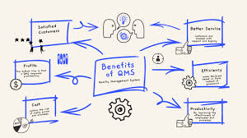
Benefits of Good Quality
Enhanced reputation for quality
Ability to command premium prices
Increased market share
Greater customer loyalty
Lower liability costs
Fewer production or service problems
Lower production costs
Higher profits

Slide 11
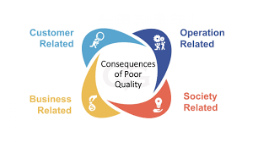
The Consequences of Poor Quality
Loss of business
Liability
Productivity
Costs

Slide 12
Costs of Quality
Appraisal costs
  Costs of activities designed to ensure quality or uncover defects
Prevention costs
  All TQ training, TQ planning, customer assessment, process control, and quality improvement costs to prevent defects from occurring

Slide 13
Costs of Quality (cont.)
Failure costs - costs incurred by defective parts/products or faulty services
  Internal failure costs
    Costs incurred to fix problems that are detected before the product/service is delivered to the customer
  External failure costs
    All costs incurred to fix problems that are detected after the product/service is delivered to the customer

Slide 14
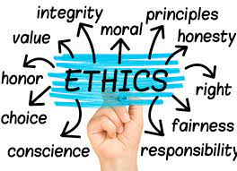
Ethics and Quality
Substandard work
  Defective products
  Substandard service
  Poor designs
  Shoddy workmanship
  Substandard parts and materials
Having knowledge of this and failing to correct
and report it in a timely manner is unethical.

Slide 15

The Baldrige Competition
The Malcolm Baldrige National Quality Award® is the highest level of national recognition that a U.S. organization can receive for performance excellence, particularly in relation to resilience and long-term success.

Slide 16
The Baldrige Competition
Award categories
    Education
    Healthcare
    Manufacturing
    Nonprofit/government
    Service
    Small Business
Purpose of the award
    Stimulate efforts to improve quality
    Recognize quality achievements
    Publicize successful programs

Slide 17
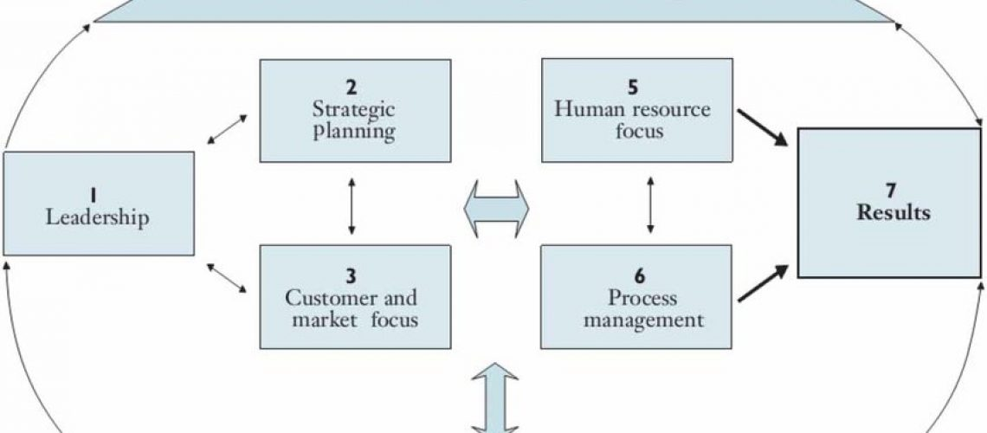
Baldrige Criteria
Leadership
Strategic planning
Customer focus
Measurement, analysis, and knowledge management
Workforce focus
Operations focus
Results

Slide 18
Quality Certification
International Organization for Standardization
ISO 9000
  Set of international standards on quality management and quality assurance, critical to international business
ISO 14000
  A set of international standards for assessing a company’s environmental performance
ISO 24700
  Pertains to the quality and performance of office equipment that contains reused components

Slide 19
Quality Certification (cont.)
ISO 9000
  Quality principles
    Principle 1 Customer focus
    Principle 2 Leadership
    Principle 3 Involvement of people
    Principle 4 Process approach
    Principle 5 System approach to management
    Principle 6 Continual improvement
    Principle 7 Factual approach to decision making
    Principle 8 Mutually beneficial supplier relationships

Slide 20
Quality and the Supply Chain
Business leaders are increasingly recognizing the importance of their supply chains in achieving their quality goals
  Requires:
    Measuring customer perceptions of quality
    Identifying problem areas
    Correcting these problems
  Supply chain quality management can benefit from a collaborative relationship with suppliers
    Helping suppliers with quality assurance efforts
    Information sharing on quality-related matters

Slide 21
Total Quality Management
A philosophy that involves everyone in an organization in a continual effort to improve quality and achieve customer satisfaction
T
Q
M

Slide 22
TQM Approach
Find out what the customer wants
Design a product or service that meets or exceeds customer wants
Design processes that facilitate doing the job right the first time
Keep track of results
Extend these concepts throughout the supply chain
Top management must be involved and committed

Slide 23
TQM Elements
Continuous improvement
Competitive benchmarking
Employee empowerment
Team approach
Decision based on fact, not opinion
Knowledge of tools
Supplier quality
Champion
Quality at the source
Suppliers are partners in the process

Slide 24
Continuous Improvement
Continuous improvement
  Philosophy that seeks to make never-ending improvements to the process of converting inputs into outputs
  Kaizen
    Japanese word for continuous improvement
ISO guidelines stress continuous improvement

Slide 25

Quality at the Source
The philosophy of making each worker responsible for the quality of his or her work
  “Do it right” and “If it isn’t right, fix it”

Slide 26
Obstacles to Implementing TQM
  Lack of company-wide definition of quality
  Lack of strategic plan for change
  Lack of customer focus
  Poor intra-organizational communication
  Lack of employee empowerment
  View of quality as a “quick fix”
  Emphasis on short-term financial results
  Inordinate presence of internal politics and “turf” issues
  Lack of strong motivation
  Lack of time to devote to quality initiatives
  Lack of leadership

Slide 27
Criticisms of TQM
  Obsessive promoters may pursue TQM programs blindly, focusing attention on quality
  Programs may not be linked to the strategies of the organization in a meaningful way
  Quality-related decisions may not be tied to market performance
  Failure to carefully plan a program before embarking on it can lead to false starts, employee confusion, and meaningless results
  Organizations sometimes pursue continuous improvement
  Quality efforts may not be tied to results

Slide 28
PDSA Cycle
Plan
Do
Study
Act
Plan-Do-Study-Act (PDSA) cycle
  Plan
    Begin by studying and documenting the current process.
    Collect data on the process or problem
    Analyze the data and develop a plan for improvement
    Specify measures for evaluating the plan
  Do
    Implement the plan, document any changes made, collect data for analysis

Slide 29
PDSA Cycle(cont.)
Plan
Do
Study
Act
Plan-Do-Study-Act (PDSA) cycle
  Study
    Evaluate the data collection during the do phase
    Check results against goals formulated during the plan phase
  Act
    If the results are successful, standardize the new method and communicate it to the relevant personnel
    Implement training for the new method
    If unsuccessful, revise the plan and repeat the process

Slide 30
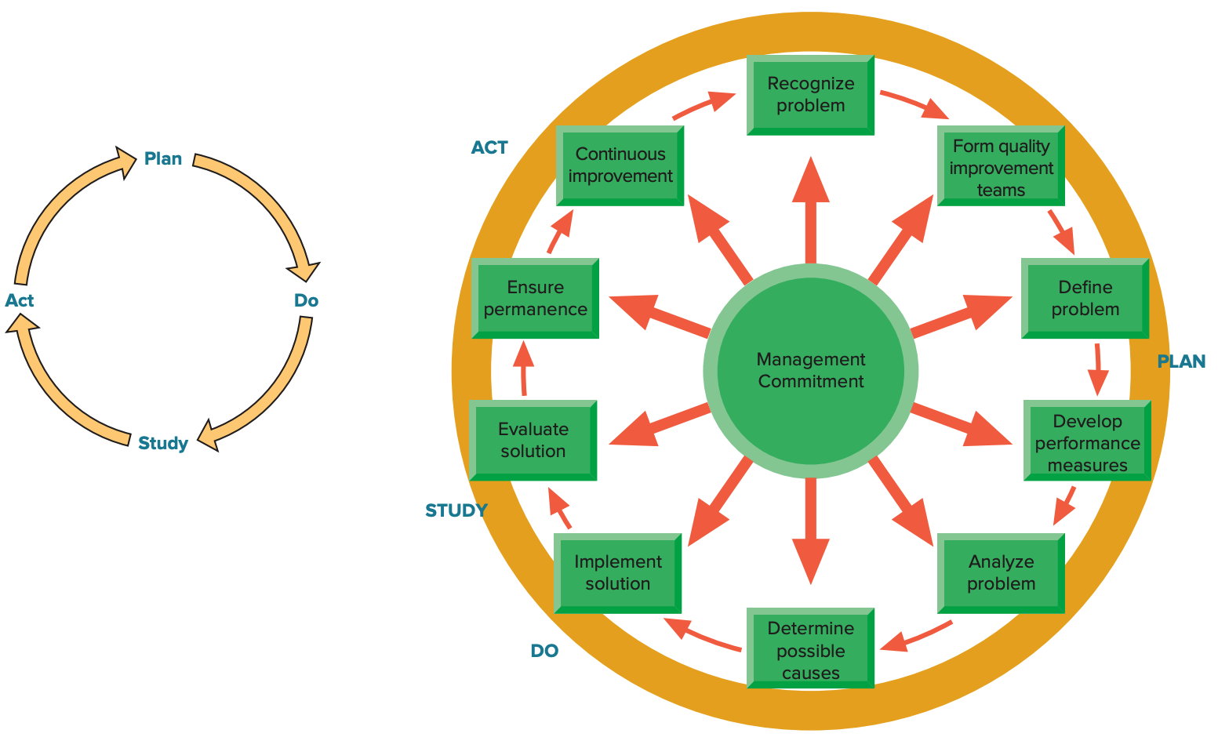
Problem Solving

Slide 31
Process Improvement
Process improvement
  A systematic approach to improving a process
    Map the process
      Collect information about the process and identify each step in the process
      Prepare a flowchart that accurately depicts the process
    Analyze the process
      Ask critical questions about the process
      Ask specific questions about each step in the process
    Redesign the process

Slide 32
Six Sigma
Six Sigma
  A business process for improving quality, reducing costs, and increasing customer satisfaction
  Statistically
    Having no more than 3.4 defects per million
  Conceptually
    Program designed to reduce defects
    Requires the use of certain tools and techniques

Slide 33
Six Sigma (cont.)
Principles
  Reduction in variation is an important goal
  The methodology is data driven; it requires data validation
  Outputs are determined by inputs
  Only a critical few inputs have a significant impact on outputs
DMAIC
  Define: Set the context and objectives for improvement
  Measure: Determine the baseline performance and capability of the process
  Analyze: Use data and tools to understand the cause-and-effect relationships of the process
  Improve: Develop the modifications that lead to a validated improvement of the process
  Control: Establish plans and procedures to ensure that improvements are sustained

Slide 34
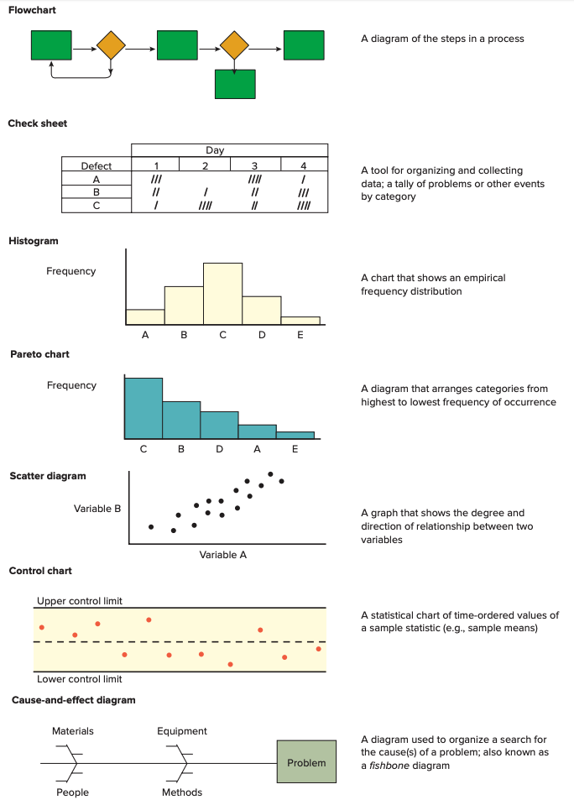
Basic Quality Tools
  Flowchart
  Check sheet
  Histogram
  Pareto chart
  Scatter diagram
  Control chart
  Cause-and-effect diagram

Slide 35
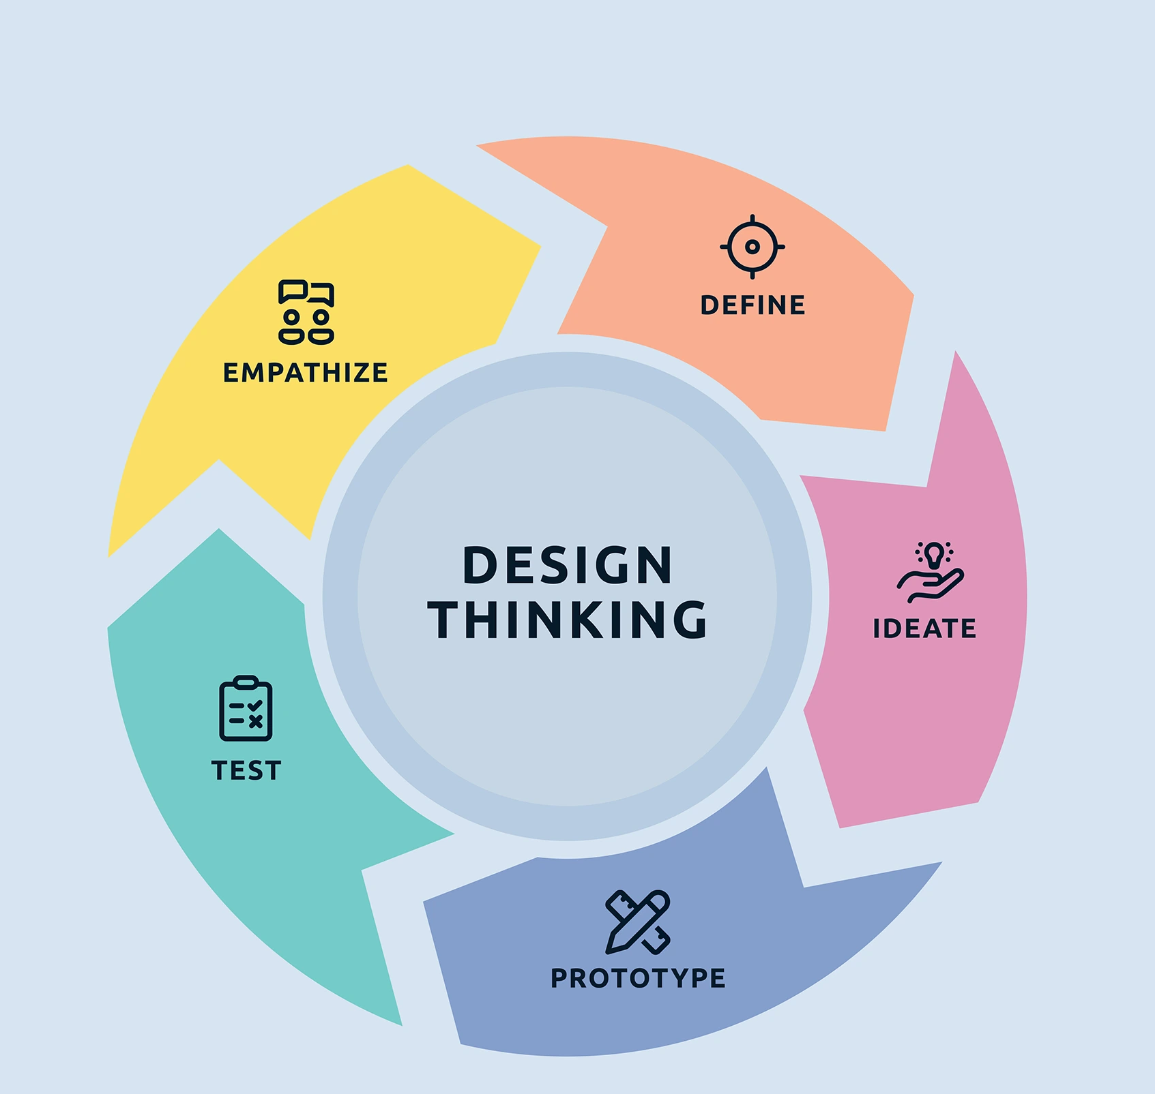
Methods for Generating Ideas
Brainstorming
Quality circles
Benchmarking

Slide 36
Quality Circles
Quality circle
  Groups of workers who meet to discuss ways of improving products or processes
    Less structured and more informal than teams involved in continuous improvement
    Quality circle teams have historically had relatively little authority to make any but the most minor changes

Slide 37
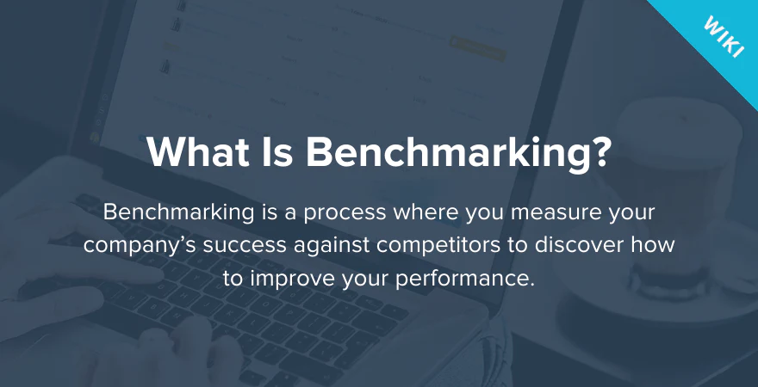
Benchmarking Process
Identify a critical process that needs improvement
Identify an organization that excels in this process
Contact that organization
Analyze the data
Improve the critical process

Slide 38
Operations Strategy
Quality is a strategic imperative for organizations
  Customers are very concerned with the quality of goods and services they receive
Quality is a never-ending journey
  It is important that most organizational members understand and buy into this idea
Customer satisfaction ≠ customer loyalty
Quality needs to be incorporated throughout the entire supply chain, not just the organization itself

Slide 39



Thank You

