Slide 1

Project Risk &Supply Chain Risk
Prepared by Dr. Manal El-Sayed
Lecture 6
PMG 663
Project Risk &Supply Chain Risk

Slide 2
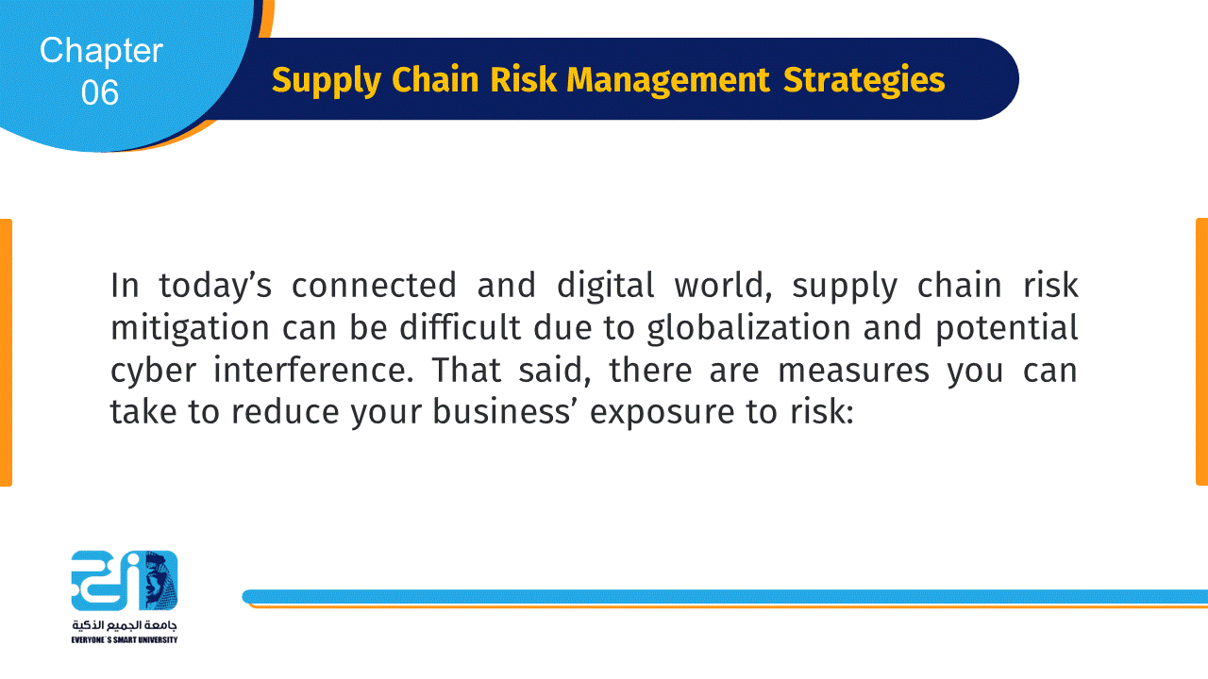

Slide 3
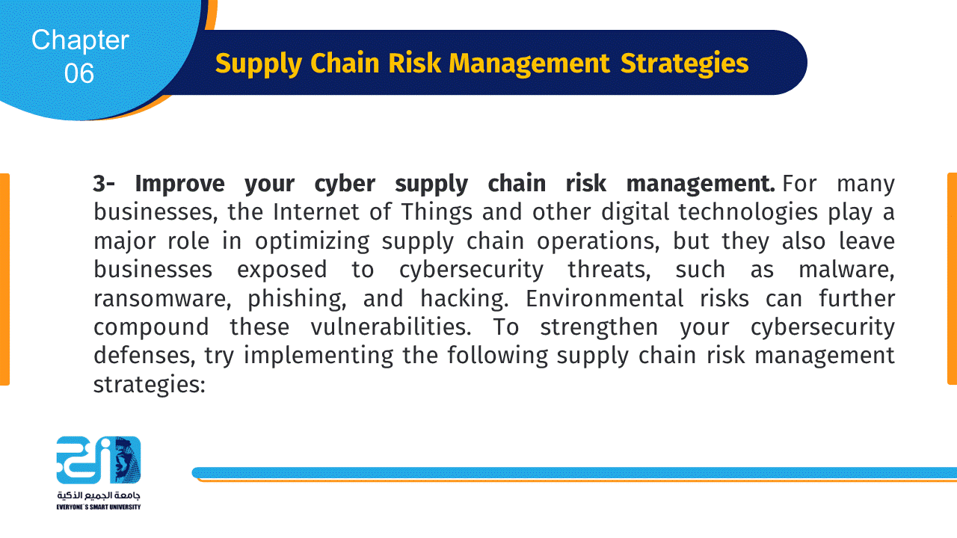

Slide 4
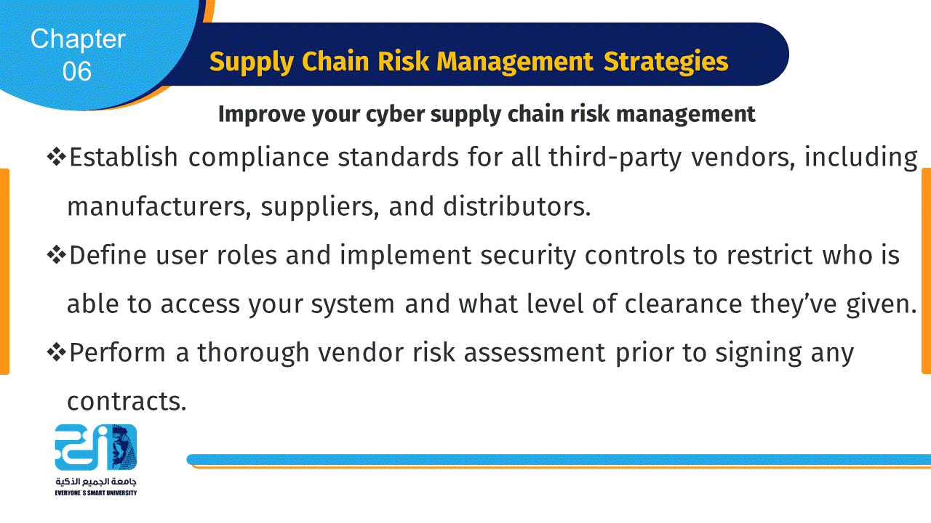

Slide 5
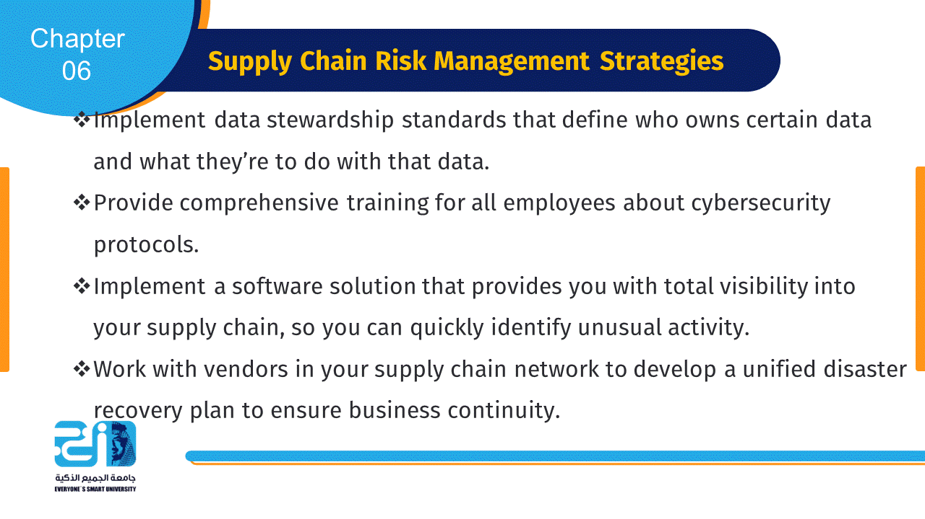

Slide 6
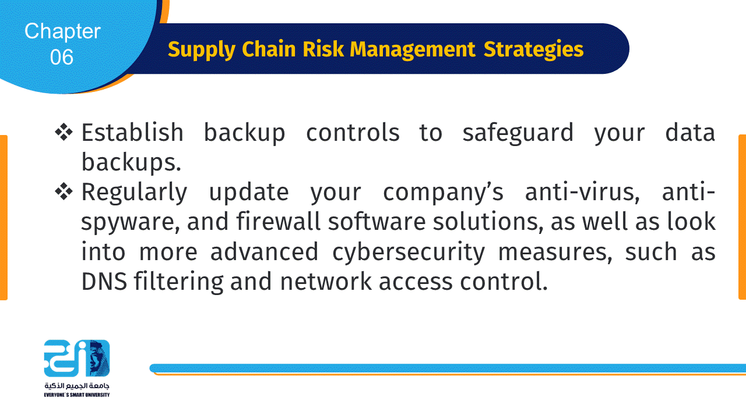

Slide 7
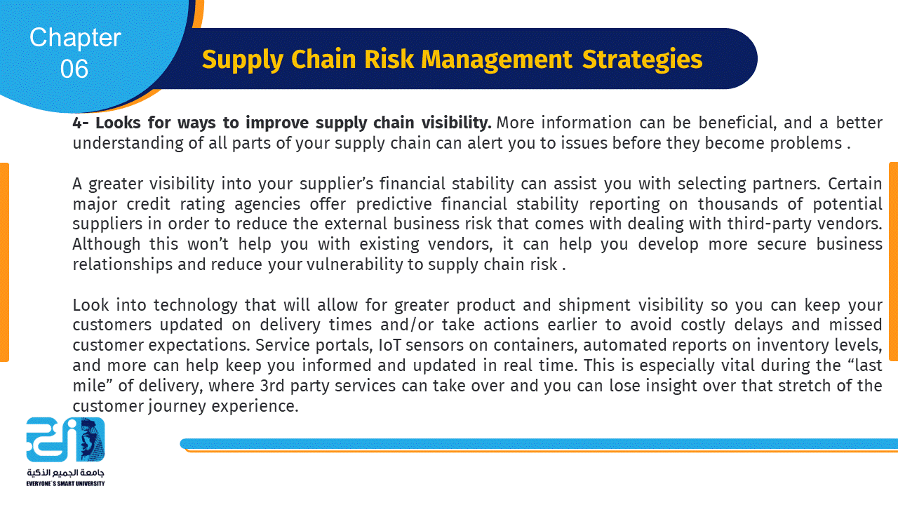

Slide 8
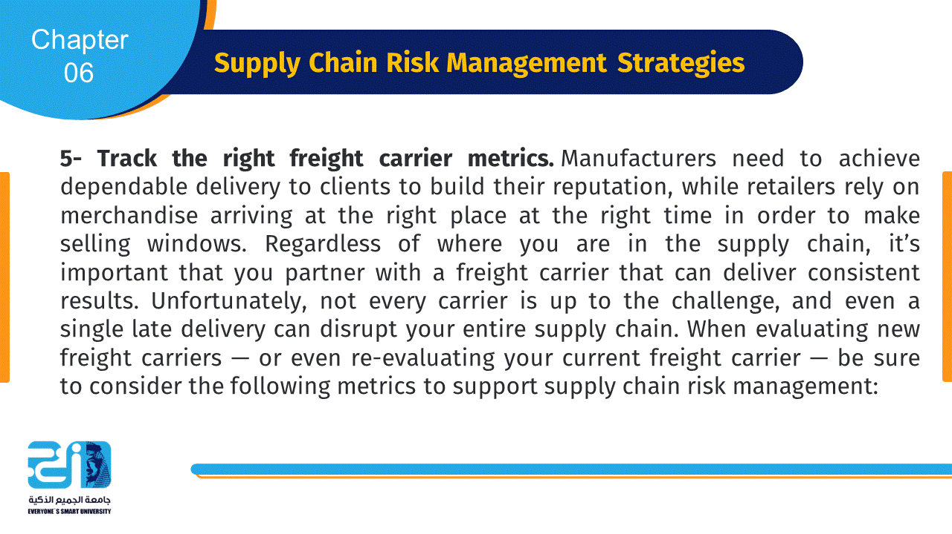

Slide 9
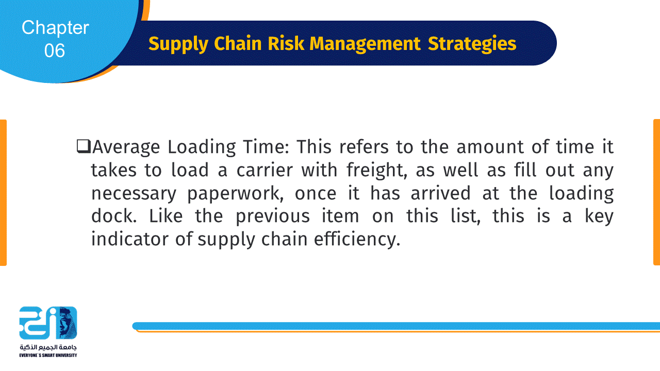

Slide 10
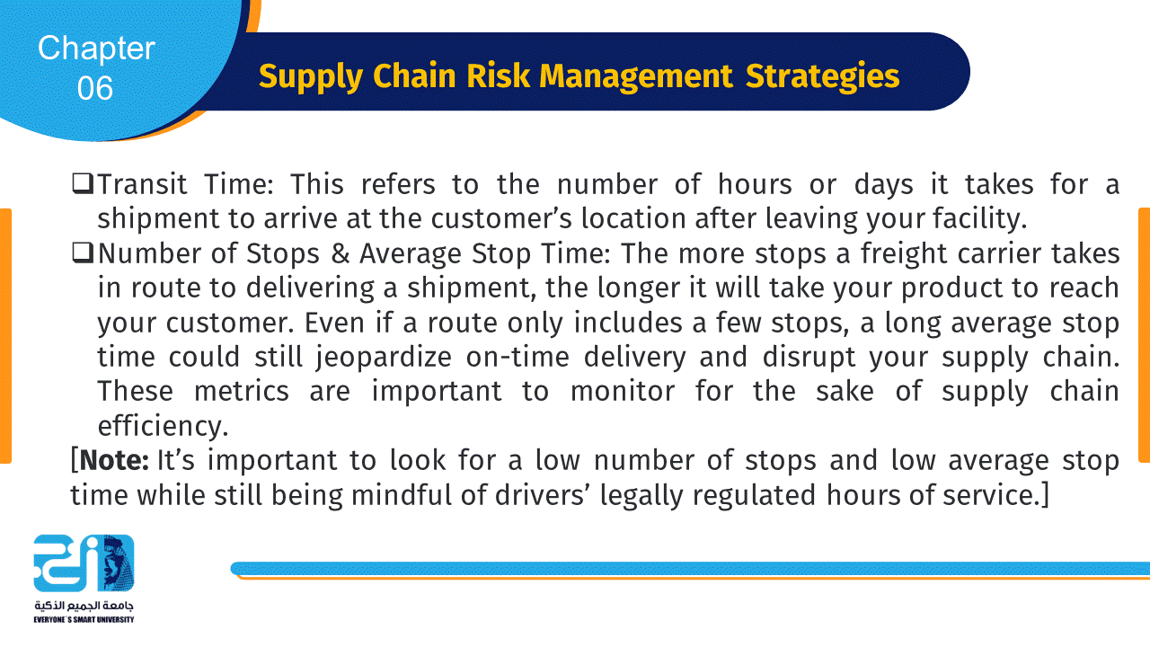

Slide 12
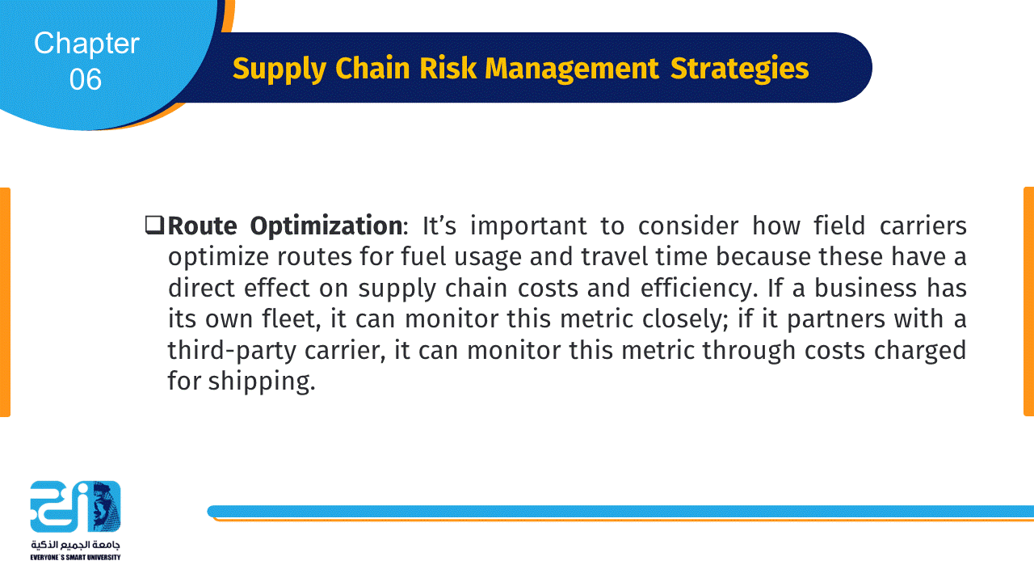

Slide 13
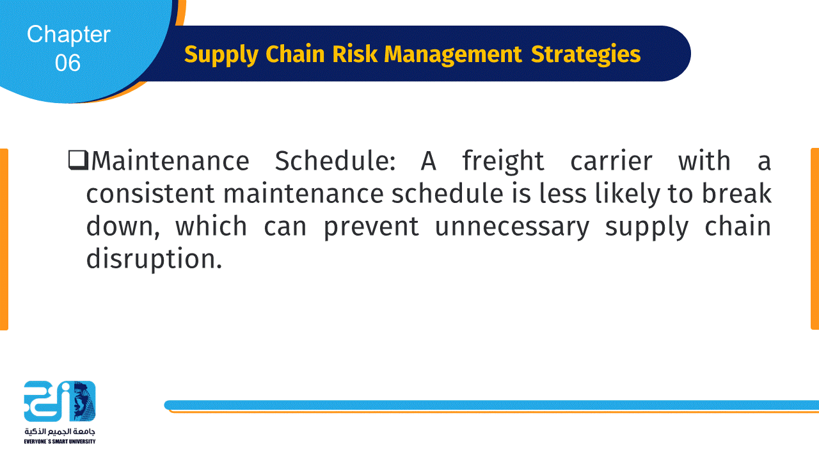

Slide 14
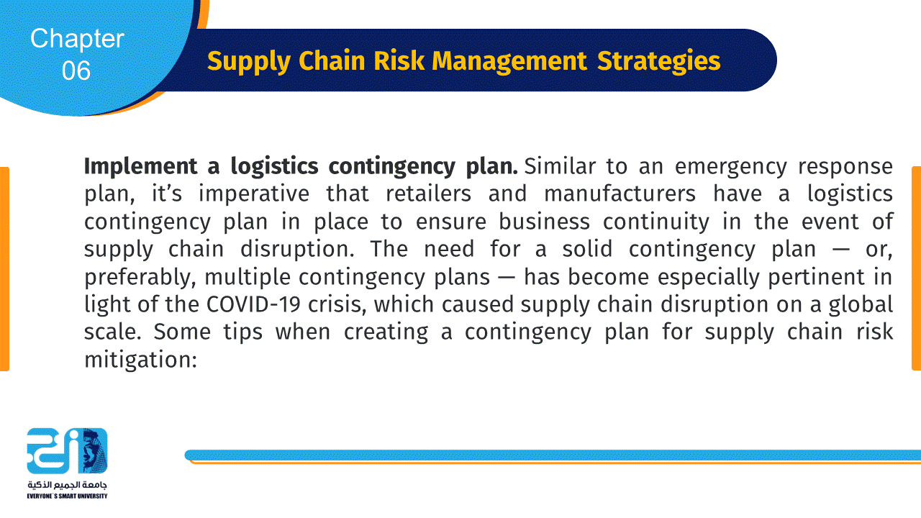

Slide 15
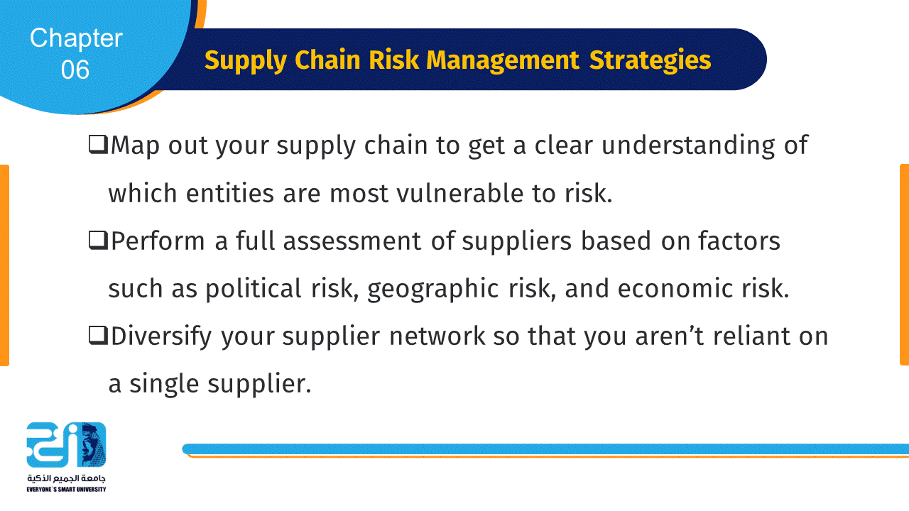

Slide 16
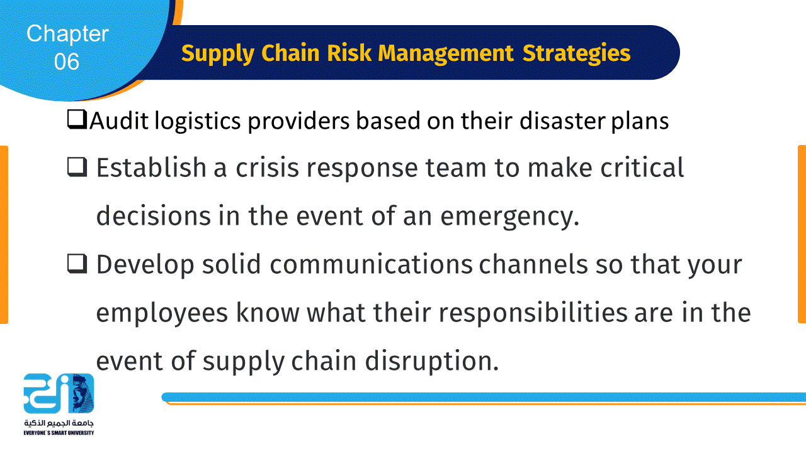

Slide 17
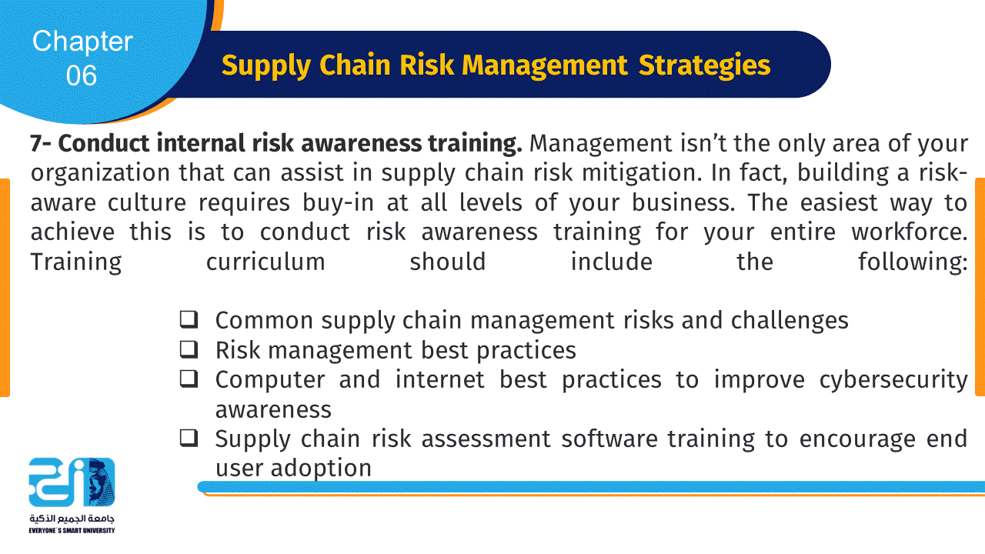

Slide 18

Chapter
06
Supply Chain Risk Management Strategies
8- Consistently monitor risk. This might seem like a given, but consistently monitoring supply chain risk factors really is the key to protecting your operations. Many organizations assume that they’re secure once they’ve implemented a supply chain risk mitigation framework, but the work doesn’t stop there. Every level of the supply chain should be carefully observed for potential risk indicators.The easiest way to do this is to invest in a scalable digital retail solution that automates monitoring for various aspects of your supply chain. This will not only provide you with security and peace of mind, but also valuable intel into how you can streamline business operations.

Slide 19
Chapter
06
Supply Chain Risk Management Strategies
9- Use data to model key risk event scenarios. Imagine being able to predict a risk event well before it ever happens. Technology hasn’t brought us there just yet but, thanks to data science, predictive analytics, and data modeling, we’ve come pretty close. Big Data has opened up a world of opportunities for businesses, including using data science and predictive analytics to create advanced models for potential risk event scenarios.By using data models to forecast what could potentially happen during a worst-case scenario, you can develop more comprehensive contingency plans that will better prepare your business for if and when disaster strikes .Curious about how this “intelligent” supply chain works?

Slide 20
Chapter
06
Supply Chain Risk Management Strategies
10- Consolidate your data for easy access. Too many solutions in your software ecosystem can gum up the works, especially if you store business data in multiple disparate systems. In order to make it easier to leverage data science, predictive analytics, and data modeling, invest in a comprehensive retail solution that keeps all of your data within a single, centralized, and well-organized repository.

Slide 21
Chapter
06
Why are today’s supply chains so vulnerable?
Widespread adoption of ‘lean’ practices
The move to off-shore manufacturing and sourcing
Out-sourcing and reduction in the supplier base
Global consolidation of suppliers
Centralised production and distribution
All of which combine to make supply chains vulnerable to disruption

Slide 22
Chapter
06
Supply chain risk
“The entire Japanese vehicle industry ground to a halt following an earthquake that stopped production of piston rings for engines provided by Riken, the industry leader in the domestic market.
Toyota, in particular, was forced to stop operations at all 12 of its domestic plants.”

Slide 23
Chapter
06
Supply chain risk
“A fire at a key Philips semiconductor factory in 2000 caused a worldwide shortage of the radio frequency chips used by both Nokia and Ericsson. Nokia immediately lined up another source and redesigned other chips so they could be produced elsewhere. However, Ericsson responded more slowly and lost an estimated $400 million in mobile phone handsets.”

Slide 24
Chapter
06
Supply chain risk
“Yesterday it emerged that ice-cream supplies may run short because Unilever’s only UK factory, based in flood-stricken Gloucester, has been closed for the past ten days.
The company usually manufacturers five million ice-creams and lollipops a day at the plant. It has stocks in freezers but it could be days before normal production resumes. Industry insiders predict that there will now be an ice-cream war as rival brands attempt to exploit Unilever’s predicament and gain market share.”
The Times, 31 July 2007

Slide 25
Chapter
06
Supply chain risk is systemic
The biggest risk to business continuity may lie outside the company in the wider supply chain
The complexity and inter-connectedness of modern supply chains increases their vulnerability to disruption
Environmental risks are outside our control, but systemic risk is created through our own decisions

Slide 26
Chapter
06
There are two generic categories of supply chain risk
Supply chains comprise nodes and links
Nodes – organisational risk
Links – network risk

Slide 27
Chapter
06
Supply Chain Risk Management
“The identification and management of risks within the supply chain and risks external to it through a coordinated approach amongst supply chain members to reduce supply chain vulnerability as a whole”.
“Avoiding the loss of customer confidence and the erosion of shareholder value resulting from supply chain disruption.”

Slide 28
Chapter
06
What's the risk
Risk = probability of occurrence x consequences

Slide 29
Chapter
06
The risk management challenge
High
Consequence/
Impact
عاقبة / تاثير
Low
إحتمالية الحدوث
Low
High
Probability of Occurrence
Where can we reduce the probability?
How can we reduce the consequence?

Slide 30
Chapter
06
The five sources of risk
Supply risk
Demand risk
Process risk
Control risk
Environmental risk

Slide 31
Chapter
06
Location of risk in the supply chain
SUPPLY
RISK
PROCESS
RISK
DEMAND
RISK
NETWORK/
CONTROL
RISK
Environmental Risk

Slide 32
Chapter
06
The five sources of supply chain risk
Supply Risk
Process Risk
Demand Risk
Loss of major accounts
Volatility of demand
Concentration of customer
base
Short life cycles
Innovative competitors
Dependency on key suppliers
Consolidation in supply markets
five sources of supply chain risk
arising from off-shore sourcing
Potential disruption at 2nd tier level
Length and variability of
replenishment lead-times
Manufacturing yield variability
Lengthy set-up times and
inflexible processes
Equipment reliability
Limited capacity/bottlenecks
Outsourcing key business
processes
Network/Control Risk
Environment Risk
Asymmetric power relationships
Poor visibility along the pipeline
Inappropriate rules that distort demand
Lack of collaborative planning and forecasts
Bullwhip effects due to multiple echelons
Natural disasters
Terrorism and war
Regulatory changes
Tax, duties and quotas
Strikes

Slide 33
Chapter
06
The five sources of supply chain risk
Environment Risk
Network/Control Risk
Natural disasters
Terrorism and war
Regulatory changes
Tax, duties and quotas
Strikes
Asymmetric power relationships
Poor visibility along the pipeline
Inappropriate rules that distort demand
Lack of collaborative planning and forecasts
Bullwhip effects due to multiple echelons

Slide 34
Chapter
06
The challenge of global logistics
PRODUCT
LINE DIVERSITY
MARKET
CONCENTRATION
PRODUCTION
DISPERSION
Techno-
logy / dev-
elopment
Custo-
mer
Parts /
Components
Marketing
/retailing
Inbound
supply
Physical
distribution
Assembly
Shorter product
life cycles
Concentrated
demand
Price erosion
Product / model
proliferation
Global sourcing
Focused factories

