Slide 1


Slide 2
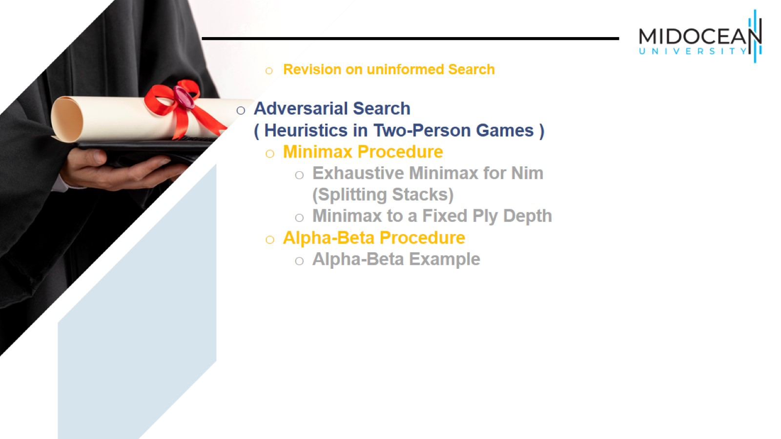

Slide 3
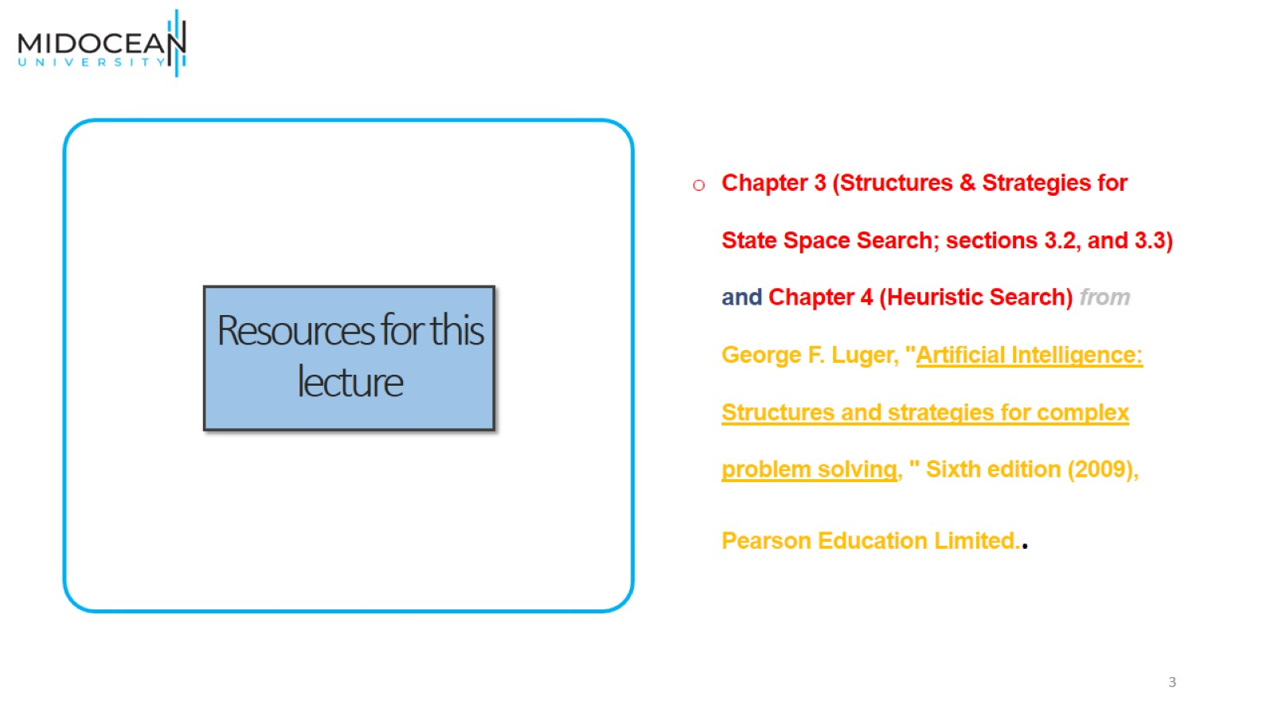
Resources for this lecture

Slide 4
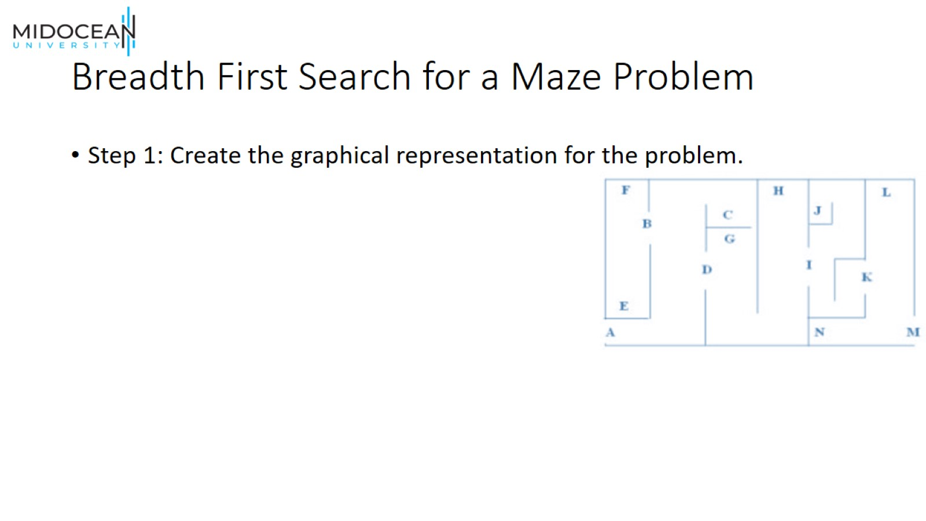
Breadth First Search for a Maze Problem

Slide 5
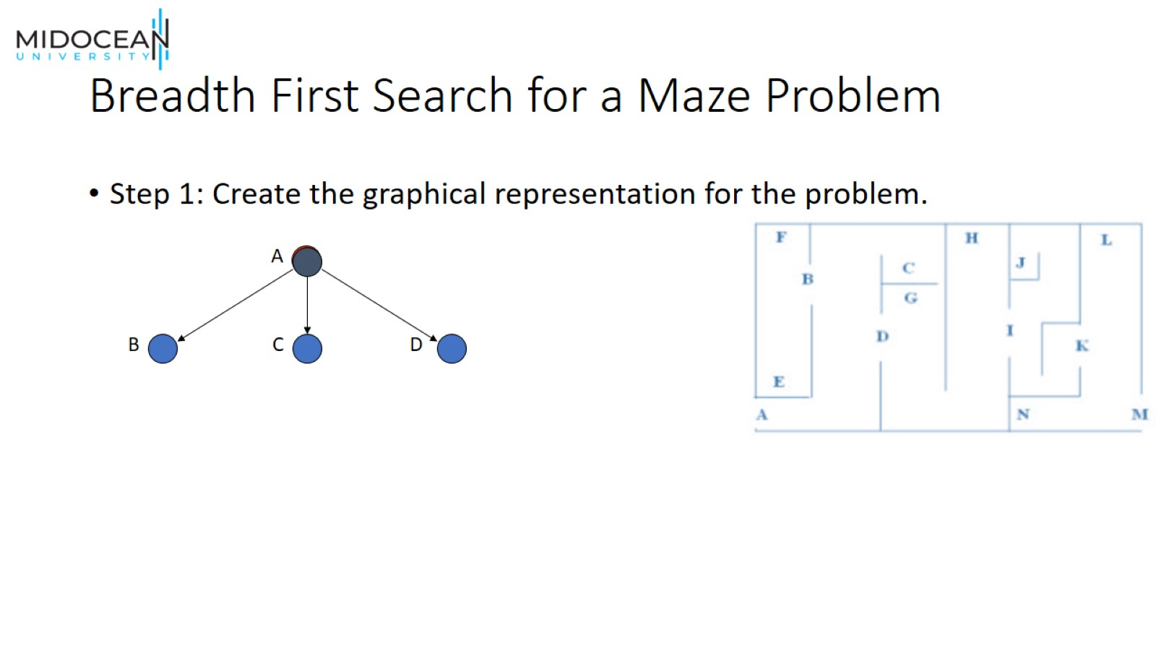
Breadth First Search for a Maze Problem

Slide 6
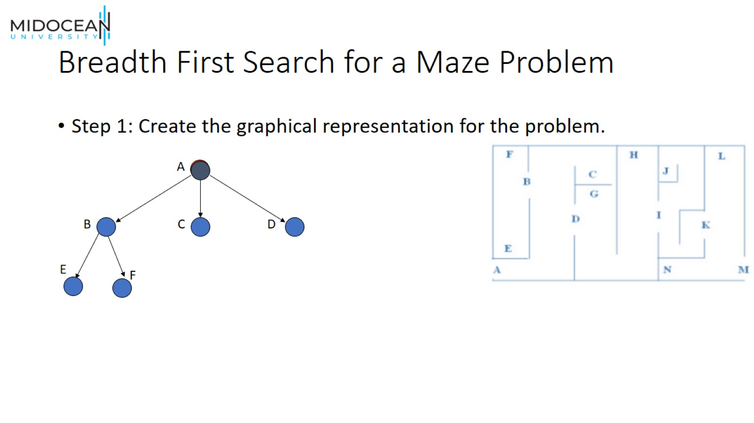
Breadth First Search for a Maze Problem

Slide 7
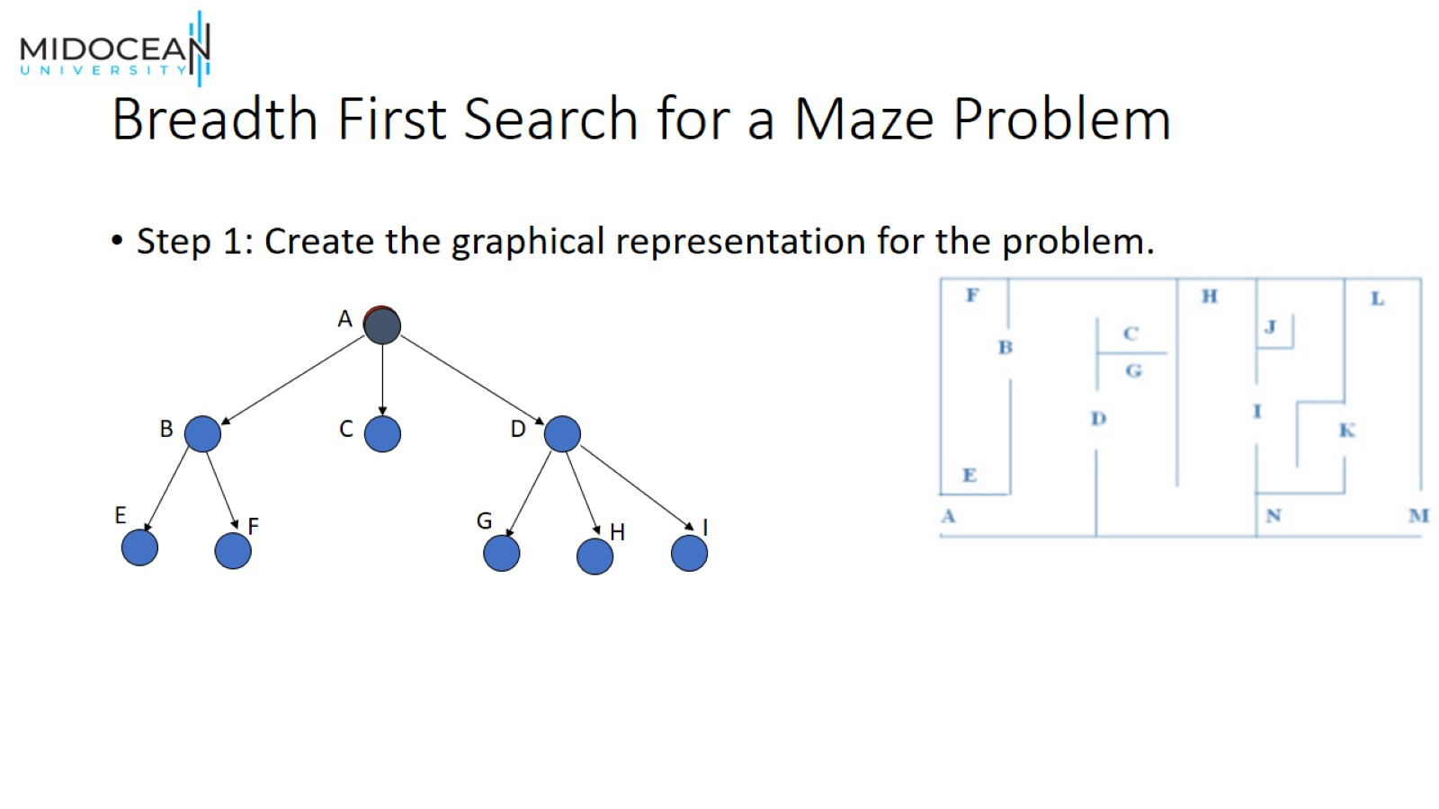
Breadth First Search for a Maze Problem

Slide 8
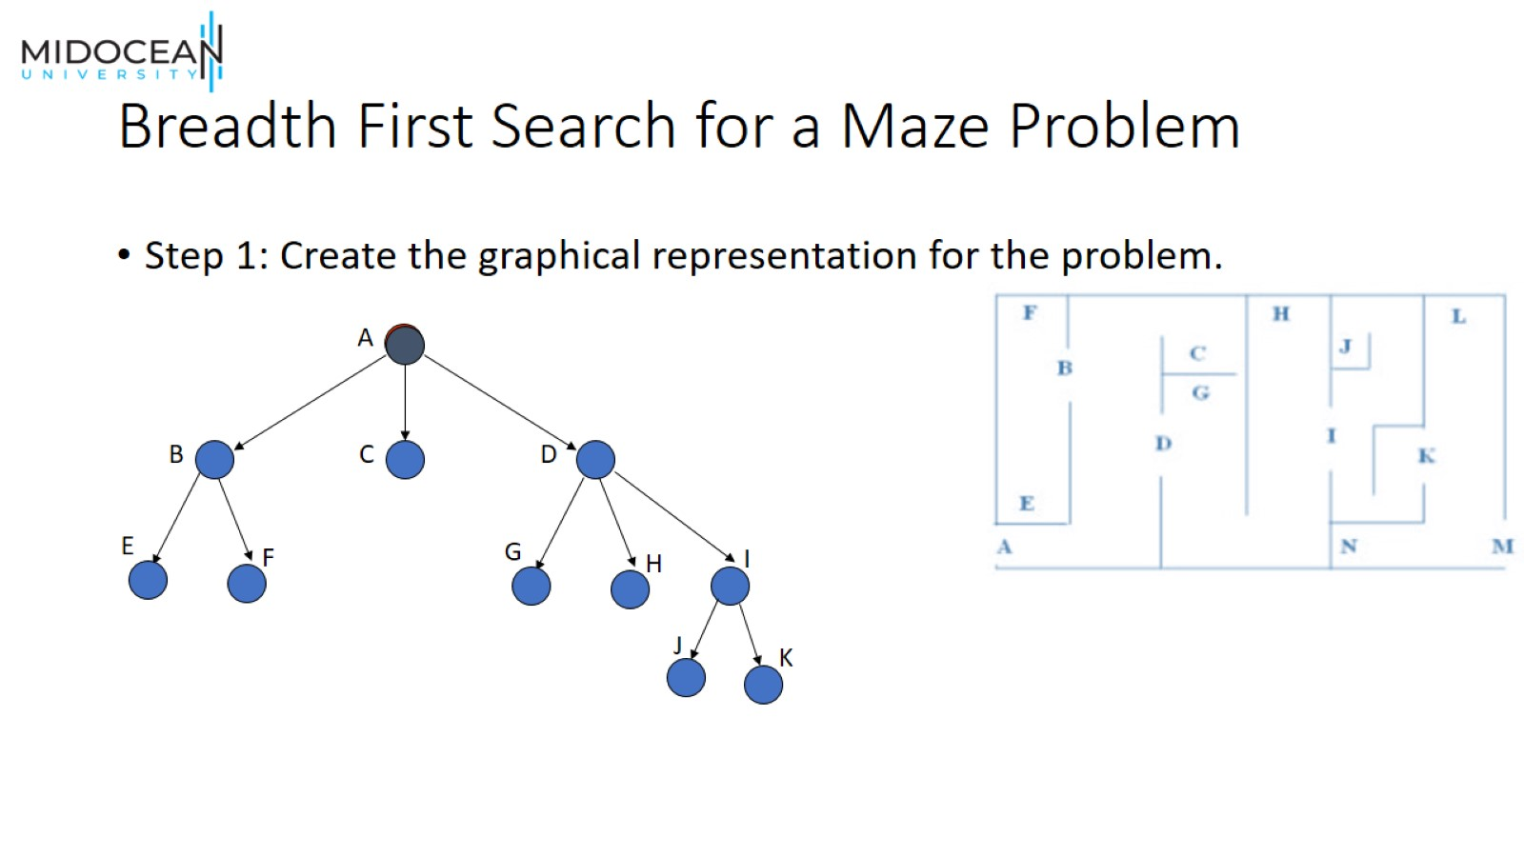
Breadth First Search for a Maze Problem

Slide 9
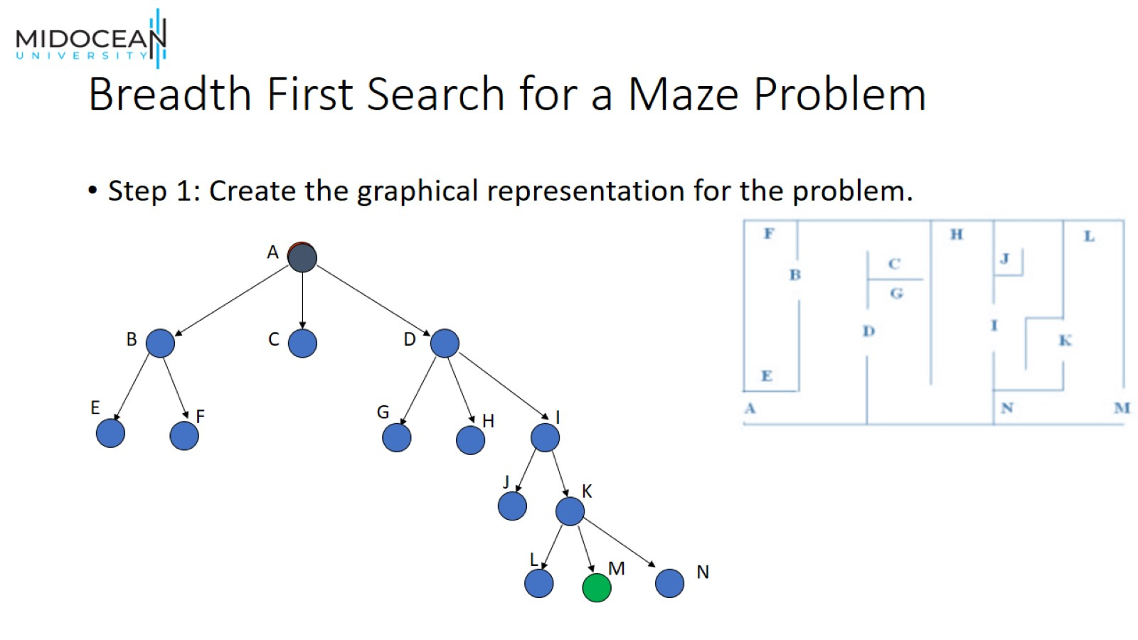
Breadth First Search for a Maze Problem

Slide 10

Adversarial Search Strategies

Slide 11
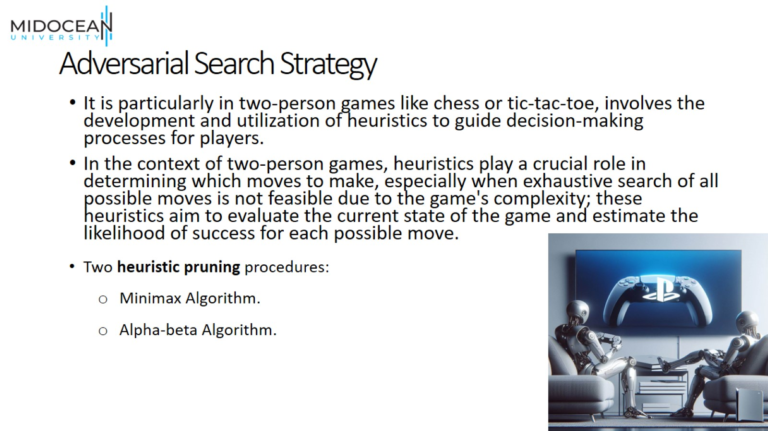
Adversarial Search Strategy

Slide 12
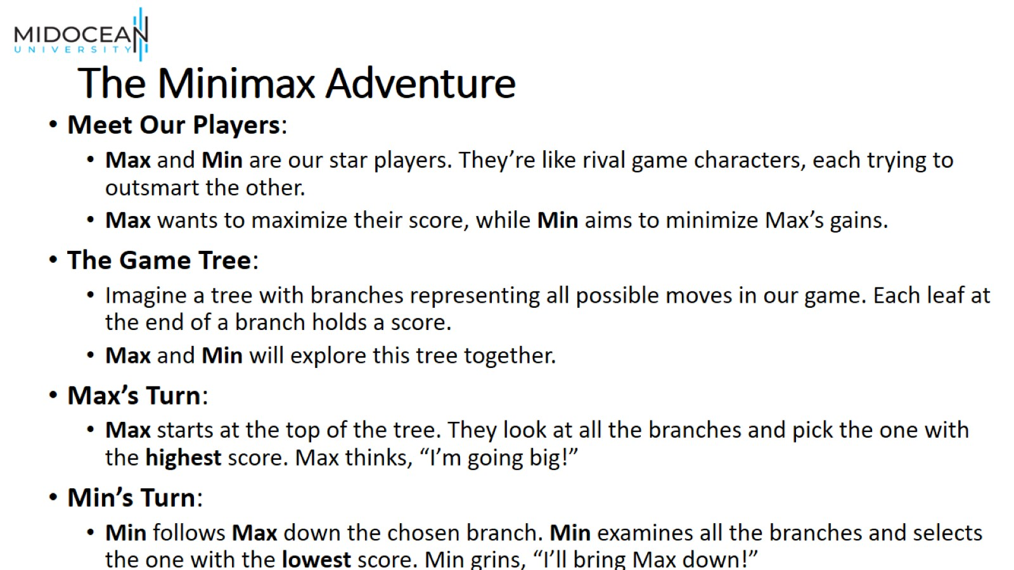
The Minimax Adventure

Slide 13
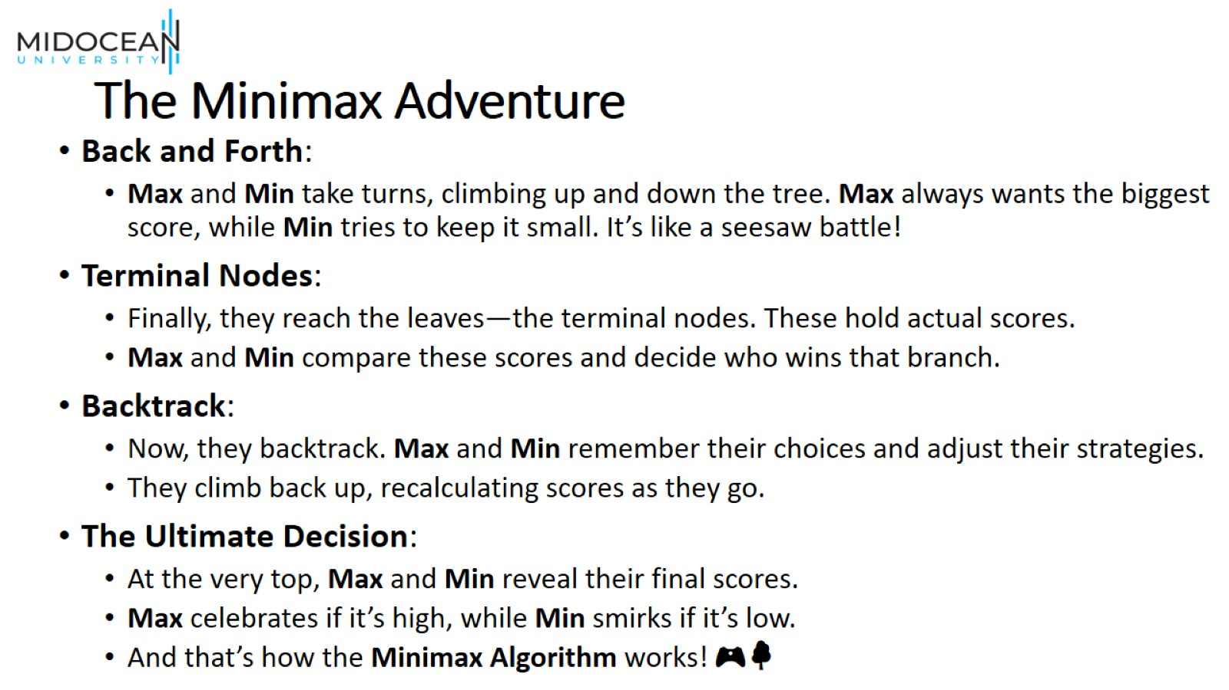
The Minimax Adventure

Slide 14
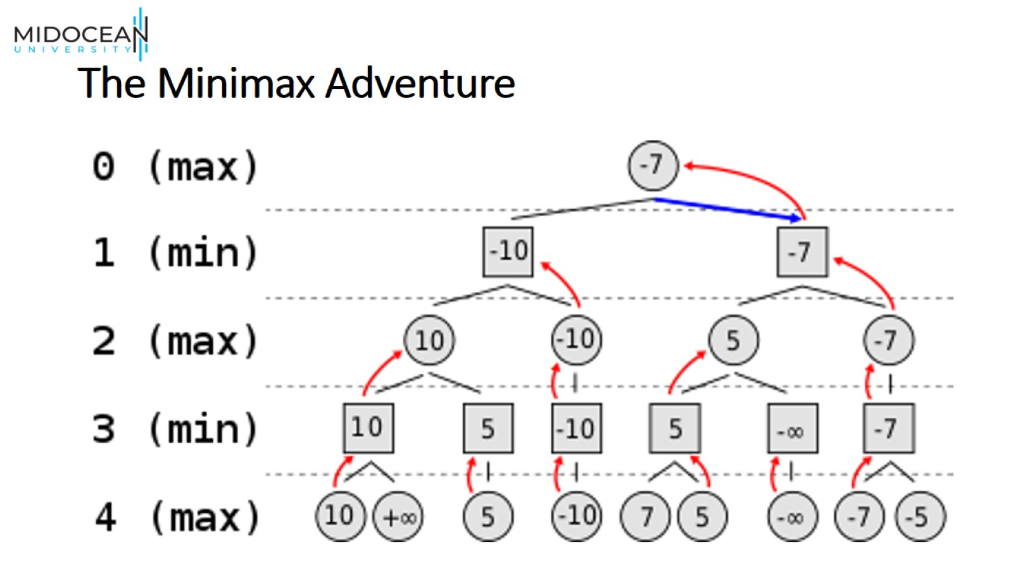
The Minimax Adventure

Slide 15
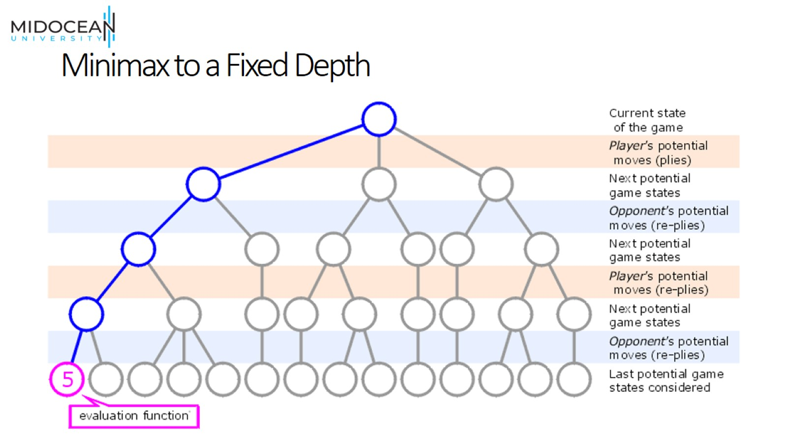
Minimax to a Fixed Depth

Slide 16
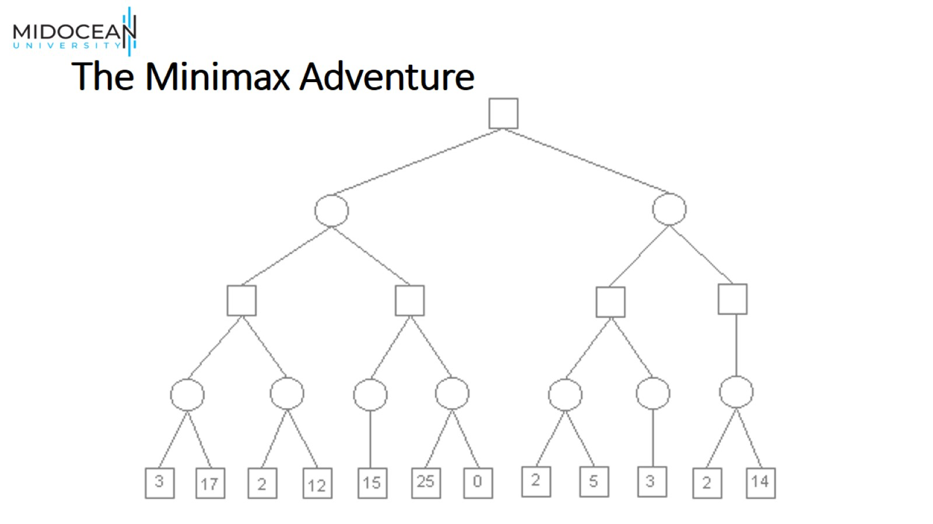
The Minimax Adventure

Slide 17
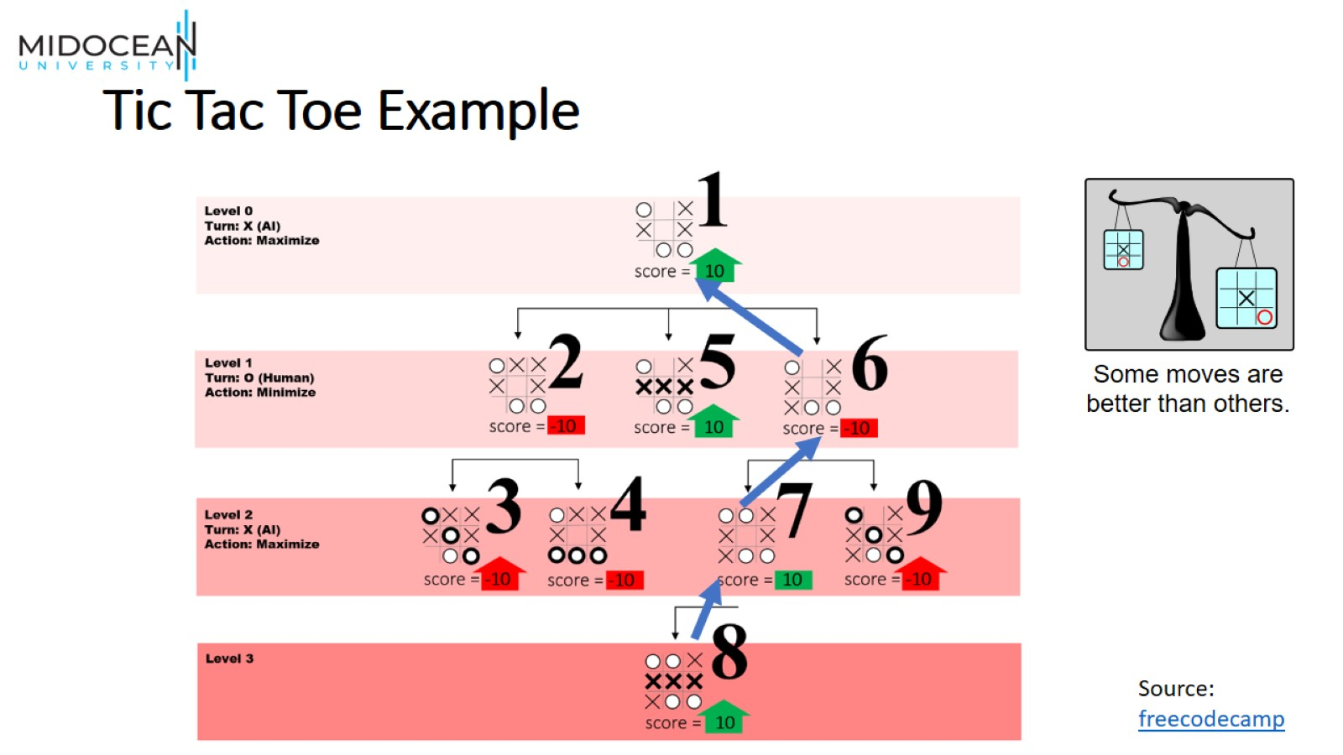
Tic Tac Toe Example

Slide 18
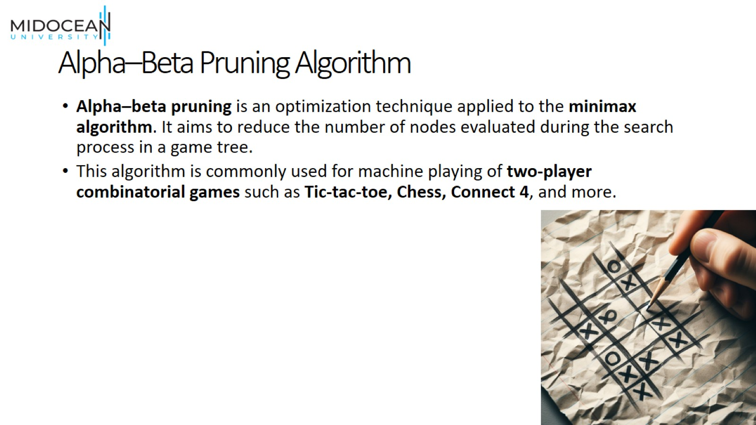
Alpha–Beta Pruning Algorithm

Slide 19
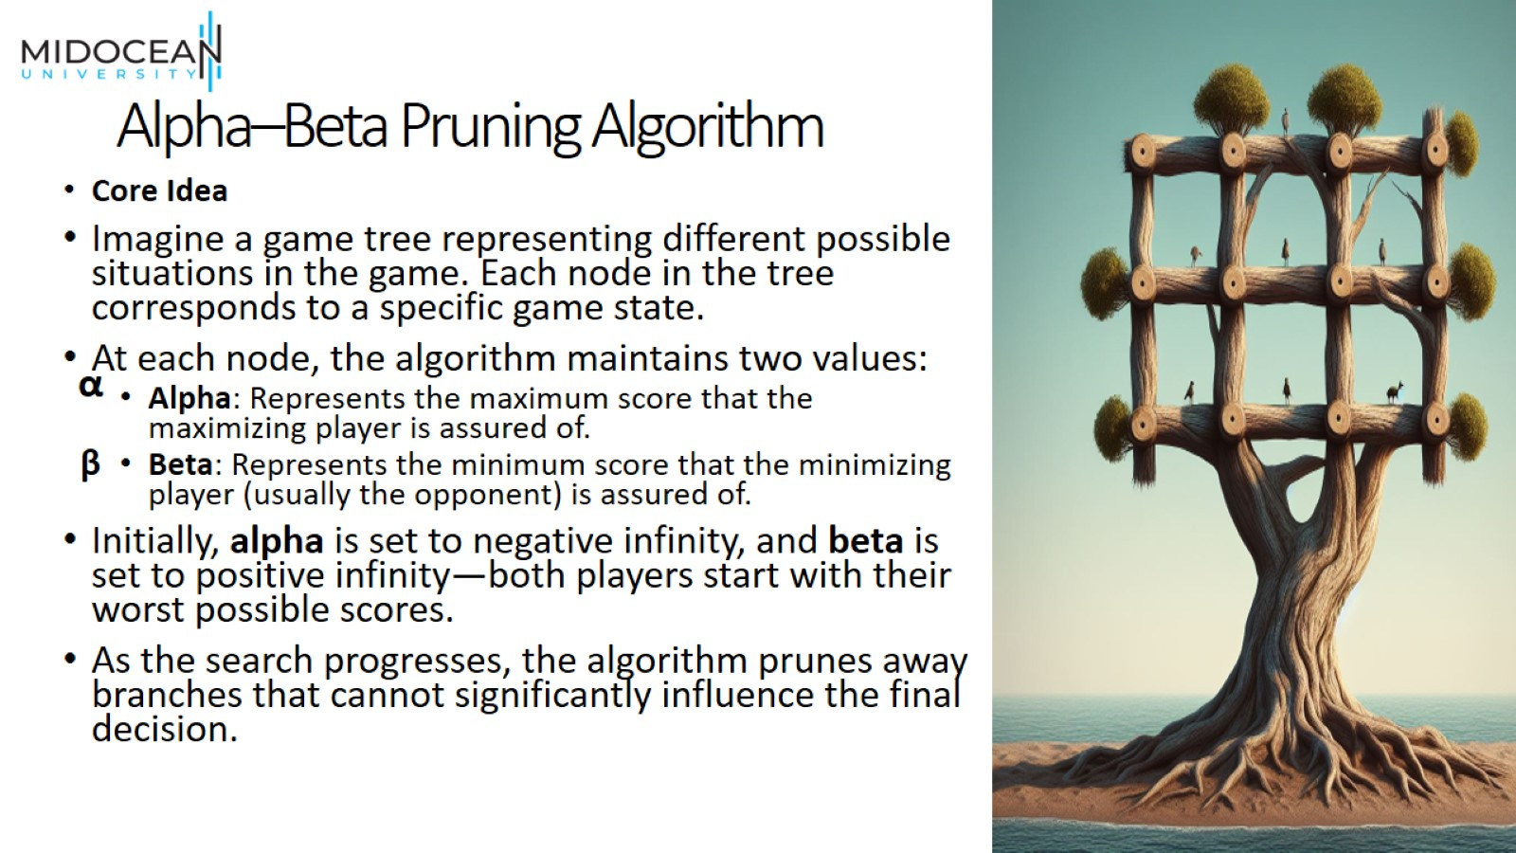
Alpha–Beta Pruning Algorithm

Slide 20
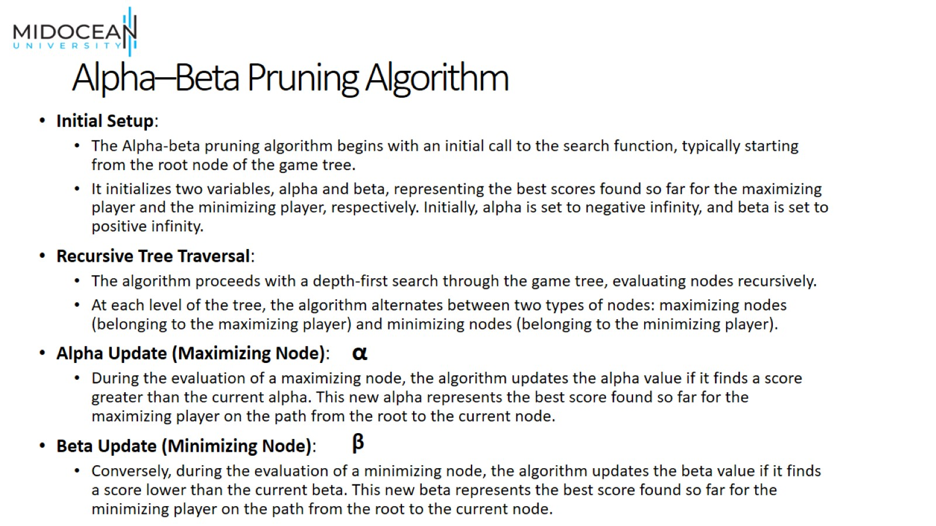
Alpha–Beta Pruning Algorithm

Slide 21
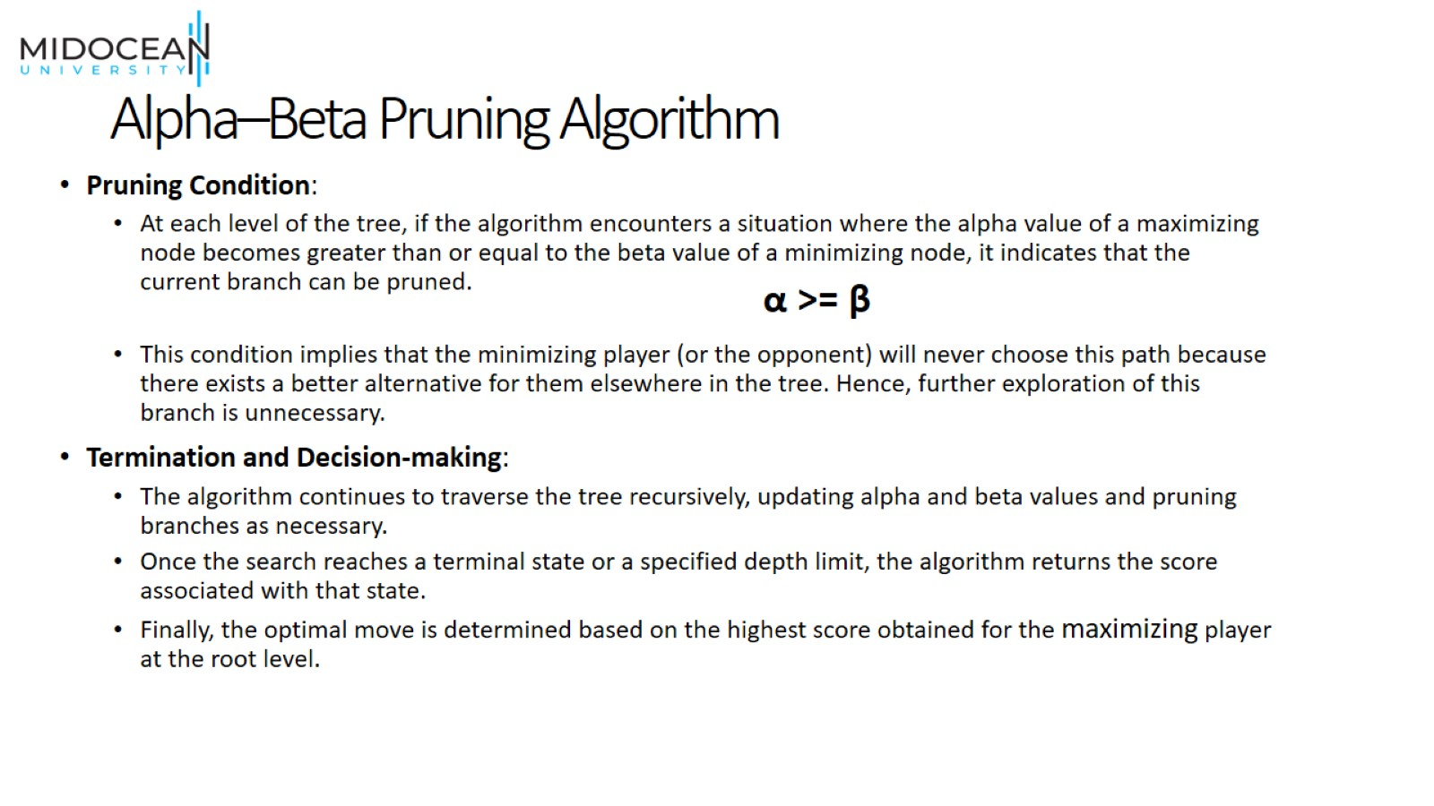
Alpha–Beta Pruning Algorithm

Slide 22
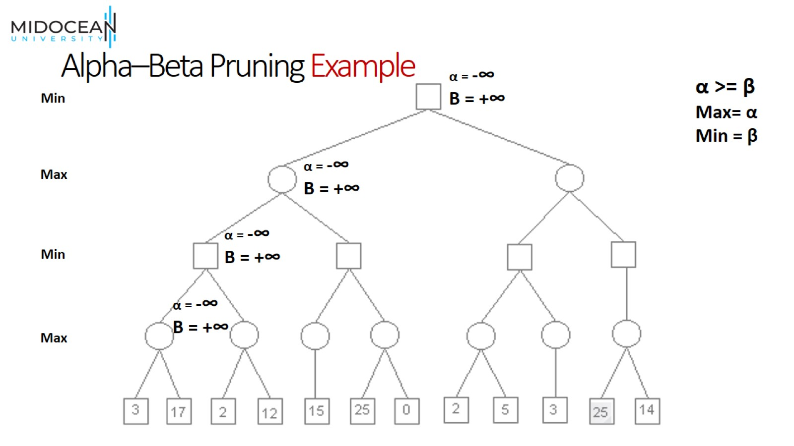
Alpha–Beta Pruning Example

Slide 23
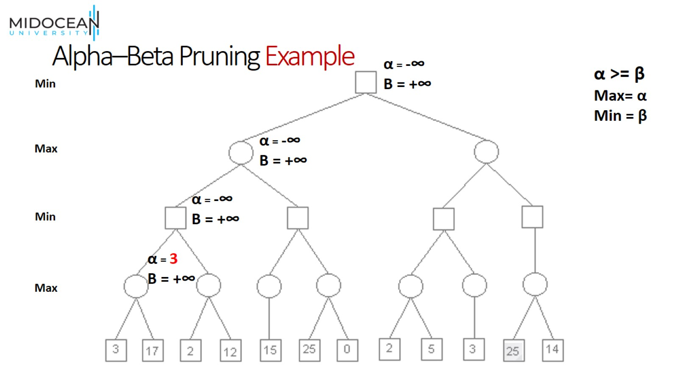
Alpha–Beta Pruning Example

Slide 24
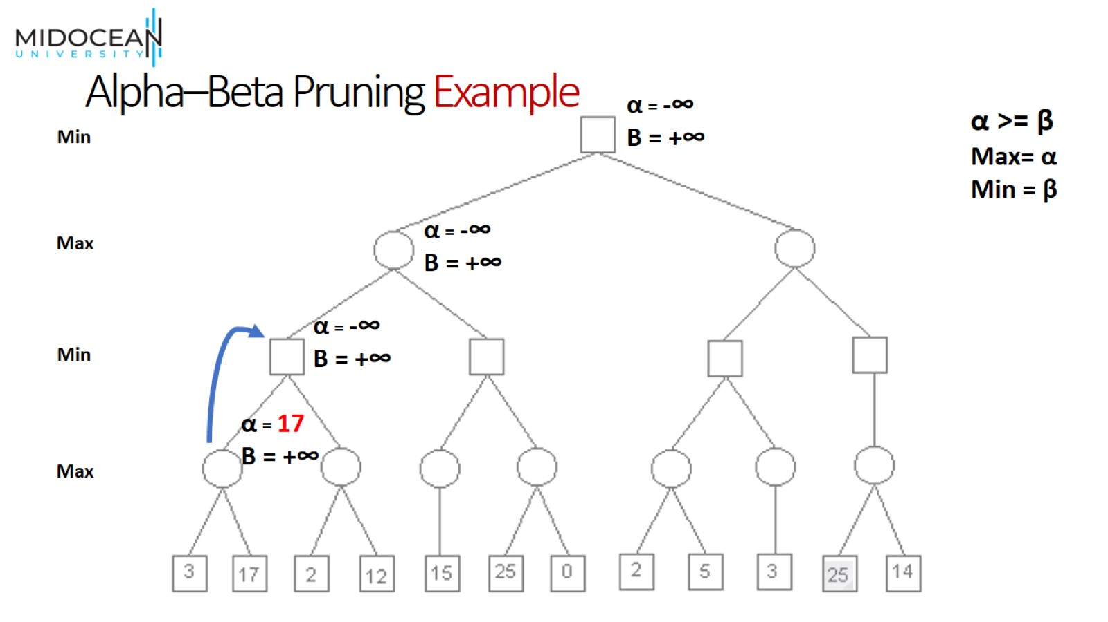
Alpha–Beta Pruning Example

Slide 25
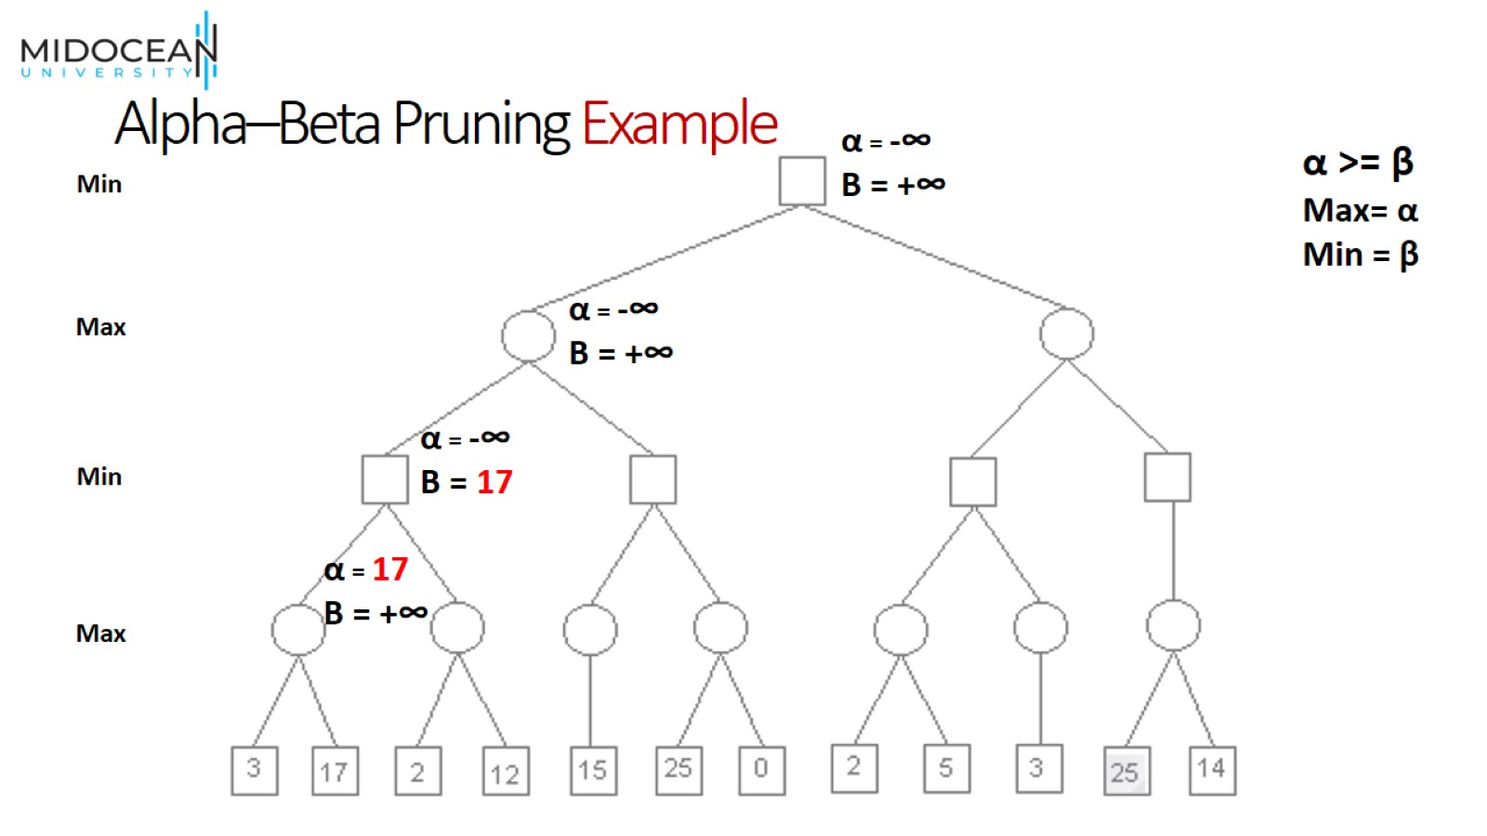
Alpha–Beta Pruning Example

Slide 26
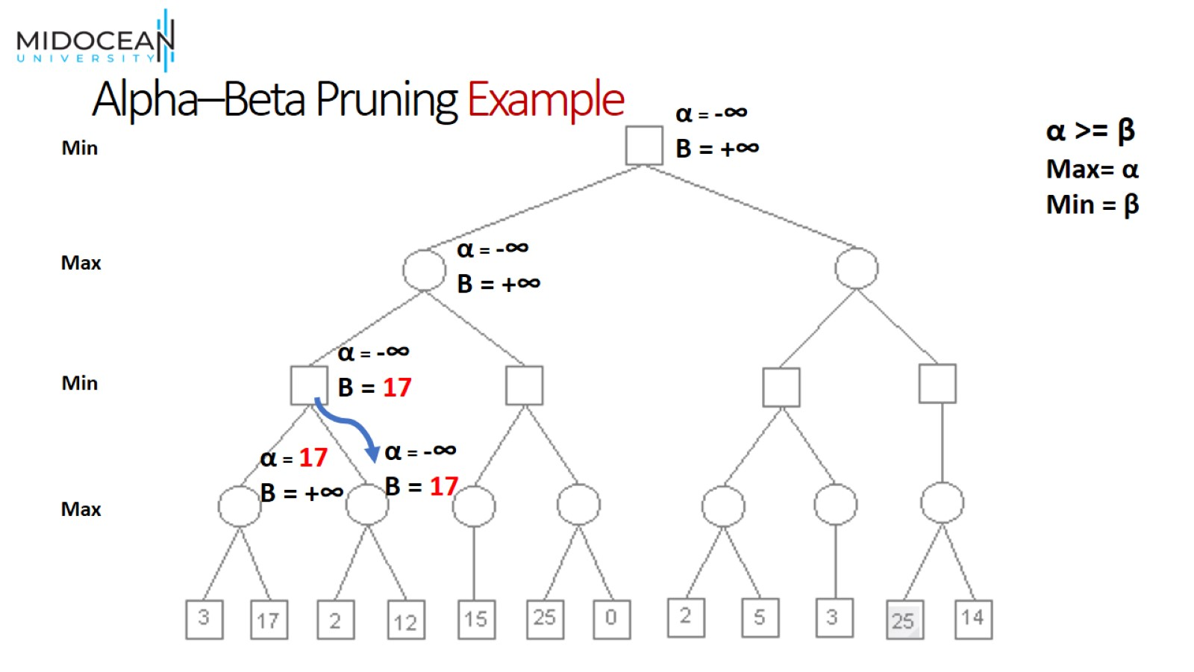
Alpha–Beta Pruning Example

Slide 27
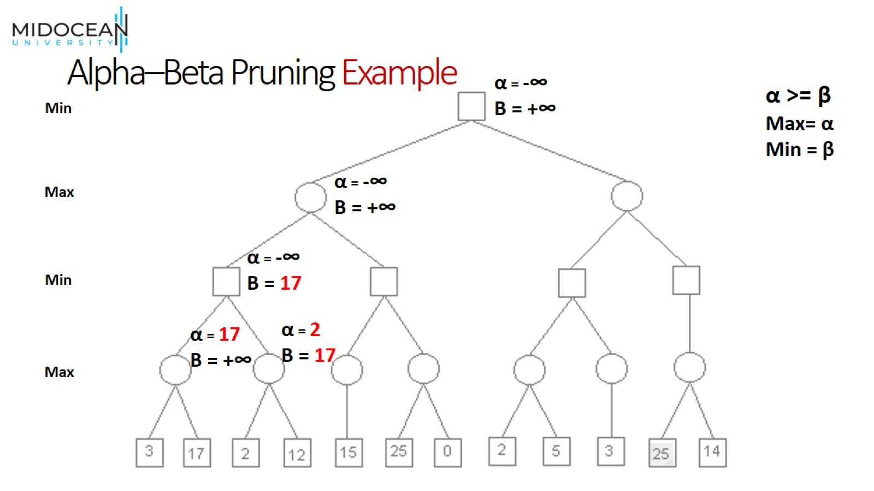
Alpha–Beta Pruning Example

Slide 28

Alpha–Beta Pruning Example

Slide 29
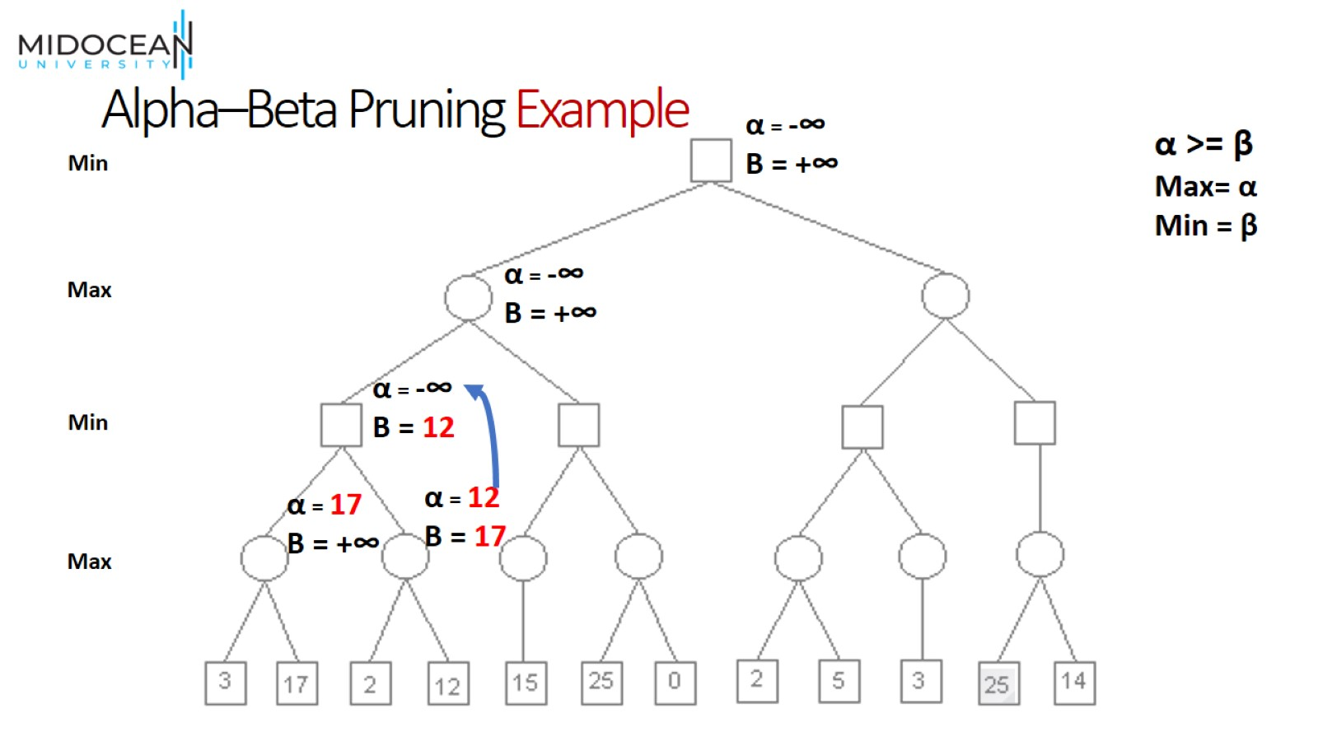
Alpha–Beta Pruning Example

Slide 30
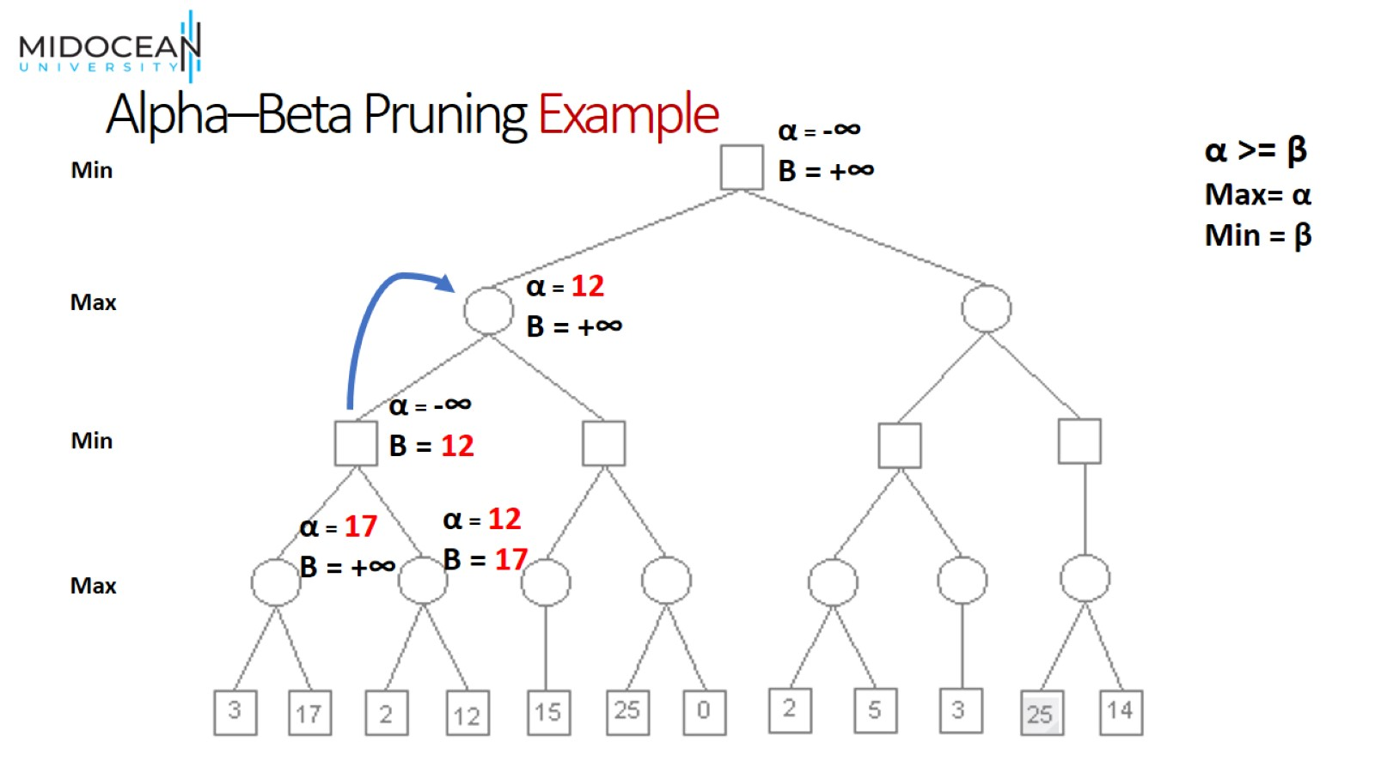
Alpha–Beta Pruning Example

Slide 31
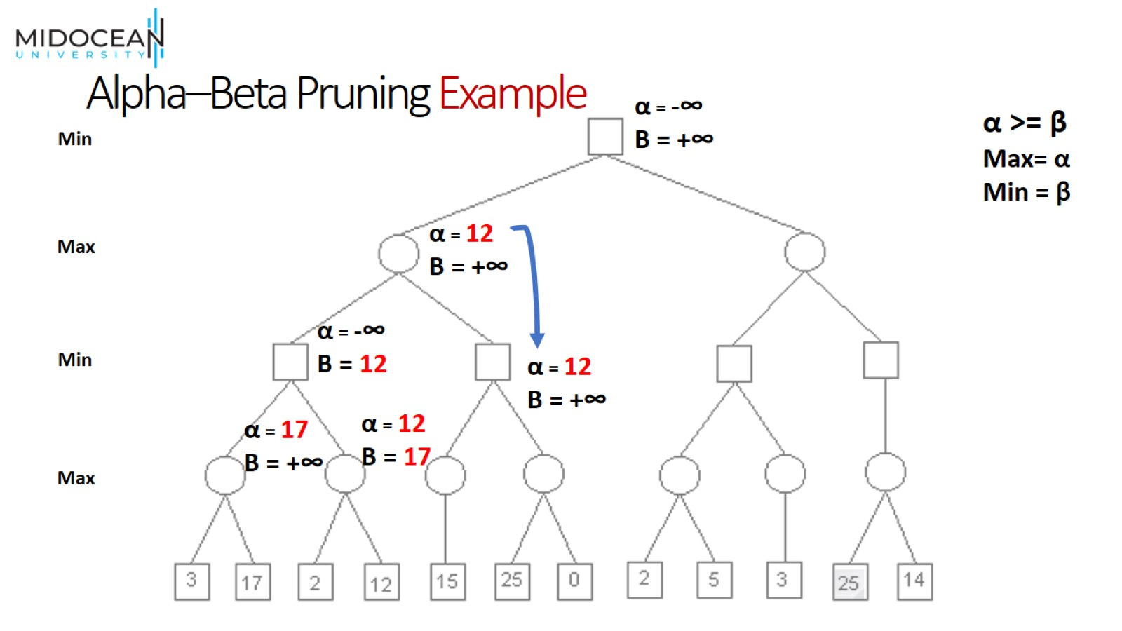
Alpha–Beta Pruning Example

Slide 32
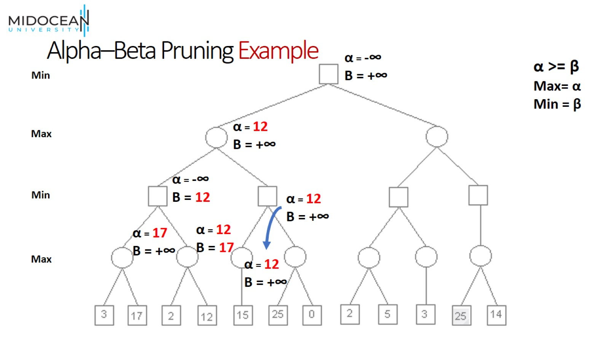
Alpha–Beta Pruning Example

Slide 33
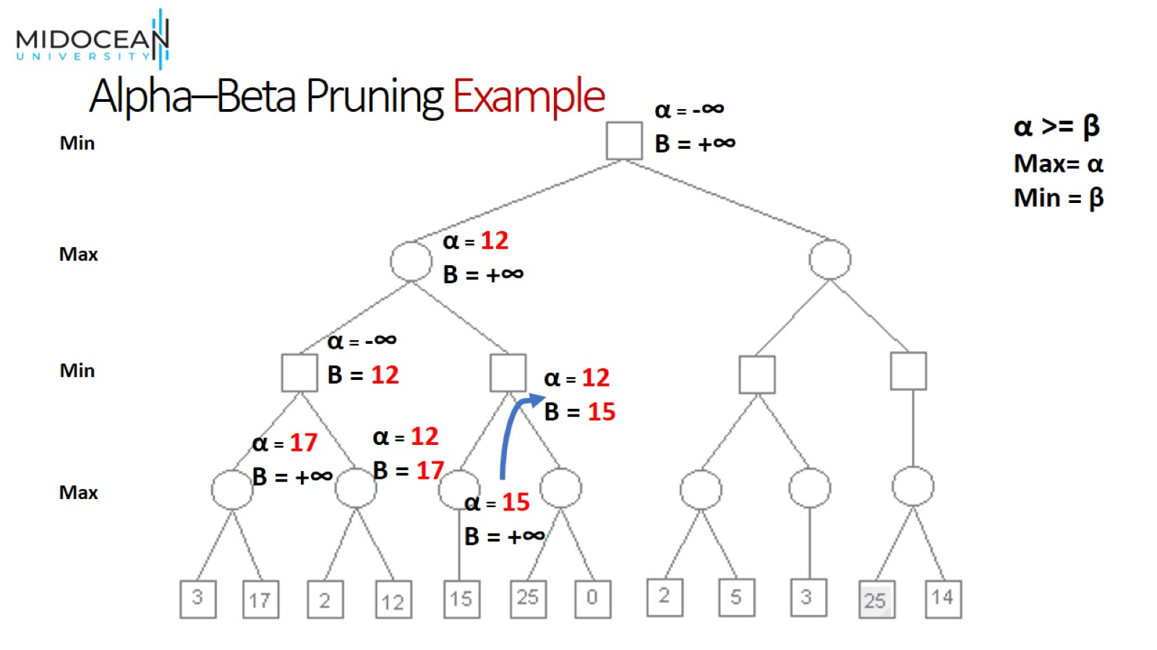
Alpha–Beta Pruning Example

Slide 34
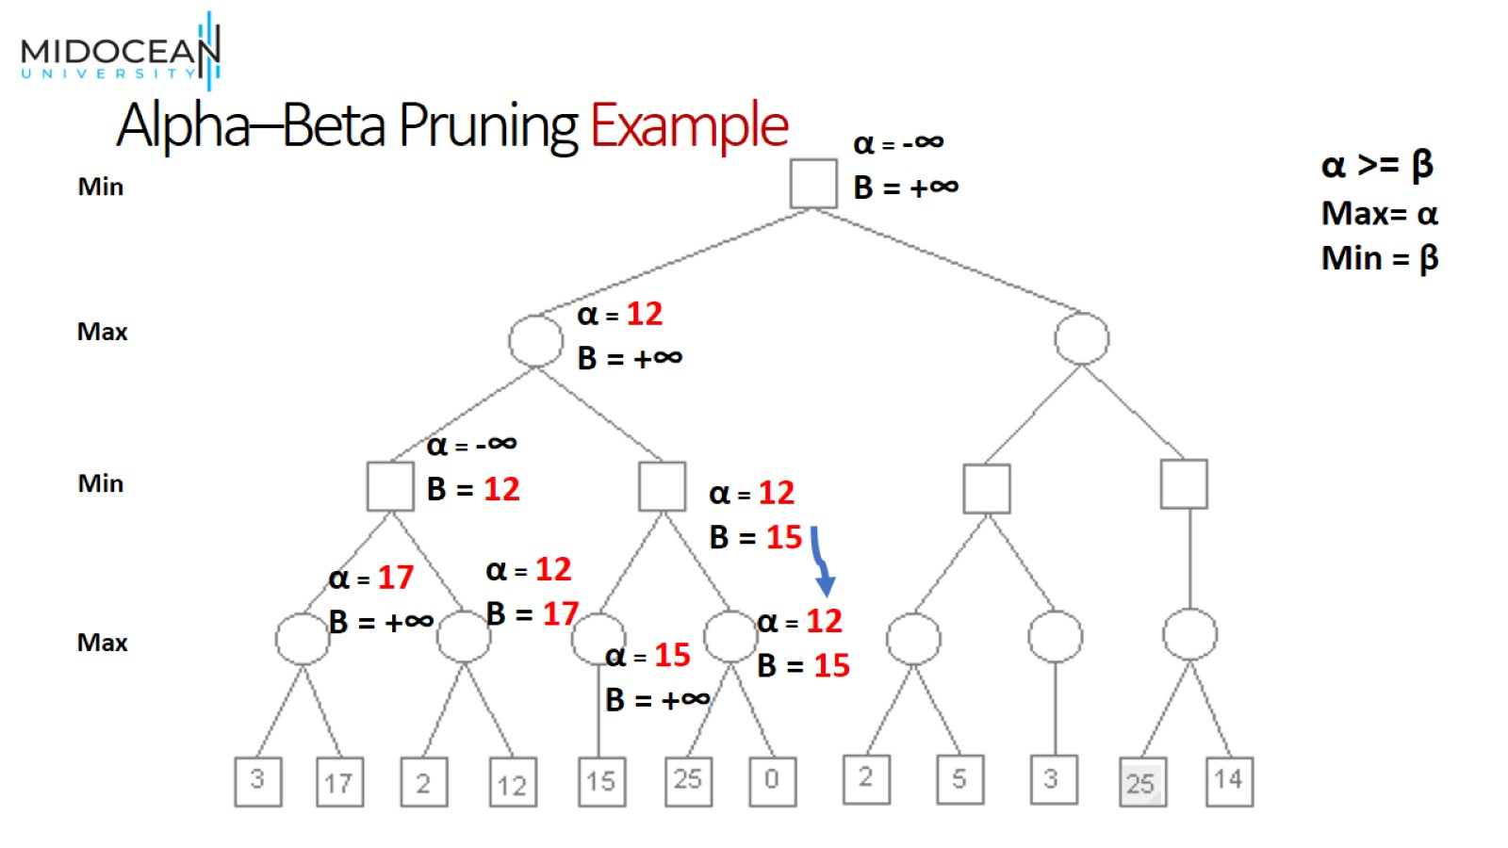
Alpha–Beta Pruning Example

Slide 35
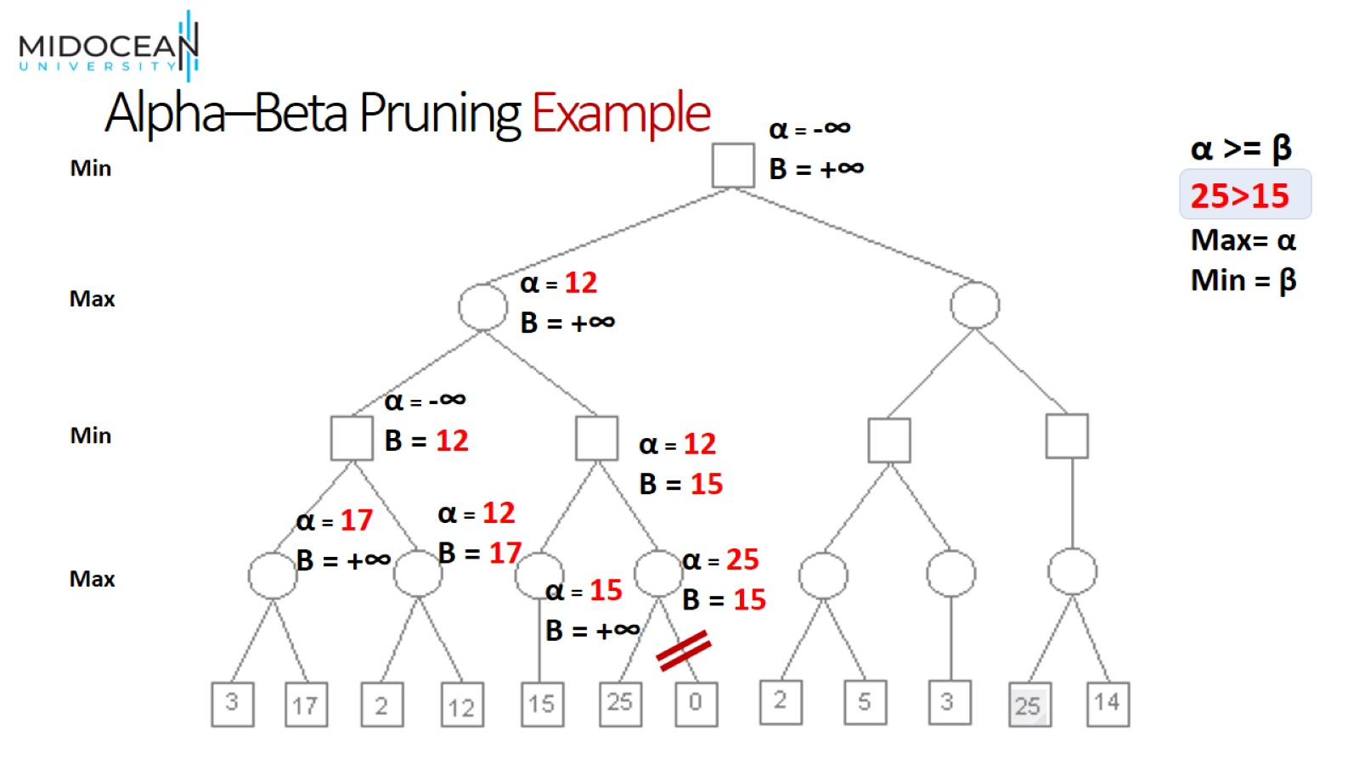
Alpha–Beta Pruning Example

Slide 36
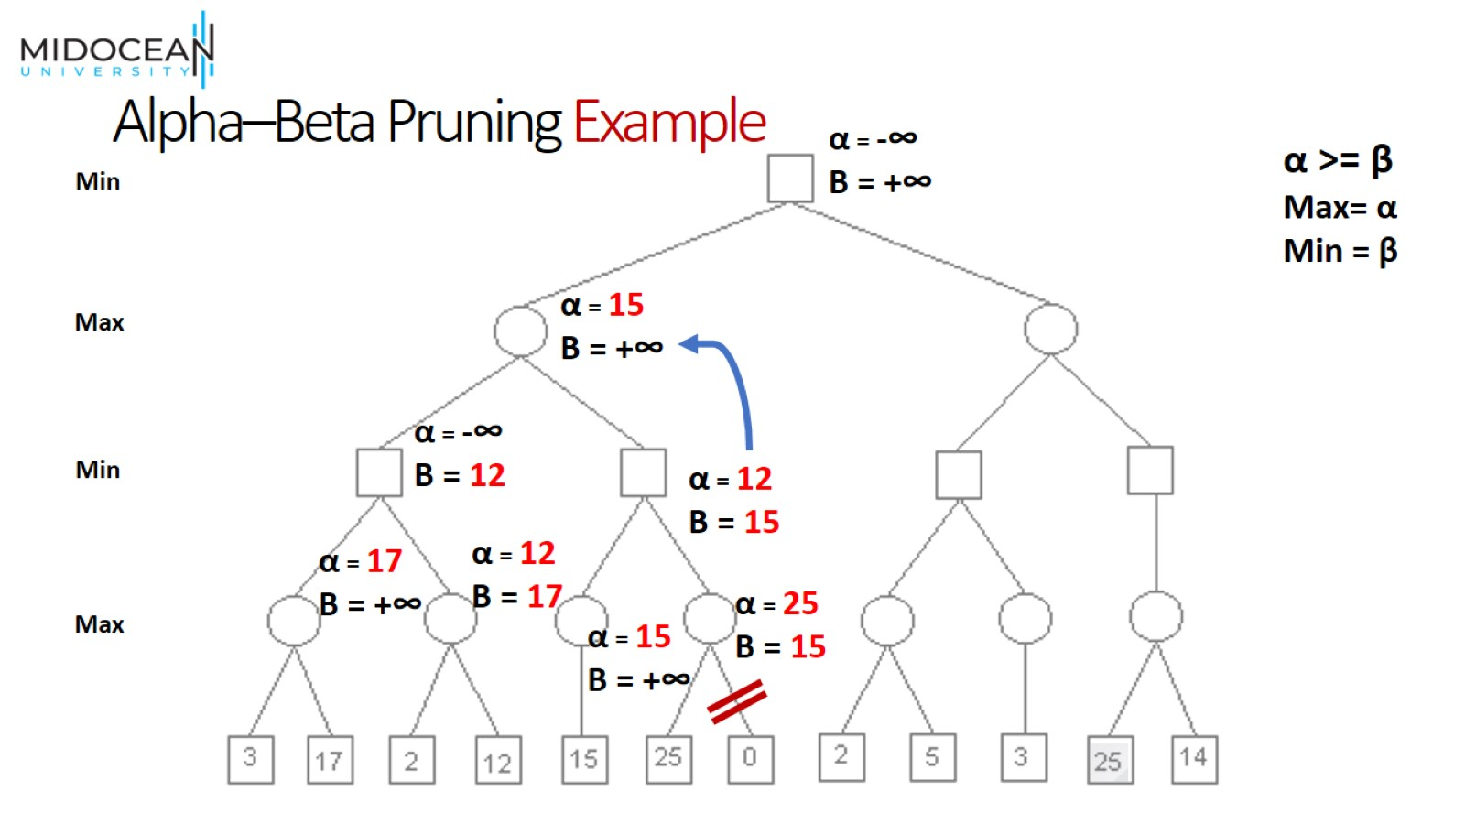
Alpha–Beta Pruning Example

Slide 37
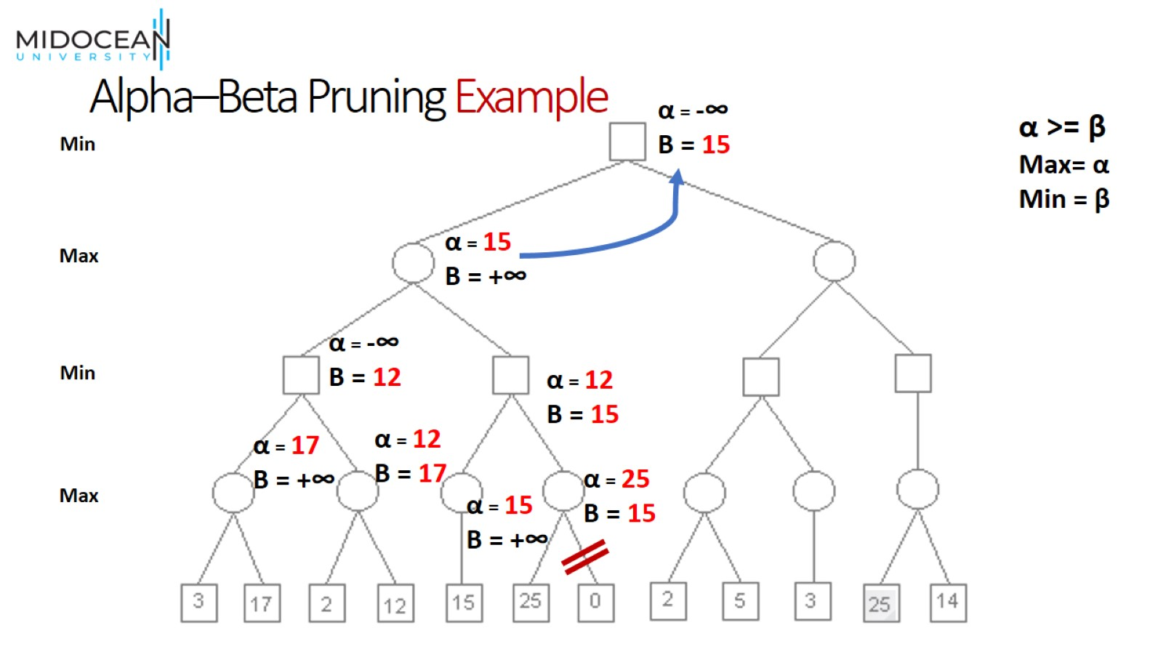
Alpha–Beta Pruning Example

Slide 38
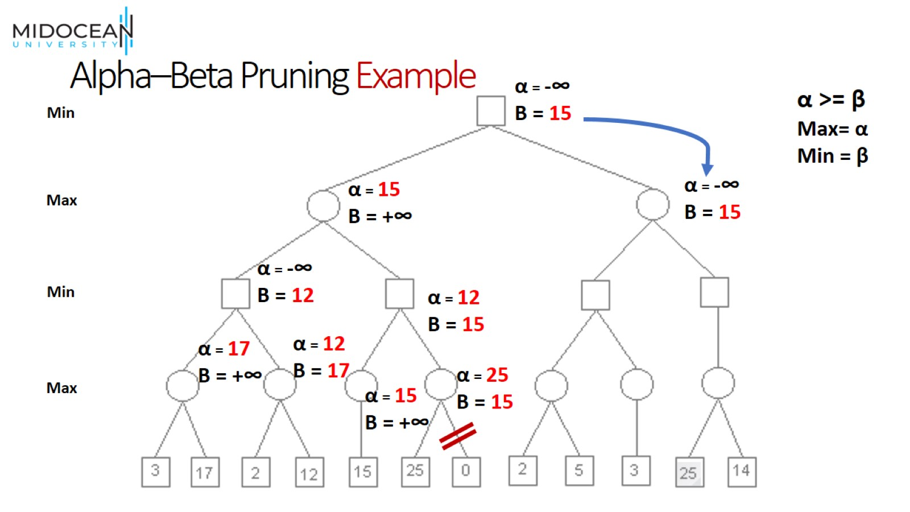
Alpha–Beta Pruning Example

Slide 39
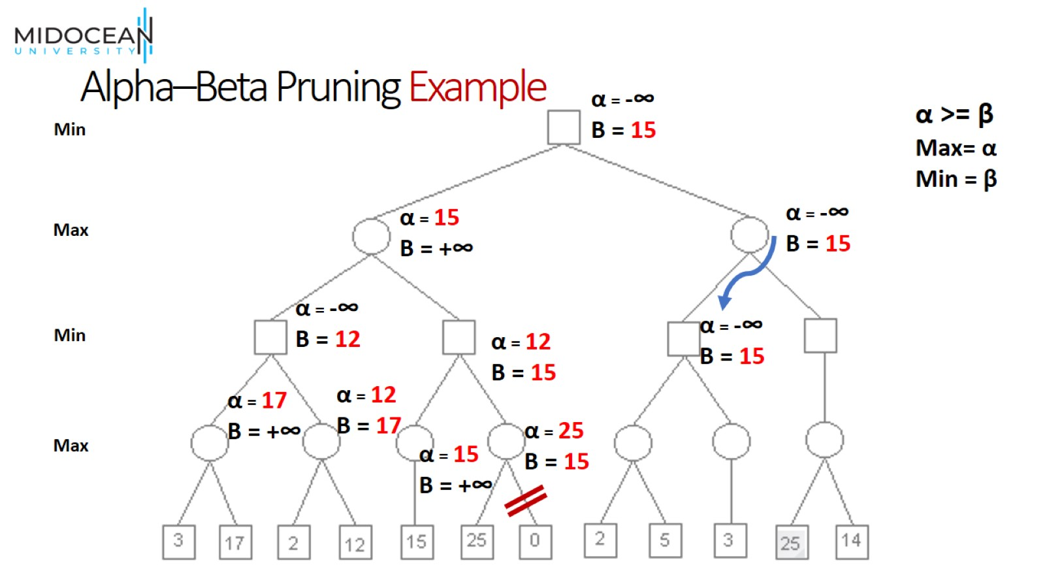
Alpha–Beta Pruning Example

Slide 40
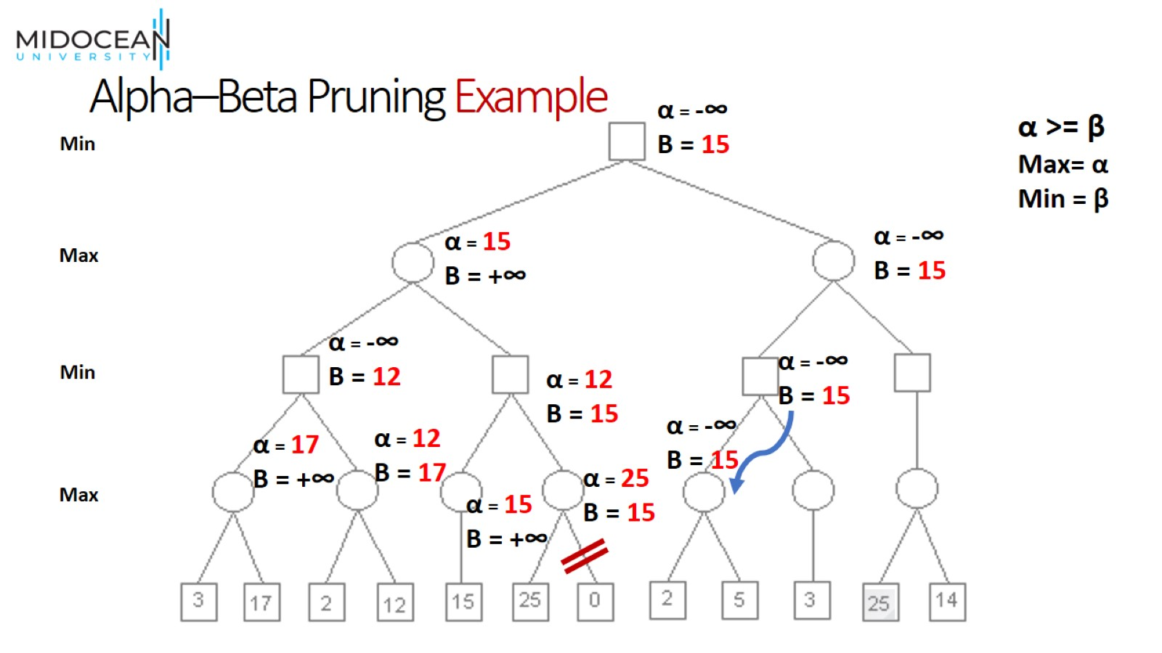
Alpha–Beta Pruning Example

Slide 41
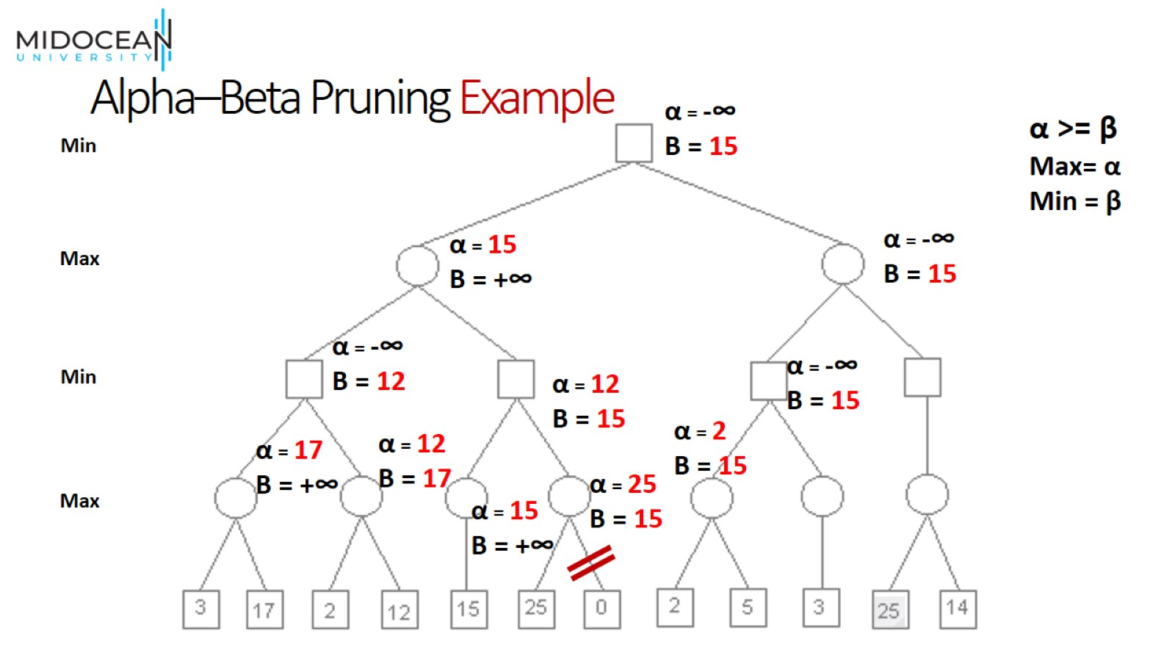
Alpha–Beta Pruning Example

Slide 42
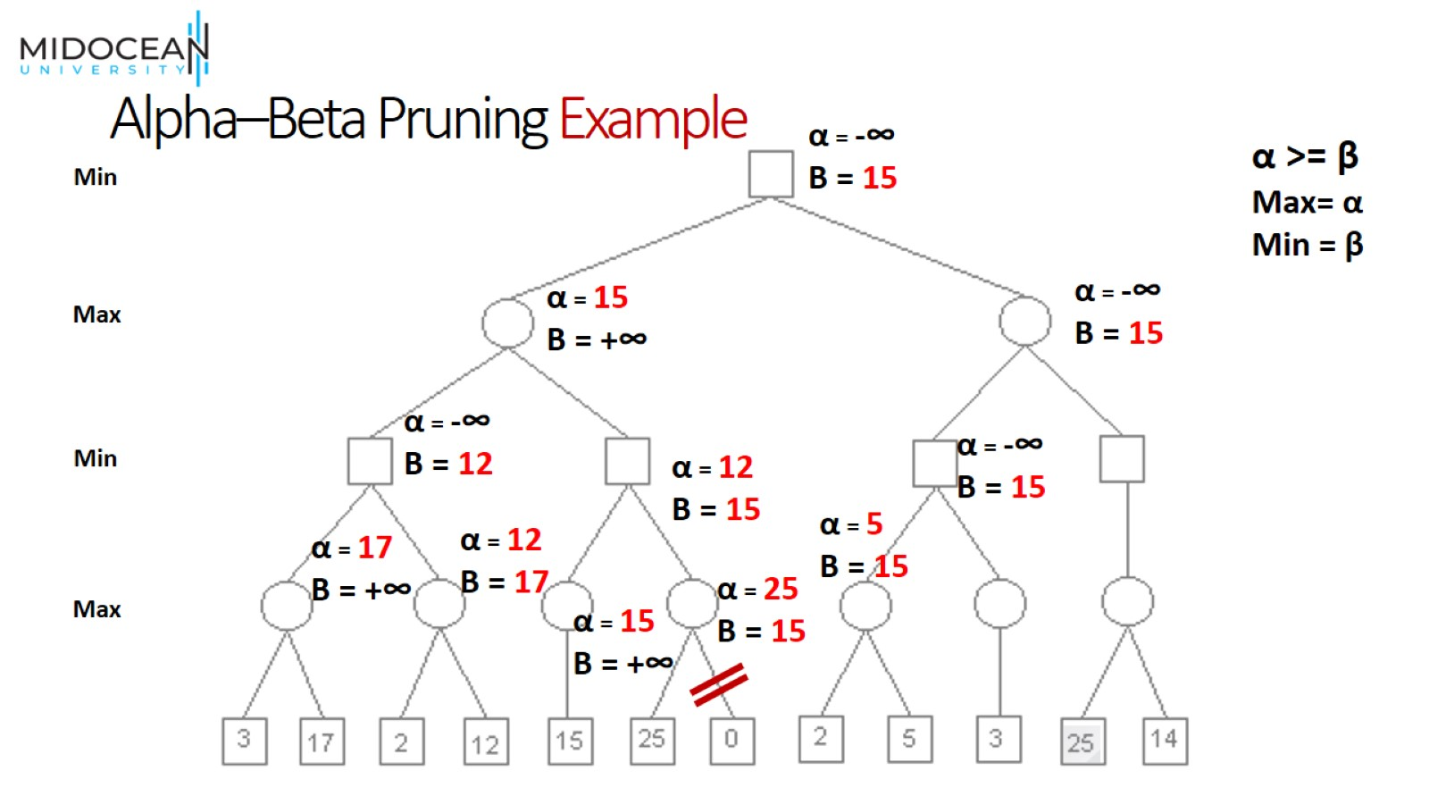
Alpha–Beta Pruning Example

Slide 43

Alpha–Beta Pruning Example

Slide 44
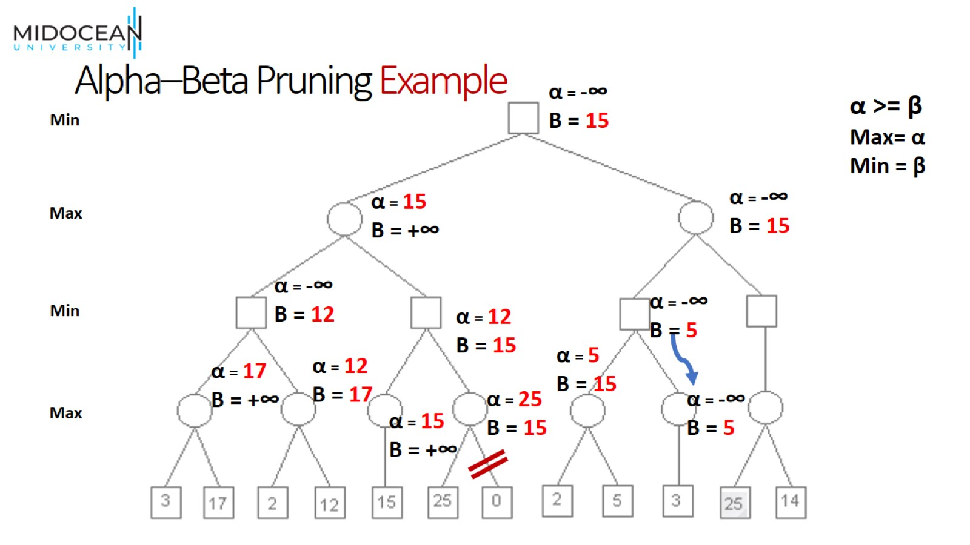
Alpha–Beta Pruning Example

Slide 45

Alpha–Beta Pruning Example

Slide 46

Alpha–Beta Pruning Example

Slide 47
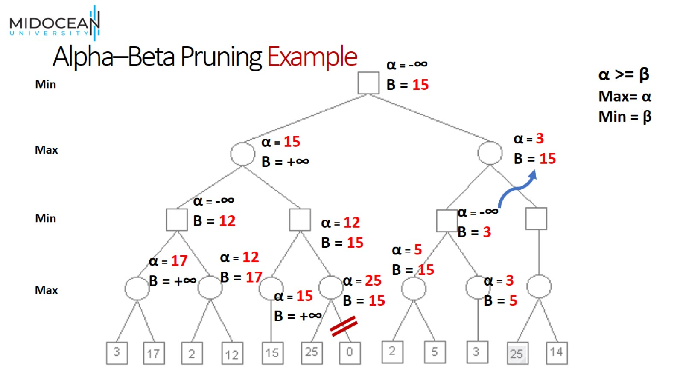
Alpha–Beta Pruning Example

Slide 48
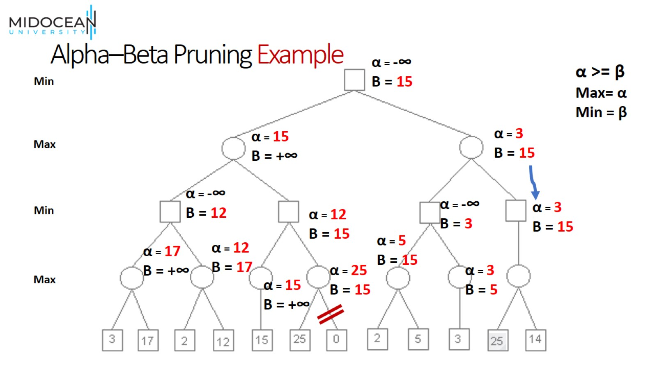
Alpha–Beta Pruning Example

Slide 49
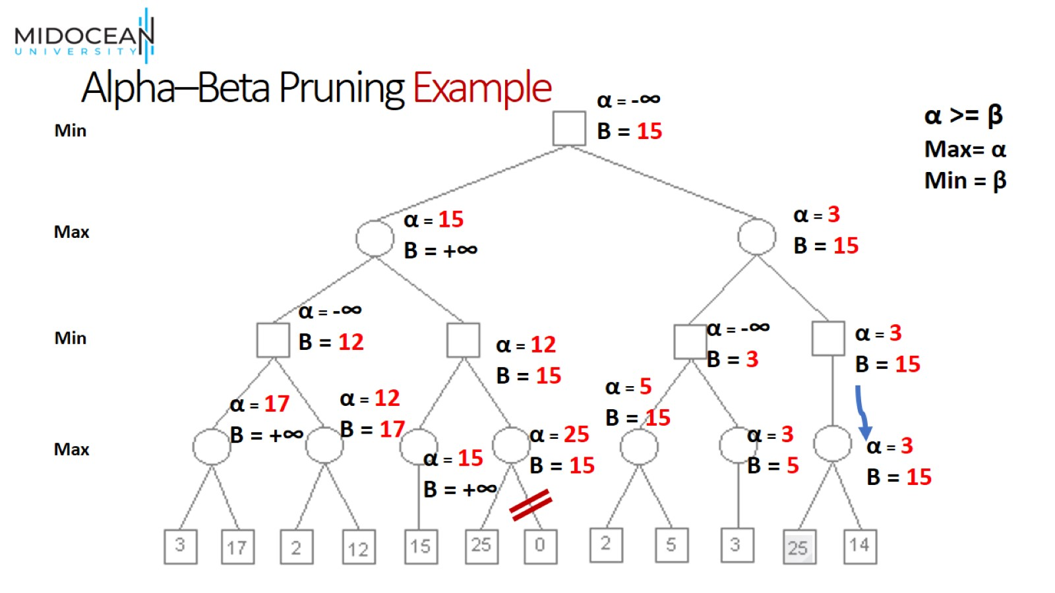
Alpha–Beta Pruning Example

Slide 50
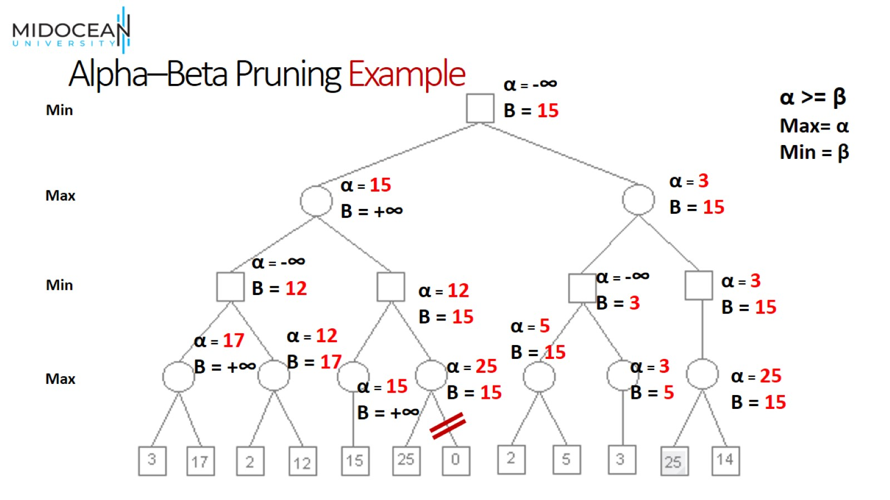
Alpha–Beta Pruning Example

Slide 51
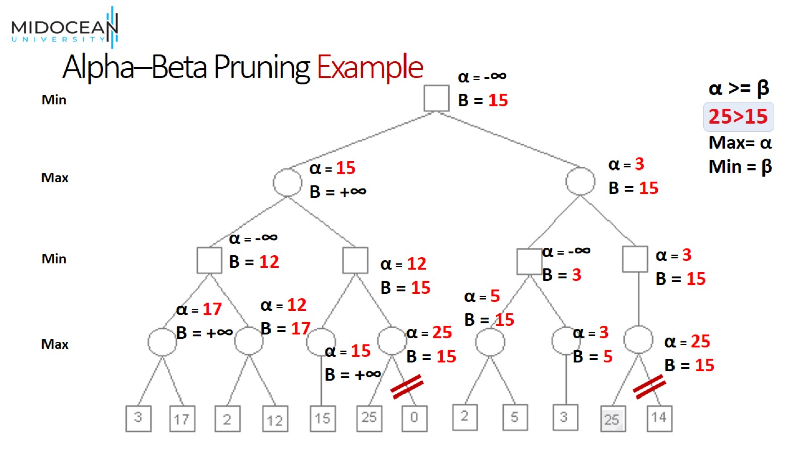
Alpha–Beta Pruning Example

Slide 52
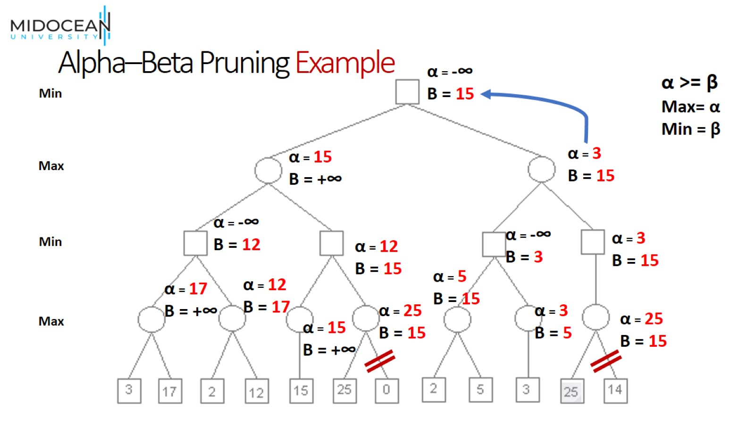
Alpha–Beta Pruning Example

Slide 53

Alpha–Beta Pruning Example

Slide 54
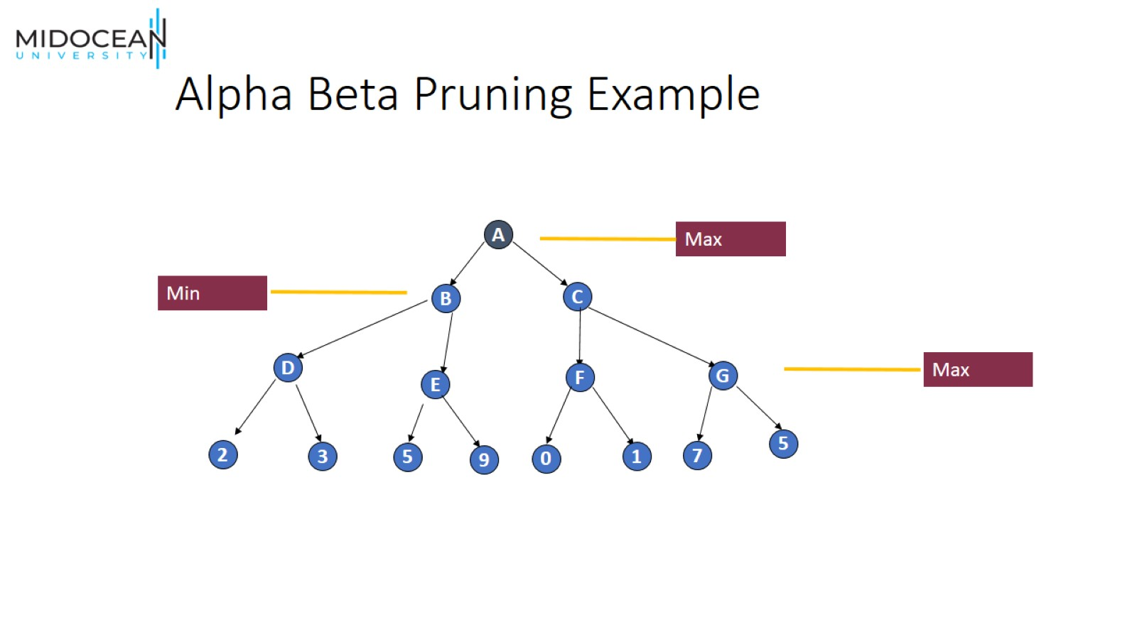
Alpha Beta Pruning Example

Slide 55
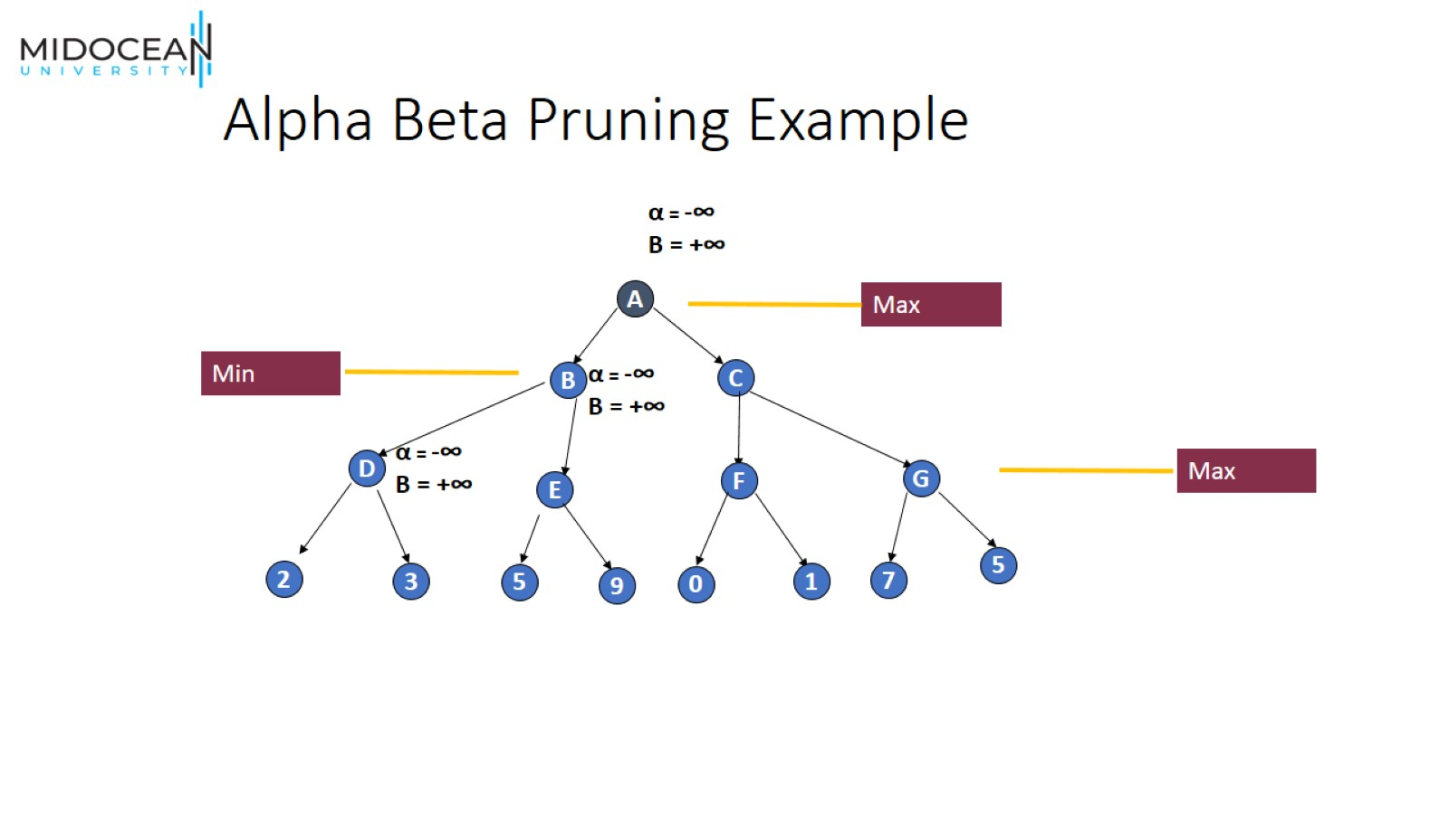
Alpha Beta Pruning Example

Slide 56

Alpha Beta Pruning Example

Slide 57

Alpha Beta Pruning Example

Slide 58
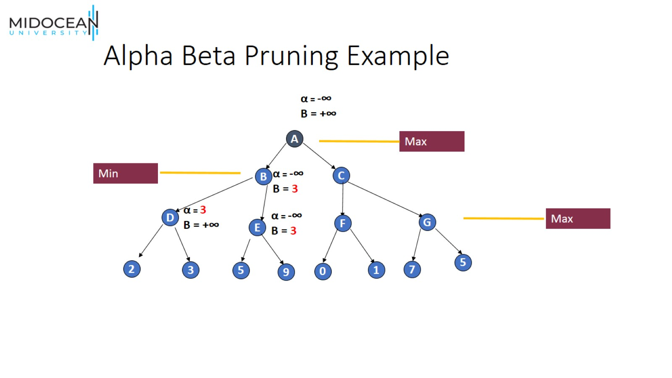
Alpha Beta Pruning Example

Slide 59

Alpha Beta Pruning Example

Slide 60
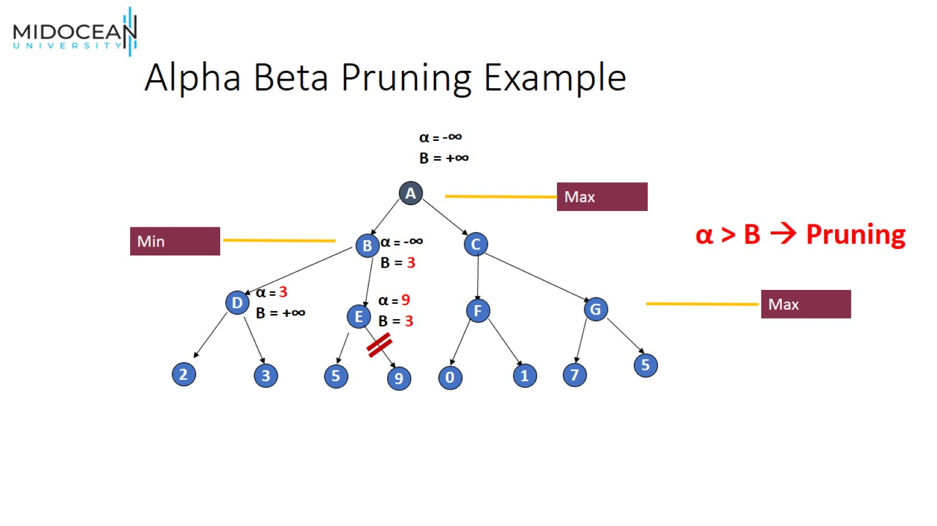
Alpha Beta Pruning Example

Slide 61

Alpha Beta Pruning Example

Slide 62

Alpha Beta Pruning Example

Slide 63

Alpha Beta Pruning Example

Slide 64

Alpha Beta Pruning Example

Slide 65

Alpha Beta Pruning Example

Slide 66


Slide 67


