Slide 1


Storage Technologies
IT403
Prepared by
Dr. Ahmed El-Douh
Lecture 7

Slide 2



Storage Technologies
Lecture 7
IT403
Common Advanced Storage Technologies
Prepared by
Dr. Ahmed El-Douh

Slide 3
Objectives
Upon completion of this module, you will be able to:
  Understand the principles of advanced storage optimization technologies such as SmartThin and SmartTier.
  Describe the mechanisms of Smart QoS and SmartPartition for performance control and resource isolation.
  Explain the role of Snapshot in data protection and recovery scenarios.
  Understand how SmartQuota manages and allocates storage resources effectively.

Slide 4
Chapter
Outlines
07
SmartThin
SmartTier
Smart QoS
SmartPartition
Snapshot
SmartQuota

Slide 5


Chapter
07
SmartThin

Slide 6
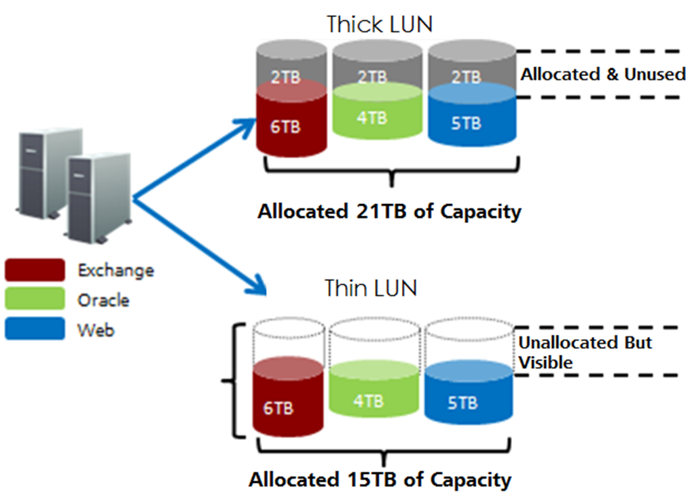
Overview of Thin Provisioning

Slide 7
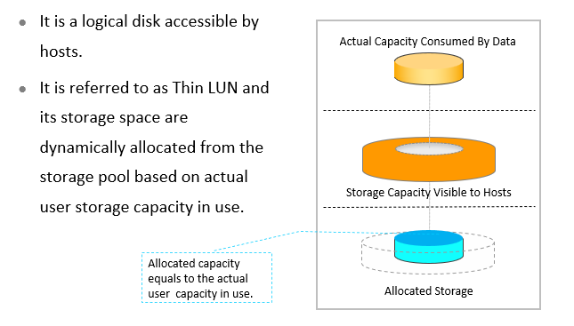
Thin LUN

Slide 8
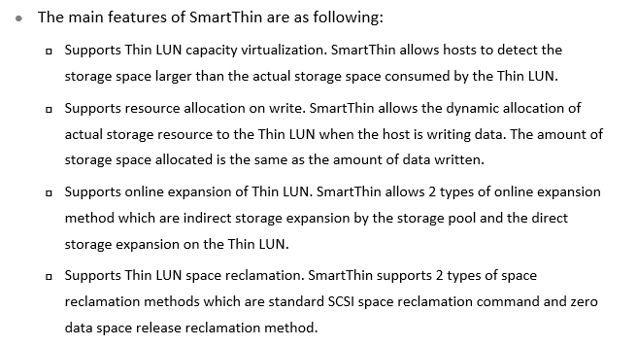
Main Features of SmartThin

Slide 9
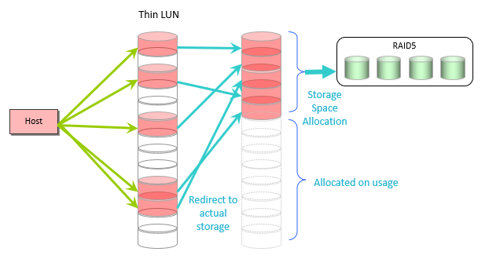
Thin LUN Capacity Virtualization

Slide 10
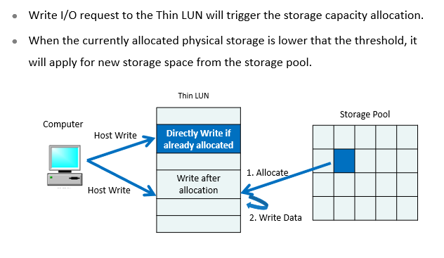
Capacity - on - write

Slide 11
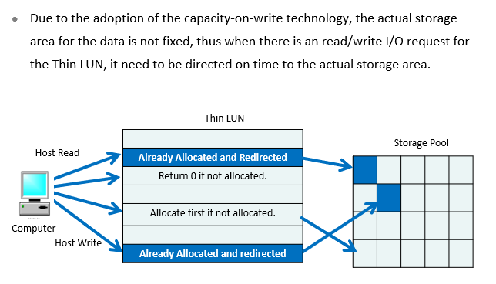
Direct - on - time

Slide 12
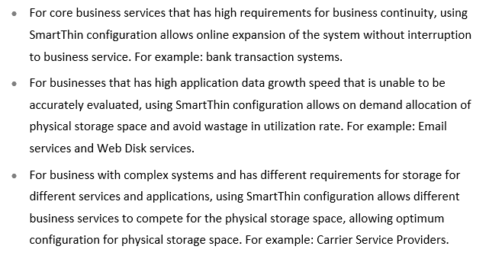
Application Scenario

Slide 13
Chapter
07
SmartTier

Slide 14
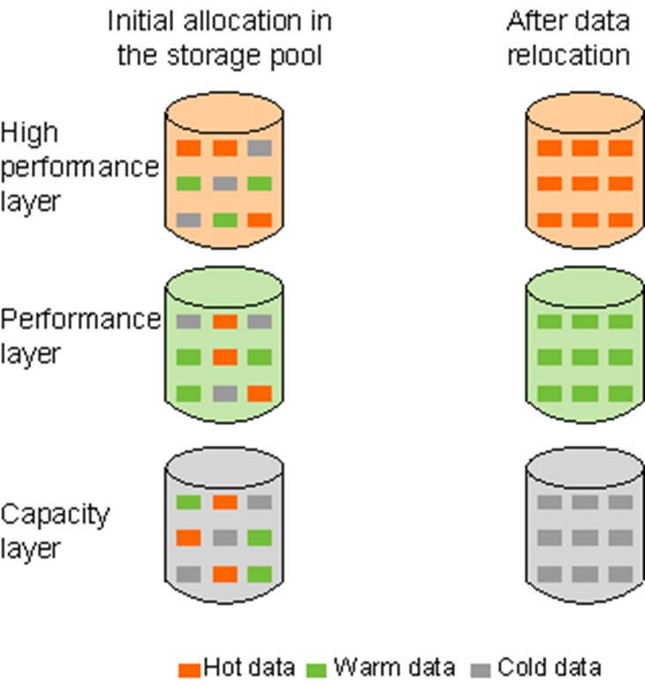
Overview of Storage Tiers

Slide 15
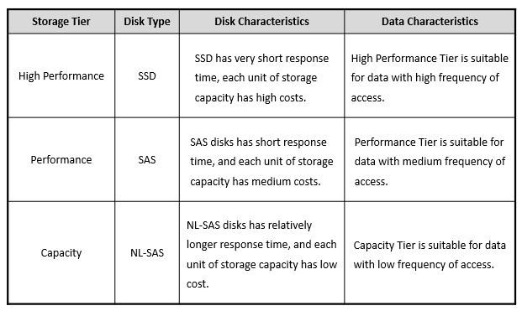
Levels of Storage Tier

Slide 16
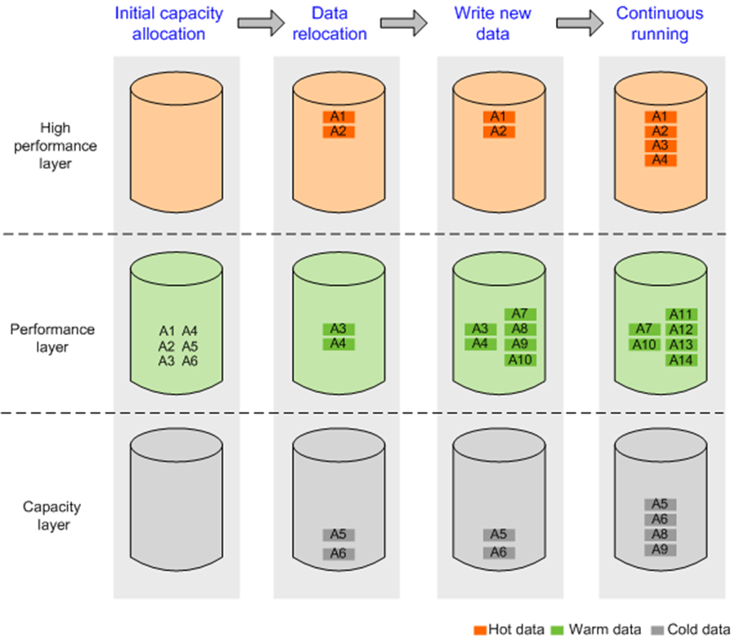
Working Principles

Slide 17
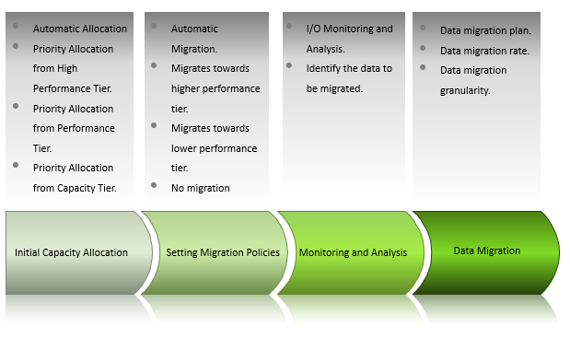
Key Technologies

Slide 18
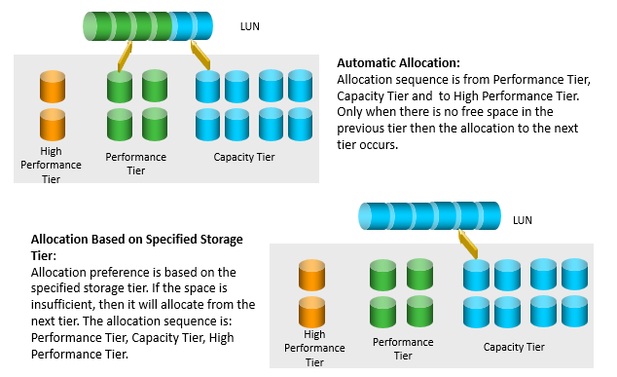
Initial Capacity Allocation

Slide 19
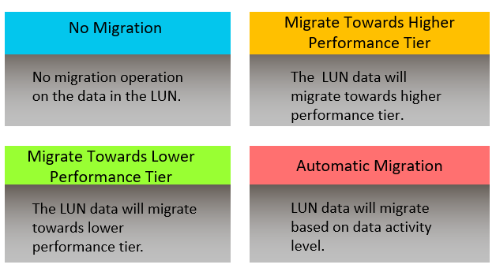
Migration Policies

Slide 20
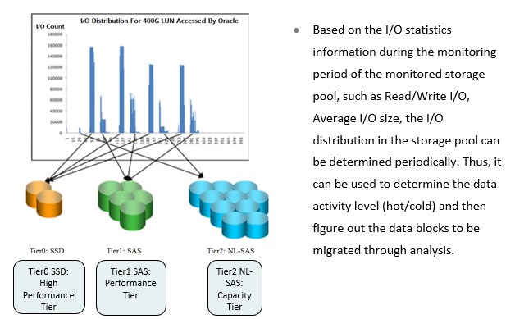
I/O Monitoring and Analysis

Slide 21
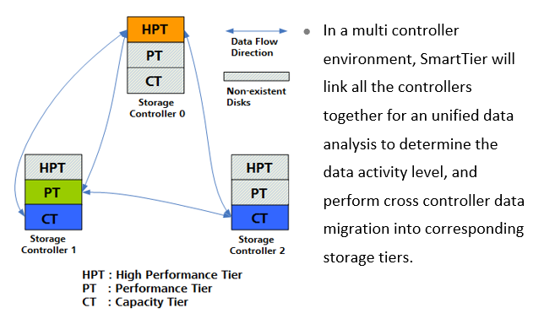
Data Migration

Slide 22
Chapter
07
SmartQoS

Slide 23
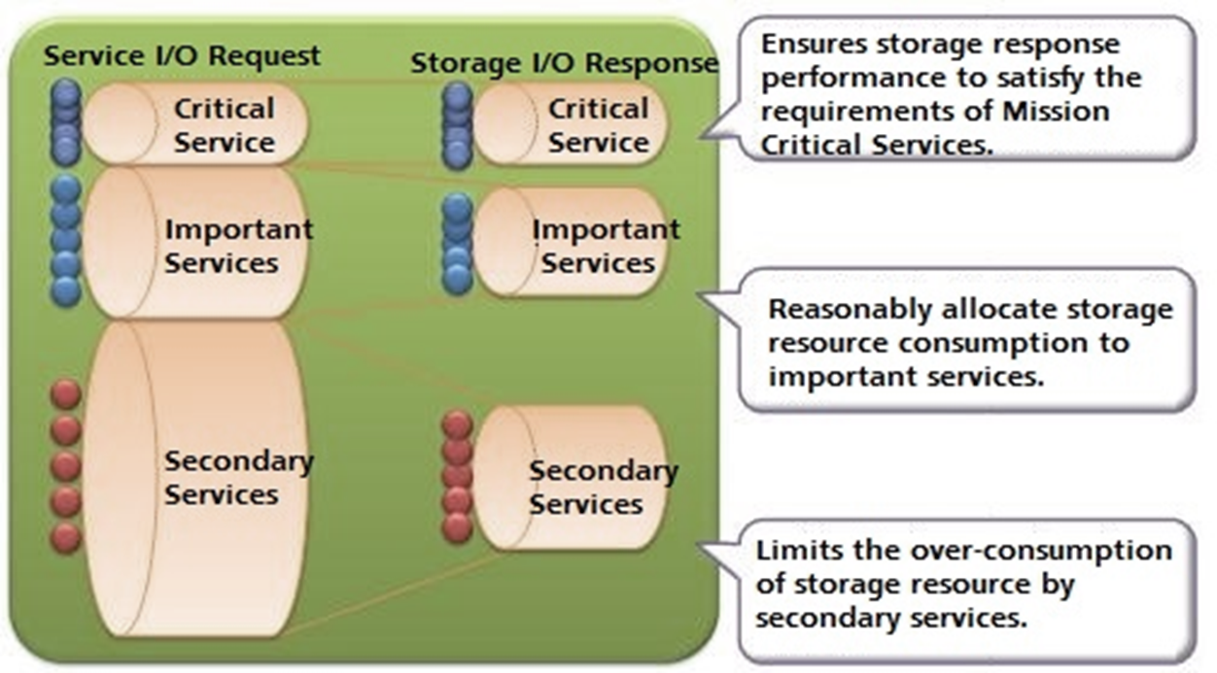
Overview

Slide 24
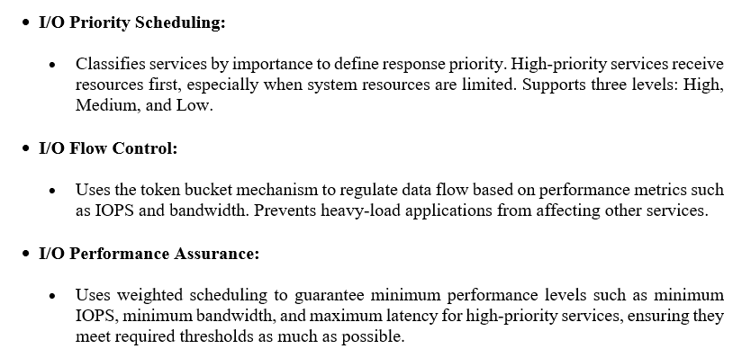
Working Principles of SmartQoS

Slide 25
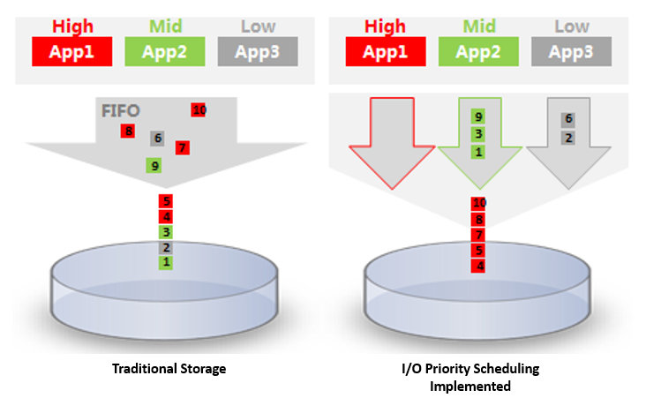
I/O Priority Scheduling

Slide 26
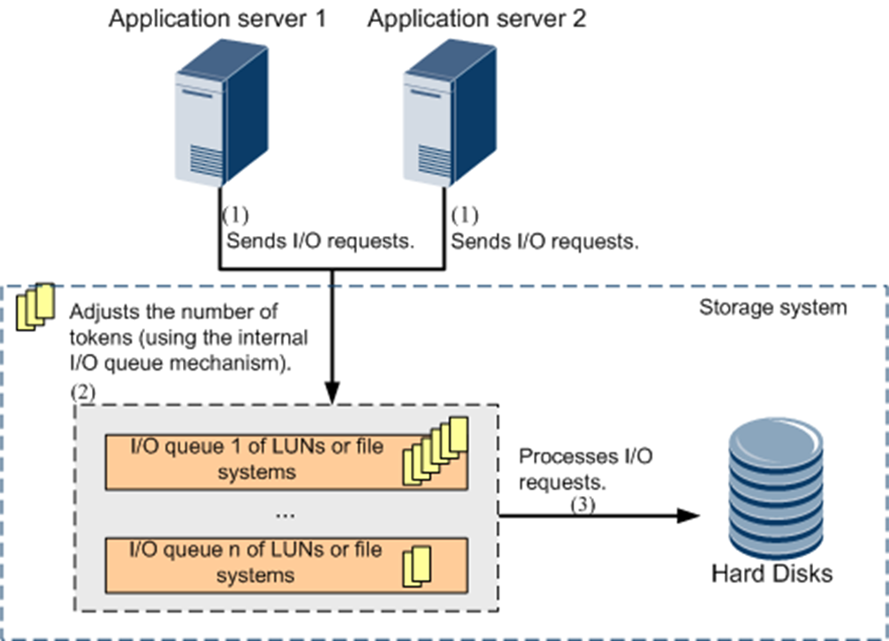
I/O Flow Control

Slide 27
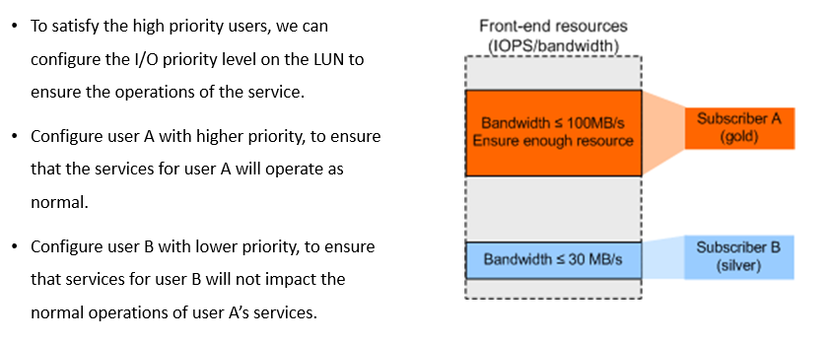
Application Scenario - Ensure Service Performance of High Priority Users

Slide 28
Chapter
07
SmartPartition

Slide 29
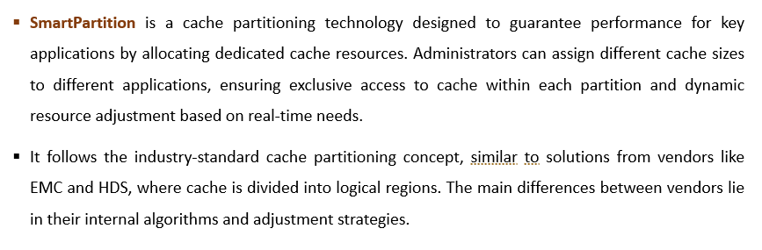
Overview of SmartPartition

Slide 30
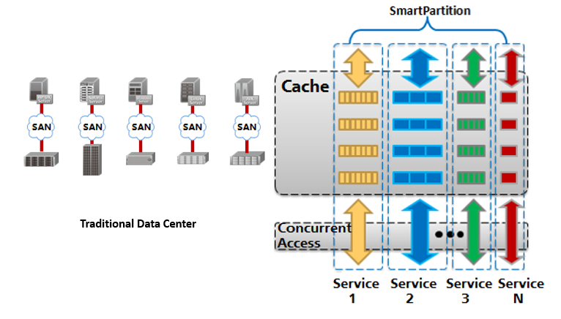
The Storage Requirements of the Converging Trend of IT Architecture

Slide 31
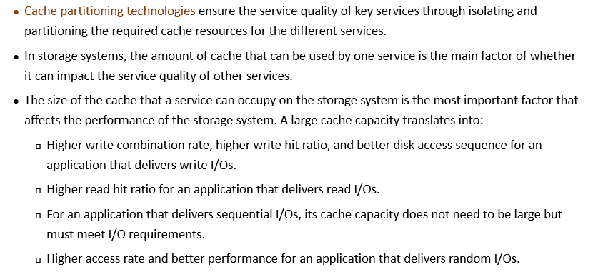
Working Principles

Slide 32
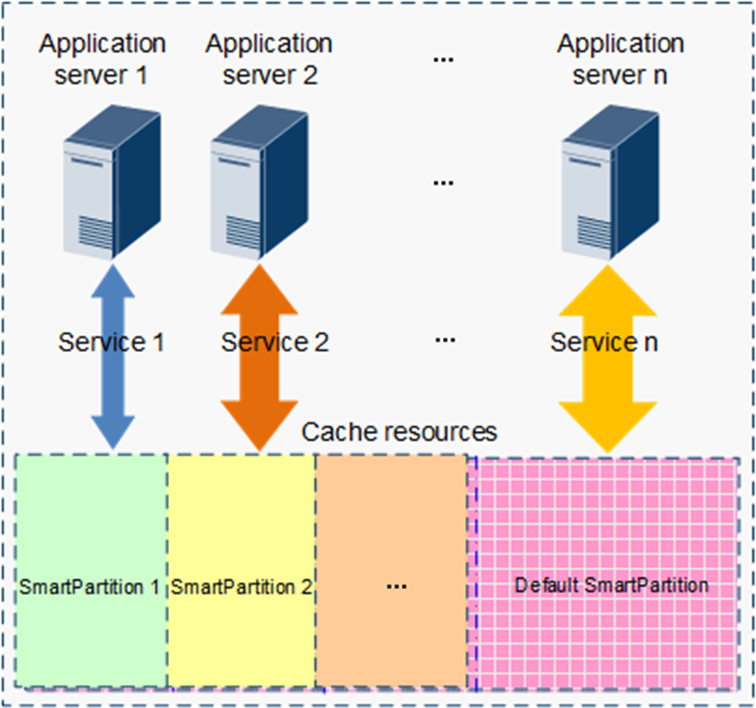
Scheduling of Multiple Applications

Slide 33
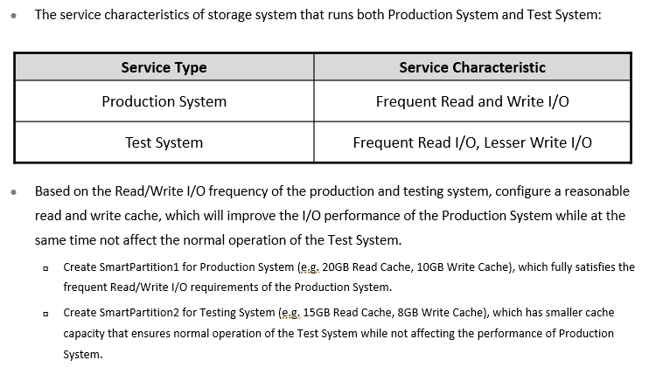
Application Scenario - Ensuring Core Service Performance In Multi - Service Scenario

Slide 34
Chapter
07
Snapshot

Slide 35
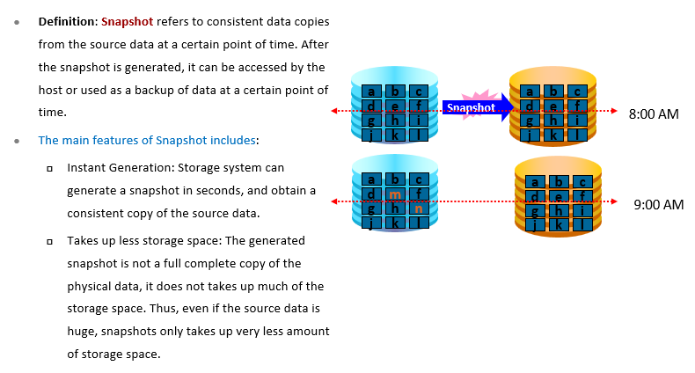
LUN Snapshot Overview

Slide 36
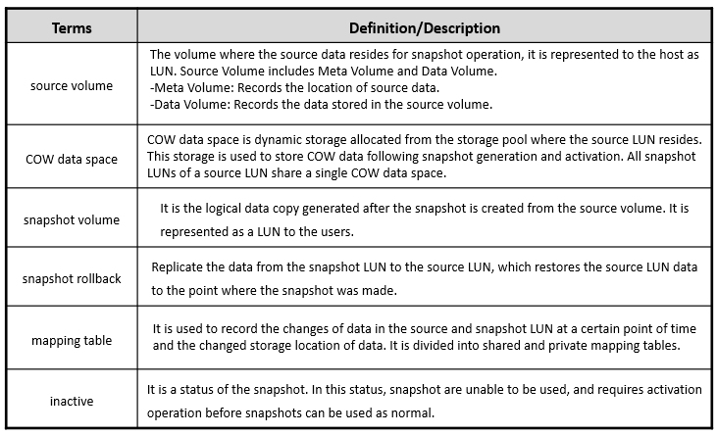
Related Concepts

Slide 37
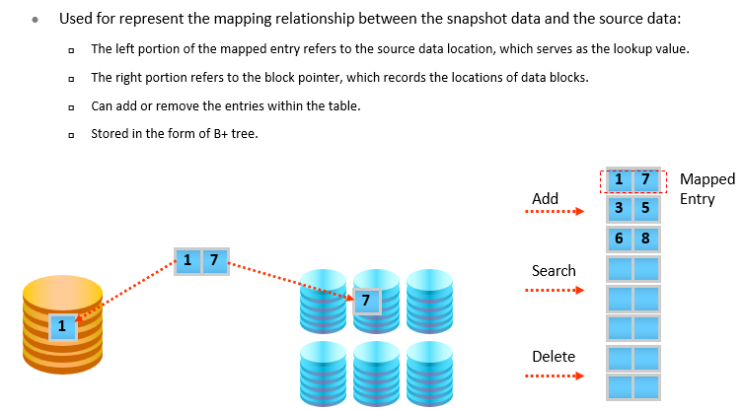
Mapping Table

Slide 38
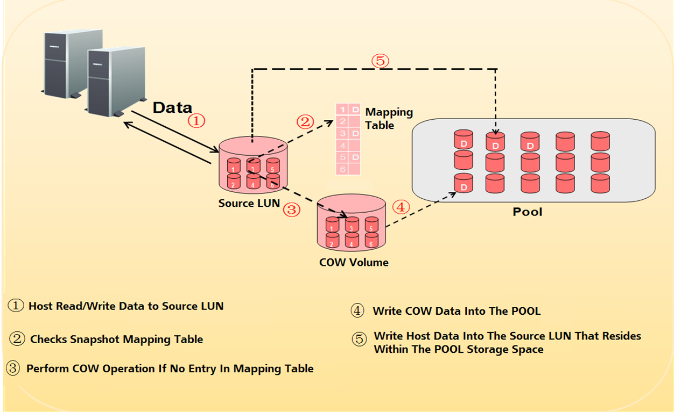
Copy On Write (COW)

Slide 39
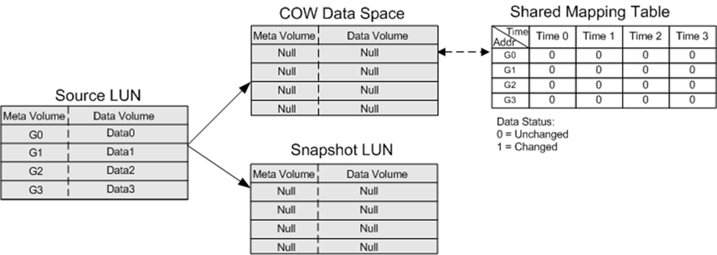
Snapshot Working Principles

Slide 40
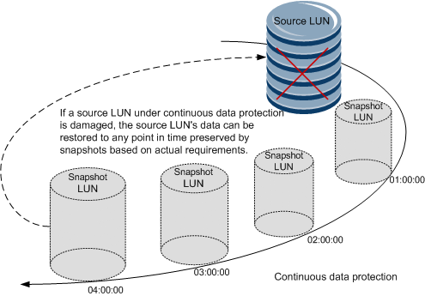
Application Scenario - Continuous Protection of Data

Slide 41
Chapter
07
SmartQuota

Slide 42
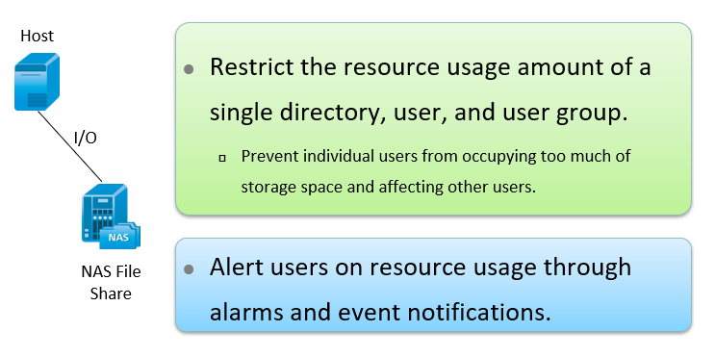
Overview of Smart Quota

Slide 43
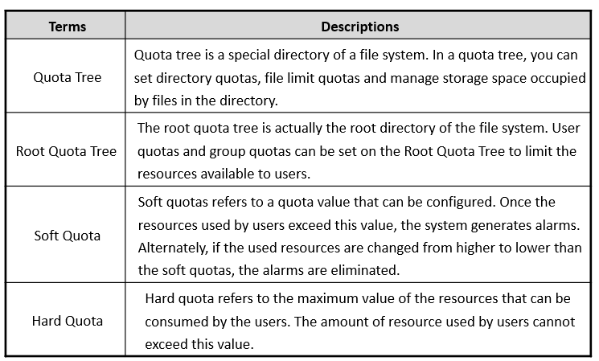
Related Terms

Slide 44
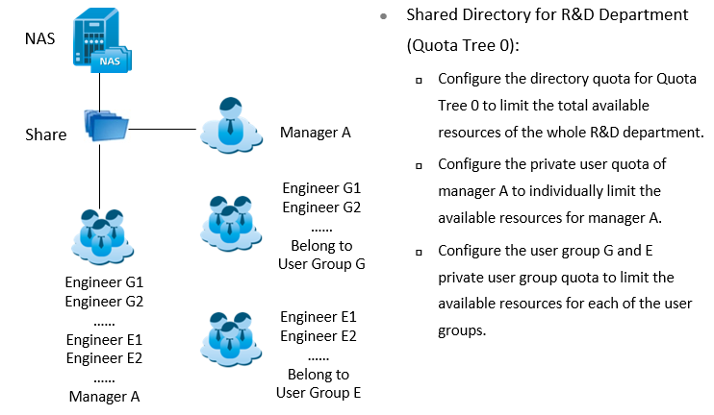
Application Scenario - Flexible Restriction of the User Resources

Slide 45



Thank You

