Slide 1



Design Thinking
Prepared by Dr. Aya Mohamed
ENT 621
Master of Entrepreneurship (semester 2)
Lecture Nine

Slide 2



In The previous Lecture: Design Thinking
Topics
v
What is the customer journey?
Customer Journey Stages
What is a customer journey map?
What's included in a customer journey map?
Steps for Creating a Customer Journey Map
Types of Customer Journey Maps
Customer Journey Map Best Practices"
Customer
Journey
Map

Slide 3
In This Lecture: Design Thinking
Topics
v
Stakeholder Mapping
What is stakeholder mapping?
Why is stakeholder mapping important?
Common types of stakeholders
Methods for mapping stakeholders
A step-by-step guide for mapping stakeholders
Stakeholder
Mapping
Guide

Slide 4
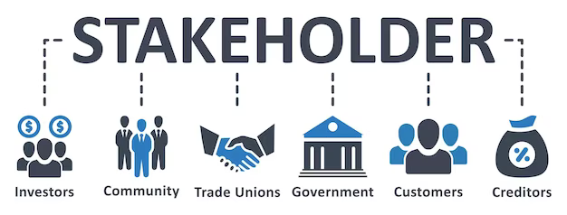
What is the meaning of stakeholders
v
Stakeholders are people or organizations that are internal or external to the project who have a vested interest in its success.
That interest can have a positive or negative impact in the project management process. Therefore, it’s crucial to know your project stakeholders

Slide 5

What is the meaning of stakeholders
v
More than just being able to identify who the stakeholders are in the project; you need to manage them. It’s a big task. How do you know who needs what when communicating with them during the project? That is the beginning of stakeholder analysis, and it starts with stakeholder mapping
What Is Stakeholder Mapping?
Stakeholder mapping is a visual process. It charts each of the stakeholders for your project, product or anything with stakeholders to show who can influence the work you’ll be doing. Stakeholders can be your client, project owner or even end-users. They are anyone who has a vested interest in the project.

Slide 6

Stakeholders Mapping
v
Using a stakeholder map allows a project manager to understand how each stakeholder is involved with the project and, therefore, how to respond to them.
For example, some stakeholders are going to need to be updated on the progress of the project regularly. These stakeholders are more likely clients, owners or top executives at the organization you’re working for.
But that is only one type of stakeholder that you’ll map. Other stakeholders can be suppliers, investors, retailers, developers, designers, et al.
In general, stakeholders can be divided into two groups: internal and external.
Internal stakeholders are participating in the project,
while external stakeholders are impacted by it

Slide 7
What Is a Stakeholder Map?
v
Stakeholder mapping is the visual process of laying out all the stakeholders of a product, project, or idea on one map. The main benefit of a stakeholder map is to get a visual representation of all the people who can influence your project and how they are connected.
What is the difference between Stakeholders and Shareholders?
Sometimes, people confuse stakeholders with shareholders.
Shareholders own a part of a public company (through shares of stock) and are interested in the company’s performance; it doesn’t mean they should be stakeholders of each project or product launched by the company.
Stakeholders can work on a more granular level and they are also often interested in the projects or product’s performance, not just because it affects the company’s stock performance.

Slide 8
When a stakeholder map is critical
It’s good to have a detailed stakeholder map and know how to involve the right people when you plan to launch a major project or product.
1. Building a product
When building a new product from scratch you’ll need to know the stakeholders for different groups. The number and the roles of stakeholders may vary depending on the type of product you are working on. Here is a list of potential stakeholders for this situation:

Slide 9
1- Building a product
Customers/users. Knowing your audience is critical for creating a product that people will love. Think of the groups of people you are serving and their needs.
Industries/markets. As a product developer, you can’t ignore what’s happening in your field, so brainstorming potential competitors, outlining market regulations, and writing down major trends can be very useful.
Suppliers. For certain products (and especially for digital platforms like Airbnb, Uber, BlaBlaCar, and others), generating a supply of certain services is as important as creating demand. If you are building a platform, what are the key suppliers and how you can ‘subsidize’ one side of the demand/supply equation if needed.
Investors. If your product needs substantial investments, you might want to include venture capital firms as major stakeholders since they will have the power to influence your product’s future

Slide 10
2. Penetrating a market
New customers. Trying asking yourself what are the needs of those who haven’t heard about your product yet. Are there any subgroups within this group?
Old customers. Which Personas are critical for your sustainable growth? Adding them to your map and understanding their challenges is key to your product’s success.
New retailers. Who are the main external stakeholders for your project? Whether you are creating a physical or a digital product, you need strong partnerships to reach new audiences

Slide 11
3. Starting a new project
Starting a new project will also need stakeholders internally. Here is how a list of stakeholders might look like:
Project Manager
Developer
Designer
CEO/C-Level exec

Slide 12
The two types of stakeholders
Internal stakeholders
Internal stakeholders are people on your team who are participating in building your product or delivering a project. Their level of engagement may vary but they all have an influence because they are a part of your organization. Here is how a list of internal stakeholders might look like:
CEO / C-level executive
Product owner
Project manager
Designer
Developer

Slide 13
The two types of stakeholders
External stakeholders
External stakeholders are those who will be impacted by your project and product, though they don’t directly participate in working on it. Here is how a list of external stakeholders might look:
customers,
suppliers,
regulatory agencies,
community groups,
the general public.

Slide 14
Internal vs external stakeholders
v
Internal stakeholders and external stakeholders are two different categories of individuals or groups who are affected by an organization or project. The main difference between the two is their relationship with the organization or project.
Internal stakeholders
Internal stakeholders are team members or groups who are directly related to the organization or project and are typically involved in its day-to-day operations or decision-making processes. Internal stakeholders have a vested interest in the success of the organization or project, and their involvement is crucial to its achievement.
Internal stakeholders may include employees, managers, and board members
External stakeholders
External stakeholders, on the other hand, are individuals or groups who are not directly related to the organization or project but are affected by its actions and decisions. External stakeholders have a varying degree of influence on the organization or project, and their involvement can have a significant impact on its success or failure.
External stakeholders can include customers, suppliers, regulatory agencies, community groups, and the general public.

Slide 15
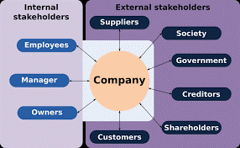
Stakeholder Mapping
v

Slide 16
What are the types of stakeholders?
Primary stakeholders are those who have a direct impact on the product or project (e.g. employees, customers).
Secondary stakeholders are those who have an indirect impact on the product or project (e.g. shareholders).
Tertiary stakeholders are those who have a potential impact on the product or project (e.g. industry experts).
Quaternary stakeholders are those who have no direct impact on the product or project but may be interested in its success or failure (e.g. media).

Slide 17
Level of involvement of stakeholders.
v
Once you have identified your stakeholders, you need to determine what level of involvement each one has, and at what stages of the project. There are three levels of involvement: high, medium, and low.
High-involvement stakeholders are those who have a significant interest in your project or organization and who could be significantly impacted by its success or failure.
Medium-involvement stakeholders are those who have some interest in your project or organization but who are not as invested as high-involvement stakeholders.
Low-involvement stakeholders are those who have little interest in your project or organization and who are not likely to be affected by its success or failure.

Slide 18
How to prioritize your project stakeholders
v
Depending on the complexity of the project or a product, you can have just a couple of stakeholders for a small project or dozens of them if the project brings a big change to your organization.
When you are dealing with a lot of internal and external stakeholders, it is very important to prioritize them.
One of the best ways to do that is to use a matrix to analyze the power that stakeholders have over your project and their level of interest in it

Slide 19
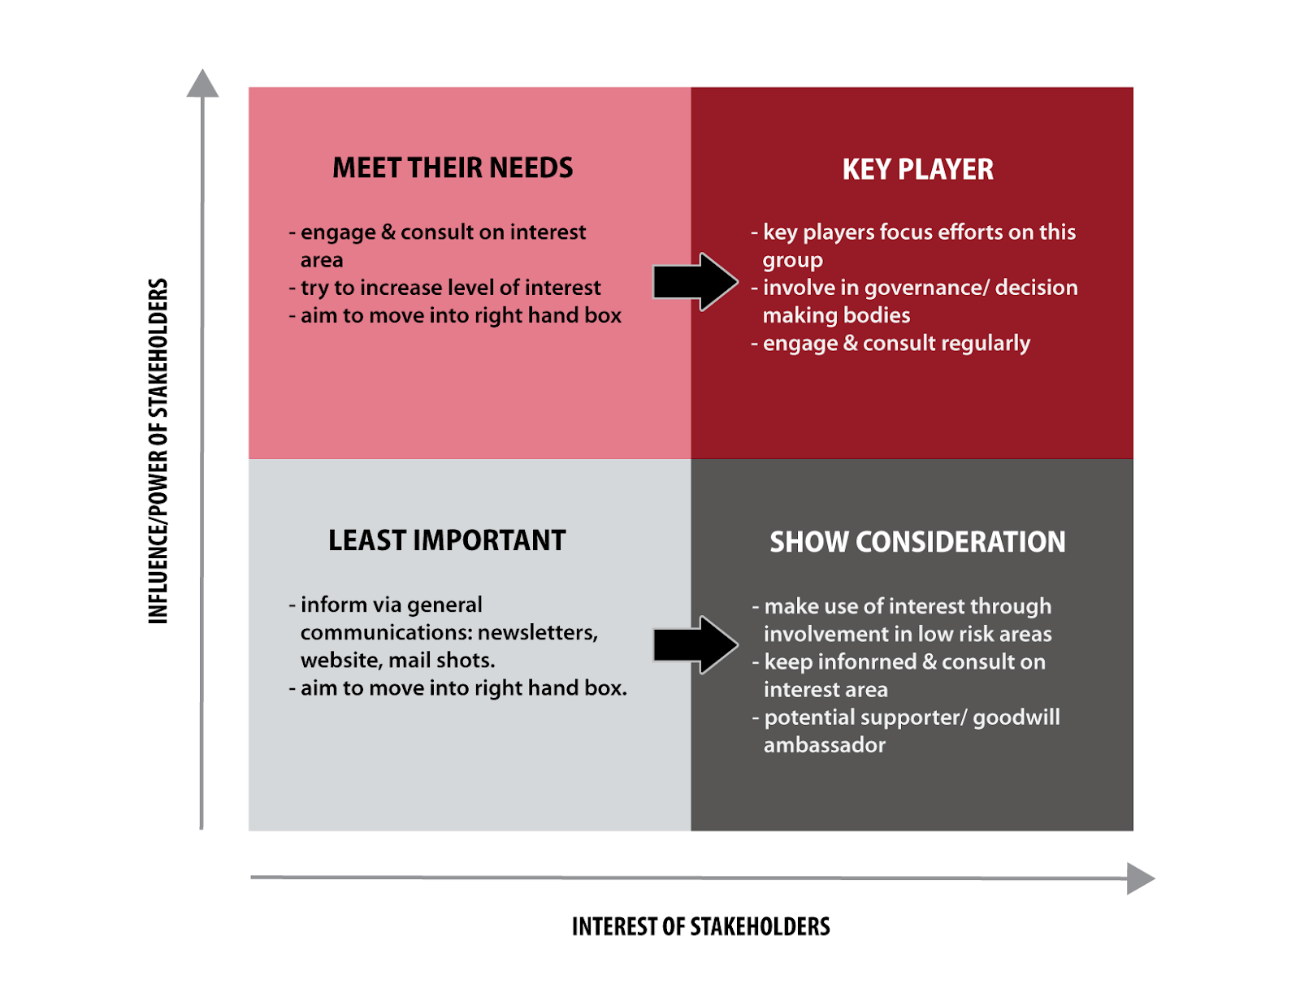
v

Slide 20
Areas of a stakeholder map
v
As the matrix shows, all stakeholders can fall into four categories:
High power, highly interested people (Manage Closely)
High power, less interested people (Keep Satisfied)
Low power, highly interested people (Keep Informed)
Low power, less interested people (Monitor)
identify key players, potential saboteurs, advocates and time wasters

Slide 21
When do I need a stakeholder map?
v
When developing new products,
kicking off a new project,
or building new features,
it's important to consider who will be involved, who will be affected, and to what extent. Stakeholder management is a helpful tool to have during the project discovery, implementation and review phases of a project, making it instrumental for collaborative project management.
For example, if you're developing a new employee portal, you'll need to map out the relationships between HR or People Operations, IT, and the employees who will be using the portal.

Slide 22
Four benefits of stakeholder mapping
v
Stakeholder mapping allows you to identify key players that will influence your project and its success.
1. Find out who has the most influence
When you build a stakeholder map, you can easily see who will have the highest level influence over a project, whether it’s the CEO or a project manager.
2. Focus on those who benefit most
Stakeholder maps help you see who will benefit most from the end-product, so you can focus on marketing to that person for either sales or resources.
3. See where resources are most plentiful
Often when you build a stakeholder map, you’ll see who has restraints on the project and who has more resources, so internally you can put the right people on your team.
4. Have a game plan
Overall, a stakeholder map gives you a good idea of who you’re trying to satisfy when building this product/project.

Slide 23
How to conduct the Stakeholder Mapping
v
Step 1
• identify relevant groups, organizations and people within and outside the organization.
agency who has interest/influence on the design challenge
Step 2
• Plot the stakeholders on the matrix-based degree of interest and influence through understanding their perspectives and unique interests on the design challenge
Step 3
• Cluster the stakeholders based on Central Agency, People, Local Government
Step 4
• Analyze and identify the link and relationship among these key stakeholders
Step 5 • Develop strategies to engage these key stakeholders: Design actionable strategies to
garner the support of key stakeholder relevant to the issue (design challenge topic)

Slide 24
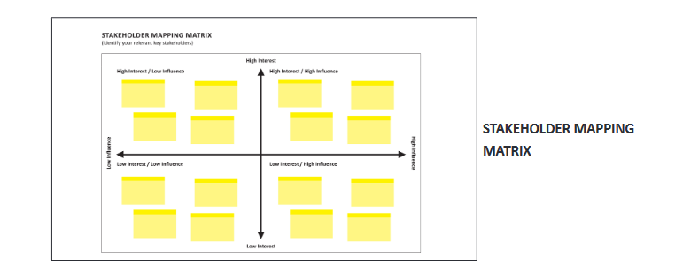
Stakeholder Mapping
v

Slide 25
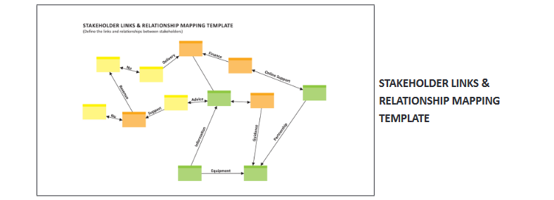
Stakeholder Mapping
v

Slide 26
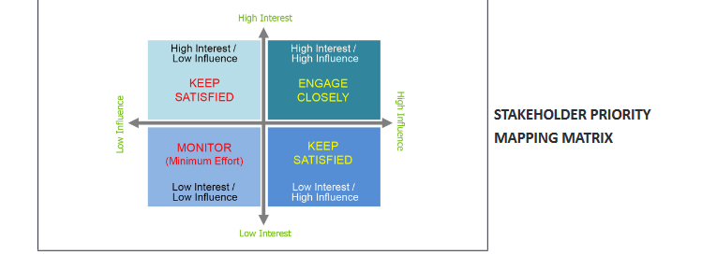
Stakeholder Mapping
v

Slide 27
Four steps to building a stakeholder map
v
1. Brainstorming
Start by identifying all the potential stakeholders — people, groups, or organizations affected by your product or project, those who have influence over it, or have an interest or concern in its success. Write down their names on a whiteboard or in a shared virtual space. At this point, try to be as granular as possible — you can always eliminate duplicates or those who actually don’t have ‘skin in the game’ later.

Slide 28
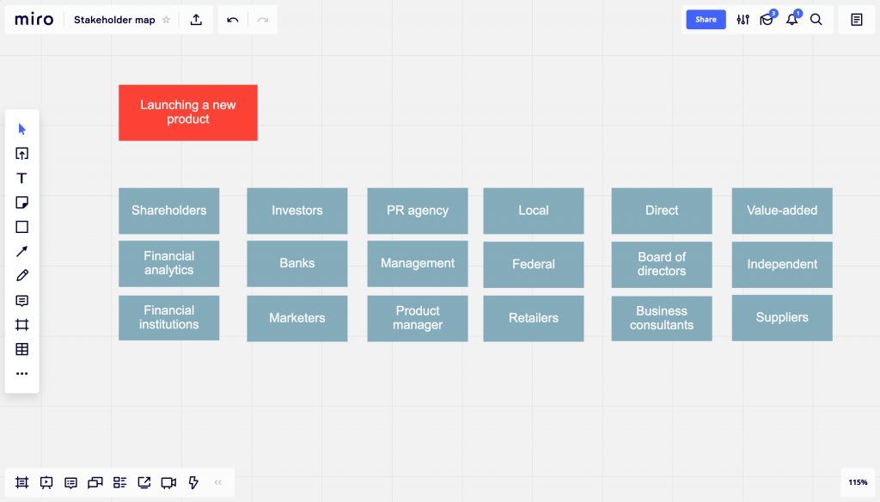
Four steps to build a stakeholder map
v
1. Brainstorming

Slide 29
Four steps to build a stakeholder map
v
2. Categorization
Now it’s time to group the results of your brainstorming. Are there any stakeholders that can be put into one category? How can you name this category? Are there any types of stakeholders you forgot about? To make sure you didn’t forget about any of the key players, check out the ‘When stakeholder map is critical’ section to see examples of the types of stakeholder's different projects require.

Slide 30
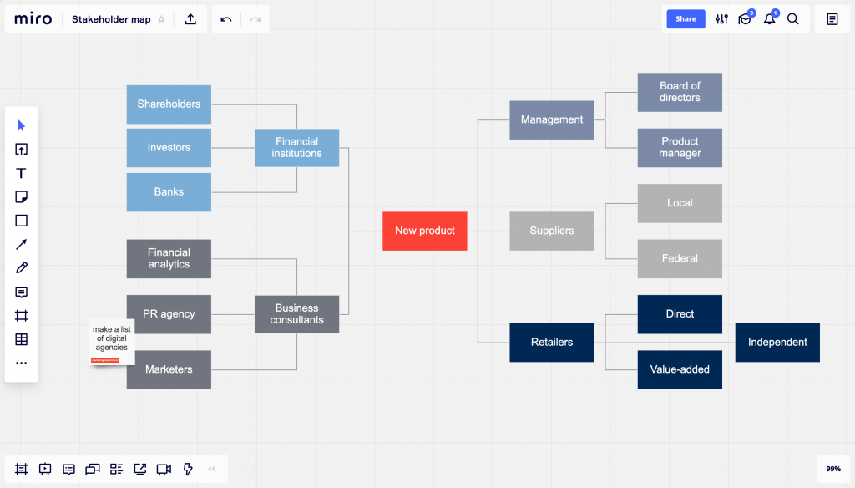
Four steps to build a stakeholder map
v
2. Categorization

Slide 31
Four steps to build a stakeholder map
v
3. Prioritization
To create a communication plan, you have to prioritize key stakeholders and make sure you start talking to them early in the project. There are different ways you can prioritize the stakeholders. You can use the matrix we shared above, or you can ask your team to vote so you can see how the group defines the main players.

Slide 32
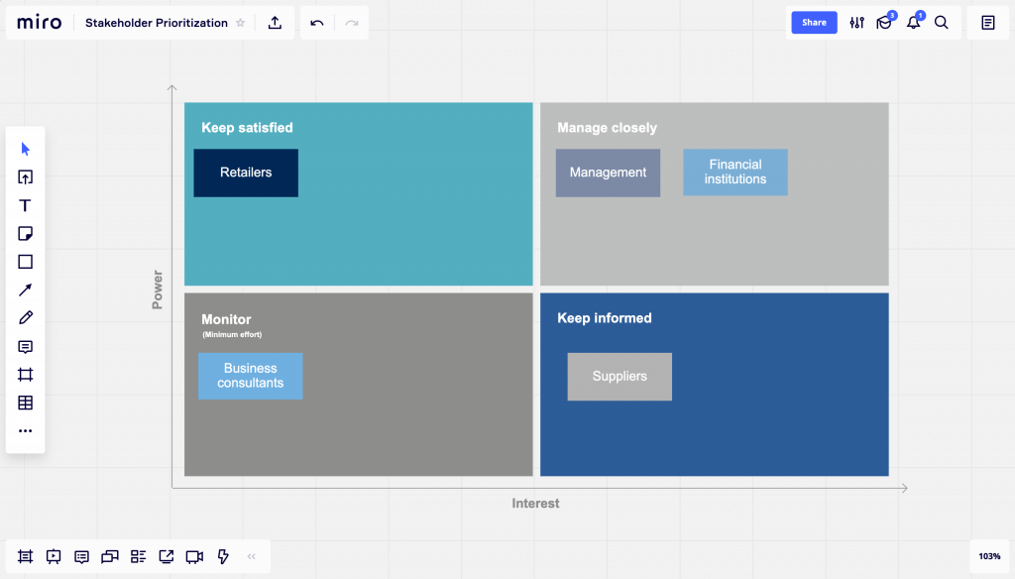
Four steps to build a stakeholder map
v
3. Prioritization

Slide 33
Four steps to build a stakeholder map
v
4. Stakeholder communications
Once your priorities are defined, it’s important to come up with a plan for engaging all the major stakeholders. There is no single recipe that can fit all possible situations, but here are some best practices that can help you create transparency and accountability for your project:
You should have a lot of face-to-face communication with high-power, highly interested people. Building trust with them first is critical for your project.
If someone is opposed to the project, you can get a buy-in from someone with the same level of power first and then ask the latter to persuade the former.
Communicating early and often is also important, because people will need time to think before making a decision.
Give each stakeholder a right amount of information depending on their interest. Some people need just an executive summary, while others will want to dive deeper.

Slide 34
v
Once you've identified all of your potential stakeholders, it's time to start mapping out their relationships with each other.
The basic components of a stakeholder map include a framework, evaluation criteria, your stakeholders, and how they’re involved. You can also include any additional information relevant to your specific project
Grid stakeholder map
A grid system is best for large projects with many stakeholders; it allows you to see all of the relationships at a glance and identify any potential conflicts early on in the process.
This can be helpful to determine each stakeholder’s level of interest or involvement. Try to organize stakeholders from high interest to low interest to guide your communication plan.

Slide 35
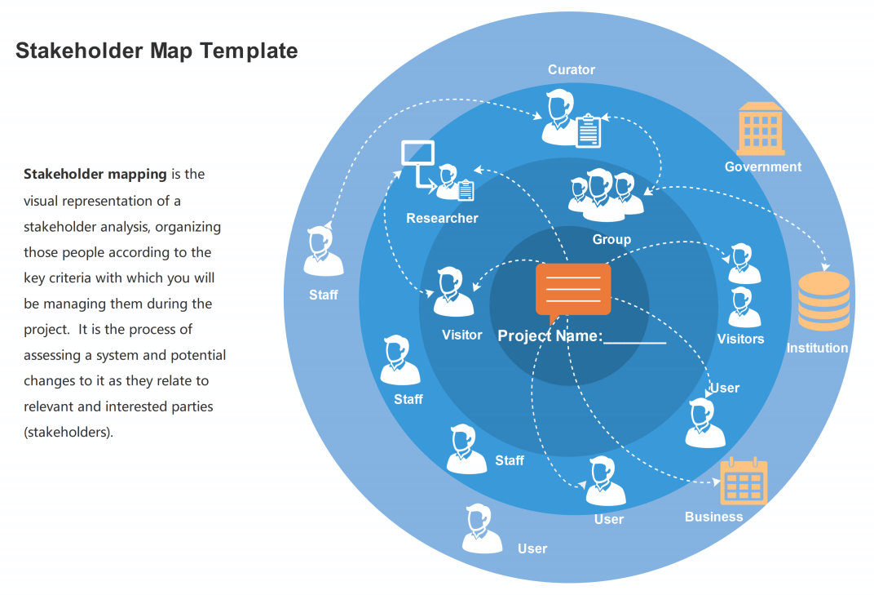
v
Network diagram (bulls-eye diagram)
A network diagram is best for smaller projects with fewer stakeholders; it provides a more detailed look at how each stakeholder interacts with others and how they might be impacted by changes throughout the process.

Slide 36
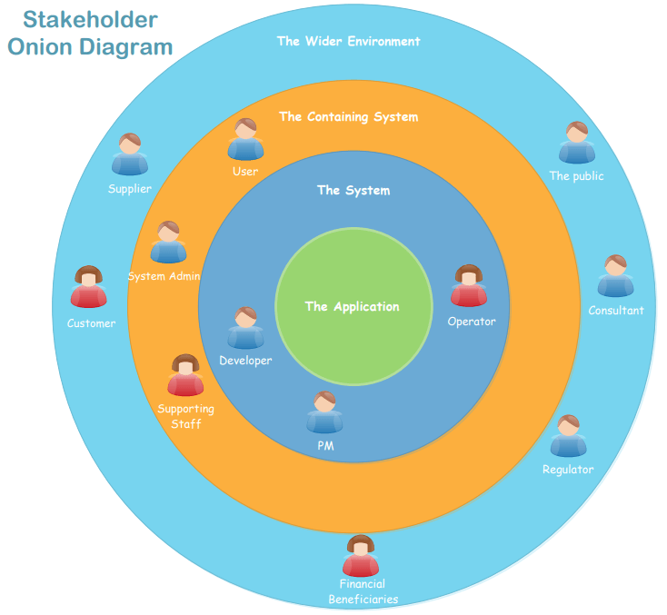
v
Network diagram (Onion diagram)
A network diagram is best for smaller projects with fewer stakeholders; it provides a more detailed look at how each stakeholder interacts with others and how they might be impacted by changes throughout the process.

Slide 37
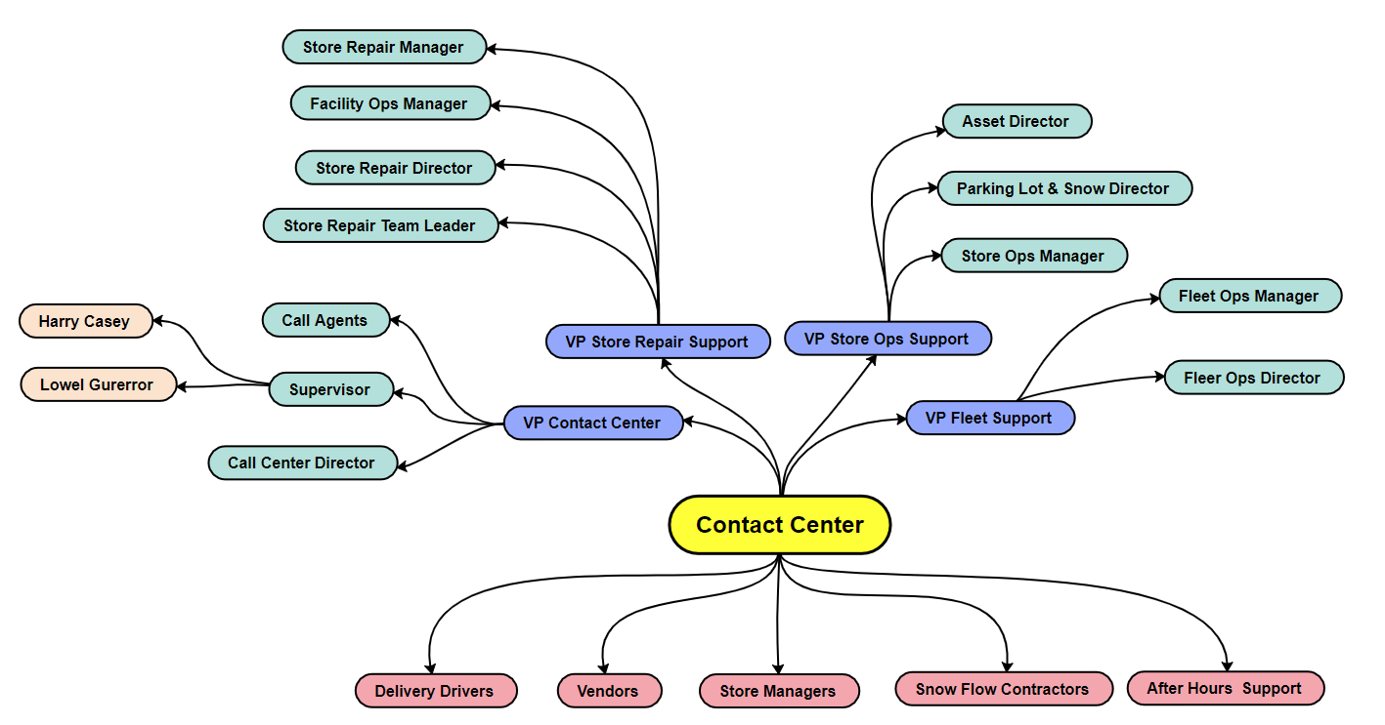
v
Network diagram (Stakeholder map mind map diagram)
A network diagram is best for smaller projects with fewer stakeholders; it provides a more detailed look at how each stakeholder interacts with others and how they might be impacted by changes throughout the process.

Slide 38
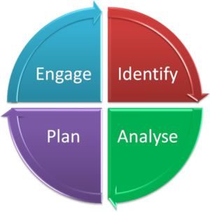
Stakeholder Map The Last step
5. Develop an engagement plan.
The final step is to develop a plan for engagement. How will you engage with each stakeholder as you develop your map and begin your project? What communication channels will you use? What type of information will you share? Once you have developed an engagement plan, you can begin implementing it and working towards achieving your goals.

Slide 39
Conclusion:
Stakeholder Map can be used to help you visually summaries and communicate the relationships between various stakeholders when working on a design challenge or any issue that require to understand various players involved.
What is Stakeholder Mapping?
Stakeholder mapping is a process to identify the key people, group and organization that have direct influence on the design challenge and understand the key stakeholders so as to better engage them.
It draws the relationship between the stakeholders and shows the importance of the stakeholder(s) as it plays a key role in influencing the development and outcome of the design challenge.

Slide 40
Conclusion:
The bottom line
Stakeholder maps provide the necessary documentation to effectively communicate thought processes, plans, and analyses in both directions (whether asynchronously or in real time), ensuring that leadership understands the reasoning behind new product or feature development, as do the employees tasked with carrying out the individual tasks.
This is why stakeholder mapping is an essential tool for any Scrum master, Agile coach, consultant, or project leader looking to foster high-impact innovation and ensure successful execution of their product development plans.

Slide 41
In This Lecture: Design Thinking
Wrap Up
v
Stakeholder Mapping
What is stakeholder mapping?
Why is stakeholder mapping important?
Common types of stakeholders
Methods for mapping stakeholders
A step-by-step guide for mapping stakeholders
Stakeholder
Mapping
Guide

Slide 42


Thank You

