Slide 1


Risk Management
MGM 510
Prepared by
Dr. Hamed Almahadin
Lecture 7

Slide 2



Ch#7
Enterprise Risk Management
www.midocean.ae

Slide 3

Chapter
Topics to Cover in Week 7
07
Enterprise Risk Management
Features of Enterprise Risk Management
Definition of enterprise risk management
Benefits of enterprise risk management
ERM and business continuity
Importance of Resilience
www.midocean.ae

Slide 4
Chapter
Enterprise Risk Management
07
The term enterprise or enterprise-wide risk management (ERM) that is now the most widely used and generally accepted terminology for this broader approach.
The fundamental idea behind the ERM approach is to move away from the practice of risk management as the separate management of individual risks.
www.midocean.ae

Slide 5
Chapter
Enterprise Risk Management
07
ERM takes a unifying, broader and more integrated approach.
The ERM approach means that an organization looks at all the risks that it faces across all of the operations that it undertakes.
www.midocean.ae

Slide 6
Chapter
Enterprise Risk Management
07
ERM is concerned with the management of the risks that can impact the objectives, key dependencies or core processes of the organization.
ERM is concerned with the management of opportunities, as well as the management of control and hazard risks.
www.midocean.ae

Slide 7
Chapter
Enterprise Risk Management
07
With the ERM approach, the relationship between risks is identified by the fact that two or more risks can have an impact on the same activity or objective.
www.midocean.ae

Slide 8
Chapter
Enterprise Risk Management
07
The ERM approach is based on looking at the objective, key dependency or core process and evaluating all of the risks that could impact the item being evaluated.
www.midocean.ae

Slide 9
Chapter
Enterprise Risk Management
07
Organizations practice risk management in a number of different ways.
However, there are many common features to most of these approaches.
www.midocean.ae

Slide 10
Chapter
Enterprise Risk Management
07
Following section gives an overview of the features of enterprise risk management as a comparison to the silo-based approach whereby risk management tools and techniques are applied to different types of risks independently.
www.midocean.ae

Slide 11
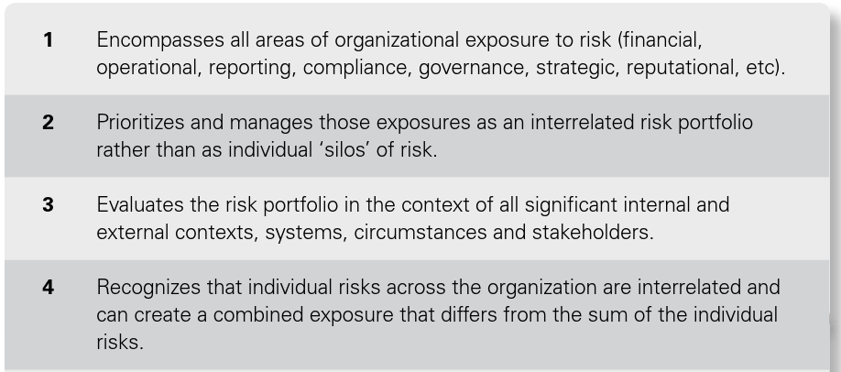
Chapter
Features of ERM
07
www.midocean.ae

Slide 12
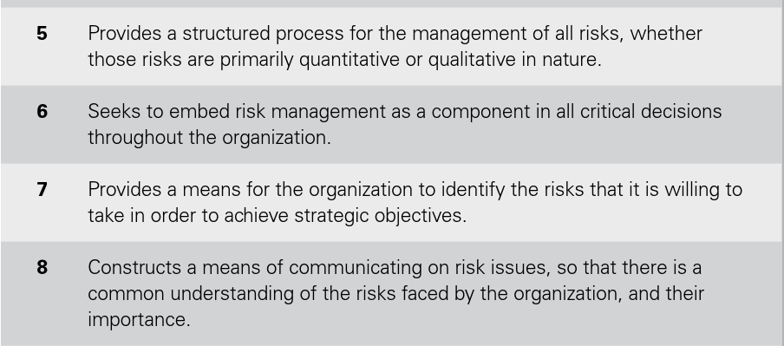
Chapter
Features of ERM
07
www.midocean.ae

Slide 13
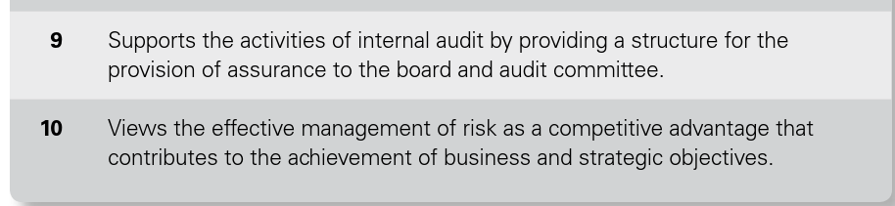
Chapter
Features of ERM
07
www.midocean.ae

Slide 14
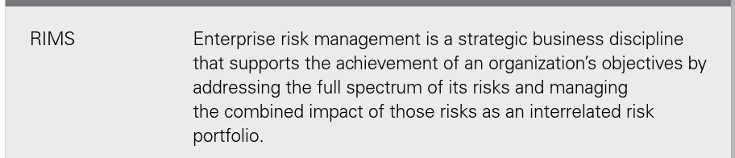
Chapter
Definition of ERM
07
www.midocean.ae

Slide 15

Chapter
Definition of ERM
07
www.midocean.ae

Slide 16
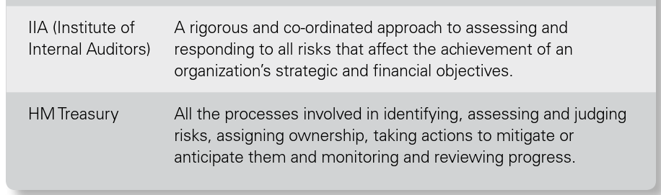
Chapter
Definition of ERM
07
www.midocean.ae

Slide 17

Chapter
Benefits of ERM
07
www.midocean.ae

Slide 18

Chapter
Benefits of ERM
07
www.midocean.ae

Slide 19

Chapter
Benefits of ERM
07
www.midocean.ae

Slide 20

Chapter
Benefits of ERM
07
www.midocean.ae

Slide 21
Chapter
ERM and Business Continuity
07
There is an important relationship between enterprise risk management (ERM) and business continuity management (BCM).
www.midocean.ae

Slide 22
Chapter
ERM and Business Continuity
07
The risk assessment that is required as part of the risk management process and the business impact analysis that is the basis of business continuity planning (BCP) are closely related.
www.midocean.ae

Slide 23
Chapter
ERM and Business Continuity
07
The normal approach to risk management is to evaluate objectives and identify the individual risks that could impact these objectives.
www.midocean.ae

Slide 24
Chapter
ERM and Business Continuity
07
The output from a business impact analysis is the identification of the critical activities that must be maintained for the organization to continue to function.
www.midocean.ae

Slide 25
Chapter
ERM and Business Continuity
07
Based on the definition of ERM set out above and the fact that it should be applied to the evaluation of core processes, it can be seen that the ERM approach and the business impact analysis approach are very similar, because both approaches are based on the identification of the key dependencies and functions that must be in place for the continuity and success of the business.
www.midocean.ae

Slide 26
Chapter
ERM in Energy and Finance
07
Risk management in the energy and finance sectors has become a well-developed specialist branch of the discipline.
In the finance sector, the objective of an ERM initiative is to enhance shareholder value by:
www.midocean.ae

Slide 27
Chapter
ERM in Energy and Finance
07
1. Improving capital and efficiency by providing an objective basis for allocating resources and exploiting natural hedges and portfolio effects.
www.midocean.ae

Slide 28
Chapter
ERM in Energy and Finance
07
2. Supporting financial decision making by considering areas of high adverse impact and by exploiting areas of risk-based advantage.
www.midocean.ae

Slide 29
Chapter
ERM in Energy and Finance
07
3. Building investor confidence by stabilizing results and protecting them disturbances and thus demonstrating proactive risk stewardship.
www.midocean.ae

Slide 30
Chapter
ERM in Energy and Finance
07
What is Basel II?
Basel II is the second set of international banking regulations defined by the Basel Committee on Bank Supervision (BCBS).
It is an extension of the regulations for minimum capital requirements as defined under Basel I.
www.midocean.ae

Slide 31
Chapter
ERM in Energy and Finance
07
The Basel II framework operates under three pillars:
Capital adequacy requirements
Supervisory review
Market discipline
www.midocean.ae

Slide 32
Chapter
ERM in Energy and Finance
07
Banks have been subjected to Basel II for some time and are preparing for implementation of the Basel III requirements by 2019.
www.midocean.ae

Slide 33
Chapter
ERM in Energy and Finance
07
The statement that risk management has failed in banks is more difficult to contradict.
However, the reality is that it was not the failure of risk management principles that caused the banking crisis.
It was the failure to correctly apply those principles.
www.midocean.ae

Slide 34
Chapter
ERM in Energy and Finance
07
Many banks made two simultaneous mistakes:
An accurate risk and reward analysis was not undertaken, so that banks made decisions on the basis of the rewards available, rather than taking a more balanced view of the risks involved in seeking those higher rewards.
www.midocean.ae

Slide 35
Chapter
ERM in Energy and Finance
07
Quantification of the level of risk involved was not accurate, because the banks were taking such a risk-aggressive approach that certain events were considered to be so unlikely that they could be ignored.
www.midocean.ae

Slide 36
Chapter
Importance of Resilience
07
One of the best-established resilience standards is the Organizational Resilience Standard (ASIS SPC.1-2009) published by the American National Standards Institute.
www.midocean.ae

Slide 37
Chapter
Importance of Resilience
07
This ASIS standard takes an enterprise-wide view of risk management, enabling an organization to develop a comprehensive strategy to prevent, when possible, prepare for, mitigate, respond to, and recover from a disruptive incident.
www.midocean.ae

Slide 38
Chapter
Importance of Resilience
07
The overall approach is that a resilient organization needs to ‘prevent, protect and prepare’ in relation to resources and assets and at the same time be able to ‘respond, recover and review’ when a crisis occurs.
www.midocean.ae

Slide 39
Chapter
Importance of Resilience
07
The emergence of resilience is an opportunity for risk management and business continuity specialists to work together to ensure a more coordinated approach to enterprise risk management, business continuity and crisis management.
www.midocean.ae

Slide 40
Chapter
Importance of Resilience
07
There are three behaviors that should be achieved by an organization if it is to achieve increased resilience:
  awareness of changes in the external, internal and risk management environments, so that constant attention to resilience is ensured;
www.midocean.ae

Slide 41
Chapter
Importance of Resilience
07
  ‘prevent, protect and prepare’ in relation to all types of resources, including assets, networks, relationships and intellectual property;
www.midocean.ae

Slide 42
Chapter
Importance of Resilience
07
  ‘respond, recover and review’ in relation to disruptive events, including the ability to respond rapidly, review lessons learnt and adapt.
www.midocean.ae

Slide 43




Thank You

