Slide 1

Strategic and Operational Management
(part 2 Formulation)
Prepared by Dr. Adam Yagoub
Lecture 6
MGM 630
Business Strategy:
Differentiation, Cost Leadership,
and Blue Oceans

Slide 2
Lecture 6
Lecture Outline
6.1 Business-Level Strategy: How to Compete for Advantage
6.2 Differentiation Strategy: Understanding Value Drivers
6.3 Cost-Leadership Strategy: Understanding Cost Drivers
6.4 Business-Level Strategy and the Five Forces: Benefits and Risks
6.5 Blue Ocean Strategy: Combining Differentiation and Cost Leadership

Slide 3

Lecture 6
Learning Objectives
1. Define business-level strategy and describe how it determines a firm’s strategic position.
2. Examine the relationship between value drivers and differentiation strategy.
3. Examine the relationship between cost drivers and the cost-leadership strategy.
4. Assess the benefits and risks of differentiation and cost-leadership strategies vis-à-vis the five forces that shape competition.
5. Evaluate value and cost drivers that may allow a firm to pursue a blue ocean strategy.
6. Assess the risks of a blue ocean strategy, and explain why it is difficult to succeed at value innovation

Slide 4
Lecture 6
Business Strategy:
Differentiation, Cost Leadership, and Blue Oceans
6.1 Business-Level Strategy: How to Compete for Advantage
Business-level strategy details the goal-directed actions managers take in their quest for competitive advantage when competing in a single product market. It may involve a single product or a group of similar products that use the same distribution channel. It concerns the broad question, “How should we compete?”

Slide 5
Lecture 6
Business Strategy:
Differentiation, Cost Leadership, and Blue Oceans
To formulate an appropriate business-level strategy, managers must answer the who, what, why, and how questions of competition:
■ Who—which customer segments will we serve?
■ What customer needs, wishes, and desires will we satisfy?
■ Why do we want to satisfy them?
■ How will we satisfy our customers’ needs?

Slide 6
Lecture 6
Business Strategy:
Differentiation, Cost Leadership, and Blue Oceans
To formulate an effective business strategy, managers need to keep in mind that competitive advantage is determined jointly by industry and firm effects. As shown in Exhibit 6.1, one route to competitive advantage is shaped by industry effects, while a second route is determined by firm effects. As discussed in Chapter 3, an industry’s profit potential can be assessed using the five forces framework plus the availability of complements. Managers need to be certain that the business strategy is aligned with the five forces that shape competition. They can evaluate performance differences among clusters of firms in the same industry by conducting a strategic-group analysis.

Slide 7
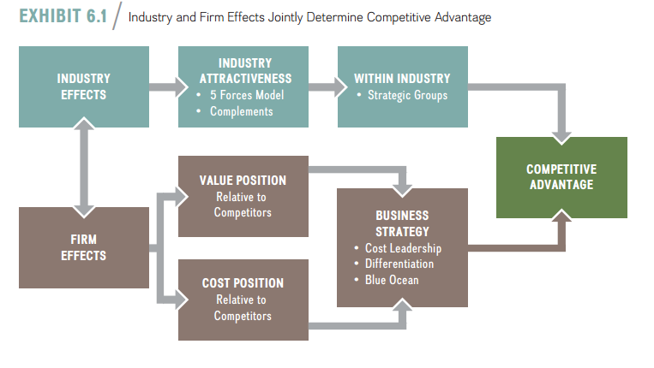
Lecture 6
Business Strategy:
Differentiation, Cost Leadership, and Blue Oceans

Slide 8
Lecture 6
Business Strategy:
Differentiation, Cost Leadership, and Blue Oceans
Strategic position
A firm’s business-level strategy determines its strategic position its strategic profile based on value creation and cost in a specific product market. A firm attempts to stake out a valuable and unique position that meets customer needs while simultaneously creating as large a gap as possible between the value the firm’s product creates and the cost required to produce it. Higher value creation tends to require higher cost. To achieve a desired strategic position, managers must make strategic trade offs choices between a cost or value position.

Slide 9
Lecture 6
Business Strategy:
Differentiation, Cost Leadership, and Blue Oceans
Managers must address the tension between value creation and the pressure to keep cost in check so as not to erode the firm’s economic value creation and profit margin. A business strategy is more likely to lead to a competitive advantage if a firm has a clear strategic profile, either as differentiator or a low-cost leader.

Slide 10
Lecture 6
Business Strategy:
Differentiation, Cost Leadership, and Blue Oceans
Generic business strategies
There are two fundamentally different generic business strategies—differentiation and cost leadership. A differentiation strategy seeks to create higher value for customers than the value that competitors create, by delivering products or services with unique features while keeping costs at the same or similar levels, allowing the firm to charge higher prices to its customers. A cost-leadership strategy, in contrast, seeks to create the same or similar value for customers by delivering products or services at a lower cost than competitors, enabling the firm to offer lower prices to its customers.

Slide 11
Lecture 6
Business Strategy:
Differentiation, Cost Leadership, and Blue Oceans
These two business strategies are called generic strategies because they can be used by any organization—manufacturing or service, large or small, for-profit or nonprofit, public or private, domestic or foreign—in the quest for competitive advantage, independent of industry context. Differentiation and cost leadership require distinct strategic positions, and in turn increase a firm’s chances to gain and sustain a competitive advantage. Because value creation and cost tend to be positively correlated, however, important trade-offs exist between value creation and low cost. A business strategy, therefore, is more likely to lead to a competitive advantage if it allows firms to either perform similar activities differently or perform different activities than their rivals that result in creating more value or offering similar products or services at lower cost.

Slide 12
Lecture 6
Business Strategy:
Differentiation, Cost Leadership, and Blue Oceans
Now we can combine the dimensions describing a firm’s strategic position (differentiation vs. cost) with the scope of competition (narrow vs. broad).As shown in Exhibit 6.2, by doing so we get the two major broad business strategies (cost leadership and differentiation), shown as the top two boxes in the matrix, and the focused version of each (shown as the bottom two boxes in the matrix). The focused versions of the two business strategies—focused cost-leadership strategy and focused differentiation strategy—are essentially the same as the broad generic strategies except that the competitive scope is narrower.

Slide 13
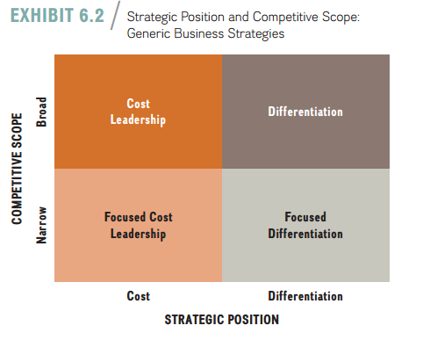
Lecture 6
Business Strategy:
Differentiation, Cost Leadership, and Blue Oceans

Slide 14
Lecture 6
Business Strategy:
Differentiation, Cost Leadership, and Blue Oceans
6.2 Differentiation Strategy:
Understanding Value Drivers The goal of a differentiation strategy is to add unique features that will increase the perceived value of goods and services in the minds of consumers so they are willing to pay a higher price. Ideally, a firm following a differentiation strategy aims to achieve in the minds of consumers a level of value creation that its competitors cannot easily match. The focus of competition in a differentiation strategy tends to be on unique product features, service, and new product launches, or on marketing and promotion rather than price. For example, the carpet company Interface is a leader in sustainability and offers innovative products such as its Cool Carpet, the world’s first carbon-neutral floor covering. Interface’s customers reward it with a willingness to pay a higher price for its environmentally friendly products.

Slide 15
Lecture 6
Business Strategy:
Differentiation, Cost Leadership, and Blue Oceans
A company that uses a differentiation strategy can achieve a competitive advantage as long as its economic value created (V − C) is greater than that of its competitors. Firm A in Exhibit 6.3 produces a generic commodity. Firm B and Firm C represent two efforts at differentiation. Firm B not only offers greater value than Firm A, but also maintains cost parity, meaning it has the same costs as Firm A. However, even if a firm fails to achieve cost parity (which is often the case because higher value creation tends to go along with higher costs in terms of higher-quality raw materials, research and development, employee training to provide superior customer service, and so on), it can still gain a competitive advantage if its economic value creation exceeds that of its competitors.

Slide 16
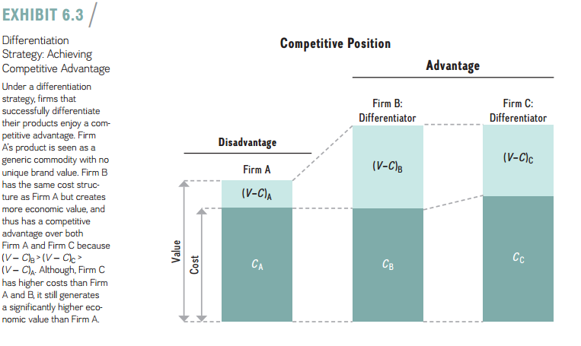

Slide 17
Lecture 6
Business Strategy:
Differentiation, Cost Leadership, and Blue Oceans
Firm C represents just such a competitive advantage. For the approach shown either in Firm B or Firm C, economic value creation, (V − C)B or (V − C)C, is greater than that of Firm A (V − C)A. Either Firm B or C, therefore, achieves a competitive advantage because it has a higher value gap over Firm A [(V − C)B > (V − C)A, or (V − C)C > (V − C)A], which allows it to charge a premium price, reflecting its higher value creation. To complete the relative comparison, although both companies pursue a differentiation strategy, Firm B also has a competitive advantage over Firm C because although both offer identical value, Firm B has lower cost, thus (V − C)B > (V − C)C.

Slide 18
Lecture 6
Business Strategy:
Differentiation, Cost Leadership, and Blue Oceans
Managers can adjust a number of different levers to improve a firm’s strategic position. These levers either increase perceived value or decrease costs. Here, we will study the most salient value drivers that managers have at their disposal (we look at cost drivers in the next section). They are:
■ Product features
■ Customer service
■ Complements

Slide 19

Lecture 6
Business Strategy:
Differentiation, Cost Leadership, and Blue Oceans
1. Product features
One of the obvious but most important levers that managers can adjust is product features, thereby increasing the perceived value of the product or service offering. Adding unique product attributes allows firms to turn commodity products into differentiated products commanding a premium price. Strong R&D capabilities are often needed to create superior product features.

Slide 20
Lecture 6
Business Strategy:
Differentiation, Cost Leadership, and Blue Oceans
2. Customer service
Managers can increase the perceived value of their firms’ product or service offerings by focusing on customer service.
3. Complements
When studying industry analysis in Chapter 3, we identified the availability of complements as an important force determining the profit potential of an industry. Complements add value to a product or service when they are consumed in tandem. Finding complements, therefore, is an important task for managers in their quest to enhance the value of their offerings.

Slide 21
Lecture 6
Business Strategy:
Differentiation, Cost Leadership, and Blue Oceans
6.3 Cost-Leadership Strategy:
Understanding Cost Drivers The goal of a cost-leadership strategy is to reduce the firm’s cost below that of its competitors while offering adequate value. The cost leader, as the name implies, focuses its attention and resources on reducing the cost to manufacture a product or deliver a service in order to offer lower prices to its customers. The cost leader attempts to optimize all of its value chain activities to achieve a low-cost position. Although staking out the lowest-cost position in the industry is the overriding strategic objective, a cost leader still needs to offer products and services of acceptable value. As an example, GM and Korean car manufacturer Kia offer some models that compete directly with one another, yet Kia’s cars tend to be produced at lower cost, while providing a similar value proposition

Slide 22
Lecture 6
Business Strategy:
Differentiation, Cost Leadership, and Blue Oceans
A cost leader can achieve a competitive advantage as long as its economic value created (V − C) is greater than that of its competitors. Firm A in Exhibit 6.4 produces a product with a cost structure vulnerable to competition. Firms B and C show two different approaches to cost leadership. Firm B achieves a competitive advantage over Firm A because Firm B not only has lower cost than Firm A, but also achieves differentiation parity(meaning it creates the same value as Firm A). As a result, Firm B’s economic value creation, (V − C)B, is greater than that of Firm A, (V − C)A. For example, as the low-cost leader, Walmart took market share from Kmart, which subsequently filed for bankruptcy

Slide 23
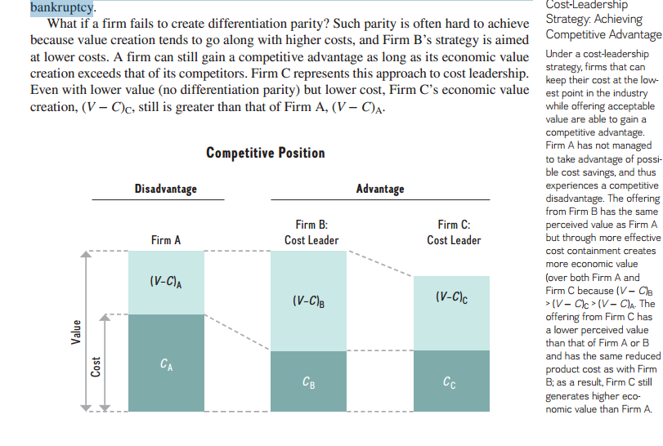
Lecture 6
Business Strategy:
Differentiation, Cost Leadership, and Blue Oceans

Slide 24
Lecture 6
Business Strategy:
Differentiation, Cost Leadership, and Blue Oceans
Although companies successful at cost leadership must excel at controlling costs, this doesn’t mean that they can neglect value creation. Kia signals the quality of its cars with a five-year, 60,000-mile warranty, one of the more generous warranties in the industry. Walmart offers products of acceptable quality, including many brand-name products. The most important cost drivers that managers can manipulate to keep their costs low are:
■ Cost of input factors.
■ Economies of scale.
■ Learning-curve effects.
■ Experience-curve effects.

Slide 25
Lecture 6
Business Strategy:
Differentiation, Cost Leadership, and Blue Oceans
6.4 Business-Level Strategy and the Five Forces: Benefits and Risks
The business-level strategies introduced in this chapter allow firms to carve out strong strategic positions that enhance the likelihood of gaining and sustaining competitive advantage. The five forces model introduced in Chapter 3 helps managers assess the forces—threat of entry, power of suppliers, power of buyers, threat of substitutes, and rivalry among existing competitors—that make some industries more attractive than others.

Slide 26
Lecture 6
Business Strategy:
Differentiation, Cost Leadership, and Blue Oceans
With this understanding of industry dynamics, managers use one of the generic business-level strategies to protect themselves against the forces that drive down profitability. Exhibit 6.7 details the relation-ship between competitive positioning and the five forces. In particular, it highlights the bene-fits and risks of differentiation and cost-leadership business strategies, which we discuss next.

Slide 27
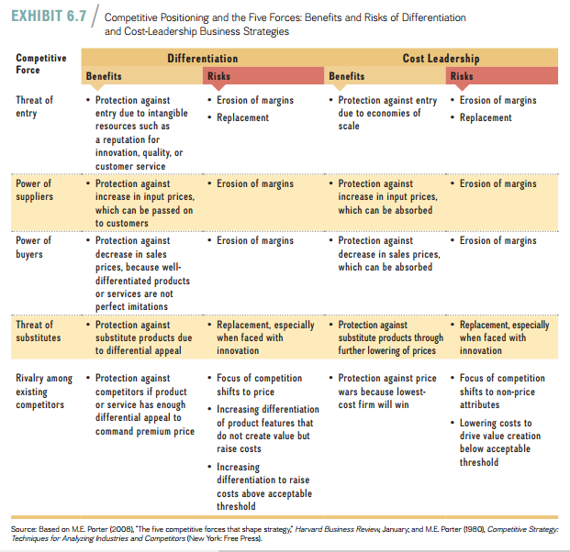
Lecture 6
Business Strategy:
Differentiation, Cost Leadership, and Blue Oceans

Slide 28
Lecture 6
Business Strategy:
Differentiation, Cost Leadership, and Blue Oceans
1. Differentiation strategy: benefits and risks
A successful differentiation strategy is likely to be based on unique or specialized features of the product, on an effective marketing campaign, or on intangible resources such as a reputation for innovation, quality, and customer service. A rival would need to improve the product features as well as build a similar or more effective reputation in order to gain market share. The threat of entry is reduced: Competitors will find such intangible advantages time-consuming and costly, and maybe impossible, to imitate. If the source of the differential appeal is intangible rather than tangible (e.g., reputation rather than observable product and service features), a differentiator is even more likely to sustain its advantage.

Slide 29
Lecture 6
Business Strategy:
Differentiation, Cost Leadership, and Blue Oceans
2. Cost Leadership Strategy: benefits and risks
A cost-leadership strategy is defined by obtaining the lowest-cost position in the industry while offering acceptable value. The cost leader, therefore, is protected from other competitors because of having the lowest cost. If a price war ensues, the low-cost leader will be the last firm standing; all other firms will be driven out as margins evaporate. Since reaping economies of scale is critical to reaching a low-cost position, the cost leader is likely to have a large market share, which in turn reduces the threat of entry.

Slide 30
Lecture 6
Business Strategy:
Differentiation, Cost Leadership, and Blue Oceans
A cost leader is also fairly well isolated from threats of powerful suppliers to increase input prices, because it is more able to absorb price increases through accepting lower profit margins. Likewise, a cost leader can absorb price reductions more easily when demanded by powerful buyers. Should substitutes emerge, the low-cost leader can try to fend them off by further lowering its prices to reinstall relative value with the substitute.

Slide 31
Lecture 6
Business Strategy:
Differentiation, Cost Leadership, and Blue Oceans
6.5 Blue Ocean Strategy:
Combining Differentiation and Cost Leadership So far we’ve seen that firms can create more economic value and their likelihood of gaining and sustaining competitive advantage in one of two ways—either increasing perceived consumer value (while containing costs) or lowering costs (while offering acceptable value). Should managers try to do both at the same time? To accomplish this, they would need to integrate two different strategic positions: differentiation and low cost.

Slide 32
Lecture 6
Business Strategy:
Differentiation, Cost Leadership, and Blue Oceans
In general the answer is no. Managers should not pursue this complex strategy because of the inherent trade-offs in different strategic positions, unless they are able to reconcile the conflicting requirements of each generic strategy.

Slide 33
Lecture 6
Business Strategy:
Differentiation, Cost Leadership, and Blue Oceans
To meet this challenge, the strategy scholars Kim and Mauborgne advance the notion of a blue ocean strategy, which is a business-level strategy that successfully combines differentiation and cost-leadership activities using value innovation to reconcile the inherent trade-offs in those two distinct strategic positions. They use the metaphor of an ocean to denote market spaces. Blue oceans represent untapped market space, the creation of additional demand, and the resulting opportunities for highly profitable growth. In contrast, red oceans are the known market space of existing industries.

Slide 34
Lecture 6
Business Strategy:
Differentiation, Cost Leadership, and Blue Oceans
In red oceans the rivalry among existing firms is cut-throat because the market space is crowded and com-petition is a zero-sum game. Products become commodities, and competition is focused mainly on price. Any market share gain comes at the expense of other competitors in the same industry, turning the oceans bloody red

Slide 35
Lecture 6
Business Strategy:
Differentiation, Cost Leadership, and Blue Oceans
1. Value innovation
For a blue ocean strategy to succeed, man-agers must resolve trade-offs between the two generic strategic positions—low cost and differentiation. This is done through value innovation, aligning innovation with total perceived consumer benefits, price and cost Instead of attempting to out-compete your rivals by offering better features or lower costs, successful value innovation makes competition irrelevant by providing a leap in value creation, thereby opening new and uncontested market spaces.

Slide 36
Lecture 6
Business Strategy:
Differentiation, Cost Leadership, and Blue Oceans
Successful value innovation requires that a firm’s strategic moves lower its costs and at the same increase the perceived value for buyers (see Exhibit 6.8). Lowering a firm’s costs is primarily achieved by eliminating and reducing the taken-for-granted factors that the firm’s rivals in their industry compete on. Perceived buyer value is increased by raising existing key success factors and by creating new elements that the industry has not offered previously.

Slide 37
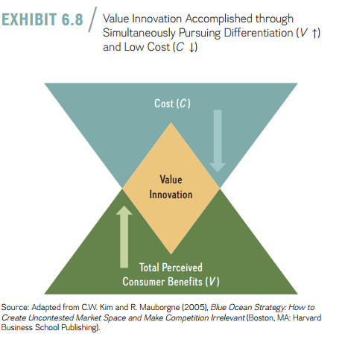
Lecture 6
Business Strategy:
Differentiation, Cost Leadership, and Blue Oceans

Slide 38
Lecture 6
Business Strategy:
Differentiation, Cost Leadership, and Blue Oceans
2. Blue ocean strategy gone bad: “Stuck in The Middle”
Although appealing in a theoretical sense, a blue ocean strategy can be quite difficult to translate into reality. The reason is that differentiation and cost leadership are distinct strategic positions that require important trade-offs. A blue ocean strategy is difficult to implement because it requires the reconciliation of fundamentally different strategic positions—differentiation and low cost—which in turn require distinct internal value chain activities (see Chapter 4) so the firm can increase value and lower cost at the same time.

Slide 39
Lecture 6
Business Strategy:
Differentiation, Cost Leadership, and Blue Oceans
Exhibit 6.9 suggests how a successfully formulated blue ocean strategy based on value innovation combines both a differentiation and low-cost position. It also shows the con-sequence of a blue ocean strategy gone bad—the firm ends up being stuck in the middle, meaning the firm has neither a clear differentiation nor a clear cost-leadership profile. Being stuck in the middle leads to inferior performance and a resulting competitive dis-advantage.

Slide 40
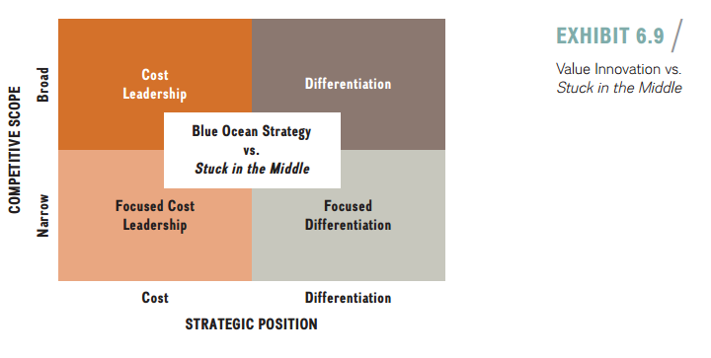
Lecture 6
Business Strategy:
Differentiation, Cost Leadership, and Blue Oceans

Slide 41
Lecture 6
The value curve is the basic component of the strategy canvas. It graphically depicts a company’s relative performance across its industry’s factors of competition. A strong value curve has focus and divergence, and it can even provide a kind of tagline as to what strategy is being undertaken or should be undertaken.

Slide 42
Lecture 6
Business Strategy:
Differentiation, Cost Leadership, and Blue Oceans
Resources:
Strategic management, third edition, 2017
Frank t. Rothaermel
Georgia Institute of Technology
Chapter 6

