Slide 1
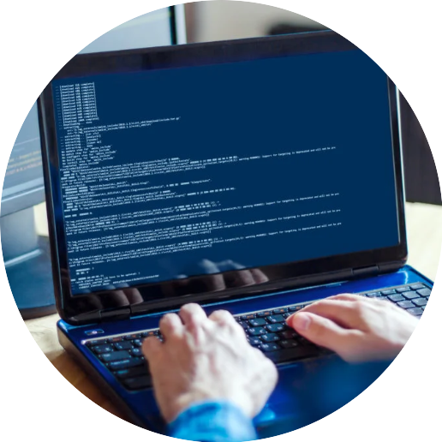


Network
Programming
in Python
Prepared by Dr. Hamada I. AbdulWakel
Lecture 9

Slide 2



Email Handling
Lecture 9
Prepared by
Dr. Hamada I. AbdulWakel
www.midocean.ae

Slide 3
Lecture
RECAP: LECTURE 8
09
Email Messages.
E-mail Construction in Python.
www.midocean.ae

Slide 4
Lecture
LECTURE MAIN POINTS
09
Email Protocols.
Sending Emails.
Securing Emails.
Retrieving Emails.
www.midocean.ae

Slide 5
Lecture
09
EMAIL PROTOCOLS
Simple Mail Transfer Protocol (SMTP): It can only be used by the MTA for sending e-mails from one host to another.
Post Office Protocol 3 (POP3): It provides a simple and standardized way for the users to gain access to the mailboxes and then download the messages.
Internet Message Access Protocol (IMAP): It provides a simple and standardized way for accessing your e-mail. It requires only a small data transfer; this scheme works well even over a slow connection.
www.midocean.ae

Slide 6
Lecture
09
POP3 VS. IMAP
With IMAP:
  All your mail stays on the server in multiple folders.
  You can connect to any computer and see all your mail and mail folders.
  If you have a dedicated connection to the Internet or you like to check your mail from various locations.
With POP3:
  You only have one folder, the Inbox folder.
  When you open your mailbox, new mail is moved from the host server and saved on your computer.
www.midocean.ae

Slide 7
Lecture
09
EMAIL MODULES
Python has three modules:
  smtplib for SMTP protocol.
  poplib for POP3 protocol.
  imaplib for IMAP protocol.
Each module has options for transmitting the information securely by using the Transport Layer Security (TLS) protocol.
Each protocol also uses some form of authentication for ensuring the confidentiality of the data.
www.midocean.ae

Slide 8
Lecture
09
SMPTLIB METHODS
SMTP(): returns an object of SMTP class.
ehlo(): identifies the client to the server. An extended hello message will be sent by the client to the server.
starttls(): starts unsecured SMTP connection with encryption for the traffic.
login(): takes username and password arguments to login to SMTP server.
www.midocean.ae

Slide 9
Lecture
09
SMPTLIB METHODS
Cont'd
sendmail(): performs an entire mail transaction.
quit(): terminates SMTP session.
www.midocean.ae

Slide 10
Lecture
09
LOCAL SMTP SERVER
Python comes with simple smtpd module which allows you to run a simple SMTP server easily.
When doing email debugging, smtpd has extreme useful DebuggingServer feature making it dump all relayed email to stdout instead of relaying them forward for email delivery.
Running a local debugging server means it’s not necessary to deal with encryption of messages or use credentials to log in to an email server.
www.midocean.ae

Slide 11
Lecture
09
LOCAL SMTP SERVER
Cont'd
Code:
import smtplib
session = smtplib.SMTP('localhost', 1025)
subject = 'Test'
body = "A test message to check the email sending using STMP"
msg = f"Subject: {subject} \n\n{body}"
session.sendmail("hamada@esu.ae.ac", "hamada_mbsoft@yahoo.com", msg)
www.midocean.ae

Slide 12
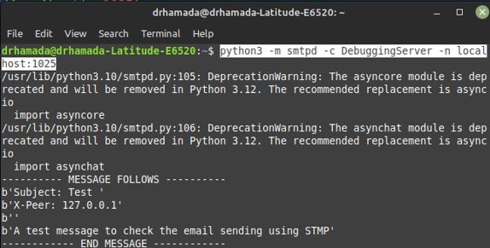
Lecture
09
LOCAL SMTP SERVER
Cont'd
www.midocean.ae

Slide 13
Lecture
09
EMAIL CLIENT APP
Code:
import smtplib, imghdr
from email.message import EmailMessage
from email.utils import make_msgid
sender = input("Enter sender email address: ")
recipient = input("Enter recipient email address: ")
msg = EmailMessage()
msg['subject'] = 'A new message with attachment'
msg['from'] = sender
msg['to'] = recipient
www.midocean.ae

Slide 14
Lecture
09
EMAIL CLIENT APP
Cont'd
Code:
msg['Message-ID'] = make_msgid()
msg.set_content("Image attached ...")
with open('image.jpg', 'rb') as f:
file = f.read()
fileType = imghdr.what(f.name)
print(fileType)
fileName = f.name
msg.add_attachment(file, maintype='image', subtype=fileType, filename = fileName)
www.midocean.ae

Slide 15

Lecture
09
EMAIL CLIENT APP
Cont'd
Code:
mailserver = 'smtp.gmail.com'
mailport = 587
session = smtplib.SMTP(mailserver, mailport)
session.ehlo()
session.sendmail(sender, recipient, msg.as_string())
print(f"You email is sent to {recipient}.")
session.quit()
www.midocean.ae

Slide 16
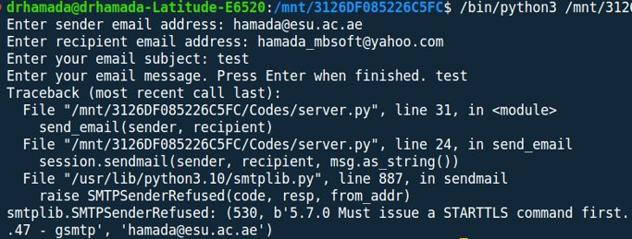
Lecture
09
EMAIL CLIENT APP
Cont'd
www.midocean.ae

Slide 17
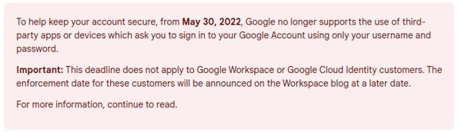
Lecture
09
LESS SECURE APPS
An App Password gives permission to a non-Google app to access Google's SMTP server.
App Passwords can only be used with accounts that have 2-step verification turned on.
Visit: https://support.google.com/accounts/answer/6010255?hl=en
www.midocean.ae

Slide 18
Lecture
09
LESS SECURE APPS
Cont'd
To use Google's SMTP server for sending email with Automation Workshop, follow the very simple set-up process:
  Open Google Account Security settings.
  Select 2-Step Verification option from the How to sign in to Google section.
  Select App passwords option (at the very bottom of the page).
  Click on the Select App field, and choose the Other (Custom name) option.
  Enter an easily recognizable name, and click the Generate button.
  Write down the generated App password.
  From now on, for the SMTP settings use this 16-character password (without spaces) along with your complete Gmail address.
www.midocean.ae

Slide 19
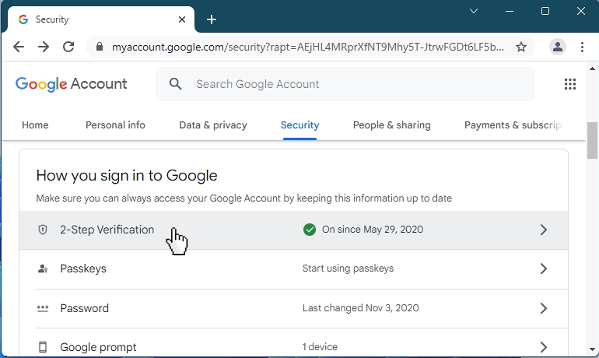
Lecture
09
LESS SECURE APPS
Cont'd
www.midocean.ae

Slide 20
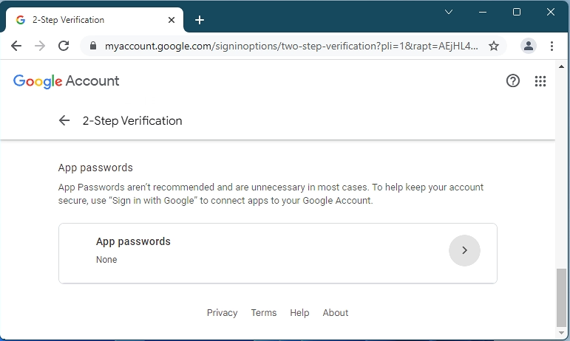
Lecture
09
LESS SECURE APPS
Cont'd
www.midocean.ae

Slide 21
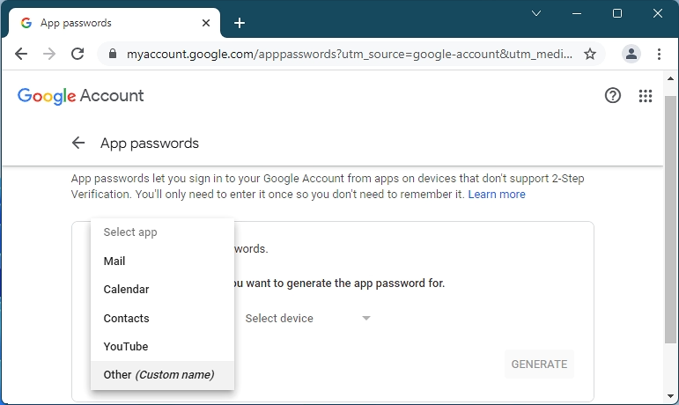
Lecture
09
LESS SECURE APPS
Cont'd
www.midocean.ae

Slide 22
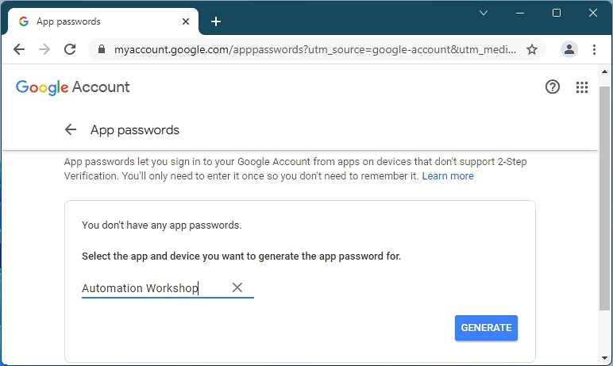
Lecture
09
LESS SECURE APPS
Cont'd
www.midocean.ae

Slide 23
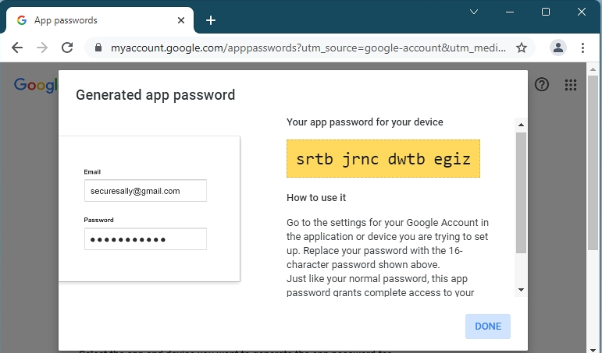
Lecture
09
LESS SECURE APPS
Cont'd
www.midocean.ae

Slide 24
Lecture
09
EMAIL CLIENT APP
Code:
import getpass
session = smtplib.SMTP(mailserver, mailport)
session.ehlo()
session.starttls()
session.ehlo() # re-identify themselves as encrypted connection
# "tgrjnuccuhsjjzji"
password = getpass.getpass(prompt="Enter you email password: ")
session.login(sender, password)
www.midocean.ae

Slide 25
Lecture
09
POP3 METHODS
POP3(): creates a POP3 object.
POP3_SSL(): creates a secured POP3 object.
user(): sets the username to get the mailbox.
pass_(): sets the password for the username.
stat(): returns mailbox status in a tuple format (message count, mailbox size).
www.midocean.ae

Slide 26
Lecture
09
POP3 METHODS
Cont'd
list():
  Retrieves a list of messages.
  Returns a tuple of:
  (responsecode, msglist, sizeofresponse)
retr():
  Retrieves a single message.
  Returns a tuple of:
  (responsecode, lines, size)
  Marks the Email as read.
www.midocean.ae

Slide 27
Lecture
09
EMAIL ACCESS CLIENT APP
Code:
import getpass, poplib
popserver = 'pop.gmail.com'
popport = 995
username = input("Enter your email user ID: ")
# "tgrjnuccuhsjjzji"
password = getpass.getpass(prompt="Enter your email password: ")
mailbox = poplib.POP3_SSL(popserver , popport)
mailbox.user(username)
mailbox.pass_(password)
www.midocean.ae

Slide 28
Lecture
09
EMAIL ACCESS CLIENT APP
Cont'd
Code:
num_messages = len(mailbox.list()[1])
print(f"Total emails: {num_messages}")
print("Getting last message")
for msg in mailbox.retr(num_messages)[1]:
print(msg)
mailbox.quit()
www.midocean.ae

Slide 29
Lecture
09
IMAP METHODS
IMAP4_SSL(): creates a secure IMAP object.
login(): logins to the server.
list():
  Lists the folders present in mailbox.
  Returns a tuple of:
  ('Ok', [list])
www.midocean.ae

Slide 30
Lecture
09
IMAP METHODS
Cont'd
select():
  Selects a specific mail folder to get messages from it.
  Returns a tuple of:
  ('Ok', [list of one item specify number of emails in this folder])
fetch():
  Returns a particular message.
  The 1st argument is the number of message, the second is the parsing format.
  Returns a tuple of:
  ('Ok', [list of message header]).
www.midocean.ae

Slide 31
Lecture
09
EMAIL ACCESS CLIENT APP
Code:
import imaplib, email
imapServer = 'imap.gmail.com'
sender = 'hamada.mbsoft@gmail.com'
password = 'tgrjnuccuhsjjzji'
conn = imaplib.IMAP4_SSL(imapServer)
conn.login(sender, password)
print(conn.list())
print(conn.select('INBOX'))
www.midocean.ae

Slide 32
Lecture
09
EMAIL ACCESS CLIENT APP
Cont'd
Code:
conn.select('INBOX')
typ, data = conn.fetch(b'6433','(RFC822)')
print(data[0])
print(data[0][1])
# convert data into email message object
msg = email.message_from_string(data[0][1].decode('utf-8'))
print("To:", msg['to'])
print("From:", msg['from'])
www.midocean.ae

Slide 33
Lecture
09
EMAIL ACCESS CLIENT APP
Cont'd
Code:
print("Subject: ", msg['subject'])
# use walk() to get message parts and check its content type
for p in msg.walk():
if p.get_content_type() == 'text/plain':
body = p.get_payload()
print(body)
www.midocean.ae

Slide 34
Lecture
09
QUESTIONS FOR ONLINE DISCUSSION
Write a program to create your own Mail Client and use it to send e-mail with attachment to "hamada@esu.ac.ae".
www.midocean.ae

Slide 35


Thank You

