Slide 1


Slide 2
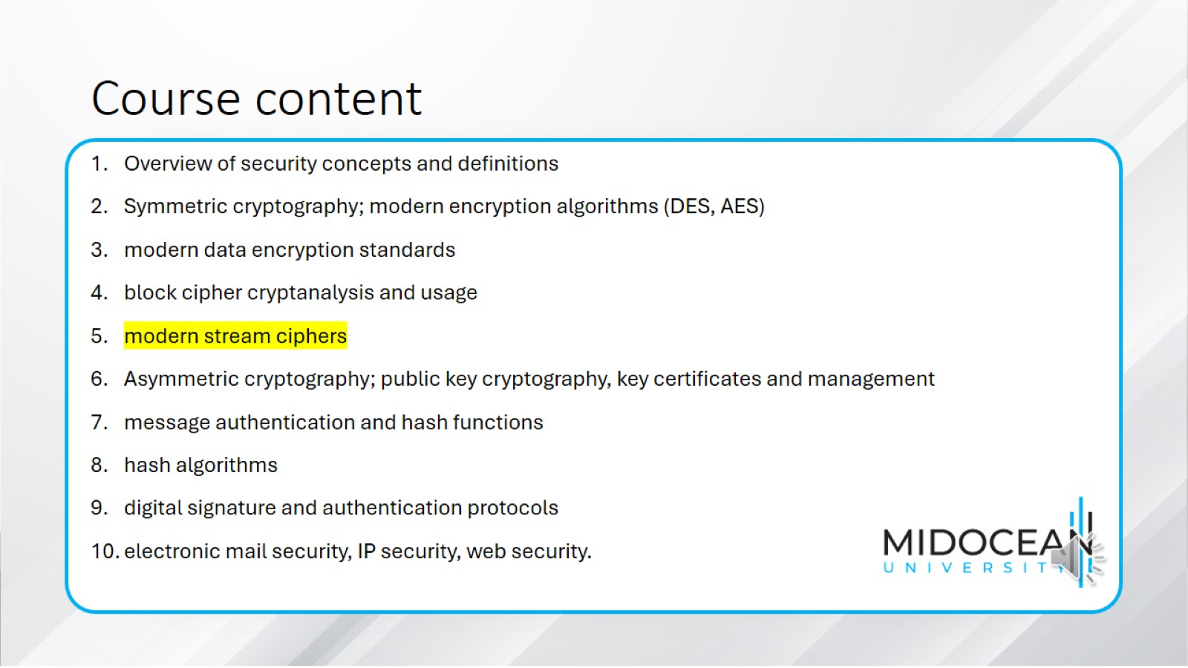
Course content

Slide 3
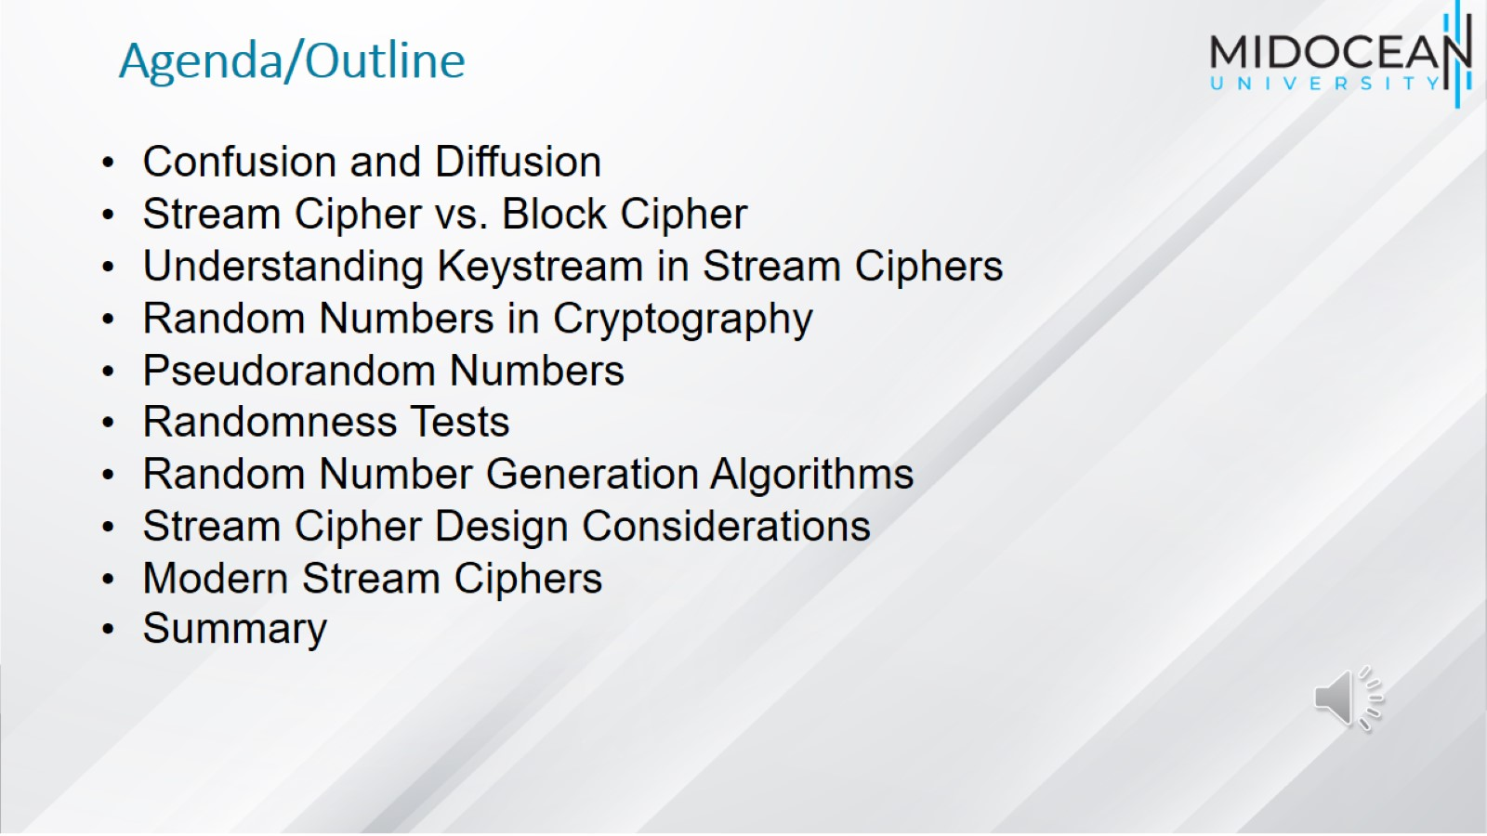
Agenda/Outline

Slide 4
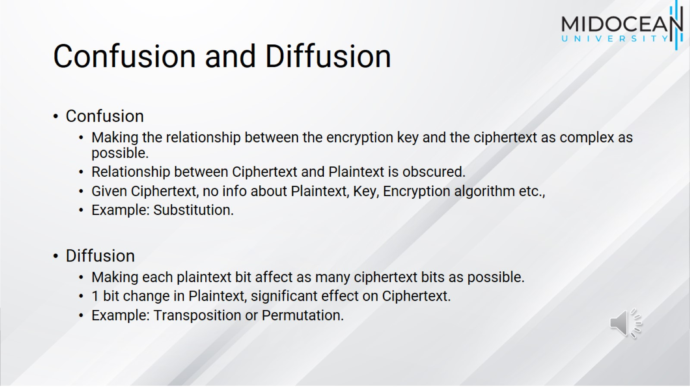
Confusion and Diffusion

Slide 5
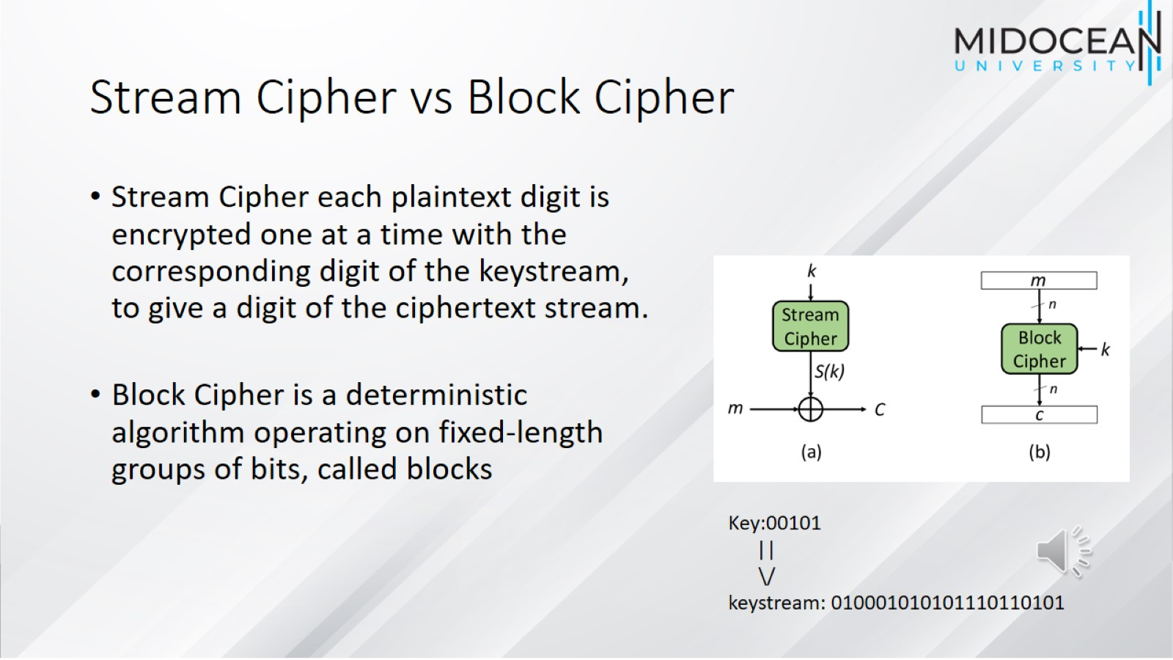
Stream Cipher vs Block Cipher

Slide 6
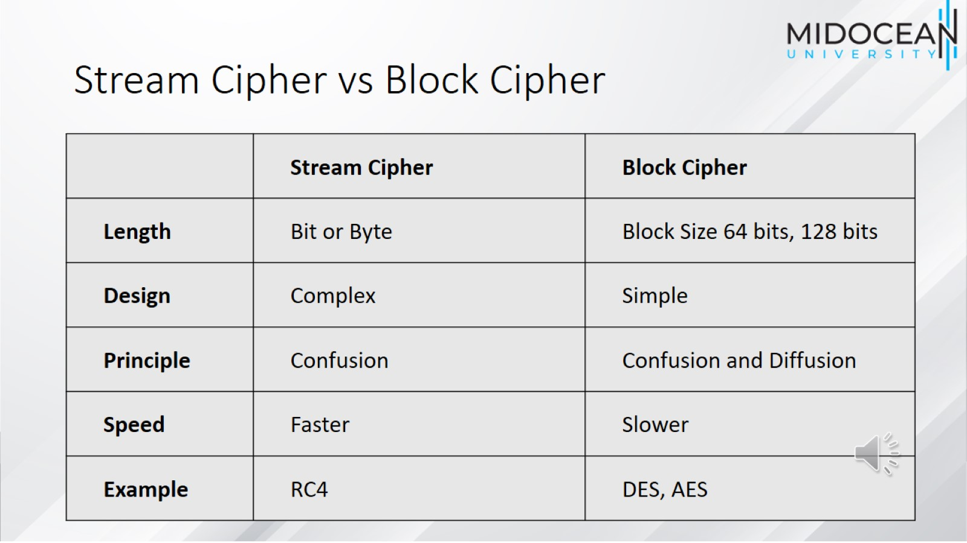
Stream Cipher vs Block Cipher

Slide 7
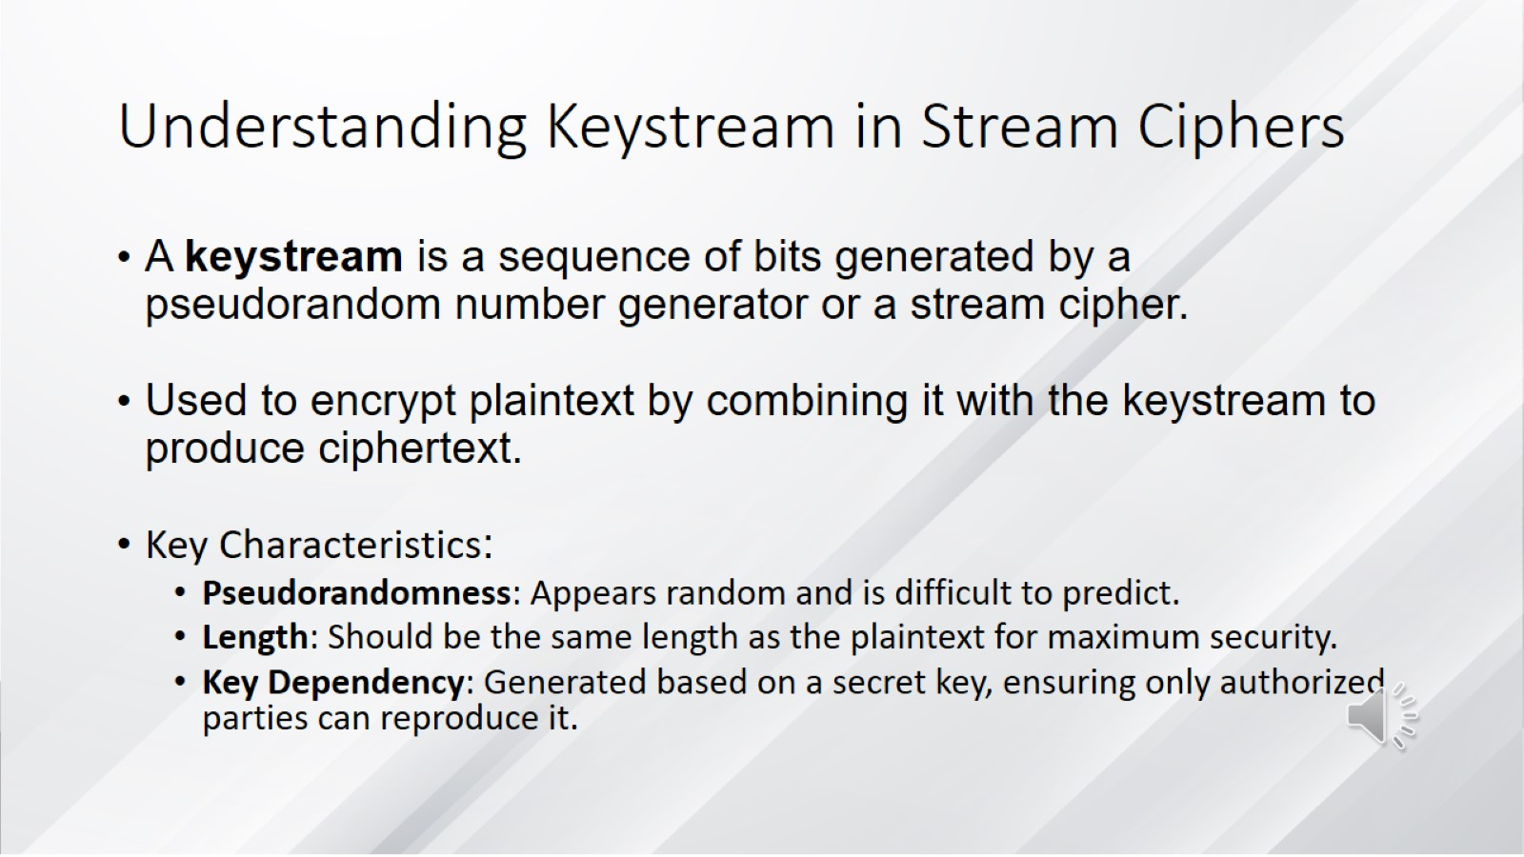
Understanding Keystream in Stream Ciphers

Slide 8
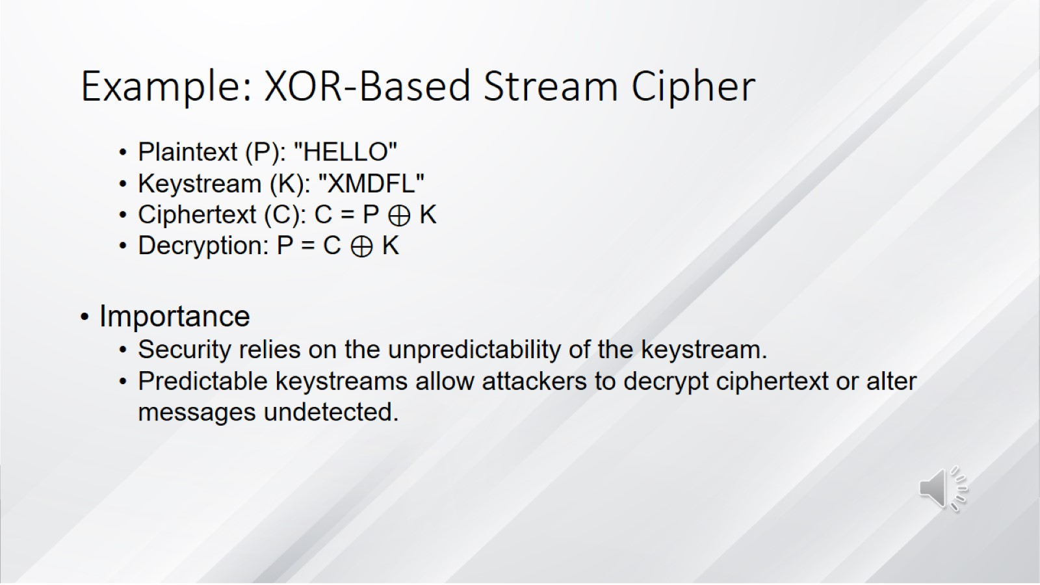
Example: XOR-Based Stream Cipher

Slide 9
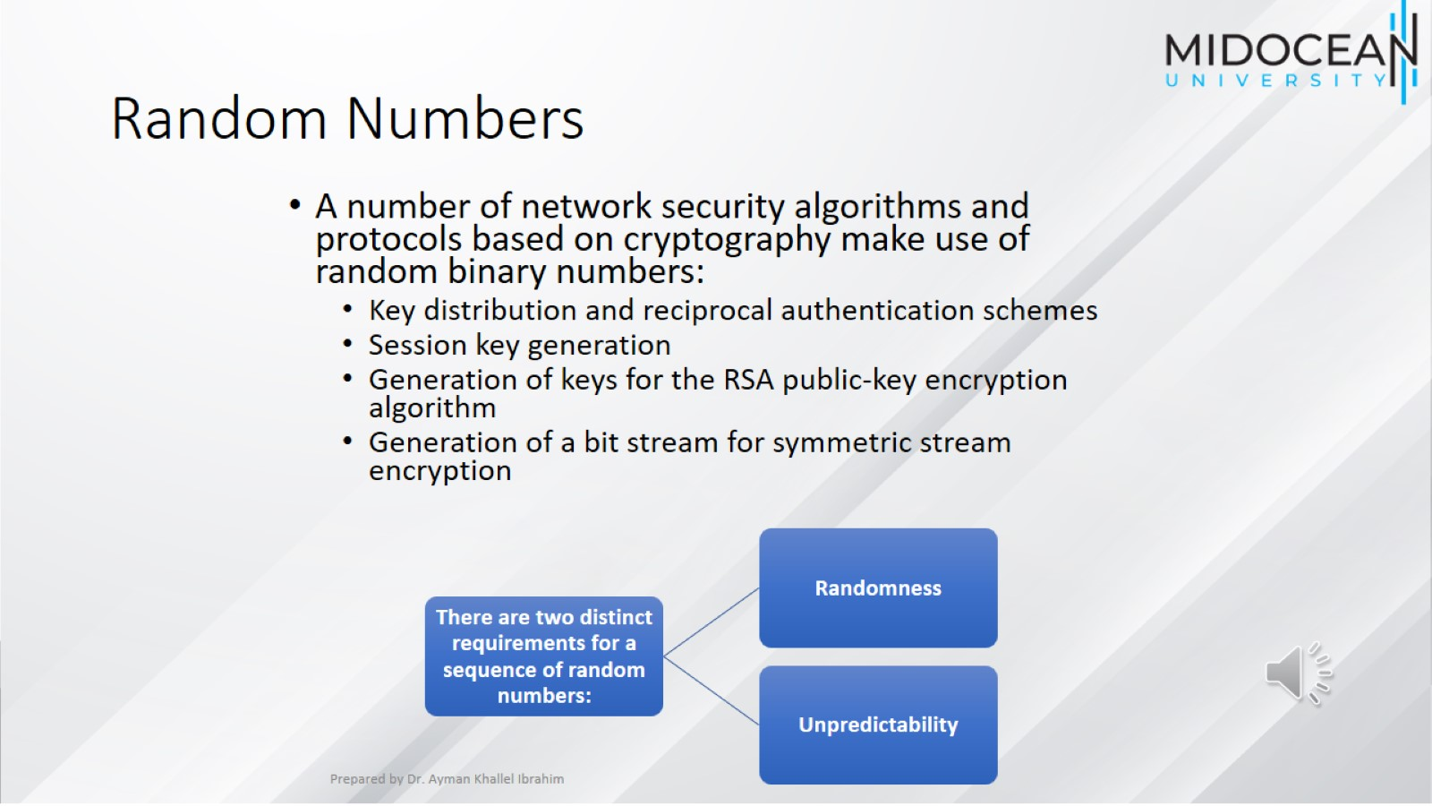
Random Numbers

Slide 10
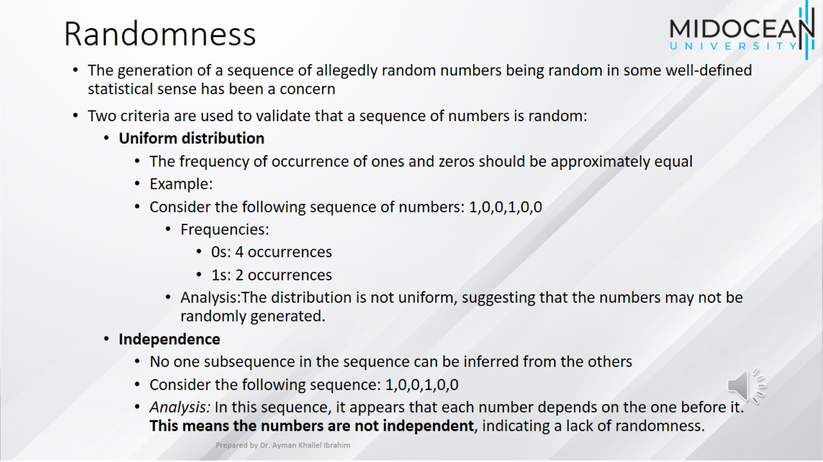
Randomness

Slide 11
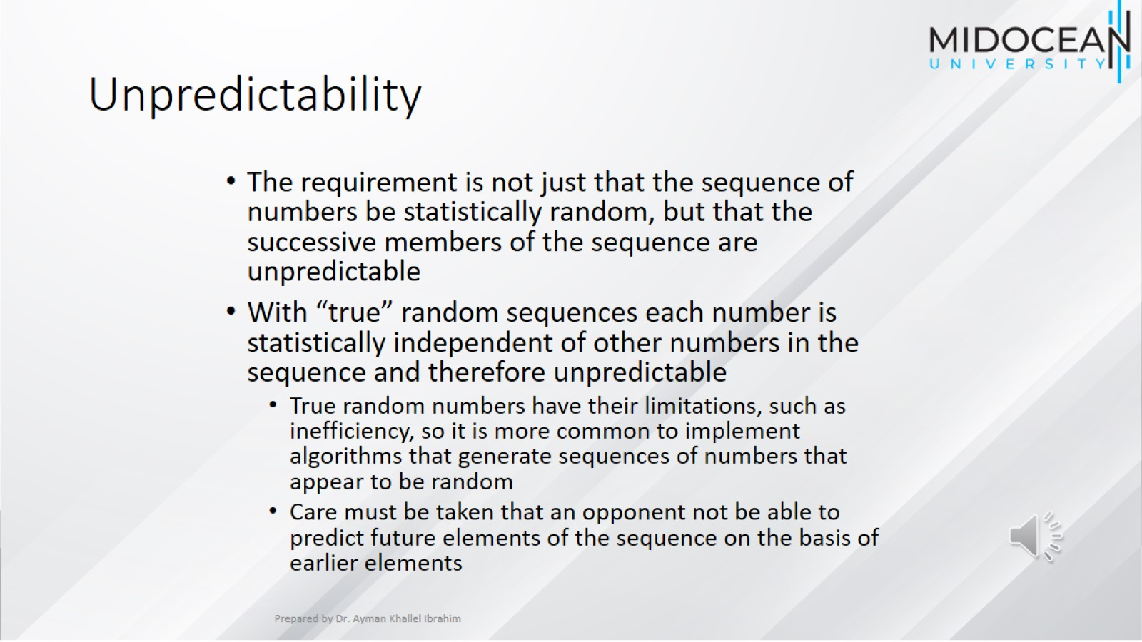
Unpredictability

Slide 12
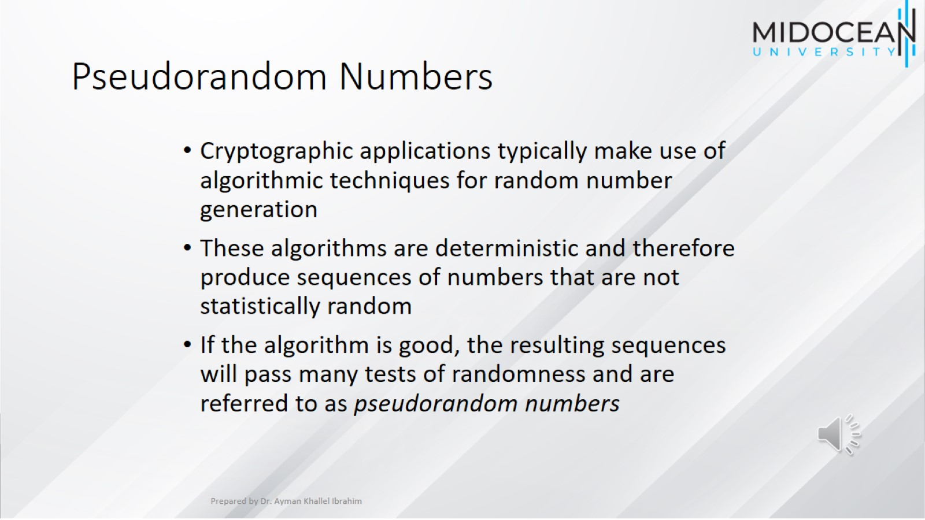
Pseudorandom Numbers

Slide 13
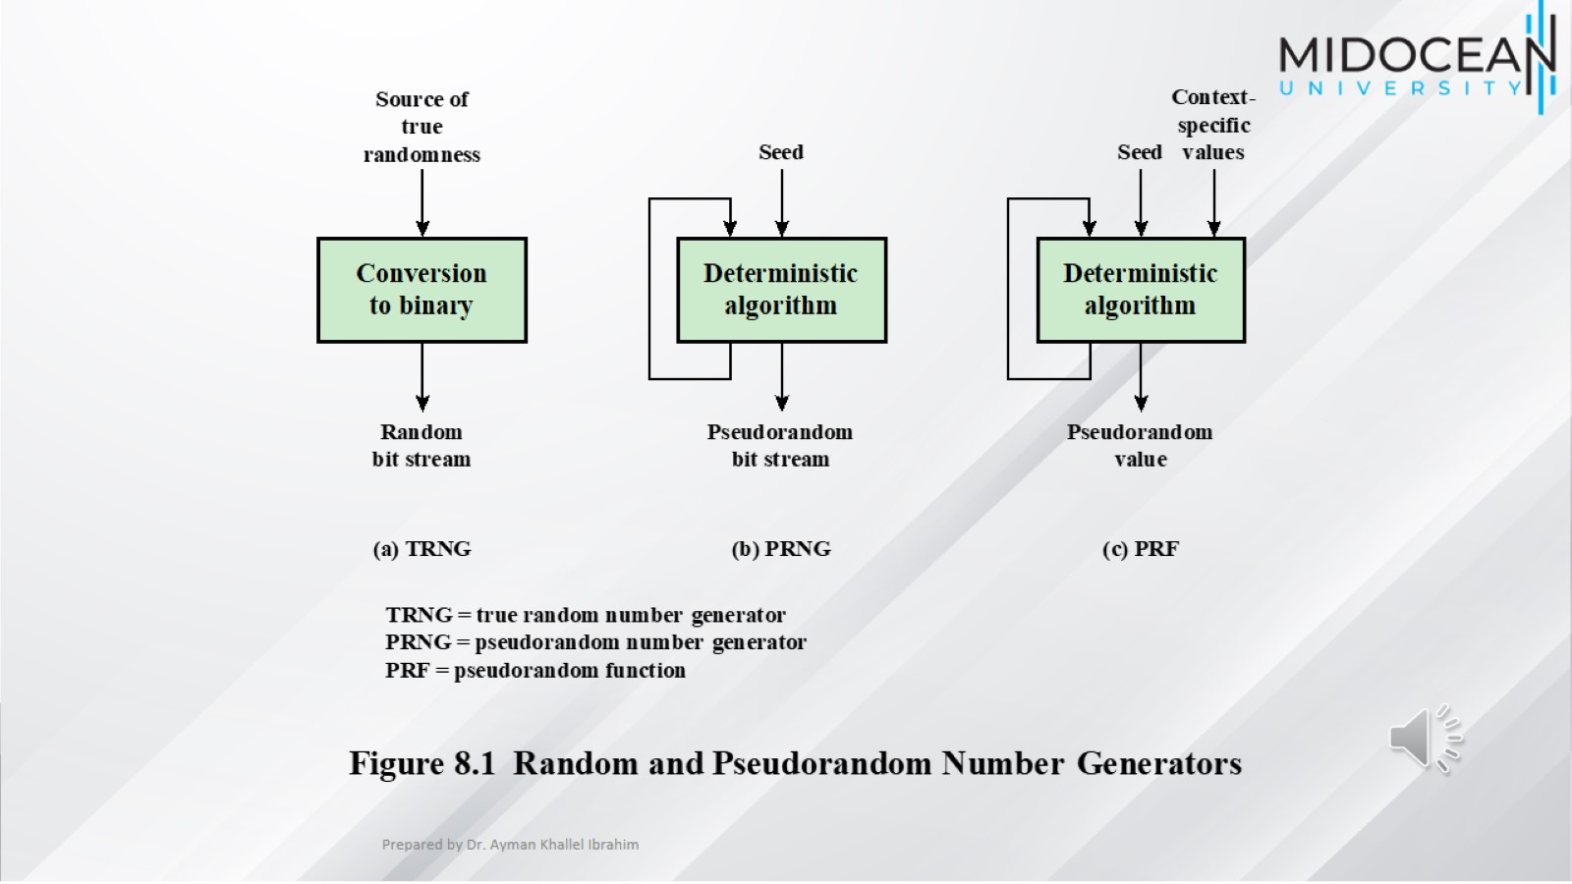

Slide 14
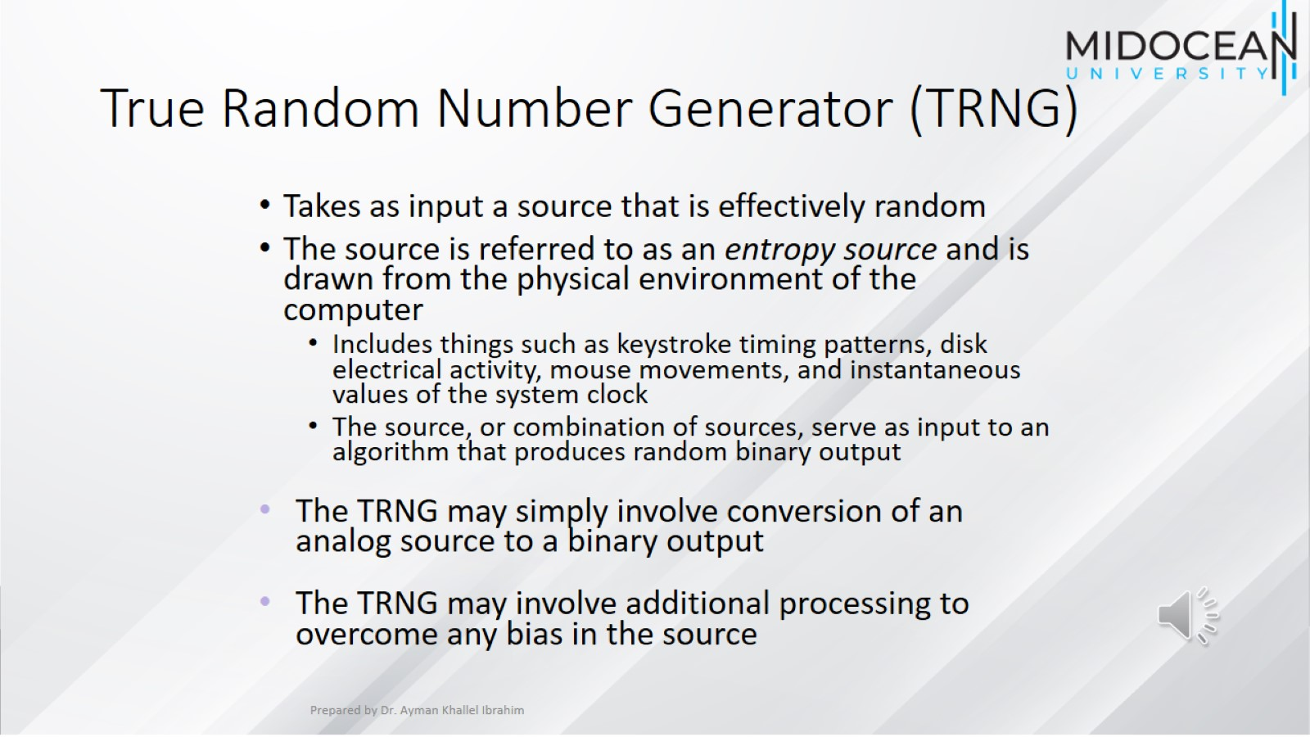
True Random Number Generator (TRNG)

Slide 15
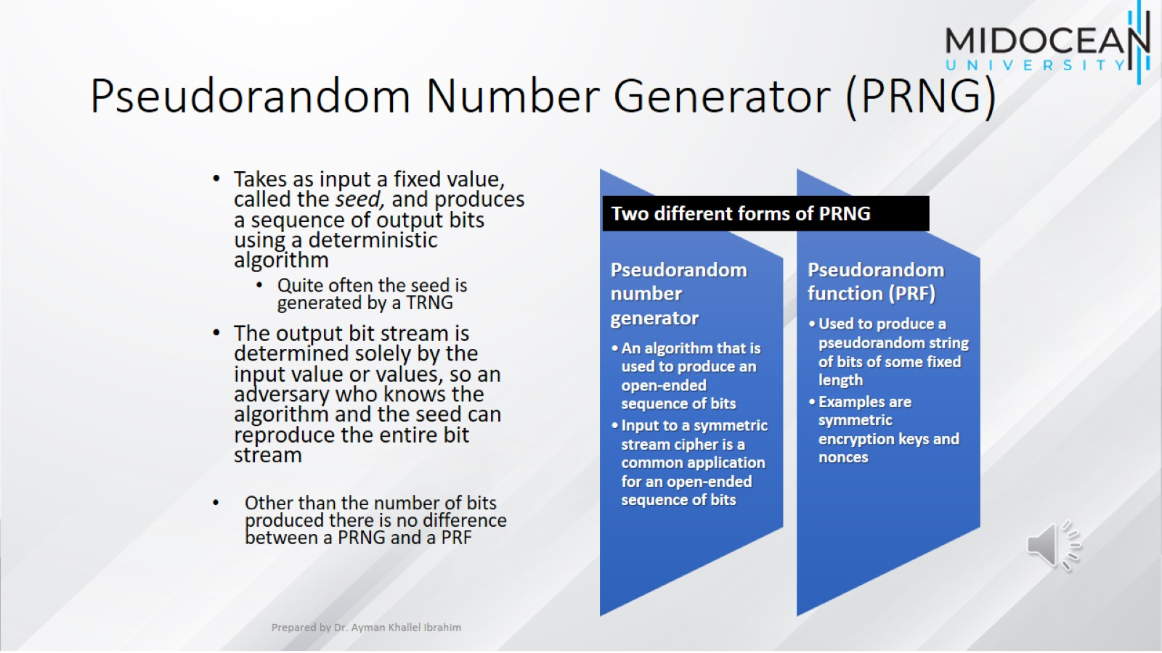
Pseudorandom Number Generator (PRNG)

Slide 16
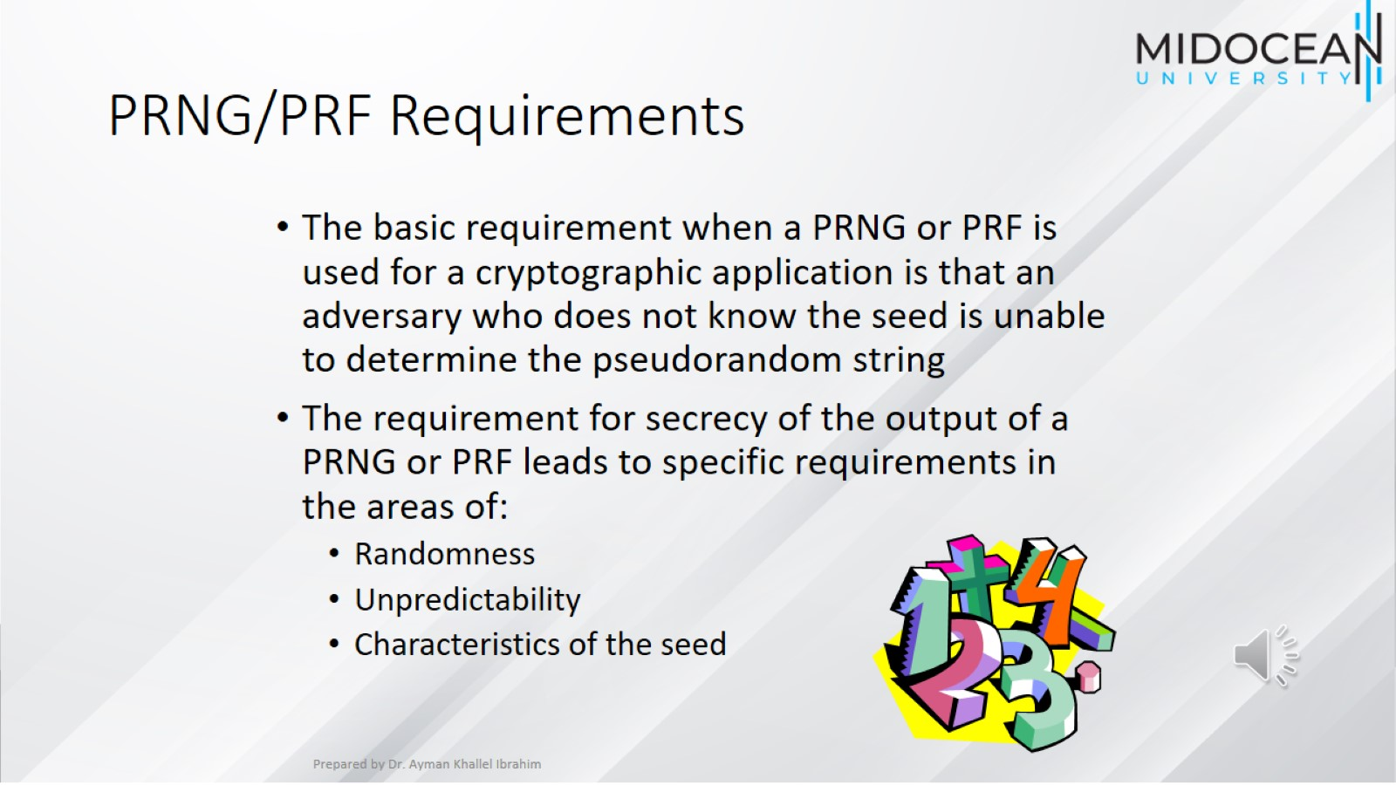
PRNG/PRF Requirements

Slide 17
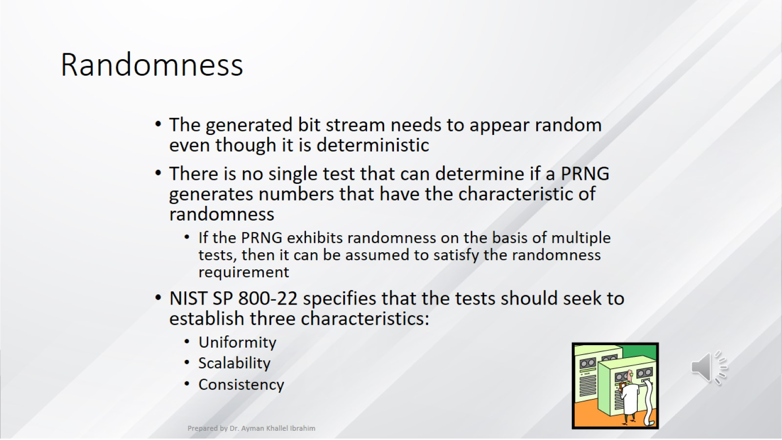
Randomness

Slide 18
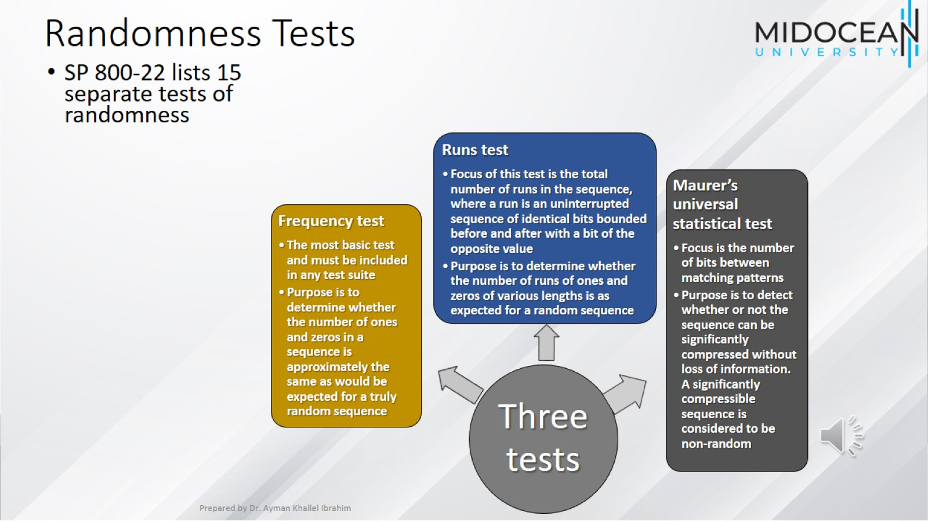
Randomness Tests

Slide 19
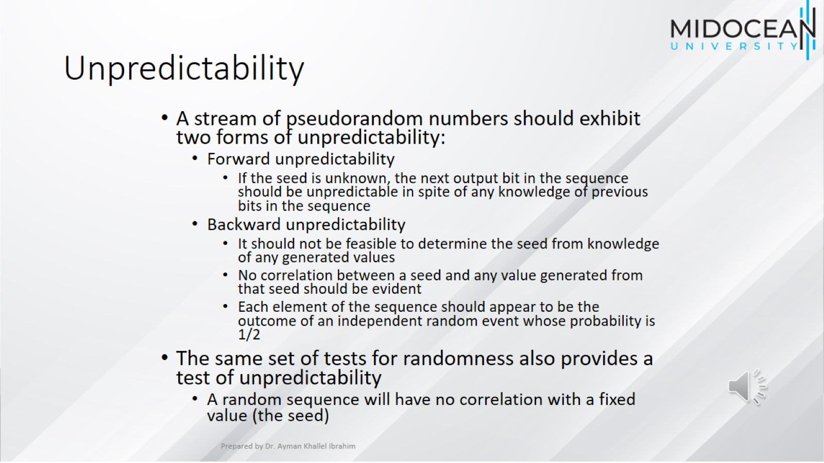
Unpredictability

Slide 20
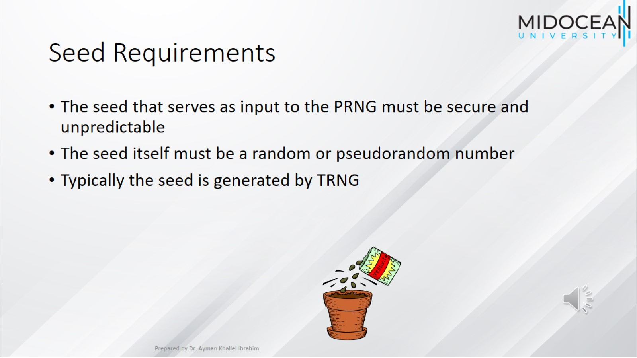
Seed Requirements

Slide 21
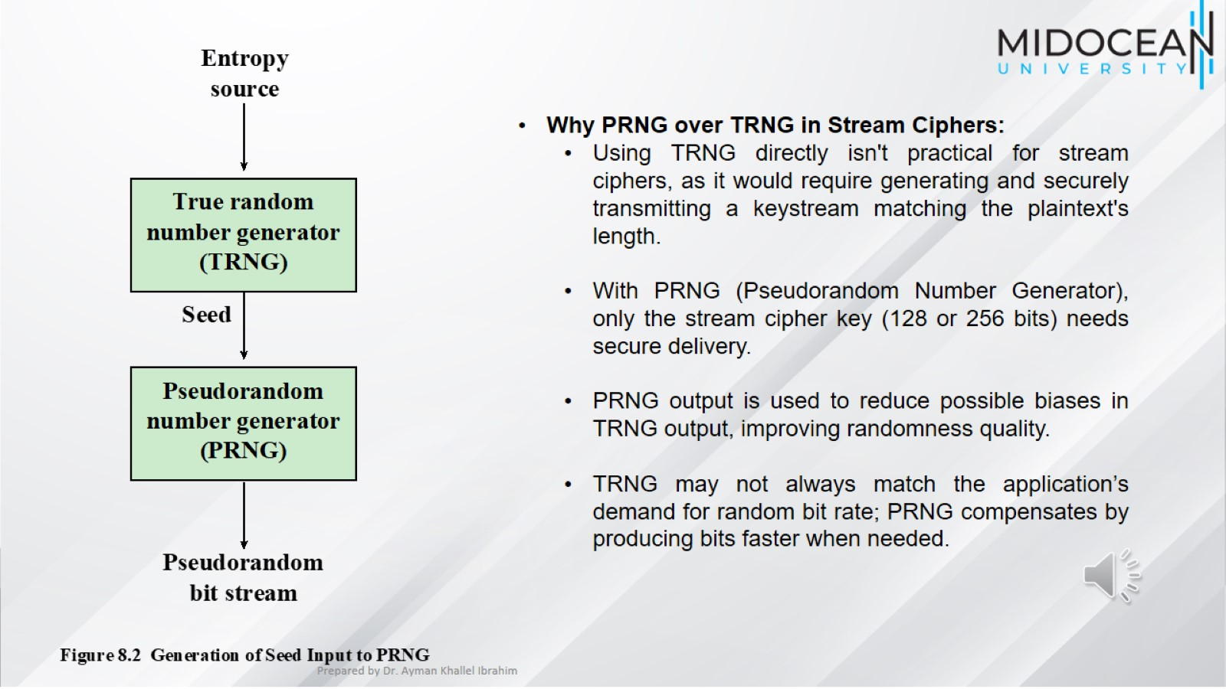

Slide 22
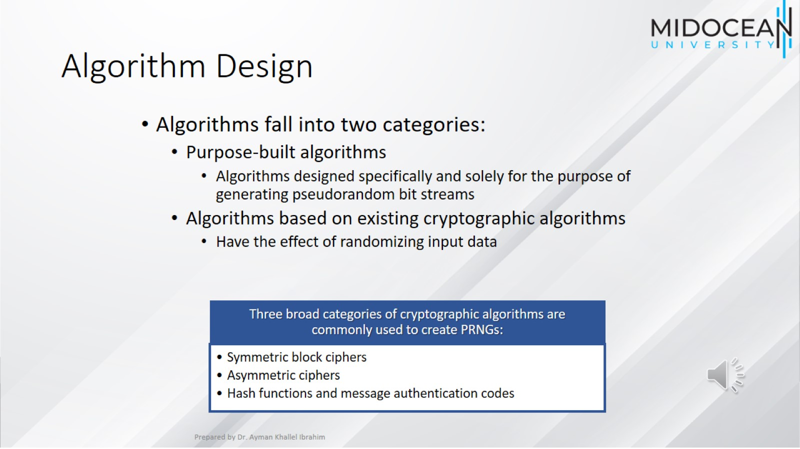
Algorithm Design

Slide 23
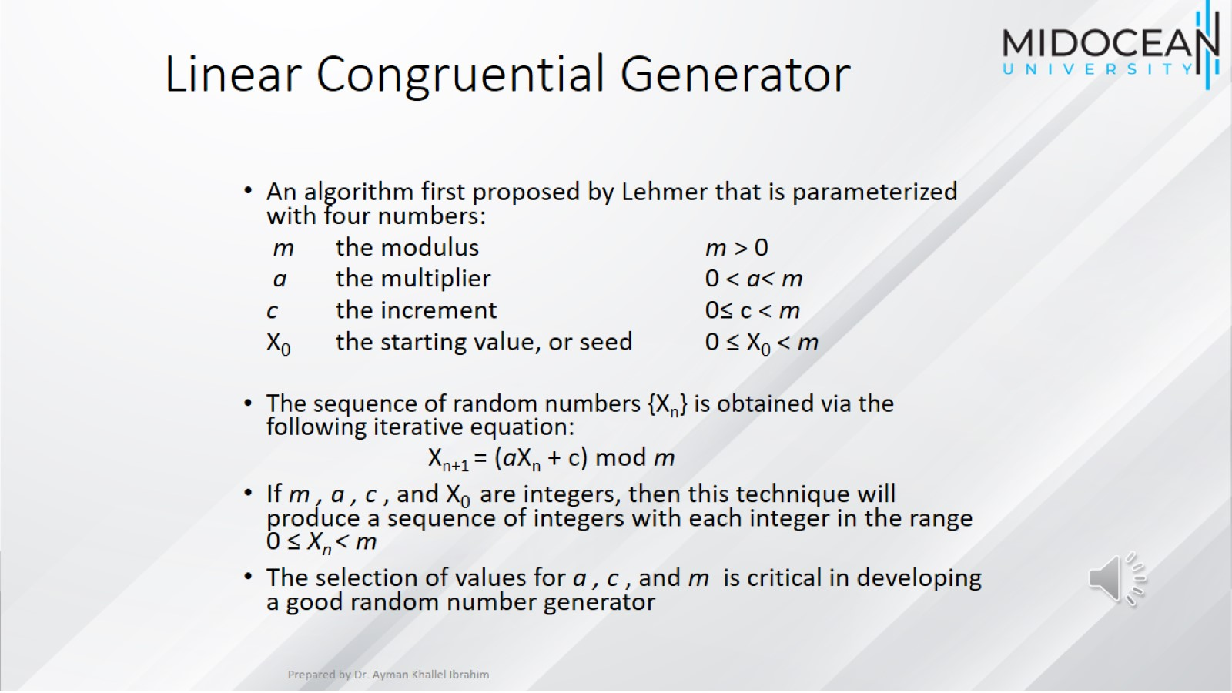
Linear Congruential Generator

Slide 24
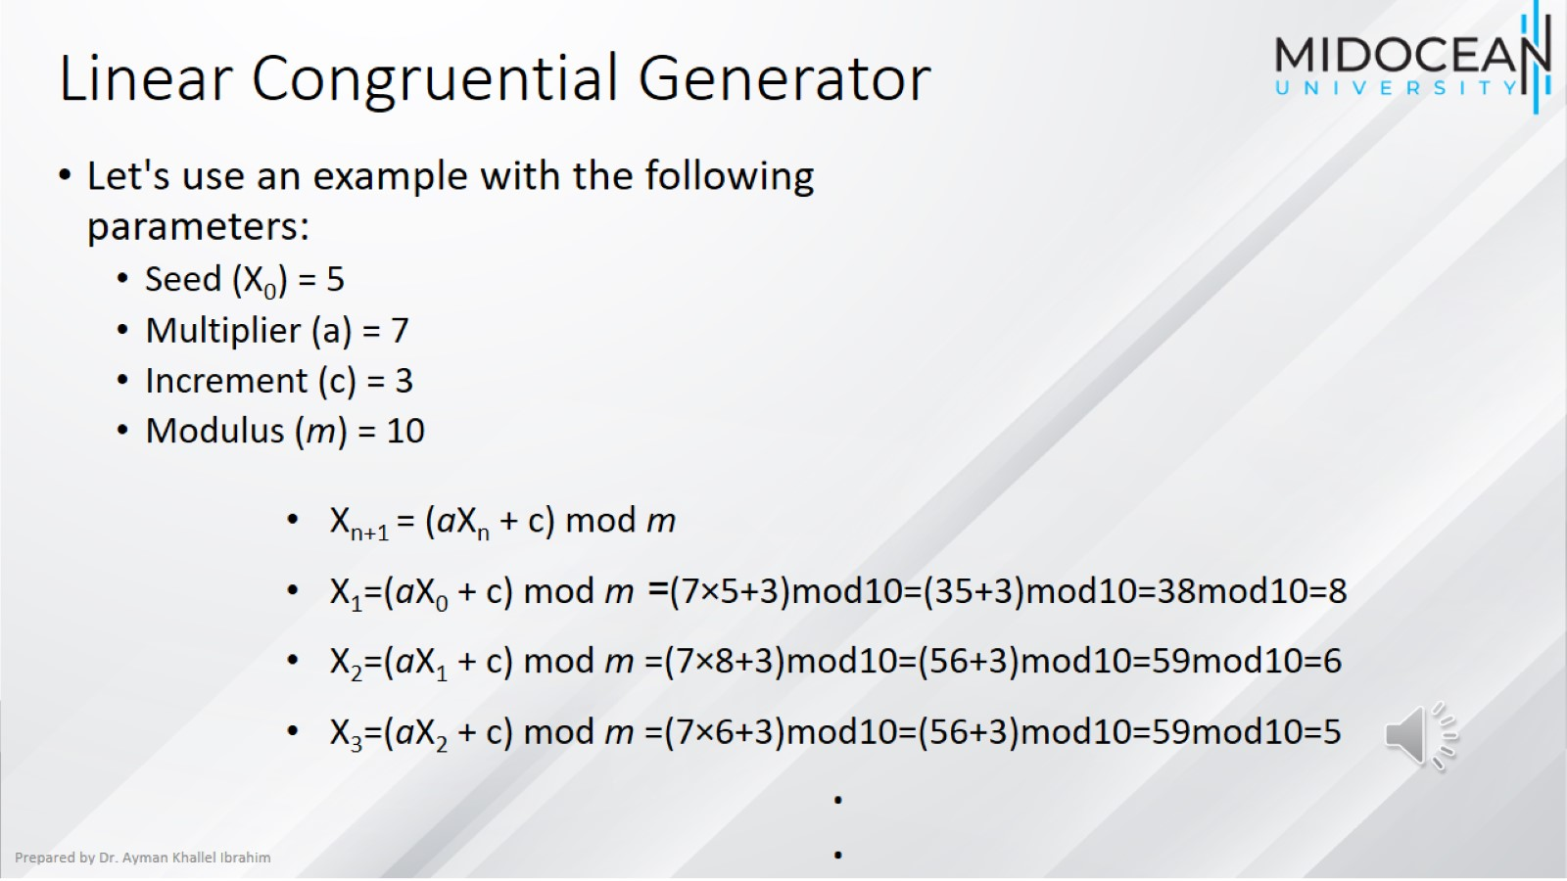
Linear Congruential Generator

Slide 25
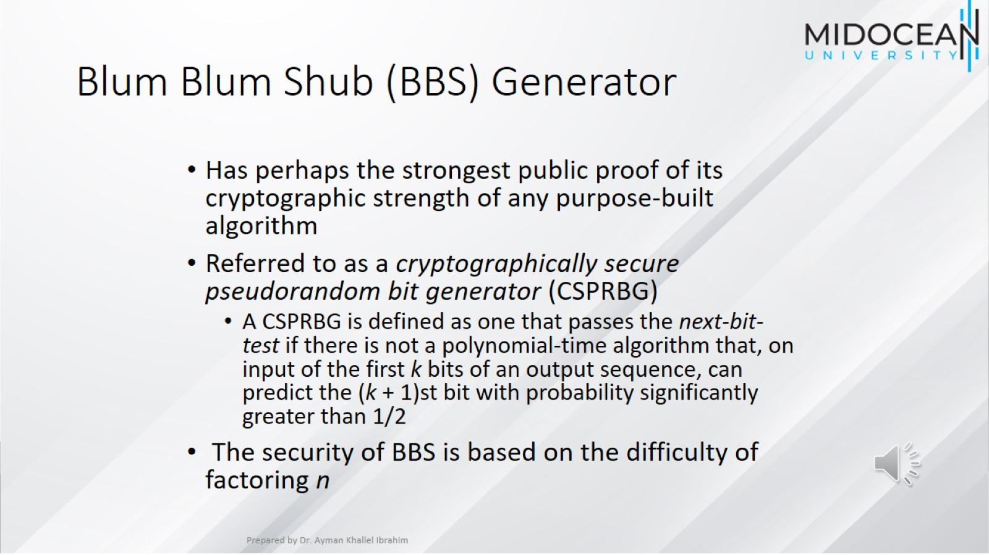
Blum Blum Shub (BBS) Generator

Slide 26
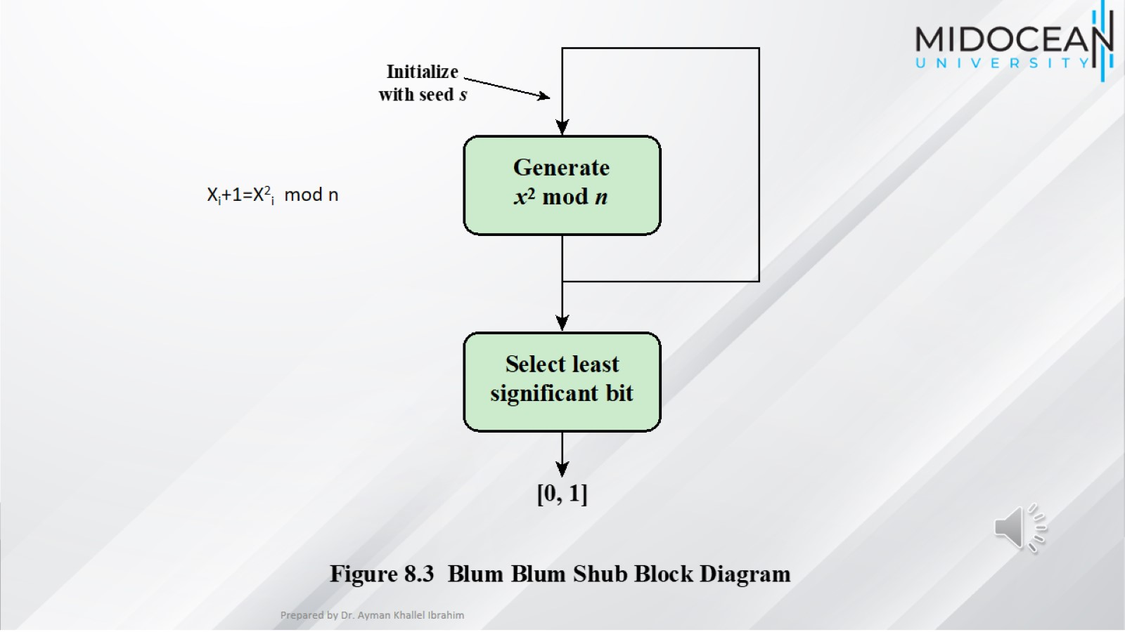

Slide 27
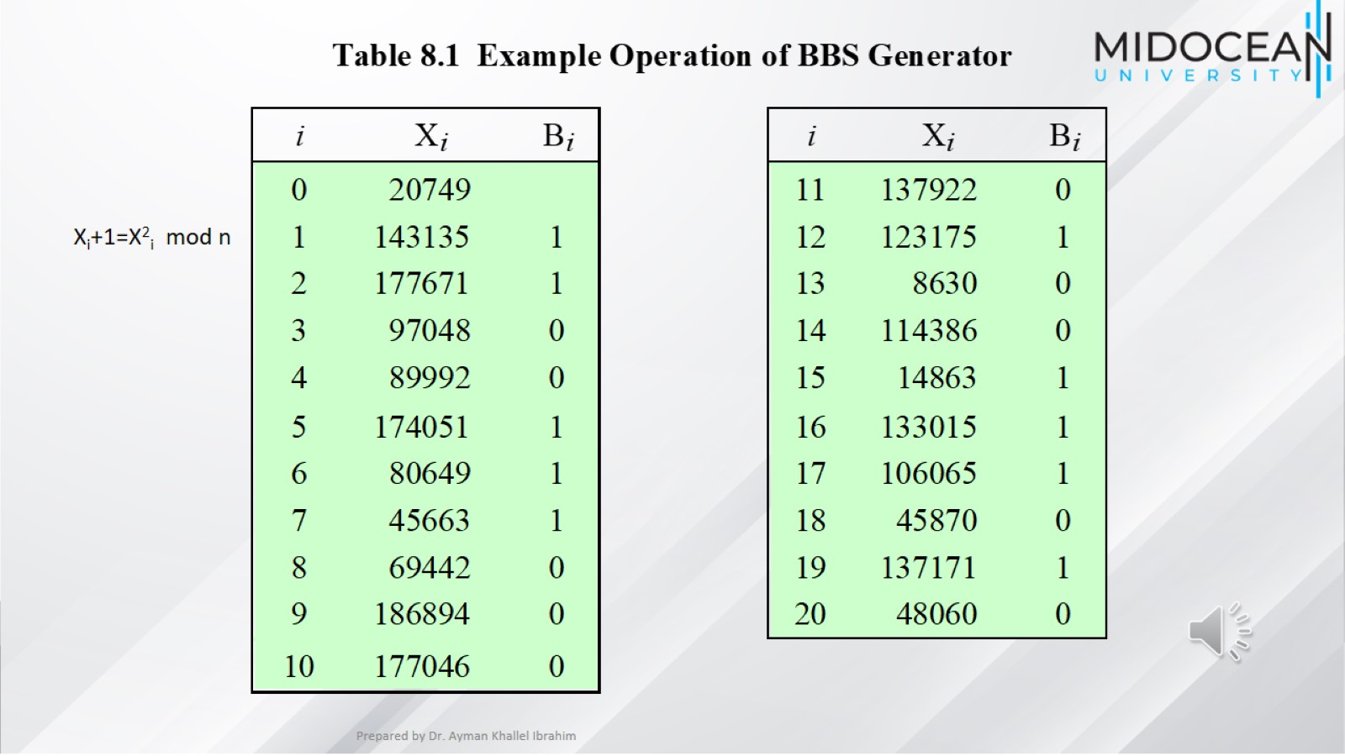

Slide 28
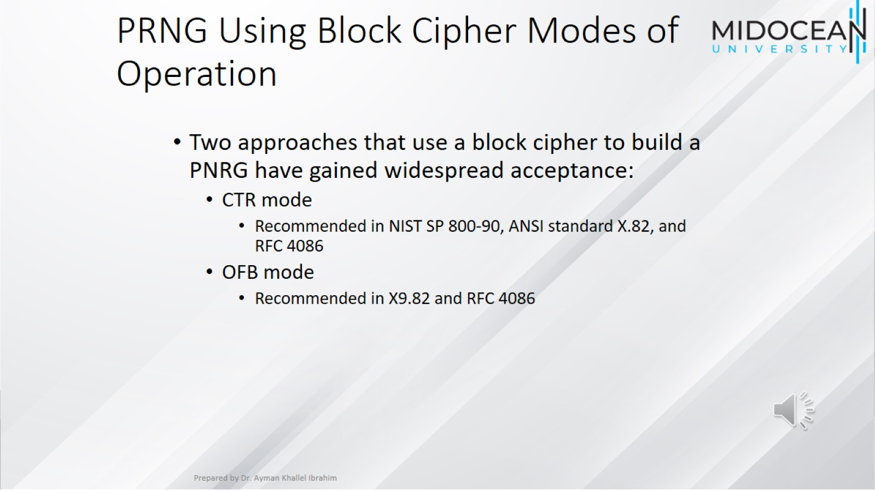
PRNG Using Block Cipher Modes of Operation

Slide 29
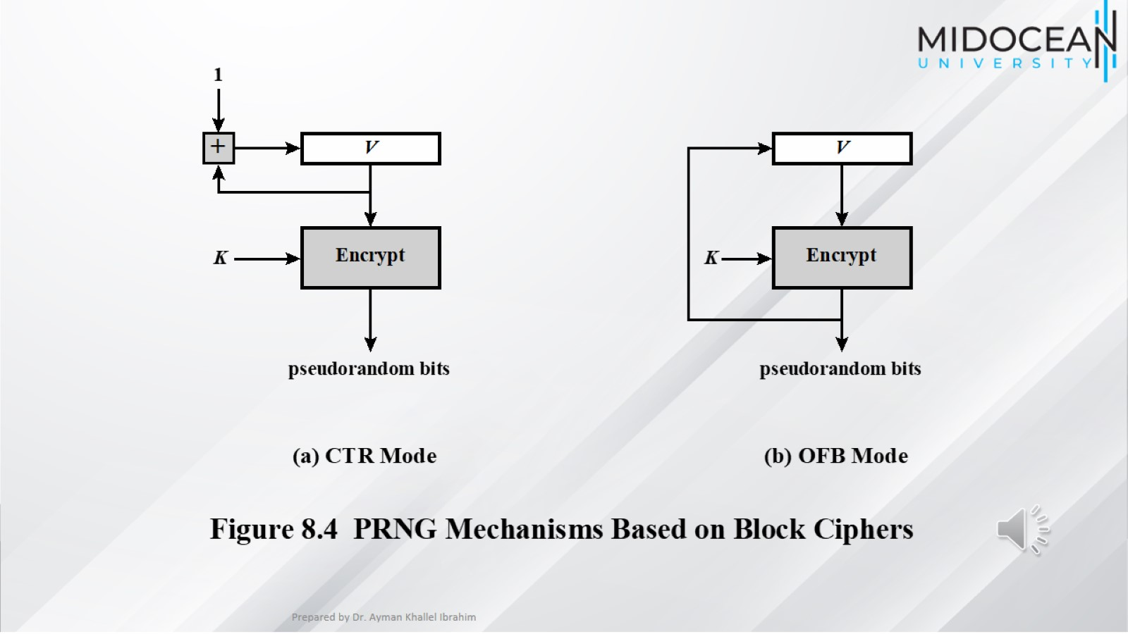

Slide 30
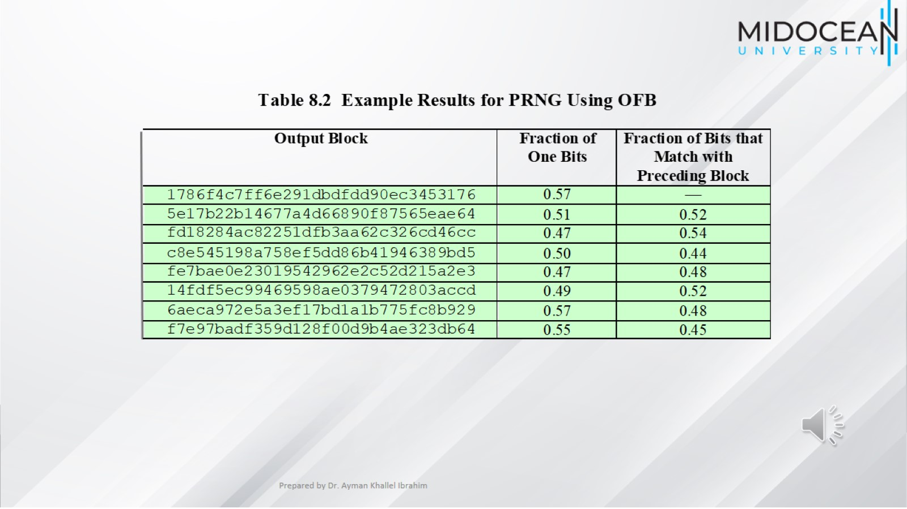

Slide 31
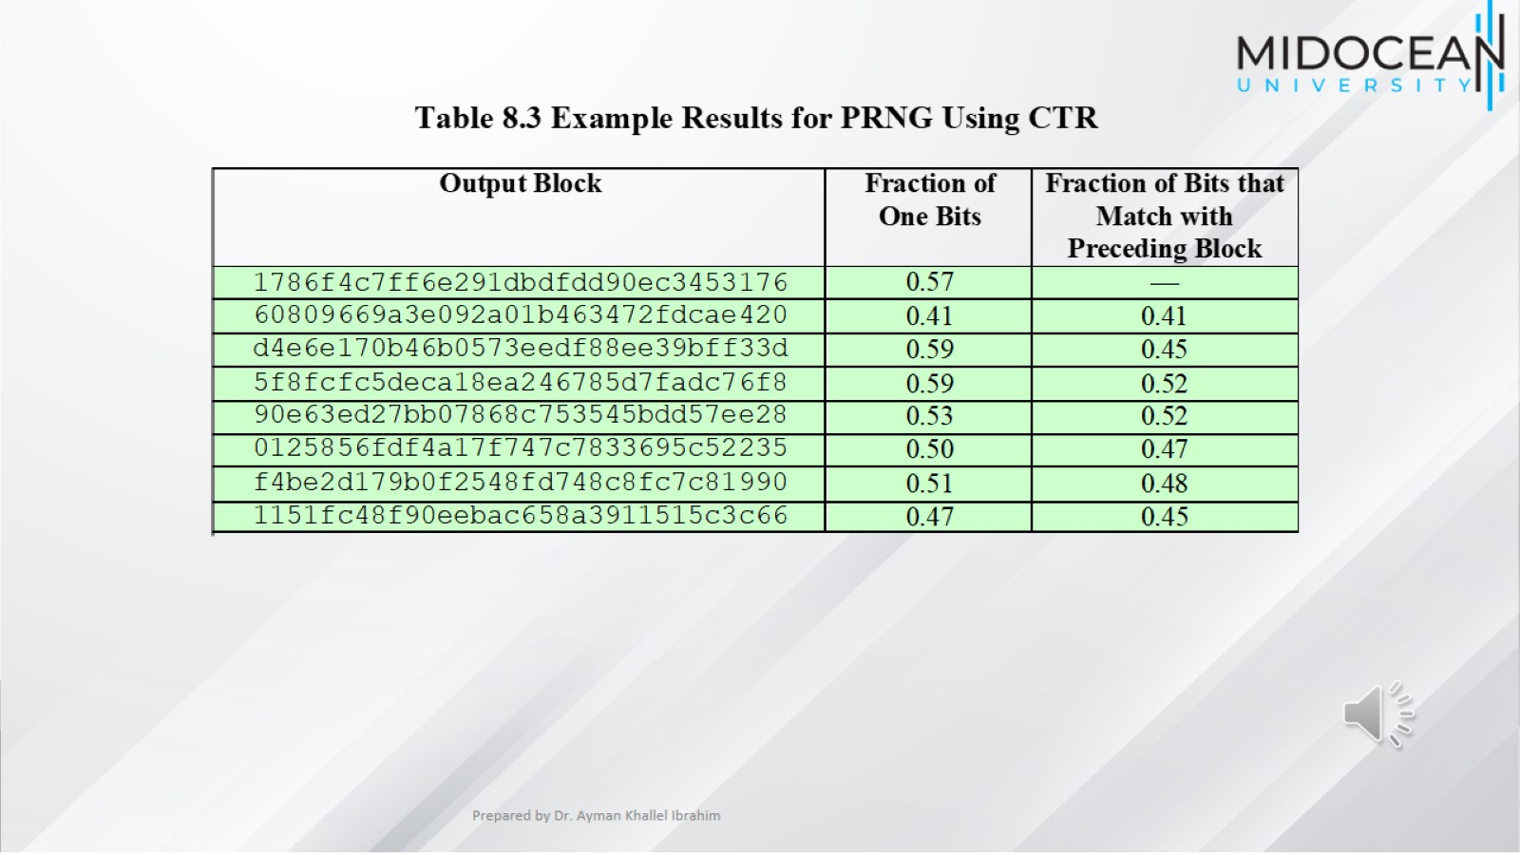

Slide 32
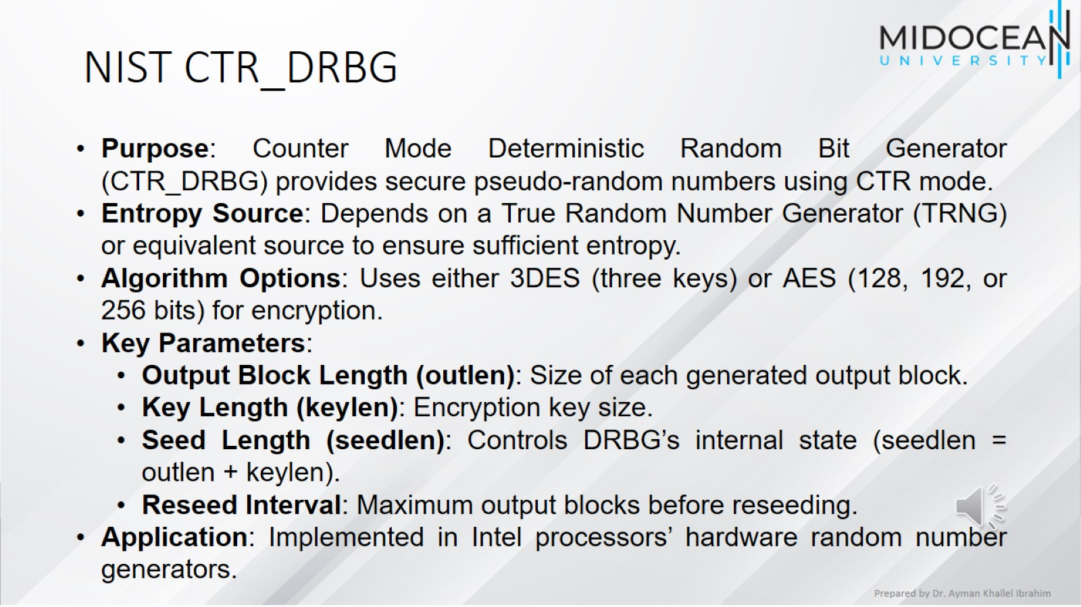
NIST CTR_DRBG

Slide 33
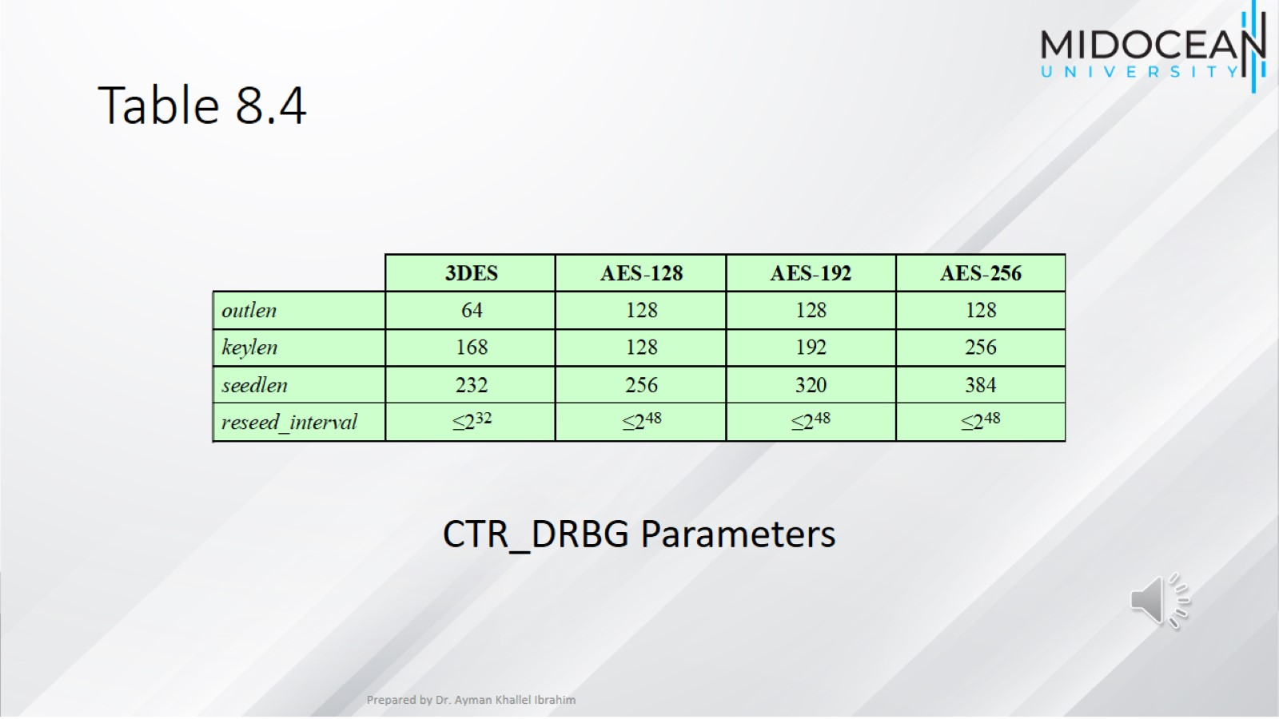
Table 8.4

Slide 34
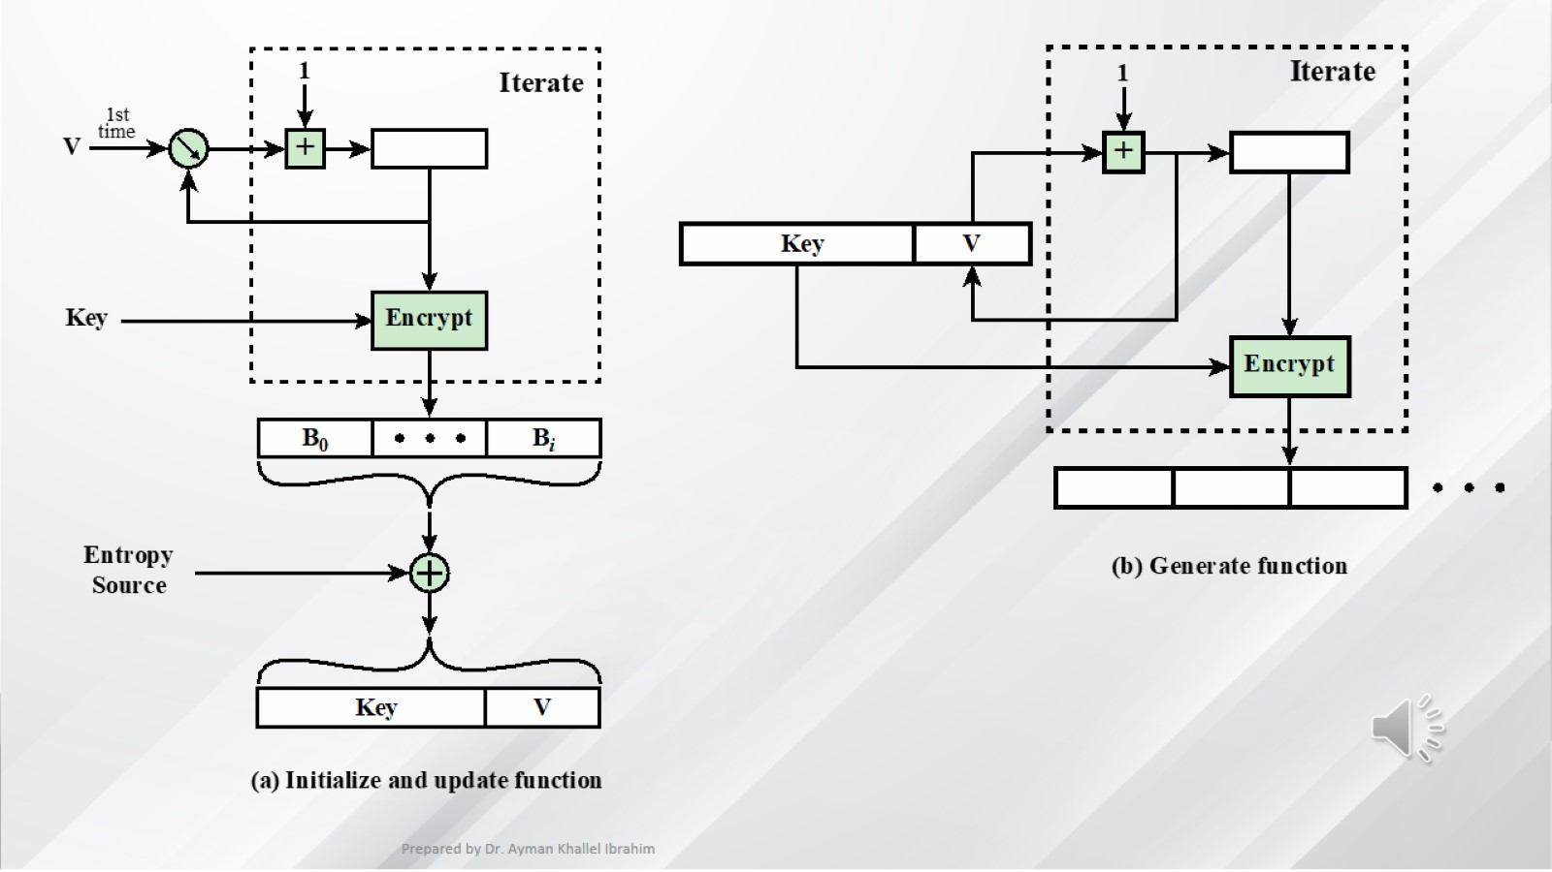

Slide 35
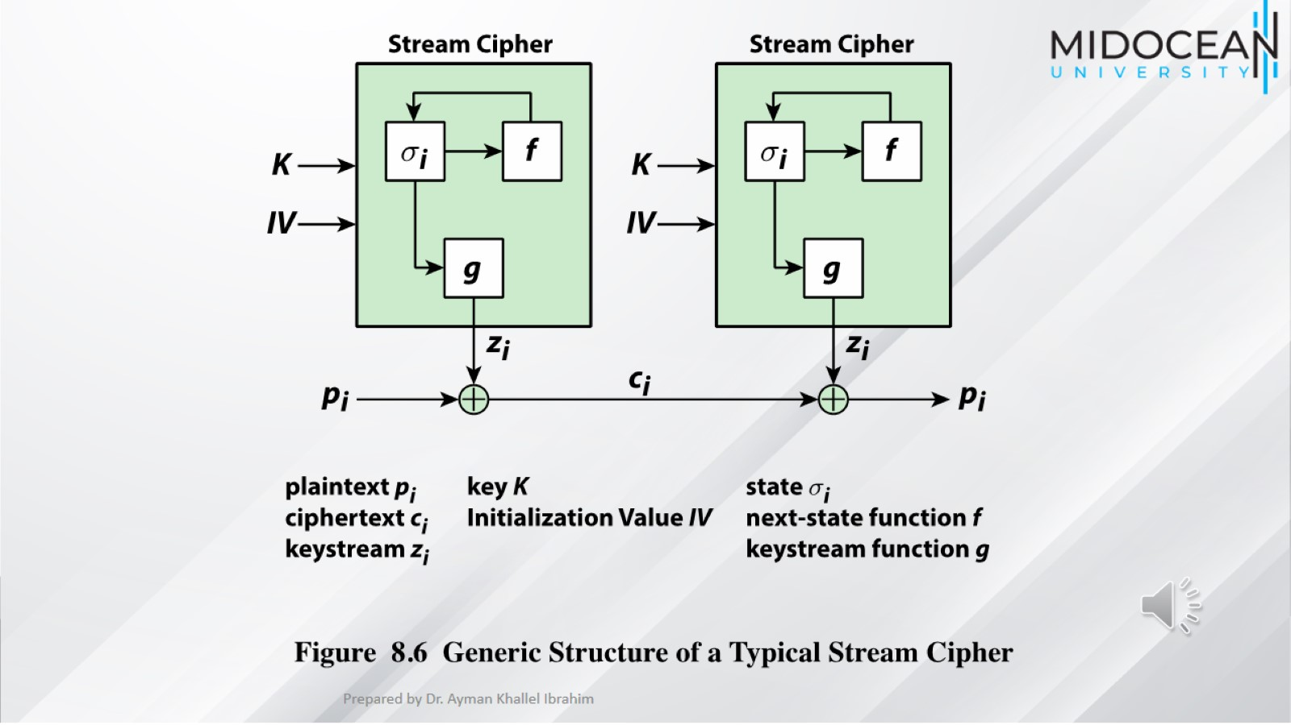

Slide 36
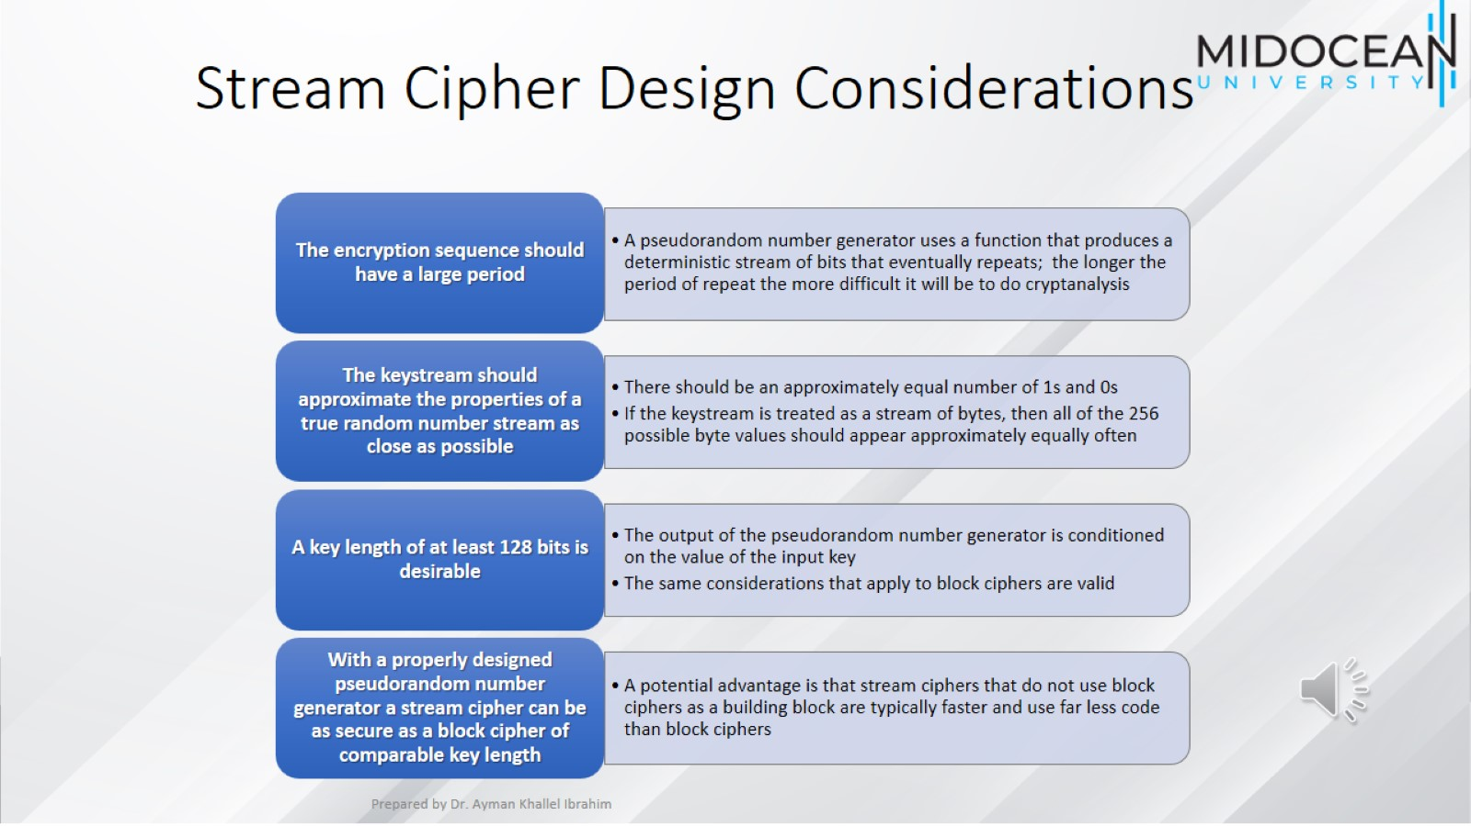
Stream Cipher Design Considerations

Slide 37
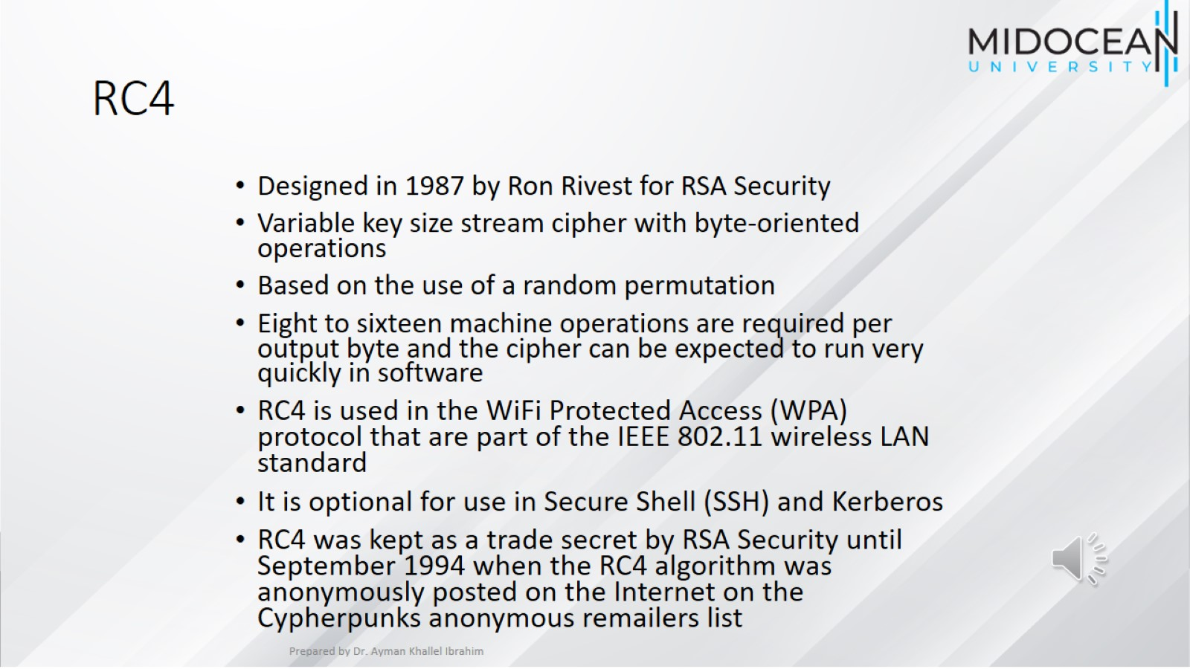
RC4

Slide 38
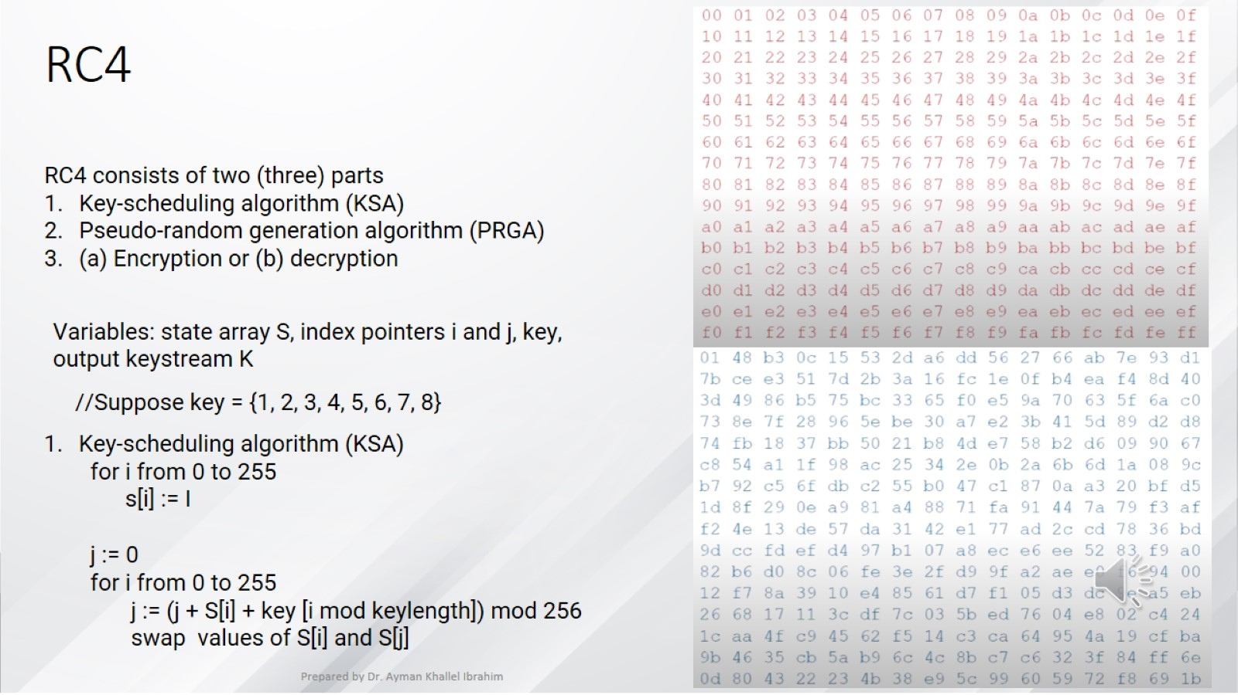
RC4

Slide 39
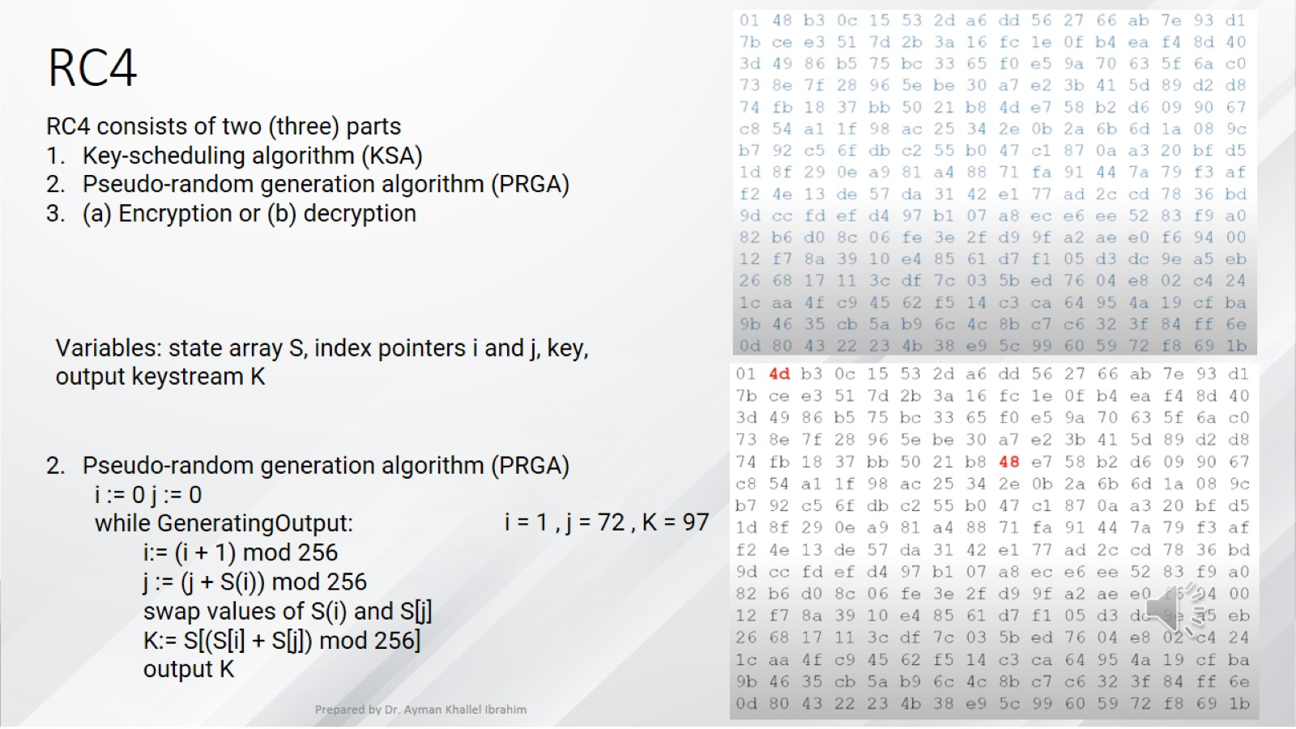
RC4

Slide 40
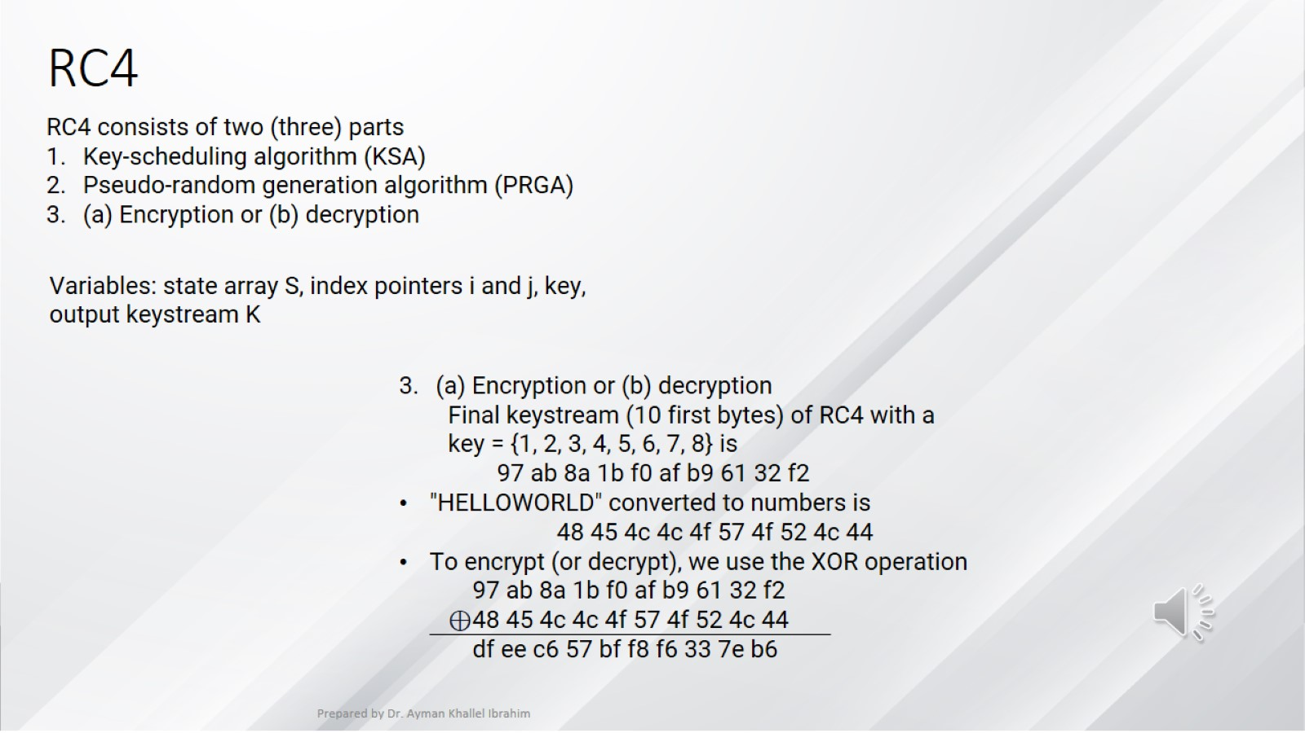
RC4

Slide 41
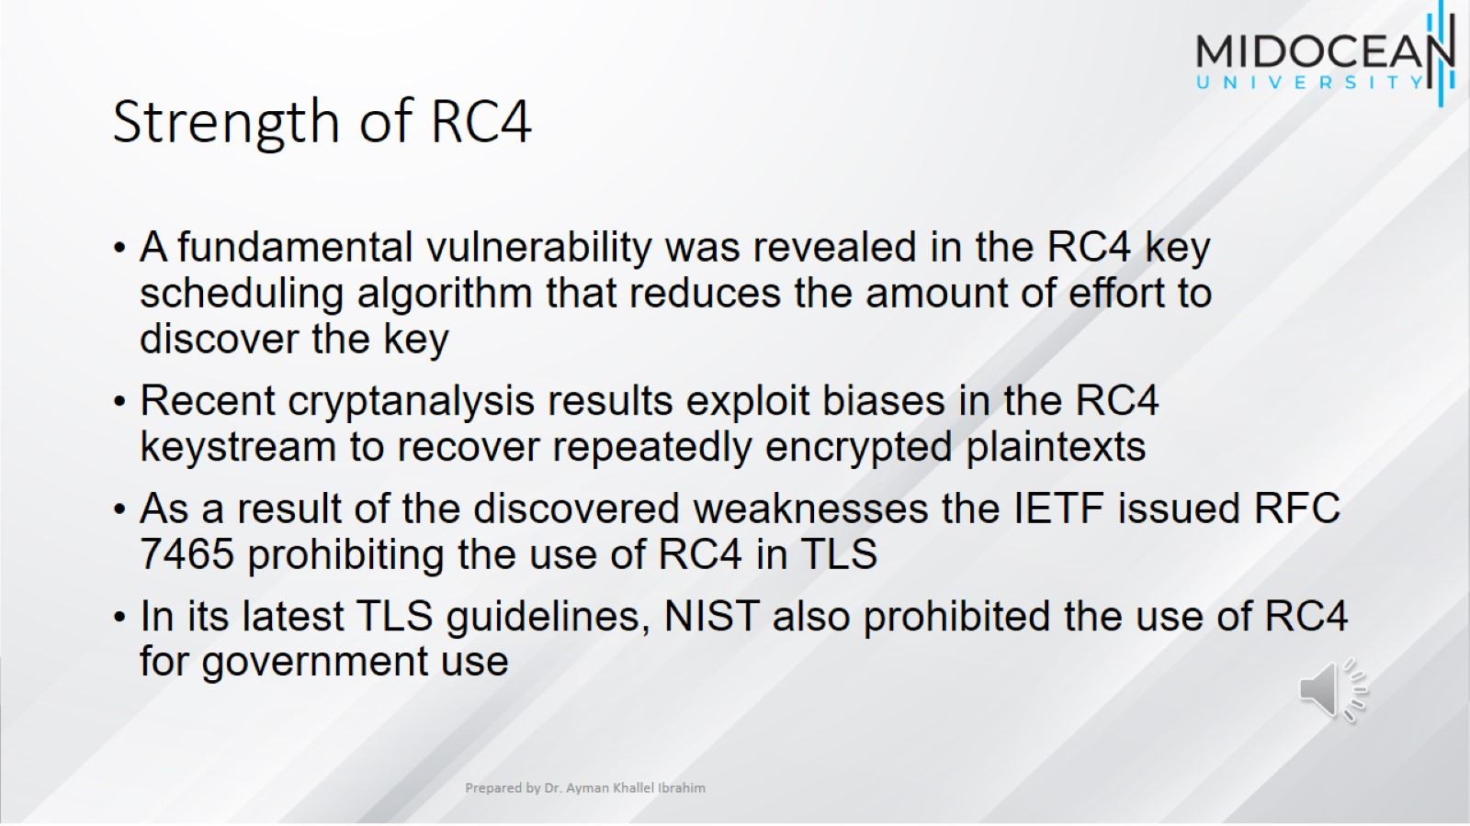
Strength of RC4

Slide 42
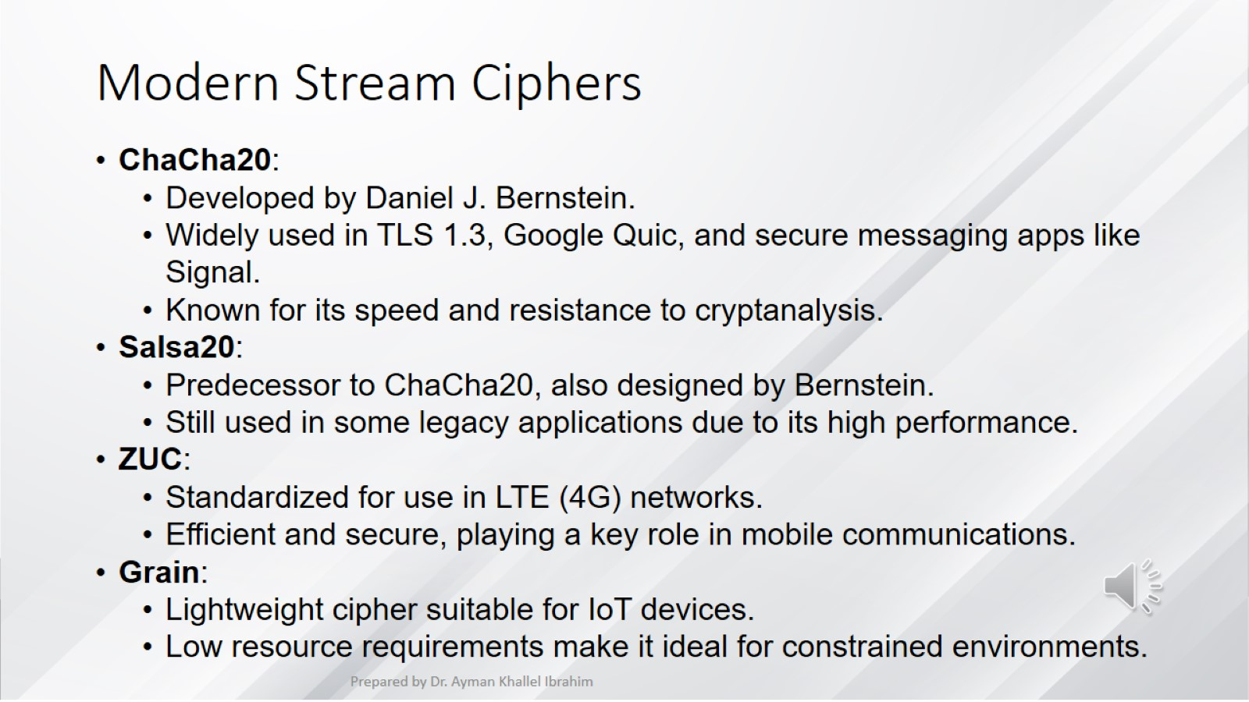
Modern Stream Ciphers

Slide 43
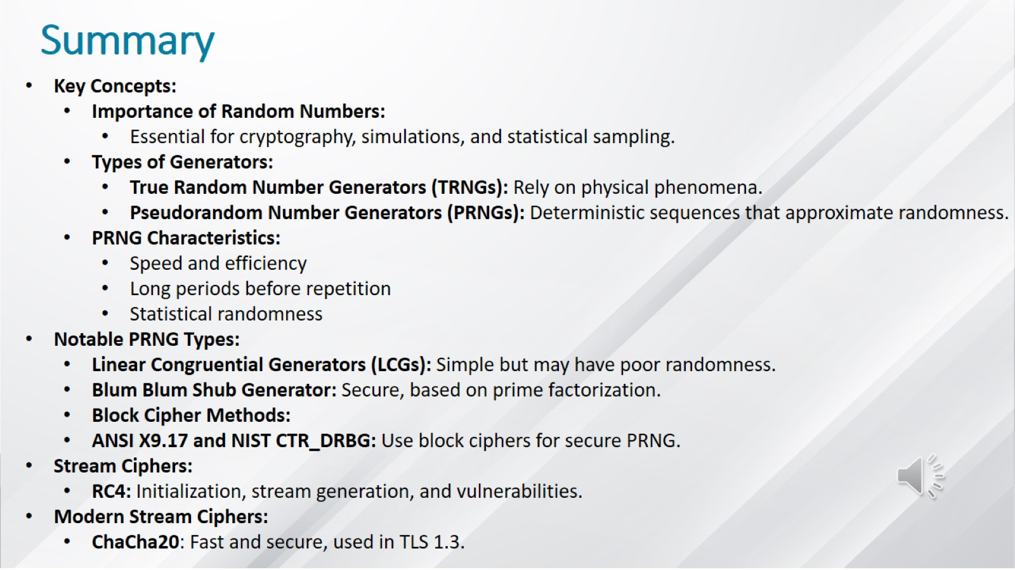
Summary

Slide 44


