Slide 1


Cybersecurity Law, Policy, and Ethics
Master of Science in Cybersecurity
Orientation show
عرض توجيهي
Dr. Kamal Alieyan
Everyone Smart University
Faculty of IT - 2022

Slide 2
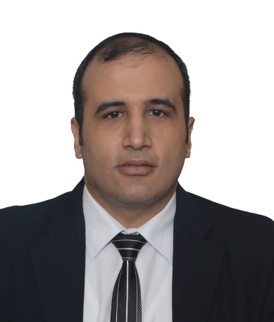

Who Am I?
Dr. Kamal Alieyan
  Assistant Professor in Cybersecurity
    Ph.D from USM, Malaysia, Jun. 2018.
    M.Sc from “University of Arab Academy for Banking and Financial Science”/ Jordan, Sep.2005.
    B.Sc from “Mu’tta University” / Jordan, Jun.2003.
Cybersecurity Law, Policy and Ethics, Dr. Kamal Alieyan, Summer 2022

Slide 3



Who Am I?
  How to reach me
    By email at kamal@esu.ac.ae
    ( please include “Cybersecurity Law, Policy and Ethics” in subject line)
  Office hours
  Discussion Time (Monday at 9:00 PM) every week
https://scholar.google.com/scholar?hl=en&as_sdt=0%2C5&q=Kamal+Alieyan&btnG=&oq=kama
https://www.scopus.com/authid/detail.uri?authorId=57000386100
https://orcid.org/0000-0002-9021-3151
Cybersecurity Law, Policy and Ethics, Dr. Kamal Alieyan, Summer 2022

Slide 4
The course that will be taught

Slide 5
Primary Goal of This Course
  This course provides an overview of the broad and constantly emerging field of cybersecurity ethics, governance, law, and compliance.
  The importance of the role of security policy is discussed.

Slide 6
Outline of Course
This course aims to:
  Provide students with concepts of:-
  Introduction to Cyberethics
  Ethical Issues in Cybersecurity
  Cybersecurity Ethics: Cyberspace and Other Applications
  Introduction to Cyber laws
  Risks in Cybersecurity
  Cyber Risks and Cyber Insurance
  Introduction to Cybersecurity Policies

Slide 7
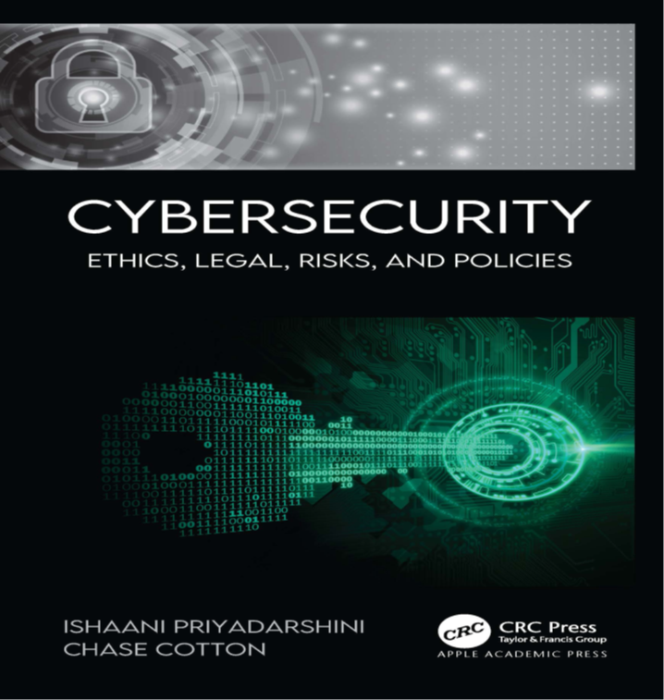
Learning Resources:
Credit Hours:
3 credit hours.
  Required Textbook:
  Apple Academic Press (2021). Cybersecurity Law Policy And Ethics. By Ishaani Priyadarshini, and Chase Cotton.
  Additional Reference:
Springer (2020). The Ethics of Cybersecurity. By Markus Christen, Bert Gordijn, and Michele Loi.

Slide 8
Units of Course Contents
  Lecture Structure:
Module | Course Unit | No.of. Weeks | Contact Hours
1 | Lecture_1 Introduction to Cyberethics | 1st | 3
2 | Lecture_2 Introduction to Cyberethics (2) | 2nd | 3
3 | Lecture_3 Ethical Issues in Cybersecurity | 3 | 3
4 | Lecture_4 Cybersecurity Ethics: Cyberspace and Other Applications | 4 | 3
5 | Lecture_5 Cybersecurity Ethics: Cyberspace and Other Applications (2) | 5 | 3
6 | Lecture_6 Introduction to Cyber laws | 6 | 3
7 | Lecture_7 Introduction to Cyber laws | 7 | 3
8 | Lecture_8 Risks in Cybersecurity | 8 | 3
9 | Lecture_9 Cyber Risks and Cyber Insurance | 9 | 3
10 | Lecture_10 Introduction to Cybersecurity Policies | 10 | 3

Slide 9
Course Information
  Assessment Method:
Short Exam
  80% marks
    Count of short Exam 10 (Weekly)
    8 Marks for every each of short Exam.
  20% Final Examination

Slide 10


Summer 2022

Slide 11
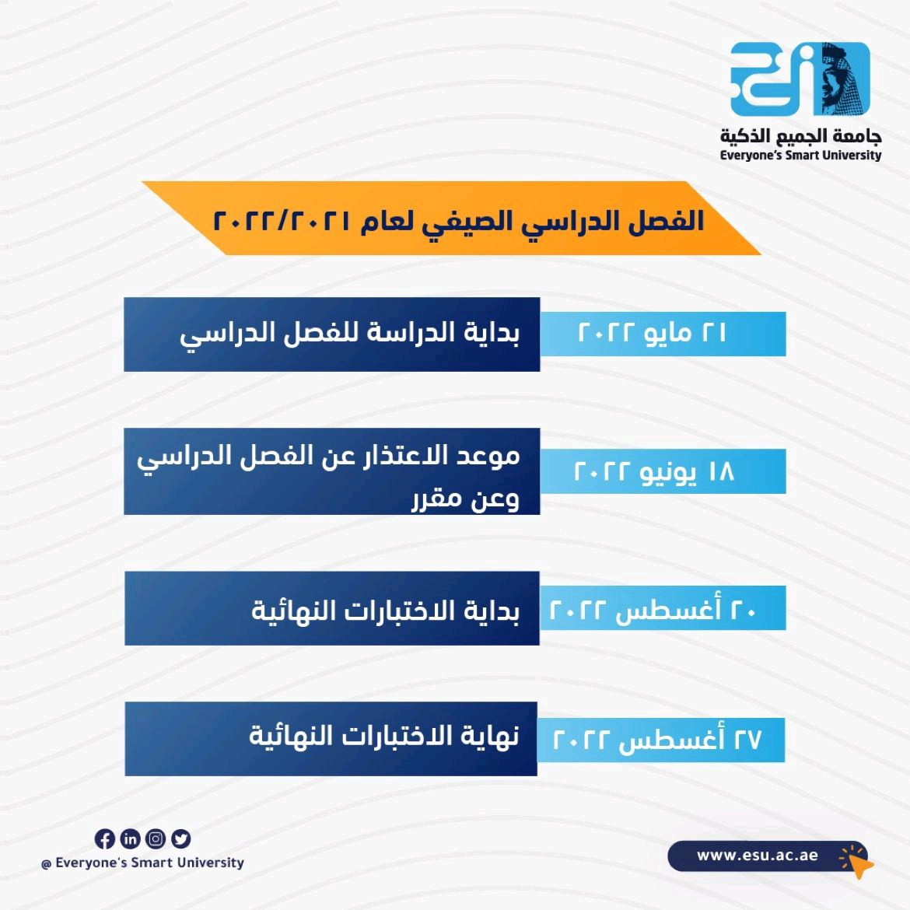
Academic Calendar

Slide 12
Academic Calendar
الفترة الزمنية التعليمية في الفصل الدراسي الصيف تكون مدة ١٣أسبوع
(منهم أسبوعين للاختبار النهائي)

Slide 13
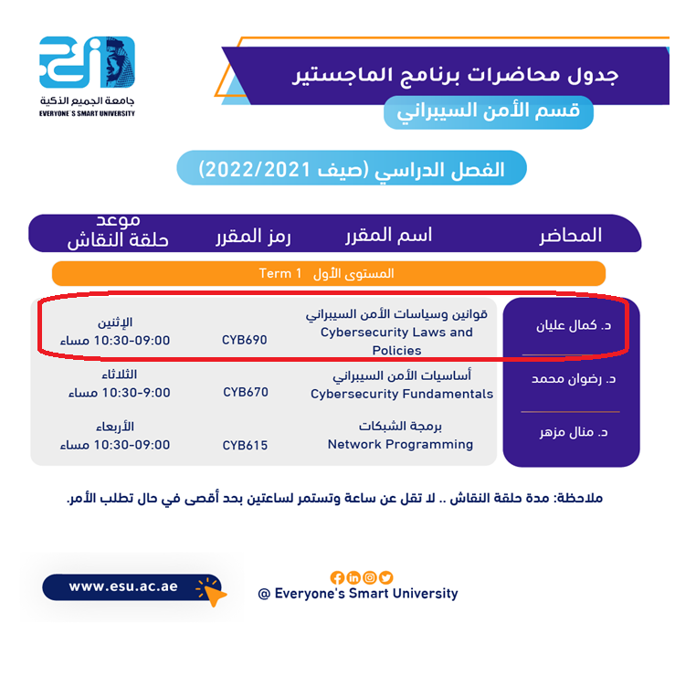
Academic Calendar
عبر برنامج ZOOM
سيتم تثبيت رابط حلقة النقاش على صفحة المقرر

Slide 14
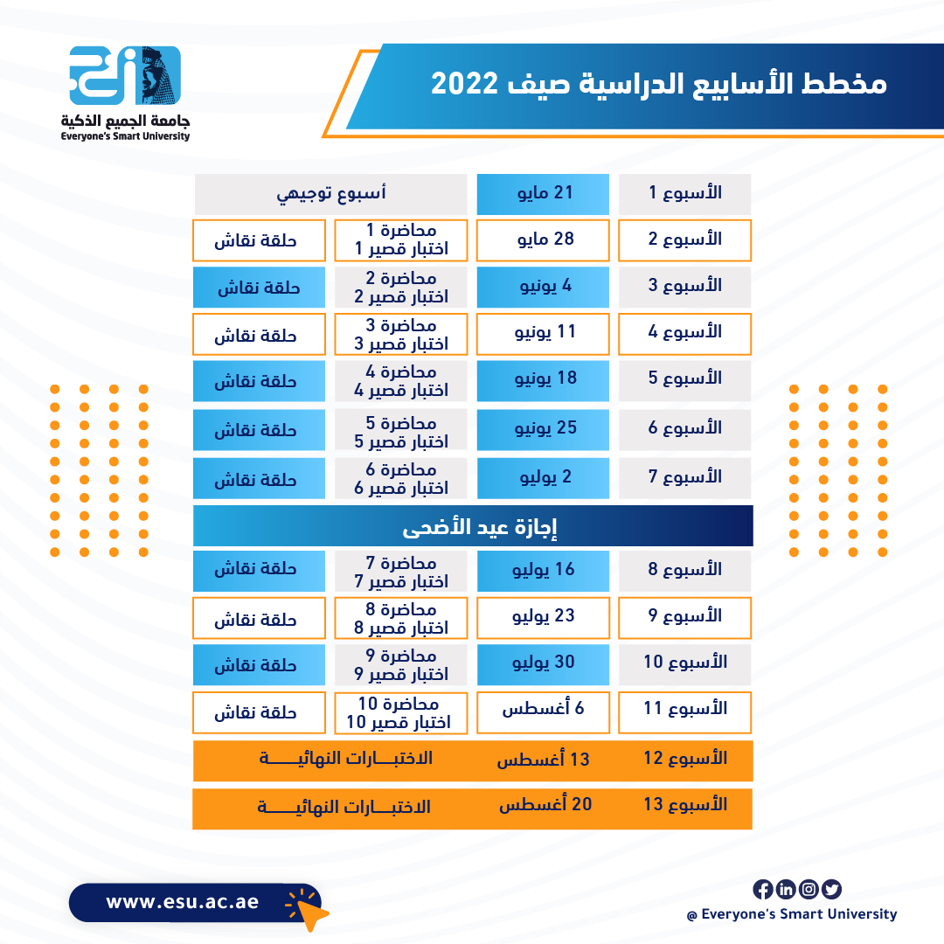
Academic Calendar
Cybersecurity Fundamentals, Dr. Redhwan Mohammed, Summer 2022

Slide 15
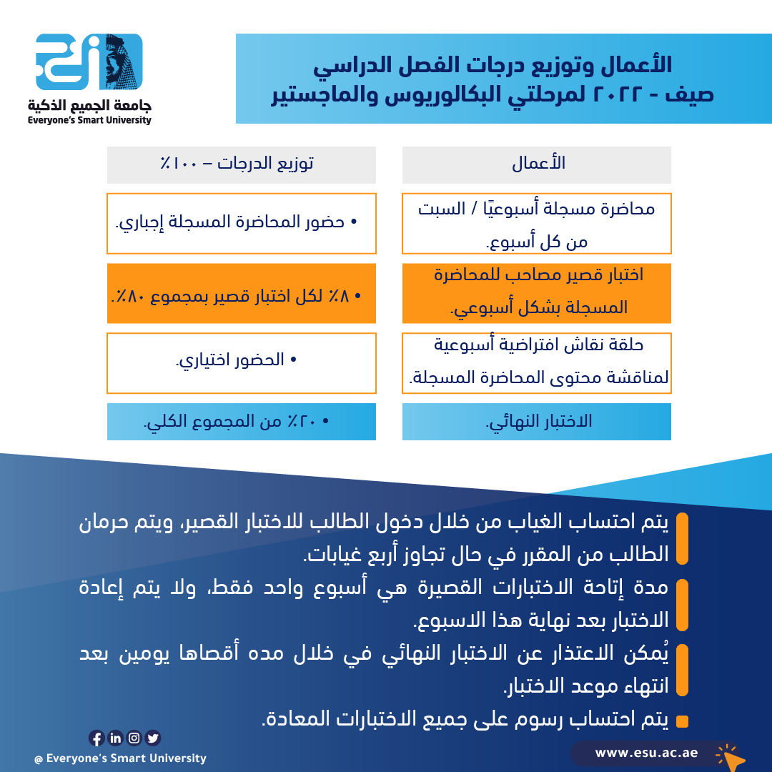
Academic Calendar
-- اللغة الأساسية في المحاضرات هي:
اللغة الإنجليزية
-- الاختبارات باللغة الإنجليزية مع وجود
ترجمة للسؤال.
Cybersecurity Fundamentals, Dr. Redhwan Mohammed, Summer 2022

Slide 16


