Slide 1




Information Systems
Dr. Amjad Qtaish
Faculty of Informatics
Midocean University
Chapter 16: Introduction to Geographic Information Systems
Information Systems (IT372)
www.midocean.ae

Slide 2

Chapter
Outline
16
    Introduction to Geographic Information Systems
What is a GIS?
Geographic Information System
Importance of GIS
Representations
Raster
Vector Data
Geospatial Data Types
Raster vs Vector
Information Systems, Dr. Amjad Qtaish
2
www.midocean.ae

Slide 3

Chapter
What is a GIS?
16
A computer system capable of holding and using data describing places on the earth’s surface.
An organized collection of computer hardware, software, geographic data, and personnel designed to efficiently capture, store, update manipulate, analyze, and display all forms of geographically referenced information.
GIS stands for Geographic Information System
GIS is a computer-based system that captures, stores, manages, analyzes, and visualizes spatial data, including maps, satellite imagery, and other geospatial information
GIS allows for the integration and analysis of data from multiple sources, helping to understand patterns, relationships, and trends in geographic data
Information Systems, Dr. Amjad Qtaish
3
www.midocean.ae

Slide 4
Chapter
Geographic Information System
16
Organized collection of
  Hardware
  Software
  Network
  Data
  People
  Procedures
Software
People
Data
Network
Procedures
Hardware
Information Systems, Dr. Amjad Qtaish
4
www.midocean.ae

Slide 5
Chapter
Geographic Information System
16
Data: The foundation of GIS is data, including
spatial data (e.g., geographic features, locations) and
attribute data (e.g., characteristics, and attributes associated with spatial data)
• Software: GIS software enables the creation, management, analysis, and visualization of spatial data. e.g., ArcGIS, QGIS, and Google Earth
• Hardware: GIS requires hardware, such as computers, servers, and GPS devices, to process and store data
• People: Skilled GIS professionals are needed to operate and analyze GIS data, interpret results, and make informed decisions
Information Systems, Dr. Amjad Qtaish
5
www.midocean.ae

Slide 6
Chapter
Importance of GIS
16
Improved Decision Making:
by providing visualizations, analysis, and insights from spatial data.
• Spatial Analysis and Modeling:
overlay analysis, proximity analysis, and network analysis.
• Data Integration and Management:
satellite imagery, aerial photography, GPS data, and other spatial datasets.
• Visualization and Communication:
maps, charts, and other graphical representations of spatial data.
• Cost and Time Savings:
GIS helps in optimizing resources, reducing costs
• Environmental and Social Impact Assessment:
infrastructure development, land use planning, and natural resource management.
Information Systems, Dr. Amjad Qtaish
6
www.midocean.ae

Slide 7
Chapter
Geographic Information System
16
A GIS is a computer-based tool for mapping and analyzing things and events that are spatially located.
Information Systems, Dr. Amjad Qtaish
7
www.midocean.ae

Slide 8
Chapter
Geographic Information System
16
A GIS integrates common database operations with visualization and geographic analysis through the use of maps.
Information Systems, Dr. Amjad Qtaish
8
www.midocean.ae

Slide 9
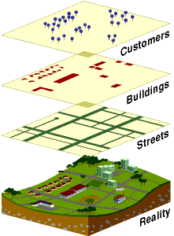
Chapter
Geographic Information System
16
A GIS stores information as a collection of thematic layers that can be linked together by geography
Information Systems, Dr. Amjad Qtaish
9
www.midocean.ae

Slide 10
Chapter
GIS helps people to:
16
Integrate information
Visualize scenarios
Solve complicated problems
Present powerful ideas
Develop effective solutions
Information Systems, Dr. Amjad Qtaish
10
www.midocean.ae

Slide 11
Chapter
Representations Occur:
16
In the human mind, when information is acquired through the senses and stored in memory
In photographs, which are two-dimensional models of light received by the camera
In written text, when information is expressed in words
In numbers that result from measurements
Information Systems, Dr. Amjad Qtaish
11
www.midocean.ae

Slide 12
Chapter
Spatial Data
16
Spatial data refers to data that has a geographic or spatial component, such as location, shape, and attributes associated with geographic features
Spatial data can be represented as points, lines, polygons, or raster images, and can be stored in various formats, such as vector and raster
Spatial data is the foundation of GIS, and it can be collected, created, and analyzed using GIS tools and techniques
Information Systems, Dr. Amjad Qtaish
12
www.midocean.ae

Slide 13
Chapter
Spatial Data Models
16
How can we represent geographic information, conceptually and digitally?
What are rasters and vectors?
What are attributes?
Information Systems, Dr. Amjad Qtaish
13
www.midocean.ae

Slide 14
Chapter
The Nature of Spatial Data
16
Distributed through space
Can be observed or described in the real world and identified by geographical location
Change through space and time
Information Systems, Dr. Amjad Qtaish
14
www.midocean.ae

Slide 15
Chapter
Sensing the World
16
  GIS data can be categorized into two main types:
  Vector data
  Raster data
  Vector data represents geographic features as points, lines, or polygons, and is used to represent discrete and well-defined features such as roads, buildings, and land parcels
  Raster data represents geographic features as a grid of cells, where each cell contains a value that represents an attribute or characteristic and is used to represent continuous data such as elevation, temperature, and precipitation
Information Systems, Dr. Amjad Qtaish
15
www.midocean.ae

Slide 16
Chapter
Raster
16
How to represent phenomena conceived as fields or discrete objects?
Raster
  Divide the world into square cells
  Register the corners to the Earth (known positions)
  Represent discrete objects as collections of one or more cells
  Represent fields by assigning attribute values to cells
  More commonly used to represent fields than discrete objects
Information Systems, Dr. Amjad Qtaish
16
www.midocean.ae

Slide 17
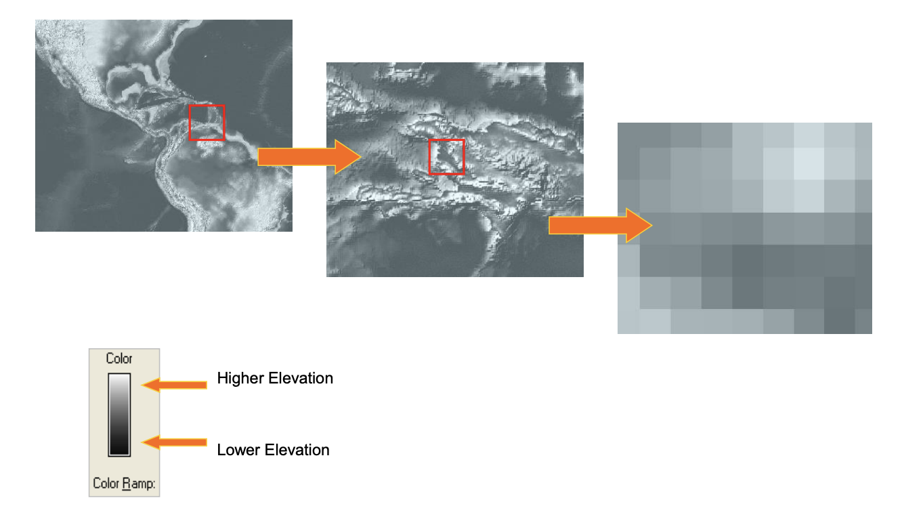
Chapter
Raster data
16
Information Systems, Dr. Amjad Qtaish
17
www.midocean.ae

Slide 18
Chapter
A raster data model uses a grid
16
One grid cell is one unit or holds one attribute.
Every cell has a value, even if it is “missing.”
A cell can hold a number or an index value standing for an attribute.
A cell has a resolution, given as the cell size in ground units.
Information Systems, Dr. Amjad Qtaish
18
www.midocean.ae

Slide 19
Chapter
Generic structure for a grid
16
Grid extent
Grid
cell
s
w
o
R
Resolution
Columns
Figure 3.1
Generic structure for a grid.
Information Systems, Dr. Amjad Qtaish
19
www.midocean.ae

Slide 20
Chapter
Generic structure for a grid
16
Legend
Mixed conifer
Douglas fir
Oak savannah
Grassland
Raster representation. Each color represents a different value of a nominal-scale field denoting land cover class.
Information Systems, Dr. Amjad Qtaish
20
www.midocean.ae

Slide 21
Chapter
Characteristics of Rasters
16
Pixel size
  The size of the cell or picture element, defining the level of spatial detail
  All variation within pixels is lost!
Assignment scheme
  The value of a cell may be an average over the cell, or a total within the cell, or the commonest value in the cell
  It may also be the value found at the cell’s central point
Information Systems, Dr. Amjad Qtaish
21
www.midocean.ae

Slide 22
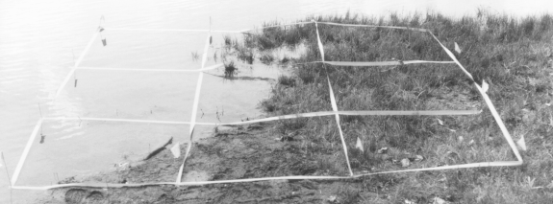
Chapter
The mixed pixel problem
16
Information Systems, Dr. Amjad Qtaish
22
www.midocean.ae

Slide 23
Chapter
Vector Data
16
Used to represent points, lines, and areas
All are represented using coordinates
  One per point
  Areas as polygons
    Straight lines between points, connecting back to the start
    Point locations recorded as coordinates
  Lines as polylines
    Straight lines between points
Information Systems, Dr. Amjad Qtaish
23
www.midocean.ae

Slide 24
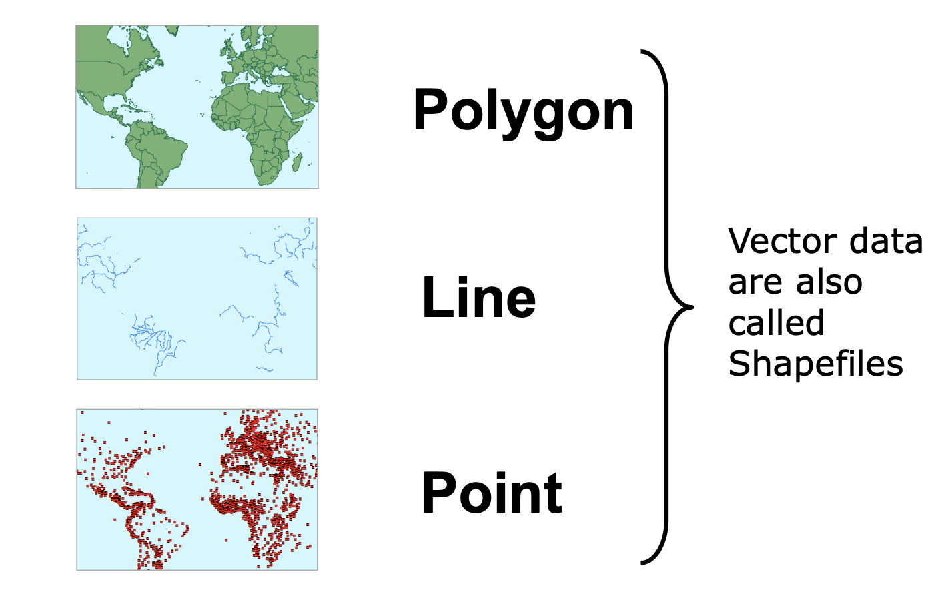
Chapter
Vector Data
16
Information Systems, Dr. Amjad Qtaish
24
www.midocean.ae

Slide 25
Chapter
The Vector Model
16
A vector data model uses points stored by their real (earth) coordinates.
Lines and areas are built from sequences of points in order.
Lines have a direction to the ordering of the points.
Polygons can be built from points or lines.
Vectors can store information about topology.
Information Systems, Dr. Amjad Qtaish
25
www.midocean.ae

Slide 26
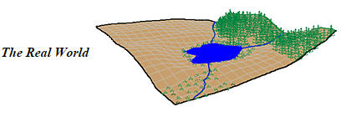
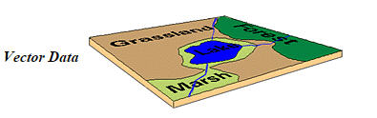
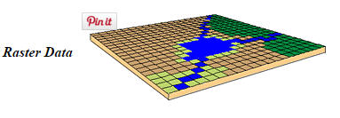
Chapter
Geospatial Data Types
16
Geospatial or coordinate data can be represented in two different data formats:
Vector:
e.g. points, lines, and polygons
Raster:
e.g. row and column matrix
Information Systems, Dr. Amjad Qtaish
26
www.midocean.ae

Slide 27
Chapter
Raster vs Vector
16
Volume of data
  Raster becomes more voluminous as cell size decreases
Source of data
  Remote sensing, elevation data come in raster form
  Vector favored for administrative data (boundaries)
Software
  Some GIS better suited to raster, some to vector
Information Systems, Dr. Amjad Qtaish
27
www.midocean.ae

Slide 28
Chapter
Building complex features
16
Simple geographic features can be used to build more complex ones.
Areas are made up of lines, which are made up of points represented by their coordinates.
Areas = {Lines} = {Points}
Information Systems, Dr. Amjad Qtaish
28
www.midocean.ae

Slide 29
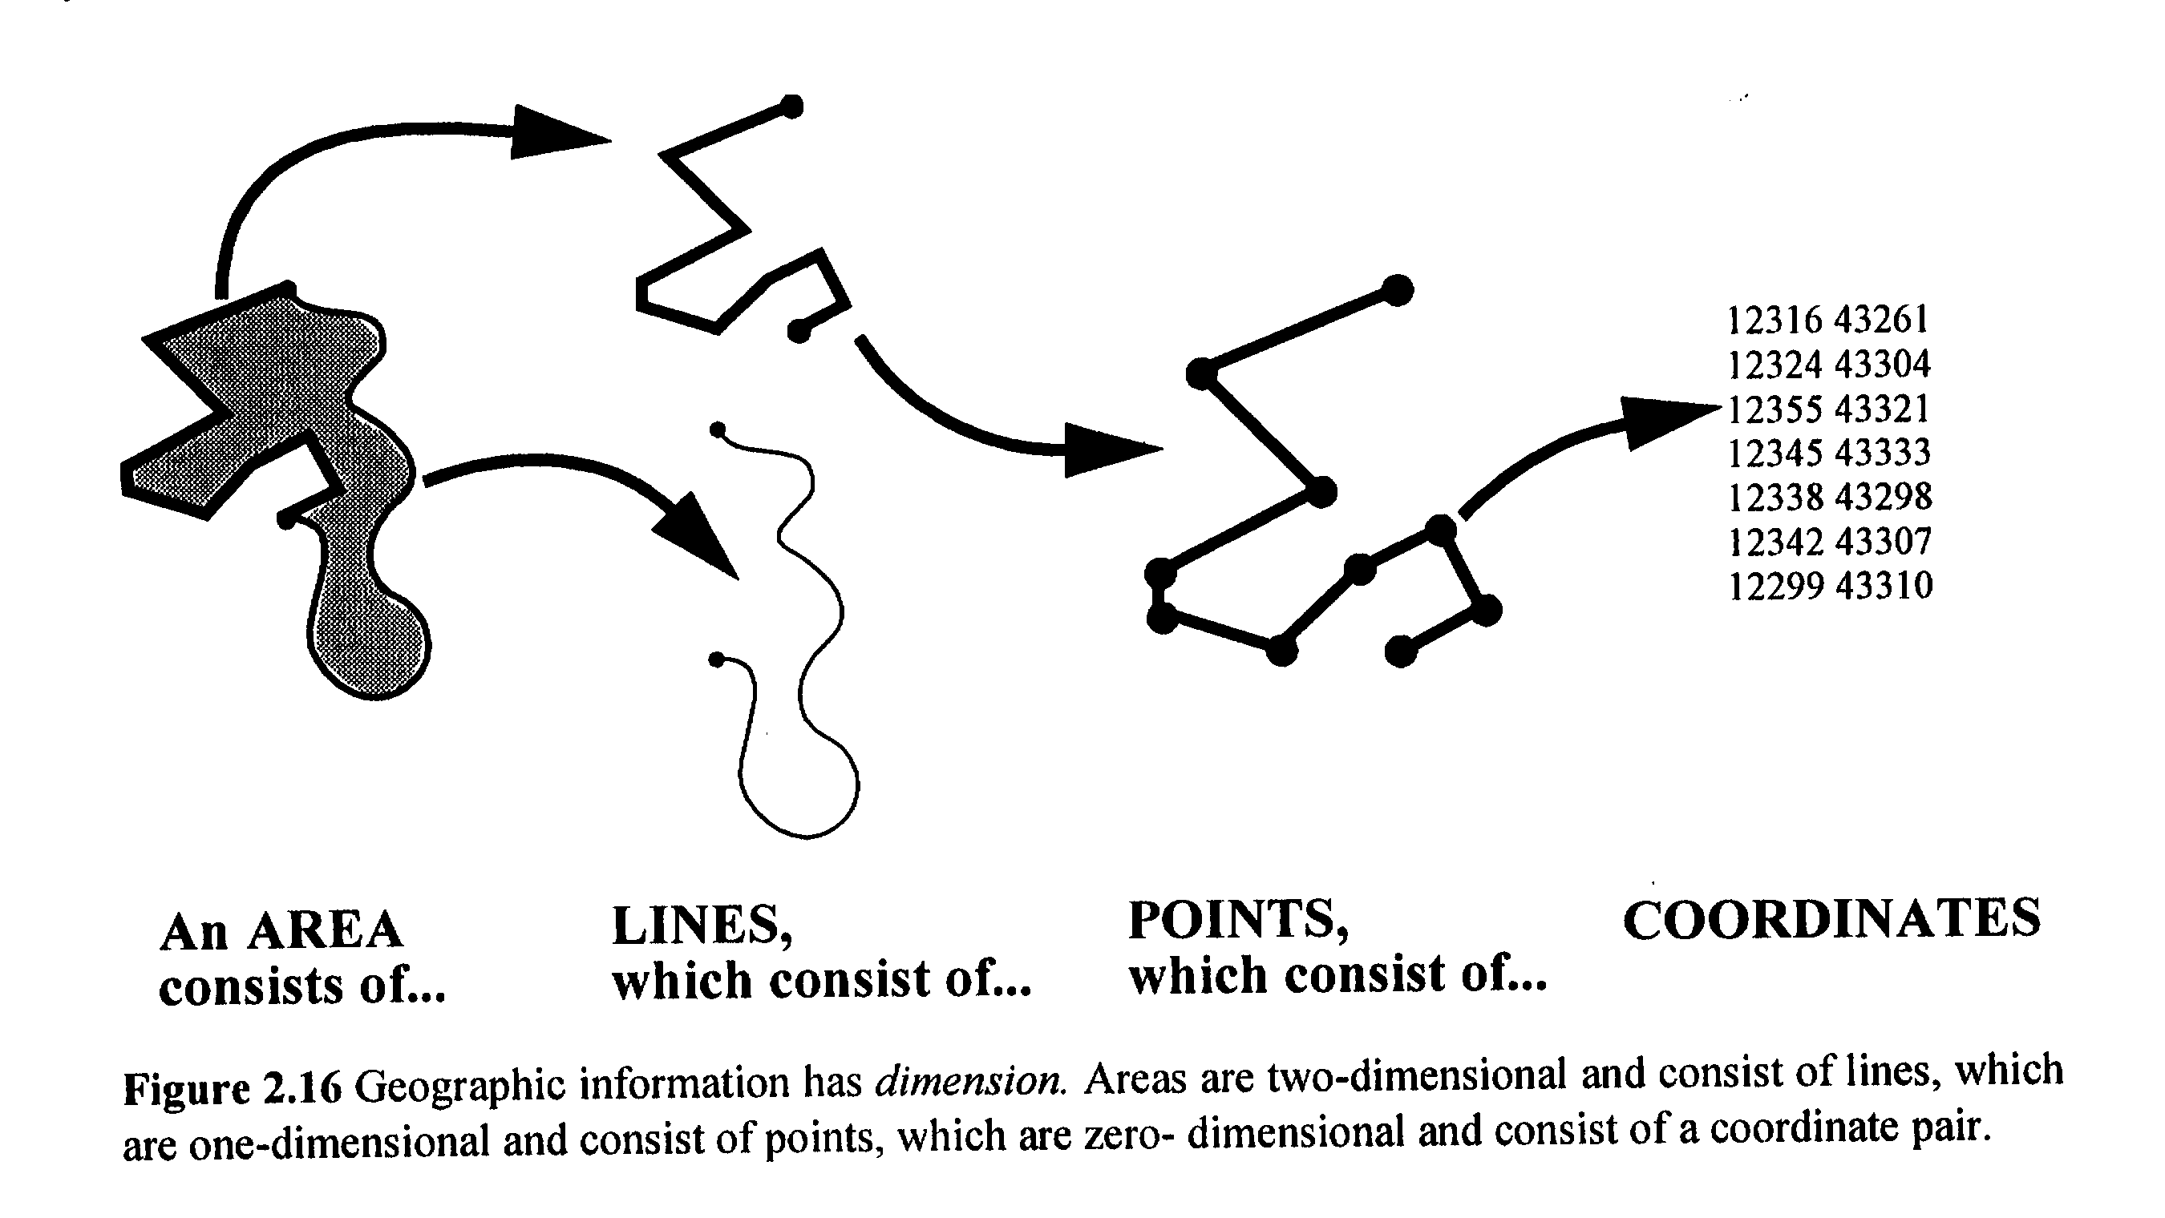
Chapter
Areas are lines are points are coordinates
16
Information Systems, Dr. Amjad Qtaish
29
www.midocean.ae

Slide 30
Chapter
Areas are lines are points are coordinates
16
The vector model: information about points, lines and polygons are encoded and stored as a collection of x,y coordinates.
The raster model: made up of a collection of grid cells, each holding a piece of information.
Information Systems, Dr. Amjad Qtaish
30
www.midocean.ae

Slide 31
Chapter
Layers
16
Layers are the building blocks of GIS, and they represent different thematic information that can be stacked on top of each other to create a map
Layers can include features such as roads, buildings, rivers, and land parcels, each represented as a separate layer with its own attributes and properties
Layers can be added, removed, and manipulated in GIS software to create complex spatial analyses and visualizations
Information Systems, Dr. Amjad Qtaish
31
www.midocean.ae

Slide 32
Chapter
Layers
16
A Map is made up of Layers or Shapefiles
Layers contain Features
Features can take the form of Points, Lines and Polygons, and are known collectively as Vector Data
Layers contain Features, and each Feature is linked to a row of information in the Attribute table
Information Systems, Dr. Amjad Qtaish
32
www.midocean.ae

Slide 33
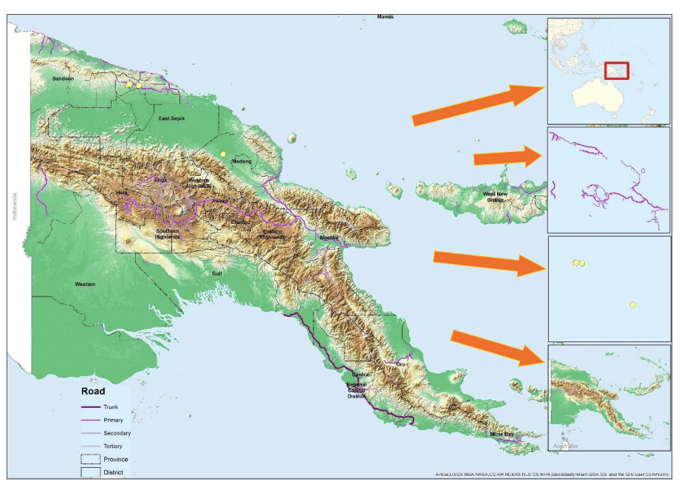
Chapter
Layers contain features
16
Information Systems, Dr. Amjad Qtaish
33
www.midocean.ae

Slide 34
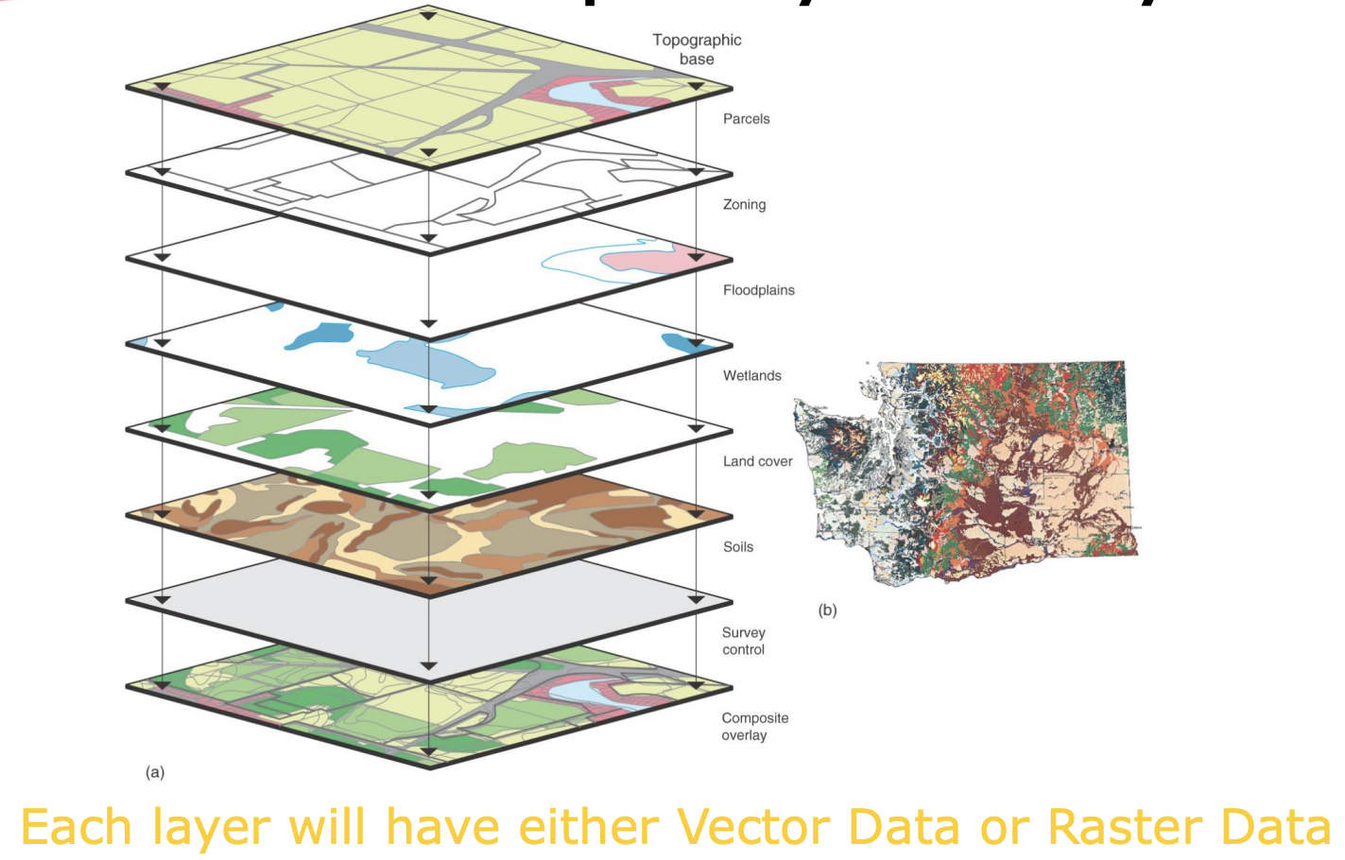
Chapter
Each map is a system of layers
16
Information Systems, Dr. Amjad Qtaish
34
www.midocean.ae

Slide 35
Chapter
Properties of Features
16
size
distribution
pattern
contiguity
neighborhood
shape
scale
orientation.
Information Systems, Dr. Amjad Qtaish
35
www.midocean.ae

Slide 36
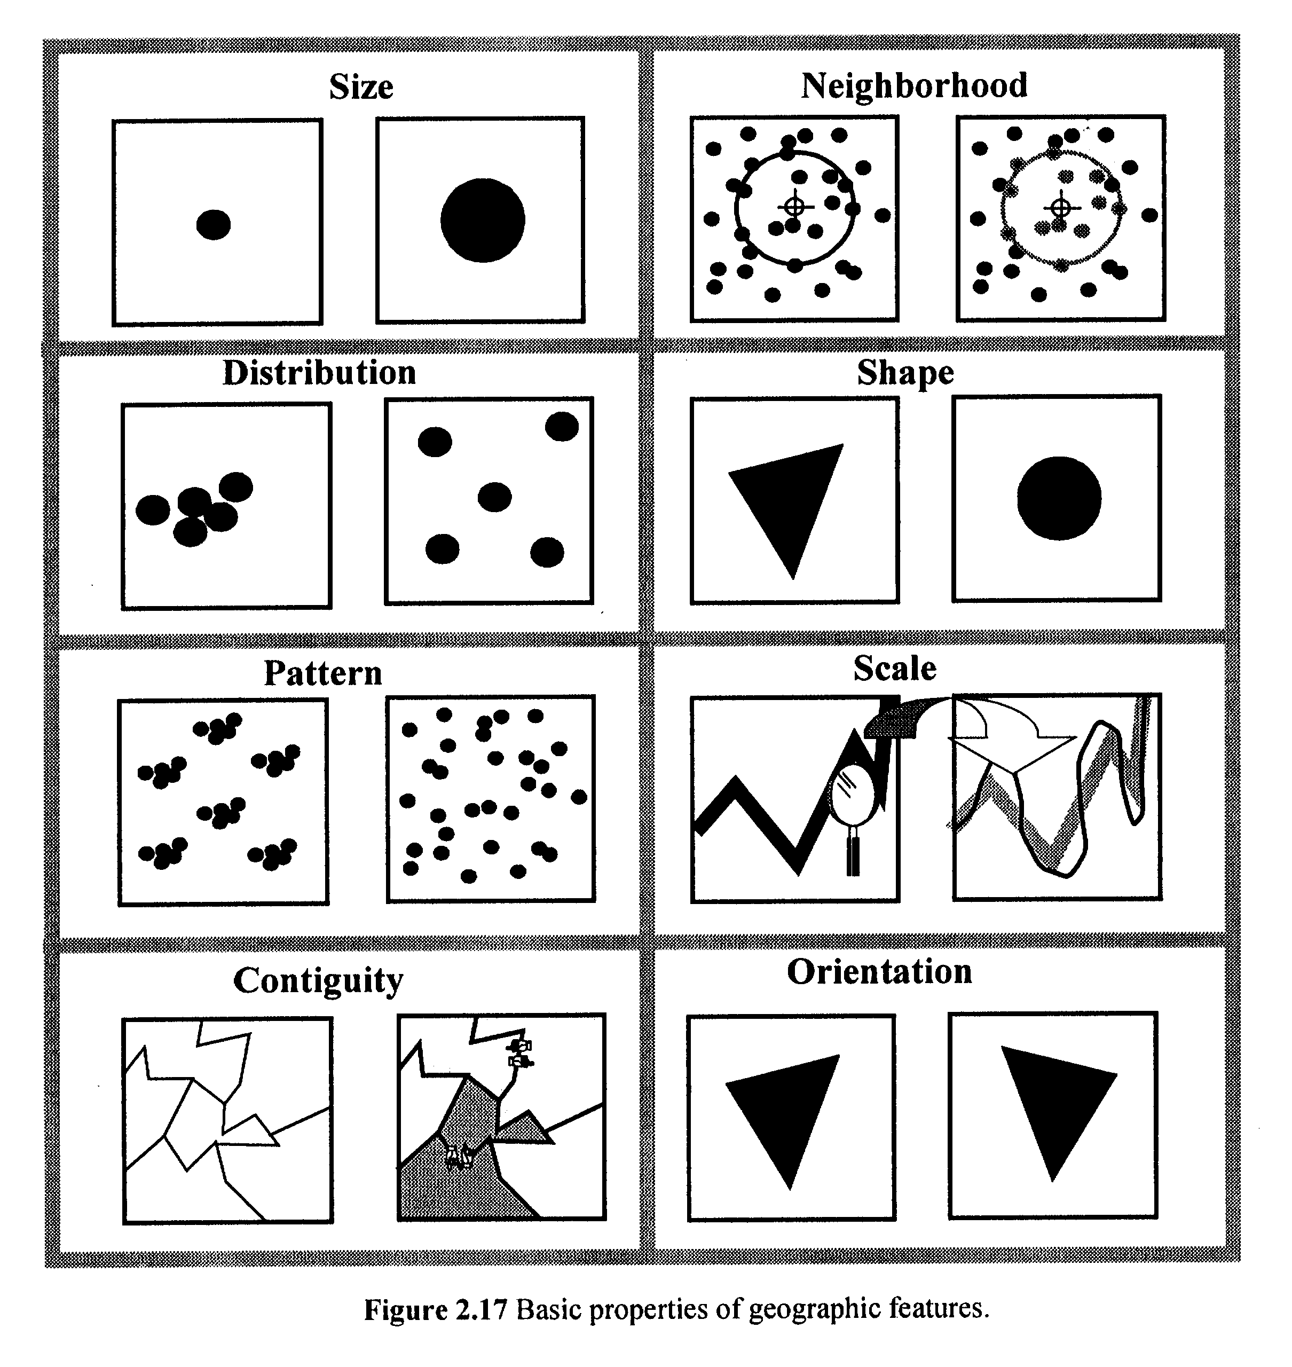
Chapter
Properties of Features
16
Basic properties of geographic features
Information Systems, Dr. Amjad Qtaish
36
www.midocean.ae

Slide 37
Chapter
Types of attributes
16
Nominal (named, e.g., placenames, ID numbers, colors)
Ordinal (ranked, e.g., soil quality, income category)
Interval (differences between values are real)
Ratio (100 kg is twice as much as 50 kg)
Cyclic (e.g., compass direction, longitude, months) – problematic in GIS?
Information Systems, Dr. Amjad Qtaish
37
www.midocean.ae

Slide 38
Chapter
In an infinitely complex world…
16
representation must be partial (limited detail)
it is necessary to generalize
Information Systems, Dr. Amjad Qtaish
38
www.midocean.ae

Slide 39
Chapter
Methods of generalization
16
Simplification
Smoothing
Aggregation
Amalgamation
Merging
Collapse
Refinement
Exaggeration
Enhancement
Displacement
Each technique resolves a specific problem of display at a coarser scale to result in an acceptable version
Information Systems, Dr. Amjad Qtaish
39
www.midocean.ae

Slide 40
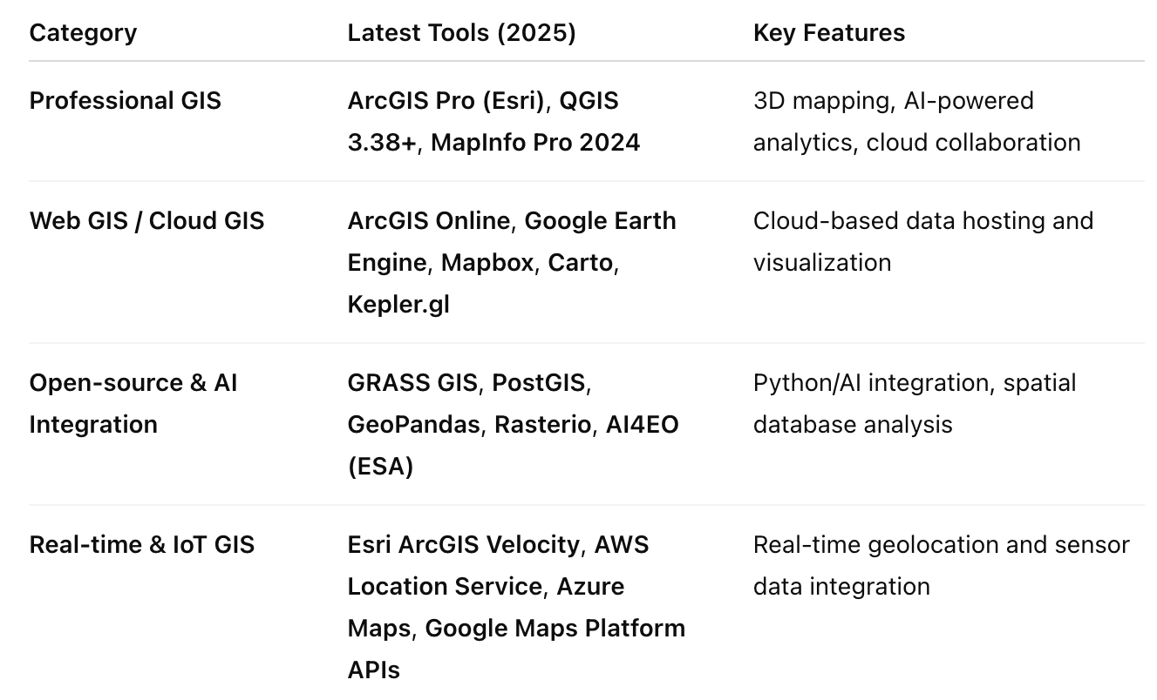
Chapter
Latest GIS Software and Platforms
16
Information Systems, Dr. Amjad Qtaish
40
www.midocean.ae

Slide 41
Chapter
Modern Data Sources and Collection
16
Modern GIS now incorporates multi-source, multi-resolution datasets:
Drones (UAVs) → High-resolution aerial imagery for mapping and 3D terrain modeling.
Satellites (e.g., Sentinel, Landsat 9, PlanetScope) → Near real-time earth observation data.
IoT Sensors → Environmental, traffic, and weather data streams.
LiDAR (Light Detection and Ranging) → Precise 3D elevation and vegetation structure mapping.
Crowdsourced Data → OpenStreetMap, citizen science platforms.
Information Systems, Dr. Amjad Qtaish
41
www.midocean.ae

Slide 42
Chapter
Raster and Vector Enhancements
16
New technologies improve how these data types are processed:
Cloud-Optimized GeoTIFFs (COGs) – optimized for streaming large raster files online.
3D & 4D Vector Tiles – used for interactive maps in platforms like Mapbox and CesiumJS.
Spatio-temporal modeling – integrates time as a fourth dimension to track changes over time (e.g., climate change, urban growth).
Information Systems, Dr. Amjad Qtaish
42
www.midocean.ae

Slide 43
Chapter
Spatial Analysis and AI Integration
16
Recent advances include:
GeoAI (Geospatial Artificial Intelligence) – applies machine learning to spatial data for pattern recognition, anomaly detection, and predictive analytics.
Deep Learning for GIS – tools like ArcGIS Deep Learning Studio and TensorFlow Geospatial analyze satellite imagery automatically.
Big Data GIS – distributed computing with platforms like Spark Geo, Google Earth Engine, and AWS SageMaker Geo.
Information Systems, Dr. Amjad Qtaish
43
www.midocean.ae

Slide 44
Chapter
Cloud and Web GIS
16
Today’s GIS ecosystems are cloud-first:
ArcGIS Online and Google Earth Engine – enable collaborative, browser-based GIS.
Serverless GIS – uses cloud computing for dynamic scaling and real-time data analytics.
API-based Mapping – Mapbox GL JS, Leaflet, and Deck.gl allow developers to embed interactive maps in web apps.
Information Systems, Dr. Amjad Qtaish
44
www.midocean.ae

Slide 45
Chapter
Summary
16
To align it with modern GIS, focus on:
AI + GIS integration (GeoAI)
Cloud-based GIS platforms (ArcGIS Online, Google Earth Engine)
Big Data and real-time analytics
3D/4D and Digital Twin modeling
Interoperable, open standards for global collaboratio
Information Systems, Dr. Amjad Qtaish
45
www.midocean.ae

Slide 46



Thank You

