Slide 1



Strategic Plan Outline
& Strategic Positioning
Prepared by Dr. Mohamed Soliman
ENT624
Entrepreneurial Strategy
Lecture 7

Slide 2



Learning Objectives
1. Use the strategic plan outline to develop organizational-level strategies, industry-market strategies, management team strategies, and financial strategies for the new venture
2. Conduct a TOWS analysis to consider the new venture's strategic position
3. Explore new approaches that shift the focus of the new venture's strategy from direct competition to the creation of new value

Slide 3
The Strategic Plan Outline
The components of the plan describe in detail how the new venture will carry out its vision. The outline contains the sections that should be covered in your team's strategic plan. The plan should be tailored to your business needs, and your section headings do not have to be exactly as shown here.
The content of your plan should cover these areas:
1. Executive Summary
• Overview of your concept (business and its mission), customers (your market/markets), and your capital requirements (financial strategies)

Slide 4
2. Concept Description: Organizational-Level Strategies
• What business are you really in?
• What is the mission of your business (your reason for existence)?
• List your key objectives: What activities will you perform? Where and how will you perform them?
What will your business offer, and how will it be special/competitive?
• What are the key values of your business? What will its relationships be with stakeholders such as customers, suppliers, employees, and the community?

Slide 5
3. Analysis of the External Environment: Industry and Market Strategies
• What are the social and economic (and other) trends of your business environment?
• Describe the current climate of your industry (recent trends and performance)
• Who are your key competitors?
• What market(s) do you serve (demographics, psychographics, etc.)? How will you create awareness and sustain your customer base?

Slide 6
4. Analysis of the Internal Environment: Management Team Strategies
• What are the strengths and experience of each team member?
• What are the knowledge, skills, and abilities you need for your business to perform?
• What do you have? What do you lack (and where can you find it)?
• How will the business be organized (structure and reporting relationships)?
5. Financial Strategies
• Estimate of start-up costs (investigate similar businesses).
• Investigate financing alternatives (debt/equity financing, listing of possible resources).
• Develop one year minimum (three to five years recommended) of pro forma statements. Financial statements include cash flow, income statements, and balance sheet.

Slide 7
6. Critical Risks and Exit Strategy
• The plan should contain an analysis of critical risks and how the entrepreneur intends to reduce these risks, including financial, organizational, and psychological risks related to the business, the entrepreneur, and the management team, as appropriate.
• Some entrepreneurs include an exit strategy for the business. This is optional, but if you intend to seek external investors, it is recommended to include these for consideration.
7. References
• Full citations of all sources cited in your strategic plan must be listed here.
8. Appendices (if appropriate)
• Surveys, copies of supplementary research materials, maps, and so on.

Slide 8
Strategies you develop for your business should build on your perceived strengths, exploit opportunities you identify, and avoid threats.
Later, you will learn how to conduct a TOWS analysis of your business to help you develop your strategies.
You can include “must do” and “should do” strategies for the sections above to help you develop short-range and long-range goals for the business.

Slide 9
Strategic Positioning: From Swot to Tows
In stable industries, the Strengths Weaknesses Opportunities Threats (SWOT) analysis remains one of the best ways to think about strategy and selecting a strategic position for the new venture.
The goal is to find a sustainable strategic position in which the firm can use its strengths to take advantage of the opportunities available in its industry and markets—while defending itself from threats and masking or correcting its weaknesses.
The challenge in identifying weaknesses and developing ways to overcome them can in itself become a strategy.
Turning the SWOT into TOWS is about doing the external analysis first—an important distinction when thinking about strategy. When doing such an analysis, it's best to work from the outside in, to do a TOWS analysis.

Slide 10
TOWS analysis (to consider the new venture's strategic position)
• Threats-Opportunities-Weaknesses-Strengths analysis is an innovative approach to analyzing the external environment and applying the new venture's strengths and weaknesses in ways that capitalize on the opportunities and minimize the threats facing the new venture.

Slide 11
--Begin by defining markets in which your firm will sell, competition that you will face, and larger industry structure (power relations, business norms, etc.) in which firm will function.
-- For this portion of the analysis, you can use the data you collected in the Knowledge of Industry Checklist (KIC).
--Then turn your attention to the trends and shifts in the external environment: Consider the following factors as you work through the TOWS Analysis.
• Economic factors: The general state of the economy, including inflation, labor market conditions, interest rates, and so on.
• Sociocultural factors: Preferences, values, and shifts in consumer trends.
• Technological factors: New technologies, technical processes, and the rate of technological change.
• Political-legal factors: Regulatory environment, including laws, statutes, and changes in government policies that affect the business.

Slide 12
-- These factors change frequently, so it is necessary to review this analysis at least annually, and more often as appropriate to your industry and the community in which the business resides.
-- Finally, summarize your analysis in a list of opportunities and a list of threats. This is the context in which you must operate.
-- Once you know what the external environment offers you (and the challenges it presents), look inside to inventory your strengths and weaknesses.
-- What skill sets, resources, networks, and so on do you have at your disposal? What are you lacking? Summarize these into a list of strengths and a list of weaknesses. This is what you have to work with.

Slide 13
-- Finally, map out your TO and WS in a matrix such as the one shown in Table 1 and study it to develop a strategy that uses your strengths to take advantage of opportunities, reduce or avoid threats, and overcome weaknesses.
-- It is also highly recommended that you develop a set of strategies and run each through the matrix in Table 1, looking for flaws (e.g., lack of management skills in a particular area, low levels of financial resources).
Table 1 TOWS: The Strategic Audit

Slide 14
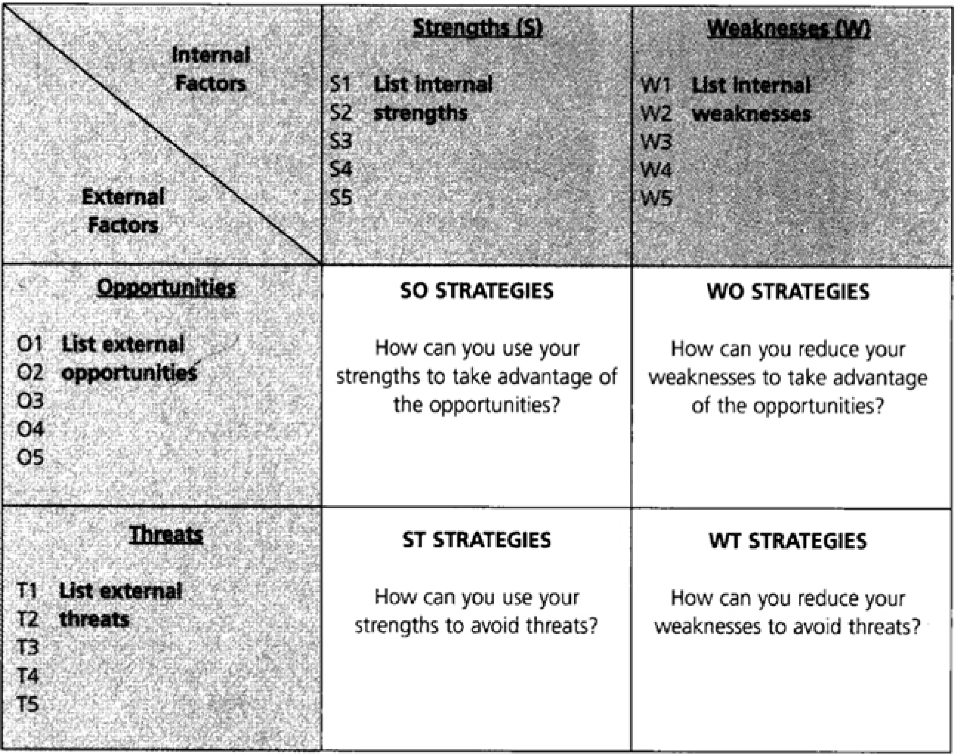

Slide 15
When you complete this analysis, you can consider some of the strategic positions for the new venture:
• The low-cost firm that churns out good enough services or products at the lowest possible cost .
• The highly differentiated firm that creates the highest-quality, best-designed, best-supported, most attractive products or services in its area.
• The narrowly focused firm that ties itself to a very specific market and serves its needs attentively, typically with segmented products and services or niche, often customized, products or services.
• The broadly focused firm that serves a wider market, either with a standardized product or through mass customization.

Slide 16
• The firm that elaborates a previously chosen position, by penetrating deeper, developing new markets or niches, developing new products, carving out space at the edge of a niche, or raising barriers to competitors wanting to do what your firm does.
• The firm that collaborates to learn—by licensing your products or services to other, more established organizations in the industry, by outsourcing, or by entering into joint ventures as a way of gaining entry into the marketplace.

Slide 17
Shifting the Focus of Strategy: Creating New Markets versus Competing Directly
Kim and Mauborgne (1999) spent 10 years researching organizations that have developed fundamentally new and superior value, creating new markets and recreating existing ones.
The researchers found six approaches that enable companies to create new market space.
Interestingly, those companies managed to do this by examining familiar information in a new light; accomplishing their goal did not require unique vision or foresight about the future.
The research showed that innovative companies break free from the competitive pack by staking out fundamentally new market space—that is, by creating products or services for which there are no direct competitors.
This path to value innovation requires a different competitive mind-set and a systematic way of looking for opportunities.

Slide 18
Instead of looking within the conventional boundaries that define how an industry competes, managers can look methodically across them. By so doing, they can find unoccupied territory that represents real value innovation.
Similar insights can be gleaned by looking across strategic groups within an industry; across buyer groups; across complementary product and service offerings, and across the functional-emotional orientation of an industry.
The change in strategic thinking is described in this way: “Instead of looking within the accepted boundaries that define how we compete, managers can look systematically across them. By doing so, they can find unoccupied territory that represents a real breakthrough in value”.
This carries valuable and transferable learning for entrepreneurs as they formulate strategy for their new ventures.
Table 2 presents the six approaches entrepreneurs and managers can use to create new market space.

Slide 19
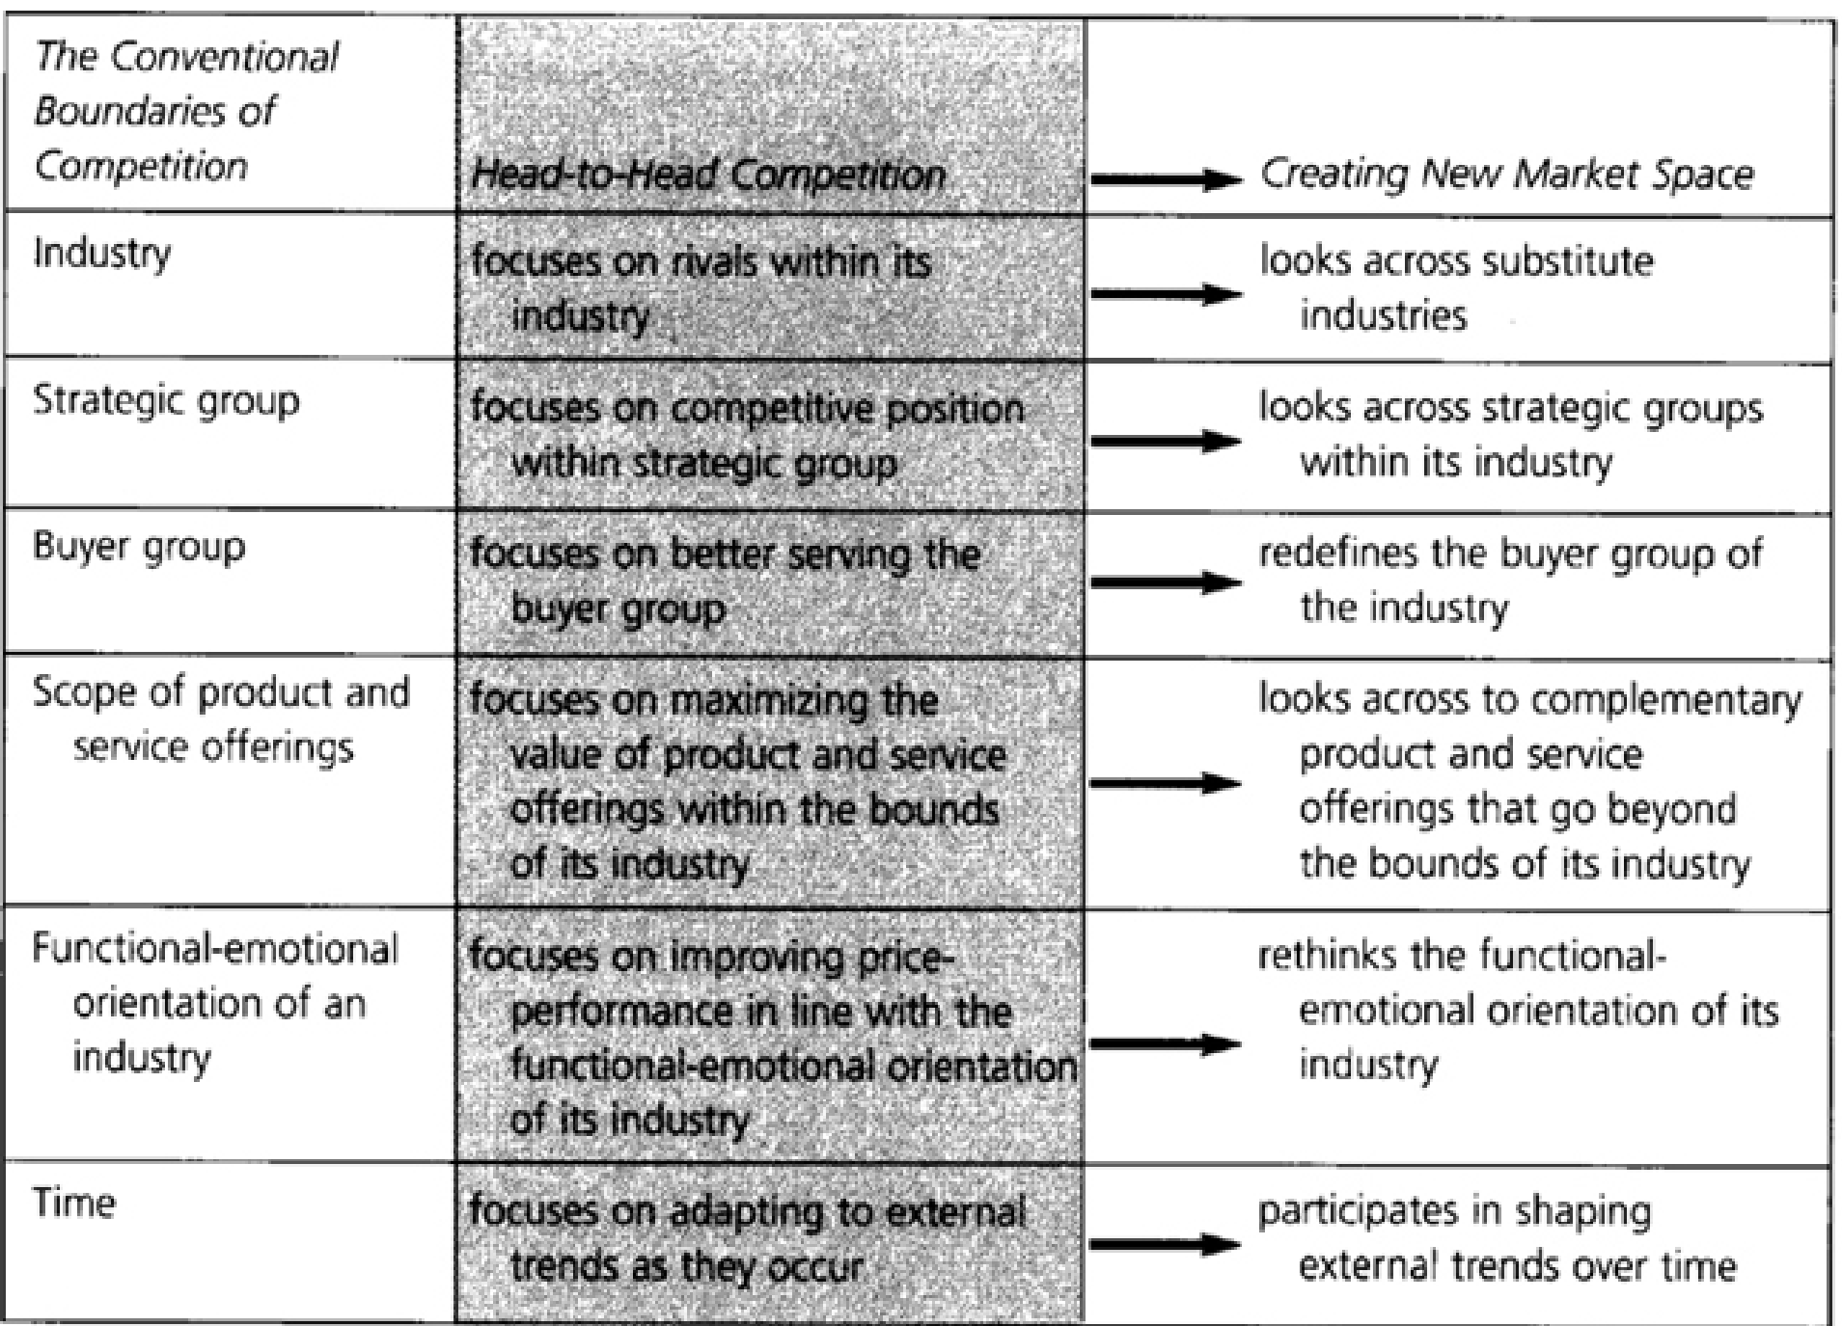

Slide 20
Conventional Boundaries of Competition --> Head-to-Head Competition --> Creating New Market Space.
Industry --> focuses on rivals within its industry --> looks across substitute industries.
2. Strategic group --> focuses on competitive position within strategic group -->looks across strategic groups within its industry.
3. Buyer group --> focuses on better serving the buyer group --> redefines the buyer group of the industry.
4. Scope of product and service offerings --> focuses on maximizing the value of product and service offerings within the bounds of its industry -->looks across to complementary product and service offerings that go beyond the bounds of its industry.
5. Functional-emotional orientation of an industry --> focuses on improving price- performance in line with the functional-emotional orientation of its industry -->rethinks the functional- emotional orientation of its industry.
6. Time --> focuses on adapting to external trends as they occur --> participates in shaping external trends over time.

Slide 21
Failures and Foibles: Do's and Don'ts on Strategy from a CEO
Stop selling and start sharing. People are much more interested in what you have to say when you're sharing your knowledge, your passion and your experience to help them solve their problems. Focus on being interested in them, and don't worry so much about being interesting. It's amazing how interesting you are when you're paying attention to your customers' needs. People buy from those they like, trust and identify with. Building rapport creates that trust and credibility. Just remember, it's about the relationship, not the sale. Nobody likes to be sold, but everyone likes to buy.
Do: Listen to what your prospects and customers say with their words and body language.
Don't: Pull out a brochure or sales sheet unless they ask for it.

Slide 22
2. Differentiate or Die. What makes you unique vs. the others in the market? Make sure there's something special about your product or service other than the price. Own something important in your customers' hearts and minds. Being good is no longer good enough—you have to find something where you're great. Use your imagination and creativity to set yourself apart from the crowd. I once worked with a business owner who always wears red. She works in a male-dominated field where everyone has basically the same credentials so at least she's easy to spot at events. “The lady in red” gets most of her work by referral, which is a great way to build a business.
Do: Talk to real customers and ask them for a report card.
Don't: Chase last week's/quarter's/year's trend.

Slide 23
3. Solve Problems People Will Pay For. Revenue is validation. Are customers voting withtheir wallets? Are your products or services the “nice to have” thing or the “have to have” thing? Be very important to your most important customers—they should think of you first for any needs in your category. Also, make sure you have more than just a “one off” good idea. Although great businesses start with great ideas, not all ideas are company-worthy. Many of the dotcoms forgot that the business model must actually work, that cash flow matters and that it's not just about building awareness but about making the sale. Janet Jackson got plenty of attention for her wardrobe malfunction in the 2004 Super Bowl, but did that sell more of her products?
Do: Test, tweak and try again.
Don't: Ask your friends or family and call it “research.”

Slide 24
4. Leverage the Evangelists. There are people out there using your product or service who would be glad to tell others about your business. If you can make them happy, they'll help you spread the word to other like-minded customers. And here's something to keep in mind: They may be using your product or service for purposes other than the ones you initially intended, so make sure you really understand what they like and dislike about your business and, more important, why. And remember, it's not about pedigree or job title—your champions can come from anywhere. At one of the startups I worked for, a hair stylist made a key introduction for our company. Friend-raising can, in fact, lead to fundraising, so make friends before you need them.
Do: Make it easy for your evangelists to try your product or service.
Don't: Discount the negatives. There may be an important insight buried within.

Slide 25
5. Be Visible. Wasn't it Woody Allen who said that 80 percent of success is just showing up?
Invisibility is not a good business strategy—if people don't know you exist, then guess what? You don't. You don't have to run a Super Bowl ad to get noticed, but you do have to be active in the communities you cater to so people know where and how to find you. Whether you have a technology business, a consumer products company or a professional services firm, you're in the relationship business. If there are businesses that target your same customer base, then find creative ways you can each leverage your contacts and databases to multiply your outreach. Best-kept secrets are just that: secrets.
Do: Put your mouth where your money is, too.
Don't: Hide in your office or behind your computer online.

Slide 26
6. Create Extraordinary Experiences. The relationships you have with your customers are based on the cumulative experiences they have with your employees, product, service and business. If your brochure or website makes one claim but the reality is very different, it’s the firsthand knowledge that will be remembered by your customers, so make sure you deliver on the promises you make every time you connect with your customers. Is it such a surprise that most of the airlines are going bankrupt while Jet Blue and Southwest are profitable?
Do: Consistently reinforce your key messages in everything you do.
Don't: Forget that every employee, partner and affiliate is an ambassador, too.

Slide 27
7. Put Passion Above All Else. Customers are savvy—they know when something is genuine or if you're just going through the motions. So do your employees, partners and affiliates.
If you don't enjoy what you are doing, find something else to do! It's hard to compete with someone who gets up feeling excited every day and who's full of ideas about their business. To them, what they do doesn't feel like work. Enthusiasm is contagious, so determine what it is you enjoy doing and then share your gift with others whose talents may lie somewhere else. When everyone plays to their strengths, the results are superior.
Do: Work you love and believe is important.
Don't: Waste time. It's your most precious commodity.

Slide 28

Case Study
Rentabook.Com: A Strategic Analysis

Slide 29
Table of Contents
I. Executive Summary
II. Organizational-Level Strategies
A. What business are we really in?
B. Mission statement
C. Key values
III. Industry and Market Strategies
A. Advertising
B. Social trends
C. Economic trends
D. Climate of industry
E. Key competitors
F. Target market
G. Student survey results
H. TOWS analysis

Slide 30
IV. Management Team Strategies
A. Location
B. Strengths and experience of team
C. Structure of http://RentABook.com
D. What does http://RentABook.com need from the team?
E. What does http://RentABook.com have and lack?
V. Financial Strategies
A. Start-up costs
B. Financing
C. Pricing strategy
D. The numbers
VI. Appendix
A. Appendix 1 (Survey)
B. Appendix 2 (Numbers)

Slide 31
Executive Summary
http://RentABook.com is an on-line textbook rental service intent on helping college students keep more of their money in their pockets. Students simply login to http://RentABook.com, borrow their textbooks for the term, and return the books after the term is over. A portion of the rental fee is used as a security deposit and is given back to the student once the books are returned. Or, students can choose to keep the book, and http://RentABook.com keeps their security deposit. Initially, http://RentABook.com will focus on DePaul University students, with plans to expand to serve college students throughout the Chicago-land area in the near future.
College textbook prices are rising. Right now, DePaul students spend an average of $400 per quarter—$1,200 per year—on books. http://RentABook.com's unique service helps students save up to 51 percent. http://RentABook.com also knows how important delivery is to students. Students need their books to

Slide 32
arrive on time. That's why http://RentABook.com guarantees on-time delivery. Or if they choose, students can elect to pick up their order at our main location. Customers include the college population who are Internet savvy and have limited disposable income.
Our management team consists of current DePaul students with backgrounds in different aspects of business—accounting, finance management, and marketing. Our team members' student status gives us personal insight into our customers' needs and interests as well as firsthand experience with the current book-buying experience. We saw an opportunity to provide more affordable books to students who value affordable prices.
Financial analysis projects that with start-up costs of $31,500, http://RentABook.com can generate net profits of $5,215 in year one, $19,514 in year two, and $25,000 by the third year. Such growth potential makes http://RentABook.com an attractive investment. Our management team is seeking $15,000 in initial bank loans. The rest of the funding will be secured using personal investments and credit.
Organizational-Level Strategies
What Business are We Really in?
http://RentABook.com is in the textbook rental service. But http://RentABook.com is really in the business of saving students money. That puts http://RentABook.com in indirect competition with other money-saving services targeting students—student rates for phone service, gym membership, parking, and so on.
Mission Statement
Our service is for students who want quality, affordable textbooks available for delivery or pick-up. Our domain name is http://RentABook.com, and our mission is to provide competitive prices and on-time delivery so that students can avoid the hassles of bookstores and other on-line retailers. We stand apart from others because of our unique services for a student community that values affordable prices
Students can log on to http://www.RentABook.com and borrow the books they need for a nominal fee and a security deposit (Visa, Master Card, AmEx, Check, Money Order, PayPal). If books are ordered no later than a certain date, they will be delivered before the first day of the semester. Students can choose to waive ship ping costs by electing to pick up their books at 245 N.

Slide 33
Southport Ave. in Chicago. At the end of the quarter, students will receive their security deposits back after books are returned. If students decide to keep their books, they can e-mail http://RentABook.com, and we will retain their security deposit.
Key Values
Our key values include:
• Dependability—Our customers trust us to deliver their books on time. We must do what we can to uphold their trust. • Service—Our customers deserve impeccable customer service. We must fulfill their requests to the
best of our ability.
• Affordable price—Our company is built on the foundation of providing students with the most affordable textbooks available.
To provide the most affordable books for our customers, we must establish a good rapport with our suppliers. A good rapport includes paying our suppliers on time and taking advantage of price discounts as much as possible. Because we rent our books to students, we do not need to purchase a large quantity of books every semester; we purchase only enough books to maintain a steady inventory each semester.
Industry and Market Strategies
Advertising
Price is the most important factor students take into account when deciding where to purchase their books. We must show how incredibly affordable it is to borrow books at http://RentABook.com. Instead of simply telling students how affordable http://RentABook.com is, show students the difference in cost between purchasing books at our competitors versus renting books at http://RentABook.com.
We need to show students the benefits of choosing http://RentABook.com. A side-by-side comparison shows what students can afford to buy when they shop with competitors versus how much more they can purchase

Slide 34
with the savings they get with http://RentABook.com. What would college students buy with the money they saved using http://RentABook.com? The way we are planning to execute our advertising strategy is to post 8 1/2 × 11-inch, four-color posters on bulletin boards throughout DePaul University. Leaflets will also be passed out in the front foyer of dormitories and student-populated apartments. We are also considering half-page ads in the DePaulia, the weekly university newspaper.
Social Trends
The most recent trend is that more and more college students are shopping on-line. College students are one of the populations that are most dependent on the Internet. About 86 percent of college students use the Internet, and 81 percent report having made a purchase on-line (Pastore, 2000b) “Internet has become an integral element of college life” (Pastore, 2000b). In 1999, e-commerce purchases done by college students totaled $2.2 billon, an increase of 18 percent from the previous year (Mack, 2000). Textbooks are one of the main things that college students buy on-line; they ranked sixth among products purchased on the Internet. Of the college students that purchase items on-line, 42 percent purchased textbooks (Ebenkamp, 2000). College students aren't the only ones purchasing school supplies on-line; 26 percent of parents doing back-to-school shopping plan to do so via the Internet, and of these, 20 percent plan to purchase textbooks on-line (Pastore, 2000a).
Economic Trends
One of the major concerns of college students is the high-priced textbooks in the bookstores. All U.S. college students together spend an average of $105 billion per year on their texts. On average, most full-time college students who purchase their books from a bookstore spend $500 per quarter (Freemna, 1999). The average cost of a textbook is about $62, according to the National Association of College Bookstores (Hardin, 2000). Many bookstores claim to offer used books to save students money, but 59 percent of students who searched for used textbooks in the fall 2003 quarter/semester didn't find any available for their classes.

Slide 35
Climate of Industry
The textbook industry is successful because of high demand. The battle for the textbook market exists between brick-and-mortar college bookstores and on-line bookstores. They compete for the $2.7 billion textbook market (Csar, 1999). More and more students are turning to the Internet to purchase their textbooks because of the lower prices and other things such as convenience. Gross sales of textbooks, in the month of August 2003, totaled about $668 million (“As Fall Buying,” 2003). Although 20 percent of college students don't purchase any textbooks at all because of the high prices, the majority of students do. Some of the factors that influence students to purchase the textbooks are the difficulty of the classes, the amount of assignments from the textbooks, and also the extent that the instructor uses lectures based on the textbooks.
Key Competitors
The textbook industry is one of the most successful industries. That is why there are so many competitors. http://RentABook.com's key competitors are: Barnes & Noble, http://Amazon.com, http://e-campus.com, http://varsitybooks.com, and the library.
Barnes & Noble is one of the most successful bookstores in the industry. It operates many stores nationwide. Barnes & Noble is also affiliated with http://textbooks.com, which is an on-line retailer (Freemna, 1999). For that reason, and also because of the current stores the company is opening on DePaul University's campus, we consider Barnes & Noble our top competitor. The company's total revenue for 2004 was $6.55 billion, with a 12.9 percent annual growth (Barnes & Noble: Key statistics, 2004). Barnes & Noble has the competitive advantage of being both an on-line retailer and bricks-and-mortar bookstore. It is a nationwide, successful, and well-known company.
http://Amazon.com, the on-line e-tailer, is also successful. Part of its success is due to the fact that Amazon has first mover advantage of being an on-line bookstore. http://Amazon.com has a well-known, trusted global brand name and reputation (which contribute to the company's success), knowledge of customer buying habits, and a high rate of continuing customers. This company sells more than just textbooks. Other things include apparel and accessories, electronics, toys and games, music, and things for the home and garden.

Slide 36
Amazon's 2004 total revenue was $6.92 billion with a 33.8 percent annual growth (http://Amazon.com Inc.: Key statistics, 2004).
http://E-campus.com is an on-line retailer of discounted textbooks, both new and used. Besides textbooks, http://e-campus.com sells college logo merchandise, electronics, computers, office and general supplies, music and gifts. Dave Thomas, Wendy's founder, backs up this company, which opened for business on July2, 1999. Amajor drawback for this company is the fact that it filed for bankruptcy in June 2001. After filing for bankruptcy, the company was bought by George Valassis, who was an investor (Tatge, 2001).
http://Varsitybooks.com, an on-line retailer, focuses on selling textbooks. Also known as Varsity Group, the company gets its books from Baker & Taylor, which is a leading U.S. book distributor (Varsity Group Inc.: Profile, 2005). This company began in 1998 and calls itself a college marketing company. It has both on-line and off-line advertising (Mack, 2000). One of the company's strategies, which it considers a competitive advantage, is to hire student campus reps to spread the word. The marketing strategy also includes radio spots, campus newspapers, and sponsorships (Csar, 1999). http://Varsitybooks.com spends in the $5 million to $10 million range on advertising campaigns. This company also supplies its books to more than 240 educational institutions. Total revenue for 2004 was $37.7 million, up 49 percent from 2003 (Varsity Group Inc.: Profile, 2005). The library is also one of our competitors because some students rent their books from the library. DePaul University's library offers students the opportunity to rent some of the books that are required for classes. Although this is good option for students because they don't have to purchase their books, the library offers only a limited selection, and only two or three books are in stock for each class. Another pitfall for the library is that these books are gone fast and can be checked out for only four weeks. There is an option to renew the book, but only if no one is on a waiting list, which is uncommon because most students want to save some
money by renting the books available. There is also the disadvantage of not being able to keep the book. Many students keep textbooks that are related to their majors for future reference, and renting them from the library doesn't give them that option. Students also have to pay a fee if the book is overdue, lost, or damaged.
One of the ways that http://RentABook.com will compete with the other competitors is by offering the students more options. We will give students the option to rent or buy their textbooks. From the survey, we saw that many students use the bookstore's buy-back program, which shows that they are not interested in keeping their textbooks; therefore, we are giving these students the option to rent their textbooks for a cheaper price.

Slide 37
As students, we also know that many students like to keep their textbooks, especially those related to their majors, so we are giving these students the option to purchase textbooks that they would like to keep. We are aware that although our prices will be cheaper than most college bookstores and Barnes & Noble, they might not be cheaper than Amazon, e-campus, or Varsity Books, but we will compete with these textbook retailers by offering students the option to pick up their textbooks from our location.
This option will save them the shipping charges, and it will guarantee them that they will get the correct book on time, which is the major reason some students don't buy their textbooks on-line; it is also the biggest concern for those who do shop on-line, according to our perceptions and those of students to whom we have talked. We will also focus on other student concerns to improve our service and differentiate ourselves from other competitors. Other concerns include availability of textbooks and convenience. We will have a variety of textbooks on all DePaul courses, and if we run out, we will order from our suppliers as orders come in to have them available to students. We will also make our service convenient by making our Web site easy to use and by having the books ready to be picked up at our location (which will be near by the Lincoln Park Campus of DePaul).
Target Market
http://RentABook.com's target market is college students, who are Internet savvy and have limited disposable income. http://RentABook.com is concerned with the buying behavior and trends of all college students, but it focuses on DePaul University's college students. Sales from other students will be welcomed and appreciated, but our first-year plan is to focus on DePaul University's college students and do most of our advertisement at DePaul University. Small advertisements, such as handing out flyers, will be done at other nearby universities to gain awareness, but not a lot of money will go toward advertisement at those universities. We chose to focus on DePaul students because of the easy accessibility; because we are all students at this university, it will be easy to advertise our business and reach our target market there.
One of the ways that we will maintain a customer base is by sending e-mails to our continuing customers, which will be done weeks before their school quarter begins. The e-mails will remind them of our business, and sending these notes a couple of weeks before a new quarter starts is a good idea because that is when

Slide 38
most students purchase their textbooks. We will also offer them promotions, such as saving 15 percent, to encourage them to shop with us instead of our competitors.
There are different ways that http://RentABook.com can create awareness. One of the ways that we will do so is by starting an advertising campaign in the spring quarter to let people know we are opening open in the fall quarter. Because we will be focusing on DePaul University students, it will be easier for us to reach the majority of this population in the spring quarter. We will also create awareness by word of mouth. As http://RentABook.com's owners, we have the advantage of being DePaul University's students; therefore, we will be able to talk about our business to our friends and faculty, hoping they will mention our business to their friends, relatives, and anyone else that will benefit from our business.
Student Survey Results
Our management team decided a create a survey (Appendix 1) and test our target market's book-buying behavior. The survey was handed out to more than 100 students from various backgrounds, ages, and majors. What our team was attempting to do was to determine how our target market was going to respond to a new and unique product. An entrepreneur can be more confident about the product with the approval of the consumer ahead of time.
When students were asked where they buy their textbooks, 60 percent said they used the DePaul bookstore. The Internet was a close second, coming in at 30 percent. The rest of the students bought their books from their friends and other peers. We find these results to be in our favor because even if we only have 30 percent of our target market, that would be enough to start our company. However, we also hope to shift those numbers, so more and more students shop on-line at http://RentABook.com.
Also, when students were asked whether they ever purchased books on-line, 64 percent answered yes. We find that these results are in our favor as well because the majority of students have already used an on-line service at some point and are familiar with the process. The only potential drawback is that some of the students may have been dissatisfied with their on-line experience and may have decided not to purchase books on-line anymore.

Slide 39
Although most students purchase their books at the bookstore, more than 79 percent were willing to give our service a try. Because students are so comfortable using the Internet, they are not opposed to shopping on our Web site. When students were asked whether they would consider purchasing their books from an on-line service, an overwhelming 79 percent answered yes and 10.5 percent answered maybe. These results made us ecstatic because we realized how comfortable our target market was with using new products and shopping on-line.
Our team also wanted to know how much, on average, a student spends on books every quarter. We found out that the average amount was about $400. Because most students take about four classes per quarter, we figured that a single textbook costs about $100. This comes out to about $1,200 a year spent on textbooks alone, whether the university is on the quarter system or the semester system. Our service was created especially to alleviate the problem of students paying too much for textbooks.
When we asked students to rate the most important factor they consider when purchasing textbooks, not to anyone's surprise, the most important factor was price. Convenience and availability came second and third. We think that price was the most important factor because demand for textbooks is inelastic. No matter how much textbooks go up in price, students will still purchase them for their classes. Also, students do not have a lot of disposable income, so every penny counts. That is why price is by far the most important factor, and that is exactly what our company will provide.
Tows Analysis
To help us develop strategies for the startup and launch of http://RentABook.com, we have conducted a TOWS analysis. In the analysis (Table 3), we identified the threats and opportunities facing our business, as well as our internal strengths and weaknesses that we can use to leverage the opportunities in the industry and marketplace and reduce or avoid the threats.

Slide 40
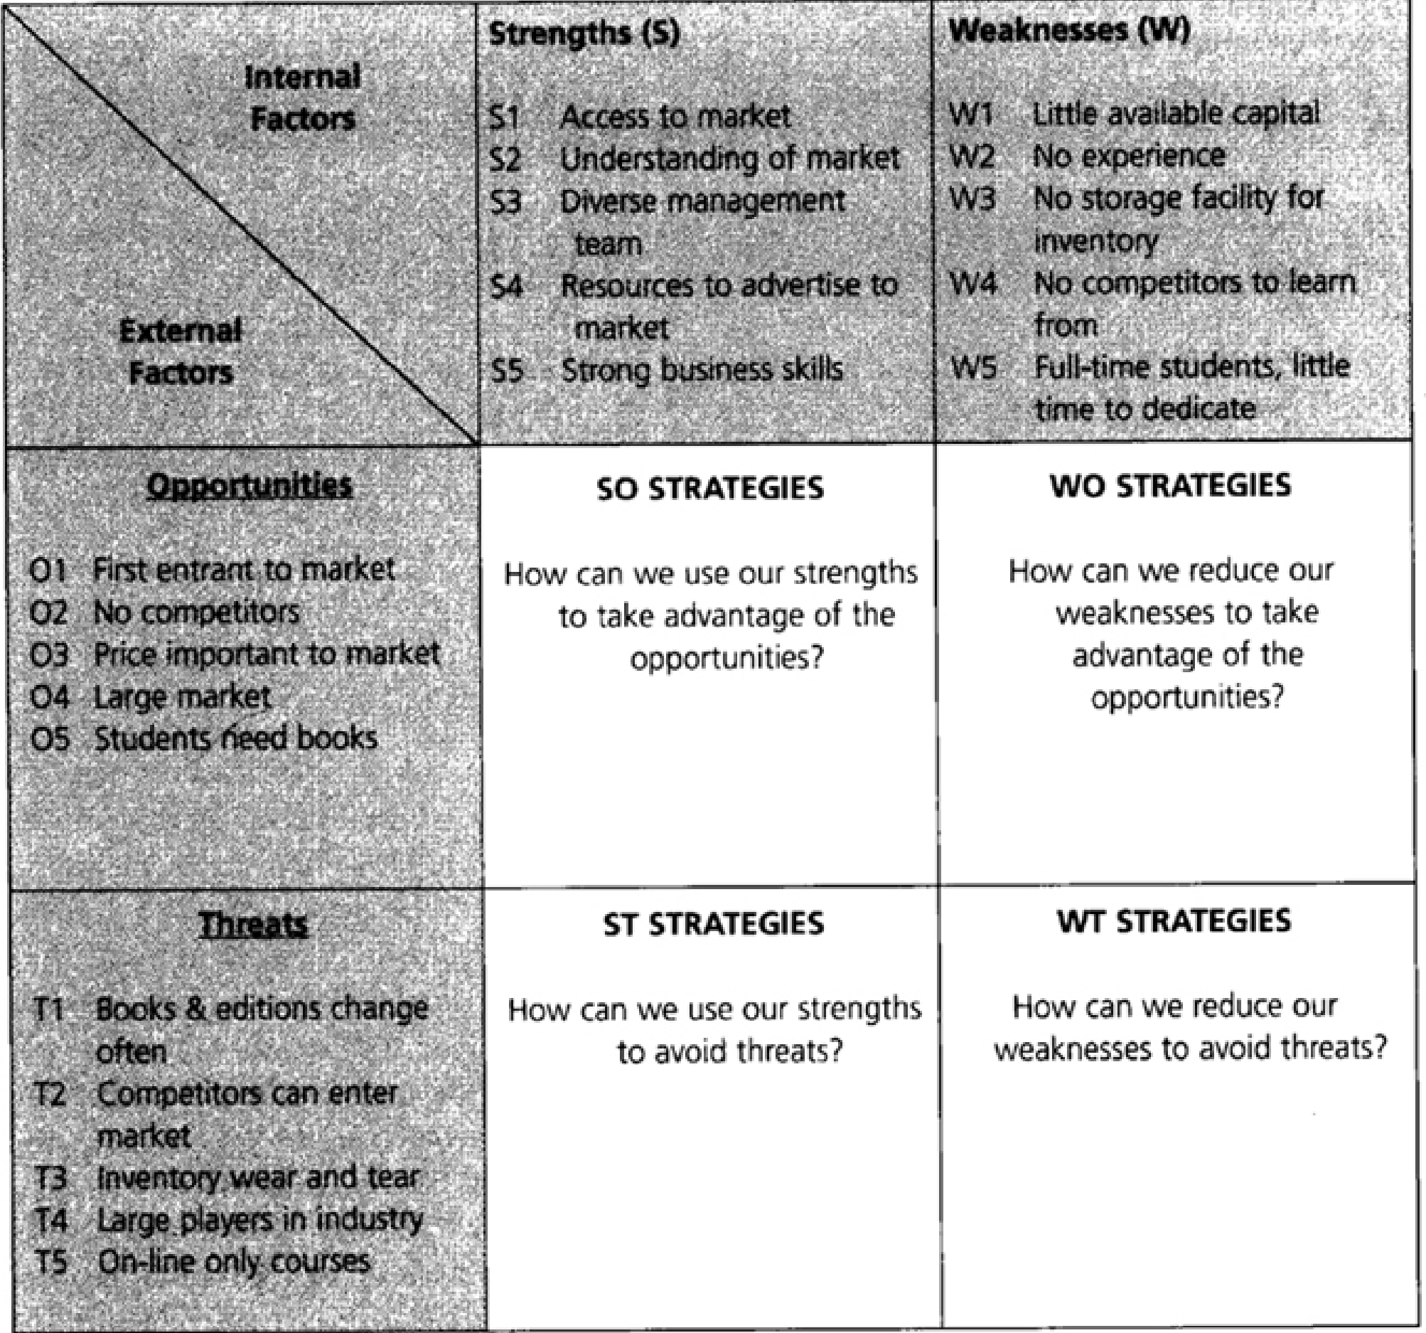

Slide 41
Management Team Strategies
As a group, the participants in http://RentABook.com have agreed on making the business relationship a general partnership. It was agreed that all the founding members would divide money shares into equal portions, and most decisions would be made as a team. The reason this is done is to ensure that no decision impact's just one team member's future. If a decision is made, it is made as a team, and because the company is a general partnership, all assume equal liability for the company. There is no future consequence to a specific person for the team's error or. As a disadvantage to this partnership, although most decisions are made as a team, some decisions will be made individually when it come to the different sectors of the business, and if the decision is a wrong one, it will reflect on the whole team and company as the general partnership assumes a team liability instead of an individual one.

Slide 42
Location
http://RentABook.com is a company that does not possess large amounts of capital, so the team has decided that the location of the warehouse and operations would be in one of the team member's household. The consequence of this decision is that a lot of money is saved. The expenses of rent and most utility bills are saved in this decision. All that is needed for the company at first is a location to store books and a place to have your systems ready to run. Although a warehouse is being considered for our future projections, to start up we would like to have a secured location. As an advantage to using a team member's apartment, we have the fact that it is located in the heart of the target market, which in this case would be Lincoln Park. This location gives http://RentABook.com the opportunity to reach out further to the customer and create a better relationship. The major disadvantage at the start will be the available storage space of the household. Although the inventory will not be as big to start as it will be in the future, some space will be needed to store the inventory that is at hand.
Strengths and Experience of Team
Although the team members and founders of http://RentABook.com are students, they have a lot of strengths that are beneficial to the company and the strategies that will be enacted. First, all the team members have knowledge and practice in all the fields that are required to run the business, and these are finance, account

Slide 43
Strengths and Experience of Team
Although the team members and founders of http://RentABook.com are students, they have a lot of strengths that are beneficial to the company and the strategies that will be enacted. First, all the team members have knowledge and practice in all the fields that are required to run the business, and these are finance, accounting, marketing, and management. We all have experience in most of these courses and also possess working experience in all of these fields. Second, as http://RentABook.com is a company created for students, we are students, and we are aware of the needs that students have wanting to purchase a textbook, and that is price. In other words, we are a part of our target market, and as a result, we know the needs of our customer. Third, because we are students and know the key factors involved in a student's decision, we will know how to reach and catch the attention of our potential customers. Finally, our competition is well known by the team because we used to be customers of these companies. With all these strengths put together, http://RentABook.com could be a great asset and benefit for the student population.

Slide 44
Structure of http://RentABook.com
One of the major advantages in the management of http://RentABook.com is that we will have no employees to start. This will give the company no worries on an hourly pay or salary for others apart from the team. As a consequence of this, the team members of http://RentABook.com will be their own employees. As stated before, most decisions within the company will be made as a team, but some members will focus more on a certain department. The team members assigned to each department are the ones who are most knowledgeable and experienced in the field. As a consequence of this analysis, the team has been structured as follows:
Andres Ayala and Maria Mendoza: Management Arby Gonzales: Accounting and marketing Staci Oliyar: Finance
With the experience of each member in his or her assigned area, http://RentABook.com will have a major strength in each department, and as a consequence of this structure, the ideas provided to the team as a whole will be more efficient and organized, and with all this in mind, the whole team will give advice and agree on a certain decision as a whole.

Slide 45
What Does http://RentABook.com Need from the Team?
The main concern before opening a business is money, but once the money is there, the individual or team has to analyze many other things if their business is to be successful. Our team needs to know how to reach out to the student market and let them know that http://RentABook.com has opened. In other words, a wellthought-out marketing strategy needs to be created so our market o knows that we provide an affordable service. Because our main goal and mission is to provide students with an affordable price that beats out our competition and saves money, we need to make sure that this is what happens. Without providing an affordable and low price, the company is lying to the market and will not be successful. Finally, we need to create a customer-company relationship within http://RentABook.com. For our service to survive throughout the years, we need to prove that we are a company that cares about the customer. By doing all this, our customers will give good words of trust and advice about our company to other incoming or current students. Furthermore, the good reputation of http://RentABook.com would create a good following of loyal customers.

Slide 46
What Does http://RentABook.com Have and Lack?
As a team, we have decided that to create a bigger inventory, the team members will donate their own books to the company. Although this will not create a big inventory, it will augment the inventory that we purchase. We also have the advantage of technology on our side. Because our business is basically run from the Internet, the fact that we have a Web site gives us a way to reach our customers in the comfort of their own homes. On our advertisements, we will post our Web site for the customer to visit and rent books, and this also creates a way of advertisement for http://RentABook.com. By students visiting the Web site alone, they will know that this company exists, and they will tell their friends about it, and with this, our Web site creates a word of mouth around our target market population. Our team possesses the skills needed to run the business. Without the skills and strategies of every one of the members, http://RentABook.com would not have been created. All of these strengths will be essential and beneficial in the running of http://RentABook.com.
Although we do possess major strengths and abilities that will benefit us when the business is in progress, our company does lack some items that could be beneficial. There is a lack of inventory within our reach because our start-up capital is not as high as other companies.

Slide 47
As students, we do not posses a lot of money, and as a solution to our lack of capital and inventory, we have decided to apply the strategy of just-in-time inventory. Although we will have a good enough stock of books to start up, when someone requests a book that is unavailable in the inventory, http://RentABook.com will order it the minute the order is received. This will create a bigger inventory for us throughout the future and also allow us to save some money on inventory. As an effect of not having a big inventory, we lack the ability of having a warehouse or storage area. Although this could be beneficial to us, it also creates the advantage of saving us money. Finally, we do not have any employees but ourselves. Because the company provides its service mostly through our Web site, we do not need to have employees at the start. This also saves us money and gives us the opportunity to invest the cash into other beneficial assets for the company. Although we do lack these things at first, in the future, they are essential to the running of our business, and they are things that will be examined in detail after the success of our business.

Slide 48
Financial Strategies
Start-up Costs
The following is a list of the start-up costs that our company is anticipating to incur in the first year of our existence. These costs include our domain name, which we will have to purchase for at least five years, as well as a server and the appropriate software to host and run our Web site to the best of its ability. We will also need a fast Internet connection to be able to manage the traffic on our Web site. The T-1 connection is one of the fastest, and we chose it because we do not want students to get frustrated at our slow connection and go to another Web site. We will also have Microsoft Commerce Manager® and PayPal® on our Web site for further convenience. Microsoft Commerce Manager will help us build our storefront, including shopping carts, inventory searches, shipment tracking, and the ability to use any major credit card securely on our Web site. We will also need our initial inventory, and the fees for the partnership agreement and legal fees. The partnership agreement will ensure that we are all protected from a legal perspective.

Slide 49
Start-Up Costs
• Five-year domain name: $350 for initial cost
$7.25 per year thereafter
• Intel Xeon processor and server: (Includes all the proper Web software and disaster recovery) $5,000 purchase price
• T-1 Internet connection 1.54 MBps $3,348 year
• Microsoft Commerce Manager $300 per year
• Fees for using PayPal $0-$3,000 2.9% + $0.30
• Initial textbook Inventory $20,000
• Shipping supplies $500
• Legal fees $300
• Partnership agreement $99
• Advertising campaign $1,200 per year
• Licensing $400
Total Start-Up Cost: $31,497

Slide 50
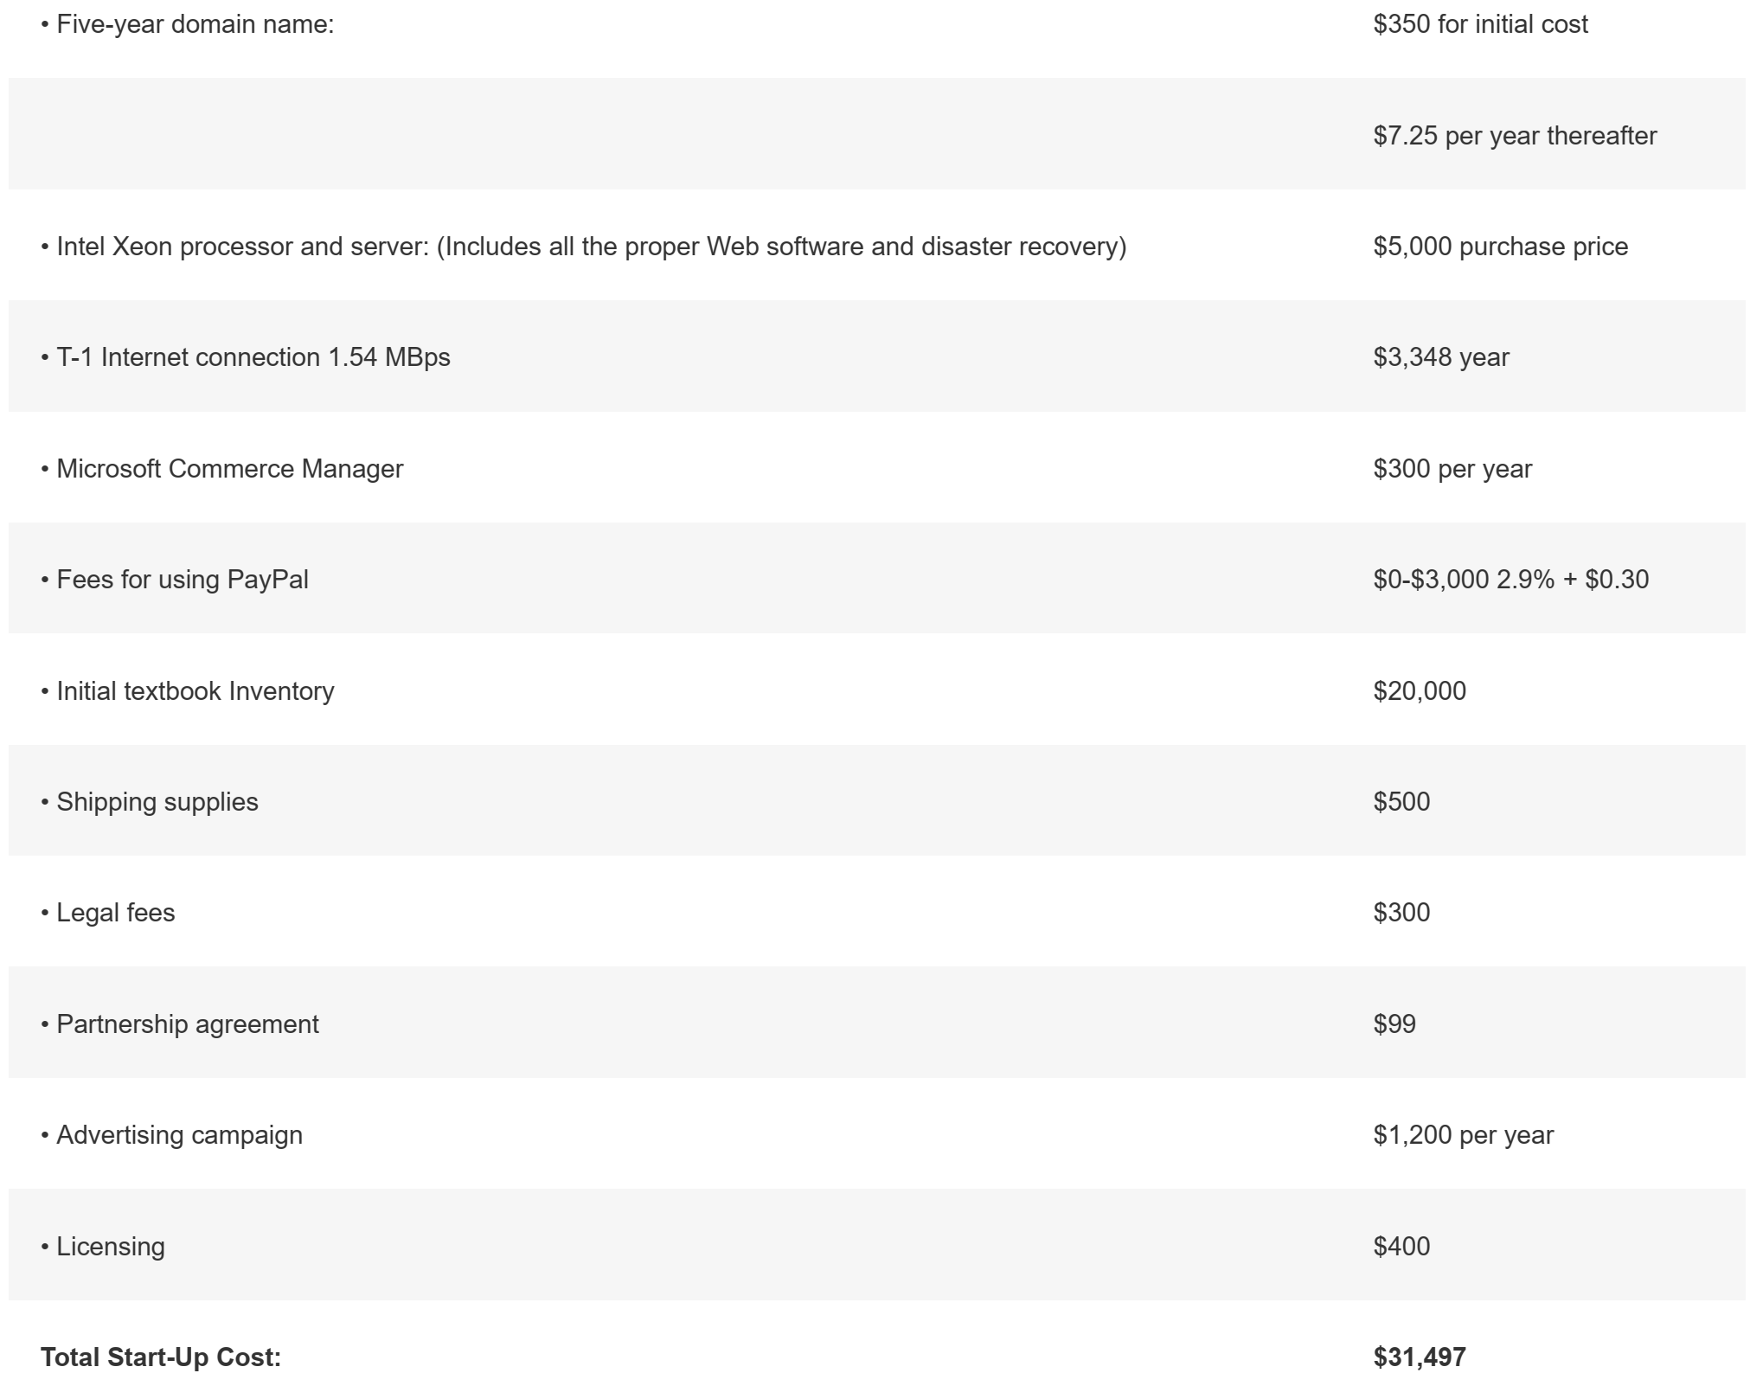

Slide 51
Our total start-up costs came out to $31,497. In our opinion, these figures are very feasible for a team of four, and we will easily be able to raise the above amount to start our company. We realize that this list may be incomplete, due to the fact that many companies incur unanticipated costs along the way. We are prepared for the fact that there may be additional costs involved with starting our business, and we are willing to be flexible enough to adjust our figures where necessary.

Slide 52
Financing
Our company will have a debt/equity structure for the financing of our company. The equity financing will come from team members themselves as well as our friends and family. The team will come up with $6,000 in personal savings as well as another $6,000 collected from family and friends for a total of $ 12,000. The rest will be debt financing. Our team will apply for a small business loan from a bank for $15,000. We think that we will be able to get such a loan because the loan amount is not very large, and we can provide the collateral. Our suppliers will also provide some of the debt financing with a $5,000 credit for our inventory for a total of $20,000. This brings our total to $32,000, which is a little bit above our initial start-up costs. Finally, our team is prepared to use credit cards in the event that we incur unanticipated costs. We will use the credit cards as a last resort.

Slide 53
Pricing Strategy
Our pricing strategy was designed to save our customers money. We can keep our price so low because we can get up to six turnovers on a textbook before it becomes obsolete. Usually, the publisher will release a new edition every two years or so. This will give our company a chance to turn over the book six times before a new edition comes out. (Three quarters per year times two years.) This analysis does not include the December session or summer school classes. In that case, our turnover would be even greater. When a book does become outdated, we will either ship it back to the publisher or sell it on our Web site at a deep discount. We will not be renting old editions of textbooks.
Our company's strategy is to save students 30 percent on every book they buy compared to the price a bookstore charges. For example, if a book is sold for $100 at the bookstore, then we will be offering the book for $70. The security deposit will be 30 percent of the $70 purchase price. In this case, the security deposit will be $21 ($70 × .30). The rest of the purchase price will be the rental charge (only $49). If a student decides to keep the book, we will keep the security deposit, and the student still gets the book for $70. If a student does decide to return the book, we refund the security deposit and the student only pays $49 to rent the book. Overall, each student saves 51 percent on every textbook rental versus if they bought the book at the bookstore.

Slide 54
The Numbers
http://RentABook.com's strategy for making extra profit is to use the deposit money to invest in 30-day Treasury bills. Because every month we will have a surplus of cash from deposits, we can increase our profits by using that money to invest in low-risk bonds. At the end of the 30-day period, the deposit will either be refunded to the customer, or in case the customer chooses to keep the book, the money will go back into the company.
In the first fiscal year of our company's existence, we project that we will end up with a net profit of $5,215 (Appendix 2). Taking into account all of our expenses, the first two quarters we will experience a loss of ($17,334) and ($5,945), respectively. However, by the time spring quarter ends, our company will be making a profit of $11,160. Our net profit for the year will be $5,215.
By year two, we project a net profit of $19,514. Overall, our company will grow at a steady rate as we gain recognition among the student population. The reason for our company's rapid growth of 274 percent from year 1 to year 2 is the fact that we will not be taking into account any more start-up costs. Our expenses from the first year onward will all be minimal, such as the upkeep of the Web site, Microsoft Commerce Manager fees, and fees for using PayPal. We predict a steady growth of our company as students begin to use our services across universities in the Chicagoland area. If our company keeps growing, within the next couple of years, we will be adding extra expenses such as renting a warehouse and hiring new employees.

Slide 55
Recap
Strategic plan outline
Strategic vision
TOWS analysis
New venture's strategic positioning
Six new approaches
Case study

Slide 56
Summary
1. Use the strategic plan outline to develop organizational-level strategies, industry-market strategies, management team strategies, and financial strategies for the new venture
• Organizational-level strategies articulate the mission and key values.
• Industry and market strategies explore the social and economic trends, the industry climate, key competitors, the markets the new venture serves, and the methods to create awareness by the customer base.
• Management team strategies explain how the new venture will capitalize on the strengths of its members and how it will compensate for what it lacks.
• Financial strategies define the start-up costs, explore financing alternatives and how they will be used, and present at least one year of projections.

Slide 57
Summary
2. Conduct a TOWS analysis to consider the new venture's strategic position.
• The Threats-Opportunities-Weaknesses-Strengths analysis is an innovative approach to analyzing the external environment and applying the new venture's strengths and weaknesses in ways that capitalize on the opportunities and minimize the threats facing the new venture.
3. Explore new approaches that shift the focus of the new venture's strategy from direct competition to the creation of new value
• Research has shown that the most innovative organizations are moving from competing directly with others in their industry to creating new value that enables them to establish new market space.

Slide 58


Thank You

