Slide 1


Early detection of academic weakness in students using artificial intelligence tools
Prepared by
Hissa Alotaibi
Submitted in fulfillment of the requirements for the degree Master of Science in Artificial Intelligence
Supervised
Dr. Yasser Abdul Hamid
College of Informatics Department of Artificial Intelligence

Slide 2

Outline:
Introduction
Problem
Project Goal
Thesis Contribution
Related Work
Proposed Approach
Baseline Model Performance
Discussion
Conclusion
Future Work

Slide 3
Introduction
The Kingdom of Saudi Arabia is keen on education and its importance, and seeks to develop the educational process and provide a suitable environment for students.
Therefore, Our project therefore focused on developing a model to help teachers identify students at risk of academic failure at an early stage and intervene to address the issue
Academic failure is often attributed to social circumstances, psychological pressures, and poor study skills such as time management or motivation. which studied the school environment and included 4,660 students from 24 schools, the results indicate that the strongest indicator is the prediction of previous grades, projects, and activities, in addition to psychological and social factors. From these results, we emphasize the importance of early and effective assessment based on the two previous points in order to identify risks and intervene to improve academic performance

Slide 4
Project Goal:
Review research studies on the causes of poor academic performance among students.
Use and analyze student data
Create a model to help teachers identify students with low grades at an early stage and assist them in passing the course
Thesis Contribution
This project focuses on school students with the aim of helping to reduce academic failure at the end of the school year, assisting teachers in identifying students at risk of failing a particular subject, and identifying high-achieving students, thereby contributing to improving the quality of the educational process. This is achieved by creating a tool designed using machine learning models and real student data to provide interpretable results, while allowing for future scalability.

Slide 5
Related Work
References | Model-Used) | Data Set | Results
Khan, I., Ahmed, M., & Ali, S. (2021). | k-Nearest Neighbors (K-NN) Multilayer Perceptron (ANN) Naïve Bayes Decision Tree (RepTree) | collected from the University of Amman over three semesters, covering 151 cases and ten predictive features of student performance | MCC (Matthews Correlatio Coefficient (K-NN)=0.517 (ANN)=0.585 Naïve Bayes=0.599 Decision Tree=0.637
Deo, R. C., Yaseen, Z. M., Al‑Ansari, N., Nguyen‑Huy, T., Langlands, T. A. M., & Galligan, L. (2020) | ELM model Random Forest (RF) Volterra model | Six years of student performance data from the University of Southern Queensland, Australia Included several in-person and distance learning courses | prediction error ELM model :0,74% Random Forest (RF) :3.12% Volterra model :1.06%
Ujkani, B., Minkovska, D., & Hinov, N. (2024) | Random forest Gradient Boosting Classifier K-NNs Neural Network LSTM XGBoost CNN | The data set from the Open University includes data on 32,593 students over a 9-munth academic period from 2014 to 2015 | Accuracy First custom Neural Network Model = 94% RF=86% XGBoost = 86% k-NN = 82% Multi-layer Preceptron=85% CNN=86%
Zeineddine, H., Braendle, U., & Farah, A. (2021) | SVM K‑NN Random Forest Gradient Boosting | The study used university student data comprising 461 cases for a specific period between 2016 and 2021 | Relative Prediction Error SVM: 3.5% K‑NN:8.0% Random Forest:6.0% Gradient Boosting:4.5%
Nimy, E., Mosia, M., & Chibaya, C. (2023) | Logistic Regression Support Vector Machine (SVM) Decision Tree Random Forest Naive Bayes | A university in South Africa used student academic data such as tests and assignments, as well as their interaction on the platform, such as the amount of time they spent on the platform, and demographic data. | Logistic Regression:11.6% (SVM):10.5% Decision Tree:12.7% Random Forest:12% Naive Bayes :7.19%

Slide 6
Related Work
References | Model-Used) | Data Set | Results
Lau, E. T., Sun, L., & Yang, Q. (2019) | ANN neural networks | The study included 1,000 cases from a Chinese university and three university programs over four years and used 11 variables | ANN neural networks: 84.8
Mondal, A. & Mukherjee, J. (2018) | Recurrent Neural Network (RNN) Artificial Neural Network (ANN) Deep Neural Network (DNN) | Data from Kaggle was used | prediction error (RNN):85% (ANN):82% (DNN):83%
Embarak, O. H., & Hawarna, S. (2023). | Artificial Neural Networks (ANN) Random Forest XGBoost algorithm Support Vector Machine (SVM) | The study collected data from 450 university students from different universities. The data included academic, behavioral, and psychological data | Accuracy ANN:82.22% Random Forest:84.44% XGBoost algorithm:87.78% (SVM):85%
Melo, E. C., & Souza, F. S. H. (2023). | Semi-Supervised Learning Logistic Regression K-Nearest Neighbors (KNN) Decision Tree XGBoost | From an educational institution in Brazil for one year, including • 5,915 cases of dropouts • 2,096 cases of graduates | Accuracy Semi-Supervised Learning:90% Logistic Regression:85.5% (KNN):87.68% Decision Tree:88.05% XGBoost 92.05%
Ben George ,E., Senthilkumar,R., Al‑Junaibi, F., & Al‑Shuaibi, Z. (2025) | Random Forest XGBoost algorithm | Data from 500 students collected from several educational institutions was used, an 10 features were utilized. | Random Forest=85% XGBoost algorithm=84%

Slide 7
Research gap:
The need to expand the scope of the study so as not to affect the generalizability of the results.
Adding the largest possible segment of students to contribute to increasing the efficiency and accuracy of the model.
Adding multiple features, different educational materials, and varying educational levels.
Need to focus on understanding the model's recommendations to help teachers make decisions
Need to study the practical application of prediction to guide real educational interventions, determine the effectiveness of the model, and measure its impact on students

Slide 8
Summary
The literature supports the use of artificial intelligence and shows its success in identifying students at risk of failing with high accuracy using different models. Based on these results, we find that the results of the models differ between studies, but the most accurate was XGBoost with 92%, while the most commonly used models are recurrent neural networks (RNN) and Random Forest. Therefore, the appropriate models for the study will be selected and trained on real data after processing and improving feature selection to give higher quality and credibility results, thus contributing academically and scientifically in this field.

Slide 9
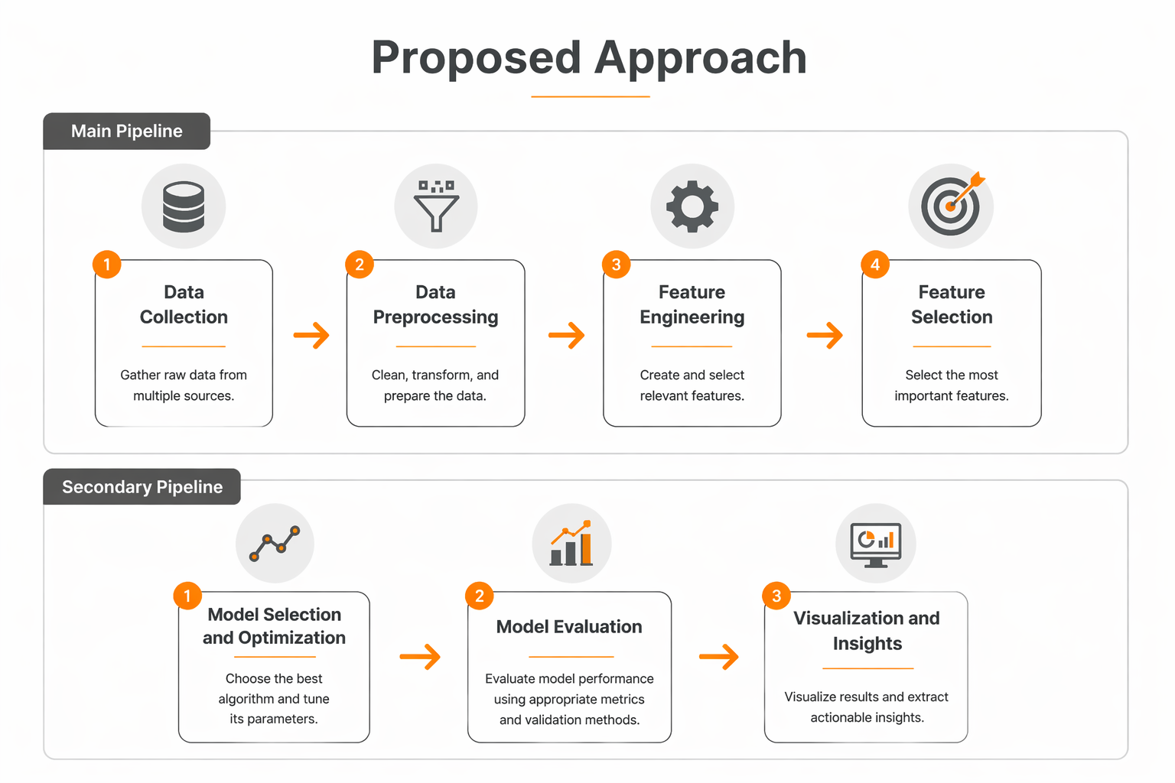

Slide 10
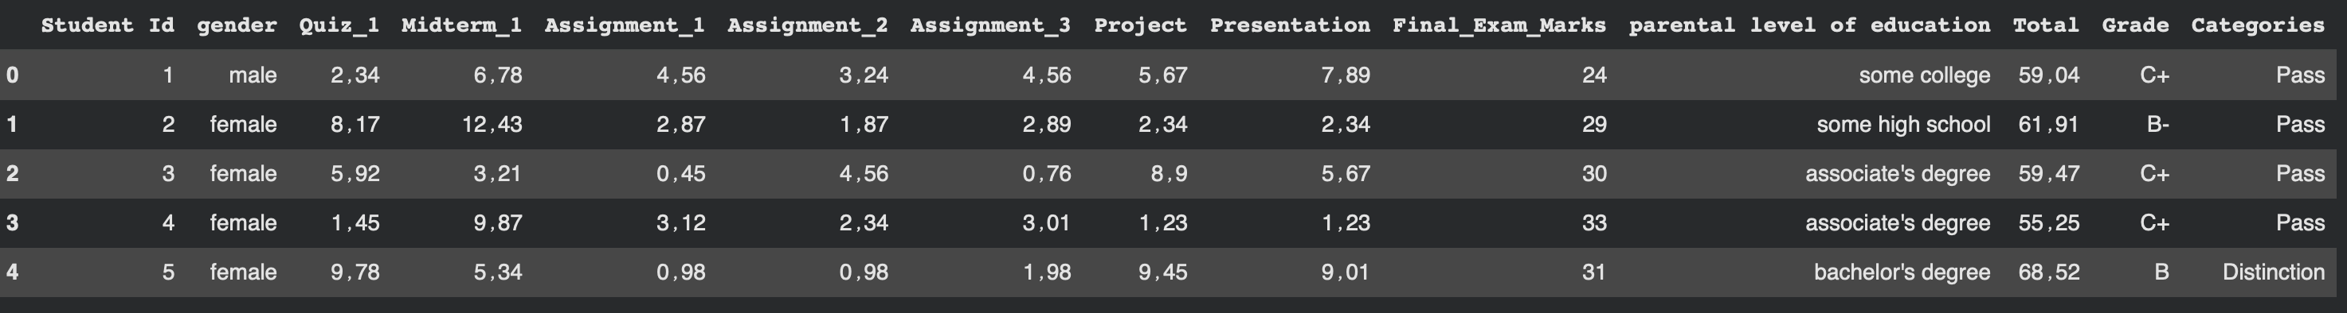
Proposed Approach
Data Collection and Description
A dataset from Kaggle relating to students’ academic performance was used. This dataset contains information on 520 students, comprising 13 columns that include students’ marks in tests, assignments, projects and presentations, as well as other details such as gender, parents’ educational attainment and final exam results. The data was categorised to analyse student performance and classify them into five groups that determine each student’s level and predict areas of academic weakness.

Slide 11
Data Preprocessing
replacing commas with periods
Converting text columns to numbers
Handling missing data
Missing values were replaced with the mean values
Removing some columns: To achieve accurate results, we had to remove certain columns such as Student Id because it provides no benefit to the predictions. The Grade and Total columns were also removed because they resulted in extremely high prediction rates,
Data Splitting
Training 80%
Testing 20%

Slide 12
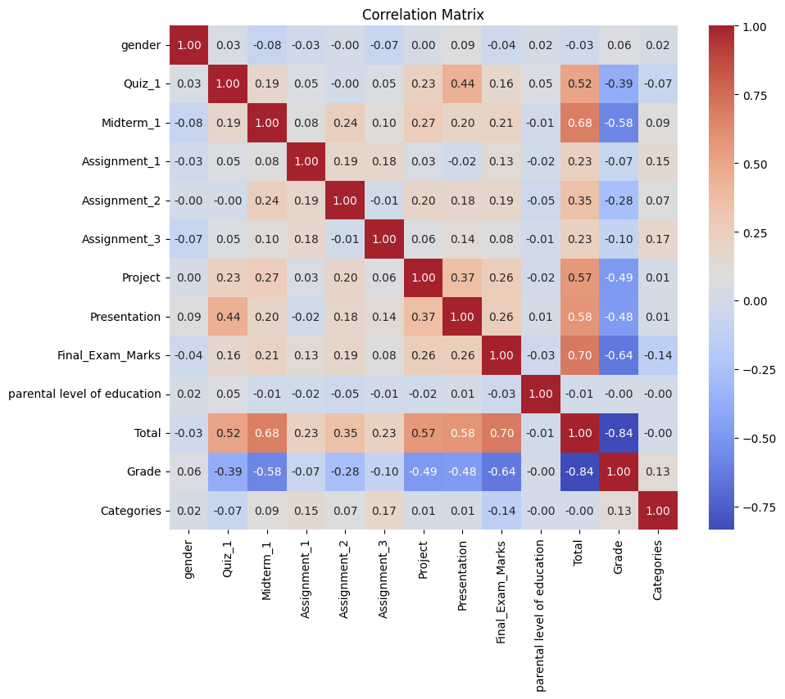
Feature Engineering
The features available for training were optimized based on the original data, such as extracting interactive features between different test scores.
From correlation matrix for our dataset, it is clear that there is a positive correlation (.44) between Quiz_1 and Midterm_1, meaning that if a student scores well on Quiz_1, they are more likely to score high on Midterm_1, and there is also a strong correlation (.70) between Final Exam and the total score, indicating that final exam scores account for the largest share of the total score. There is a positive correlation (0.68) between Midterm-1 and the total score, while weak and negative correlations were observed between Assignment

Slide 13
Feature Selection
Features with a strong influence on the prediction of academic underachievement were selected by examining the previous correlation matrix, analyzing the relationships between features, choosing those most closely associated with academic underachievement, and removing features that cause overfitting—such as Grade and Total—to improve class distribution. The column that the models will predict is “Categories,” so that we have five classifications.

Slide 14
Model Selection and Optimization
The machine learning models used are suitable for the task of predicting academic underachievement, including KNN, Decision Tree, Random Forest, and XGBoost
They were optimized using GridSearchCV to obtain the best parameters, such as the number of trees in Random Forest and XGBoost and the tree depth in Decision Tree
We also used optimization techniques such as cross-validation to reduce overfitting and ensure that the models are capable of good generalization

Slide 15
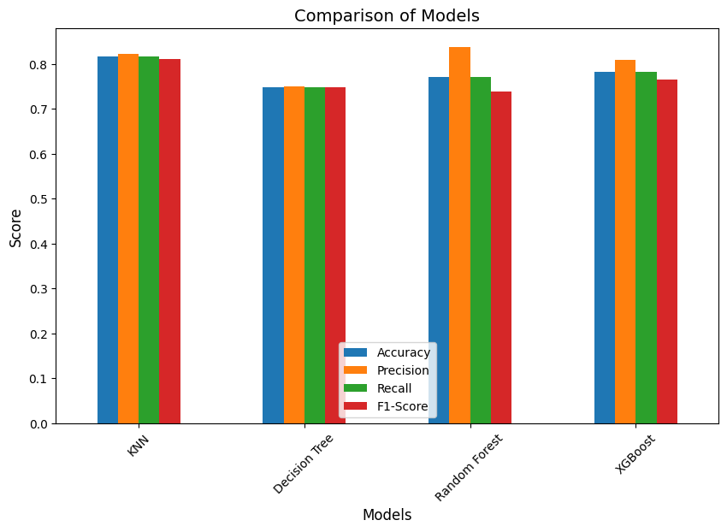
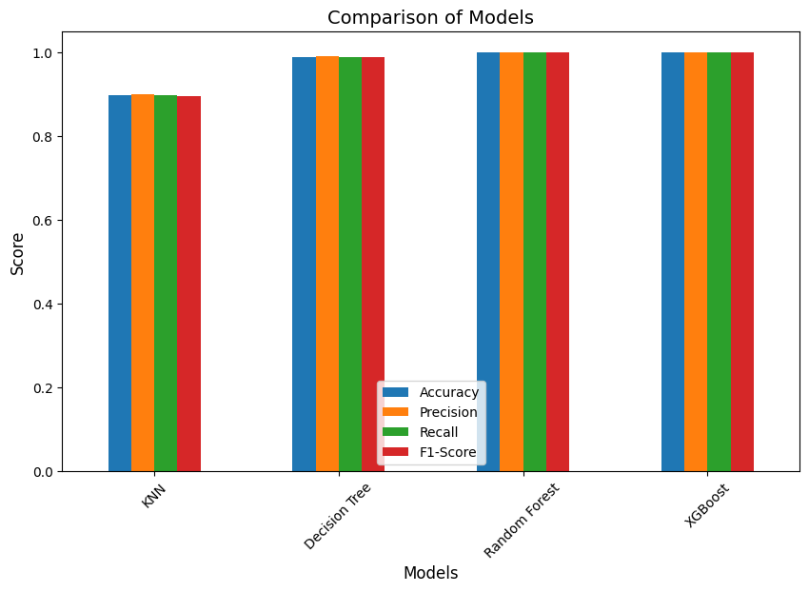
Model Evaluation
The study presented results in two phases.
The first phase included all features in the dataset, and the results were unrealistic and extremely high due to the presence of “Grade” and “Total,” with accuracy reaching 100%, indicating “overfitting.”
As for the second phase the features causing high accuracy were removed because the models treated them as redundant, and the results became more realistic

Slide 16
the models’ results varied and were more realistic. The best model in terms of overall performance is KNN, as precision, recall, and F1-score are more balanced in this model, while Random Forest also achieved high precision but failed to improve the F1 -Score, and thus did not outperform KNN in terms of balance, making KNN the best model when considering the balance between accuracy and recall. As for the XGBoost model, its performance was average compared to the rest of the models, and the decision tree model performed the worst among them and needs parameter tuning.

Slide 17
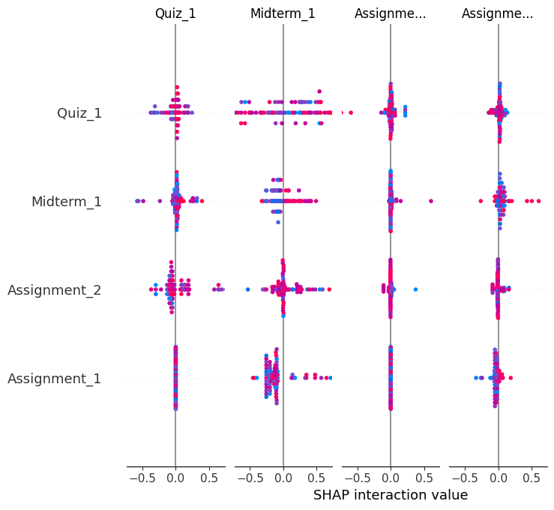
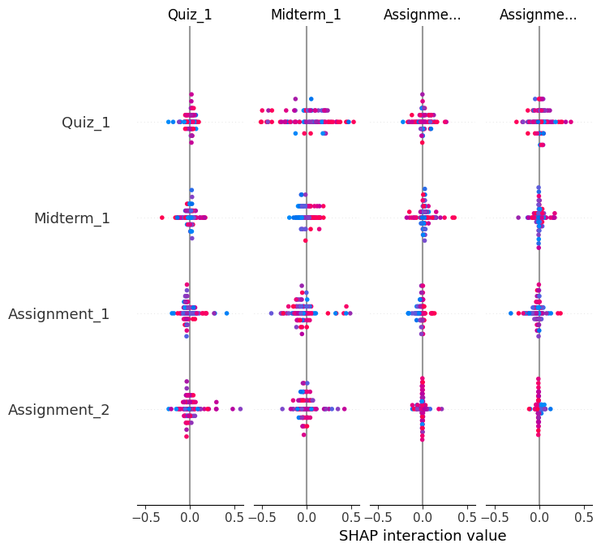
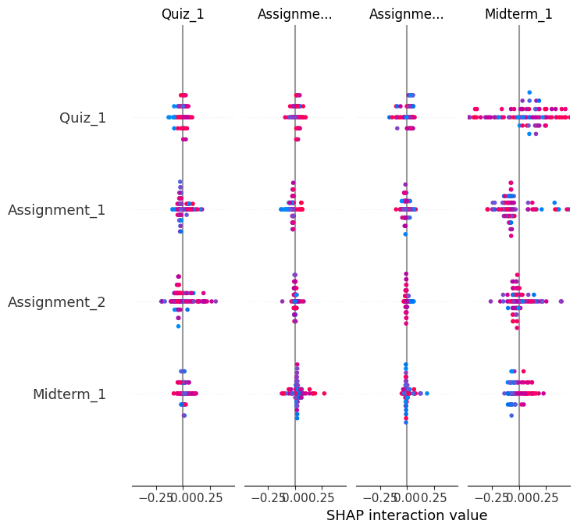
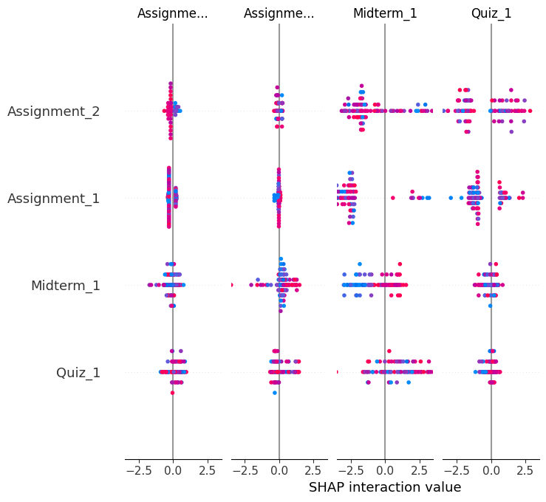
  Visualization and Insights
KNN | Decision Tree
XGBoost | Random Forest
After using SHAP diagrams, we observe that In the Decision Tree ، KNN models, we see that the features Midterm 1 and Quiz_1 have a significant impact on the final result and play a key role in determining academic success. The SHAP values show strong interactions with these features, where red dots indicate a positive impact and blue dots indicate a negative impact.. In the RF model, the feature with the greatest impact on the results was Quiz_1 compared to the other features, whereas in XGBoost, the features Assignment_1 and Assignment_2 had the greatest impact.

Slide 18
Baseline Model Performance
Following the high results and the overfitting issue in the first phase of the model،We removed columns that were irrelevant to the prediction process, such as :
student ID, and removed features that caused overfitting, such as Total،Grade
Therefore، the results became more realistic. After adjusting them with GridSearchCV, the performance metrics appeared as follows:
(Model) | (Accuracy) | (Precision) | (Recall) | F1 (F1-Score)
KNN | 0.82 | 0.83 | 0.82 | 0.81
Decision Tree | 0.75 | 0.75 | 0.75 | 0.75
Random Forest | 0.77 | 0.84 | 0.77 | 0.74
XGBoost | 0.78 | 0.81 | 0.78 | 0.76

Slide 19
Discussion
The use of artificial intelligence in predicting student performance is important for improving their final results and identifying underperforming students early on so that teachers can intervene and address their weaknesses. The models yielded good results after a careful selection of appropriate features. The most significant findings were as follows:
A student’s performance on projects and presentations has a strong correlation with test scores
Students who performed well on the midterm exam achieved high scores on the final exam
Simplifying the model improved results by removing several features and focusing on those most influential on student performance
The KNN model showed more balanced and stable results and achieved the highest accuracy value, reaching 0.82
The RF model achieved the highest Precision value, meaning it is best at reducing false positives
The model with the lowest performance is DT compared to the other models

Slide 20
Conclusion
Early prediction of student performance is one of the most important factors in addressing academic underachievement, and artificial intelligence has proven its effectiveness and accuracy in identifying this group, while the models demonstrated varying degrees of accuracy, some of which were quite good. It became clear to us from the data set that students’ performance on assignments and projects plays a significant role in improving their grades, as students who are engaged in their work perform well on exams, unlike those who are not. Furthermore, data analysis revealed that students who scored high on the midterm exam were also able to perform well on the final exam, which highlights the importance of closely monitoring students before final exams and ensuring they complete all assignments correctly. Therefore, it is important to incorporate artificial intelligence into education and use it as a tool to assist both teachers and students in achieving good results, reducing academic underperformance among students, and reducing the teacher’s workload.

Slide 21
Future Work
• Use of deep learning techniques: We can expand the scope of the curriculum to incorporate deep learning techniques, such as neural networks, to improve predictions
• Adding new features: We can introduce a set of new features to improve predictions, such as student online behavior, previous years’ grades, or interaction with educational platforms
• Model optimization: We can optimize the models using other techniques such as Gradient Boosting and LightGBM to achieve better performance.
• The number of categories can be reduced from five to just two to improve the models’ performance.

Slide 22
Thank you

