Slide 1


Time Value of Money II: Equal Multiple Payments
Prepared by Dr. Omar Al-kasasbeh
FNT 615
Finance Concepts
Lecture 6

Slide 2



Finance Concepts
FNT 615
Finance Concepts
Prepared by
Dr. Omar Al-kasasbeh

Slide 3
Lecture
6
Time Value of Money II: Equal Multiple Payments

Slide 4
Lecture
6
Table of contents
1- Perpetuity
2- Calculating the Present Value of an Annuity
3- Calculating Annuities Used in Structured Settlements
4- Loan Amortization
5- Stated versus Effective Rates

Slide 5
Lecture
6
In Time Value of Money, I, we learned that the value of money changes with the passage of time. Decisionmakers consider how investments, projects, and even opportunity costs gain value as we move forward into the future. They similarly consider how value in the future can be reduced to a value in present or past periods. We saw that these value projections are called determination of future value (compounding, moving forward on a timeline) or present value (discounting, moving backward on a timeline). The easiest way to visualize this movement through time, whether forward or backward, is by use of a timeline.

Slide 6
Lecture
6
What Is a Perpetuity?
A perpetuity is a series of payments or receipts that continues forever, or perpetually. One of the best ways to analyze the basics of an annuity (the stream of payments to be paid or received in the future) is by starting with a perpetuity.
for example, is preferred stock. Most preferred stock issues carry a fixed and predetermined rate of dividend. If we assume that the dividend will not change in future years, then preferred dividend shareholders will receive a fixed amount of money in future years assuming, of course, that the company’s board of directors declares the dividends sufficient to fund these requirements. If we assume that the dividend is declared and paid and that it remains constant, this represents a perpetuity.

Slide 7
Lecture
6
To place a current market value on this stream of future income, how much should an investor pay for one share of this preferred stock? The calculation is a present value. The amount the investor pays today for that one share is equal to the annual dividend (assuming it is declared and paid) divided by the rate of return. But be careful it is not the rate on the face of the preferred stock but the required rate of return, the “market rate” that investors expect from a stock of this level of risk. We must also note an important fact affecting all investment valuations: the value of an investment generally represents our expectations of all future cash flows from that investment, discounted to today’s dollars. Because a perpetuity is a stream of payments continuing indefinitely, determining the future value isn’t possible.

Slide 8
Lecture
6
The study of perpetuities in corporate finance is a first step to understanding valuation models of certain investments, such as the dividend discount model and the constant growth model, to be addressed in other chapters. Our ability to discount future cash flows, even infinite cash flows, to a present value is a clue to the price at which a company’s stock might trade. From a personal financial planning perspective, the individual investor is also better able to be certain that they are paying a fair price for holdings in their portfolio. For purposes of long-term or retirement planning, the investor must consider that a fixed and unchanging dividend, such as from preferred stock, might not adequately protect the holder from inflation in times of rising prices.

Slide 9
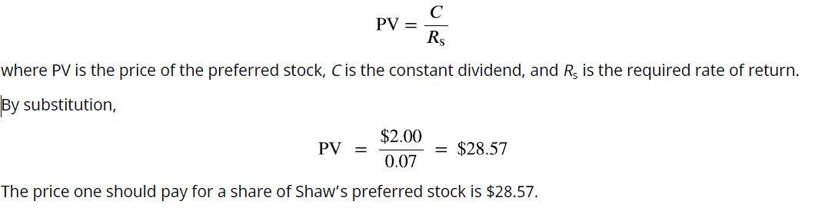
Lecture
6
How to Value a Perpetuity
The holder of one share will expect to receive a $2.00 dividend for every share owned. Although a perpetuity may allow for growth of that dividend, we will hold that constant now. We must know one additional fact: the required rate of return. This is our random variable, which can cause fluctuation in the price of the preferred stock. Let’s assume that the required rate of return, which we’ll call RS, is 7%. This is the rate of return that the market expects in order to take on the risk of an investment such as Shaw. Determination of the price of Shaw’s preferred stock becomes quite simple because the expected annual cash flow should not change, making it a constant perpetuity. The constant perpetuity formula is

Slide 10
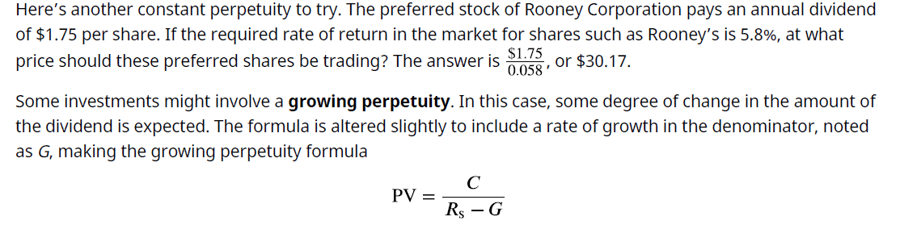
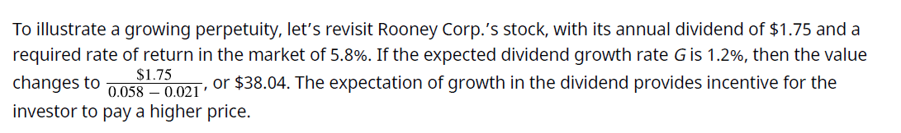
Lecture
6

Slide 11
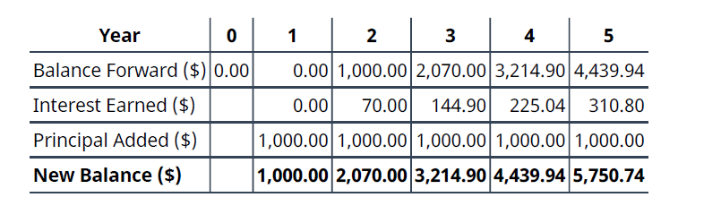
Lecture
6
Calculating the Present Value of an Annuity
An annuity is a stream of fixed periodic payments to be paid or received in the future. Present or future values of these streams of payments can be calculated by applying time value of money formulas to each of these payments. We’ll begin with determining the present value. Before exploring present value, it’s helpful to analyze the behavior of a stream of payments over time. Assume that we commit to a program of investing $1,000 at the end of each year for five years, earning 7% compounded annually throughout. The high rate is locked in based partly on our commitment beginning today, even though we will invest no money until the end of the first year. Refer to the timeline shown in Table

Slide 12
Lecture
6
Annual deposits of $1,000 made at the end of each year accumulate through compound interest at an annual rate of 7%, resulting in a final balance of $5,750.74 after five years, including $5,000 in principal and $750.74 in accumulated interest. The first deposit begins earning interest in the second year, whereas the final deposit earns no interest because it is made at the end of the investment period. This illustrates the characteristics of an ordinary annuity, in which equal payments are made at the end of each period. Similarly, receiving $25,000 annually for five years, beginning one year from now, represents an ordinary annuity, and its present value is determined by calculating the amount that must be invested today at an 8% annual interest rate to finance these future payments.

Slide 13
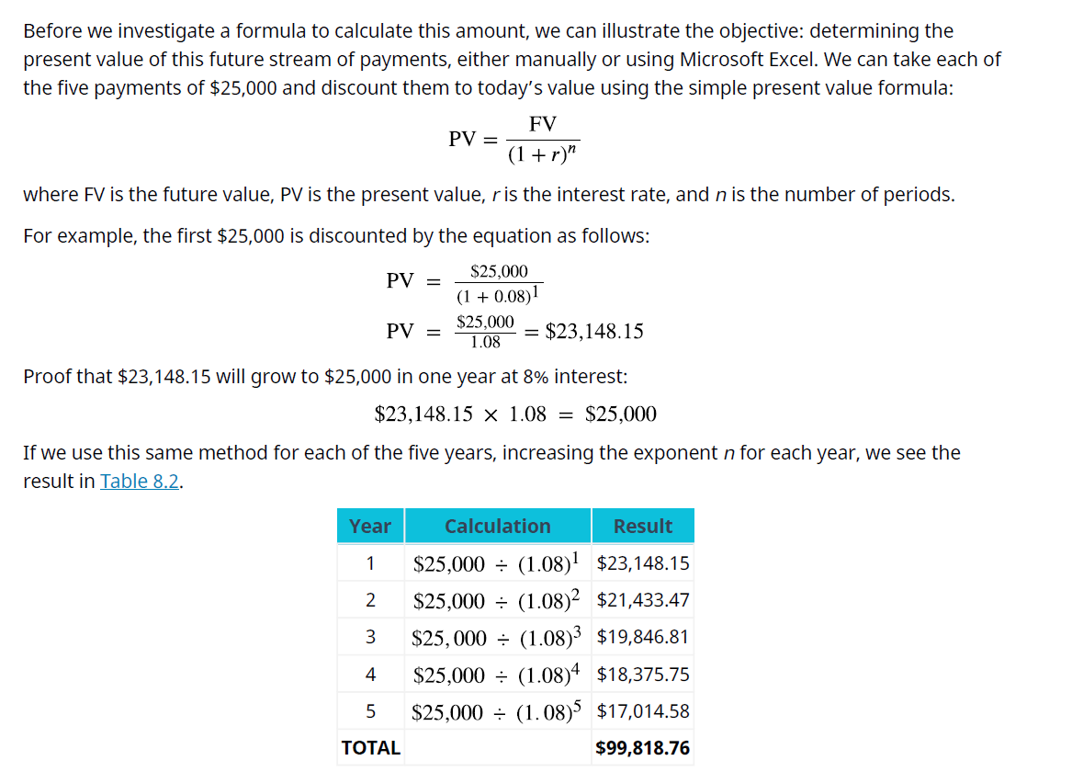
Lecture
6

Slide 14
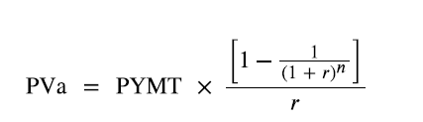
Lecture
6
We begin with the amount calculated in our table, $99,818.76. Before any money is withdrawn, a year’s worth of interest at 8% is compounded and added to our balance. Then our first $25,000 is withdrawn, leaving us with $82,804.26. This process continues until the end of five years, when, aside from a minor rounding difference, the fund has “done its job” and is equal to zero. However, we can make this simpler. Because each payment withdrawn or added is the same, we can calculate the present value of an annuity in one step using an equation. Rather than the multiple steps above, we will use the following equation:
where PVa is the present value of the annuity and PYMT is the amount of one payment.
In this example, PYMT is $25,000 at the end of each of five years. Note that the greater the number of periods and/or the size of the amount borrowed, the greater the chances of large rounding errors

Slide 15
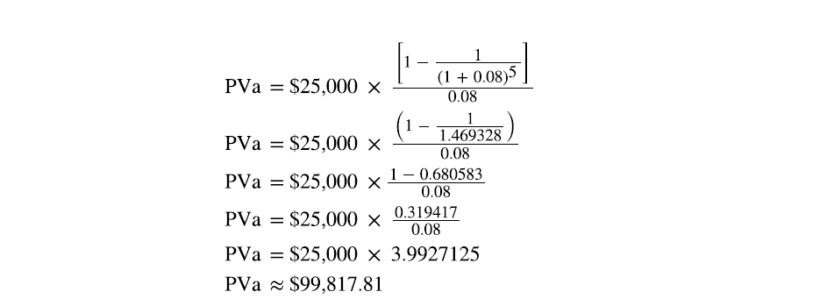
Lecture
6
In both cases, barring a rounding difference caused by decimal expansion, we come to the same result using the equation as when we calculate each of multiple years. It’s important to note that rounding differences can become significant when dealing with larger multipliers, as in the financing of a multimillion-dollar machine or facility. In this text, we will ignore them.

Slide 16
Lecture
6
The present value of an ordinary annuity is widely applied in investment and financial decision-making to compare a series of future cash flows with an immediate lump-sum payment. For example, an investor may choose between receiving $120,000 annually for ten years or a single payment of $787,000 today. Since future cash flows cannot be directly compared with a present amount, they must be discounted using an appropriate discount rate, such as 9%, to determine their present value. This approach enables decision-makers to evaluate the economic equivalence of the available alternatives and select the option that maximizes financial value.

Slide 17
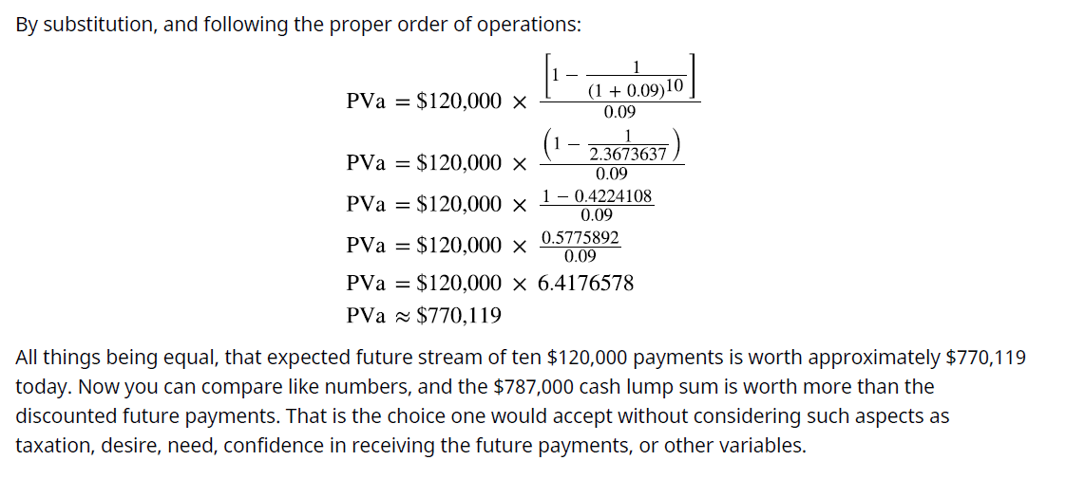
Lecture
6

Slide 18
Lecture
6
An annuity due differs from an ordinary annuity in the timing of payments, as payments are made at the beginning of each period rather than at the end. Consequently, each payment earns interest for one additional period, resulting in a higher present value than an ordinary annuity. The present value of an annuity due is calculated by first determining the present value of an ordinary annuity and then multiplying the result by (1 + i), where i represents the interest rate. This adjustment accounts for the extra compounding period associated with an annuity due.

Slide 19
Lecture
6
In our original example from this section, we wished to withdraw $25,000 each year for five years from a fund that we would establish now. We determined how much that fund should be worth today if we intend to receive our first payment one year from now. Throughout this fund’s life, it will earn 8% annually. This time, let’s assume we’ll withdraw our first payment immediately, at point zero, making this an annuity due. Because we’re trying to determine how much our starting balance should be, it makes sense that we must begin with a larger number. Why? Because we’re pulling our first payment out immediately, so less money will remain to start compounding to the amount we need to fund all five of our planned payments! Our rule can be stated as follows:
Whether one is calculating present value or future value, the result of an annuity due must always be larger than that of an ordinary annuity, all other facts remaining constant. Here is the stream of solutions for the example above, but please notice that we will multiply by (1 + i), one additional period, following the same order of operations:

Slide 20
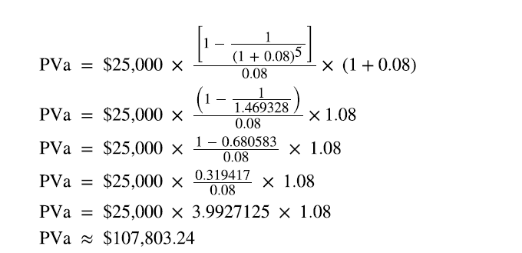
Lecture
6
That’s how much we must start our fund with today, before we earn any interest or draw out any money. Note that it’s larger than the $99,817.81 that would be required for an ordinary annuity. It must be, because we’re about to diminish our compounding power with an immediate withdrawal, so we have to begin with a larger amount.

Slide 21
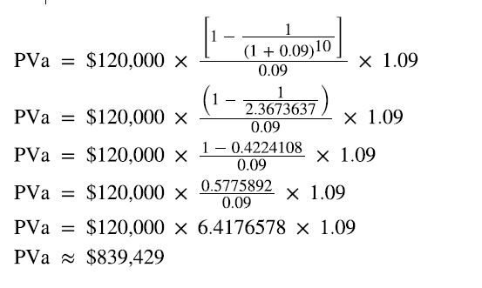
Lecture
6
To reinforce this, let’s use the same approach for our lottery example above. Reviewing the facts, you have a choice of receiving 10 annual payments of your $1.2 million winnings, each worth $120,000, and you discount at a rate of 9%. The only difference is that this time, you can receive your first $120,000 right away; you don’t have to wait a year. This is now an annuity due. We solve it just as before, except that we multiply by one additional period of interest, (1 + i):

Slide 22
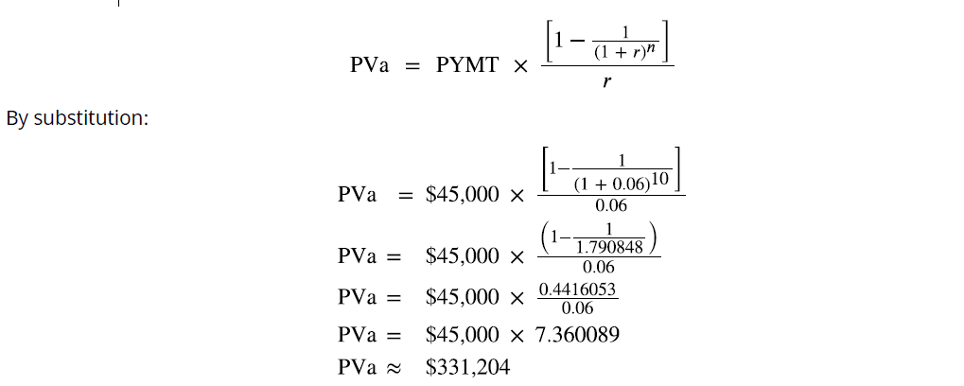
Lecture
6
Calculating Annuities Used in Structured Settlements
What would a fair cash distribution by year mean? If you have a preferred discount rate (the percentage we all must know to calculate the time value of money) of 6% and you expect equal distributions of $45,000 over 10 years, beginning one year from now, you can use the present value of an annuity formula to compare the alternatives:

Slide 23


Lecture
6
Using our example of an annuity with five payments of $25,000 at 8%, we compare the present values of the ordinary annuity of $99,817.81 and the annuity due of $107,803.24.
The result shows that the present value of the annuity due is 8% higher than the present value of the ordinary annuity.

Slide 24
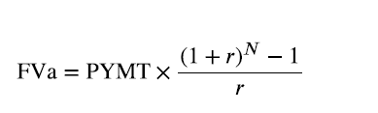
Lecture
6
Calculating the Future Value of an Annuity
if the amount of periodic investment is always the same, we may take a one-step shortcut to calculate the future value of that stream by using the formula presented below:
where FVa is the future value of the annuity, PYMT is a one-time payment or receipt in the series, r is the interest rate, and n is the number of periods.
As we did in our section on present values of annuities, we will begin with an ordinary annuity and then proceed to an annuity due.
Let’s assume that you lock in a contract for an investment opportunity at 4% per year, but you cannot make the first investment until one year from now. This is counterintuitive for an investor, perhaps, but because it is the basis of the formula and procedures for ordinary annuities, we will accept this assumption. You plan to invest $3,000 at the end of each year. How much money will you have at the end of five years?

Slide 25
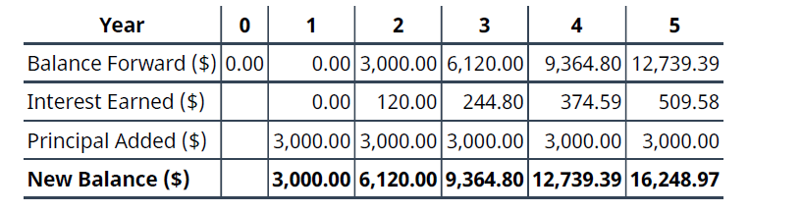
Lecture
6
In the table above, we have made five calculations, and for a longer-term contract such as 10, 25, or 40 years, this would be tedious. Fortunately, as with present values, this ordinary annuity can be solved in one step because all payments are identical.

Slide 26
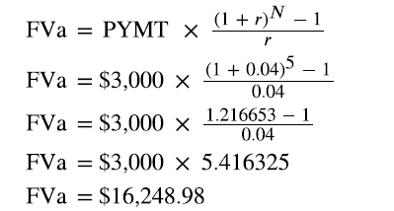
Lecture
6
An ordinary annuity delays the first payment until the end of the first period, causing the first year to generate no returns and preventing the final payment from earning any interest before the investment period ends. In contrast, an annuity due begins with an immediate payment, allowing every installment to earn interest for an additional period. As a result, annuities due always produce higher present and future values than ordinary annuities because each payment benefits from an extra compounding period.

Slide 27
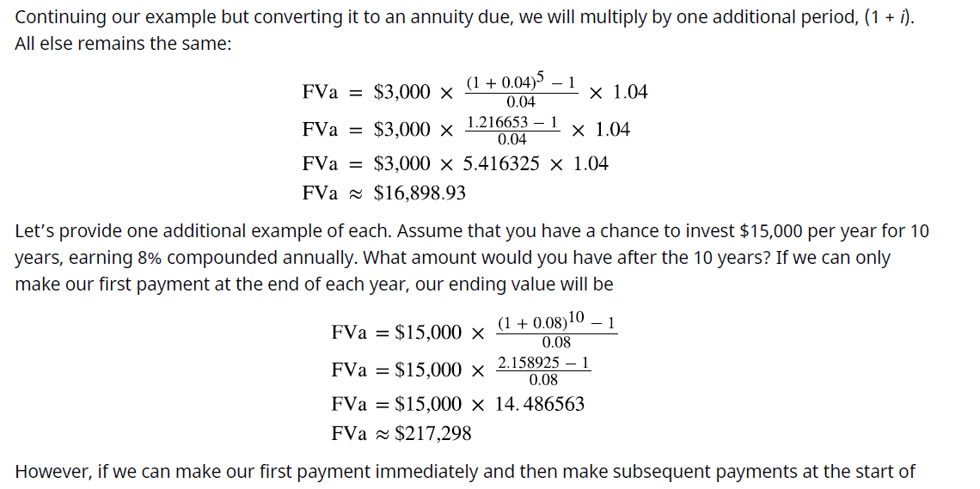

Lecture
6
The

Slide 28
Lecture
6
The present value of an ordinary annuity is commonly applied in retirement planning to determine the annual withdrawal that can be sustained from an investment fund. For example, an individual investing $75,000 in an annuity earning 3% annually over five years can use the present value of an ordinary annuity formula to calculate the equal annual payment. In this case, the $75,000 represents the present value, the 3% is the discount rate, the investment period is five years, and the annual payment is the unknown variable to be determined. This approach helps establish a sustainable withdrawal plan while accounting for the time value of money.

Slide 29
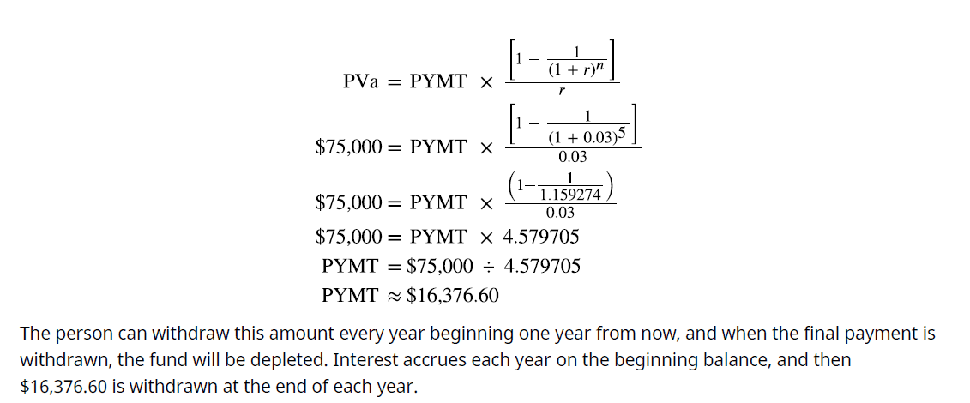
Lecture
6

Slide 30
Lecture
6
In this chapter, we will focus on fixed-rate loans.
Typical business loans include the following:
• Term loans generally bear a maturity date and a set rate of interest and are typically used to finance investments in assets such as equipment, buildings, and possibly other acquired firms. The length of the term loan is generally designed to match the useful life of the asset being financed, and it will usually be repaid on a monthly schedule. It’s common for a term loan to be backed by collateral, such as the asset itself or other assets of the business.
• Revolving lines of credit (revolvers), are used to finance the short-term working capital needs of a business. Revolvers will have a specific maximum but no set schedule of monthly payments. Interest accrues on the amount of cash that a company has drawn down from the facility. These credit lines may be secured by accounts receivable, inventory, other assets of the business, or sometimes simply the good faith and credit of the company if the firm is strong, creditworthy, and established with the lender.

Slide 31
Lecture
6
Personal loans are available in different forms depending on the borrower’s financial needs and credit profile. A personal line of credit allows borrowers to access funds as needed, with interest charged only on the outstanding balance, and approval is typically based on credit scores provided by agencies such as Experian, Equifax, and TransUnion. An unsecured personal loan provides a fixed amount that is repaid in periodic installments with interest and does not require collateral, relying instead on the borrower’s creditworthiness. In contrast, a secured personal loan requires collateral, such as a vehicle in the case of an auto loan, allowing the lender to seize the asset if the borrower defaults on repayment.

Slide 32
Lecture
6
- A mortgage loan is another type of secured personal loan, but for a longer period, such as 20, 25, or even 30 years. The home being purchased or built is the collateral, and the home may be foreclosed upon if the borrower defaults. Full title to the home typically remains with the lender as long as an unpaid balance
remains on the debt.
- Student loans are borrowings intended to fund college or career education, and they can come from a financial institution or the government. Interest rates on these loans are generally low and advantageous, and repayment does not begin until after the borrower’s education Is complete.

Slide 33

Lecture
6
Loan amortization represents the systematic repayment of a loan through equal periodic installments that include both principal and interest. The periodic payment can be determined using the present value of an ordinary annuity formula:
For loans with monthly repayments, the annual interest rate is divided by 12, while the loan term in years is multiplied by 12 to obtain the total number of payment periods. For example, a $32,000 auto loan with an annual interest rate of 6% and a maturity of three years is converted to a monthly interest rate of 0.5% (6% ÷ 12) and 36 monthly payments (3 × 12). These values are substituted into the present value of an ordinary annuity formula to calculate the fixed monthly payment required to fully amortize the loan.

Slide 34
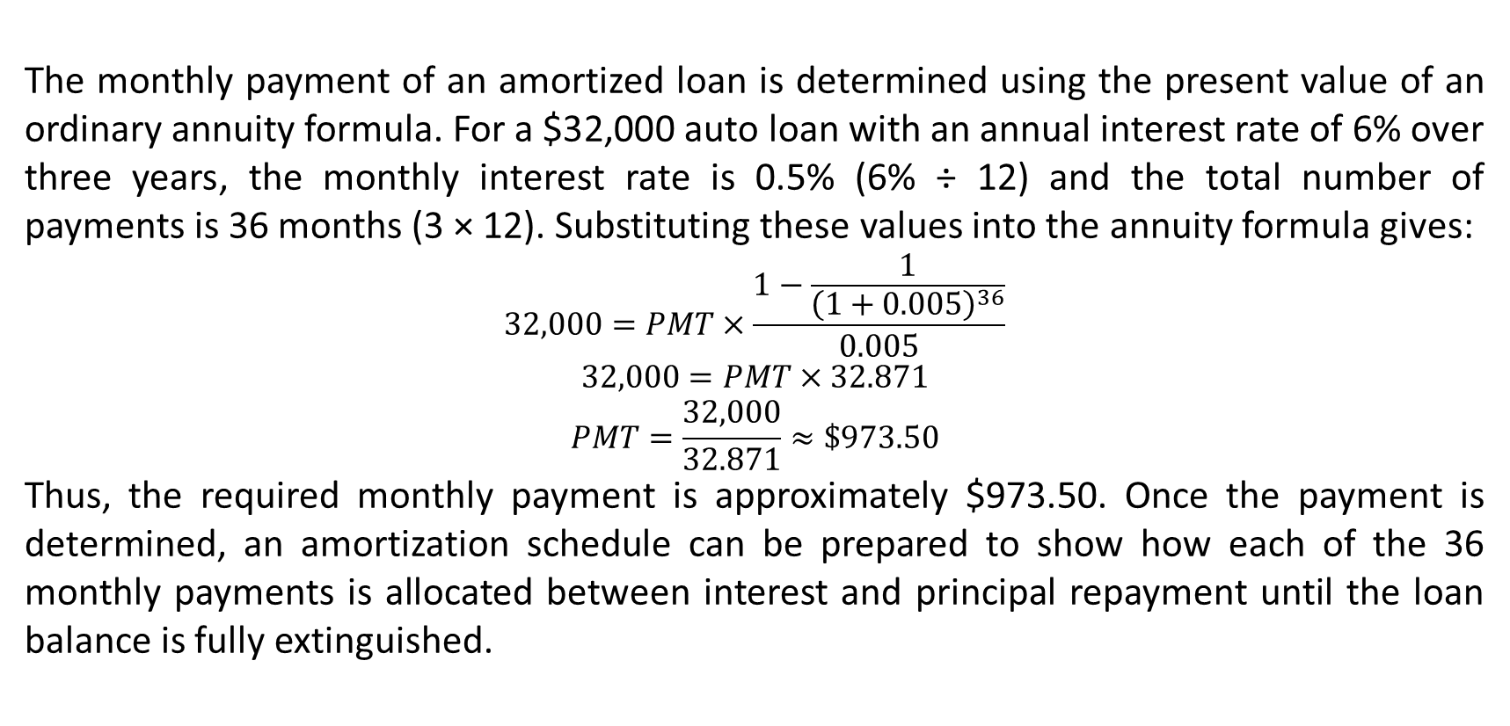
Lecture
6
The monthly payment of an amortized loan is determined using the present value of an ordinary annuity formula. For a $32,000 auto loan with an annual interest rate of 6% over three years, the monthly interest rate is 0.5% (6% ÷ 12) and the total number of payments is 36 months (3 × 12). Substituting these values into the annuity formula gives:
$$32,000=PMT×\frac{1−\frac{1}{{\left(1+0.005\right)}^{36}}}{0.005}$$
$$32,000=PMT×32.871$$
$$PMT=\frac{32,000}{32.871}≈\$973.50$$
Thus, the required monthly payment is approximately $973.50. Once the payment is determined, an amortization schedule can be prepared to show how each of the 36 monthly payments is allocated between interest and principal repayment until the loan balance is fully extinguished.

Slide 35
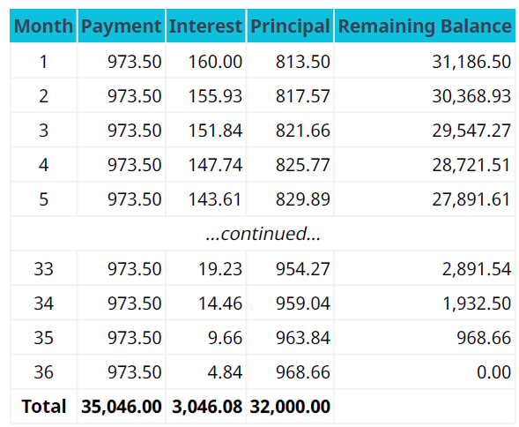
Lecture
6
Two extracts from an amortization table are shown in Table
This table resembles proofs we have seen of annuities, but let’s focus on some details:
1. Each fixed payment contains both interest and principal repayment.
2. Because the payments are fixed and the amount of remaining debt is decreasing, the monthly interest portion is always decreasing, and the amount of principal payment therefore must be increasing.

Slide 36
Lecture
6
In an amortized loan, a larger proportion of each payment is allocated to interest during the early repayment periods, while the proportion applied to principal gradually increases over time. For the $32,000 auto loan, the total repayment consists of $32,000 in principal and $3,046.08 in interest, representing the lender’s revenue. The same amortization principle applies to long-term mortgage financing. For example, purchasing a $200,000 house with a $60,000 down payment requires financing $140,000 over 20 years at an annual interest rate of 3.6%. To calculate the monthly mortgage payment using the present value of an ordinary annuity formula, the loan term is converted to 240 monthly periods (n = 240), and the annual interest rate is converted to a monthly rate of 0.3% (r = 3.6% ÷ 12) before applying the annuity formula.

Slide 37
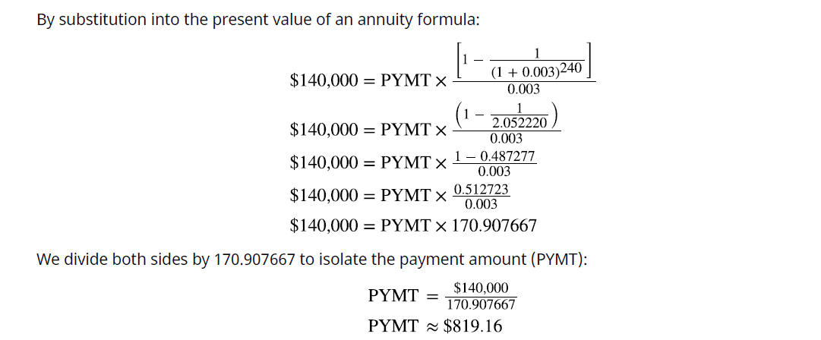
Lecture
6

Slide 38
Lecture
6
The effective interest rate differs from the stated (nominal) interest rate because it incorporates the effect of compounding within a year. When interest is compounded more than once annually, the effective annual rate exceeds the stated annual rate. However, if interest is compounded only once per year, both rates are identical. For example, a credit card charging a stated interest rate of 1.5% per month is often interpreted as 18% annually (1.5% × 12), but the effective annual rate is higher because monthly interest is compounded. If a $1,000 credit card balance remains unpaid after the first month, $15 in interest is added, increasing the balance to $1,015. Subsequent monthly interest is then calculated on the new balance, illustrating how compounding increases the effective annual interest rate over time.

Slide 39
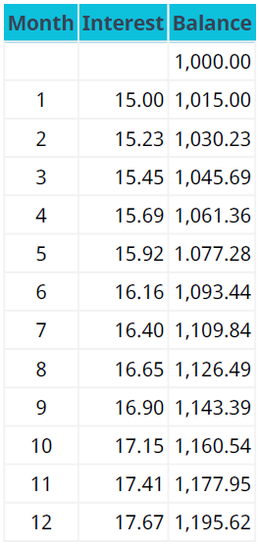

Lecture
6
The monthly calculation of interest starts to compound on past interest assessments in addition to the $1,000 initial purchase (see Table). Because interest compounds monthly rather than annually, the effective annual rate is 19.56%, not the intuitive rate of the stated 1.5% times 12 months, or 18%. Our basic compounding formula of (1+i)^n by substitution shows:
To isolate the effective annual rate, we then deduct 1 because our interest calculations are based on the value
of $1:
Therefore, it falls to the consumer/borrower to understand the true cost of borrowing, especially when larger dollar amounts are involved. If we had been dealing with $10,000 rather than $1,000, the annual difference would be more than $156.

Slide 40
Lecture
6
A payday advance loan (PAL) is a short-term loan designed to provide immediate cash until the borrower’s next paycheck. In a typical arrangement, a borrower receives $200 in exchange for a postdated check and pays a $14 fee upon repayment one week later. Although this fee may appear relatively small, it represents 7% of the loan amount for only one week. When annualized over 52 weeks, the stated annual interest rate reaches approximately 364%, which may exceed legal lending limits in some jurisdictions and raise concerns about usury. Consequently, while payday advance loans may provide temporary financial relief, their extremely high borrowing costs can lead to significant financial hardship, particularly for individuals who rely on them repeatedly.

Slide 41
Lecture
Summary
6
1 Perpetuities
A perpetuity is an investment that is intended to provide an expected return indefinitely, either remaining constant or growing by an incremental amount. Preferred stock is a common example with a preestablished dividend formula. An indefinite stream of payments cannot be compounded into a future value, but it can be discounted to a present value, providing an opportunity to determine the amount an investor should be willing to pay for a share of that stock.
2 Annuities
An annuity is a stream of fixed periodic payments that is expected to be paid or received. Calculations of future value or present value are commonly performed on these payment streams for a wide number of reasons in business and personal financial analysis, as seen in the chapter focusing on single amounts, particularly in loan repayment.

Slide 42
Lecture
Summary
6
3 Loan Amortization
Loans are contracts between a lender and a borrower. Failure to observe the rules of that contract, such as payment of interest or repayment of the amount owed, can subject the borrower to substantial penalties as well as damage to their credit. Loan agreements bearing a fixed rate of interest have a scheduled amortization, or rate and time of repayments with interest. Several types of business and personal loans were described.
4 Stated versus Effective Rates
For a borrower to understand the true cost of financing, they must be familiar with interannual compounding, which can cause a stated interest rate that appears to be annual to actually be higher. The effective rate of interest was demonstrated to understand that true cost.

Slide 43


Thank You

