Slide 1


Principle of Management
MGM111
Dr. Magdy alhaj
Making decisions Organizational Structure

Slide 2


Lecture objective
Making Decision define
Making Decision theory
Type of decision
Rationality in Making Decision
Strategic Making Decision
Techniques that Enhance Quality in
Making Decision
Making Decision Process

Slide 3

Making decisions
Managers are faced with decisions when a problem occurs or when an opportunity arises.

Slide 4
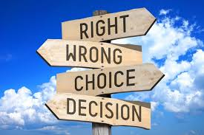
Making decisions
Problem – A situation in which some aspect of organizational performance is less than desirable.
Opportunity – A situation that has the potential to provide additional beneficial outcomes.

Slide 5

Making Decision define
Making Decision :
a process of choosing among alternative courses of action for the purpose of attaining a goal or goals
Managerial Decision Making :
is synonymous with the whole process of management

Slide 6
What is Making Decision???
Making Decision is at the heart of organizational effectiveness.
Two dominant issues affect how decisions are made in organizations;
  Stability (application of existing practices and maintenance of existing performance levels)
  Change (environmental demands for quick response and emerging problems that are ambiguous)

Slide 7
What is Making Decision con..?
Participative making decision structures are required to effectively manage change.
Empowering people to participate in important decisions is highly motivating to them.
Broad participation infuses the making decision process with the full spectrum of knowledge and good ideas that people throughout the organization have to contribute

Slide 8
Making Decision Theory
Daniel Griffith’s Theory of Leadership is About Decision Making :
  Administration is making decision.
  Organization’s structure is determined by the nature of its making decision process.

Slide 9
Griffith (continued)
    An individual's rank equals his or her degree of control of the making decision process.
    Effectiveness of the leader is inversely proportional to the number of decisions made personally.
    The major differences between types of organizations are related to differences in the making decision process.

Slide 10

Making Decision versus Problem Solving
Simon’s 4 Phases of Decision Making
1. Intelligence
2. Design
3. Choice
4. Implementation
making Decision and problem solving
are interchangeable

Slide 11
Type of decision
Programmed decisions – Decisions made in response to routine situations that have occurred in the past.
Non programmed decisions – Decisions made in response to situations that are unique, unstructured, or poorly defined.

Slide 12

Responses to Decision Situations
Programmed decisions
Non Programmed decisions
Alternatives are familiar to decision makers
Responses are routine
Alternatives are not familiar to decision makers
Responses require creativity

Slide 13
Individual v. Organizational Making Decision
What is meant by the expectation that administrators should be “decisive”?
How is this different from “organizational decisions”?
It is the responsibility of administrators to establish making decision processes that establish a positive culture.

Slide 14
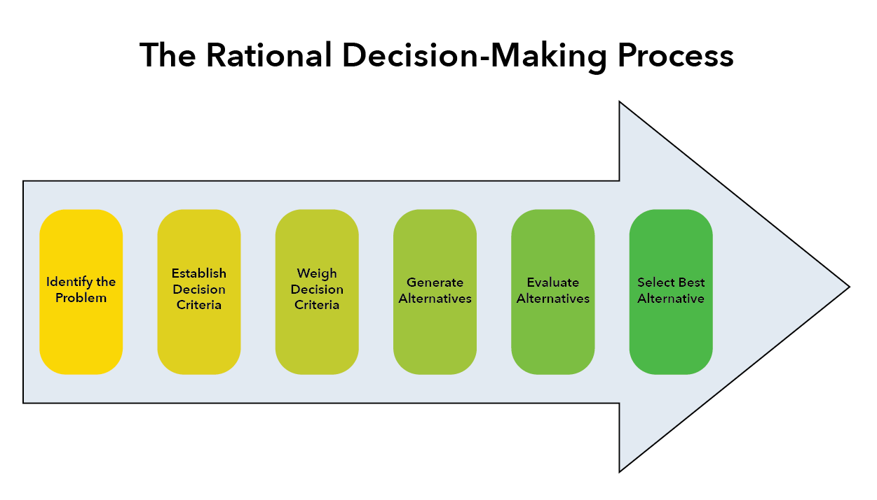
Rationality in Making Decision

Slide 15
Rationality in Making Decision
Herbert Simon’s three phases of making decision :
  Intelligence activity - gathering information regarding the need for a decision to be made
  Design activity - alternatives are envisioned, developed and analyzed
  Choice activity - selecting a course of action

Slide 16

Rationality in Making Decision cont..
Peter Drucker’s rational steps in making decision :
  Define the Problem
  Analyze the Problem
  Develop Alternative Solutions
  Decide on the Best Solution
  Convert decisions into Effective Actions

Slide 17
Rationality in Making Decision cont..
The above models assume that making decision is an orderly, rational process that possesses an inner logic.
The steps in the process follow one another in an orderly, logical and sequential flow

Slide 18
Rational Making Decision Models
Some models add a “feedback loop” to make successively better decisions eventually reaching “optimal” decisions.
We must recognize that we generally make decisions that are called “satisficing”, that is, they are a solution that is satisfactory, but not necessarily the optimal solution.

Slide 19
Strategic Making Decision
Strategic making decision occurs at the highest levels in organizations:
– This strategy defines the long-term direction of the firm.
– Two important areas for strategic decision making are:
Strategy selection.
Evaluation of portfolios.

Slide 20
Strategy Selection: The Strategic Making Decision Matrix
A two-dimensional grid used to select the best strategic alternative in light of multiple organizational objectives.

Slide 21

Operational Making Decision
Operational making decision relates to decision
situations that cover much shorter time spans. These
decisions are typically made at lower levels within the
organization, but that need not always be the case.

Slide 22
Applying Structure to the Making Decision Process
Alternative Courses of Action
– Strategies that might be implemented in a making decision situation.
States of Nature
– Conditions over which the decision maker has little or no control.
Payoffs
– The outcomes of decision situations.

Slide 23

Applying Structure to the Making Decision Process
Payoff Table
A matrix that organizes the alternative courses of action, states of nature, and payoffs for a decision situation.

Slide 24
Techniques that Enhance Quality in Making Decision
The manner in which the information in the payoff table is analyzed is a function of the making decision environment.
Three different making decision environments are generally identified depending on the amount of knowledge that exists about future conditions that might occur.

Slide 25
Techniques that Enhance Quality in
Making Decision
Types of Making Decision Environments:
making Decision under certainty
• In making decision under certainty, the decision maker knows with certainty what conditions will subsequently occur and affect the decision outcomes.
making Decision under risk
• In making decision under risk, the probabilities are used to obtain expected values of outcomes for each decision alternative.

Slide 26
Techniques that Enhance Quality in
Making Decision
Types of Making Decision Environments:
making Decision under risk (topics)
• Expected value
The product of a payoff and its probability of occurrence.
• Expected monetary value (EMV)
The sum of each expected value for an alternative.
• Decision tree
A branching diagram that illustrates the alternatives.
states of nature for a decision situation.

Slide 27
Techniques that Enhance Quality in
Making Decision
Types of Decision Making Environments:
making Decision under uncertainty
In some cases a decision maker cannot assess the probability of occurrence for the various states of nature.
When no probabilities are available, the situation is referred to as making decision under uncertainty.

Slide 28
Making Decision Under Uncertainty
Several outcomes possible for each course of action
but the decision maker does not know, or cannot estimate the probability of occurrence
More difficult - insufficient information
Assessing the decision maker's (and/or the organizational) attitude toward risk

Slide 29
Making Decision Under Risk (Risk Analysis)
Probabilistic or stochastic decision situation
Must consider several possible outcomes for each alternative, each with a probability
Long-run probabilities of the occurrences of the given outcomes are assumed known or estimated
Assess the (calculated) degree of risk associated with each alternative

Slide 30
Risk Analysis
Calculate the expected value of each alternative
Select the alternative with the best expected value

Slide 31
Ethical and Social Implications in
Making Decision
What are the ethical and social implications of my decision?
How will the decision affect the personal lives of my employees?
How do I balance economic and social considerations?

Slide 32
Participative Making Decision
Potential benefits:
  Make better decisions
  Enhance the growth and development of participants

Slide 33
Participative or Democratic
Democratic making decision may involve a vote, with the majority winning.
The leader should work with participants in the organization to establish a process for making decisions.
Participants should evaluate how the process is working and suggest changes for making the process better.

Slide 34
Making Decision Process
Systematic Making Decision Process (Simon, 1977)
Intelligence
Design
Choice
Implementation
Modeling is Essential to the Process

Slide 35
Making Decision Process cont..
Intelligence phase
  Reality is examined
  The problem is identified and defined
Design phase
  Representative model is constructed
  The model is validated and evaluation criteria are set
Choice phase
  Includes a proposed solution to the model
  If reasonable, move on to the
Implementation phase
  Solution to the original problem
  Failure: Return to the modeling process

Slide 36
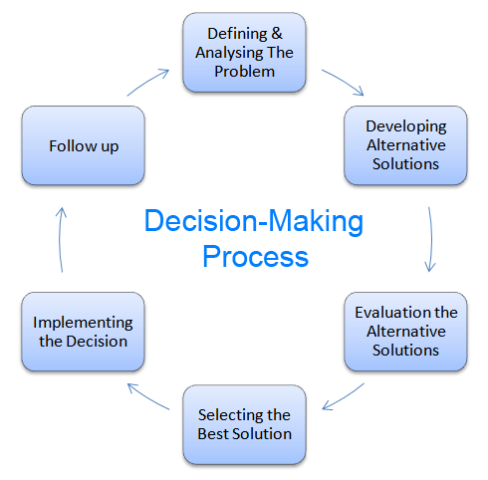
Making Decision Process cont..

Slide 37
Measuring Outcomes
Goal attainment
Maximize profit
Minimize cost
Customer satisfaction level (minimize number of complaints)
Maximize quality or satisfaction ratings (surveys)

