Slide 1


Introduction to
Healthcare Systems
Prepared by Dr. Abdulaziz Alsaedi
MHA611
Healthcare Systems
Lecture 01

Slide 2

Outlines:
An introduction to the Health.
An introduction to the System.
An introduction to the Health Systems.
Building blocks of the Health Systems.
System thinking in healthcare.
Habits of the system thinker.
International organizations and health systems.
Summary.

Slide 3
Part One:
Introduction to the Health and Health Systems

Slide 4

Chapter
An Introduction to the Health
01
Everyone has an interest in health, as reflected in truisms such as “at least you’ve got your health” and “if you’ve got your health, you’ve got just about everything.”
Discussions about health and healthcare often draw on two key statements from international organizations that formed after the conclusion of World War II.
The first is the definition of health, as stated in the Preamble to the Constitution of the World Health
Organization (WHO), adopted in 1946 and entering into force in 1948: “Health is a state of complete physical, mental, and social well-being and not merely the absence of disease or infirmity”
Book: healthcare System around the world

Slide 5
Chapter
An Introduction to the Health
01
The second statement comes from the Universal Declaration of Human Rights proclaimed in 1948 by the United Nations General Assembly: “Everyone has the right to a standard of living adequate for the health and well-being of himself and his family, including food, clothing, housing, and medical care and necessary social services and the right to security in the event of unemployment, sickness, disability, widowhood, old age or other lack of livelihood in circumstances beyond his control”.
Some governments include the right to health in their constitutions, while others do not.
It is incorrect to assume that the population whose constitution declares health to be a human right do better than people living in countries where this is not explicitly stated.
Instead, it is necessary to look at how each nation’s healthcare delivery functions in practice.
Book: healthcare System around the world

Slide 6
Chapter
An Introduction to the System
01
The human body is a system composed of many physiological subsystems that are interconnected in a holistic way. The subsystems, including respiratory, circulatory, neurological, endocrine, and musculoskeletal systems, communicate and are interdependent. They work together for the purposes of survival, adaptation, growth, and development.
They also interact with the environment and respond to feedback from within and outside the system.
In many ways, the interconnectivity of the various subsystems and their extension as a whole into the environment form the building blocks of larger systems, such as family, community, and nation.
As with any system, a health system has inputs. These include financial, material, and human resources that differentiate one health system from another.
Book: Comparative Health Systems A global perspectives

Slide 7
Chapter
An Introduction to the Health Systems
01
One of the major “inputs” into any healthcare system is patients.
Patients present with a variety of symptoms/diseases/injuries; however, they also come with a myriad of characteristics, such as personality, life experiences, knowledge, attitudes, cultural norms, education level, income level, intellect, prejudice, religious and other belief systems, emotions, biological strengths and weaknesses, and genetic makeup.
In addition, patients may or may not be plugged into society’s infrastructure, such as having access to transportation, childcare, or health insurance.
Book: Comparative Health Systems A global perspectives

Slide 8
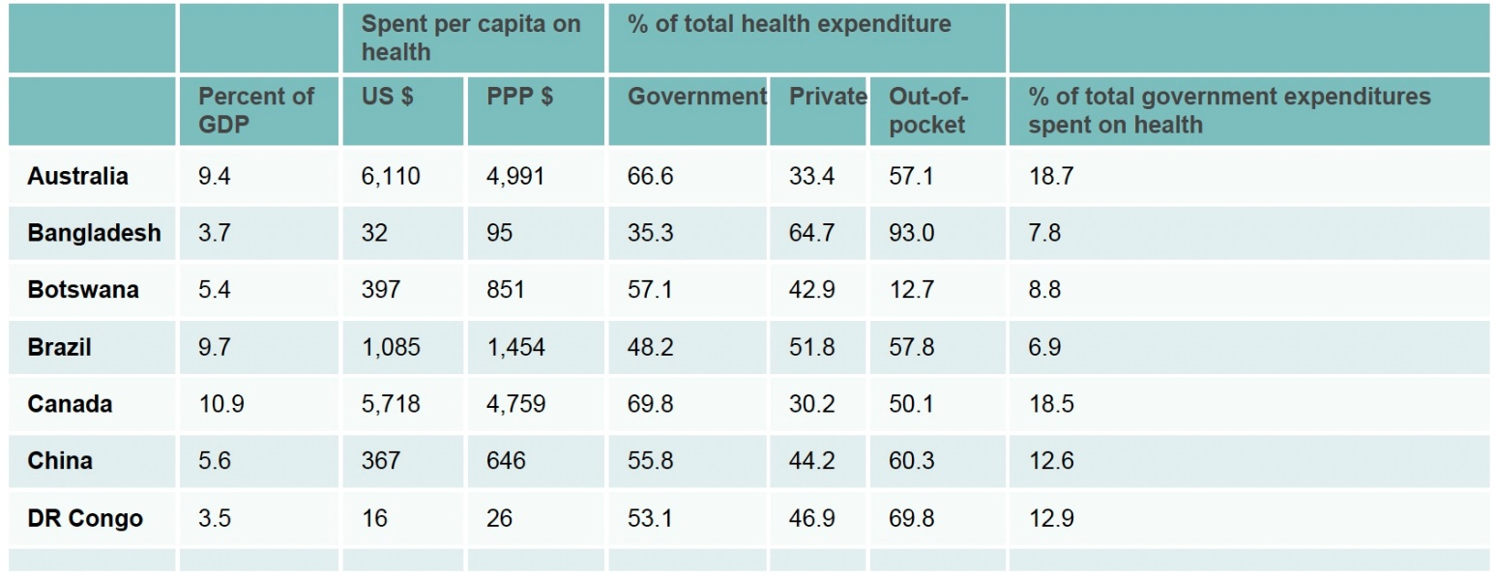
Chapter
An Introduction to the Health Systems
01
Health systems arise within a social, cultural, political, and economic context.
As with all human-constructed systems, there is considerable diversity in size, scope, and form.
As a result, health systems have structure, processes, and outcomes that vary considerably.
Book: Comparative Health Systems A global perspectives

Slide 9
Chapter
An Introduction to the Health Systems
01
The health system as described by the World Health Organization (WHO) is the sum total of all the organizations, institutions, and resources whose primary purpose is to improve health.
A health system needs staff, funds, information, supplies, transport, communications, and overall guidance and direction.
Furthermore, it needs to provide services that are responsive and financially fair, while treating people decently.
Within this definition, there are several concepts that need to be understood before one embarks on the task of studying health systems. First and foremost, an agreed-on definition of health is paramount.
Book: Comparative Health Systems A global perspectives

Slide 10
Chapter
An Introduction to the Health Systems
01
There are many different ways to organize and deliver healthcare to a population, and to some extent, each country’s method of organizing healthcare delivery is unique and based on its specific situation, including its history and culture, the amount of money it has to spend, and the value it places on different outcomes.
Designing and running a healthcare system therefore requires making difficult choices that are almost guaranteed not to please/ satisfy everyone, at least not all the time.
It is not surprising that public discussions about healthcare often become heated because the demand for health services is theoretically unlimited, yet no government has unlimited resources.
Book: healthcare System around the world

Slide 11
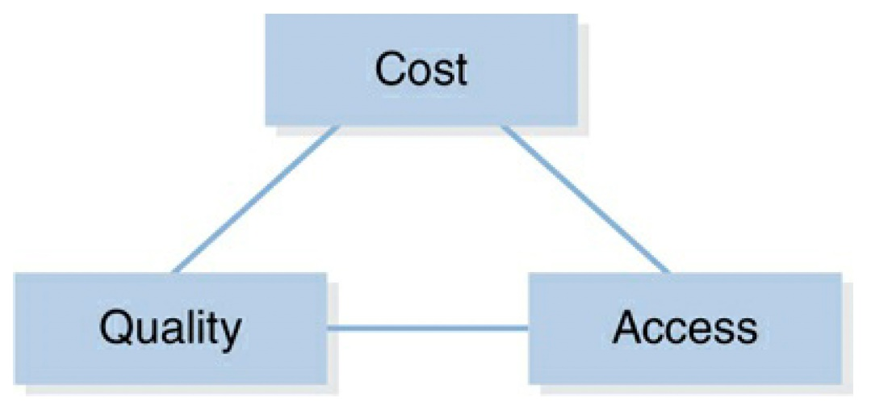
Chapter
Building Blocks of the Health System
01
Even though every health system is unique in its given social and cultural environment, all health systems have common elements that are necessary for functionality.
These building blocks not only help us to understand health systems better, but they also provide opportunities for system improvement.
The WHO, the World Bank, and various governments around the world have a common understanding of these key elements.
Book: Health System Science

Slide 12
Chapter
Building Blocks of the Health System
01
Some would describe them as critical success factors that are essential to a health system’s survival:
Service delivery:
Good health services are those that deliver effective, safe, quality personal and non-personal health interventions to those who need them, when and where needed, with minimum waste of resources.
Health workforce:
A well-performing health workforce is one that works in ways that are responsive, fair, and efficient to achieve the best health outcomes possible, given available resources and circumstances (i.e., there are sufficient staff, fairly distributed; they are competent, responsive, and productive).
Book: Health System Science

Slide 13
Chapter
Building Blocks of the Health System
01
Health Information:
A well-functioning health information system is one that ensures the production, analysis, dissemination, and use of reliable and timely.
Medical Technology:
A well-functioning health system ensures equitable access to essential medical products, drugs, vaccines, and technologies of assured quality, safety, efficacy, and their scientifically sound and cost-effective use.
Book: Health System Science

Slide 14
Chapter
Building Blocks of the Health System
01
Health Financing:
A good health financing system raises adequate funds for health, in ways that ensure people can use needed services and are protected from financial catastrophe or impoverishment associated with having to pay for them; it provides incentives for providers and users to be efficient.
Leadership and governance:
Leadership and governance involve ensuring that strategic policy frameworks exist and are combined with effective oversight.
Book: Health System Science

Slide 15
Part Two:
System Thinking

Slide 16
Chapter
Systems thinking in healthcare
01
In general, there are two different types of thinking: linear thinking and systems thinking.
Linear thinking approaches problems in a logical, sequential manner. If there is a challenge, one must identify the issue and implement a solution to obtain an end result.
Systems thinking is a philosophy, mindset, and set of tools that facilitate an individual’s thought process to see the interrelatedness of the parts of a system and the cohesion across those parts.
Systems thinking principles have been increasingly promoted as critical for innovation, problem-solving, and collaboration in multiple fields, including the health professions.
Systems thinking in healthcare is a holistic approach to understanding a system’s component parts, and the interrelatedness of these parts, to better understand how a system works and evolves over time.
Book: Health System Science

Slide 17
Chapter
Systems thinking in healthcare
01
Systems thinking takes a more holistic and cohesive approach to challenges and visualizes the seen and unseen drivers, connections, and consequences of interactions at play in any given situation.
One must examine the system as a whole while simultaneously understanding the component parts in order to understand and influence a system.
To provide patient-centered care, physicians and other healthcare professionals must take into account all the systems around the patient and how they interact with each other. For example, a patient’s health is not only determined by the treatment prescribed.
It is also determined by the support and resources available in the home, community, and workplace.
Book: Health System Science

Slide 18
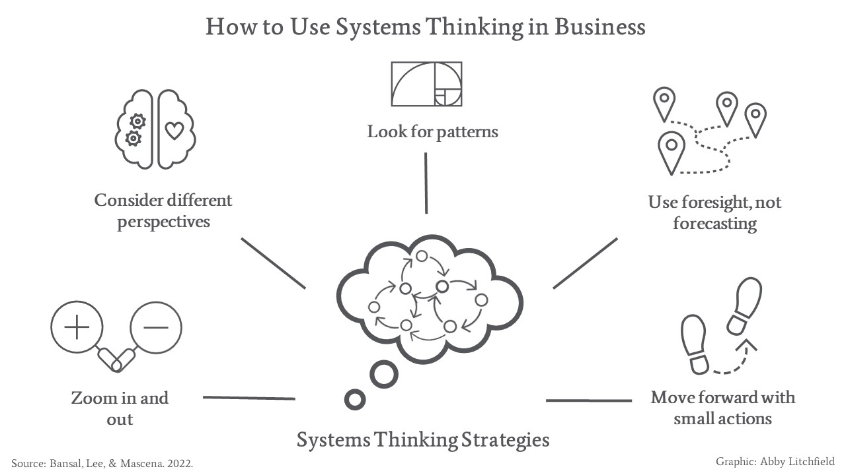
Chapter
Systems thinking in healthcare
01
Book: Health System Science

Slide 19
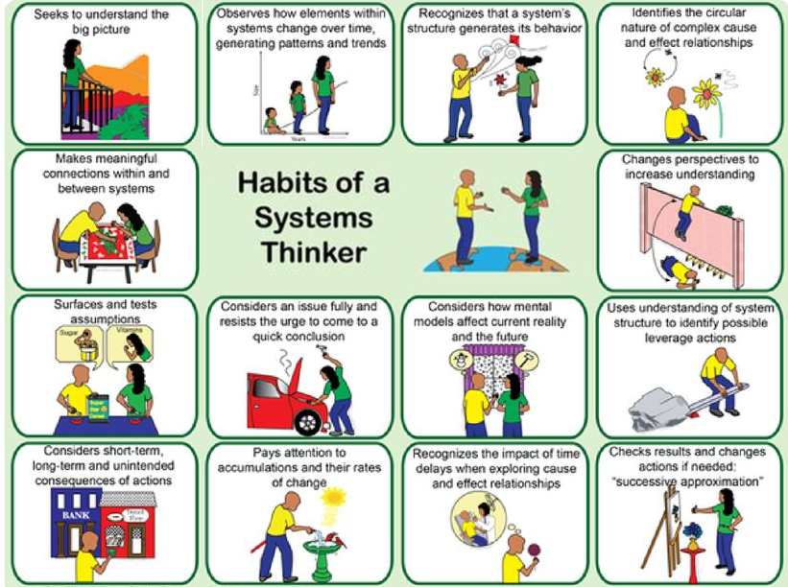
Chapter
Habits of a system thinker
01
The Waters Foundation identified and developed a library of “Habits of a Systems Thinker” and tools that are used in multiple international settings.
The habits and tools allow individuals and teams to examine systems and thinking processes.
Book: Health System Science

Slide 20
Chapter
Habits of a system thinker
01
Habit 1: Seeks to understand the big picture:
The core of systems thinking is the desire and ability to see situations using a holistic lens.
Systems thinkers seek to understand the big picture as they address the situation’s specifics.
System thinkers consider previous events or factors that may have influenced or contributed to the present situation as well as possible results (i.e., downstream effects) of present actions.
Systems thinkers pause to consider factors somewhat removed from the situation that may have a bearing on what is occurring in the present.
They maintain a balance between the big picture and important details.
Book: Health System Science

Slide 21
Chapter
Habits of a system thinker
01
Habit 2: Observes how elements within systems change over time, generating patterns and trends:
Systems thinkers observe how components of a system change over time and are able to see patterns and trends as they emerge.
Systems thinkers consider the important elements that change in the system and how they have changed over time.
They observe how quickly or slowly the important elements increase or decrease, and they derive the patterns or trends that emerge over time.
Systems thinkers use this habit to move beyond the here and now and see the system as dynamic and changing over time.
Book: Health System Science

Slide 22
Chapter
Habits of a system thinker
01
Habit 3: Recognizes that a system’s structure generates its behavior:
A systems thinker focuses on system structure and avoids blaming individuals when things go wrong.
As Paul Batalden has stated, “Every process (system) is designed to perfectly achieve the results it gets.”
Systems thinkers observe how the parts of the system affect one another and how the organization and the interaction of the parts influence the outputs or outcomes of the system.
When things go wrong, systems thinkers reflect on how the existing system, the interaction of its parts, or both have contributed to the poor outcome.
They focus on internal causes rather than dwelling on external blame.
Book: Health System Science

Slide 23
Chapter
Habits of a system thinker
01
Habit 4: Identifies the circular nature of complex cause and effect relationships:
A systems thinker sees the interdependencies in a system and uncovers circular causal connections or feedback loops.
Complex cause and effect relationships are often circular, and the effect comes back around and impacts the cause.
Systems thinkers observe how the parts affect one another and determine where the feedback loops emerge.
They study the feedback loops to determine if one loop is more influential over time than another. Systems thinkers use causal loops as a visual tool to represent complex cause and effect relationships.
Book: Health System Science

Slide 24
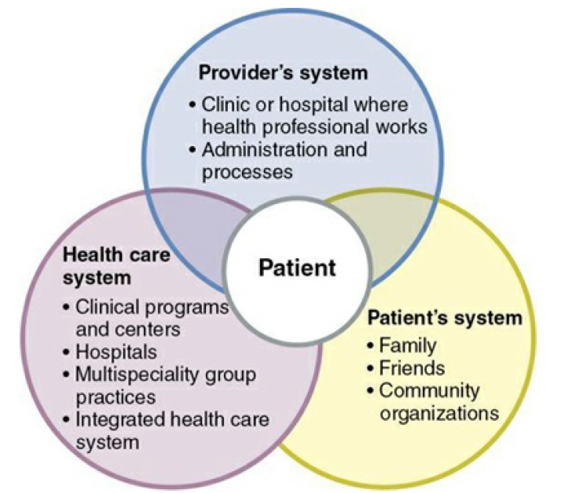
Chapter
Habits of a system thinker
01
Habit 5: Makes meaningful connections within and between systems:
A systems thinker sees how concepts, facts, and ideas link together, which can lead to new learning, discoveries, and innovations.
Systems thinkers study the relationships among pieces of the system and how they affect understanding of the whole.
They consider how the different perspectives of a system work together to benefit the system, and they appreciate how the understanding of one system transfers to the understanding of another system.
Book: Health System Science

Slide 25
Chapter
Habits of a system thinker
01
Habit 6: Changes perspectives to increase understanding:
A systems thinker increases understanding by changing the ways he or she looks at the system.
Individuals see the world from their own perspective reflecting their personal point of view shaped by their personal experiences and values.
While an individual’s perception is his or her reality, the more perspectives that are considered, the closer physicians and other healthcare professionals get to a shared or actual reality.
The medical profession operates at a very fast pace, and physicians and other healthcare professionals see the system through their own lens. If they do not step back and take in the perspectives of others, suboptimal care results.
Book: Health System Science

Slide 26
Chapter
Habits of a system thinker
01
Habit 7: Surfaces and tests assumptions:
A systems thinker tests theories and surfaces assumptions, perhaps with others, in order to improve performance.
Occasionally, these assumptions can hinder the understanding of reality, so it becomes very important to surface and test these assumptions in order to improve performance.
This becomes especially important in the current complex healthcare system, so physicians and other healthcare professionals do not jump to the wrong conclusions.
When physicians and other healthcare professionals accept or reject other people’s conclusions, they need to be confident that their reasoning is based on facts.
Book: Health System Science

Slide 27
Chapter
Habits of a system thinker
01
Habit 8: Considers an issue fully and resists the urge to come to a quick conclusion:
A systems thinker takes the necessary time to understand the dynamics of a system before taking action.
In the fast modern world, people can often be under pressure to devise quick fixes to the problems encountered.
Quick fixes in a complex system might work in the short term, but they can have unintended and undesired consequences in the long term.
Taking a systems view helps one see the impact of an action on all the parts, short and long term, as well as helping one recognize the impact of feedback and time delays in implementing a solution.
Book: Health System Science

Slide 28
Chapter
Habits of a system thinker
01
Habit 9: Considers how mental models affect current reality and the future:
A systems thinker is aware of how beliefs and attitudes influence perspectives and actions.
In any given situation, an individual perceives and interprets what is happening, thus creating a picture, or mental model, of some aspect of the world.
A systems thinker is aware of how these mental models influence perspectives and, ultimately, actions taken.
In today’s rapidly changing and complex healthcare environment, where interprofessional collaborations are more important than ever, shared mental models are a critical component of effective teamwork.
Book: Health System Science

Slide 29
Chapter
Habits of a system thinker
01
Habit 10: Uses an understanding of system structure to identify possible leverage actions:
A systems thinker uses system understanding to determine what small actions will most likely produce desirable results.
Based on an understanding of the structure, interdependencies, and feedback within a system, a systems thinker implements the leverage action that seems most likely to produce desirable outcomes.
Book: Health System Science

Slide 30
Chapter
Habits of a system thinker
01
Habit 11: Considers short-term, long-term, and unintended consequences of actions:
Systems thinkers look ahead and anticipate not only the immediate results of actions but also the effects down the road. They think about and evaluate the short- and long-term unintended consequences of their actions that could lead to new actions and then consider the tradeoffs.
They take the necessary time to reflect on the consequences of their actions and think about who will be impacted and what possible results, both desirable and undesirable, they will see from the decision.
They carefully weigh the price of the short-term pain with the value of the long-term gain.
Based on an understanding of the structure, interdependencies, and feedback within a system, a systems thinker implements the leverage action that seems most likely to produce desirable outcomes.
Book: Health System Science

Slide 31
Chapter
Habits of a system thinker
01
Habit 12: Pays attention to accumulations and their rates of change:
Systems thinkers pay attention to the elements in the systems that change.
They see the quantity of material or information that has been built up or diminished over time.
They identify what they can measure and assess and how quickly or slowly accumulations increase or decrease.
They also evaluate how these accumulations impact other elements in the system and what might happen if an accumulation reaches a tipping point.
Book: Health System Science

Slide 32
Chapter
Habits of a system thinker
01
Habit 13: Recognizes the impact of time delays when exploring cause and effect relationships:
Systems thinkers understand that cause and effect are frequently not closely related in time.
They consider whether the change they are making will show immediate results or will require patience to see the impact.
If they need to wait, they consider how long it will take to see the desired results once the change is made to the system.
They recognize the need to monitor the results, consider the impact of time delays, and make minor adjustments before discarding a potentially valuable idea.
Book: Health System Science

Slide 33
Chapter
Habits of a system thinker
01
Habit 14: checks results and changes actions if needed: “successive approximation”:
Systems thinkers establish benchmarks to help assess gradual improvement.
They consider the indicators they expect to see as they are looking for progress, and they schedule time to pause and assess the effects of the current plan in order to take necessary actions and adjustments.
They embrace change as a process and constantly strive for improvement.
They learn from experience and use that experience to improve their actions through a successive approximation process such as a Plan-Do-Study-Act (PDSA) cycle.
Book: Health System Science

Slide 34
Chapter
Application of System Thinking to healthcare
01
Case Study:
Mrs. Wilson is 28 weeks pregnant. She has missed the majority of her prenatal care appointments and has not had any of the recommended laboratory testing. As her physician, you seek to understand the reasons behind her missing visits and testing as you emphasize the importance of prenatal care.
Book: Health System Science

Slide 35
Chapter
Application of System Thinking to healthcare
01
Answer to the Case Study:
You might begin by surfacing and testing assumptions (Habit 7).
You begin by listening to Mrs. Wilson’s story to get to know her and understand how her pregnancy has been progressing thus far from her perspective. This demonstrates changing your perspective to increase understanding (Habit 6).
And your ability to consider the issues fully and resist the urge to come to a quick conclusion (Habit 8).
Continue to gather her history and perform her examination, you explicitly consider how mental models affect current reality and the future (Habit 9).
Book: Health System Science

Slide 36
Part Three:
International Organizations’ roles in Health Systems

Slide 37
Chapter
International Organizations and Health Systems
01
Although national health systems have an important role in providing health services, they are not the only entities that are tasked with improving and ensuring the health of individuals and populations.
There is a spectrum of organizations that directly and indirectly contribute to global health, including foundations, development banks, nongovernmental organizations, bilateral agencies, and intergovernmental organizations.
Myriad organizations and agencies that are independent of governments or larger health systems work to provide conditions conducive to good health.
Book: Comparative Health Systems A global perspectives

Slide 38

Chapter
International Organizations and Health Systems
01
World Health Organization (WHO):
It was founded in 1948 as a specialized agency of the United Nations focused on global public health.
Its overall mission is “the attainment of all people to the highest level of health.
Through research, health policymaking, education initiatives, and disease monitoring and intervention, the WHO seeks to stop the spread of communicable diseases and lessen the burden of chronic disease.
Book: Comparative Health Systems A global perspectives

Slide 39
Chapter
International Organizations and Health Systems
01
WHO's Role in the COVID-19 Pandemic Response
The World Health Organization (WHO) has played a central role in leading the global response to the COVID-19 pandemic.
On January 30, 2020, the WHO Director-General declared the COVID-19 outbreak a Public Health Emergency of International Concern (PHEIC), its highest level of global health emergency.
The WHO rapidly scaled up its response, utilizing its 149 country offices to support member states in preparing for and responding to the pandemic.
Book: Comparative Health Systems A global perspectives

Slide 40
Chapter
International Organizations and Health Systems
01
WHO's Role in the COVID-19 Pandemic Response
The WHO convened meetings with health experts and funders to accelerate global research on COVID-19 and facilitate prompt diagnosis and optimal care for those affected.
It launched the Solidarity Trial, an international clinical trial to find an effective treatment for COVID-19.
Book: Comparative Health Systems A global perspectives

Slide 41
Chapter
International Organizations and Health Systems
01
WHO's Role in the COVID-19 Pandemic Response
The WHO provided state-endorsed guidance and set norms and standards on outbreak preparedness and response.
It conducted country missions to assess national capacity and support efforts to strengthen preparedness and response capabilities.
The WHO shipped critical supplies to countries worldwide, such as 1.5 million diagnostic kits to 126 countries and millions of masks, gowns, gloves, and other PPE to 133 countries.
Book: Comparative Health Systems A global perspectives

Slide 42

Chapter
International Organizations and Health Systems
01
Organization for Economic Cooperation and Development:
Originating in 1948 as the Organization for European Economic Cooperation, then reformed in 1961 as the Organization for Economic Co-operation and Development (OECD).
Its mission is to implement policies that improve the economic and social wellbeing of people around the world.
Through government collaboration and analysis of successful strategies and underlying global issues, the OECD provides a forum for implementing quality of life improvement for every country.
Book: Comparative Health Systems A global perspectives

Slide 43
Chapter
International Organizations and Health Systems
01
OECD and Health Systems:
The Organization for Economic Co-operation and Development (OECD) plays a pivotal role in shaping health systems across its member countries.
Its efforts focus on enhancing the performance, accessibility, and sustainability of health care through various initiatives.
the OECD's work in health systems is crucial for guiding countries toward achieving high-performing, equitable, and sustainable healthcare solutions.
Book: Comparative Health Systems A global perspectives

Slide 44
Chapter
International Organizations and Health Systems
01
OECD and Health Systems:
The OECD conducts comprehensive assessments of health systems through its publication Health at a Glance, which provides indicators of health outcomes, access to care, and system resources across member countries. This data helps identify best practices and areas needing improvement.
The OECD supports evidence-based policy-making to improve health system efficiency. This includes addressing chronic diseases, promoting healthy lifestyles, and enhancing mental health services.
Book: Comparative Health Systems A global perspectives

Slide 45
Chapter
International Organizations and Health Systems
01
OECD and Health Systems:
Recognizing the growing role of technology in healthcare, the OECD promotes digital health initiatives. It encourages countries to adopt telemedicine and artificial intelligence while managing associated risks and costs.
The OECD stresses the need for health systems to be resilient against shocks such as pandemics and climate change. This includes preparing for an ageing population and ensuring that healthcare budgets can sustain high-quality care without excessive spending increases.
Book: Comparative Health Systems A global perspectives

Slide 46
Chapter
Summary
01
Health is a state of complete physical, mental, and social well-being and not merely the absence of disease or infirmity.
A Patient is the major input into any healthcare system.
System Thinking is a holistic approach to understanding a system’s component parts.
Health systems are the sum total of all the organizations, institutions, and resources whose primary purpose is to improve health.
There are many different ways to organize and deliver healthcare to a population.
Cost, Quality, and Access are the three building blocks of the healthcare system.
Systems thinking in healthcare is a holistic approach to understanding a system’s component parts

Slide 47
Chapter
References:
01
Wang, H. (2016). Comparative Health Systems: A Global Perspective. In International Encyclopedia of Public Health. Jones & Bartlett Learning. https://doi.org/10.1016/B978-0-12-803678-5.00085-0
Rivki, M., Bachtiar, A. M., Informatika, T., Teknik, F., & Indonesia, U. K. (2013). healthcare Systems Around The World (Issue 112).
Will, K. K., Mutyala, J., & Essary, A. C. (2023). Health Systems Science. Jaapa, 36(6), 45–46. https://doi.org/10.1097/01.jaa.0000931464.13332.f1

Slide 48



Thank You

