Slide 1





F
DIGITAL MEDIA ETHICS
Prepared by Dr. Sherihan Mohamed
Intro Lecture
DIGITAL MEDIA ETHICS

Slide 2

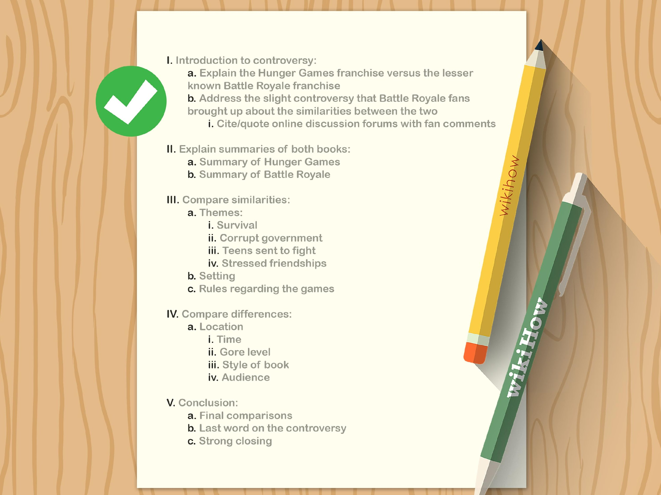

OUTLINES:
* COURSE DESCRIPTION
* LEARNING OUTCOMES
* TOPICS
* INTRODUCTION TO DIGITAL MEDIA ETHICS
“WHAT DO WE MEAN WITH DIGITAL MEDIA ETHICS?”

Slide 3
COURSE DESCRIPTION
DIGITAL MEDIA ETHICS

Slide 4



DIGITAL MEDIA ETHICS
COURSE DESCRIPTION
WHY DO WE LEARN DIGITAL MEDIA ETHICS?

Slide 5

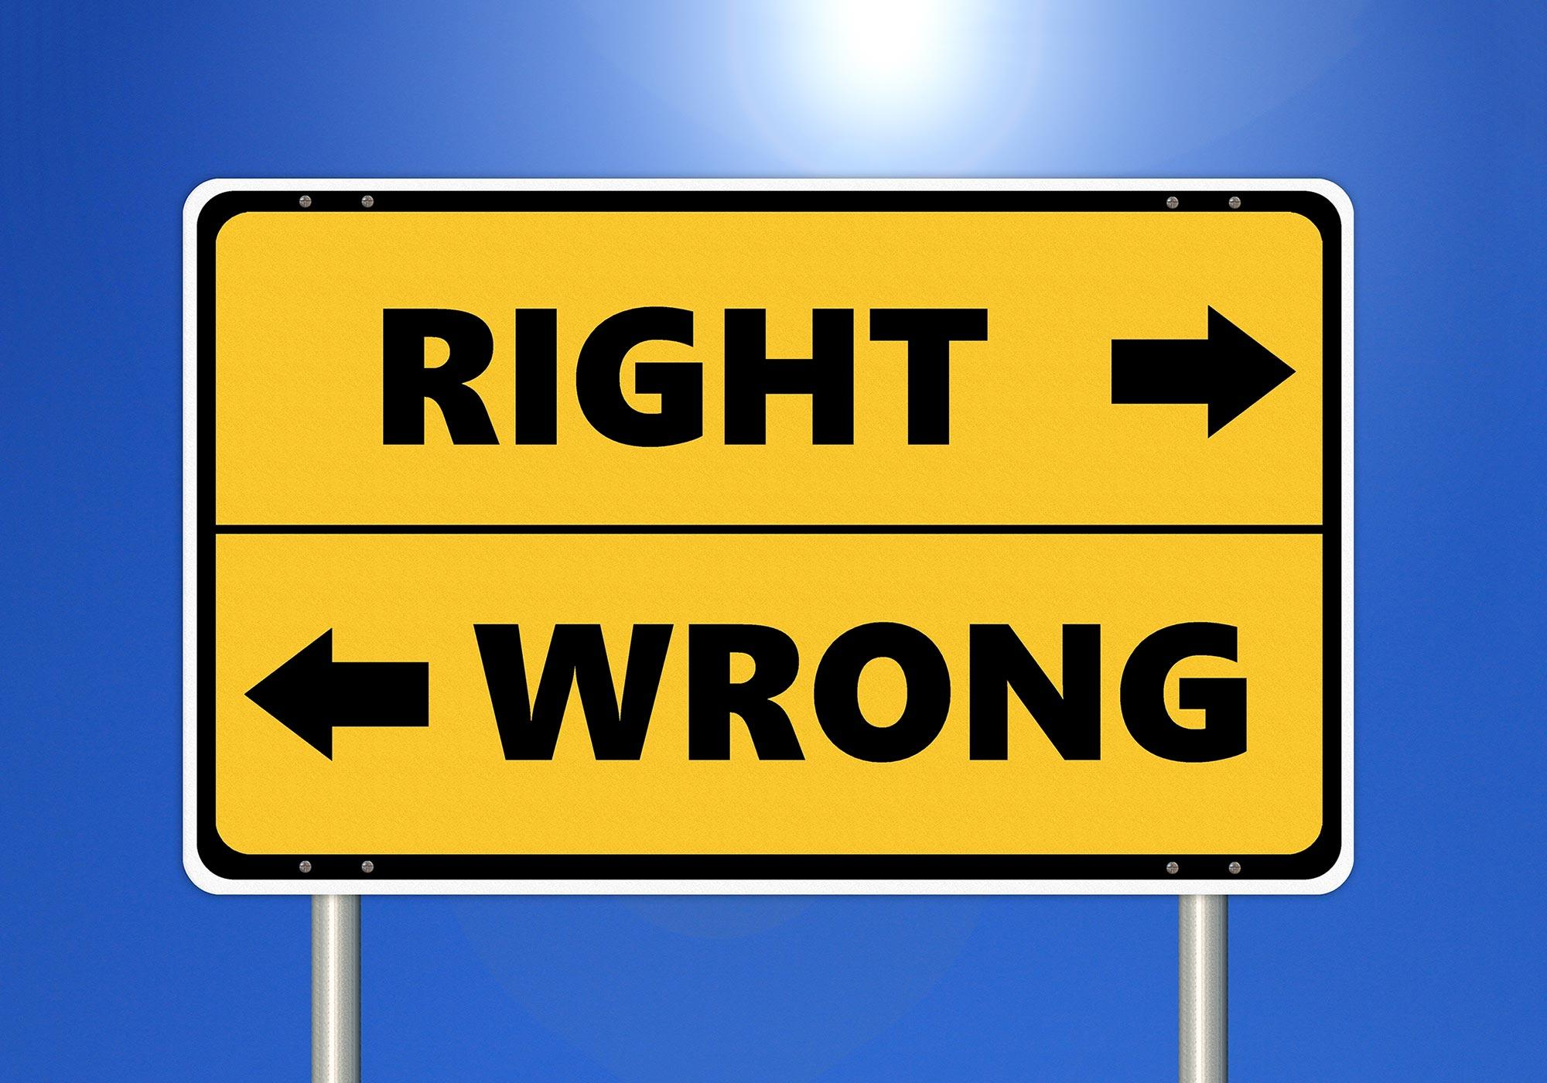
COURSE DESCRIPTION
Exploring the active process of moral decision-making—that is, doing ethics—is an inescapable part of life.
We routinely make ethical judgments, assess our ideological values, and interrogate our moral outlooks.

Slide 6

COURSE DESCRIPTION
While you may unquestioningly embrace the beliefs and values you inherited from your culture, society, and/or family, critically examining your decision-making process through ethical deliberation is the only way to make your ethical framework truly yours.

Slide 7



COURSE DESCRIPTION
Thus, this course raises questions with no ready answers, spurring you to reflect on your moral approaches.
The goal is to help you reason through ethical issues using various theoretical frameworks to reach logically defensible answers, instead of reacting with your gut or anecdotal evidence.

Slide 8


COURSE DESCRIPTION
The process of doing ethics is nothing if not devoted to serious, careful reflection and application.
As such, this course emphasizes both the theoretical underpinnings of how we come to a given moral philosophy and case studies specific to digital media.

Slide 9

COURSE DESCRIPTION
We will consider how different moral philosophies apply across cultures and across different contemporary media practices and platforms in areas such as advertising, promotional marketing, big data, software and interface design, and fake news.

Slide 10
DIGITAL MEDIA ETHICS
LEARNING OUTCOMES
LEARNING OUTCOMES

Slide 11

LEARNING OUTCOMES:
After Learning this course, We have to ASK…
WHAT WILL THIS COURSE ADD TO ME?

Slide 12
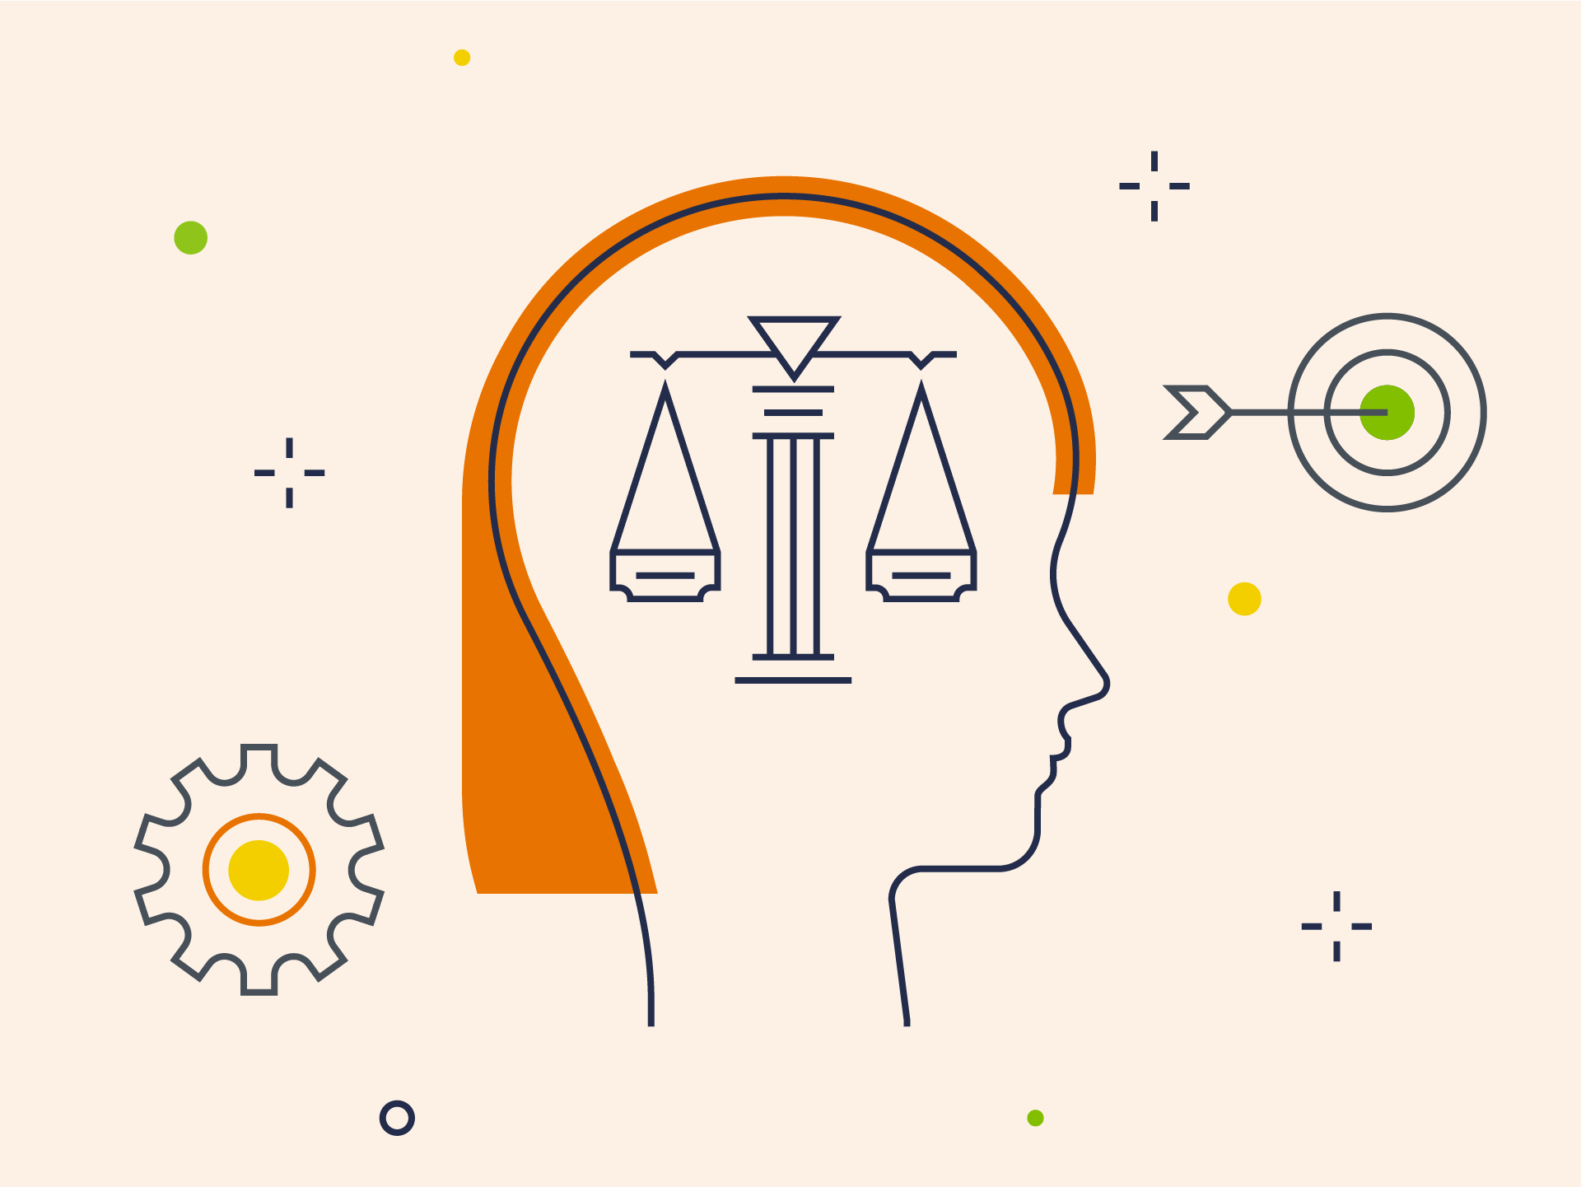
LEARNING OUTCOMES:
Having successfully completed this course, student should be able to:
• Identify and explain key ethical theories.
• Articulate current codes of behavior for media professionals working in digital media environments.

Slide 13


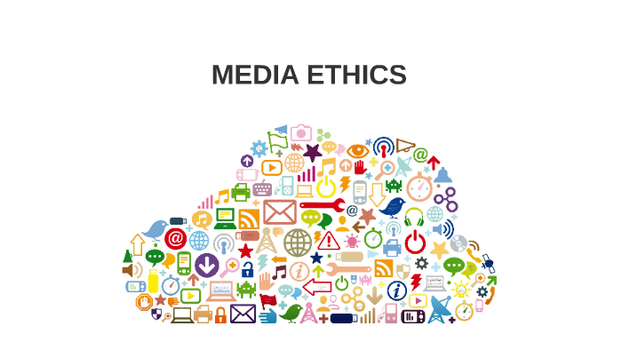
LEARNING OUTCOMES:
• Apply ethical models across communications professions.
• Discuss and deliberate on moral dilemmas involving digital media practices and forms, using various ethical frameworks.

Slide 14

LEARNING OUTCOMES:
• Logically justify your ethical decision-making process in a given scenario.
• Retroactively apply theories of ethics to better understand your decision-making processes in past real-life dilemmas.

Slide 15
DIGITAL MEDIA ETHICS
TOPICS
TOPICS

Slide 16
TOPICS
1. Central Issues in the Ethics of Digital Media.
Trough this chapter we will take a look on a classic case-study of cyberbullying that introduces representative ethical issues evoked by digital media. This case study is accompanied by one of the primary pedagogical/teaching elements of the book – questions designed to foster initial reflection and discussion (for individuals, small groups, or a class at large).

Slide 17
TOPICS
Privacy in the (Post-)Digital Era.
* We explore how different people in different cultures understand and value “privacy” and private life in different ways.
* We then examine the important meta-ethical positions of ethical absolutism, ethical relativism, and ethical pluralism.

Slide 18


TOPICS
3. Copying and Distributing via Digital Media: Copyright, Copyleft, Global Perspectives.
We explore four aspects of life online that offer remarkable new possibilities in our personal and shared lives while also confronting
us with new ethical questions and challenges.

Slide 19
TOPICS
4. Friendship, Slow/Fair Technology, and Democracy.
We explore some aspects of life online that offer remarkable new possibilities in our personal and shared lives while also confronting us with new ethical questions and challenges. We examine first how friendship is both amplified and threatened by social networking sites (SNSs) such as Facebook.

Slide 20


TOPICS
5. Digital Media Ethics: Overview, Frameworks, Resources
This chapter provides especially those new to ethics with an overview of the most commonly used theoretical frameworks for ethical analysis and decision-making.

Slide 21


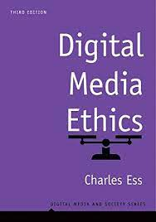

Recommended Reference:
Digital Media Ethics (Digital Media and Society Series), 3rd Edition, by Charles Ess

Slide 22
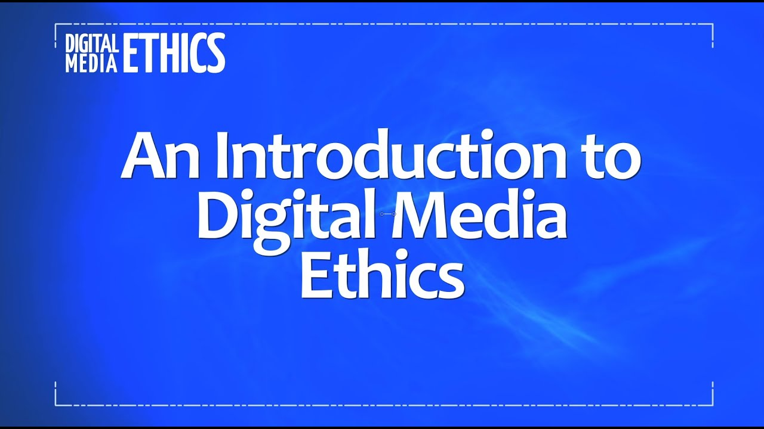
WHAT DO WE MEAN WITH DIGITAL MEDIA ETHICS?

Slide 23
WHAT DO WE MEAN WITH DIGITAL MEDIA ETHICS?
Digital media ethics deals with the distinct ethical problems, practices and norms of digital news media.
Digital news media includes online journalism, blogging, digital photojournalism, citizen journalism and social media.
It includes questions about how professional journalism should use this ‘new media’ to research and publish stories, as well as how to use text or images provided by citizens.

Slide 24

WHAT DO WE MEAN WITH DIGITAL MEDIA ETHICS?
A central question is to what extent existing media ethics is suitable for today’s and tomorrow’s news media that is immediate, interactive and “always on” – a journalism of amateurs and professionals?
Most of the principles were developed over the past century, originating in the construction of professional, objective ethics for mass commercial newspapers in the late 19th century.

Slide 25

WHAT DO WE MEAN WITH DIGITAL MEDIA ETHICS?
A related problem, created by new media, is..
* How to handle errors and corrections when reports and commentary are constantly being updated.
* Should news organizations go back and correct all of these mistakes which populate mountains of material?
* Should they correct errors later and not leave a trace of the original mistake –what is called “unpublishing?”

Slide 26


THANKS

Slide 27
DIGITAL MEDIA ETHICS
Prepared by Dr. Sherihan Mohamed
Introduction
DIGITAL MEDIA ETHICS

