Slide 1

Operating Systems
Prepared by Dr. Alaa Mohamed
Module 2
Processes

Slide 2

Module
02
Processes
Objectives:
  Process Concept
  Process Scheduling
  Operations on Processes
  Interprocess Communication

Slide 3
Module
02
Processes
Topics:
  Identify the separate components of a process and illustrate how they are represented in an operating system.
  Describe how processes are created and terminated in an operating system.
  Describe and contrast interprocess communication using shared memory and message passing.

Slide 4
Module
02
Process Concept
Process – a program in execution; process execution must progress in a specific order.
A process refers to an entity that helps in representing the fundamental unit of work that must be implemented in any Operating system.
In other words, we write the computer programs in the form of a text file, thus when we run them, these turn into processes that complete all of the duties specified in the program.

Slide 5
Module
02
Process Concept
A program can be divided into four pieces when put into memory to become a process:
  The program code, also called text section
  Current activity including program counter, processor registers
  Stack containing temporary data
    Function parameters, return addresses, local variables
  Data section containing global variables
  Heap containing memory dynamically allocated during run time

Slide 6
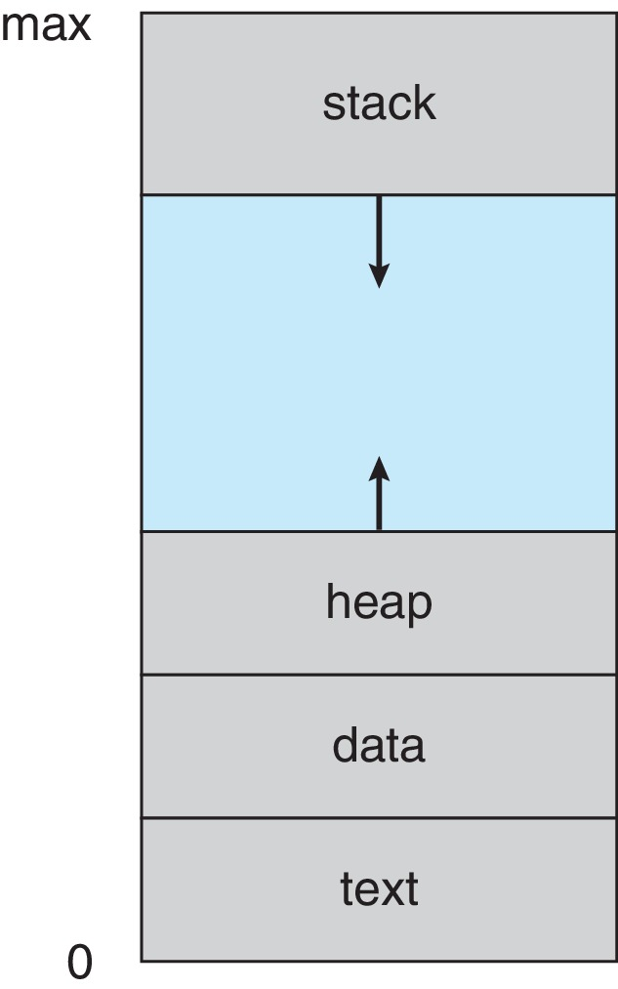
Module
02
Process in Memory

Slide 7
Module
02
Process Concept (Cont.)
Program is passive entity stored on disk (executable file); process is active
  Program becomes process when executable file loaded into memory
Execution of program started via GUI mouse clicks, command line entry of its name, etc
One program can be several processes
  Consider multiple users executing the same program

Slide 8
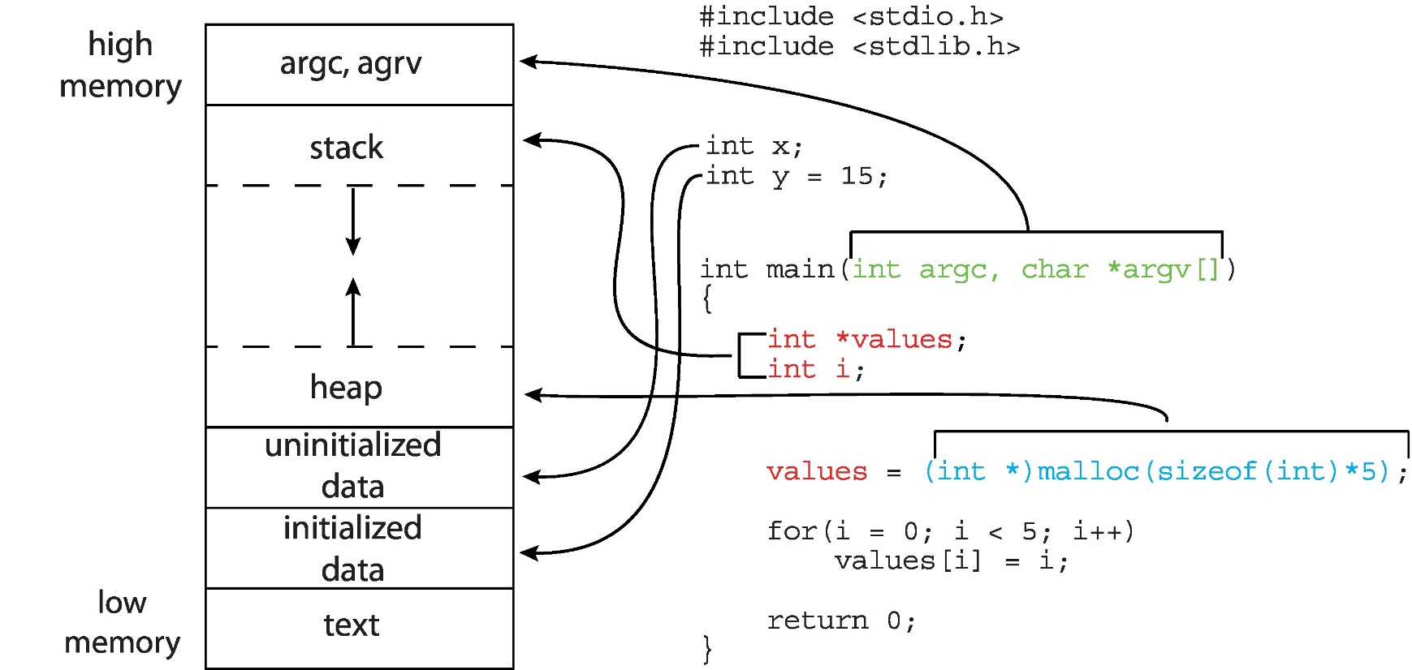
Module
02
Memory Layout of a C Program

Slide 9
Module
02
Process State
As a process executes, it changes state
  New: The process is being created
  Ready: The process is waiting to be assigned to a processor
  Running: Instructions are being executed
  Waiting: The process is waiting for some event to occur
  Terminated: The process has finished execution

Slide 10
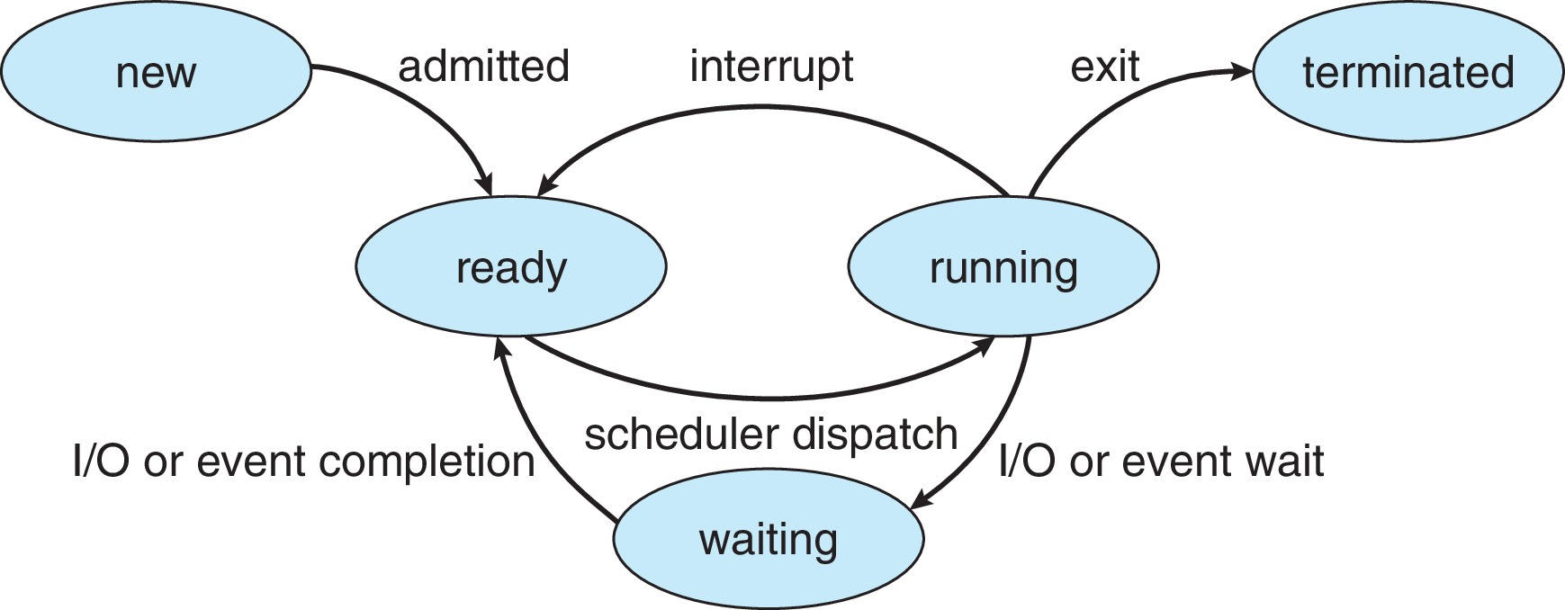
Module
02
Diagram of Process State

Slide 11
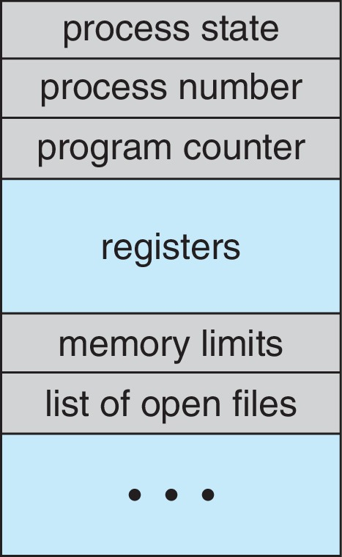
Module
02
Process Control Block (PCB)
Every process has a process control block, which is a data structure managed by the operating system.
PCB stores all of the information required to maintain track of a process.
  Process state – running, waiting, etc
  Process Number (ID). Each process in the OS has its own unique identifier.

Slide 12
Module
02
Process Control Block (PCB)
  Program counter – location of instruction to next execute.
  CPU registers – contents of all process-centric registers.
  CPU scheduling information- priorities.

Slide 13
Module
02
Process Control Block (PCB)
  Memory-management information – memory allocated to the process
  Accounting information
  I/O status information – I/O devices allocated to process, list of open files.
  The PCB architecture is fully dependent on the operating system, and different operating systems may include different information.

Slide 14
Module
02
Process Scheduling
When there are several or more runnable processes, the operating system chooses which one to run first; this is known as process scheduling.
A scheduler is a program that uses a scheduling algorithm to make choices.

Slide 15
Module
02
Process Scheduling
The following are characteristics of a good scheduling algorithm:
  For users, response time should be kept to minimum.
  The total number of jobs processed every hour should be as high as possible.
  Maximize the CPU use.
  Each process should be given an equal amount of CPU time.
x

Slide 16
Module
02
Process Scheduling
Maintains scheduling queues of processes
All processes, upon entering the system, are stored in the Job Queue (set of all processes in the system)
Processes in the Ready state are placed in the Ready Queue (set of all processes residing in main memory, ready and waiting to execute)

Slide 17
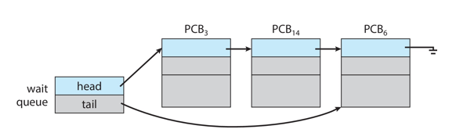
Module
02
Process Scheduling
Processes waiting for a device to become available are placed in Device Queues. There are unique device queues available for each I/O device.
Processes migrate among the various queues

Slide 18
Module
02
Representation of Process Scheduling
A new process is initially put in the Ready queue. It waits in the ready queue until it is selected for execution(or dispatched). Once the process is assigned to the CPU and is executing, one of the following several events can occur:
The process could issue an I/O request, and then be placed in the I/O queue.
The process could create a new subprocess and wait for its termination.
The process could be removed forcibly from the CPU, as a result of an interrupt, and be put back in the ready queue.

Slide 19
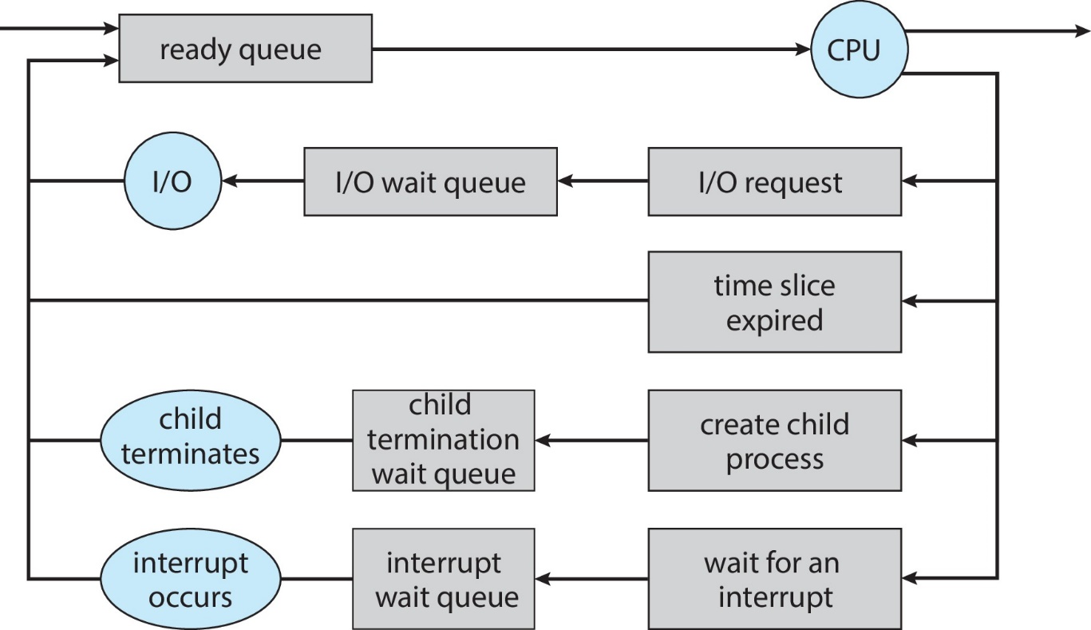
Module
02
Representation of Process Scheduling

Slide 20
Module
02
schedulers
Short-term scheduler (or CPU scheduler) – selects which process should be executed next and allocates CPU
  Sometimes the only scheduler in a system
  Short-term scheduler is invoked frequently (milliseconds) ⇒ (must be fast)

Slide 21
Module
02
schedulers
Long-term scheduler (or job scheduler) – selects which processes should be brought into the ready queue
  Long-term scheduler is invoked infrequently (seconds, minutes) ⇒ (may be slow)
  The long-term scheduler controls the degree of multiprogramming

Slide 22
Module
02
Schedulers
Processes can be described as either:
  I/O-bound process – spends more time doing I/O than computations, many short CPU bursts
  CPU-bound process – spends more time doing computations; few very long CPU bursts
Long-term scheduler strives for good process mix

Slide 23
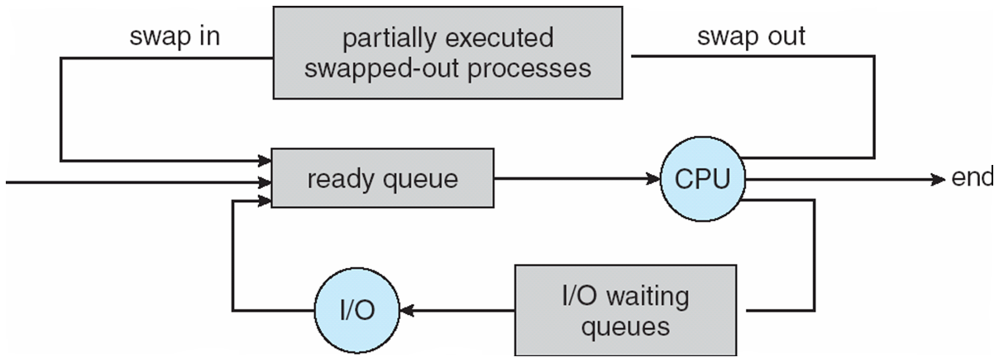
Module
02
Medium term schedulers
Medium-term scheduler can be added if degree of multiple programming needs to decrease
  Remove process from memory, store on disk, bring back in from disk to continue execution: swapping

Slide 24
Module
02
Context Switch
When CPU switches to another process, the system must save the state of the old process and load the saved state for the new process via a context switch
Context of a process represented in the PCB. When a context switch occurs, the Kernel saves the context of the old process in its PCB and loads the saved context of the new process scheduled to run.

Slide 25
Module
02
Context Switch
Context-switch time is overhead; the system does no useful work while switching
  The more complex the OS and the PCB ➔ the longer the context switch
Time dependent on hardware support
  Some hardware provides multiple sets of registers per CPU ➔ multiple contexts loaded at once

Slide 26
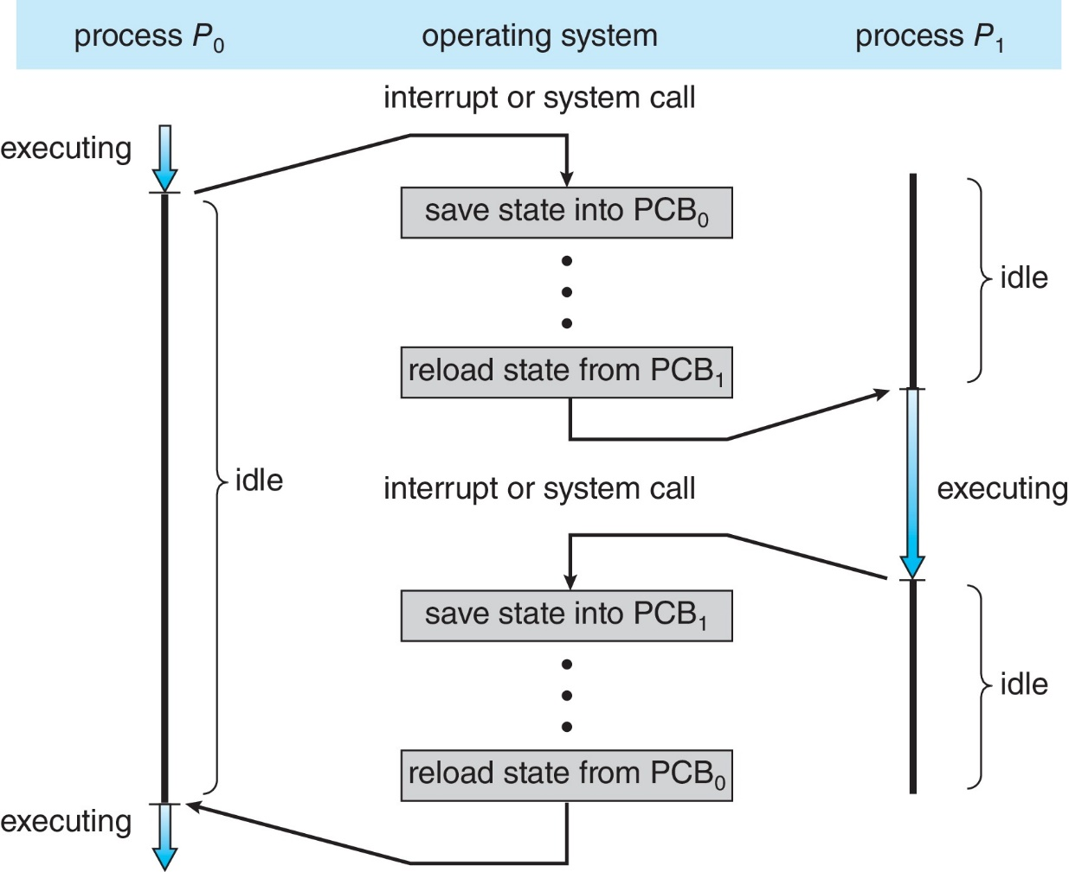
Module
02
CPU Switch From Process to Process
A context switch occurs when the CPU
switches from one process to another.

Slide 27
Module
02
Operations on Processes
System must provide mechanisms for:
  process creation
  process termination on Processes

Slide 28
Module
02
Process Creation
Parent process create children processes, which, in turn create other processes, forming a tree of processes
Generally, process identified and managed via a process identifier (pid)
Resource sharing options
  Parent and children share all resources
  Children share subset of parent’s resources
  Parent and child share no resources

Slide 29
Module
02
Process Creation
Execution options
  Parent and children execute concurrently.
  Parents Wait for the child process to terminate before proceeding. Parent process makes a wait() system call, for either a specific child process or for any particular child process, which causes the parent process to block until the wait() returns.

Slide 30
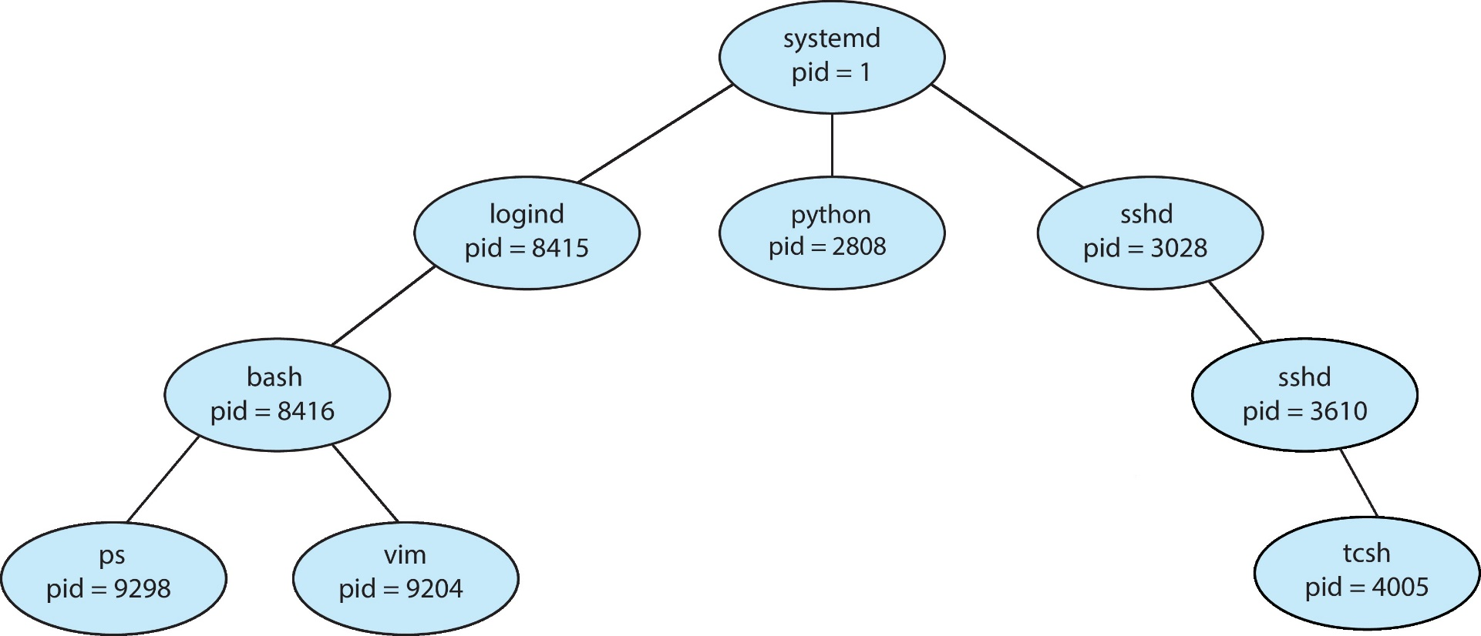
Module
02
Tree Of processes in Linux

Slide 31
Module
02
Process Creation (Cont.)
There are also two possibilities in terms of the address space of the new process:
  Child duplicate of parent
  Child has a program loaded into it
UNIX examples
  fork() system call creates new process
  exec() system call used after a fork() to replace the process’ memory space with a new program
  Parent process calls wait() for the child to terminate

Slide 32
Module
02
Process Termination
Process executes last statement and then asks the operating system to delete it using the exit() system call.
Process’ resources are deallocated by operating system

Slide 33
Module
02
Process Termination
Parent may terminate the execution of children processes using the abort() system call. Some reasons for doing so:
  Child has exceeded allocated resources
  Task assigned to child is no longer required
  The parent is exiting and the operating systems does not allow a child to continue if its parent terminates

Slide 34
Module
02
Process Termination
Some operating systems do not allow child to exists if its parent has terminated. If a process terminates, then all its children must also be terminated.
  cascading termination. All children, grandchildren, etc. are terminated.
  The termination is initiated by the operating system.
The parent process may wait for termination of a child process by using the wait()system call. The call returns status information and the pid of the terminated process

Slide 35
Module
02
Inter-Process Communication
Processes within a system may be independent or cooperating
Cooperating process can affect or be affected by other processes, including sharing data
Reasons for cooperating processes:
  Information sharing
  Computation speedup
  Modularity
  Convenience

Slide 36
Module
02
Inter-Process Communication
Cooperating processes need interprocess communication (IPC)
Two models of IPC
  Shared memory
  Message passing

Slide 37
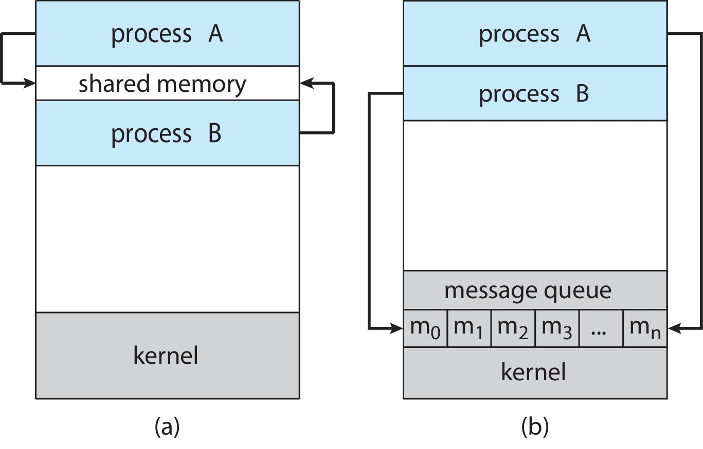
Module
02
Inter-Process Communication
(a) Shared memory. (b) Message passing.

Slide 38
Module
02
Shared Memory
An area of memory shared among the processes that wish to communicate
The communication is under the control of the users processes not the operating system.
Major issues is to provide mechanism that will allow the user processes to synchronize their actions when they access shared memory.
Synchronization is discussed in great details in Module 4

Slide 39
Module
02
Message Passing
Mechanism for processes to communicate and to synchronize their actions
Message system – processes communicate with each other without resorting to shared variables
IPC facility provides two operations:
  send(message)
  receive(message)
The message size is either fixed or variable

Slide 40
Module
02
Synchronization
Message passing may be either blocking or non-blocking
Blocking is considered synchronous
  Blocking send -- the sender is blocked until the message is received
  Blocking receive -- the receiver is blocked until a message is available

Slide 41
Module
02
Synchronization
Non-blocking is considered asynchronous
  Non-blocking send -- the sender sends the message and continue
  Non-blocking receive -- the receiver receives:
    A valid message, or
    Null message
Different combinations possible
  If both send and receive are blocking, we have a rendezvous

Slide 42
Module
02
End of Module 2

