Slide 1

A Comparative Study of Fake News Detection Using Machine Learning, Deep Learning, and Large Language Models
Prepared By
Name: Rayan Shukri ID No.: 251000636
Name: Sultan Hassan ID No.: 251002896
Subervized by
Wesam Ahmed

Slide 2
Agenda
Introduction
Objective
Contribution
Related work
Proposed framework
Dataset

Slide 3
Introduction
What is Fake News?
Fake news = false or misleading content presented as real news.
Goal: influence opinions or serve political/financial interests.
Social media algorithms amplify and accelerate its spread.
Example: COVID-19 misinformation caused real-world harm.
Role of AI:
Enhances accuracy, scalability, and adaptability.

Slide 4
Objective
Explore and compare three major AI paradigms
Machine Learning (ML)
Deep Learning (DL)
Large Language Models (LLMs)
In terms of their strengths, weaknesses, and effectiveness.

Slide 5
Contribution
1- Implement and evaluate ML, DL, and LLMs for fake news detection.
2- Apply all models on the same datasets and compare with standard metrics.
3- Assess strengths and weaknesses in performance, robustness, and generalization.
4- Present findings to guide future researchs and development.

Slide 6
Related Work
Ref | Year | Dataset(s) | Model(s) | Results | Advantages | Limitations
Machine Learning (ML)
Hansrajh et al.[1] | 2021 | LIAR, ISOT | Ensemble: LR, SVM, LDA, SGD, Ridge | LIAR: F1 = 0.682, Acc = 0.681, ISOT: F1 = 0.984, Acc = 0.985, | ensemble outperformed individual classifiers | lower accuracy on short claims, lack of contextual/social signals)
Deep Learning (DL)
Ajik et al. [2] | 2023 | FakeNewsNet, ISOT | Optimized CNN + LSTM | Accuracy: ~94.6% (FakeNewsNet), ~96.1% (ISOT) | Hybrid CNN-LSTM captured both local features and sequential dependencies; outperformed baseline DL models | Computationally expensive; requires large labeled datasets for training
Large Language Models (LLM)
Huang et al. [3] | 2025 | Kaggle Fake News dataset (~5,000 articles; balanced real/fake) | Hybrid Transformer + BiGRU + Bayesian Optimization | Transformer+BiGRU: Train 100%, Test 99.67% Transformer+BiGRU+Bayesian: Train 100%, Test 99.73% | - Near-perfect detection accuracy - Bayesian optimization improved robustness (+0.06%) | - Small dataset (risk of overfitting) - No testing on multilingual or multimodal datasets

Slide 7
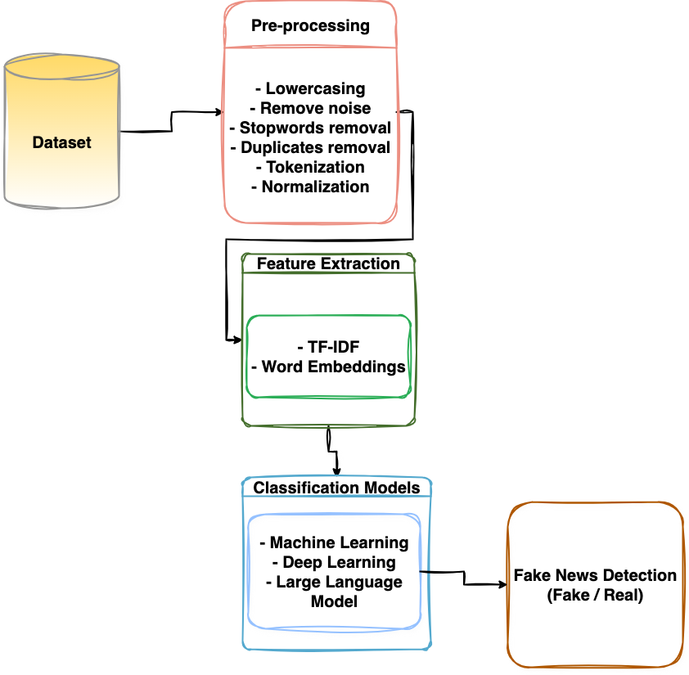
Proposed framework

Slide 8
COVID Fake News Dataset
The dataset consists of COVID-19 related news headlines labeled as either real or fake. Its purpose is to provide a benchmark for evaluating the performance of machine learning, deep learning, and transformer-based models in fake news detection.
Dataset Source:
Key Details:
https://doi.org/10.5281/zenodo.4282522
Total Rows: 10,201
Number of Columns: 2
Target Label: Fake News classification (yes/no)
Format: CSV
Columns Included:
headlines: COVID-related news headline text
outcome: Binary label (0 = fake, 1 = real)

Slide 9





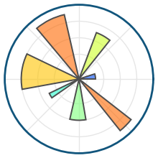

Hardware and Software Libraries
Hardware Environment
Software Environment
Kaggle / Google Colab (GPU-enabled)
RAM: ≥16 GB
GPU: NVIDIA Tesla T4 (or equivalent)
Storage: ~10 GB
Programming Language: Python
Core Libraries: Pandas, NumPy
Machine Learning: Scikit-learn
NLP Tools: NLTK, SpaCy
Transformers: Hugging Face Transformers
Deep Learning: TensorFlow, PyTorch
Visualization: Matplotlib, Seaborn

Slide 10
References
[1] Hansrajh, A., Adeliyi, T. T., & Wing, J. (2021). Detection of online fake news usingblending ensemble learning. Scientific Programming, 2021, 1–14.
[2] Ajik, E. D., Obuandike, G. N., & Echobu, F. O. (2023). Fake news detection usingoptimized CNN and LSTM techniques. Journal of Information Systems andInformatics, 5(3), 1044–1056.
[3] Huang, T., Xu, Z., Yu, P., Yi, J., & Xu, X. (2025). A hybrid transformer model for fakenews detection: Leveraging Bayesian optimization and bidirectional recurrent unit.arXiv preprint arXiv:2502.09097.
[4] Hakim, K. B. A., & Easwaramoorthy, S. V. (2024). Impact of Fake News on Social MediaTowards Public Users of Different Age Groups. arXiv preprint arXiv:2411.05638.
[5] Surjatmodjo, D., Unde, A. A., Cangara, H., & Sonni, A. F. (2024). Information pandemic: acritical review of disinformation spread on social media and its implications for stateresilience. Social Sciences, 13(8), 418.
[6] Chen, J. A., Chung, W. C., Hung, C. L., & Wu, C. Y. (2025). Identifying Disinformation on theExtended Impacts of COVID-19: Methodological Investigation Using a Fuzzy Ranking Ensemble ofNatural Language Processing Models. Journal of Medical Internet Research, 27, e73601.
[7] Alghamdi, J., Lin, Y., & Luo, S. (2023). Towards COVID-19 fake news detection usingtransformer-based models. Knowledge-Based Systems, 274, 110642.
[8] Allcott, H., & Gentzkow, M. (2017). Social media and fake news in the 2016 election. Journal ofeconomic perspectives, 31(2), 211-236.

Slide 11
Thank You!

