Slide 2




Welcome to the professional quality track
Now that we have identified a project that is suitable for PFS with PVA, we must confirm that the project performance (TASKS and TEAM) will be compliant with HPMQS by developing PDQP.

Slide 3


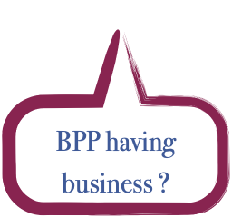

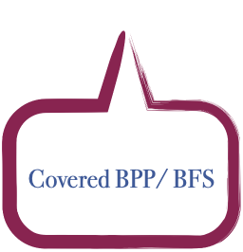
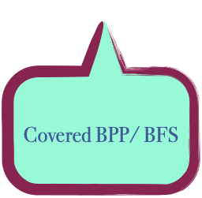


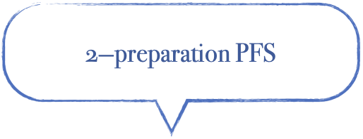
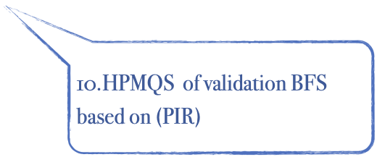
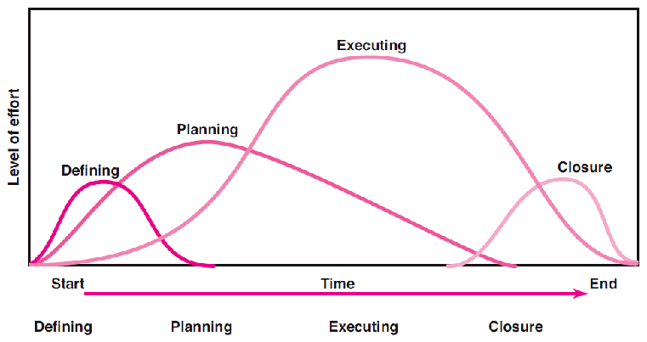
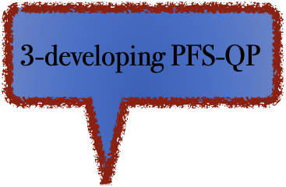

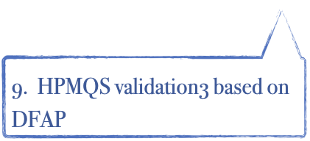
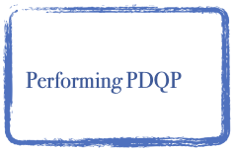
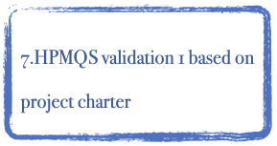



Designed and developed by Dr.Mahmoud Ibrahim @2023
Sec.1
New
Sec.2
Sec.3
New
4-Initiating
project-fit
PDQP

Slide 4
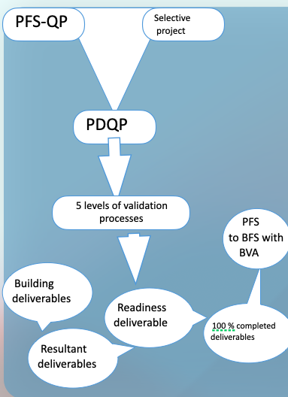
The root cause of the project success
Designed and Delivered by Dr Mahmoud Ibrahim @2023

Slide 5

Lecture outline
1st section content :
The PDQP baselines
2nd section content :
Conducting of the PDQP
3rd section content :
Developing the performance standards of the PDQP

Slide 6


Slide 7
The upgraded PMQP “PDQP”
-Most Project Managers are aware that delivering projects within "time, cost and quality" is critical to their success.
-HPMQS defines quality as the extent to which the final deliverable meets the customer's requirements and cover BPP

Slide 8
the difference between….
 | The traditional PQP | PDQP
Meaning | is primarily concerned with meeting the critical project management process which are time ,scope and cost and meeting the quality requirements specified for this processes . | is primarily concerned with acceptance of the deliverable production process with documentation for the completed produced deliverables that have been formally accepted, and those completed deliverables that have not been formally accepted along with the reasons for non-acceptance.
Used technicality | PjT | DFT and PjT
Value added | None | BVA with PVA

Slide 9
What is PDQP?
PFS-QP
Selective project
PDQP
Is the systematic process of transforming success criteria and success factors into quality standards to "Delivering Quality" by ensuring customer requirements are met by conforming the DFT to PFS-QP throughout the selected project and ensuring alignment with desired outcomes by achieving high-quality results.
5 levels of validation processes
PFS to BFS with BVA
Building deliverables
Readiness deliverable
100 % completed deliverables
Resultant deliverables
Designed and Delivered by Dr Mahmoud Ibrahim @2023

Slide 10
The impact of the PDQP functions on the BPP
PDQP functions | Based on what | The result
HPMQAP | 1- verifying DFT based on PQDA standards | Having “Resultant deliverables”
HPMQCP | 2-validating DFT based on PQDA standards
PQP | 3-validating the “Resultant deliverables”with its PjT based on the project completion criteria | Having “Readiness deliverables”
HPMQS -acceptance plan | 4-“Readiness deliverables” testing acceptance of the“Readiness deliverables”based on the acceptance criteria | Having 100% official completed deliverables (PFS with the maximum PVA)
HPMQCI | 5- Verifying and validating the DFT of the PFS based on the business case success criteria | Having BTS with the maximum BVA
Designed and Delivered by Dr Mahmoud Ibrahim @2023

Slide 11
the PDQP life cycle
1 | Before the PLC : | integrating 4th planning stages of HPMQS with the PLC | For transforming the integration the DFT with PjT to outcome to 100 % completed deliverables
2 | During the PLC : | Developing and merge HPMQAP and HPMQCP with the PQP | For monitoring and controlling the project execution phase for having the PFS with PVA
3 | After the PLC : | Developing the HPMQCI | For validated the BVA from the BTS

Slide 12
PDQP elements

Slide 13
PDQP conducting steps
It includes steps for conducting HPMQA and HPMQC activities ,acceptance testing and the HPMQCI for the post implication validation to identify and rectify any quality issues or deviations from the desired standards.
-ThePDQP also defines the roles and responsibilities of team members involved in ensuring quality and establishes clear objectives and metrics for measuring quality performance.

Slide 14

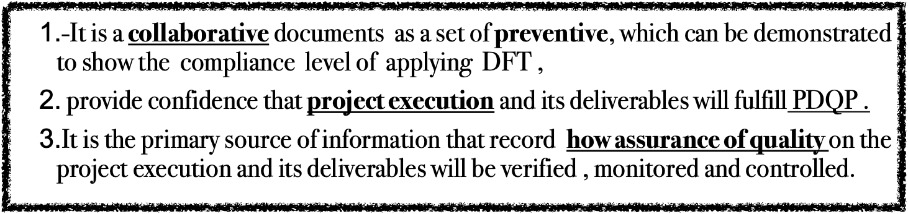
HPMQAP
A systematic approach for verifying and regulating the PjT and DFT processes in project performance to produce acceptable outcomes from both the customer and manager viewpoints.

Slide 15
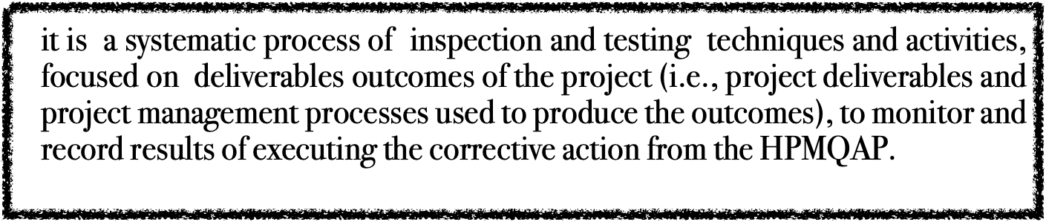

HPMQC
1- producing the “Resultant deliverables”.
2-minimizing the rework
3- confirm the improvement of the deliverable building process
4- Tracking rework
5-Tracking the total number of errors fixed,

Slide 16
HPMQCI
After a project is closed, the role of quality continuous improvement is to
1-Assessing the project's outcomes and identify areas for improvement.
2- Analyzing the BFS performance against the defined PDQP standards, evaluating BVA whether the project achieved its desired outcomes, and identifying any gaps or opportunities for further enhancement

Slide 17


Slide 18
1-Determining the DFT quality targets
The First step in planning the PDQP is designing proactive process, and procedures aim to :
1. Verify project quality targets based on the integration process between the DFT and the PjT.
2. Prevent defects and errors from occurring through various project activities such as planning, tracking, and so on
3. Continuously improve quality levels
4 .Ensure maintaining compliance with the HPMQS success criteria and factors and the acceptance criteria.

Slide 19
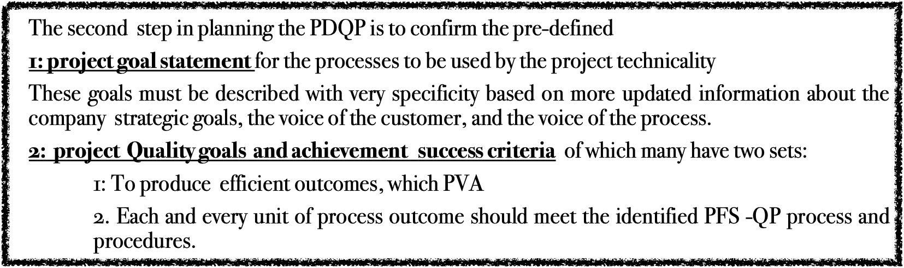

Slide 20
The PDQP targets
PDQP quality targets | Deliverable quality targets | Project technicality (PJT) quality Targets
Aims to | Effectively meeting the customer requirements and covering the BPP successfully | The project management plans are compliance with the project plan and the completion criteria
 | Having superior BVA | Having PVA
The deliverable production process | The deliverable building process has almost no defects. | Rework is reduced by increasing the efficiency of the project execution phase.
Finished deliverables | Having the delivery 100% signed off and totally acknowledged by the customers (PFS) | Getting the (readiness deliverable )
Its role | Extended until the BPP is successfully closed. | After the project is completed,
Designed and Delivered by Dr Mahmoud Ibrahim @2023

Slide 21
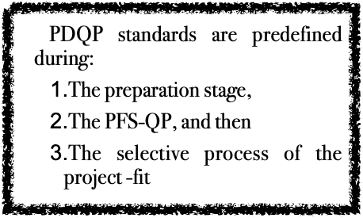
3- identifying the PDQP standards
*To transform success criteria and success factors into quality standards, you can follow these steps:
1. Define Success Criteria: First, clearly define the success criteria for your project. These are the measurable outcomes that will determine whether the project is successful or not.
2. Identify Success Factors: Next, identify the key success factors that contribute to achieving the success criteria. These can include specific actions, behaviors, or resources that are necessary for success.
3. Develop Quality Standards: Based on the identified success factors, develop quality standards that outline the specific requirements and expectations for each factor. These standards should be measurable, achievable, relevant, and time-bound.
-Activities that must be fulfilled the quality levels and completed to a high-quality standard as a project considered most essential to its success or failure in order to achieve your project's goals.
4. Communicate and Implement Standards: Ensure that the quality standards are effectively communicated to all project stakeholders, including team members, clients, and management. Implement the standards throughout the project lifecycle and track progress towards meeting them.
5. Monitor and Evaluate Performance: Continuously monitor and evaluate the performance of the project against the quality standards. Regularly assess whether the success factors are being met and whether any adjustments or improvements need to be made.
6. Make Continuous Improvements: Based on the performance evaluations, make necessary adjustments to improve the project's adherence to the quality standards. This could involve refining processes, providing additional training, or allocating more resources if needed

Slide 22
4-Identify quality level
The quality level that a project can achieve depends upon the efficiency
1-This helps in understanding where and why a process can go wrong and also assists in addressing those areas in the respective procedures.
2-This information also helps to determine the different types of reviews and audits to be performed and how often they will be performed during the project lifecycle.
The “garbage in”—“garbage out” philosophy works very well here. Hence, in developing the quality assurance plan, -it is very important that the project team understand the various processes to be used in the project.

Slide 23
HPMQAP

Slide 24
5-Scheduling the reviews and audits process of the HPMQA
1— The project manager and a HPMQS quality manager should fix a detailed timetable for all scheduled reviews and audits that will be used for assessing the PjT/DFT processes used in the project to achieve the project goals and to produce quality deliverables
2-This schedule should also be documented in the both the HPMQP and project plan

Slide 25
6-determining the HPMQA inspection techniques
Inspections are sometimes called gate reviews, process reviews, audits, and walkthroughs.
A quality audit is a structured, independent review to determine whether project activities comply with DFT and PjT as project policies, processes, and procedures.
-The objective of a quality audit is to identify missing, inefficient or ineffective policies, processes, and procedures in use on the project.
The subsequent effort to correct these deficiencies should result in a reduced cost of quality and an increase in sponsor or customer acceptance of the project’s product.
Quality audits may be scheduled or random and may be conducted by internal or external auditors.

Slide 26
HPMQCP

Slide 27
7- Identifying and scheduling Tasks and Activities for “HPMQC ”
identify the task and activities of the quality control team. The HPMQA plan should clearly :
1-explain the inspections and testing procedures for quality control,
2-their frequencies and
3-how they will be conducted at the various stages of the project lifecycle.

Slide 28
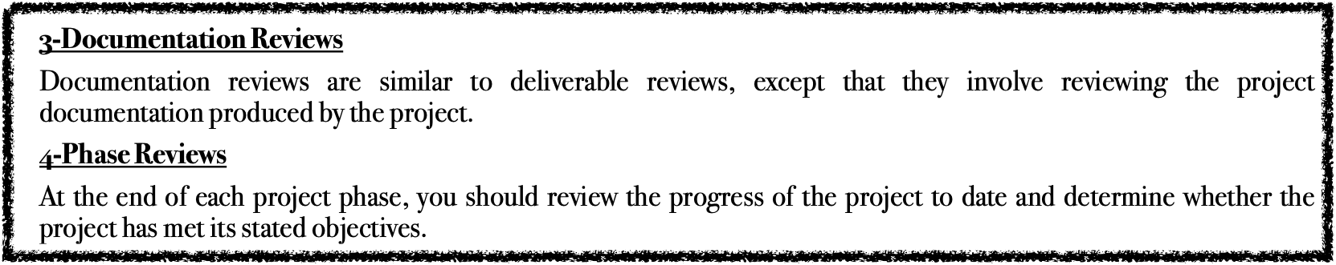
8- Determine HPMQC techniques include:
1-Peer Reviews
Asking team members to review each other's deliverables to control the level of quality achieved by the project. Peer Reviews will also allow you to identify any quality issues early in the Execution phase of the project.
2-Deliverable Reviews
You can plan and perform formal reviews of deliverables across the project to increase your likelihood of meeting the Quality Targets.

Slide 29
Regarding the efficiency of the PjT

Slide 30
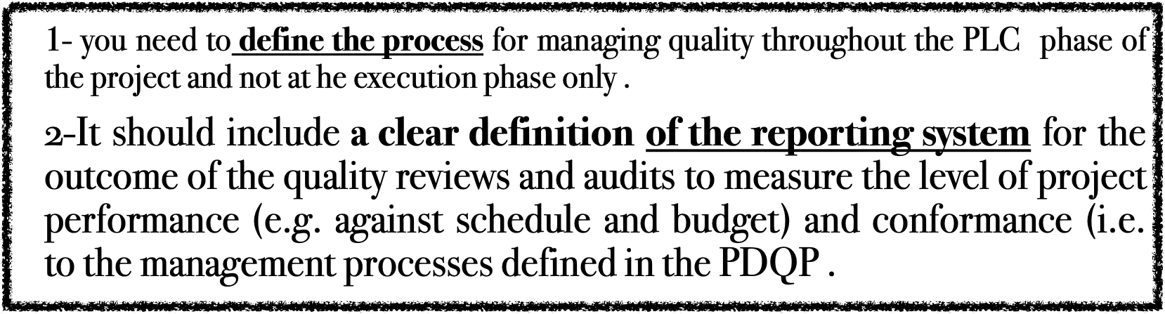
9-very clear definition of the reporting system

Slide 31
Regarding the project scope validation

Slide 32

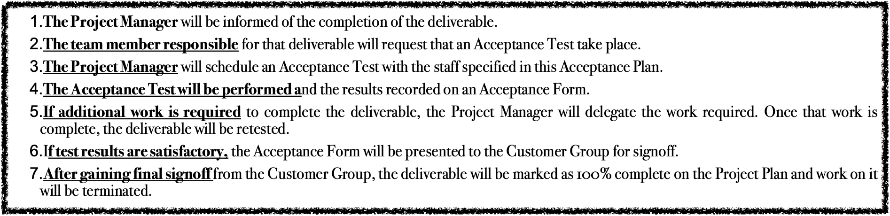
10-confirming the scheduling of the acceptance tests and its conducting process
To accept deliverables as complete for this project, we will perform the following acceptance test activities:

Slide 33
Regarding the PjT at execution monitoring and controlling

Slide 34
11-the PDQP supporting the project manager throughout execution processes
By following the guidelines and protocols outlined in the PDQP ,project manager can systematically monitor and evaluate the quality of the project deliverables and take appropriate actions to address any deficiencies or non-compliance.
-This helps to ensure that all project deliverables are thoroughly reviewed and validated against the defined CUSTOMERS requirements before the project is closed, thus ensuring that the desired quality standards are met.

Slide 35
Regarding the project's formal completion

Slide 36
12-PDQP role in closing the project
(PCR)
The PDQA plays a crucial role in closing a project. Here are some key roles it serves:
1. Ensuring the completion of project deliverables: The quality plan outlines the required quality standards for each deliverable and ensures that they are met before the project is closed. This helps to ensure that all project objectives have been achieved.
2. Conducting final inspections and audits: The quality plan includes procedures for conducting inspections and audits at the end of the project. This helps to identify any remaining quality issues or deviations from the plan, which can then be addressed before closing the project.
3. Documenting lessons learned: The quality plan facilitates the capture of lessons learned throughout the project. This includes documenting what went well, what didn't go as planned, and any recommendations for future projects. This information is valuable for improving future project performance and avoiding similar mistakes.
4. Transitioning deliverables to operations: The quality plan outlines the processes for transitioning project deliverables to the operational environment. It ensures that the necessary quality checks and tests are conducted before handing over the deliverables to the operations team.
5. Closing out quality-related activities: The quality plan provides guidance on how to close out quality-related activities, such as closing out non-conformances or addressing any outstanding corrective actions or improvement opportunities. This helps to ensure that all quality-related issues are resolved before closing the project.
Overall, the PDQA is essential for ensuring that the project is closed in a controlled manner, with adequate attention given to quality considerations. It helps to ensure that the project outcomes meet the desired quality standards and that any lessons learned are captured for future improvement.

Slide 37
Regarding after Poject's formal completion

Slide 38
13-The role of HPMQCI for having (BVA)
_PIR_
The continuous improvement process may include gathering feedback from stakeholders, conducting post-project reviews, and analyzing data to identify trends and patterns. Based on the findings, actions can be taken to refine processes, address any weaknesses or bottlenecks, and implement changes to improve future project performance.
Additionally, quality continuous improvement can involve sharing lessons learned from the project with the wider organization or industry. This helps to disseminate knowledge and best practices, enabling others to benefit from the project's successes and avoid potential pitfalls in future endeavors.
Ultimately, the aim of quality continuous improvement after a project is closed is to leverage the project's outcomes and experiences to drive ongoing improvement, enhance organizational capabilities, and ensure that future projects deliver even higher levels of quality and success.(BVA)

Slide 39
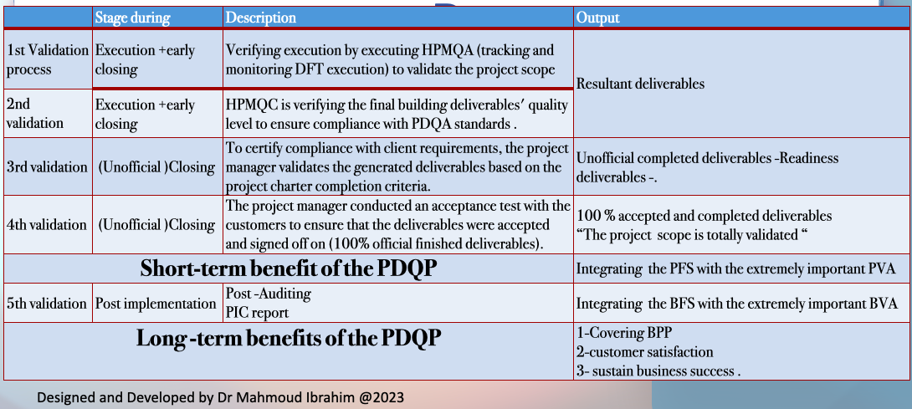
The output ( official blueprint for project success)
Having well-structured approved PDQP with performance standards for its components such as HPMQA, HPMQC ,the Acceptance plan HPMQCI as follows

Slide 40
The Abbreviations

Slide 41
abbreviations | Stands for
PjT | Project technicality
PQP | Project quality plan
PMQC | Project Management quality control
PMQA | Project management quality assurance
BVA | Business value added
PVA | Project value added
HPMQAP | Holistic project management quality assurance plan
HPMQCP | Holistic project management quality control plan
HPMQA | Holistic project management quality assurance
HPMQC | Holistic project management quality control
HPMQA/C | Holistic project management quality assurance and control
PDQP | Project deliverable Quality plan
HPMQCIP | Holistic project management quality continues improvement plan

Slide 42


