Slide 1



Enterprise Risk Management
PMG 611
Lecture 5
Implementing ERM in the Enterprise
Prepared by
Dr. Eng. Abdullah Jameel Halawany

Slide 2

Lecture
Session Outline
05
Roles and Responsibilities of an Enterprise Risk Management Function
ERM Activity Scope and Review Planning
Risk Management Policies, Standards, and Strategies
Risk Management Reviews and Corrective Action Practices
5–2

Slide 3
Lecture
Introduction
05
Implementing ERM in the Enterprise
PMG 611
Enterprise Risk Management
5–3

Slide 4
Lecture
Introduction
05
Virtually, all larger public companies today have some type of Risk Management Department or function.
Their formal enterprise risk management was structure as a lower-level department which often was primarily responsible for purchasing insurance and implementing routine loss prevention programs for certain high-frequency exposures.
That risk management function usually did not receive the respect it should deserve in today’s era of ERM.
5–4

Slide 5
Lecture
Introduction
05
Those Risk Management Functions were not structured at a senior or C-level status in enterprise charts.
An effective Risk Management Function would be headed by a Chief Risk Officer (CRO)
An executive whose responsibility is to ascertain that enterprise risks are properly understood and translated into meaningful
  business requirements
  Objectives
  metrics.
5–5

Slide 6
Lecture
Introduction
05
Even if an enterprise has a traditional ‘‘insurance department,’’ the ERM framework provides an enterprise with an excellent opportunity to reengineer their existing insurance-based risk management function along the lines of the ERM framework or to create a separate new ERM function for the enterprise.
5–6

Slide 7
Lecture
Introduction
05
Given the importance of risk management in today’s enterprise, ERM functions should operate at a higher level than the traditional insurance-based risk function groups that sometimes operated side by side with such facility support functions as property security and loss prevention.
While these latter functions are important to an enterprise, the ERM department should take a higher and more prominent role.
5–7

Slide 8
Roles and Responsibilities of an Enterprise Risk Management Function
Lecture
05
Implementing ERM in the Enterprise
PMG 611
Enterprise Risk Management
5–8

Slide 9
Lecture
Roles and Responsibilities of an Enterprise Risk Management Function
05
The responsibilities of today’s enterprise risk function have been broadened and deepened to include regulations, capital markets concerns, financial reporting, the many issues surrounding globalization, intellectual capital, and, of course, all aspects of IT.
To be effective, the enterprise risk function and its CRO must have their eyes wide open regarding the various levels of risks impacting all levels of the enterprise.
5–9

Slide 10
Lecture
Roles and Responsibilities of an Enterprise Risk Management Function
05
For a public corporation, an enterprise risk management function should be a senior-level operating unit with authority covering the entire enterprise.
For a larger enterprise with multiple and differing business operations, there may be a need for separate multiple risk management units, but all should report to a single responsible risk function headed by a CRO
5–10

Slide 11
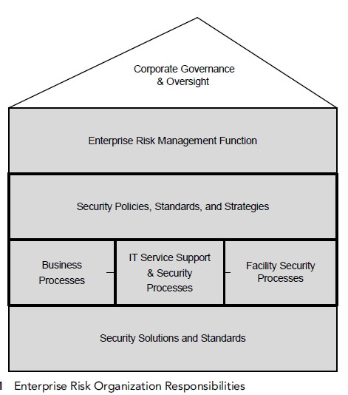
Lecture
Roles and Responsibilities of an Enterprise Risk Management Function
05
Whether a relatively small organization or a multidivisional, multicounty type of enterprise, any risk management function should follow these same general operational standards and guidelines.
5–11

Slide 12
Lecture
CRO Responsibilities
05
A key component of an effective ERM function is the need for enterprise leadership that is responsible for the overall risk management process.
That title of ‘‘chief’’ means little unless the CRO has the authority and responsibility to effectively manage the enterprise risk program and to communicate these activities to senior management.
5–12

Slide 13
Lecture
CRO Responsibilities
05
The major responsibility of the CRO is
  To manage the process of assessing risks throughout the enterprise,
  To implement appropriate corrective actions,
  To communicate risk issues and events to all levels of the enterprise.
  Supporting risk management function.
5–13

Slide 14
Lecture
CRO Responsibilities
05
Risk Management Function should have several staff specialists to help review and help minimize enterprise risks in addition to developing risk management policies, standards, and strategies.
These are persons with the abilities to understand and help implement corrective actions for general business, IT, and basic insurance-related risks.
ERM specialists should have the authority and responsibility to both identify specific enterprise risks and to actually help implement corrective actions to minimize those identified risks.
5–14

Slide 15
Lecture
05
Enterprise Risk Management Function vs. Internal Audit
Internal auditors review internal controls and make recommendations for improvement
Usually take no active role in helping to implement those recommended changes, unless specifically engaged as internal consultants.
Very important difference between an enterprise risk management function and internal audit is that the ERM group will usually go beyond just reviewing an area and making recommendations for subsequent follow-up.
5–15

Slide 16
Lecture
Examples of How an Effective Enterprise Risk Management Function Might Operate
05
Take Actions
An enterprise Risk Management Analyst reviews the potential new product liability risks in a given business area.
Risk Management Function may identify governmental actions that may place some foreign country operations at risk.
An Enterprise Risk Management Specialist with strong IT skills may access system vulnerabilities in what is often called a firewall perimeter surrounding an area of IT operations.
5–16

Slide 17
ERM Activity Scope and Review Planning
Lecture
05
Implementing ERM in the Enterprise
PMG 611
Enterprise Risk Management
5–17

Slide 18
Lecture
ERM Activity Scope and Review Planning
05
An effective ERM function should not, however, just go from one risk-related area to another without any type of organized plan or approach.
ERM function should follow a risk review plan covering an extended time period.
By its very nature, risk management will always be responding to crises as they occur, but that response should try to follow a standard, consistent approach throughout the enterprise.
5–18

Slide 19
Lecture
ERM Activity Scope
05
ERM function should first develop an understanding of and document the risk areas that are in their scope of operations.
There are always some risk events either too big or too little to be included within the scope of the ERM group.
We are referring to very major events such as violent weather, major economic disruptions, and the like.
5–19

Slide 20
Lecture
ERM Activity Scope
05
The CEO along with the risk management organization may be able to have some high-level risk response plans in place for such events, but often cannot realistically do much beyond having some very general plans or statements of support in place.
Similarly, there will always be some risk areas that are perhaps troublesome difficulties but are not within the scope of the ERM group.
Should have some internal guidelines coving the types of risks it can realistically manage.
5–20

Slide 21
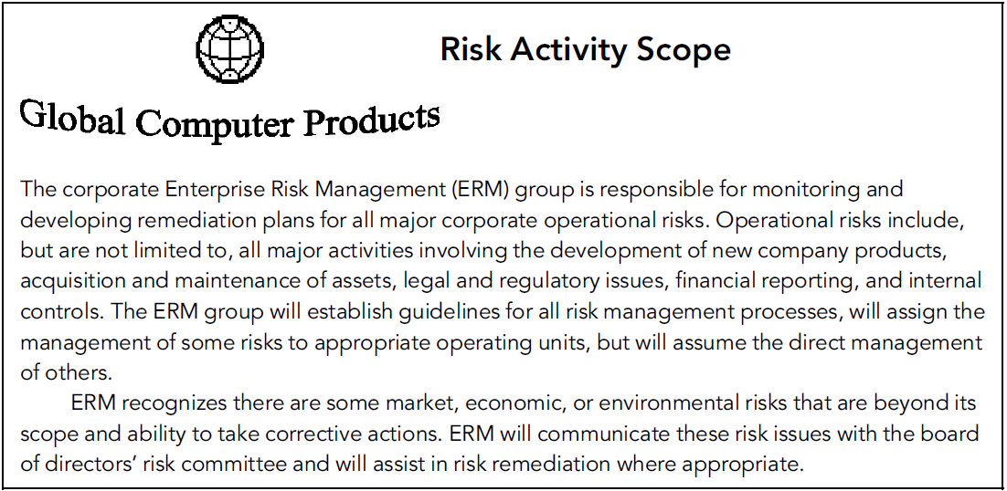
Lecture
Risk Activity Scope: Example
05
5–21

Slide 22
Lecture
ERM Activity Scope
05
This type of risk responsibility scope document should be an internal ERM policy statement and would not be developed for general distribution to enterprise stakeholders at large.
It shows ERM’s areas of risk management expertise, where the enterprise is responsible for various risks, and the acceptance of other entities, such as the legal department or local fire departments, for handling other risks.
5–22

Slide 23
Lecture
ERM Activity Scope
05
This is the type of document that the CRO should share in a board or CEO-level briefing so that they are aware of the ERM’s planned area of scope.
The CRO should gain approval and endorsement for these high-level plans or should adjust them in light of suggested changes.
5–23

Slide 24
Lecture
ERM Review Planning
05
Risk Management Group should establish a strong understanding of the higher risk areas that are with their defined scope and develop risk management project plans for these enterprise risk areas.
This is the process of defining risk likelihood and criticality.
ERM function needs to develop a monitoring or review approach.
5–24

Slide 25
Lecture
ERM Review Planning
05
Based on its estimate of the higher likelihood and higher loss probability risk areas, the enterprise risk management function should monitor and review risk areas taking the following approaches:
  Initiate immediate action to resolve the risk.
  Review the risk area and propose corrective actions to reduce risk exposures.
  Arrange with internal audit to perform a review of a selected risk area.
  Monitor the risk area on a continuous basis.
  Develop plans to take action only in the event of a risk occurrence.
5–25

Slide 26
Lecture
ERM Review Planning
05
Risk Management should develop an annual risk assessment action plan.
Such a time plan would assign responsibilities for the coverage of various risk events, estimate the enterprise risk group’s time to correct and review, and include some time and budget estimates.
The plan should be reviewed and approved by senior management.
When others such as internal audit are expected to complete portions of the action plan, these events should be coordinated.
5–26

Slide 27
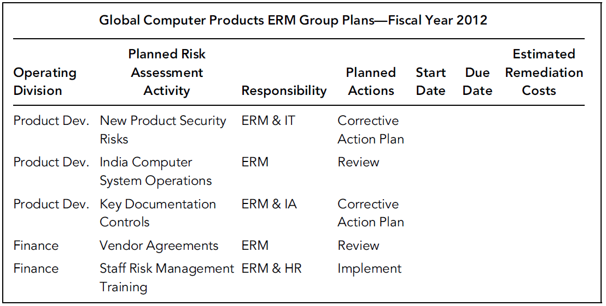
Lecture
Annual Risk Action Plan Example
05
5–27

Slide 28
Risk Management Policies, Standards, and Strategies
Lecture
05
Implementing ERM in the Enterprise
PMG 611
Enterprise Risk Management
5–28

Slide 29
Lecture
05
Risk Management Policies, Standards, and Strategies
The Risk Management Function must encompass all enterprise units and levels.
The ERM function must be managed and communicated to a wide group of responsible persons throughout the enterprise.
There are needs to develop some risk management policies and standards that are followed by units in the enterprise, following a consistent strategy.
Designated managers throughout the enterprise should be trained on these risk management policies and then charged with their implementation.
5–29

Slide 30
Lecture
05
Risk Management Policies, Standards, and Strategies
The point here is that while enterprise risk should be managed and directed by a central CRO-led function, responsibilities and tasks need to be pushed down and across the enterprise by building a risk-sensitive culture throughout the enterprise.
Stakeholders at all levels need to be aware of some of the risks that the enterprise is facing, the consequences of those risk exposures, and some of the steps they can put in place to limit those risks.
5–30

Slide 31
Lecture
05
Risk Management Policies, Standards, and Strategies
Some of the steps necessary to build and implement an effective risk management culture:
Build a Risk-Awareness Culture.
  The ‘‘tone at the top’’
Creating the Enterprise-Wide Risk Management Organization.
  Professional staff (a good understanding of the risks impacting the enterprise, techniques for limiting risk exposures).
Enterprise Risk Management Policies and Standards.
5–31

Slide 32
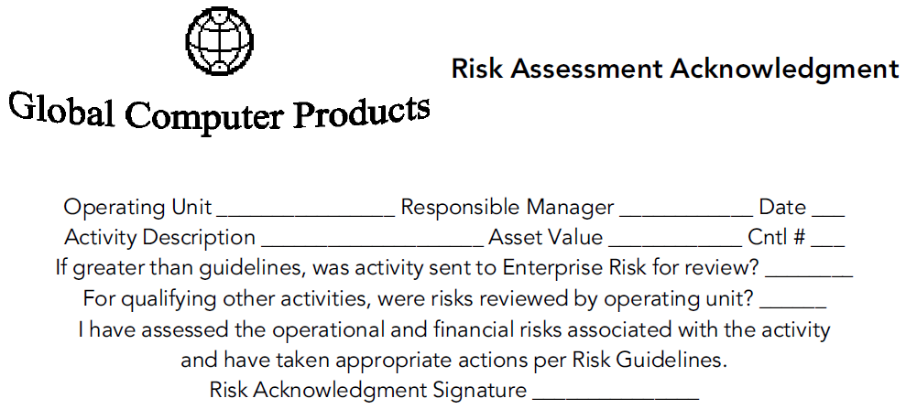
Lecture
05
Risk Assessment Sign-Off Acknowledgment Form
The purpose of such a risk assessment signoff form to encourage all stakeholders to acknowledge that they have considered risks when authorizing and approving a financial transaction above some designated value.
5–32

Slide 33
Risk Management Reviews and Corrective Action Practices
Lecture
05
Implementing ERM in the Enterprise
PMG 611
Enterprise Risk Management
5–33

Slide 34
Lecture
05
Risk Management Reviews and Corrective Action Practices
Risk Assessment Reviews (RARs) should examine key areas in the enterprise and make recommendations for both improving internal controls and reducing risk likelihoods.
The Risk Management Group should develop such a review approach, communicating their review plans and procedures with senior management, internal audit, and the board audit committee.
5–34

Slide 35
Lecture
05
Risk Management Reviews and Corrective Action Practices
RAR reviewers would emphasize a wide range of identified risks in the area selected and then would suggest approaches to eliminate or minimize these risks.
the Enterprise Risk Reviewers should form a standard set of review steps to review the identified area.
5–35

Slide 36
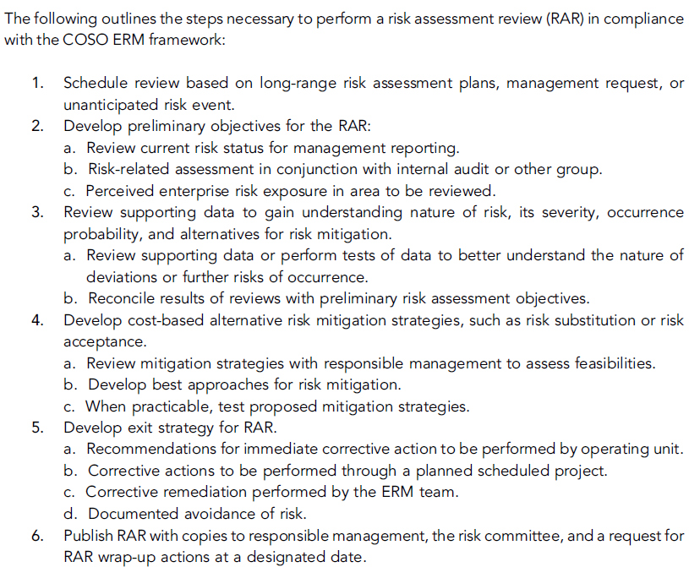
Lecture
05
RAR Sample Review Guidance
5–36

Slide 37

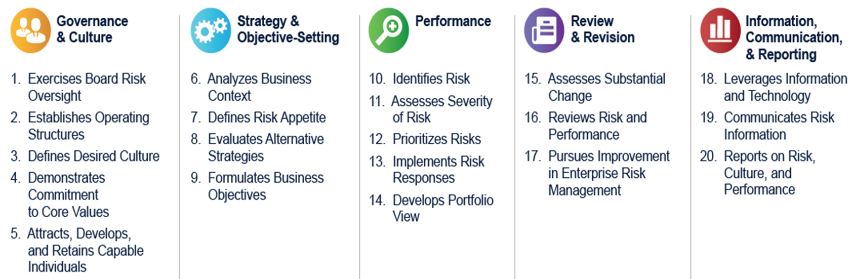
5–37

Slide 38
Lecture
05
Summary
Implementing ERM in the Enterprise
PMG 611
Enterprise Risk Management
5–38

Slide 39
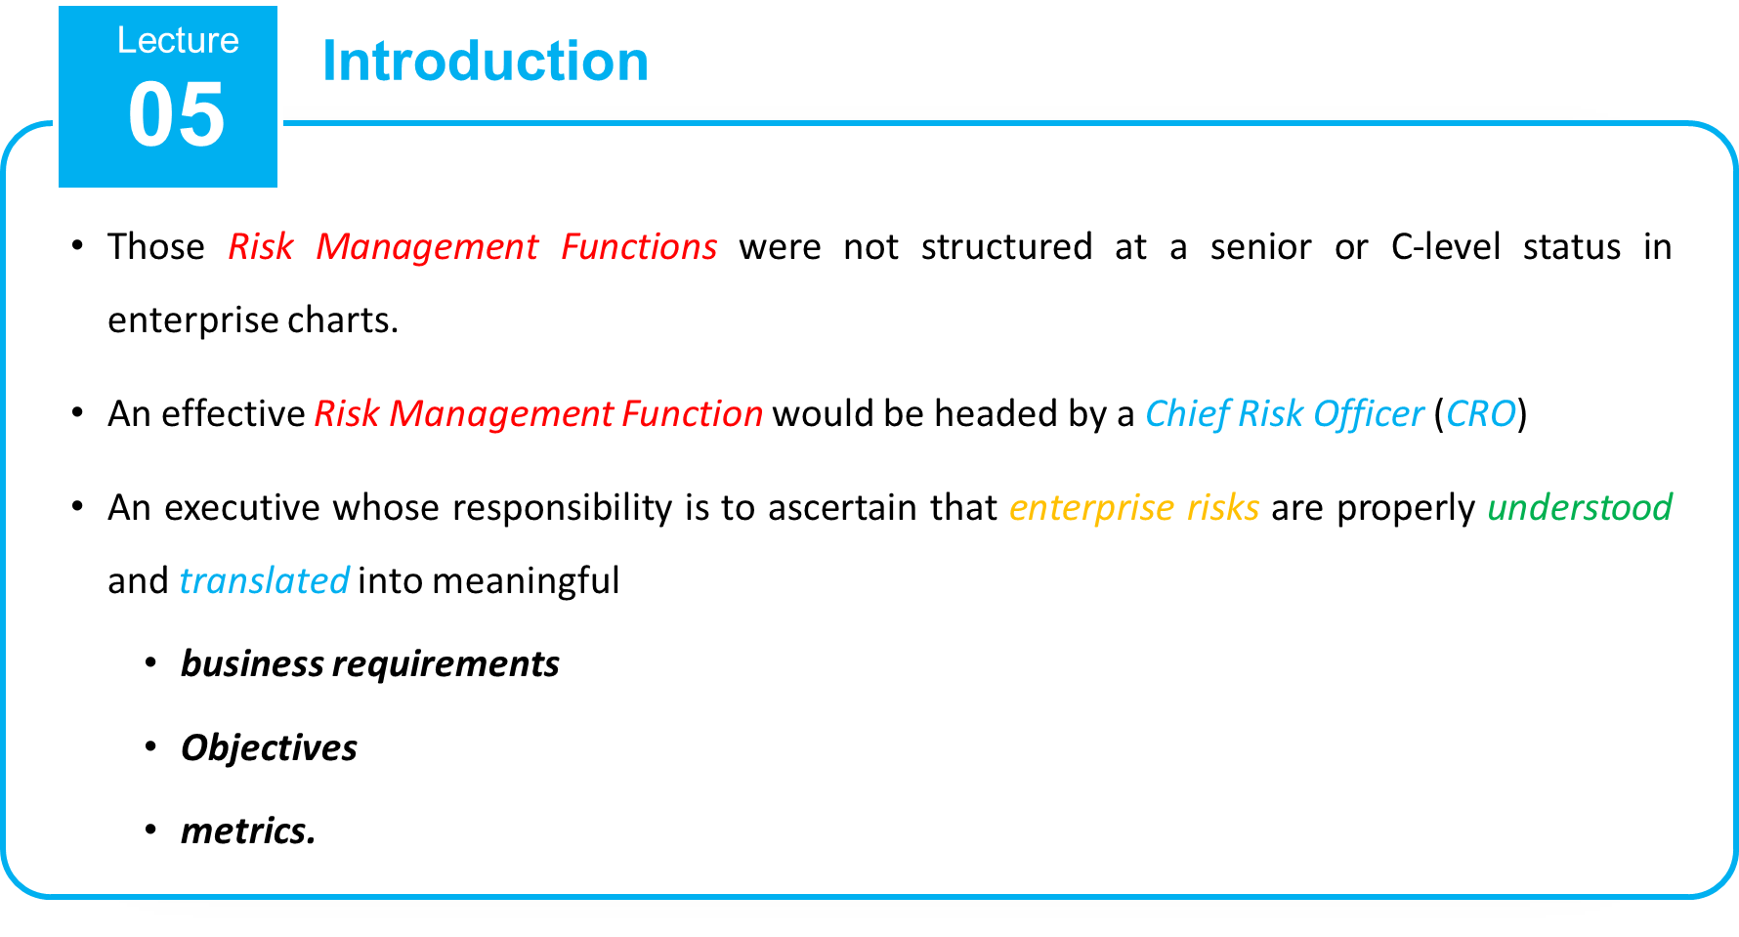
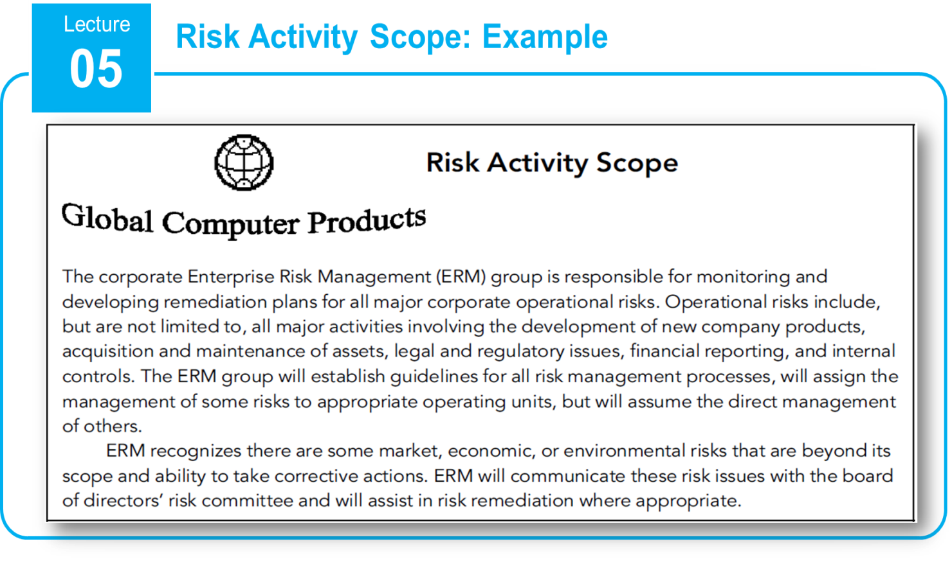
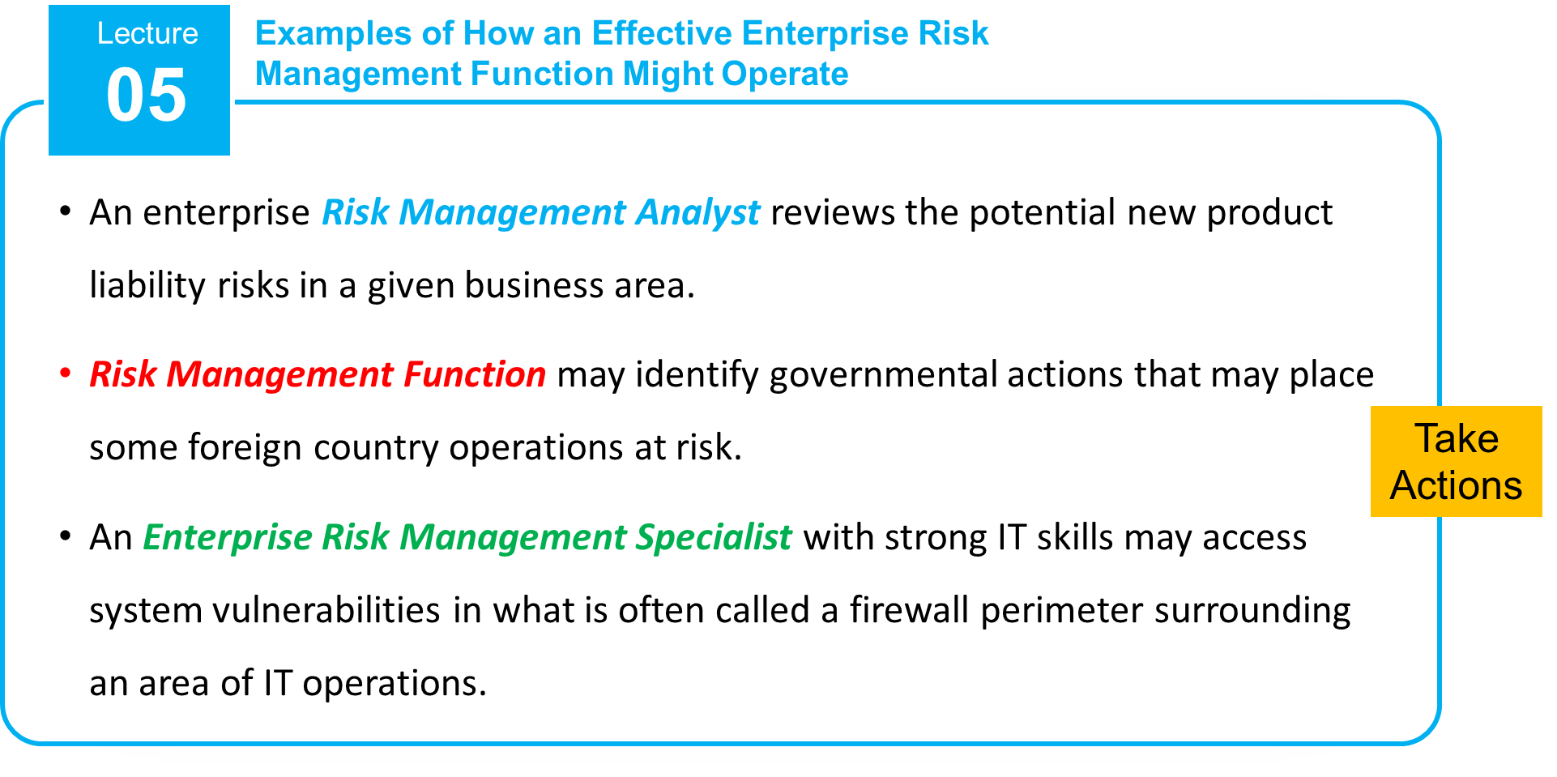
5–39

Slide 40
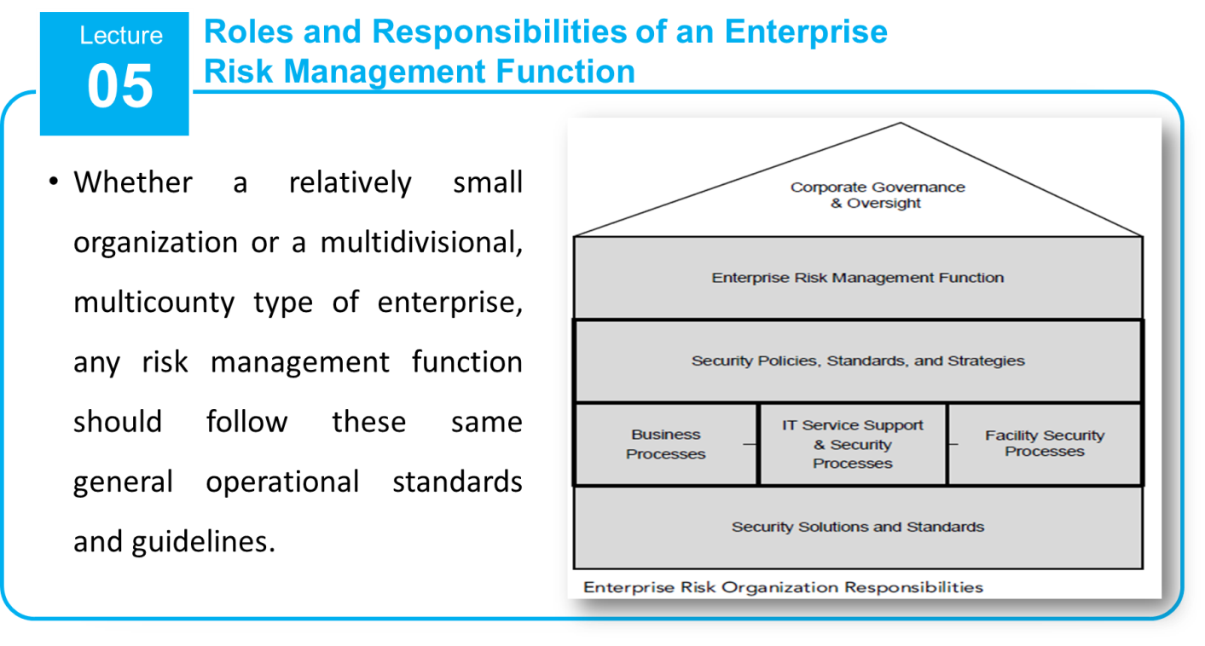
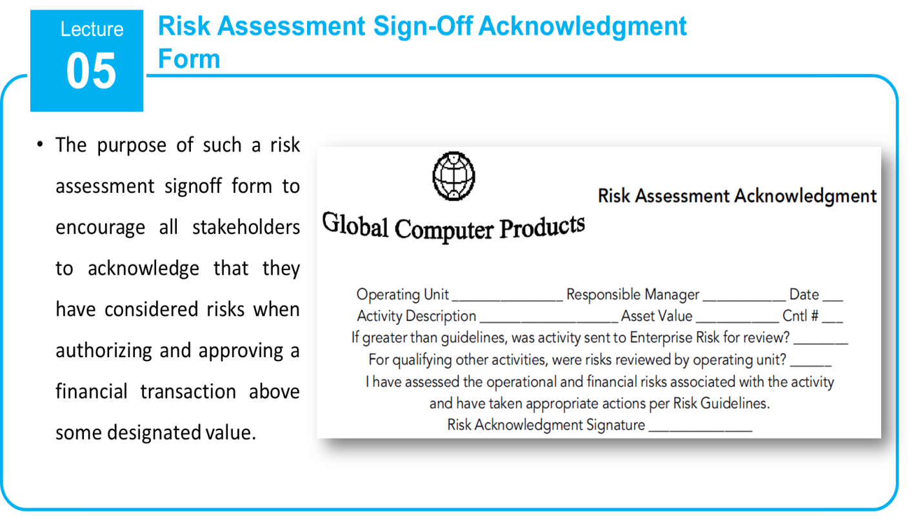
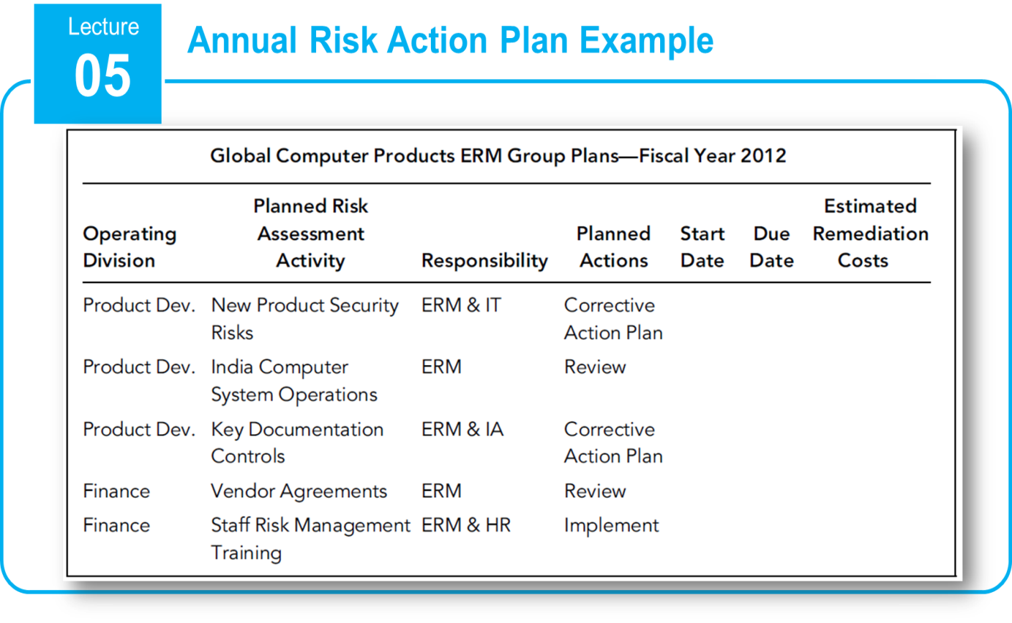
5–40

Slide 41
References
COSO Enterprise Risk Management: Establishing Effective Governance, Risk, and Compliance Processes. Robert R. Moeller.
3-48

Slide 42



Thank You

