Slide 1


Project Time Management
مقرر: إداره وقت المشروع
Prepared by Dr. Amira Elfekky
PMG 212
Lecture 8

Slide 2

Agenda
Critical Path method
Scheduling Terminology
Estimate the duration
Scheduling Consists of
Develop the Schedule
The common Scheduling Failures
www.midocean.ae

Slide 3
Agenda
Critical Path method
Scheduling Terminology
Estimate the duration
Scheduling Consists of
Develop the Schedule
The common Scheduling Failures
www.midocean.ae

Slide 4
Chapter
08
Critical Path
One or more continuous chains of zero or negative float activities running from the start event to the finish event in the schedule.
The Critical Path is normally the Longest Path (longest series of continuous activities) in the schedule.
Any activity on the critical path is called a Critical Activity.
www.midocean.ae

Slide 5
Chapter
08
Critical Path method
Activity | Duration
A | 1
B | 7
C | 6
D | 4
E | 8
F | 6
G | 4
H | 3
I | 5
J | 5
K | 3
Sum | 52
The critical path method (CPM) is a technique that’s used by project managers to create a project schedule and estimate the total duration of a project.
www.midocean.ae

Slide 6
Chapter
08
Critical Path method
The CPM method, also known as critical path analysis (CPA), consists in using a network diagram to visually represent the sequences of tasks needed to complete a project.
Once these task sequences or paths are defined, their duration is calculated to identify the critical path, which determines the total duration of the project.
www.midocean.ae

Slide 7
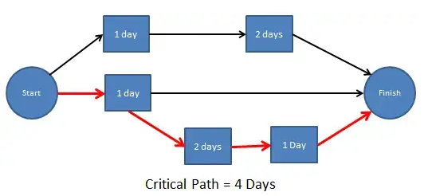
Chapter
08
Critical Path method
www.midocean.ae

Slide 8
Chapter
08
Critical Path method
Why use critical path analysis?
CPA can provide valuable insight on how to plan projects, allocate resources, pace towards milestones, and schedule tasks.
Here are some reasons why you should use the critical path method:
Improves future planning: CPM can be used to compare expectations with actual progress. The data used from current projects can inform future project plans.
Facilitates more effective resource management: CPM helps project managers prioritize tasks, giving them a better idea of how to avoid resource constraints.
www.midocean.ae

Slide 9
Chapter
08
Critical Path method
Helps avoid bottlenecks: Bottlenecks in projects can result in lost valuable time. Plotting out project dependencies using a network diagram will give you a better idea of which activities can and can’t run in parallel, allowing you to schedule work accordingly.
www.midocean.ae

Slide 10
Chapter
08
Critical Path method
www.midocean.ae

Slide 11
Chapter
08
Critical Path method
The seven (7) steps in the CPM are:
Step 1: List of all activities required to complete the project
Step 2: Determine the sequence of activities
Step 3: Draw a network diagram
Step 4: Determine the time that each activity will take to completion
Step 5: Determine the dependencies between the activities
Step 6: Determine the critical path
Step 7: Update the network diagram as the project progresses
www.midocean.ae

Slide 12
Chapter
08
Critical Path method
The seven (7) steps in the CPM are:
Step 1: List all the activities or tasks required to complete the project, such as measuring, cutting, assembling, painting, etc.
Step 2: Estimate the duration of each activity or task, based on the resources available and the complexity of the work.
Step 3: Identify the dependencies between the activities or tasks, such as which ones need to be done before or after others.
www.midocean.ae

Slide 13
Chapter
08
Critical Path method
The seven (7) steps in the CPM are:
Step 4: Draw a network diagram that shows the sequence and dependencies of the activities or tasks, using nodes to represent activities and arrows to represent dependencies.
Step 5: Calculate the earliest start time (ES), earliest finish time (EF), latest start time (LS), and latest finish time (LF) for each activity or task, using the forward and backward pass methods.
www.midocean.ae

Slide 14
Chapter
08
Critical Path method
The seven (7) steps in the CPM are:
Step 6: Calculate the total float (TF) or slack for each activity or task, which is the difference between the LF and EF or between the LS and ES. The float represents how much activity can be delayed without affecting the project completion time.
Step 7: Identify the critical path, the longest path in the network diagram with zero float. The critical path determines the minimum completion time of the project, and any delay in any activity on this path will delay the entire project.
www.midocean.ae

Slide 15
Agenda
Critical Path method
Scheduling Terminology
Estimate the duration
Scheduling Consists of
Develop the Schedule
The common Scheduling Failures
www.midocean.ae

Slide 16
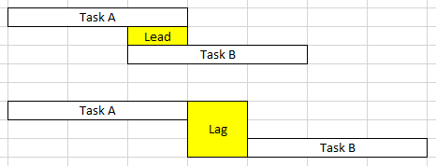
Chapter
08
Scheduling Terminology
Lead & Lag
Lead and Lag are the duration unit of tasks.
Lead is portrayed by negative (-) sign
whereas Lag is by positive (+) sign.
www.midocean.ae

Slide 17
Chapter
08
Scheduling Terminology
Float
Total Float
Amount of time an activity can exceed its early finish date without affecting the project end date or other imposed dates.
Free Float
Amount of time by which an activity can exceed its early finish date without affecting the early start date of any successor(s).
Negative Float
Amount of time that the start or finish of any activity exceeds the time allowed.
www.midocean.ae

Slide 18
Chapter
08
Scheduling Terminology
The disadvantages of showing float on the schedule
End user may delay start of activity thinking there is slack time
May cause false sense of security
Once used as an activity -- it’s gone forever
Assumes CPM is complete with correct logic
www.midocean.ae

Slide 19
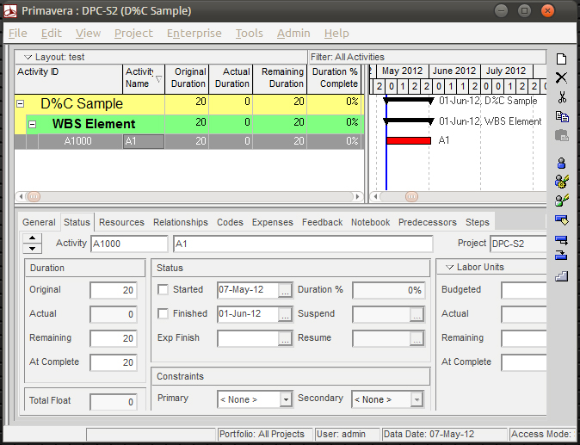
Chapter
08
Scheduling Terminology
Duration - Original / Remaining
Duration: is the amount of time required to complete an activity.
www.midocean.ae

Slide 20
Chapter
08
Scheduling Terminology
Original Duration - the planned estimate of the number of work periods required to accomplish an activity.
Remaining Duration - the number of work periods currently forecast to complete the activity.
Work periods can be hours, days, weeks or months.
www.midocean.ae

Slide 21
Agenda
Critical Path method
Scheduling Terminology
Estimate the duration
Scheduling Consists of
Develop the Schedule
The common Scheduling Failures
www.midocean.ae

Slide 22
Chapter
08
Estimate the duration
Historical information
Market information
Rates of installation
What is a “Normal” rate of installation? How do we come up with this? Varies by area?
www.midocean.ae

Slide 23
Chapter
08
Calendar(s)
The work periods and holidays defined for the Project.
There can be multiple Calendars on a Project:
Engineering - 5 day work week
Manufacturing - 7 day work week
Construction - 6 day work week
Different local Holidays ?
www.midocean.ae

Slide 24
Chapter
08
Project Assumptions
Project assumptions are identified at the beginning of the project. Throughout the project life cycle, they will be refined and reanalyzed.
An assumption is what you believe to be true. These are anticipated events or circumstances that are expected during your project’s life cycle. You make assumptions based on your experience or the information available on hand.
www.midocean.ae

Slide 25
Chapter
08
Project Constraints
Project Constraints are identified at the beginning of the project. Throughout the project life cycle, they will be refined and reanalyzed.
These constraints are defined at the beginning of your project, and you must work within their boundaries.
A constraint can be of two types:
usiness Constraints
Technical Constraints
www.midocean.ae

Slide 26
Agenda
Critical Path method
Scheduling Terminology
Estimate the duration
Scheduling Consists of
Develop the Schedule
The common Scheduling Failures
www.midocean.ae

Slide 27
Chapter
08
Scheduling Consists of
Determining the activity duration's.
Ties individual plans together.
Timing of activities.
Minimizing resource conflicts.
Identifying critical activities.
www.midocean.ae

Slide 28
Chapter
08
Scheduling Consists of
Establishing the baseline.
Providing a tool for project evaluation.
Provides outputs for analysis.
Monitoring and analyzing progress.
Assists in developing work-arounds
www.midocean.ae

Slide 29
Chapter
08
Information Gathering
  Information outlining the project is available in many forms and from many sources
  From the project scope description look for similar projects
  The Client - gather as much information about this Project and other similar Projects in which they have been involved.
www.midocean.ae

Slide 30
Chapter
08
Information Gathering
Asking about these simple questions
What are you going to do?
How long is it going to take?
What do you need to start the activity?
What do you need to finish the activity?
www.midocean.ae

Slide 31
Agenda
Critical Path method
Scheduling Terminology
Estimate the duration
Scheduling Consists of
Develop the Schedule
The common Scheduling Failures
www.midocean.ae

Slide 32
Chapter
08
Develop the Schedule
  Integrate individual plans
  Identify activities
  Determine activity duration
  Determine activity sequence
  Establish dependencies and constraints
  Identify critical activities
  Optimize the application of resources
www.midocean.ae

Slide 33
Chapter
08
Types of logic among the activities
Mandatory/Hard logic
Preferential/Preferred/Discretionary/soft logic
www.midocean.ae

Slide 34
Chapter
08
Developing an EPC Schedule
Engage in an iterative process.
  Starting with Level I and II, build the schedule.
  Check viability (milestone comparisons, curves, etc.).
  Build Level III with activity logic, resources, etc.
  Confirm Level I and II, and then finalize Level III baseline.
Planners facilitate discussions between Engineering, Procurement, Construction, and Startup team members, and interface between workgroups to optimize the overall schedule.
www.midocean.ae

Slide 35
Chapter
08
Communicate the Schedule
The project’s principal sequences and overall strategy is clear to the team.
The project must have basic boundaries and commitments identified.
The project needs a workable plan to accomplish its objectives and everyone understands their role.
www.midocean.ae

Slide 36
Chapter
08
Implement the Schedule
Once everyone (including the Client) agrees on the Schedule, it becomes the BASELINE Schedule.
This the reference point from which the Project will be measured from and from which all VARIANCES/ CLAIMS will be analyzed.
A copy of this Schedule will be updated with actual progress and then it becomes the Current Schedule which will change as the Project evolves.
www.midocean.ae

Slide 37
Agenda
Critical Path method
Scheduling Terminology
Estimate the duration
Scheduling Consists of
Develop the Schedule
The common Scheduling Failures
www.midocean.ae

Slide 38
Chapter
08
The common Scheduling Failures
Lack of buy-in by all project team members
Lack of planning
Poorly defined activities
Inappropriate scheduling detail
Inadequate logic ties
www.midocean.ae

Slide 39
Chapter
08
The common Scheduling Failures
Poor duration estimating
Lack of information
Failure to disseminate the proper information to all parties
Excessive details that overwhelm the sanity
Updates without analysis
www.midocean.ae

Slide 40

www.midocean.ae

Slide 41




Thank You

