Slide 1


Marketing Management
MGM612
Dr. Ayman Hassan
  Lecture - 4 - Marketing Ethics and Social Responsibility

Slide 2


Chapter
3
Marketing Ethics and Social Responsibility
Lecture 4
Dr. Ayman Hassan

Slide 3

Chapter
3
In the previous lecture,
We have discussed
Marketing strategy (Introduction, define, Developing and Creating )
History of strategic marketing management
Marketing strategy vs. marketing plan
Market Analysis
Explain The (4 P’s) and (7 P’s) of Marketing

Slide 4
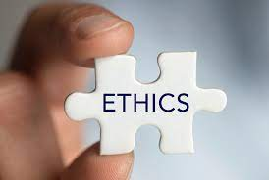
Learning Outcomes
Chapter
3
After studying this chapter you should be able to:
Learn the principles of socially responsible marketing.
Learn the role of ethics in marketing.
Know the major social criticisms of marketing.
Ethical issues in marketing

Slide 5
Chapter
3
What are ethics ?
Ethics is the art and science of determining good and bad or right or wrong moral behavior.
Ethics is based on well-founded standards of right and wrong that prescribe what humans ought to do, usually in terms of rights, obligations, benefits to society, fairness, or specific virtues.
Some years ago, sociologist Raymond Baumhart asked business people, "What does ethics mean to you?" Among their replies were the following:
"Ethics has to do with what my feelings tell me is right or wrong."
"Ethics has to do with my religious beliefs."
"Being ethical is doing what the law requires."
"Ethics consists of the standards of behavior our society accepts."
"I don't know what the word means."
These replies might be typical of our own. The meaning of "ethics" is hard to pin down, and the views many people have about ethics are shaky.

Slide 6
Chapter
3
Marketing Ethics
Marketing ethics is the area of applied ethics which deals with the moral principles behind the operation and regulation of marketing. Some areas of marketing ethics (ethics of advertising and promotion) overlap with media ethics.
Marketing ethics are a set of moral principles that guide a company's promotional activities.
Organizations that establish and implement marketing ethics are typically trying to respect the rights, desires and expectations of consumers.
While business leaders seek to generate operational revenue and earn profits, they may also prioritize the goals of practicing integrity, honesty and fairness.
A company's philosophy of ethics often relates to its organizational mission. Usually, C-level executives, directors and high-level managers are responsible for creating and enforcing these guidelines

Slide 7
Chapter
3
Examples of ethical marketing
One of the most important parts of ethical marketing is making sure you're communicating honestly about the quality and features of a product.
It's also beneficial when marketers can listen to and apply the feedback of customers.
If a marketer feels there are improvements to be made, they can work with company executives and product development team members to enhance a product and provide more value to consumers.
High-quality, useful products and truthful advertising can build trust among audiences and attract loyal customers.
Addressing public issues and working to bring about positive social change can be an excellent way to conduct ethical marketing.
Such as concern for the environment, cleanliness and pollution prevention
The idea of marketing ethics is similar to the concept of corporate social responsibility (CSR).

Slide 8

Chapter
3
Why Business ethics ?
Business ethics is a set of laws about how a business should conduct itself.
(In general, for any business to be successful, it must operate legally and humanely. )
Customers develop positive attitude towards the firm, its products and its services.
To create a good image of the company in the minds of customers and employees.
Most companies that adopt modern management systems have what is known as a code of conduct and ethics.

Slide 9
Chapter
3
Ethical Behavior in Business
Ethics
The moral principles or values that generally govern the conduct of an individual.
Morals
The rules people develop as a result of cultural values and norms.
Morals involve “good” and “bad” as well as “deviant” behaviors

Slide 10
Chapter
3
Ethical Decision Making
Influential Factors
Extent of Problems
Probability of Harm
Top Management
Actions
Time Until
Consequences
Potential Consequences
Number Affected
Social Consensus

Slide 11
Chapter
3
Ethical decision-making process
Look for and identify ethical issues. What feels wrong?
Obtain unbiased facts and look for distorted or missing information.
Identify the stakeholders and their motivation and influence.
Understand situational factors.
Identify the values and look for competing values.
Seek additional assistance and foster open discussion.
Reinforce the values of mutual respect and reason-giving.
Formulate solutions using best-known ethical frameworks as a guide.
Evaluate proposed alternatives including potential consequences.
Select and implement the most ethical solution.
Monitor and assess the outcome.
Work to avoid future problems

Slide 12
Chapter
3
Making Decisions on Ethical Issues
Here are some steps if you find yourself in an ethical dilemma:
Identify the ethical dilemma.
Discover alternative actions.
Decide who might be affected.
List the probable effects of the alternatives.
Select the best alternative.

Slide 13
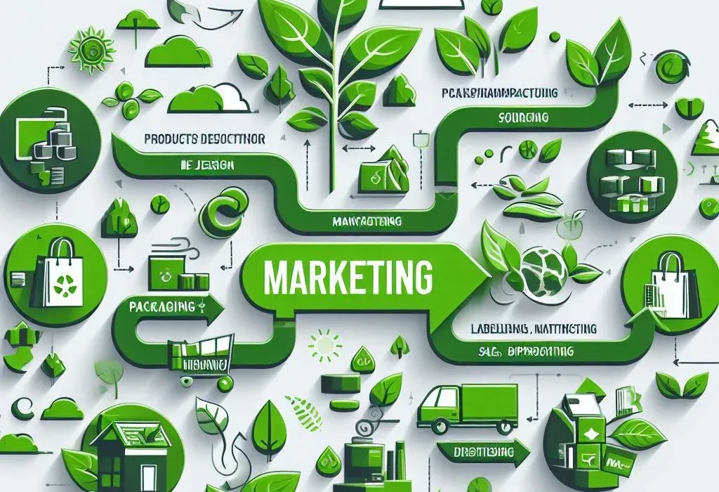
Chapter
3
Green Marketing

Slide 14
Chapter
3
Green Marketing
The development and marketing of products designed to minimize negative effects on the environment or improve the environment.
  Environmentally aware customers pay more for products
  Companies must try to educate customers of environmental benefits

Slide 15
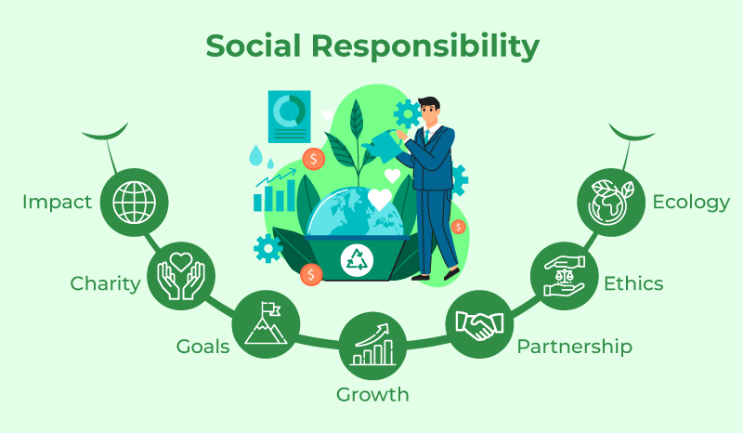
Chapter
3
Social Responsibility
Social responsibility is the duty to do what is best for the good of society.
A conflict of interest is when a business is tempted to put profits before social welfare.

Slide 16
Chapter
3
Social Responsibility
The ethical obligations of a business are:
Provide safe products
Create jobs
Protect the environment
Contribute to the standard of living in society

Slide 17
Chapter
3
Theories of Social Responsibility – Summary
Theory | Social Responsibility
Maximizing profits | To maximize profits for stockholders.
Moral minimum | To avoid causing harm and to compensate for harm caused. لتجنب الاضرار وتعويض الضرر الذي حدث.
Stakeholder interest | To consider the interests of all stakeholders, including stockholders, employees, customers, suppliers, creditors, and local community.
Corporate citizenship | To do good and solve social problems.

Slide 18
Chapter
3
Social Criticisms of Marketing
Marketing’s Impact on Individual Consumers
  High Prices
    High costs of distribution
    High advertising and promotion costs
    Excessive markups
Goal 1: Know the major social criticisms of marketing

Slide 19
Chapter
3
Chapter
Social Criticisms of Marketing
Marketing’s Impact on Individual Consumers
  Deceptive Practices
    Pricing
    Promotion
    Packaging
  High-Pressure Selling

Slide 20
Chapter
3
Social Criticisms of Marketing
Marketing’s Impact on Individual Consumers
  Shoddy or unsafe products
  Planned obsolescence
  Poor service to disadvantaged consumers
Goal 1: Know the major social criticisms of marketing

Slide 21
Chapter
3
Social Criticisms of Marketing
Marketing’s Impact on Society as a Whole
  False wants and too much materialism
  Too few social goods
  Cultural pollution
  Too much political power
Goal 1: Know the major social criticisms of marketing

Slide 22
Chapter
3
Social Criticisms of Marketing
Marketing’s Impact on Other Businesses
  Acquisitions of competitors
  Marketing practices that create barriers to entry
  Unfair competitive marketing practices
Goal 1: Know the major social criticisms of marketing

Slide 23
Chapter
3
Citizen & Public Actions to Regulate Marketing
Consumerism
  Traditional seller’s rights
  Traditional buyer’s rights
  Additional rights proposed by consumer advocates
    Each proposed right has led to more specific proposals by consumerists
Goal 2: Be able to define and understand consumerism and environmentalism

Slide 24
Chapter
3
Citizen & Public Actions to Regulate Marketing
Environmentalism
  An organized movement of concerned citizens, businesses and government agencies to protect and improve people’s living environment
  Environmental Sustainability
    Pollution prevention
    Product stewardship
    New environmental technology
    Sustainability vision
Goal 2: Be able to define and understand consumerism and environmentalism

Slide 25
Chapter
3
Citizen & Public Actions to Regulate Marketing
Public Actions to Regulate Marketing
  Major legal issues affect every area of marketing management, including:
    Selling and advertising decisions
    Channel decisions
    Product decisions
    Packaging decisions
    Price decisions
    Competitive reaction decisions
Goal 2: Be able to define and understand consumerism and environmentalism

Slide 26
Chapter
3
Business Actions Toward Socially Responsible Marketing
Enlightened Marketing
  Customer-Oriented Marketing:
    Companies view and organize their marketing activities from the consumer’s point of view.
  Innovative Marketing:
    Companies seek real product and marketing improvements.
Goal 3: Learn the principles of socially responsible marketing

Slide 27
Chapter
3
Business Actions Toward Socially Responsible Marketing
Enlightened Marketing
  Value Marketing:
    Companies put most of their resources into value-building marketing investments.
  Sense-of-Mission Marketing:
    Companies define their mission in broad social terms, rather than in narrow product terms.
Goal 3: Learn the principles of socially responsible marketing

Slide 28
Chapter
3
Business Actions Toward Socially Responsible Marketing
Enlightened Marketing
  Societal Marketing:
    Companies make marketing decisions
    by considering consumers’ wants, the
    company’s requirements, consumers’
    long-run interests, and society’s
    long-run interests.
Goal 3: Learn the principles of socially responsible marketing

Slide 29
Chapter
3
Business Actions Toward Socially Responsible Marketing
Enlightened Marketing
  Societal Classification of Products
    Deficient products
    Pleasing products
    Salutary products
    Desirable products
Goal 3: Learn the principles of socially responsible marketing

Slide 30
Chapter
3
Business Actions Toward Socially Responsible Marketing
Marketing Ethics
  Corporate marketing ethics policies
    Distributor relations, advertising standards, customer service, pricing, product development and general ethical standards.
  Guiding principle in policy determination
    Free market and legal system
    Individual companies and managers
  International ethical policies are a special challenge
Goal 4: Learn the role of ethics in marketing

Slide 31
Chapter
3
Ethical issues in marketing
Major Ethical Concerns
Ethical values are situation specific and time oriented
Everyone must have an ethical base that applies to conduct in the business world and in personal life
How can we assess moral behavior of marketers?

Slide 32
Chapter
3
Major Ethical Concerns
By its very nature, marketing ethics is controversial, and there is no universally accepted approach for resolving questions
Ethical issues address a problem, situation, or opportunity that requires an individual, group, or organization to choose among several actions that must be evaluated as right or wrong
The organization and stakeholders define marketing ethical issues that must be identified and resolved to build trust and effective relationships with stakeholders

Slide 33
Chapter
3
Major Ethical Concerns
Ethics brings many rewards to organizations that nurture it, but managing ethics requires activity and attention on several levels including the following:
  Complying with the law
  Setting ethical standards
  Dealing with the complex decisions related to trade-offs between the bottom line and ethical conduct
  High ethical standards require both organizations and individuals to conform to sound moral principles
  Organizational culture and individual moral philosophies and values influence the recognition of ethical issues and marketing ethics decisions

Slide 34
Chapter
3
Major Ethical Concerns
Ethical Concerns in Marketing Communication
Ethical issues in public relations and publicity
Ethical issues in personal selling
Ethical issues in sales promotion
Ethical issues in advertising
Ethical issues in Packaging
Ethics in marketing research

Slide 35
Chapter
3
Ethical Concerns in Marketing Communication
Ethics in communication requires dignity in preparation and implementation of communication programs
Integrity involves avoiding deceiving others of behaving purely in an expedient fashion. Integrity is the quality of being morally good
Marketing and marketing communication are activities in which ethics and morals play key roles
Advertising and promotion are areas where a lapse in ethical standards or judgement can result in actions that are highly visible and damaging to a company

Slide 36
Chapter
3
Ethical issues in public relations and publicity
Public relations is a deliberate planned and sustained effort to establish and maintain mutual line of understanding between an organization and its publics
Publicity is any form of commercially significant news item about an organization, goods, medium that is not paid for by the sponsor
The way firms confront negative publicity has important strategic as well as ethical ramifications
The primary ethical issue concerns whether firms confess to product shortcomings and acknowledge problems or, instead, attempt to cover up the problems

Slide 37
Chapter
3
Ethical issues in personal selling
Personal selling is a concise effort on the part of the seller to induce a prospective buyer to purchase something that he had not originally decided to buy, even if he had thought of it favourably
Ethical issues include making unsubstantiated claims and undeliverable promises
Company’s penalty and reward structures have some effect on sales person’s ethical conduct

Slide 38
Chapter
3
Ethical issues in sales promotion
Sales promotion is the function of marketing which seeks to achieve given objectives by the adding of extrinsic tangible value to a product or service
It concerns the making of a featured offer to a defined customer group within a specific time limit
Consumer-oriented sales promotions are unethical when the sales promoter offers consumers a reward for their behavior that is never delivered

Slide 39
Chapter
3
Ethical issues in advertising
One of the major problems in advertising and promotion is the lack of a clear and acceptable code of conduct
Advertising codes vary from country to country
Advertising is primarily meant to influence the independent thinking of the consumer and change his behavior
Advertising can be considered as a brain- washing catalyst, which is intended to manipulate the consumer into thinking that the advertised product is the best for him, and it does not matter much whether the consumer really needs the product or not

Slide 40
Chapter
3
Ethical issues in packaging
Four aspects of packaging involve ethical issues:
  i) Label information
  ii) Packaging graphics
  iii) Packaging safety
  iv) Environmental implications of packaging
Label information on packages can mislead consumers by providing exaggerated information or by unethically suggesting that product contains more of desired attributes or less of desired attributes that is actually the case

Slide 41
Chapter
3
Ethics in marketing research
Marketing research is subjected to public scrutiny, as it involves direct contact with the public
Identification of people affected by marketing research enables us to be aware of some readily discernible and easily avoidable ethical pitfalls
With regard to the public as a whole, ethical concerns revolve primarily around the methods of gaining and reporting research results
Care should be taken to avoid incomplete reporting, misleading reporting, and biased research

Slide 42
Chapter
3
See you in the next lecture

Slide 43
Chapter
3
Resources and References
Establishing Your Target Market | DECA Direct Online
What Is Strategic Marketing Management? (airfocus.com)
What Is Competitive Advantage? (thebalancemoney.com)

Slide 44



Thanks for listening.
01
Best wishes
Dr. Ayman Hassan

