Slide 1


Human Resources
Analytics
Prepared by Dr. Samah Abdelfatah
HRM 623
Lecture 03

Slide 2



SCAN THE MARKET, MANAGE THE RISK
Chapter
03
Lecture 03
HRM 623
Prepared by
Dr. Samah Abdelfatah
www.midocean.ae

Slide 3

Chapter
MAIN TOPICS
03
Environmental Scan— The Big Picture—The Value of Statistical Analysis—The Importance of Risk Assessment—The Employee Value Proposition
www.midocean.ae

Slide 4
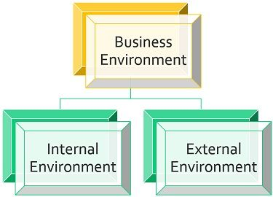
ENVIRONMENTAL SCAN
An environmental scan studies all forces external to an organization
that are relevant to its operation. HCM:21 also looks internally at situations that may need reconfiguring in the new term. The key question a scan answers is: What is going on outside and inside that might affect future operations?
Chapter
03
www.midocean.ae

Slide 5
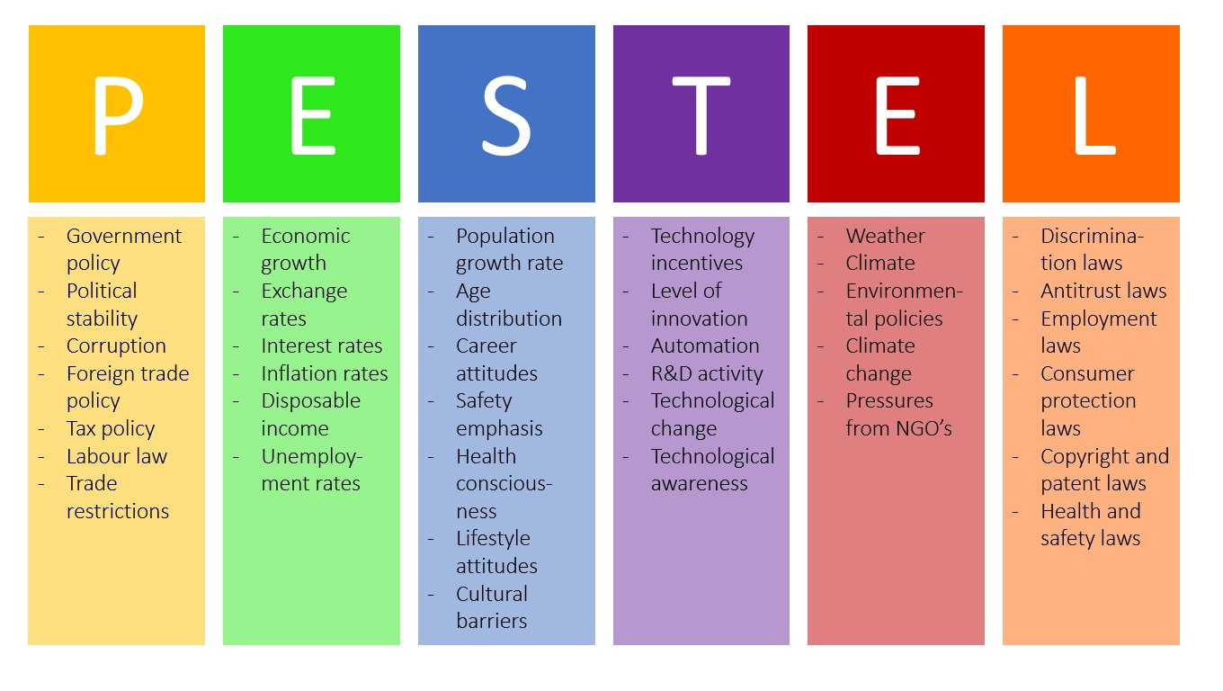

Slide 6
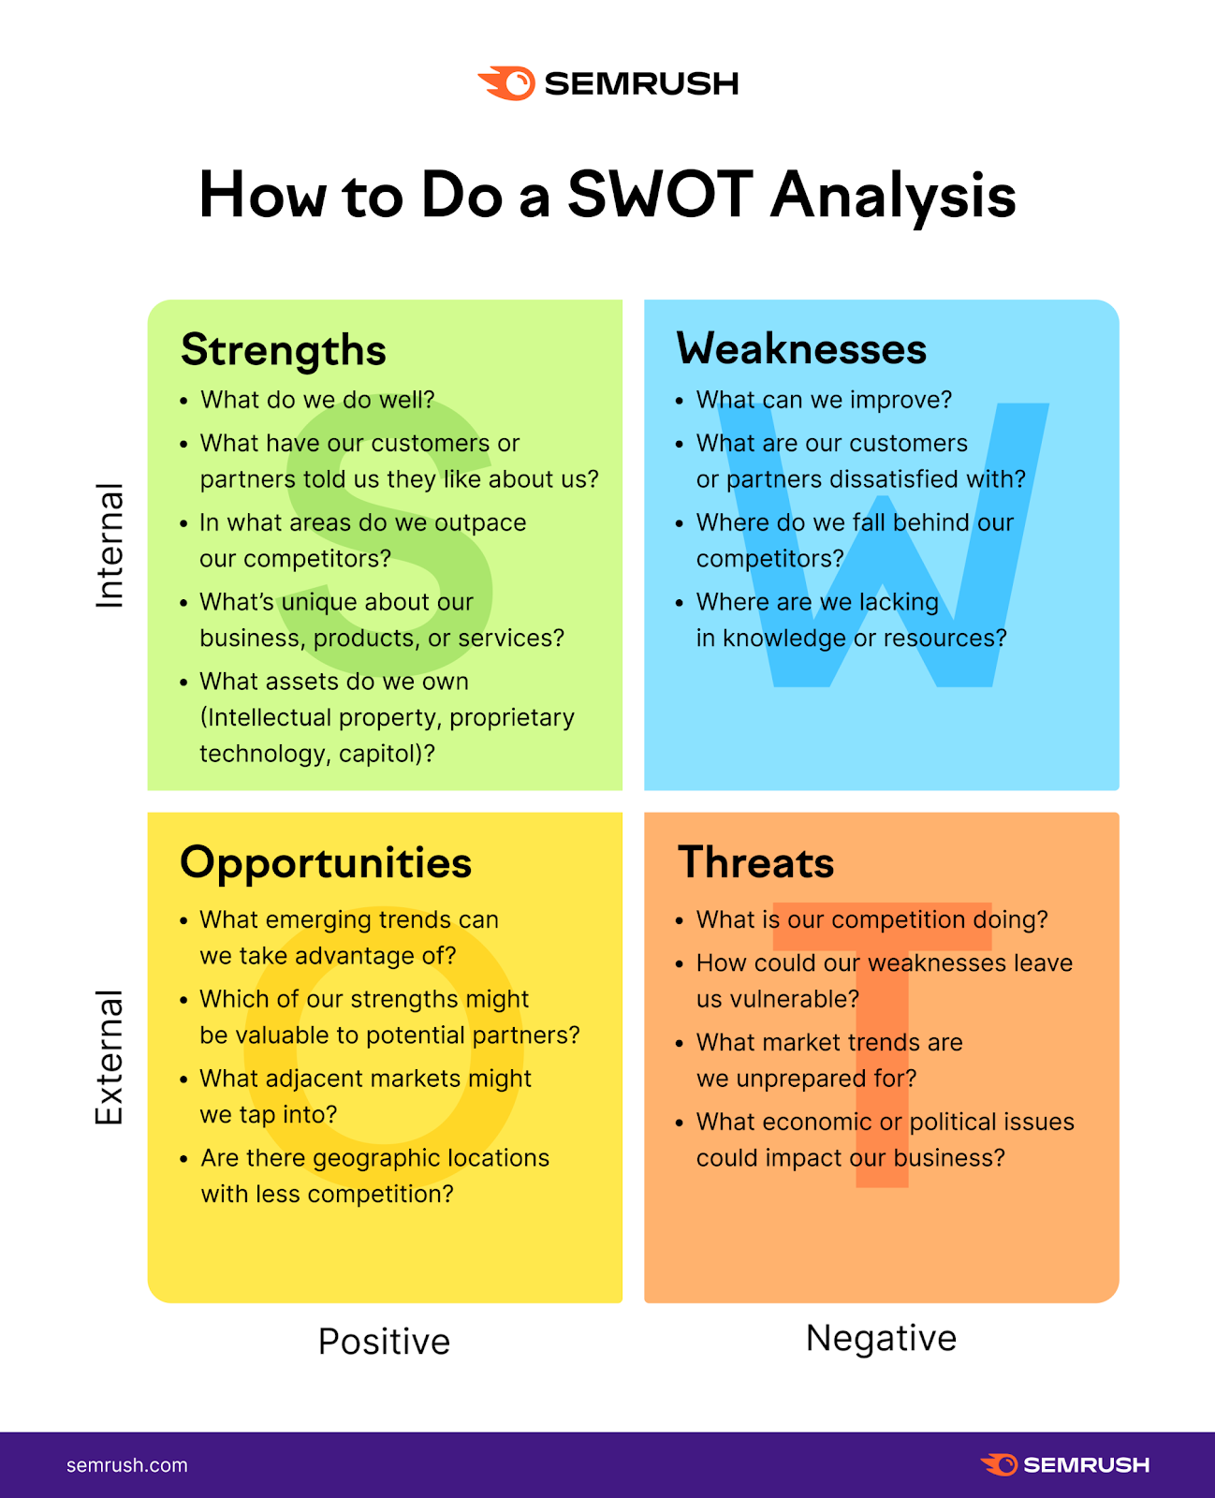

Slide 7
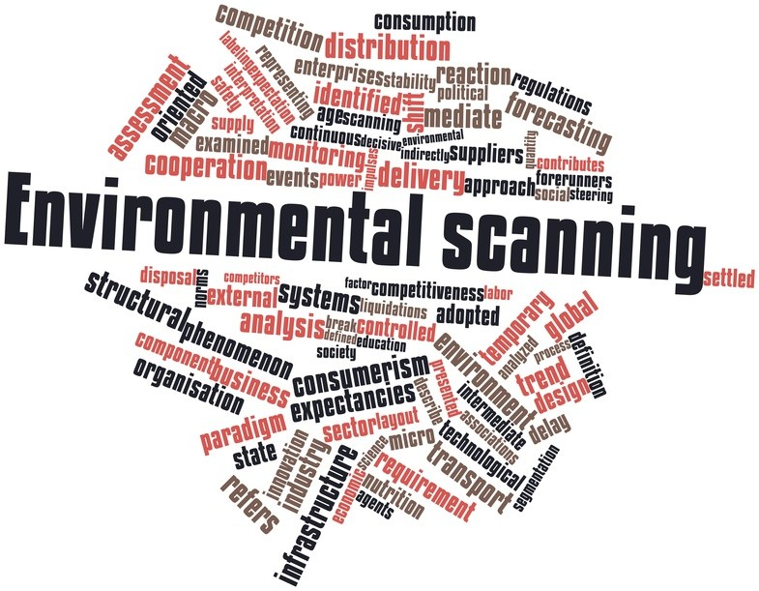
ENVIRONMENTAL SCAN
How broadly or deeply the SCAN is conducted?
A true scan, however, is both wide and deep. It is not confined to one aspect of the external environment, such as labor demographics or economic trends. The intent is to find something useful, not just collect information that confirms current or past beliefs.
Chapter
03
www.midocean.ae

Slide 8
Chapter
THE BIG PICTURE
03
Predictive management executes a strategic scan of the external forces and internal factors that can affect the three fundamentals of an organization:
Human capital
Structural capital
patents and copyrights, software programs and codified processes, physical facilities and equipment
Relational capital
knowledge and contacts you have with external stakeholders, which includes everyone who is touched by your organization
employees
www.midocean.ae

Slide 9
Chapter
THE EXTERNAL FORCES :
03
Industry trends | Customer demands and interests
Competitors | Supplier capacity
Brand reputation | Materials quality, prices, and availability
Technological advancements | Labor supply
Regulations and laws | Job applicants
Regional, national, and global economic situation | Educational institutions
Globalization demands | Stockholders
www.midocean.ae

Slide 10
Chapter
THE INTERNAL FORCES :
03
Vision | Facilities and equipment
Values | Product life cycles
Culture | Employee brand awareness
Leadership | General turnover levels
Management wisdom | Skills and capability levels
Mission-critical retention rates | Financial capability
Engagement levels | Ability to enter new markets
Quality, innovation, productivity, service (QIPS) levels
www.midocean.ae

Slide 11
MATRIX, FOR A STRATEGIC SCAN OF AN ORGANIZATION’S ENVIRONMENT
Chapter
03
Figure 3.1 is an outline or template, in the form of a matrix, for a strategic scan of an organization’s environment. It is not all-inclusive; in practice, the list of forces and factors that management generates can be much larger
www.midocean.ae

Slide 12
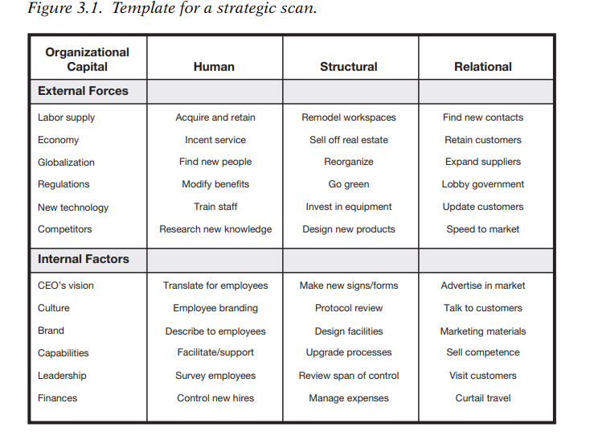
www.midocean.ae

Slide 13

Chapter
THE VALUE OF STATISTICAL ANALYSIS
03
The value of analysis is in the patterns in data that it uncovers.
These patterns are not readily apparent in standard reviews and reports.
Hence, analytics is more about structure and logic than about statistical procedures.
www.midocean.ae

Slide 14
Chapter
THE IMPORTANCE OF RISK ASSESSMENT
03
First, scan lists of potential risks
Second, each risk is rated on a scale regard to its likelihood of occurring
Third applying the optional responses. From importance and likelihood, you decide how to mitigate the effects
of risks
Risk is a central element in any kind of planning
human capital planning must now include risk assessment
Risk assessment has three steps.
www.midocean.ae

Slide 15
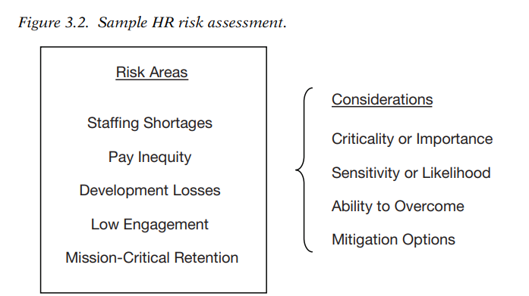
At The Corporate Level, Examples Of Potential Risks Could Be Immediate
www.midocean.ae

Slide 16
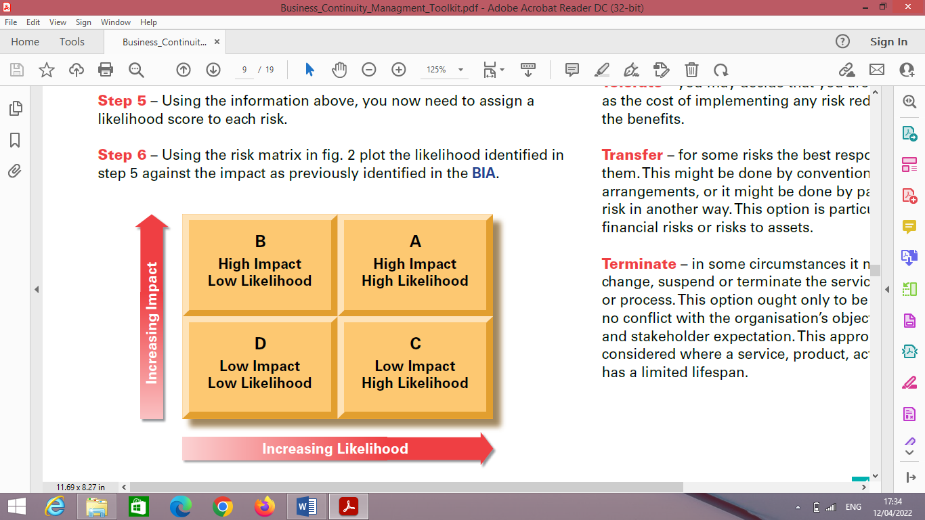
SECOND STEP :RATING RISKS
RISK MATRIX
www.midocean.ae

Slide 17
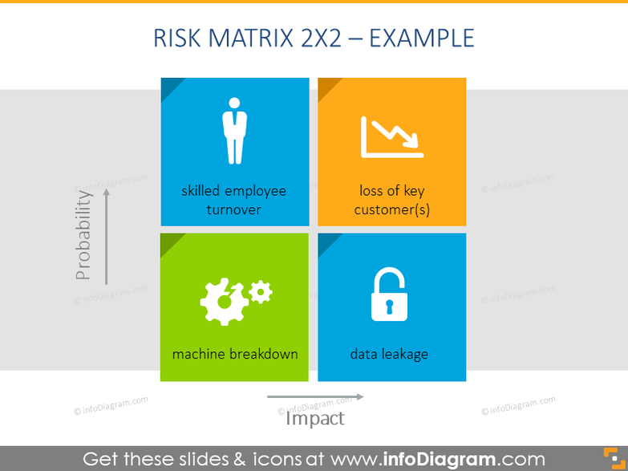
RISK MATRIX EXAMPLE
www.midocean.ae

Slide 18
Chapter
THIRD :MITIGATING RISKS
03
From importance and likelihood, you decide how to mitigate the effects of those risks.
For example, how will you handle the following?
Avoid the risk by postponing or not implementing something—or just wait?
Transfer the risk to a third party—in which case, who could do it better?
Reduce risk by introducing controls, but how and what controls?
Accept the risk if the cost outweighs the benefit—but how to balance the situation?
Capitalize on an unexpected positive result—or how best to stay agile
The task is to develop a risk-mitigation plan that prepares you ahead of any problem’s arrival.
www.midocean.ae

Slide 19
Chapter
THE EMPLOYEE VALUE PROPOSITION
03
EMPLOYEE VALUE PROPOSITION is the unique set of benefits and experiences a company offers to attract and retain talent.
While measuring the people practices of an organization is not always easy, measuring the results .
What is found that highly engaged, motivated teams outperform their peers.
The first step is hiring the right people; the second step is keeping them
www.midocean.ae

Slide 20
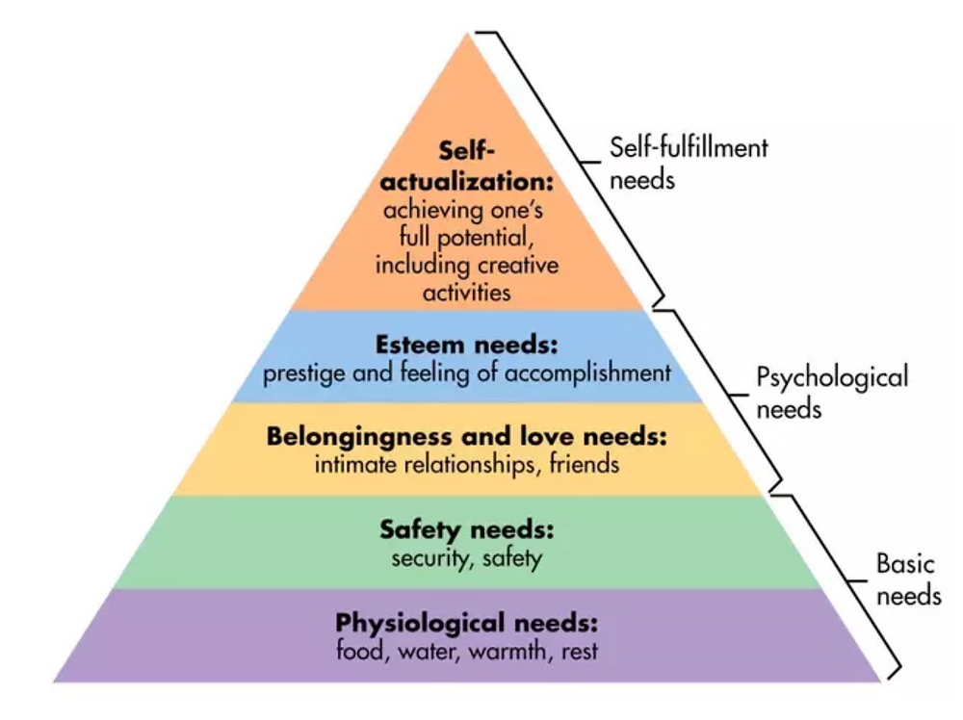
Chapter
WHAT IS YOUR EMPLOYEE VALUE PROPOSITION?
03
Abraham Maslow developed the idea that certain basic needs must be met in each of our lives, and once these needs have been met, it frees us to increase our engagement and continue our development. Maslow’s hierarchy of needs has five levels:
www.midocean.ae

Slide 21
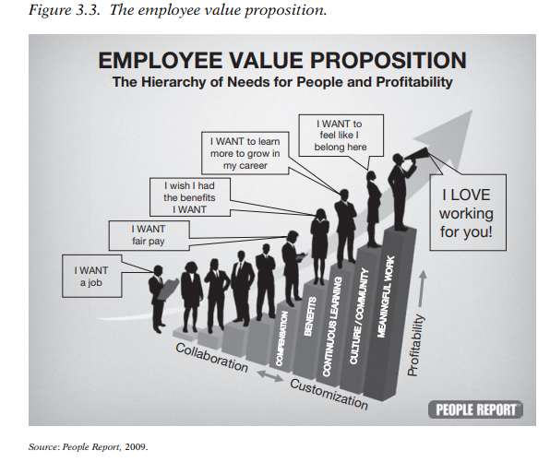
www.midocean.ae

Slide 22
Chapter
HOW TO ACHIEVE EMPLOYEE VALUE PROPOSITION
03
It can be achieved through:
Compensation
A Paycheck and More
Retention Drives Sales
A Place They Belong
One Size No Longer Fits All
www.midocean.ae

Slide 23
Chapter
COMPENSATION
03
We find that the most basic employee need to be satisfied is an individual’s compensation and benefits. Typically, the obvious tool for organizations to meet those needs is periodic compensation increases.
However, even in the current recessionary period, a paycheck is easily replicated by competitors; remember—‘‘If people come for money, they will leave for money
www.midocean.ae

Slide 24
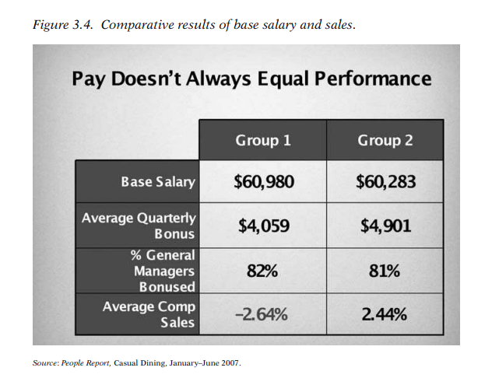
Chapter
COMPENSATION
03
www.midocean.ae

Slide 25
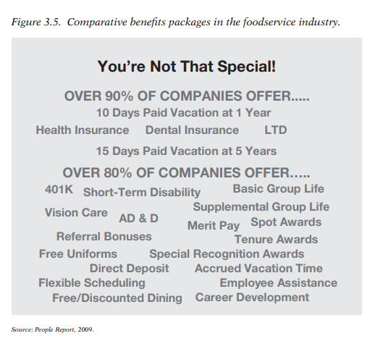
Chapter
COMPENSATION
03
www.midocean.ae

Slide 26
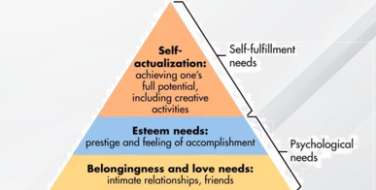
Chapter
A PAYCHECK AND MORE
03
As a look at the needs hierarchy shows, people do not want just a paycheck—they want a paycheck and more.
Part of the ‘‘more’’ most employees want can be seen in the higher steps up the hierarchy.
They want to grow in their role and have a chance to move up within the organization, and they want to feel that they are appreciated and that they belong.
www.midocean.ae

Slide 27
Chapter
A PAYCHECK AND MORE
03
Many proactive operators have turned to data mining, as ‘‘data mining shows that these personality traits are better predictors of worker productivity (especially turnover) than more traditional ability testing.
Data mining and predictive analytics help match employees who are most compatible with particular jobs.
www.midocean.ae

Slide 28
Chapter
A PAYCHECK AND MORE
03
Talent assessment and screening firms specialize in helping match applicants to job requirements, assisting companies in streamlining the process.
They help find the best fit that leads to hiring employees with a much longer tenure.
www.midocean.ae

Slide 29
Chapter
RETENTION DRIVES SALES
03
Research found that companies that reported the lowest comparable (comp) unit sales also employed general managers with the shortest average tenure.
The tenure of general managers impacts the retention of managers and employees as well.
As the length of employment for general managers increases, line-level management and hourly employee turnover drops.
www.midocean.ae

Slide 30
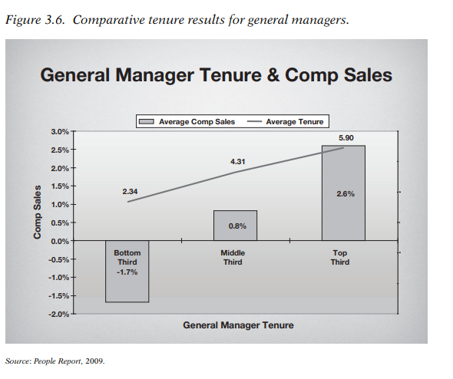
www.midocean.ae

Slide 31
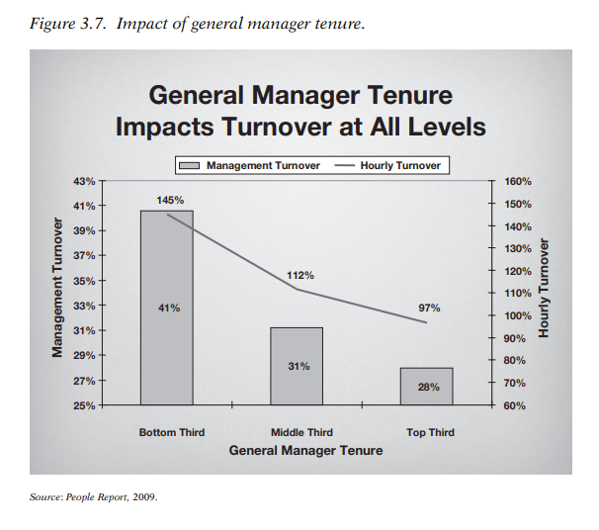
www.midocean.ae

Slide 32
Chapter
A PLACE THEY BELONG
03
Creating a workforce where people feel included is important, for this reason: People don’t work where they have to; they work where they want to.
The culture of the work environment. Do employees feel like members of the work community? Do they feel as if they have a chance to increase their role in the organization or do they simply feel viewed as ‘‘replaceable cogs in a machine?’’
www.midocean.ae

Slide 33
Chapter
A PLACE THEY BELONG
03
One thing is certain: When the work environment begins to get worse, the best employees are often the first ones leave because they have the most options.
www.midocean.ae

Slide 34
Chapter
ONE SIZE NO LONGER FITS ALL
03
When attempting to satisfy worker needs, it is increasingly clear that you must first identify worker wants. Not all workers want the same things.
For example, the employee value proposition that might appeal to college students may not be as attractive to baby boomers.
www.midocean.ae

Slide 35
Chapter
ONE SIZE NO LONGER FITS ALL
03
Instead of trying to appeal to everyone, and in the process satisfying no one, successful companies are taking a novel approach to recruiting and providing for their employees. They carefully identify their target worker audience and then appeal directly to that crowd.
www.midocean.ae

Slide 36
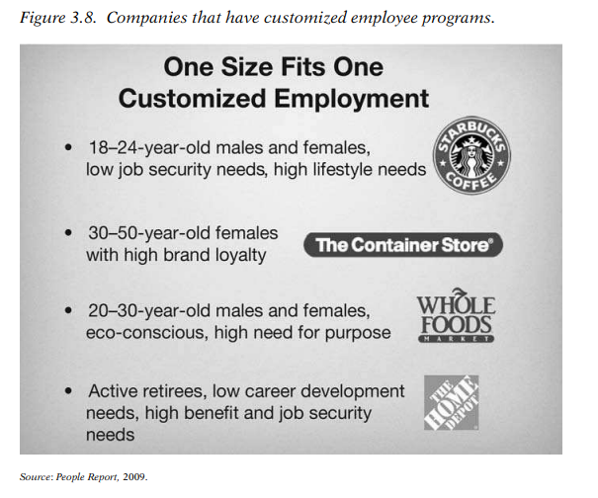
Chapter
ONE SIZE NO LONGER FITS ALL
03
www.midocean.ae

Slide 37
Chapter
ONE SIZE NO LONGER FITS ALL
03
Research indicates that leading companies have long since moved past relying on traditional compensation and benefits offerings to attract and retain a quality workforce.
Instead, they operate with a focus on ‘‘total rewards,’’ offering a combination of competitive compensation and benefits, flexible schedules, lifestyle rewards, switched-on training programs, an inclusive workplace, and a commitment to lifelong learning
www.midocean.ae

Slide 38
Chapter
ONE SIZE NO LONGER FITS ALL
03
These same companies think creatively about how they recruit new employees to join them.
They cast wide nets that encompass women, minorities, students, retirees, and candidates from other industries. They count on referrals and recognition as a great place to work to attract candidates to their doors.
www.midocean.ae

Slide 39
Chapter
ONE SIZE NO LONGER FITS ALL
03
These approaches enable proactive operators to meet the challenge of the times.
Change is imperative, and in both the near and longer term, human capital excellence will be a textbook advantage for the winners in this marketplace.
www.midocean.ae

Slide 40
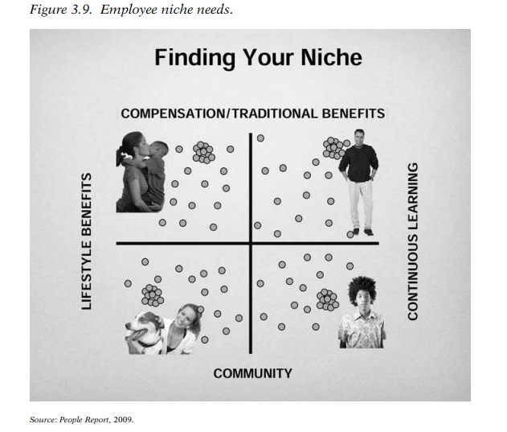
Chapter
ONE SIZE NO LONGER FITS ALL
03
www.midocean.ae

Slide 41



Thank You

