Slide 1


Flutter & Dart Complete Guide
Prepared by Eng. Yousef Salah Kassem
DAFL 8
SOLID Principles
Lecture 8

Slide 2


Chapter
Table Of Content
08
SOLID in Flutter
SOLID Principles Overview
SRP
OPC
LSP
ISP
DSP

Slide 3
Introduction

Slide 4
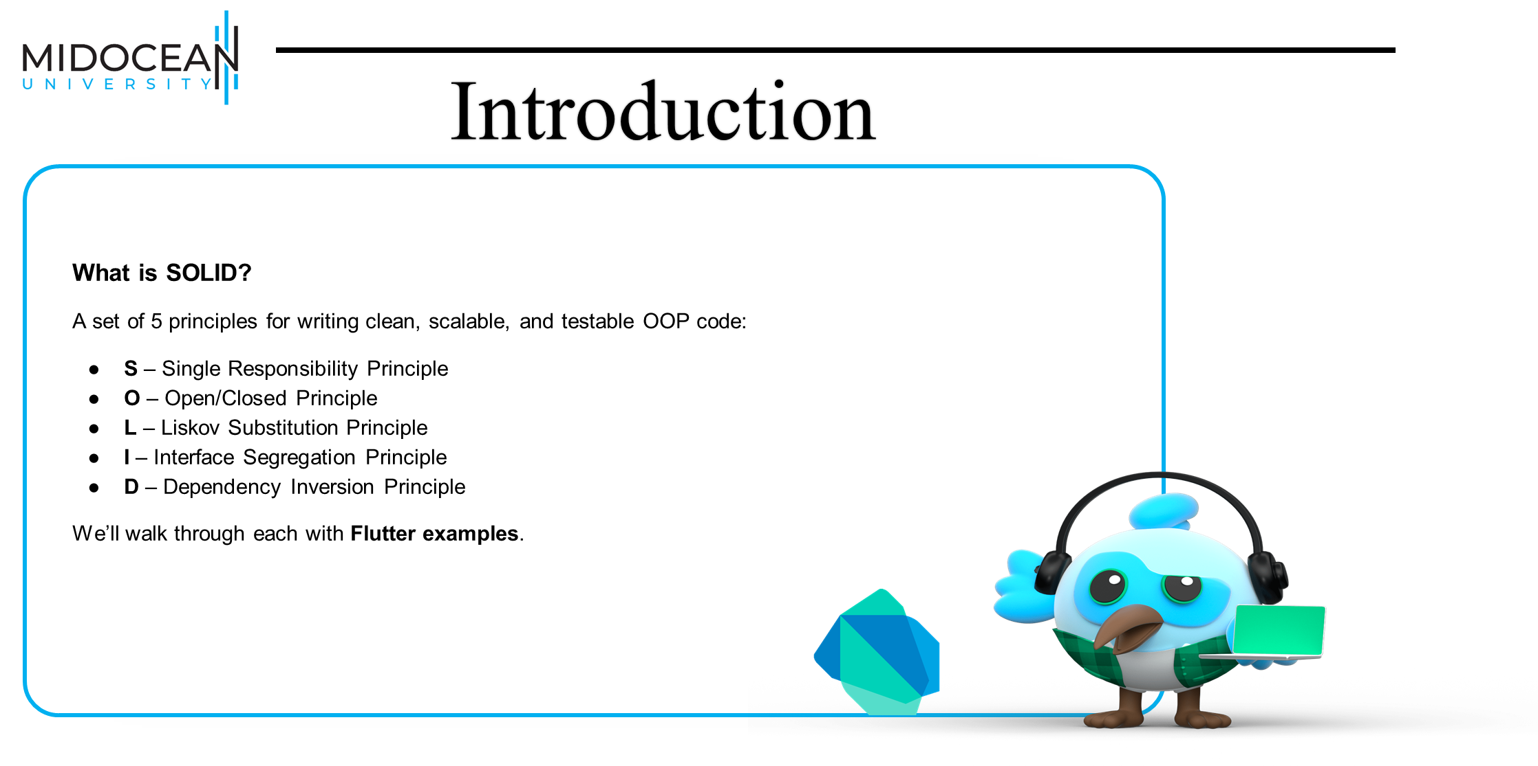

Slide 5
Single Responsibility Principle

Slide 6
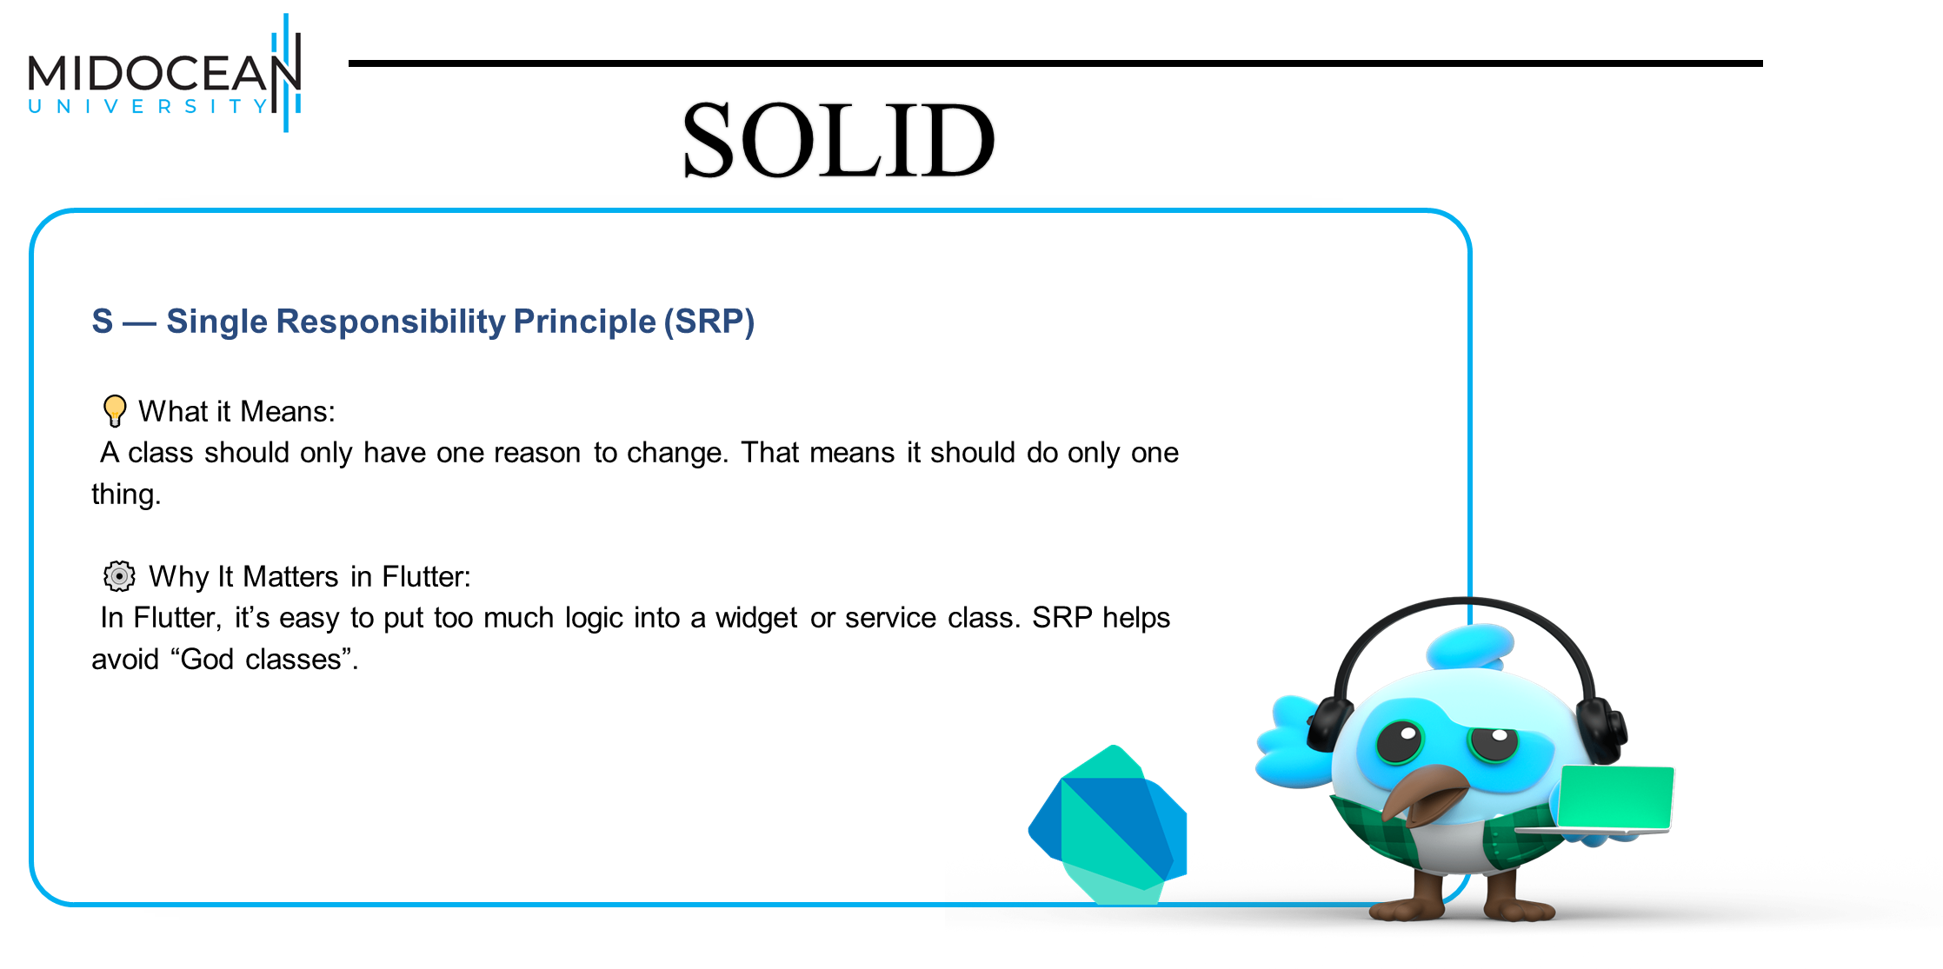

Slide 7
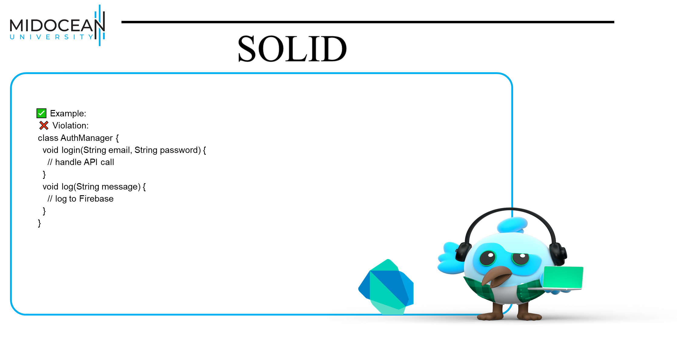

Slide 8


Slide 9
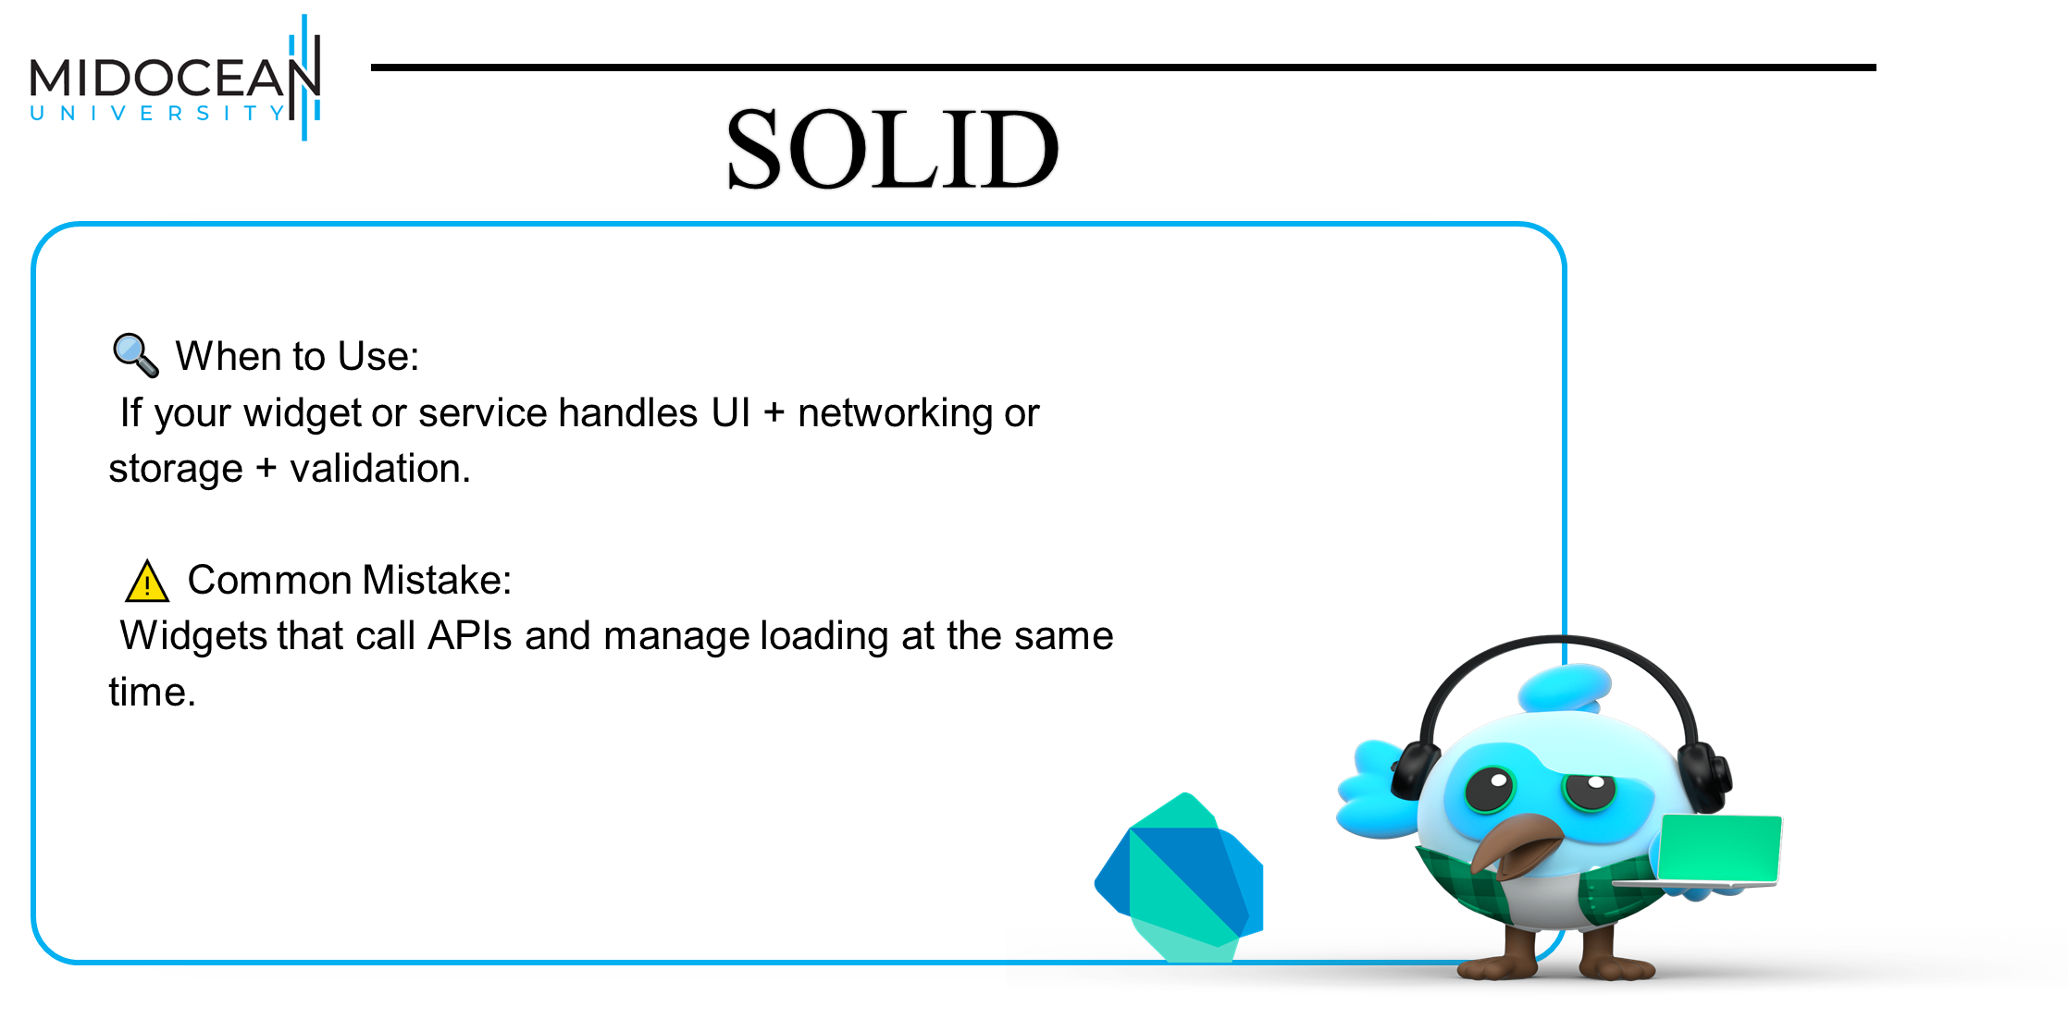

Slide 10
Open Closed Principle

Slide 11
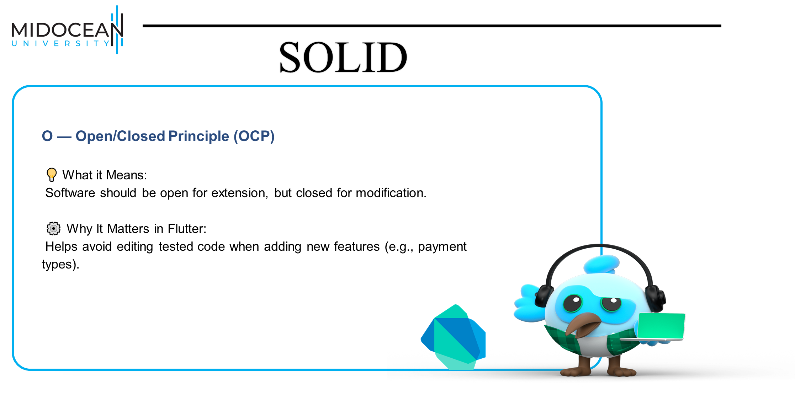

Slide 13


Slide 14
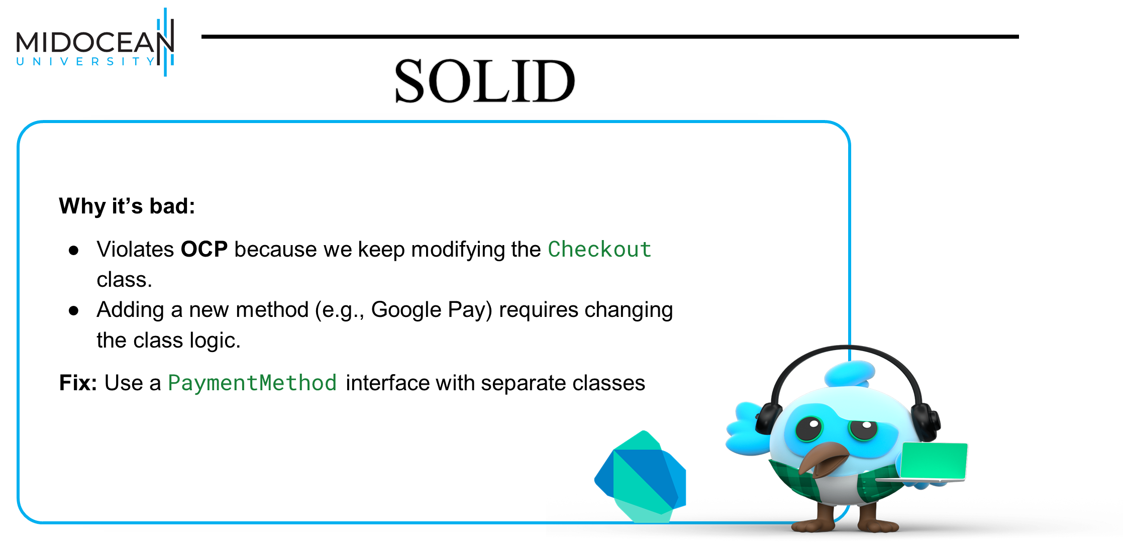

Slide 15
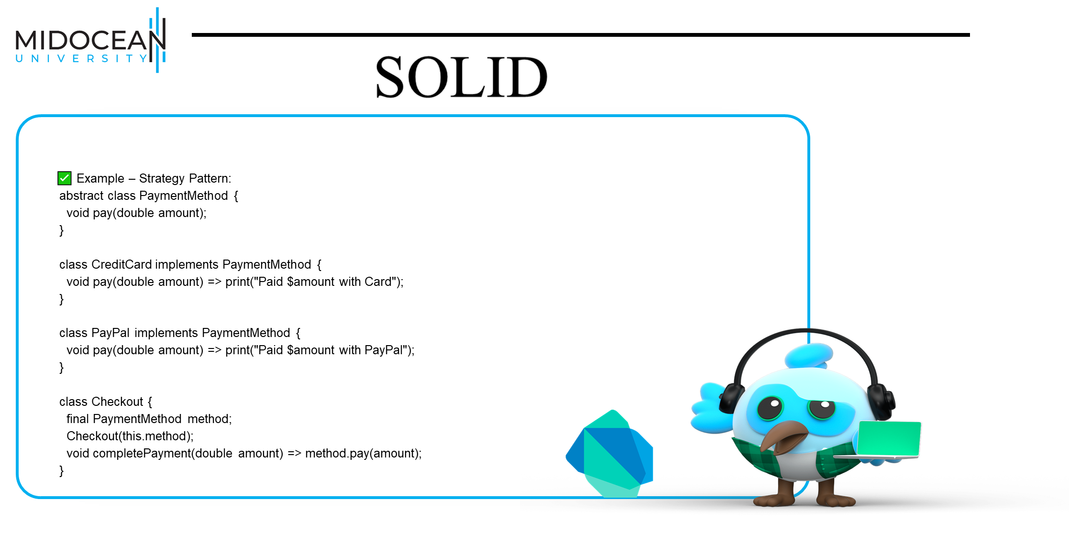

Slide 16


Slide 17
Liskov Substitution Principle

Slide 18


Slide 19


Slide 20


Slide 21
Interface Segregation Principle

Slide 22


Slide 24


Slide 25


Slide 26


Slide 27
Dependency Inversion Principle

Slide 28


Slide 29
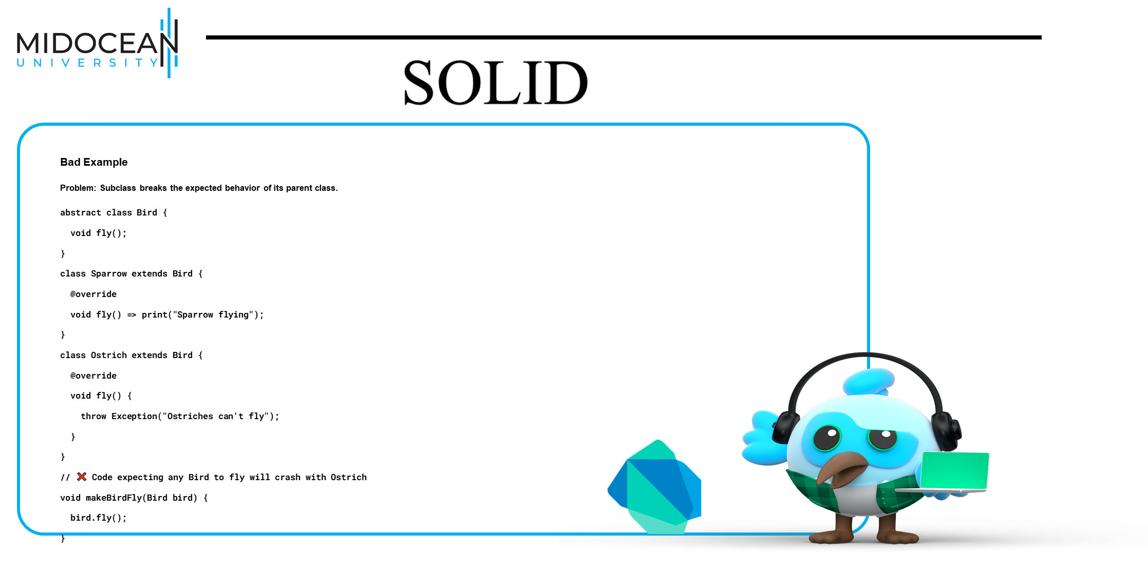

Slide 30


Slide 31
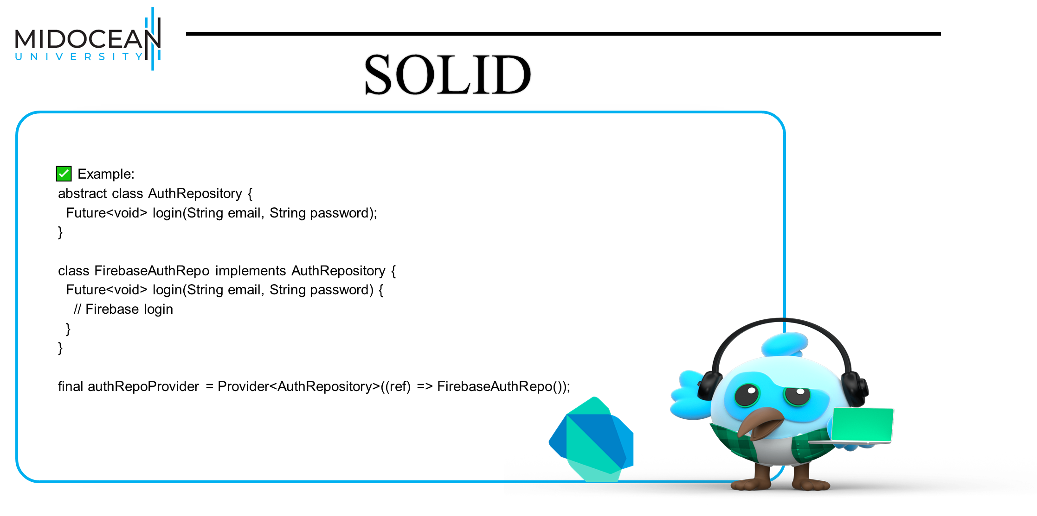

Slide 32
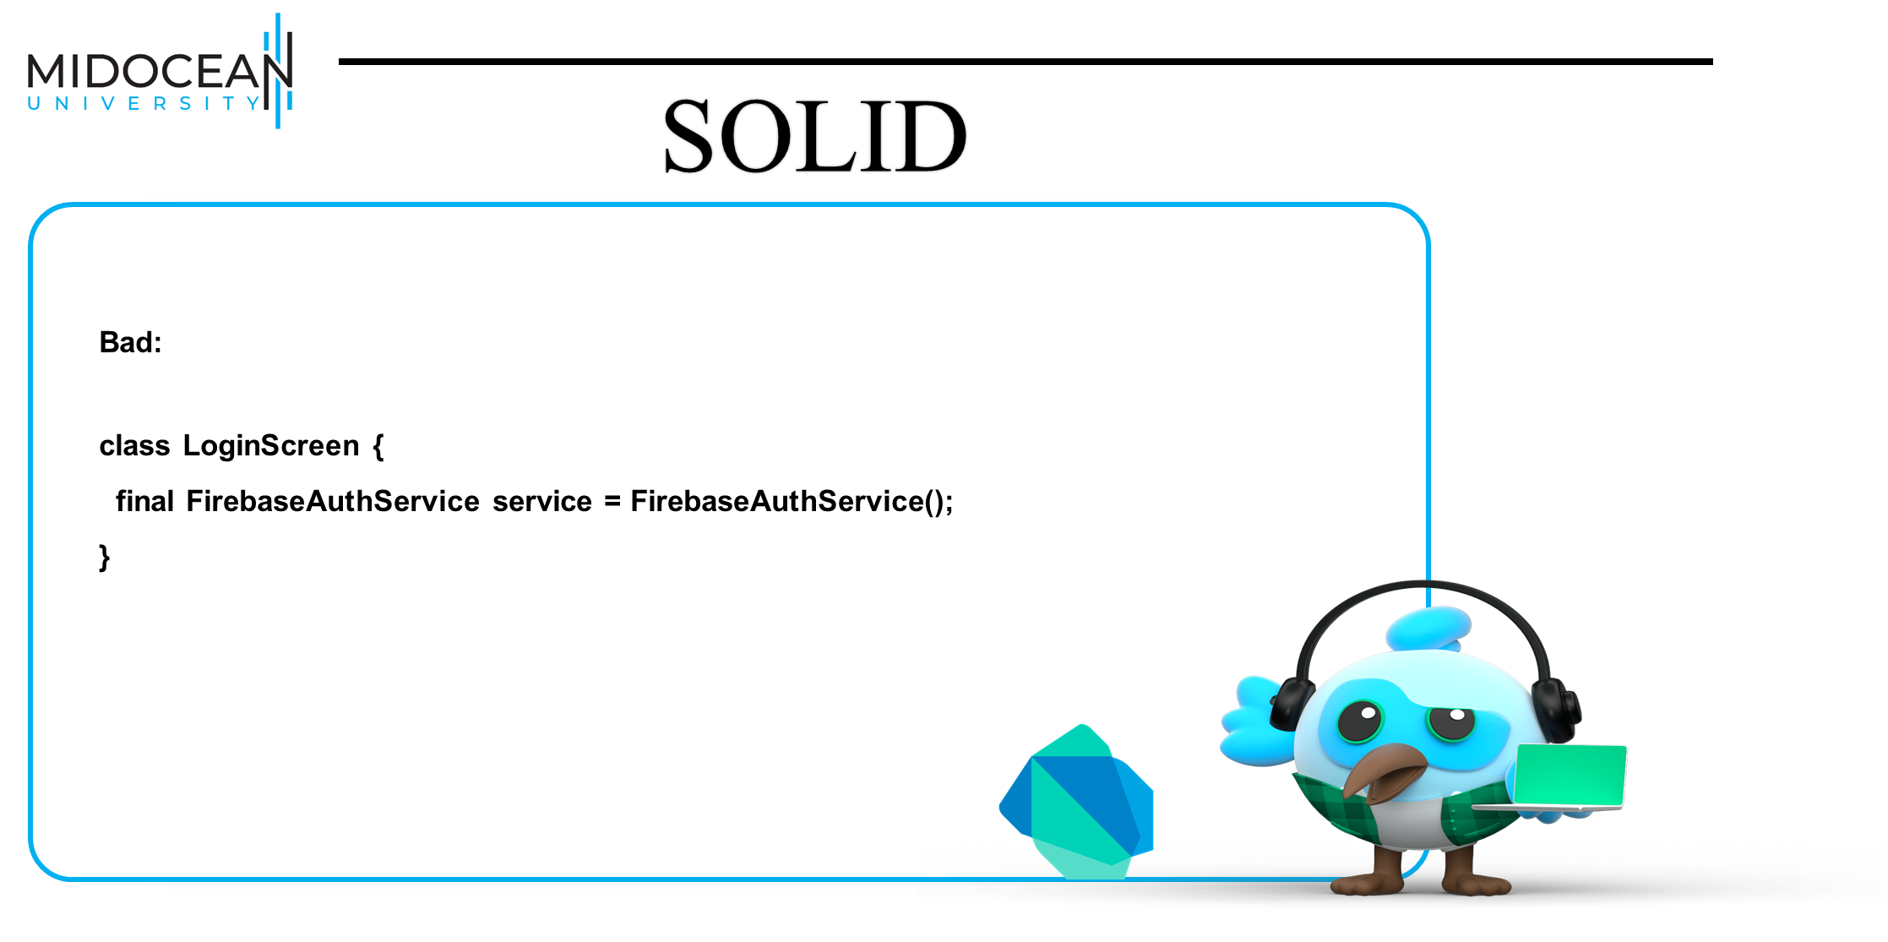

Slide 33
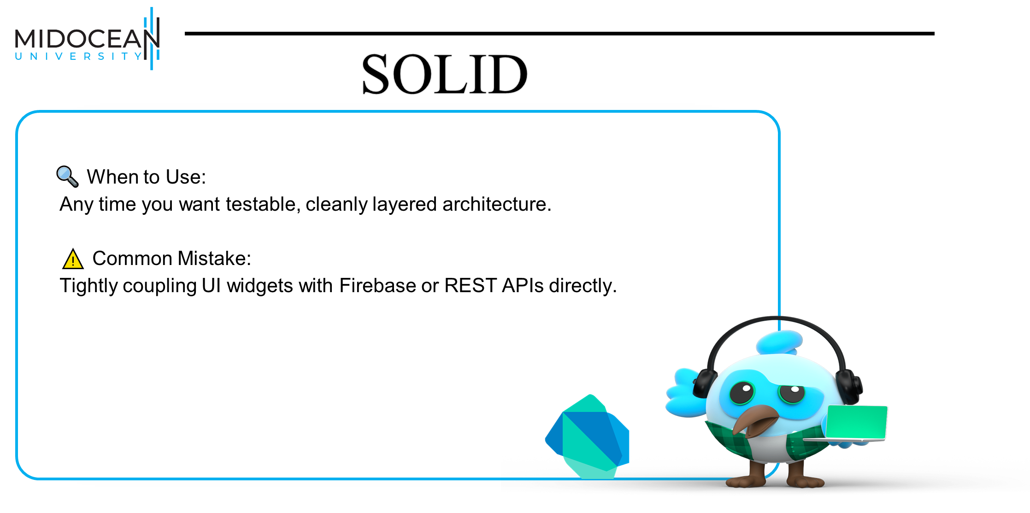

Slide 34


Slide 35
Scenarios

Slide 36
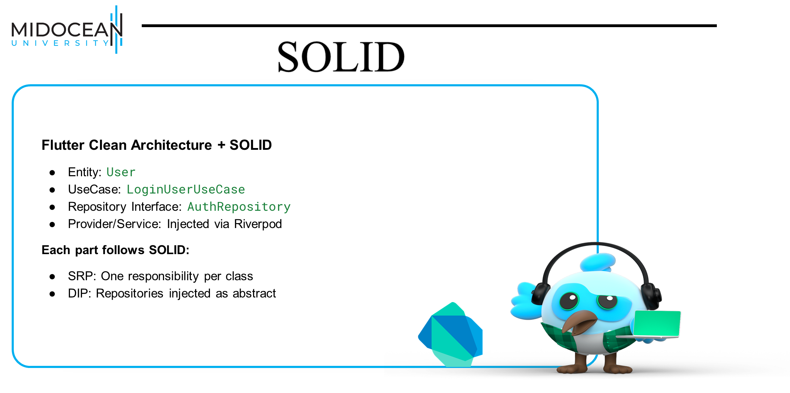

Slide 37


Slide 38


Slide 39
What is Next ?

Slide 40



Thank You

