Slide 1

Chapter 8
Everyone’s Smart
University
Leadership and Motivation
PMG511
Project Leadership
Dr.Sara Adel

Slide 2

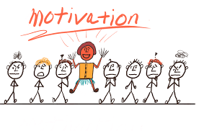
Learning Outcomes:
8.1 Define and explain motivation.
8.2 Compare and contrast the motivational leadership theories?
8.3 Compare and contrast contemporary theories of motivation.
8.4 How leaders motivate a unique groups of workers?
8.5 Summary and Conclusions.
8.6 Self Assessment.
Dr.Sara Adel

Slide 3
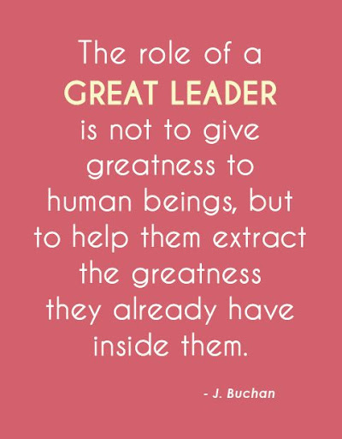
Dr.Sara Adel

Slide 4
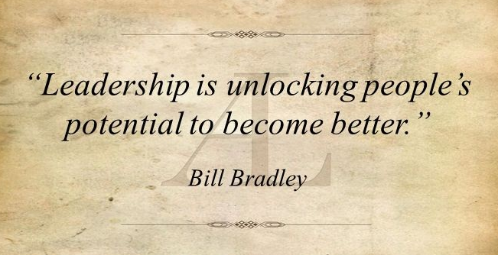
Dr.Sara Adel

Slide 5
8.1 Define and explain motivation.
Dr.Sara Adel

Slide 6

What is Motivation?
Motivation is something that moves the person to action, and continues him in the course of action already initiated.
Dr.Sara Adel

Slide 7

What is Motivation?
Motivation refers to the process by which a person’s efforts are energized, directed, and sustained toward attaining a goal.
- Individuals differ in motivational drive and their overall motivation varies from situation to situation.
Motivation has three key elements:
  The energy element is a measure of intensity or drive where the quality of the effort is considered along with its intensity.
  High levels of effort lead to favorable job performance when the effort is directed toward, and consistent with, organizational goals.
  Finally, motivation includes a persistence dimension where employees keep putting forth effort to achieve those goals.
Dr.Sara Adel

Slide 8
Leaders and Motivation?
- Effective leaders inspire movements that exist only when people choose to move in the same direction.
- Being proficient at motivating your team will, without a doubt, be a measure of your success as a leader.
- Motivation is one key performance indicator (KPI) that should be on any leader's dashboard!
- Without a leader, movements fragment and get nowhere. The leader’s job is to inspire people to work together in the service of something greater than themselves.
- Positive energy is infectious. It is one of the most powerful tools in the leadership toolbox when it comes to inspiring others in the workplace.
Dr.Sara Adel

Slide 9

Why leaders need to motivate their followers?
Motivation is important because it allows you as a leader to meet and even exceed your own organizational goals!
Dr.Sara Adel

Slide 10
Benefits of a motivated workforce:
Cost savings: Motivated employees will not only work faster, but they will use their creativity .
Increased quality: Motivated employees will produce quality products, costing you less resources for rework.
Reduced turn over: Turn-over doesn't only cost you money to replace the individuals, but it also slows down your organization's progress while replacements are being trained.
Speed to market: Everyone wants their product or services yesterday! Actually, the day you release your new product, people will already want a newer version! Having a motivated workforce will ensure that your product release cycle is reduced minimally.
Contributing to a better society: Motivated employees make happy people, who in turn contribute to a better society.
Dr.Sara Adel

Slide 11
8.2 Compare and contrast the motivational leadership theories?
Dr.Sara Adel

Slide 12
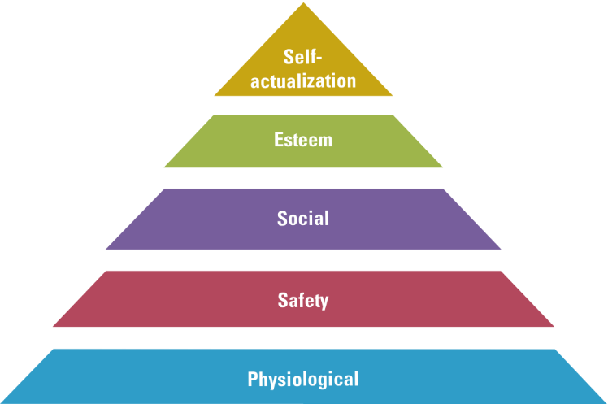
1- Maslow’s Hierarchy of Needs
Dr.Sara Adel

Slide 13
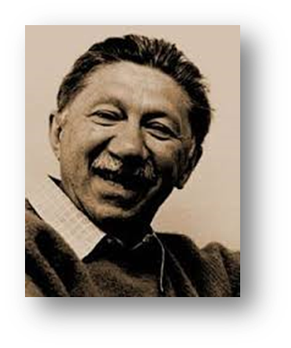
Maslow’s Hierarchy of Needs
Abraham Maslow’s Hierarchy of Needs theory (1943), is one of the most widely known theories of motivation. Maslow was a psychologist who proposed that within every person is a hierarchy of five needs:
  Physiological needs such as food, drink, shelter, sleep, and other physical requirements.
  Safety needs such as security and protection from harm as well as assurance that physical needs will continue to be met
  Social needs including affection, belongingness, acceptance, and friendship.
  Esteem needs, which include internal esteem factors such as self-respect, autonomy, and achievement, and external esteem factors such as status, recognition, and attention.
  Self-actualization needs that include growth and achieving one’s potential.
Dr.Sara Adel

Slide 14
Maslow’s Hierarchy of Needs
Maslow argued that each level must be substantially satisfied before the next need becomes dominant; an individual moves up the hierarchy from one level to the next. Lower-order need are satisfied predominantly externally, while higher-order needs are satisfied internally.
leaders will do things to satisfy team needs. But remember: Once a need is substantially satisfied, it no longer motivates.
This theory is widely popular among practicing managers probably because it’s easy to understand and intuitive. However, there is no empirical support provided for theory; other studies could not validate it.
Dr.Sara Adel

Slide 15
2- McGregor’s Theory X and Theory Y
Douglas McGregor is best known for proposing two assumptions about human nature: Theory X and Theory Y. Simply put Theory X is a negative view of people and Theory Y is a positive view.
McGregor believed that Theory Y assumptions should guide management practice and proposed that participation in decision making, responsible and challenging jobs, and good group relations would maximize employee motivation.
Here we see Berkshire Hathaway Chairman and CEO Warren Buffet, a Theory Y leader, participating in the company’s annual shareholders’ meeting.
Dr.Sara Adel

Slide 16
McGregor’s Theory X and Theory Y
Theory X:
Little ambition
Dislike work
Avoid responsibility
Must be closely controlled
Theory Y:
Enjoy work
Seek and accept responsibility
Exercise self-direction
Dr.Sara Adel

Slide 17
3- Herzberg’s Two-Factor Theory
Frederick Herzberg’s two-factor theory (or motivation-hygiene theory) proposes that:
Intrinsic factors are related to job satisfaction.
Extrinsic factors are associated with job dissatisfaction.
It was popular from the 1960s to the early 1980s.
Dr.Sara Adel

Slide 18
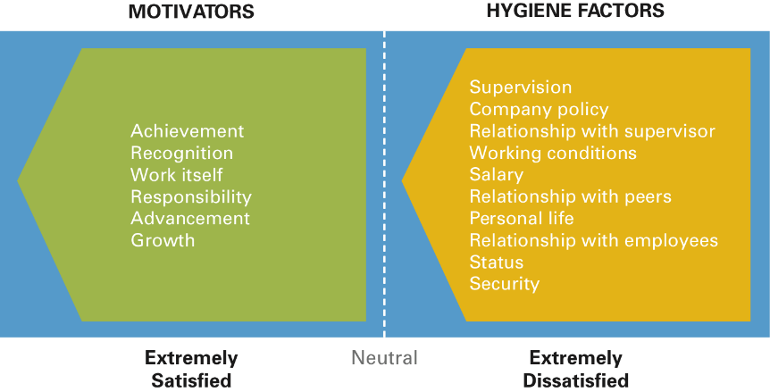
Herzberg’s Two-Factor Theory
Dr.Sara Adel

Slide 19
Satisfaction vs. Dissatisfaction
Herzberg also concluded that the traditional view –that the opposite of satisfaction was dissatisfaction–was wrong.
The opposite of “satisfaction” is “no satisfaction” and the opposite of “dissatisfaction” is “no dissatisfaction.”
To motivate people, Herzberg suggested emphasizing motivators, the intrinsic factors having to do with the job itself.
Dr.Sara Adel

Slide 20
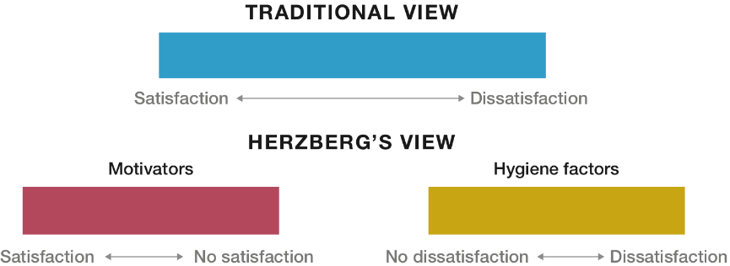
Satisfaction vs. Dissatisfaction
Dr.Sara Adel

Slide 21
4- McClelland’s Three-Needs Theory
Three acquired needs are work motives:
  Need for achievement
  Need for power
  Need for affiliation
Dr.Sara Adel

Slide 22
McClelland’s Three-Needs Theory
David McClelland and his associates proposed the three-needs theory, which says three acquired needs are major motives in work.
These three needs include:
The need for achievement , which is the drive to succeed and excel in relation to a set of standards
The need for power which is the need to make others behave in a way that they would not behave otherwise.
The need for affiliation , which is the desire for friendly and close interpersonal relationships.

Slide 23
8.3 Compare and contrast contemporary (modern/days) theories of motivation.
Dr.Sara Adel

Slide 24
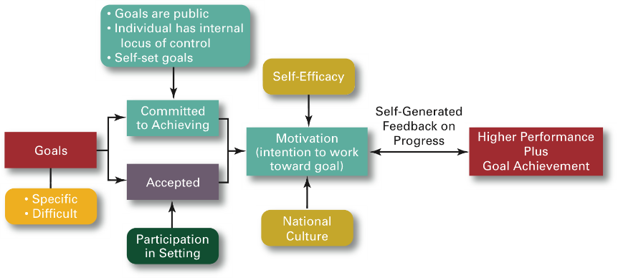
1- Goal-Setting Theory
Dr.Sara Adel

Slide 25
Goal-Setting Theory
(1) Working toward a goal is a major source of job motivation.
(2) specific and challenging goals are superior motivating forces.
people do better if they get feedback on how well they’re progressing toward their goals.
Dr.Sara Adel

Slide 26
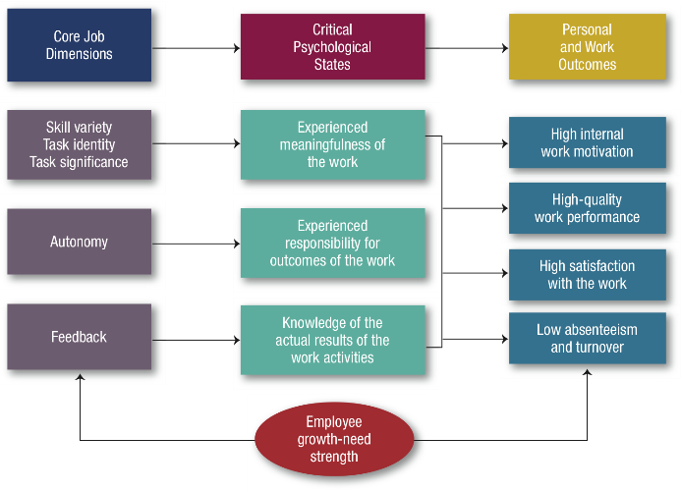
2- Job Characteristics Model (JCM)
Dr.Sara Adel

Slide 27
3- Equity Theory
  The term equity is the concept of fairness and comparable treatment when compared with others who behave in similar ways. There’s considerable evidence that employees compare themselves to others and that inequities influence how much effort they exert.
  Equity theory, developed by J. Stacey Adams, proposes that employees compare what they get from a job (outcomes) to what they put into it (inputs) and then compare their inputs-outcomes ratio with the inputs-outcomes ratios of relevant others,
  When inequities occur, employees attempt to do something about it. The result might be lower or higher productivity, improved or reduced quality of output, increased absenteeism, or voluntary resignation.
Dr.Sara Adel

Slide 28
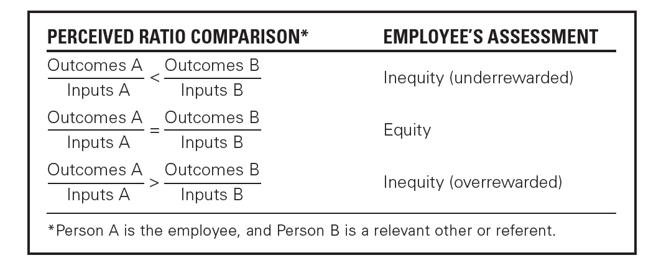
3- Equity Theory
Dr.Sara Adel

Slide 29
8.4 How leaders motivate a unique groups of workers?
Dr.Sara Adel

Slide 30

Dr.Sara Adel

Slide 31

How leaders motivate a unique groups of workers?
Motivating:
  Diverse employees
  Professionals
  Contingent workers
Dr.Sara Adel

Slide 32

Motivating:
1- Diverse employees
To maximize motivation among today’s diverse workforce, leaders need to think in terms of flexibility. For instance, studies tell us that:
  Men place more importance on having autonomy in their jobs than women do.
  The opportunity to learn, convenient and flexible work hours, and good interpersonal relations are more important to women than to men.
  Having the opportunity to be independent and to be exposed to different experiences is important, whereas older workers may prefer highly structured work opportunities.
Dr.Sara Adel

Slide 33

Motivating:
  2- Professionals
Motivating professionals is different from motivating nonprofessionals. Professionals have a strong and long-term commitment to their field of expertise, they need to keep current and regularly update their knowledge, and, because of their commitment to their profession, they work beyond a 40-hour week.
Dr.Sara Adel

Slide 34
Motivating:
  2- Professionals
Motivating professionals
Money and promotions tend to be low motivators for professionals, but job challenge tends to rank high.
Professionals tend to be focused on their work as their central life interest, whereas nonprofessionals typically have outside interests that can compensate for needs not met on the job.
Dr.Sara Adel

Slide 35
Motivating:
3- Contingent workers
There’s no simple solution for motivating contingent employees—temporary part-time and contract workers who don’t have security or stability.
temporary employee might be motivated by the opportunity to become a permanent employee or an opportunity for training.
Dr.Sara Adel
Notes:
.

Slide 36

Designing Appropriate Rewards Programs
  Open-book management
  Employee recognition programs
  pay-for-performance.
Dr.Sara Adel

Slide 37
Designing Appropriate Rewards Programs
  Open-book management
Many organizations of various sizes involve their employees in workplace decisions by opening up the financial statements (the “books”) so that employees will be motivated to make better decisions about their work and be better able to understand the implications of what they do, how they do it, and the ultimate impact on the bottom line. This approach is called open-book management.
Dr.Sara Adel

Slide 38
Employee recognition programs
Can motivate employees by providing personal attention and expressions of interest, approval, and appreciation for a job well done.
congratulate an employee in private or public for a good job or send a handwritten note or email message acknowledging something positive that the employee has done.
Dr.Sara Adel

Slide 39

Pay-for-Performance
Dr.Sara Adel

Slide 40
Low-Cost Rewards Program
  Clarify role in organization
  Keep communication open
  Show individual company cares
Dr.Sara Adel

Slide 41
AS A LEADER
Speak Loudly Everyday To your team
We are one
I am Happy ……..We are Happy
I am stronger ……We are Stronger
I am the Best …..We are the best
Dr.Sara Adel

Slide 42
SMART LEADER
Start with scheduling more one on one time.
Find out what motivates them.
Provide the resources they need to do their work exceptionally well.
Praise and compliment them often.
Help co-create purposeful work.
Help them develop new skills.
Actively involve them.
Believe in them.
Dr.Sara Adel

Slide 43
SMART LEADER
"Share your plan for a brighter and better future, talk about the actions you must take, and constantly reiterate the reasons why you will be successful. Create a vision statement that inspires and rallies your team and organization."
Dr.Sara Adel

Slide 44
SMART LEADER
Leadership Builds Relationships
Relationships build real motivation.
Relationships are the foundation upon which winning teams and organizations are built,"
Dr.Sara Adel

Slide 45
SMART LEADER
Leadership Creates Purpose-Driven Goals
Real employee motivation is driven by purpose and a desire to make a difference.
In fact, people are most energized when they are using their strengths for a purpose beyond themselves. When employees feel as though the work they do is playing an integral role in the overall success of the company and the world, they are motivated to work harder.”
Dr.Sara Adel

Slide 46

Motivators
It is what makes us want to come to work.
Norms often established by industry, organization, or previous leaders.
What motivates you may or may not motivate others?
Motivators are highly personal; the leader must consider each team member individually.
Divided into Extrinsic and Intrinsic motivators.
Dr.Sara Adel

Slide 47
Extrinsic Motivators
Money / Power
  Want to ‘move up’ in the organization or earn higher wages.
  Ex: Salespeople, CEO’s, Politicians
Recognition
  Often motivated most by acknowledgement of those in power.
  Ex: Entertainment, Lawyers, Interns
Interpersonal Relationships
  Relationships with co-workers and a cooperative atmosphere are valued.
  Ex: Religious Leaders, Social Workers
Dr.Sara Adel
Notes:
.

Slide 48
Intrinsic Motivators
Autonomy / Interesting Work
  Prefer the excitement of new and innovative endeavors.
  Ex: Architects, Engineers
Purpose
  Need to feel that their work is beneficial to the causes they care about.
  Ex: Doctors, Teachers, Military
Mastery / Exploration
  Personal achievement, problem solving opportunities, and creative endeavors are sought.
  Ex: Artists, Scientists
Dr.Sara Adel

Slide 49
8.5 Summary and Conclusions.
Dr.Sara Adel

Slide 50
- Motivation is something that moves the person to action.
- Motivation has three key element.
- Effective leaders inspire movements that exist only when people choose to move in the same direction.
- Benefits of a motivated workforce is very important to create healthy environment in organization.
- Motivational leadership theories.
- Leaders motivate and rewards his team for effective productivity.
Summary and Conclusions:
Dr.Sara Adel

Slide 51
8.6 Self Assessment.
Dr.Sara Adel

Slide 52

Self Assessment
1- How would you define the second level of needs in Maslow's hierarchy - safety needs?
2- How would you define Herzberg's 'motivators’?
3- Illustrate how Herzberg's ideas differ from those of Maslow.?
4- Explain what is meant by (a) equity theory?
Dr.Sara Adel

Slide 53
Self Assessment
Read the article
http://news.bbc.co.uk/1/hi/magazine/6246249.stm
Question 1
Identify three non-financial incentives that the companies mentioned in the article are using to try to motivate their employees.
Question 2
Analyze the advantages and disadvantages of using non-financial incentives as the principal tool to raise levels of motivation.
Question 3
Discuss, with reference to appropriate motivation theory, the extent to which happier employees are more motivated.
Dr.Sara Adel

Slide 54
Self Assessment
عرضت عليك المواصفات الخاصة بعدد من الافراد في مواقع العمل و طلب منك اختيار واحدة من الطرق الاتية، و ذلك لحفزهم على تحسين الاداء. اقرأ مواصفات كل فرد، ثم اذكر الطريقة المناسبة، مع ذكر اسباب اختيارك لها:
الطرق المتاحة:
خطة حوافز مالية
تهديد بالفصل
مزايا عينية (اثاث اضافي، و سكرتير...)
اثراء وظيفي
حريات في التصرف
زيادة في المرتب
Dr.Sara Adel

Slide 55
الحالة الثالثة: إسماعيل
  يعمل في واحدة من اكبر شركات الاغذية المحفوظة.
  عمره 53 سنة، و اب لثلاثة، احدهم متزوج و الباقيان بالجامعة.
  يعمل بالشركة منذ 9 سنوات.
  يحصل على المشاركة في الارباح من خلال نظام الحوافز.
  يعود كثيرا الى المدير عند اتخاذ القرار.
الحالة الرابعة: عبد الله
  موظف غير متفرغ بأحد مكاتب الاستشارات الإدارية.
  عمره 28 سنة و كان يعمل بالمكتب قبل ان ينتقل الى مدينة أخري، ثم عاد الى المكتب بعد استقالته.
  موظف نشط بدرجة كبيرة.
  يدرس حالياً الماجستير في ادارة المشاريع.
الحالة الاولى: عبد الرحمن
  مندوب مبيعات لشركة ادوية كبرى.
  تتطلب وظيفته المرور على الاطباء للترويج لمنتجات الشركة.
  عمره 31 سنة، متزوج، و اب لطفل واحد.
  لديه مشروع بناء منزل لم يكتمل.
الحالة الثانية: ندى
  مشرفة تمريض في مستشفى كبير.
  عمرها 28 سنة، متزوجة و ام لطفلين.
  تدرس في الوقت الحالي دبلوم دراسات عليا في التمريض.
  مشهود لها بالكفاءة العالية.
  تتطلع الى ان تحصل على وظيفة أفضل.
Dr.Sara Adel

Slide 56
Resources:
Leadership: Theory and Practice, 7th Edition
Intrinsic Motivation at Work: 2nd Edition: What Really Drives Employee Engagement.
© Pearson Education Limited 2015
Project Team Leadership and Communication by Samuel Malachowsky, 2018.
Dr.Sara Adel

Slide 57
THANKS!
Dr.Sara Adel

