Slide 1


Marketing Management
MGM612
Dr. Ayman Hassan
  Lecture - 6 - Branding

Slide 2

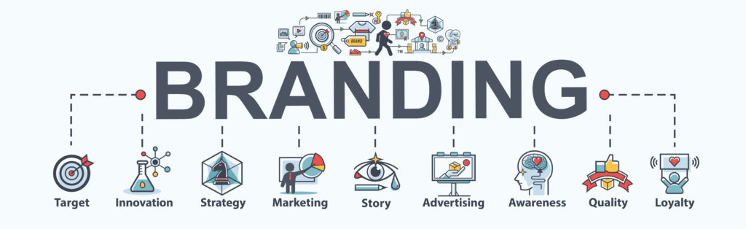
Chapter
5
Branding
Lecture 6
Dr. Ayman Hassan

Slide 3
Chapter
5
In the previous lecture,
We have discussed
Define the consumer market and construct a simple model of consumer buyer behavior
Name the four major factors that influence consumer buyer behavior
List and understand the major types of buying decision behavior and the stages in the buyer decision process

Slide 4
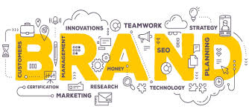
Learning Outcomes
Chapter
5
After studying this chapter you will be able to know all of the following:
Brand Definition
The Importance Of Branding
Forms Of Brands
Elements Of A Brand
Types Of Brands
Branding Mechanisms

Slide 5
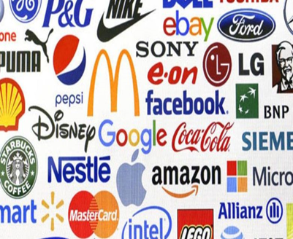
Chapter
5
Branding
Branding:
The use of a name, design, symbol, or a combination of those elements that at organization uses to help differentiate its products from the competition
Branding
describes a company’s or event’s efforts to develop a personality and make its products or services different from the competition

Slide 6
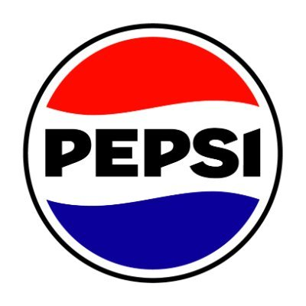
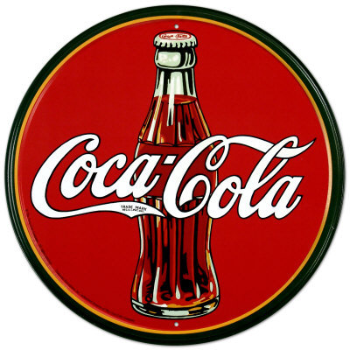
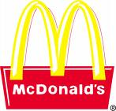

Chapter
5
Brand definition
“A brand is a name, term, design, symbol, or any other feature that identifies one seller’s good or service as distinct from those of other sellers” American Marketing Association
      Branding is endowing products and services with the power of a brand” (Kotler & Keller, 2015

Slide 7
Chapter
5
Brand definition
“Branding is the process of giving a meaning to specific organization, company, products or services by creating and shaping a brand in consumers’ minds. It is a strategy designed by organizations to help people to quickly identify and experience their brand, and give them a reason to choose their products over the competition’s, by clarifying what this particular brand is and is not.

Slide 8
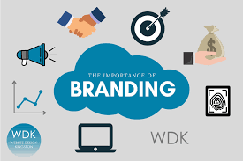
Chapter
5
The Importance of Branding
To build product recognition and customer loyalty
To ensure quality and consistency
To capitalize on brand exposure
Branding builds confidence
Branding builds an emotional connection
Branding tells your story in an instant

Slide 9
Chapter
5
benefits of a Strong Brand
There are a number of benefits associated with the development of a strong brand:
Strong brands have the power to create business value and impact more than just corporate revenues and profit margins
Strong brands also create competitive advantage, command price premiums and decrease cost of entry into new markets
Strong brands reduce business risk and attract and retain talented staff

Slide 10
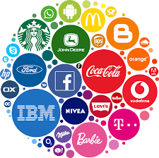
Chapter
5
Characteristics of a successful brand include
Positive, distinctive and generate positive feelings and association
Easy to remember and pronounce
Logo is easily recognizable
Implies the benefits the product delivers
Consistent with the image of the rest of the product lines, organization, and/or city
Legally and ethically permissible

Slide 11
Chapter
5
How can it be done?
Companies tend to use different tools to create and shape a brand. For example, branding can be achieved through:
Brand definition: purpose, values, promise
Brand positioning statement
Brand identity: name, tone of voice, visual identity design (which includes the logo design, color palette, typographies…)
Advertising and communications: TV, radio, magazines, outdoor ads, website, mobile apps…
Sponsoring and partnerships

Slide 12
Chapter
5
How can it be done?
Product and packaging design
In-store experience
Workspace experience and management style
Customer service
Pricing strategy

Slide 13
Chapter
5
Forms of Brands
The Forms of brand used depends on the particular entity using it. The following are some of the most common forms of brands:
Corporate Brands:
Corporate branding is a way for companies to market themselves in order to give themselves an edge against their competition. They make a series of important decisions in order to accomplish this, such as pricing, mission, target market, and values.
Personal Brands:
As mentioned above, branding isn't just for companies anymore. People use tools like social media to build their own personas, thereby boosting their brands. This includes regular social media posts, sharing images and videos, and conducting meet-and-greets.

Slide 14
Chapter
5
Forms of Brands
Product Brands:
This type of branding, which is also known as merchandise branding, involves marketing one particular product.
Branding a product requires market research and choosing the proper target market.
Service Brands:
This kind of branding applies to services, which often requires some creativity, as you can't actually show services in a physical way

Slide 15
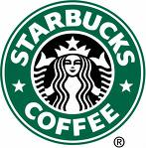
Chapter
5
Brand understanding
Brand.
A name, term, design, symbol, or combination of these elements that identifies a product and distinguishes it from its competitors

Slide 16
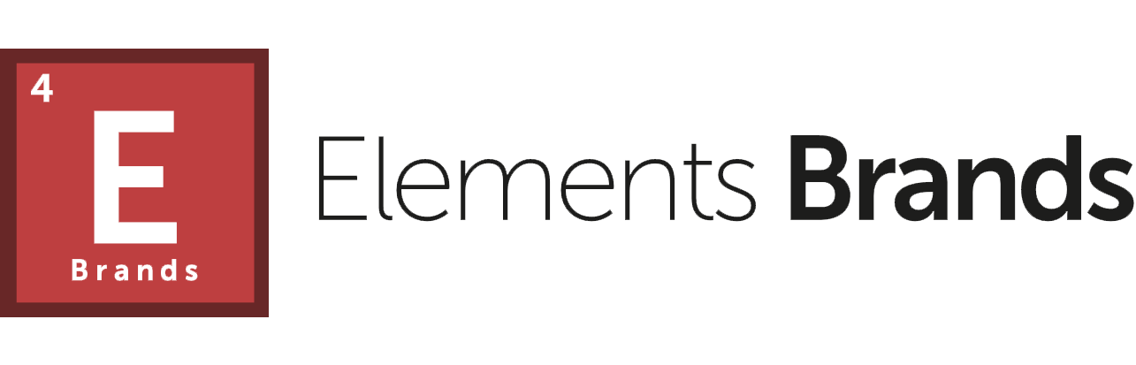
Chapter
5
Brand Elements
Brand Name
Brand Mark
Trade Name
Trade Character
Trade Mark

Slide 17
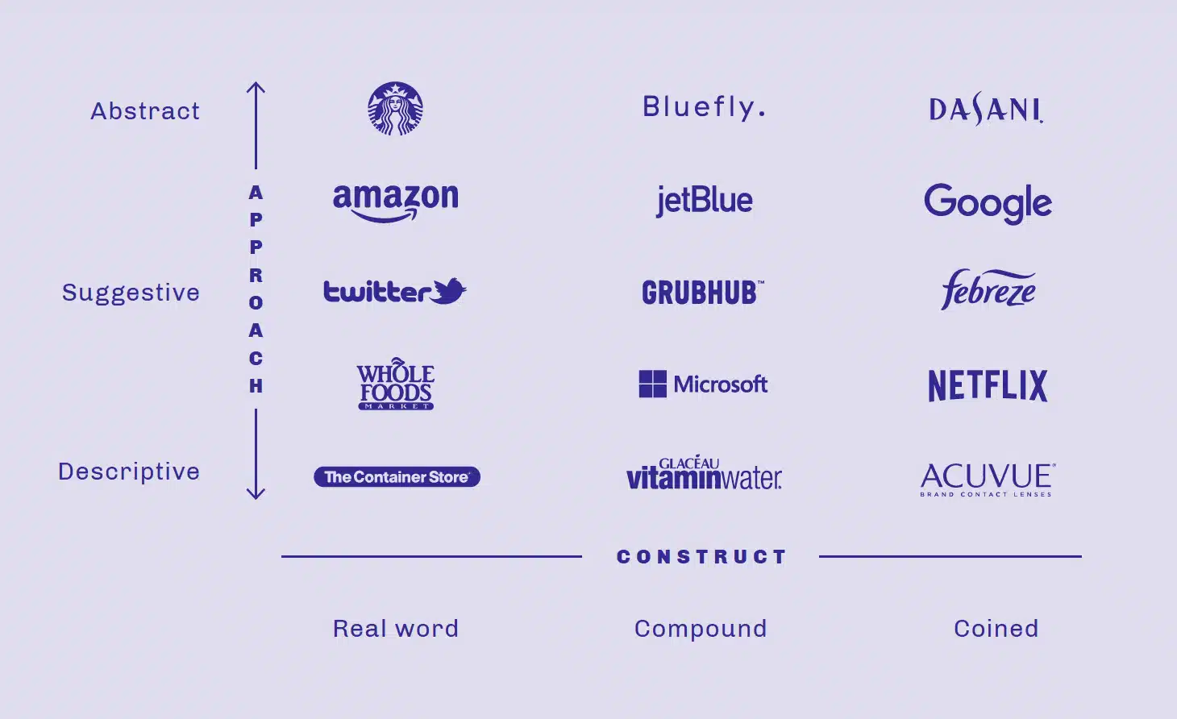
Chapter
5
Brand Name
Brand Name
(or product brand) a word, group of words, letters, or numbers that represents a product that can be spoken
  Should be easily pronounced, distinctive, and recognizable

Slide 18

Chapter
5
Brand Mark
Brand Mark
The part of a brand that is a symbol or design
  It may include distinctive colors or lettering
Brand marks can come in a variety of forms, including the following:
Logos
Colors
Pictures
Icons

Slide 19
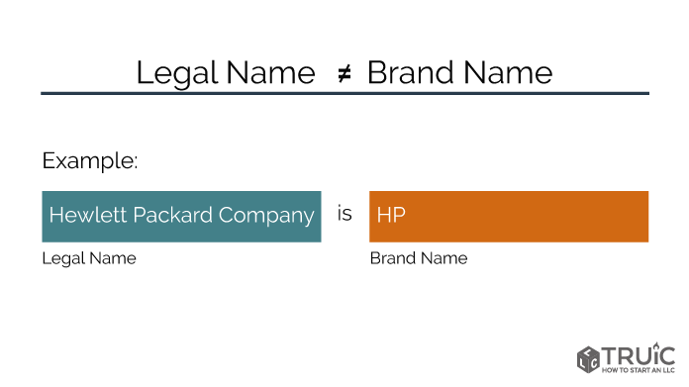
Chapter
5
Trade Name
Trade Name
(or corporate brand) identifies and promotes a company or a division of a particular corporation
  The legal name used while conducting business
  Used to promote a positive image of the organization (quality, value, reliability)

Slide 20


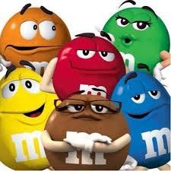

Chapter
5
Trade Character
A brand mark with human form or characteristics

Slide 21

Chapter
5
Trade Mark
A brand name, brand mark, trade name, trade character, or a combination of these that is given legal protection by the federal government

Slide 22
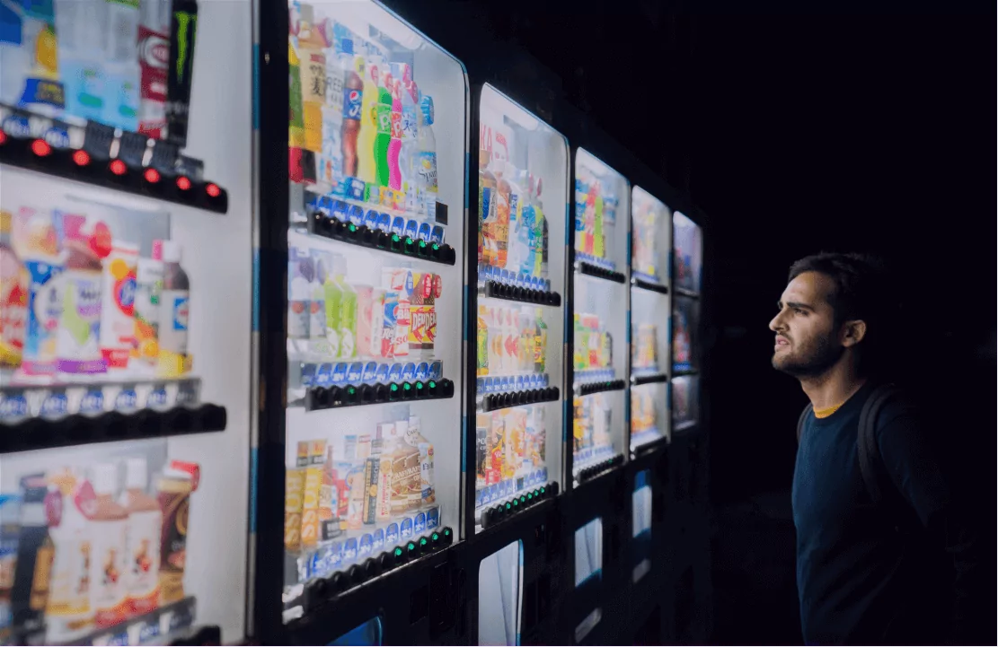
Chapter
5
Product recognition
It is important that customers who are satisfied with a product can easily recognize and find a company’s branded products when they want to buy them again

Slide 23

Chapter
5
Quality and consistency
Companies communicate to customers that they can expect consistent quality and performance, before purchase and after purchase

Slide 24
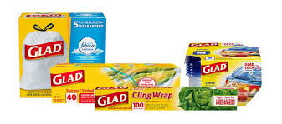
Chapter
5
Brand exposure
Helps companies extend their products into new target markets, new product lines, and new categories
  Customers are more willing to try new products that carry a name they are familiar with
  Example: GLAD family of products
    Started with trash bags and has now moved into food storage containers and baggies

Slide 25
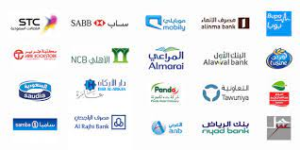
Chapter
5
Types of Brands
National Brands
(producer brands) owned by national manufacturers
  Generate the majority of sales for most categories
  Examples: Hershey Foods, Whirlpool, Ford, Hilton, American Airlines, Kraft and Nestle
  Internet based national brands
    Amazon.com, eBay, Monster

Slide 26


Chapter
5
Types of Brands
Private Distributor Brands
private brands, store brands, or dealer brands
  Developed and owned by wholesalers and retailers
  Examples: Arizona for JC Penney, George for Wal-Mart, Villager for Kohl's
Both are private distributor brands from SEARS

Slide 27
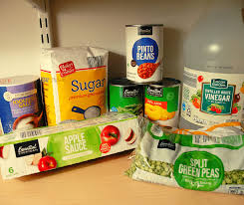
Chapter
5
Types of Brands
Generic Brands
Does not carry a company identity
  Packaging usually features a description of the product
    Example: Pancake Mix, Paper Towels
  Usually sold in supermarkets and discount stores
  Often sold for 30 – 50% less than name brands

Slide 28
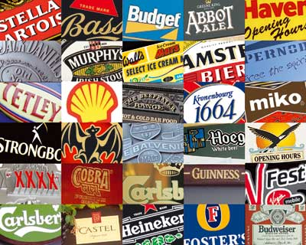
Chapter
5
Brand Strategies
Brand Extension
Brand Licensing
Mixed Brands
Co-Branding

Slide 29
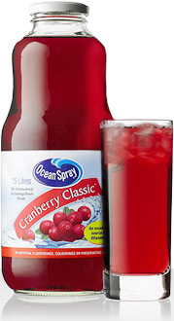
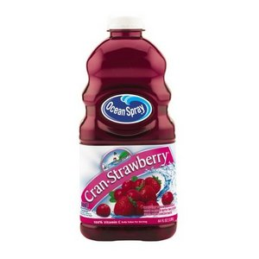
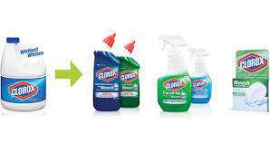
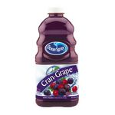
Chapter
5
Brand extension
A branding strategy that uses an existing brand name to promote a new or improved product in a company’s product line
Brand extension refers to the use of a successful brand name to launch a new or modified product or service in a new market

Slide 30
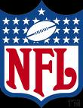
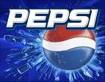

Chapter
5
Brand Licensing
Some companies allow other organizations to use their brand, brand mark, or trade character through Brand licensing
Licensing company gets a fee (Royalty) in return for authorization

Slide 31
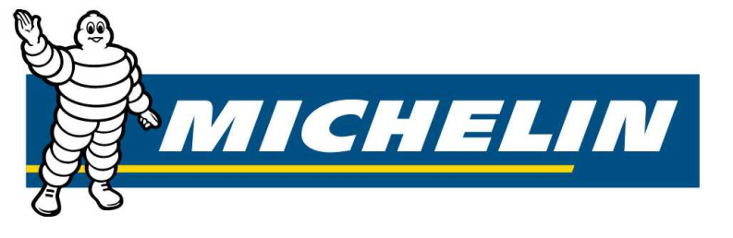
Chapter
5
Mixed brands
Offer a combination of manufacturer, private distributor, and generic brands
Their own National Brand tires
Private Brand for SEARS

Slide 32
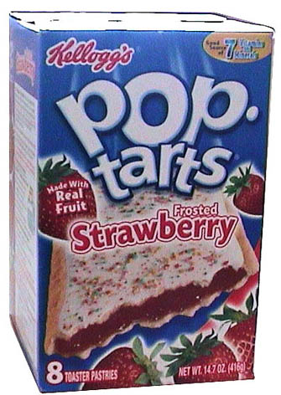
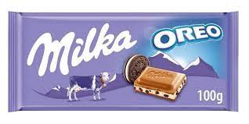

Chapter
5
Co-branding
Combines one or more brands in the manufacture of a product or in the delivery of a service
Co-branding
is the practice of using multiple brand names to jointly promote or market a single product or service

Slide 33
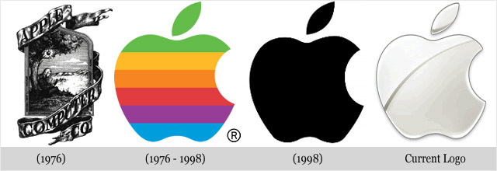
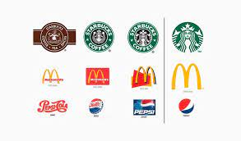
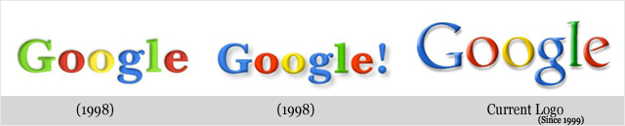
Chapter
5
Re-Branding
  Rebranding - a change to the brand name, logo, or image of a product or company
  brand owner revisits the brand with the purpose of updating or revising
Rebranding is the updating or creation of a new name, term, symbol, design, or a combination thereof for an established brand with the intention of developing a differentiated (new) position in the mind of stakeholders and competitors

Slide 34
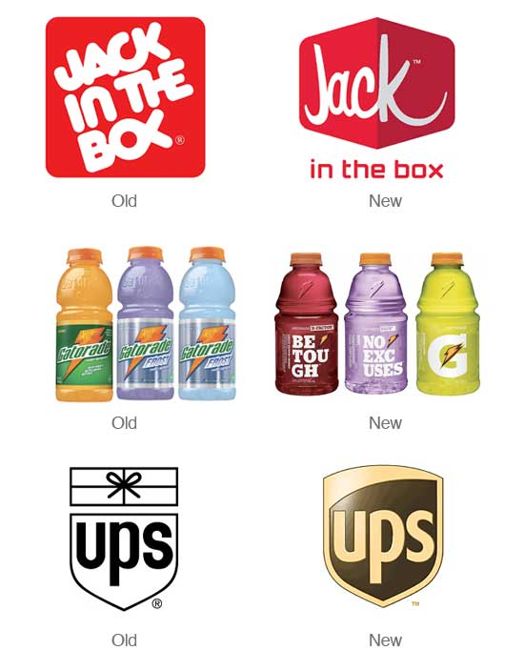
Chapter
5
Partial Rebrand
Situations when a brand has been firmly established yet is simply outdated or needs to be refreshed.

Slide 35

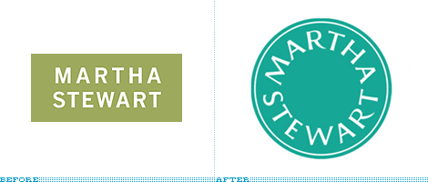
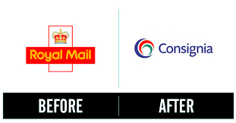
Chapter
5
Total Rebrand
Situations when a brand’s intent to erase any previous brand identity and replace it with completely new imagery

Slide 36
Chapter
5
Why Rebrand?
Rebranding can help change a businesses:
  Quality
  Target Market
  New Product Line
  Repositioning and Image
  Altered Public Image

Slide 37
Chapter
5
Branding Mechanisms
Branding Efforts Often Include the Use Of:
Slogan
Brand Mark
Logo
Trademark
Graphics

Slide 38
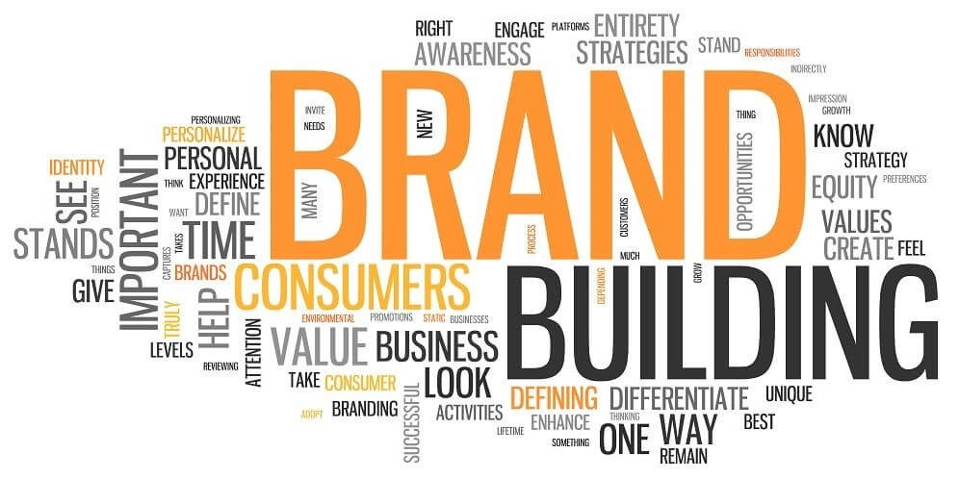
Chapter
5
Brand Building
Brand awareness
Brand image
Brand equity
Brand loyalty

Slide 39

Chapter
5
Branding
Brand awareness
is the process of working toward maximizing recognition of a particular brand
Brand image
refers to consumer perceptions linked to a particular brand such as health, excitement, fun or family
For example, the Disney brand is associated with family fun and entertainment

Slide 40
Chapter
5
Event branding opportunities may include
Naming, Event Offerings
Promotions and Co-Promotions
Sponsorship Opportunities
Merchandising Opportunities
Hospitality

Slide 41
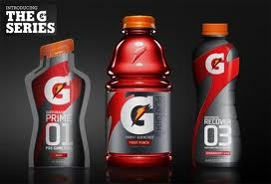
Chapter
5
Branding
Re-establishing brand position and strengthening the brand is a critical component for maintaining a strong brand
Re-branding requires careful planning and exceptional attention to detail
According to the Charlotte Observer, Charlotte’s rebranding effort cost the franchise nearly $3 million but has resulted in an immediate uptick in sales, with an increase of 59% in new ticket sales and a significant boost in sponsorship and merchandise sales

Slide 42
Chapter
5
See you in the next lecture

Slide 43

Chapter
5
Resources and References
Branding: What it is and why it’s important | Talent Evolution
12 Important Types of Brand Elements for a Cohesive Identity

